Slide 1
30TH NOV’21
Ecological Sustainability in Industrial Region
Haldia Edition
Exide Industries Ltd. Haldia
30th Nov 2021

Slide 2
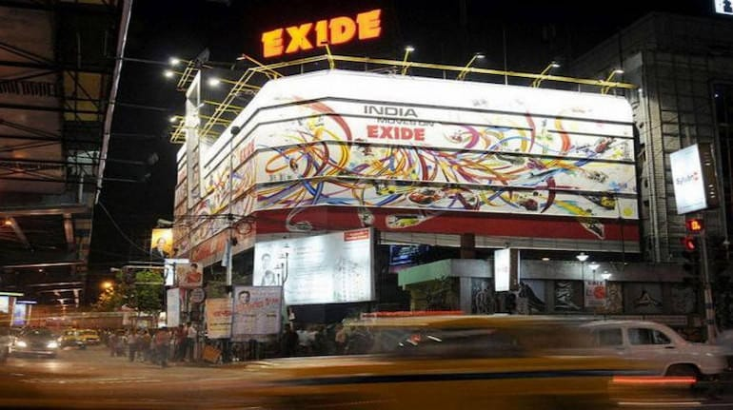
EXIDE INDUSTRIES LTD.
For more than six decades, Exide has been one of India's most reliable brands, enjoying unrivalled reputation and recall. Our constant emphasis on innovation, extensive geographic footprint, strong relationship with marquee clients and steady technology upgradations with global business partners have made us a distinct frontrunner in the lead-acid storage batteries space for both automotive and industrial applications
LEADERSHIP
A leader in packaged power technology, EIL today is India's largest storage battery company with widest range of both conventional flooded as well as latest VRLA batteries. Apart from serving the domestic market the company exports batteries which have captured niches in South East Asian and European markets.

Slide 3
GEOGRAPHIC PRESENCE
MANUFACTURING CAPACITIES
Locational Advantage
Multi-locational facilities evade supply risks, ensuring delivery
Strategically located near markets
Proximity to ports facilitate cost-efficient exports and imports
Legend
ISO 9001:2015
ISO 14001:2015
IATF 16949-2016
OHSAS 18001:2007

Slide 4
Vision
To become a Global Power House respected by customers and preferred by investors, known for innovative products and solutions.
Mission
To outperform at market exceeding expectations of customers and shareholders through the accelerated evolution of people, processes and technologies in its journey towards excellence.

Slide 5
Core Values
Leadership
Integrity
People Development and Involvement
Agility
Passion for innovation and Technology
Channel Partner Relationship
Striving for Excellence
Customer Orientation
Management by Processes and Facts
Responsible Corporate Citizenship

Slide 6
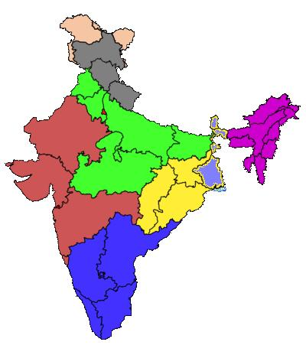
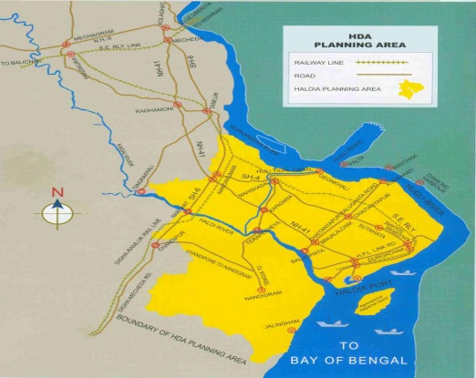
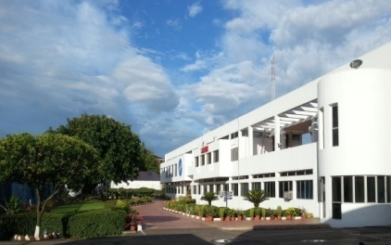
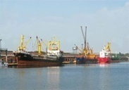
Introduction Of Haldia
There are many Large , Medium & Small scale industries in and around Haldia
Surrounded by several Benchmark Companies
Exide Haldia
KoPT

Slide 7
Exide - Haldia at a Glance
N
Alpha
Project
Admin
Building
Automotive
Factory
Newly acquired
19.4 Acre land
Industrial Factory
Traction Factory
Auto Charging & Dispatch
Operation started | Mar ’80 |  |  | Employees | 700
Plant Area | 41 Acres +19.4 Acres
 |  |  |  | Product range | Automotive Industrial
Floor space | 59,950 m²
Green Area | 42,627 m²

Slide 8
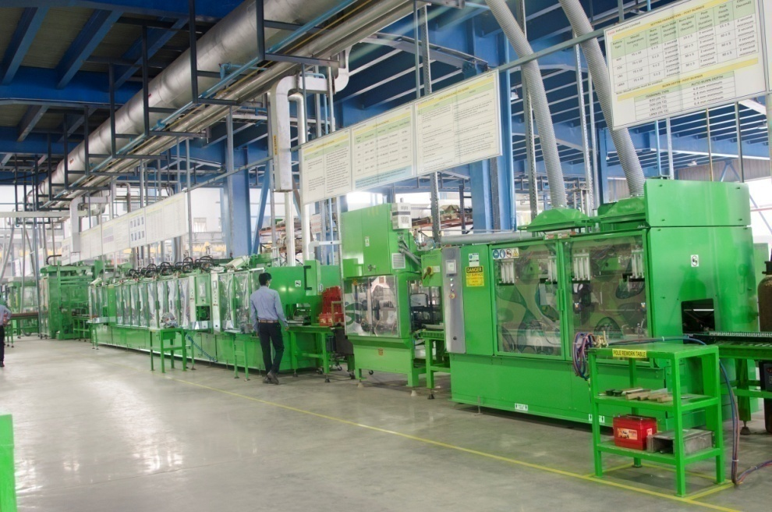
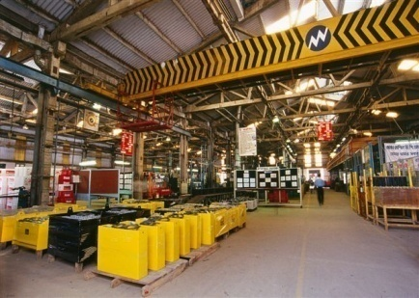
Plant Capacity
AUTOMOTIVE
5.3 MILLION BATTERIES / YEAR
INDUSTRIAL
2028 MILLION AMPERE HOUR/YEAR
(2.1 Million 12V Batteries + 1.2 Million 2V Cells)

Slide 10
ECOLOGICAL SUSTAINIBILITY
It is basically everything connected to the Earths Ecosystem.
Amongst other things, ecological sustainability relates to the functioning of the Earth's biogeochemical system, which includes the following:
Water (pollutants, groundwater levels, salinity, temperature, alien species)
Air (pollutants, particles, ozone layer, climate system, noise)
Land (pollutants, erosion, land use, alien species)
Biodiversity (species and habitats (natural habitats), GMOs)
Ecosystem services (e.g. pollination, photosynthesis, water purification, climate control)
It includes Human health due to the over all Environment pollution in the Industrial Zone.

Slide 11
EXIDE
Committed to serve with cleaner safer and sustainable world.
HR POLICY
SUSTAINABILITY POLICY
BIODIRVERSITY POLICY
PRODUCT RESPOSIBILITY POLICY
EHS POLICY

Slide 12
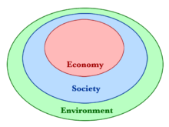
Our Focus
Exide is focussed on sustainability of
Economy
Society
Environment
Increasing ratio of population and industrialization have a lot of negative impacts on the human and other living systems. Utilization of natural resources abruptly and other non-enviro-friendly activities should be controlled and there is need to put Environment sustainability plan in place by all Industries to handover a cleaner and safer world to our upcoming generation

Slide 13
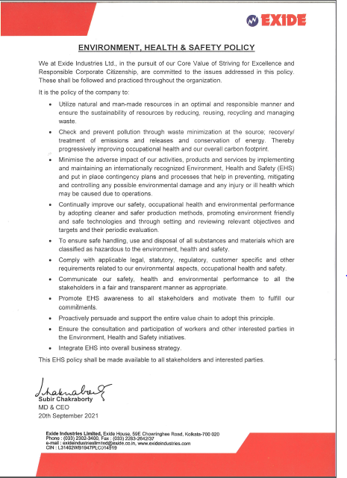
Environment Health and Safety Policy
Commitment towards protecting
Environment
Occupational Health
And safety of people
Focus on continual improvement and sustain the standards, complying all statutory requirements.

Slide 14
Battery Manufacturing Process

Slide 15
Initiative towards Ecological Sustainability
Protect Environment
Soil
Air
Water
Waste management
Reduction in Energy
Sustainable source of ingredients on procurement
Strong Vendor policy on recycling of used battery.
Corporate Social Responsibility

Slide 16
TO REDUCE PROCESS WATER

Slide 17
Initiatives to reduce process water
PASTE RECOVERY SYSTEM
DM water line for make up
+VE TANK
- VE TANK
BEFORE
Over flow
To Homogeneous Tank
To Homogeneous Tank
Positive Pasting M/c
DRAIN
Negative Pasting M/c
TO DRAIN
AOD Pump
AOD Pump
SUMP PIT
SUMP PIT
DM water line for make up
+VE TANK
- VE TANK
TO BE USED IN:
a) Reuse in pasting M/C
b) In machine washing
c) In Paste Mixing
AFTER
Over flow
SS Tank for +VE water
To Homogeneous Tank
To Homogeneous Tank
SS Tank for -VE water
Positive Pasting M/c
Negative Pasting M/c
AOD Pump
AOD Pump
SUMP PIT
Overflow
SUMP PIT

Slide 18
Initiatives to reduce process water
BEFORE
Cooling Tower
Over flow
J/F Tank
Reservoir
Pump
Over flow to Drain
AFTER
Cooling Tower
V
Storage Tank
J/F Tank
Over flow
Reservoir
Pump
As make up water
BENEFIT : RAW WATER = 40 KL/DAY
TO BE USED IN : Recycle back to the system

Slide 19
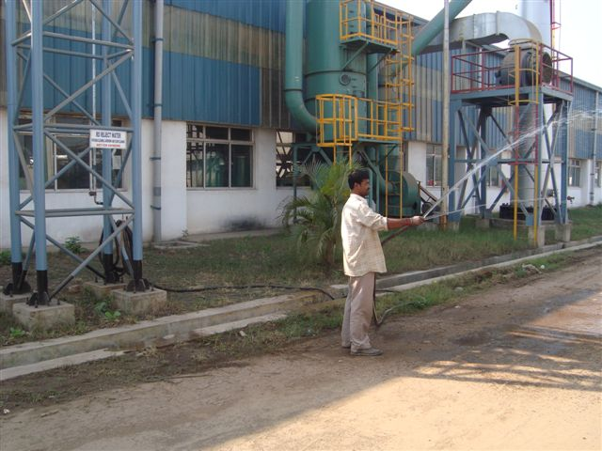
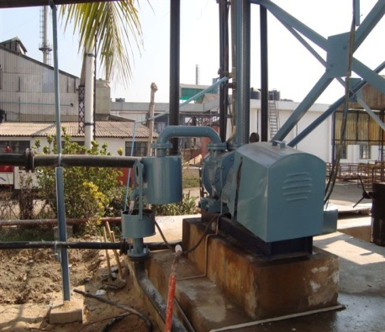
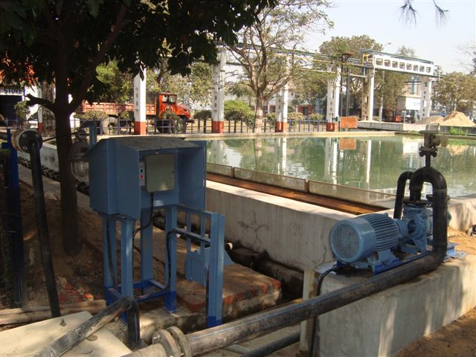
CONTINUOUS ACTIVITY-REUSE OF WASTE WATER FROM RO PLANT AND LAGOON DISCHARGE
Re-use of RO waste water.
Use for Gardening
Use in E.T.P for Lime slurry preparation
Re-use of Lagoon discharge water for battery charging process

Slide 20
REDUCTION OF PROCESS WATER THROUGH TECHNOLOGY UPGRADATION
Conversion of dry filling to wet filling for positive plates
Conversion of conventional water bath charging to re-circulation charging
Dry Filling
Wet Filling
Generation of fines
X
Generation of fines eliminated
Acid Pickling
Drying
Generation of huge sludge
X
Generation of sludge eliminated
Washing
Finished Plates to Assembly
Drying
Finished Plates to Assembly

Slide 21
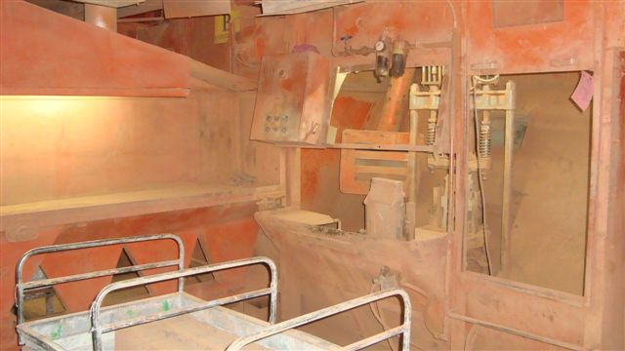
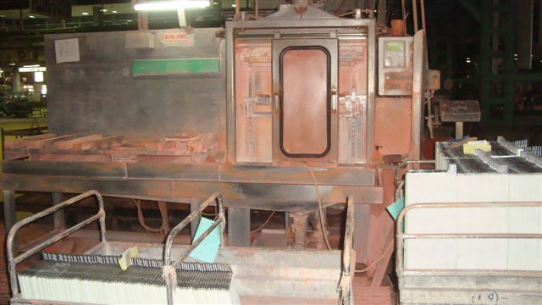
OXIDE FILLING PROCESS CHANGE IN TUBULAR PLATES FOR INDUSTRIAL
DRY OXIDE FILLING
WET FILLING
ADVANTAGES
Generation of fines eliminated
Minimum sludge generation due to
elimination of pickling

Slide 22
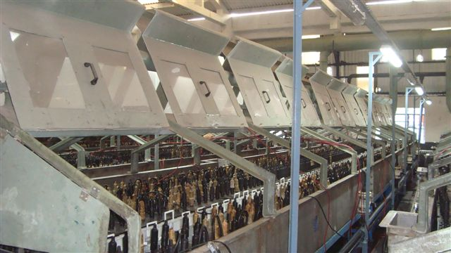
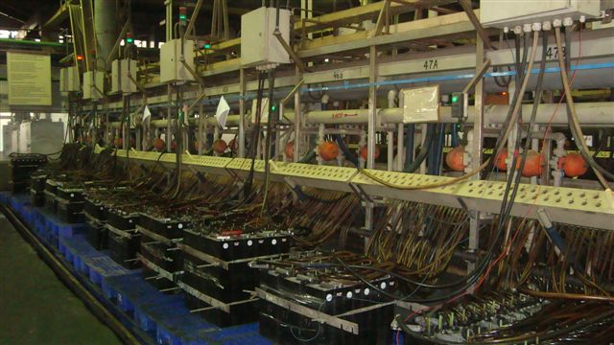
BATTERY CHARGING PROCESS- WATER BATH CHARGING TO RECIRCULATION CHARGING
WATER BATH CHARGING
RECIRCULATION CHARGING
ADVANTAGES
Availability of optimum specific gravity acid for
formation of positive & negative plates enables
low AH I/P during charging
Use of chilled acid enables charging to takes place at
50 % lower time

Slide 23
WATER CONSUMPTION REPORT
Automotive Production(Million Ah)
INDUSTRIAL & AUTOMOTIVE
Prod. Volume Increase from 2016-17 to 2020-21 - 50%
Raw Water Cons. Reduction - 29%

Slide 24
WATER CONSUMPTION REPORT
Raw Water(KL)/MT of Lead
2016-17 | 2017-18 | 2018-19 | 2019-20 | 2020-21 | 2021-22(YTD Sept) | 2022-23 | 2023-24 | 2024-25
5.70 | 5.72 | 5.19 | 4.58 | 4.43 | 4.82 | 4.21 | 4.00 | 3.80
DM Water(KL)/MT of Lead
2016-17 | 2017-18 | 2018-19 | 2019-20 | 2020-21 | 2021-22(YTD Sept) | 2022-23 | 2023-24 | 2024-25
1.48 | 1.40 | 1.35 | 1.80 | 1.48 | 1.57 | 1.49 | 1.42 | 1.35
28% Redn.
16% Redn.

Slide 25
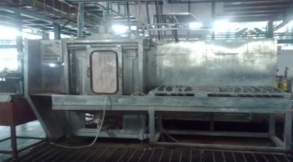
PROJECTS ON WASTE & SLUDGE REDUCTION
BEFORE
Initially process water directly goes to ETP. After treatment more sludge generated.
SLURRY MIXING & PREPARATION
PLANT
Red Slurry
Red Slurry
P
Red Slurry
S.T.-2
S.T.-3
Pump On
S.T.-1
P
ETP DRAIN
AFTER
P
P
M/C
No process for recovering the Slurry and Spill out DM after decanting .
P
P
MAIN DM LINE
L1
P
MIXING TANK
L1
Initiative taken to reuse of water after recovery from process water.
Which helps to reduce 6 Kl of water savings every day. Simultaneously reduction in ETP treatment and reduction in sludge generation.
Red Slurry
Red Slurry
Red Slurry
Red Slurry
TO BE USED IN:
Slurry Mixing
R.T.-1
R.T.-2
R.T.-3
P
P
Converted in closed loop system and scrap is reduced
P
Benefit :
6 KL/ Day
P

Slide 26
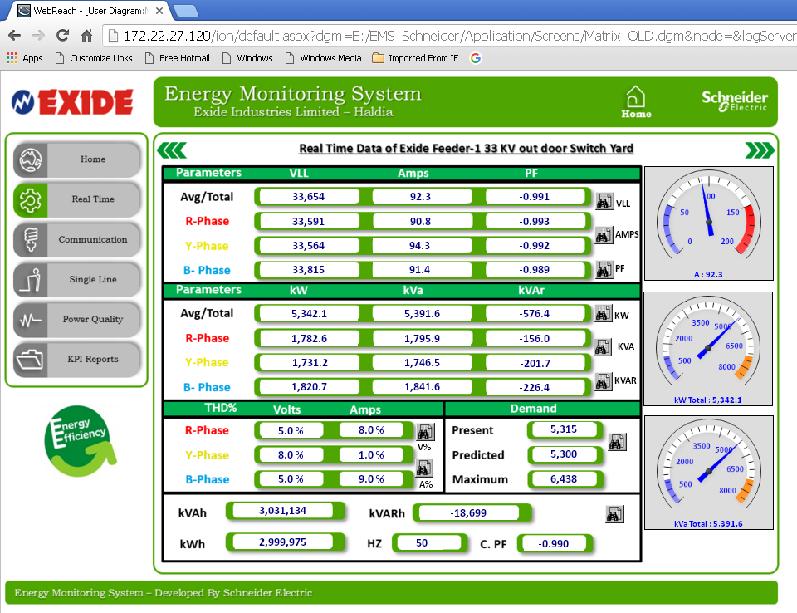
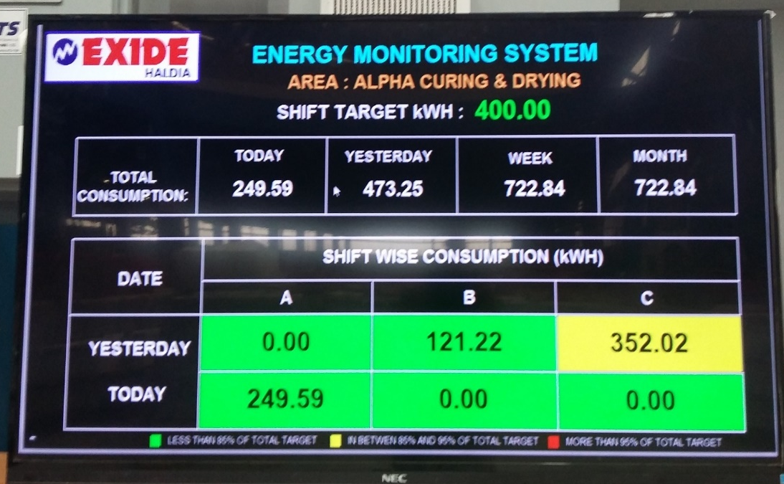
ENERGY CONSUMPTION REPORT
36% Redn
ELECTRICAL LOAD DEMAND MONITERING THORUGH VARIOUS ENERGY MANAGEMENT PROJECT

Slide 27
CONFORMATION TO ENVIRONMENTAL NORMS
Monitoring of outside discharge water -pH, Pb, COD, BOD & TSS
Sl. NO | Location | Parameters | Month
 |  |  | Aug-2021 |  | Sep-2021 |  | Oct-2021
1 | Lagoon Discharge | pH (6.5-8.5) | 7.3 | 7.3 | 7.36 | 6.9 | 7.53 | 7.1
 |  | Pb(0.1mg/lt) | 0.027 | 0.056 | 0.027 | 0.073 | 0.024 | 0.054
 |  | COD(250 mg/lt) | 8.5 | - | 4 | - | 9.1 | -
 |  | BOD(30mg/lt) | <2 | - | <2 | - | <2 | -
 |  | TSS(50 mg/lt) | 11 | - | 14 | - | 10 | -
2 | Traction Discharge | pH (6.5-8.5) | 7.53 | 7 | 7.28 | 7.1 | 8.35 | 6.7
 |  | Pb(0.1mg/lt) | 0.02 | 0.032 | 0.022 | 0.061 | 0.019 | 0.073
 |  | COD(250 mg/lt) | 4.3 | - | 4 | - | 9.1 | -
 |  | BOD(30mg/lt) | <2 | - | <2 | - | <2 | -
 |  | TSS(50 mg/lt) | 9 | - | 11 | - | 10 | -
Schedule:
Self Engaged outside Agency-Weekly
Internal Lab & on-line monitoring system
BDL | → | Below detectable level
ND | → | Not Done

Slide 28
STACK SAMPLING
Stack | Apr-21 | Jun-21 | Aug-21 | Sep-21 | Oct-21
Alloy - Blending Pot(Burner )
Alloy - Blending Pot
Reaction Pot (Auto)
Grid Casting Pot (Auto ) |  |  | 0.58
Li Shan Oxide Mill 12MT (Auto) | 3.99/ BDL |  | 0.33
Assembly (Auto )
Pasting (Auto ) | 7.41/BDL
Jarformation (Scrubber No.1)
Jarformation (Scrubber No.2)
Oxide Ball Mill (Auto) | 8.16/BDL
Oxide Ball Mill (Auto) | 4.79/BDL |  | 1.77
Grid Casting ( Indl)
Pasting ( Indl)
Spine Casting (Indl) |  | 18/5.2 | 0.70 |  | 14/6.8
Ball Mill (Indl) | 5.75/BDL |  | 0.78
Assembly (Indl) |  | 19/6.2 |  |  | 12/7.9
Exide filling | 14.5/BDL
Rotary Shaker ( Indl)
Casting ( Traction)
Pasting( Traction) |  | 20/6.1 | 8.84
Ball Mill ( Traction) | 6.75/BDL
Assembly(Traction) |  | 15/5.9
Cell charging (Traction)
Assembly ( Auto)
Charging (Indl)
Strip Caster |  | 19/6.2 |  |  | 20/7.1
2 nos Recator | 0.67/BDL | 17/7.1 | 0.45 |  | 18/7.4
2 nos Paste mixer
Assembly (Automotive Alpha) |  | 18/6.5 |  |  | 20/7.2
DG set (Auto. Alpha) |  | 70 |  |  | 50
Alpha charging
Oxide Filling (Sungwoon)(Indl)
Ball Mill (Indl) | 4.8/BDL |  | 0.46 | 12/5.75
30 MAh Indl Charging
Dry Gel charging
OMI charging New
1500 KVA no3- Trac
Inabtech charging
Rack charging
24 MT ball mill Auto | 5.67/BDL |  |  | 10/4.25
Positive expander with assy |  |  |  | 12/4.2
Stack sampling schedule for particulate matter- 25 mg / Nm³, Pb- 10 mg / Nm³
By WBPCB
By self engaged outside agency

Slide 29
Work zone Air monitoring schedule for SPM, RPM, SO₂, NO₂, Pb
Sl No | Location |  | Jan 21 |  | Jul 21
1 | Auto. Grid Casting |  | 4.621,1.195,0.014,0.027,0.045 |  | 4.722,1.234,0.015,0.029,0.055
2 | Auto. Pasting |  | 4.622,1.194,0.015,0.027,0.049 |  | 4.287,1.166,0.017,0.029, 0.051
3 | Auto. Plate Brushing |  | 4.956,1.212,0.015,0.028,0.034 |  | 4.852,1.098,0.014,0.03,0.035
4 | Auto. Assembly |  | 4.767,1.124,0.017,0.025,0.027 |  | 4.667,1.157,0.018,0.026,0.033
5 | Indl. Grid Casting |  | 3.687,1.125,0.015,0.027,0.03 |  | 3.745,1.159,0.016,0.029,0.032
6 | Indl. Pasting |  | 5.113,1.197,0.019,0.029,0.036 |  | 5.297,1.324,0,02,0.031,0.38
7 | Indl. Rotary Shaker |  | 5.844,2.453,0.017,0.032,0.037 |  | 6.025,2.607,0.018,0.033,0.038
8 | Indl. Assembly |  | 4.397,1.223,0.016,0.024,0.031 |  | 4.412,1.307, 0.017,0.026, 0.032
9 | Traction Grid Casting |  | 3.875,1.023,0.014,0.029,0.034 |  | 3.924,1.101, 0.013,0.013, 0.37
10 | Traction Pasting |  | 4.712,1.236,0.014,0.029,0.031 |  | 4.802,1.287,0.016,0.031,0.033
11 | Traction Slurry Filling |  | 4.456,1.412,0.017,0.032,0.037 |  | 4.667,1.603,0.018,0.033,0.038
12 | Traction Assembly |  | 4.321,1.339,0.012,0.024,0.027 |  | 4.485,1.412,0.013,0.026,0.032
13 | Alpha Casting |  | 4.302,1.411,0.014,0.033,0.047 |  | 4.447,1.487,0.015,0.034,0.051
14 | Alpha Pasting |  | 4.896,1,135,0.015,0.027,0.024 |  | 5.158,1.147,0.016,0.028,0.027
15 | Alpha Reactor pot |  | 4.023,1.023,0.013,0.025,0.024 |  | 4.332,1.147,0.014,0.027,0.029
12 | Traction Assembly |  | 5.237,2.362,0.012,0.32,0.033 |  | 5.698,2.204,0.014,0.034,0.039
Parameter – SPM-10 mg/m³, RPM – 5 mg/m³ ,SO₂ -5 mg/m³, NO₂-6 mg/m³, Pb- 0.15 mg/m³
By self engaged outside agency (unit- mg/m³)

Slide 30
 | Ambient Air Quality Monitoring schedule for PM ₁₀, PM _{2.5} ,SO2, No2 & Pb
S l No | Location | January | Feb | March | April | May | June | July | August | Sept | Oct | Nov | Dec
1 | Near Admn. Building |  |  |  | 79.43,29.01,14.52,33.88,0.82,33.41
2 | Beside R.O. Plant of Traction Factory |  |  |  |  | 74.58,26.81,13.68,34.03,0.80,33.75
3 | Near auto acid mixing area |  |  |  |  |  | 28.43,16.62,35.96,0.82,
4 | Near Traction Factory Gate |  |  |  |  |  |  | 79.95,26.26,14.49,32.72,0.82
5 | Near industrial test house |  |  |  |  |  |  |  | 54.68,17.84,10.79,29.06,0.69
6 | Near Industrial DG house |  |  |  |  |  |  |  |  | 89.16,32.05,13.62,42.14,0.87
7 | Near Lihshan ball mill-traction |  |  |  |  |  |  |  |  |  | 68.73,26.91,14.72,32.73,0.66
8 | Outside charging area of traction factory
9 | Near Auto. Test House
Parameter: PM10-100 µg /m³, PM2.5-60 µg /m³ , SO₂- 80 µg /m³ , NO₂-80 µg /m³, Pb-1 µg /m³
By self engaged outside agency

Slide 31
PRODUCT RESPONSIBILITY POLICY
Ensure life cycle assessment of products in order to determine the environment impact of product
Evaluate the human & environment safety of each product through assessments of hazards associated with the raw material and their interaction with product(mixtures)

Slide 32
Our Products are made with sustainably sourced ingredients
Lead and Lead Alloys
Sulphuric Acid
Polypropylene Co Polymer

Slide 33
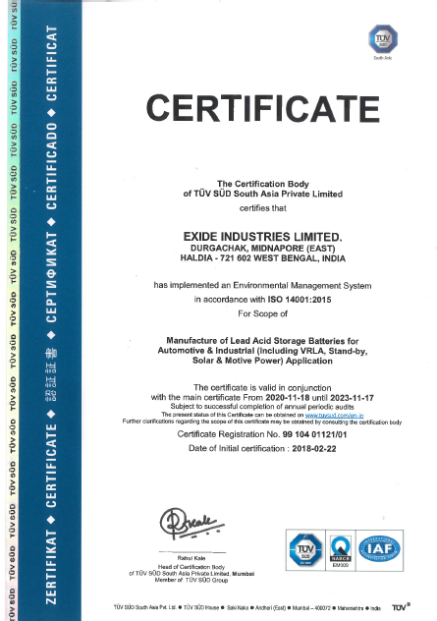
ISO 14001
Exide is ISO 14001 certified company-
Environment protection is a key element on Exide Business –
Complying all regulatory compliance
Compliance on ISO 14001 requirements
Regular monitoring on pollution control devices
Audit to find out scope of opportunities.
Looking for improvements

Slide 34
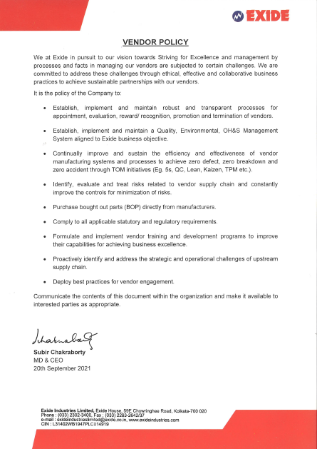
Green Sourcing & Procurement plan
VENDOR POLICY
Establish implement and maintained QEHS system aligned to Exide business objective.
Continual improvement and sustain the efficiency of vendor manufacturing system
Comply all applicable statutory and regulatory requirements.
Deploy best practice for vendor engagement.

Slide 35
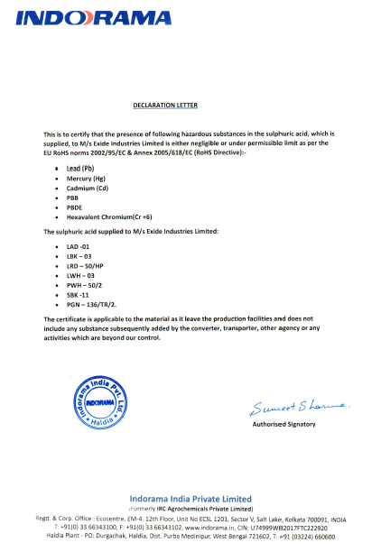
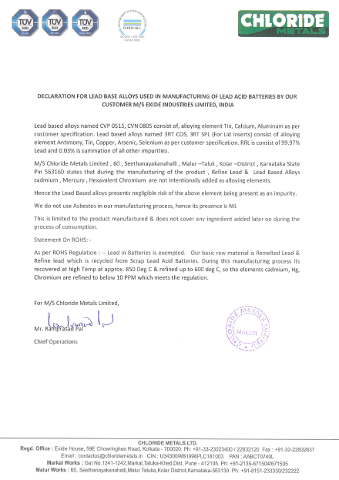
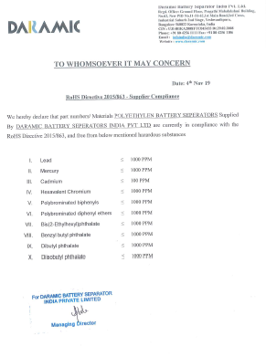
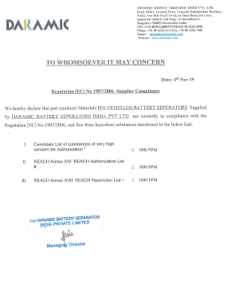
Green Sourcing
Procuring of the environment friendly resources from well known and standard vendor.
Our vendors are also engaged in sustainability programe.
Complying all statutory and regulatory requirement.

Slide 36
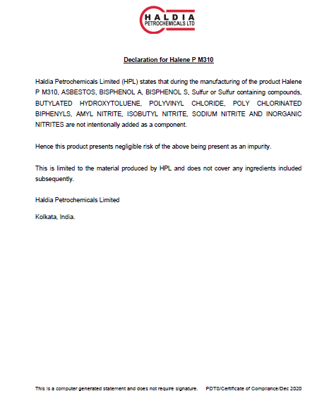
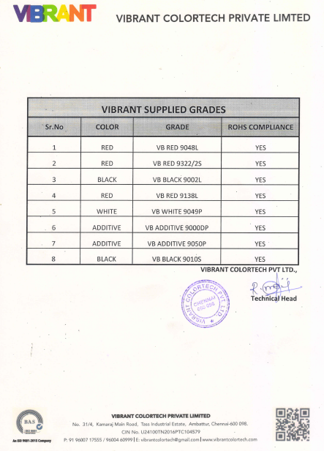
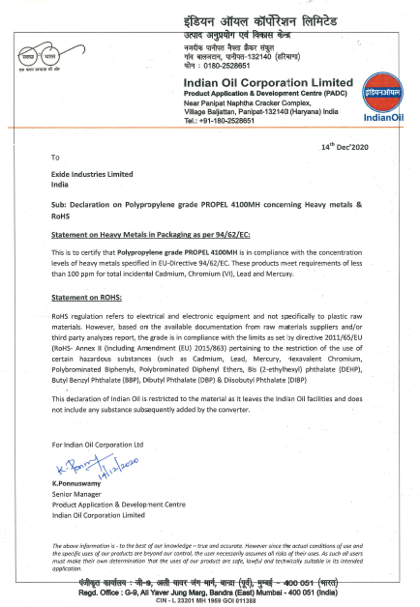
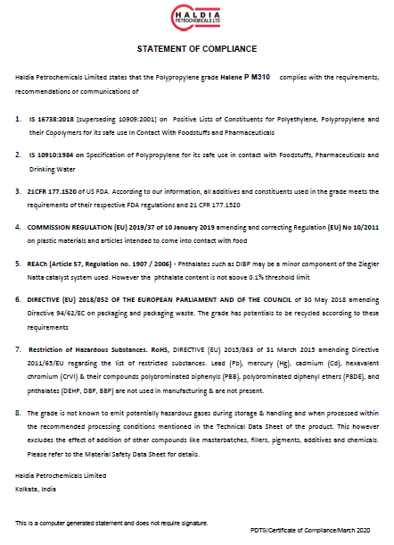
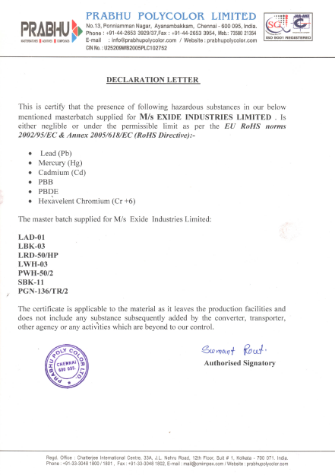
Green Sourcing

Slide 37
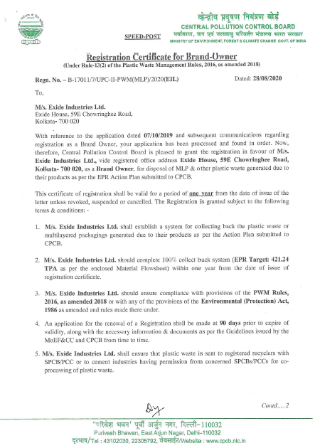
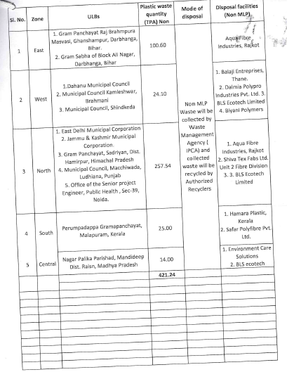
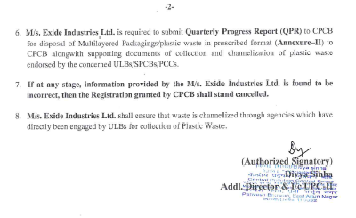
Standard Procedure of Disposal
Exide has been registered as a Brand Owner for disposal of MLP (Multi Layered Plastics) & other plastic waste generated due to the products as per the EPR action plan submitted to CPCB.
CPCB has granted the registration in favour of EIL

Slide 38
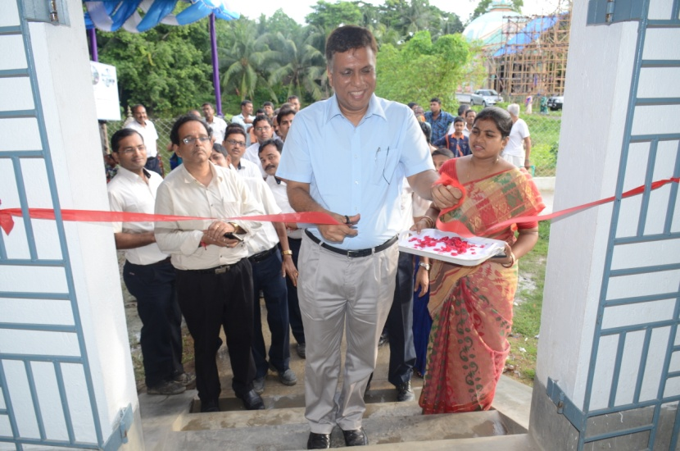
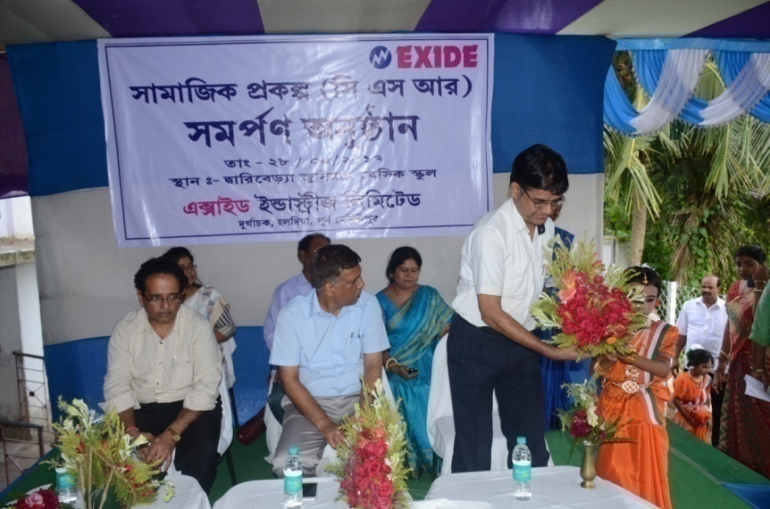
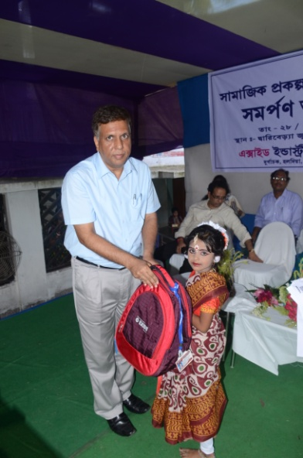
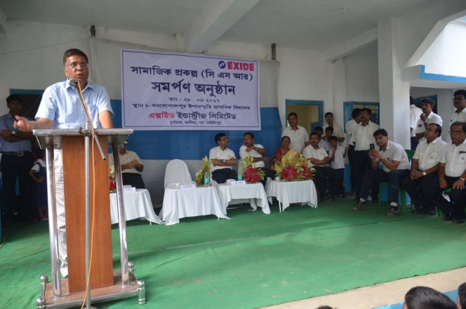
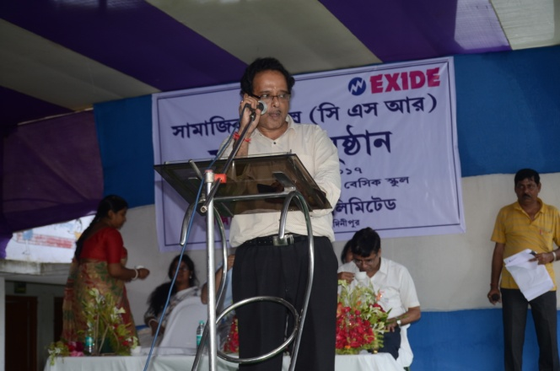
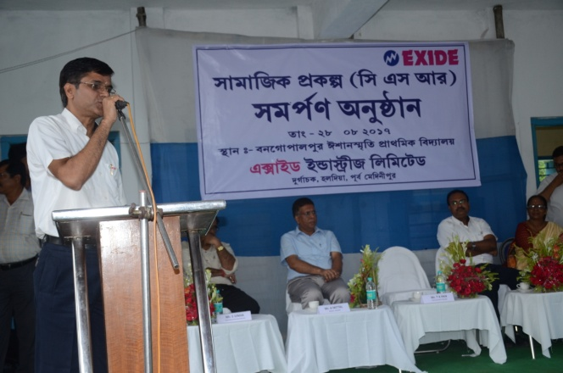
CSR Activity

Slide 39
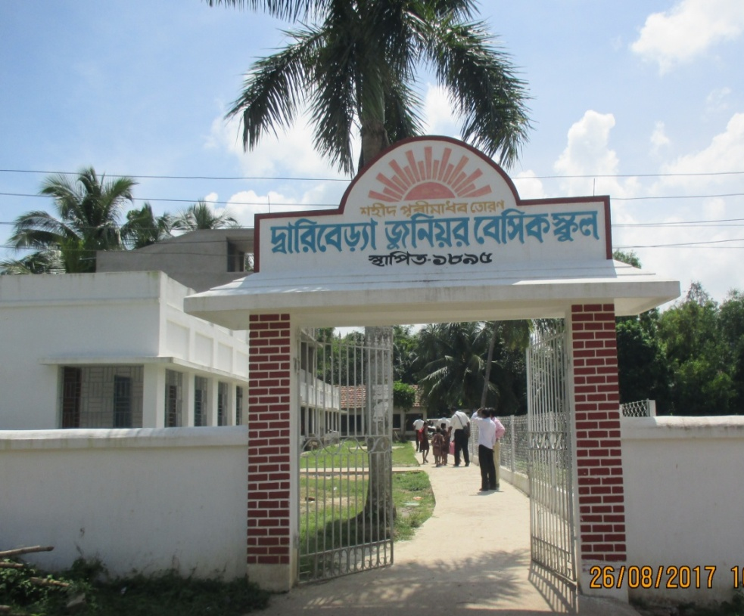
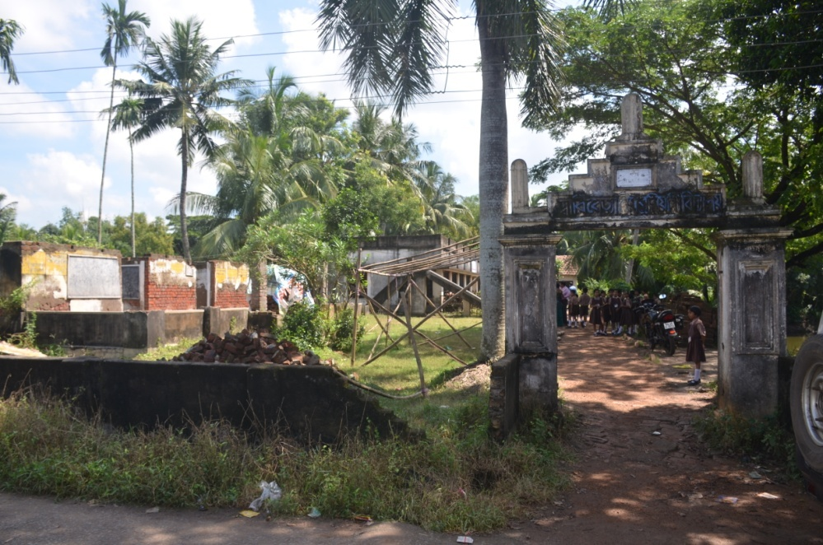
Dariberia Lower Primary School
A School in need for
Urgent Repair
School After CSR Project
For Transformation: Activities Planned Under CSR
1 | 2 New Class Rooms | 6 | Water Pipe Line
2 | Class Room Furniture | 7 | Water Tank
3 | Electrification of New Class Rooms | 8 | 2 Toilets
4 | Boundary wall | 9 | Approach Road
5 | Water Purifier | 10 | School Children Health Check Up

Slide 40
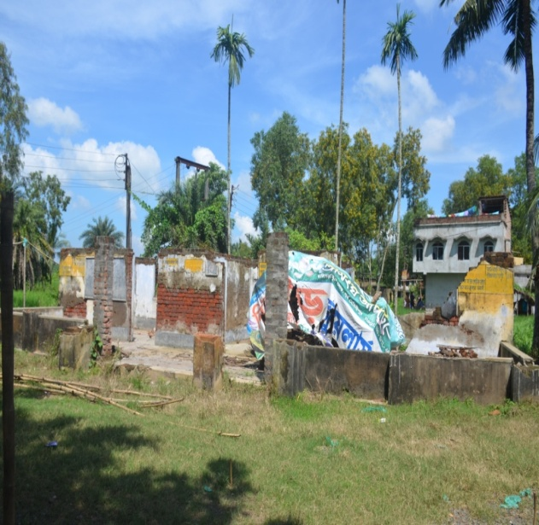
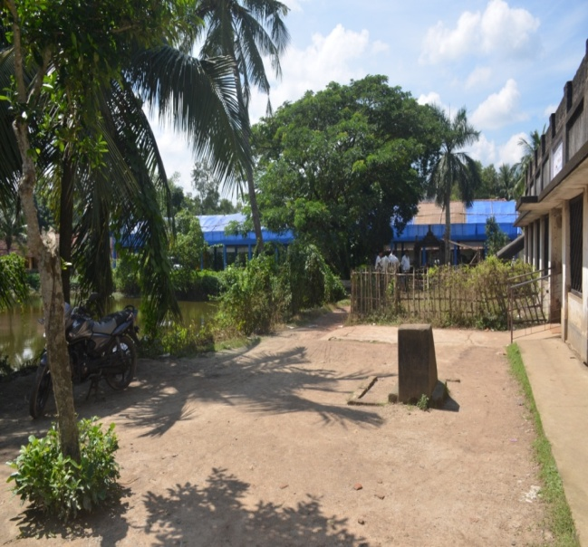
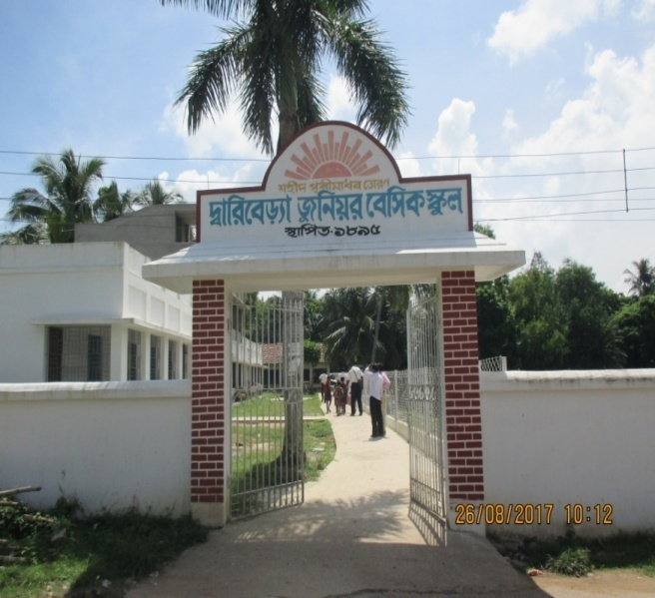
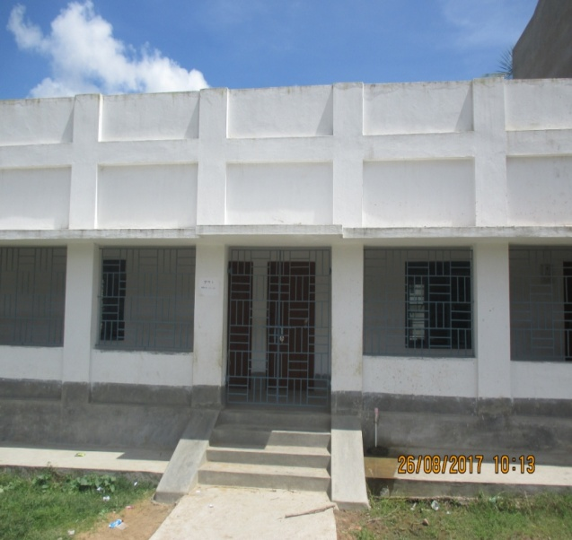
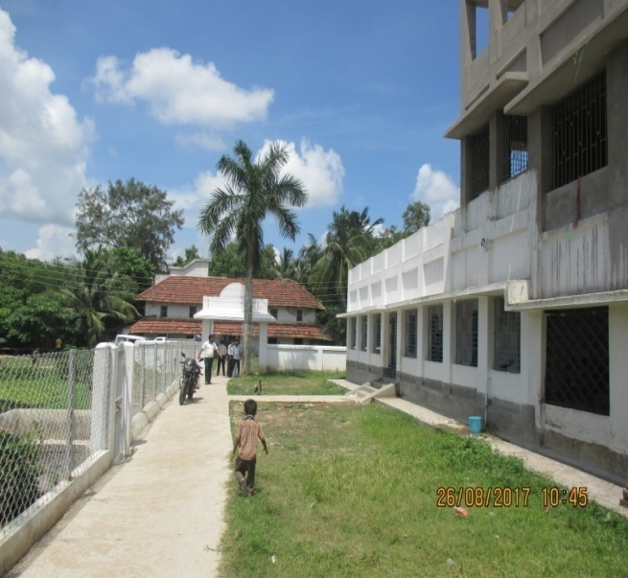
How The Transformation Happened Under CSR
Before
Before
Before
After
After
After

Slide 41
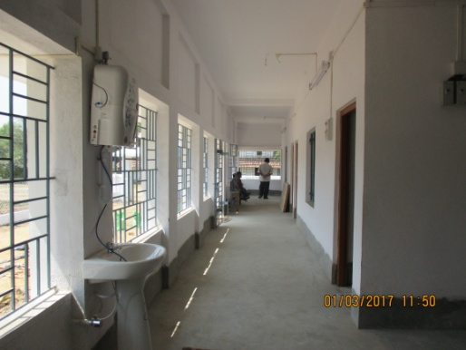
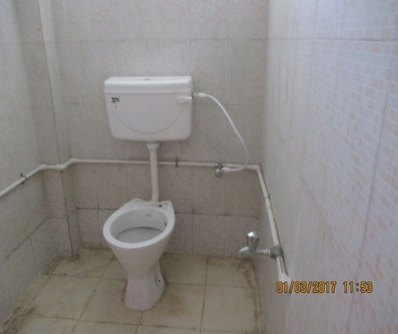
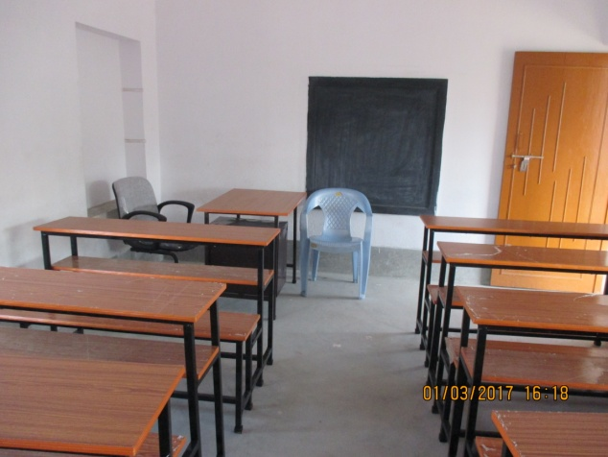
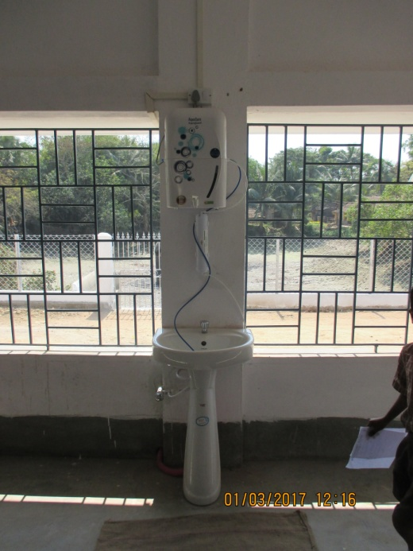
Activities Implemented Under CSR
New Class Rooms
Water Pipe Line
Toilet
Class Room Furniture
Water Purifier
Toilet
Staircase
Boundary Wall
Urinal

Slide 42
Health Check-up Program
Health Camp
Registration
Paediatric check up
Eye check up
General Health check up
Routine Blood Test

Slide 43
OPPORTUNITIES FOR IMPROVEMENT
Infrastructure
Development of at least one alternate agency for waste Management – for continuity of operation in cases of unforeseen interruptions at current sole agency.
A State Referral Laboratory at Haldia – Credible and quick testing services that can be utilised by industries.
Recognition
The Pollution Control Board may recognise, reward and promote best practices of industries – some can be adopted by others.

Slide 44
Together We Can
Together We Will
Thank you

