Slide 1
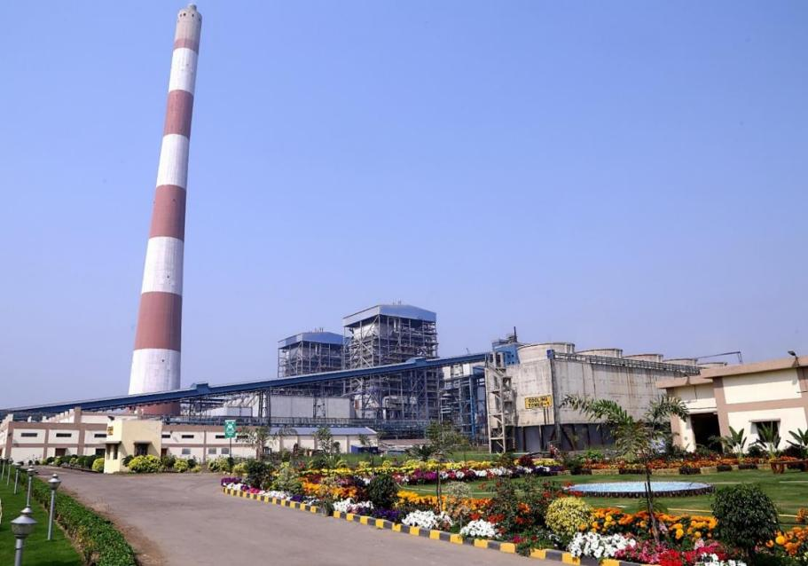
HALDIA ENERGY LIMITED
BEST ENVIRONMENTAL
MANAGEMENT PRACTICE
Mr. Chiranjib Bhowmik, General Manager
Dr. SANJOY CHAKRABORTY, chief manager
30.11.2021

Slide 2
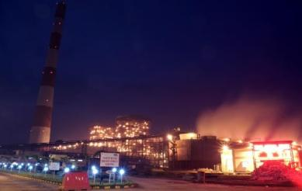
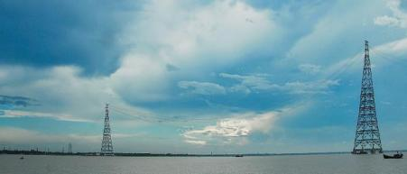
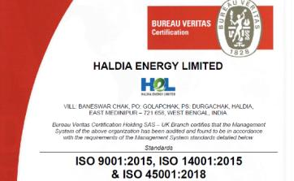
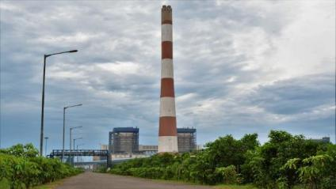
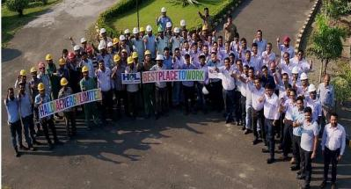
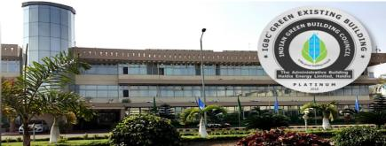
Brief About the Organization
2x 300 MW thermal power- catering >37% demand of Kolkata
89 km long transmission corridor with 2x 236 m tall RCT- tallest in India
IMS certification in very 1st year
>1lakh surviving plants in green belt
Platinum green building
Ranked among top 3 private power generators
Overview

Slide 3
Sources of Pollutants in Thermal Power Plant
Chimney Emission
Noise
O/P- Power
Intake water
Boiler
Coal
TG
Water Treatment
Process Reject
Condenser
Other Process Wastes
Hazardous waste
E- Waste
Bio Medical Wastes
Municipal Solid Waste
Boiler blowdown
Ash
Cooling Tower blowdown
Solid Waste
Effluents
Hazardous Waste
Gaseous Pollutant
Other Wastes
Other pollutants
Ash
(from coal combustion)
Effluent
(water treatment, blowdown)
Waste oil
Cotton waste
Insulations
E- Waste
Chimney emission
(after ESP)
Bio medical
MSW
Noise
Fugitive emission

Slide 4
HEL Approach to Environment Management
Environment Management Model
Performance
+
Efficiency
Infrastructure development
Environment friendly
+
Segregation at source
Innovation
+
Excellence
Reduce
Recycle
Utilize
Surpass
Coal Consumption
Process make up
Water conservation
Emission
Effluents
STP
Rain water harvesting
Ash
Hazardous waste
E waste
Technology Adoption
Green buildings
Biodiversity Conservation
Organic composter

Slide 5
R.E.D.U.C.E

Slide 6
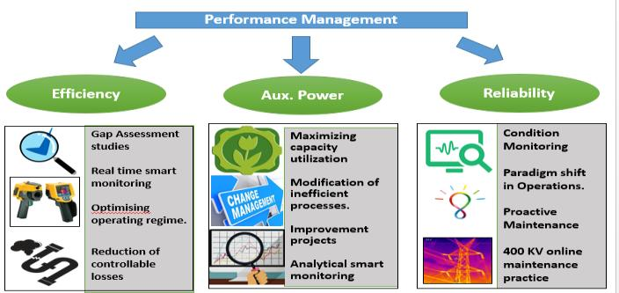
Reduction of GHG Emission
~15% reduction of specific GHG Emission
Improvement of station efficiency
Reduction of Auxiliary Power Consumption
Less power consumption/ unit generation
Improving reliability
Less interruption in generation
Less oil consumption

Slide 7
Water Consumption Reduction Drives
Focus on All Volatile Treatment rather than Conventional treatment.
Maintaining stricter water quality parameters.
Reduction in process make up water requirement.
Modification of water treatment methods
Changing water pretreatment polymeric dosing type
Exploring of new chemicals regime in cooling water Cycle
Intake water as per water tide schedule
Improved water quality and less reject in water treatment. Increased COC.
2018
2019
2020
2021
Regular water audit for identification and stoppage of undesired water leakages.

Slide 8
R.E.U.S.E

Slide 9
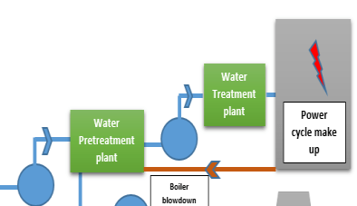
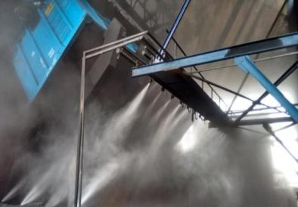
Water Recycling Drives
Process water recycling
Back feeding blowdown in water pre treatment
Area
Sludge pond water is being recycled.
All process filtration back wash system water are recycled.
Usage of waste water in different applications
Applications
Water spraying on roads
Sprinkling in dry fog dust suppression to control fugitive emissions.
Sprinkling at other areas prone to dust emission

Slide 10
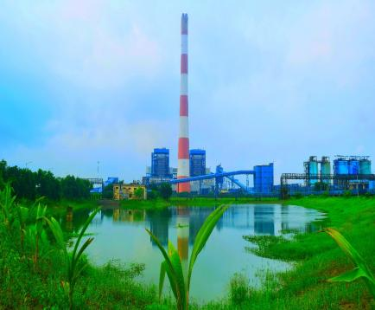
Other Major Environment Improvement Initiatives
Development of Rainwater Harvesting Pond of Capacity 72000 m3
Development of a large water reservoir to store rain water.
Development of catchment area to utilize rain water as raw water.
Pumping energy saving.
Around 8-9% water conservation for Plant operation
Water Conservation ( M3) | 1,30,000
Energy Conservation ( kWh) | 36,000
Coal Saving (kg) | 25,000

Slide 11
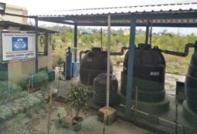
Other Water Conservation Initiatives Adapted
Sewage Treatment for Office waste water
Green building initiatives- Replacement of existing appliances with water efficient fittings. Resulted in 30% water saving.
Rain water harvesting- expanding roof top area utilization.
Officers’ residential buildings are built as zero liquid discharge buildings.

Slide 12
U.T.I.L.I.S.E

Slide 13
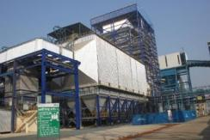
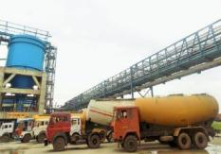
Utilization of Fly Ash
Environment friendly conveying and storage.
Disposal in sealed bulkers to cement and allied industries.
Major percentage to Cement Industries.
Wet ash used for Structural filling.
100% ash utilisation achieved since inception.

Slide 14
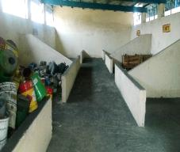
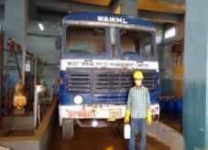
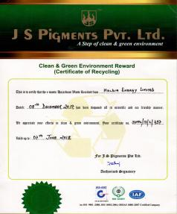
Hazardous Waste Management and Utilisation
Hazardous Waste Segregation at source
Waste Oil
Non Recyclable wastes
E waste
Segregation and Storage
Used oil
Spent oil
Used resin
Oil soaked cotton
Exhausted resin
Used filters
Computer accessories
Batteries
Electrical items
Disposal
Green Certificate
Handling by Govt. Approved agencies
Reconditioning
Recycling
Incinerate/ Compost/ Safe disposal
Valued use
Safe disposal

Slide 15
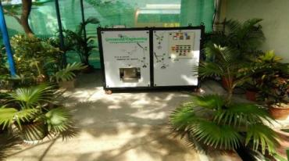
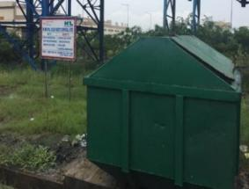
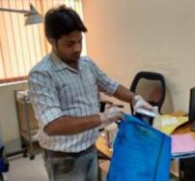
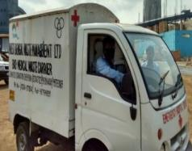
Municipal Solid Waste & Bio medical Waste
MSW Classification
Kitchen and Canteen waste
Garden waste
Other non Bio degradable waste
Automatic composter machine
Automatic composter
Handling by Govt. Approved agency
Organic manures for gardening purpose
Recycling
Safe disposal
MSW Bin
Bio medical wastes
Segregation at source
Handling by Govt. Approved agency
Safe disposal

Slide 16
S.U.R.P.A.S.S

Slide 17
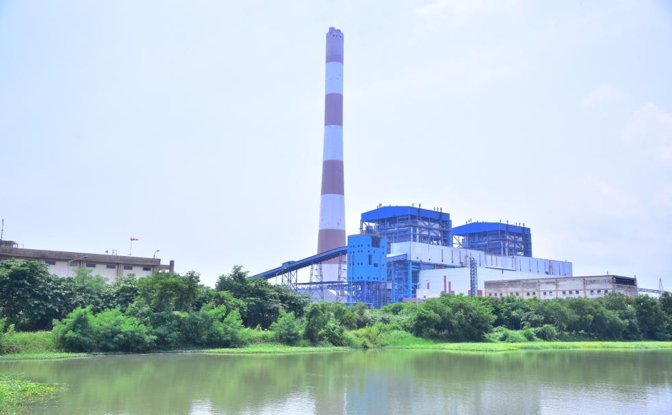
NATURE SERVE
BIODIVERSITY CONSERVATION AT HALDIA ENERGY LIMITED

Slide 18
BIODIVERSITY CONSERVATION AT HALDIA ENERGY LIMITED
Sustainability (being equally responsible for people, planet, profit), being one of the core values of the group, has always been of prime significance and guiding light for HEL in shaping up its operating dimensions.

Slide 19
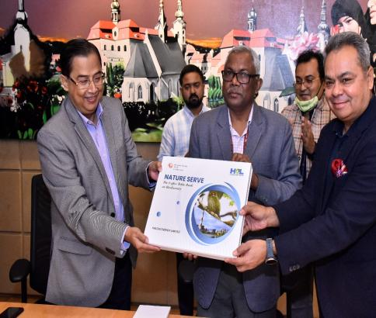
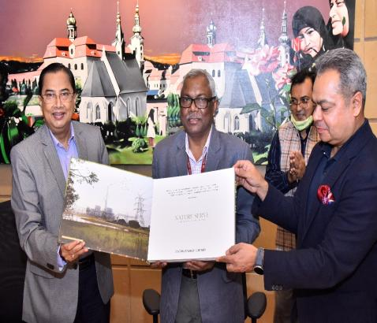
HALDIA ENERGY LIMITED UNVEILS “NATURE SERVE” AN ILLUSTRATIVE BOOK ON BIODIVERSITY
Dr. S. Kerketta, Director, Ministry of Environment, Forest and Climate Change (MoEF& CC), Delhi, Government of India unveil Nature Serve on 20.11.2021 at Kolkata

Slide 20
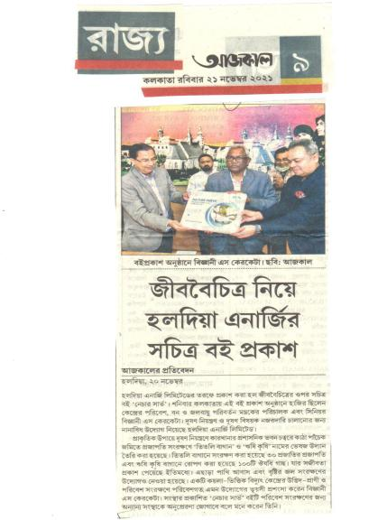
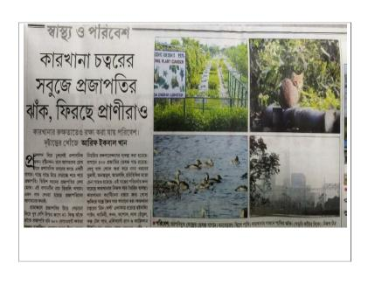
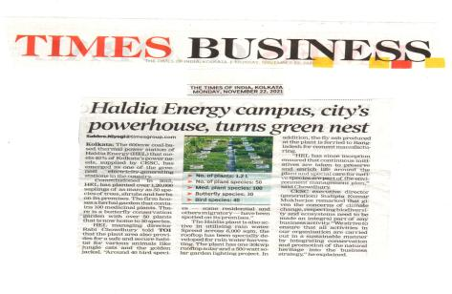
UNVEILS “NATURE SERVE”

Slide 21
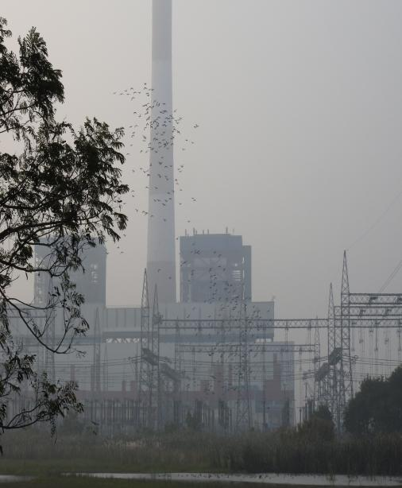
HEL NATURE CONSERVATION VALUES
Haldia Energy Limited (HEL), since its inception, has been striving hard for the sustainable growth of its business.
Environment Management is among the critical areas to ensure that the operational aspects do not lead to failure in complying with environmental norms and statutes.
Moreover, we aim to leave a positive impact on the surrounding atmosphere for generations to come.

Slide 22
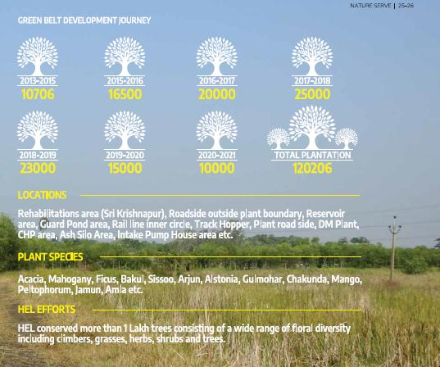
FLORAL BIODIVERSITY
Plants are the green wealth of the planet Earth. They not only supply Oxygen but also reduce Carbon Dioxide and act as natural air conditioners.
HEL started plantation programme within its compound in 2013 .
HEL maintains a large space for preserving and storing a wide range of floral diversity including climbers, grasses, herbs, shrubs and trees.

Slide 23
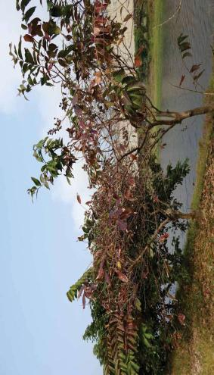
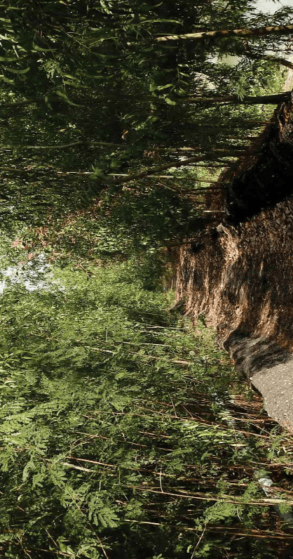
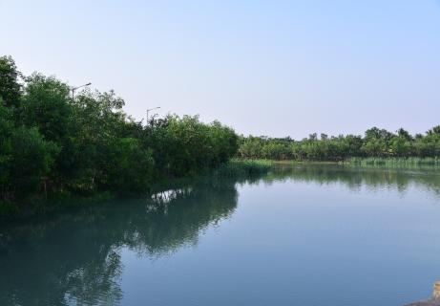
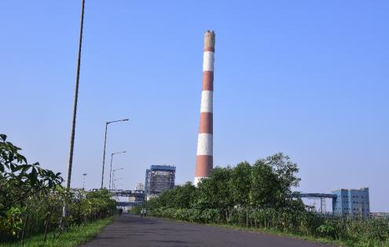
PLANTATION MANAGEMENT

Slide 24
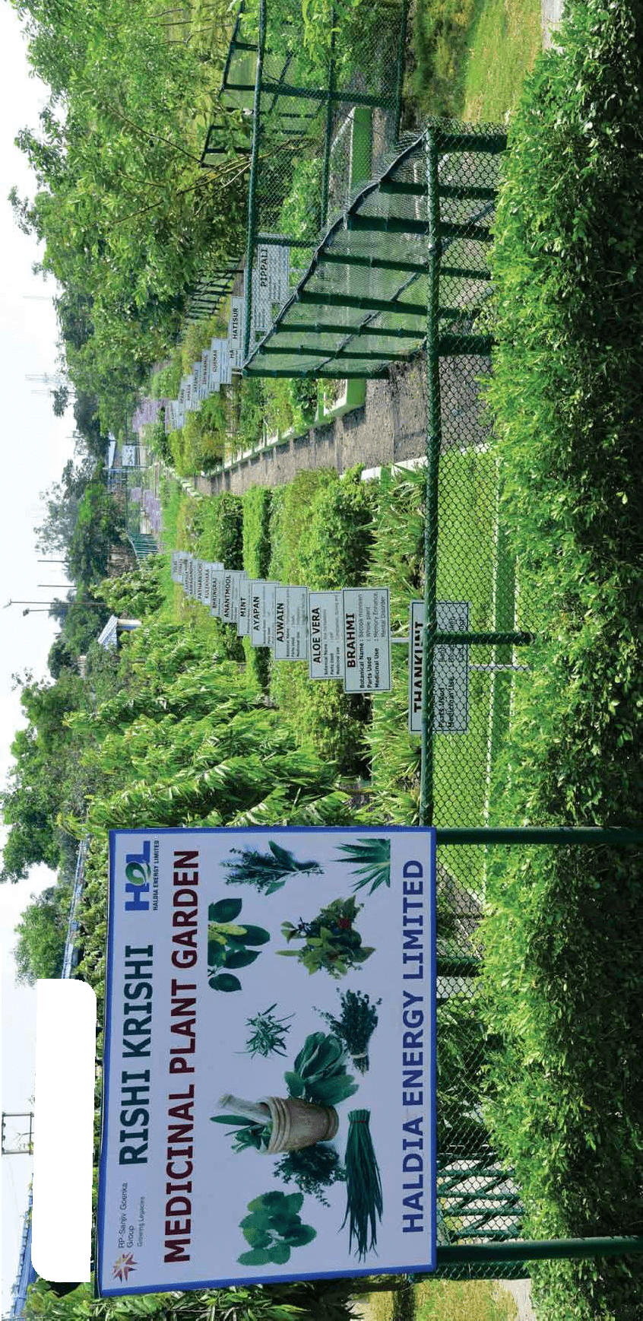
PROJECT “RISHI KRISHI”
ECHOING INDIAN AYURVEDA LEGACY
Another noteworthy project that was conceived to conserve the biodiversity as well as to showcase the thousand-year-old Ayurveda legacy is suitably named “RISHI KRISHI”.
It is a herbal medicinal plant garden consisting of 80 invaluable species of medicinal plants within Plant premises.
It also encourages the employees and the community to utilize medicinal plants for improving health and quality of life.

Slide 25
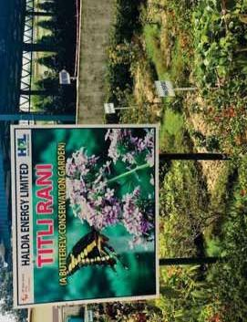
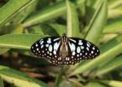
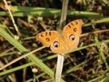
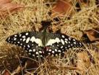
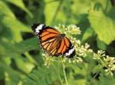
FAUNAL BIODIVERSITY
BUTTERFLIES CONSERVATION
Butterflies are the second largest group of pollinators after honey bees which is an added advantage as areas rich in butterflies are rich in other invertebrates and other species of the food chain.
HEL recognizes the significance of host plants and this has led to the inception of the project "TITLI RANI” or Butterfly Conservation Park. The park is of open-air type.
Presently, about 17 butterfly species, belonging to 5 families have been recorded from the HEL plant area.

Slide 26
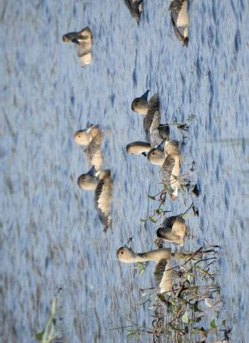
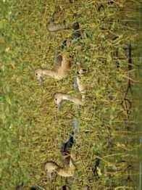
FAUNAL BIODIVERSITY
BIRDS
Birds are sensitive to the overall habitat quality and biodiversity of a particular place. 38 bird species belonging to 30 families have been sighted inside HEL.
Large numbers (more than 500) of Lesser Whistling Teals (Dendrocygna javanica) were recorded from the waterbodies of the HEL plant.
The landscape of HEL plant is perfectly suited for these birds, since these water bodies provide suitable habitat as well as security.

Slide 27
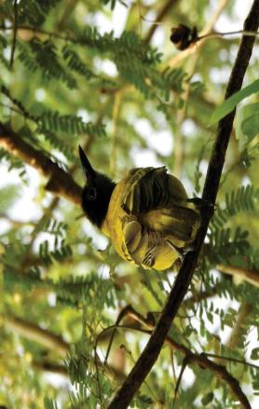
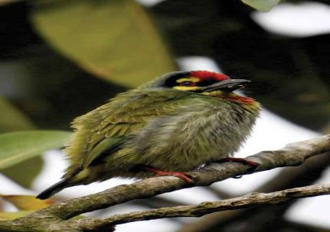
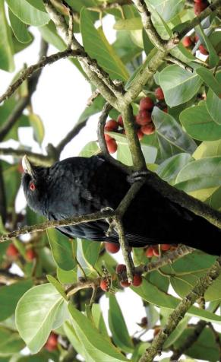
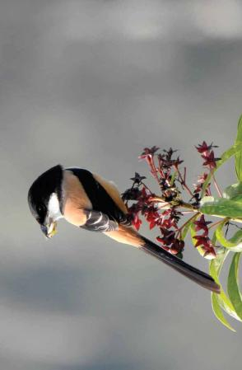
FAUNAL BIODIVERSITY
Black Hooded Oriole
Coppersmith Barbet
Asian Koel
Long Tailed Shrike

Slide 28
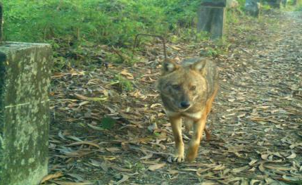
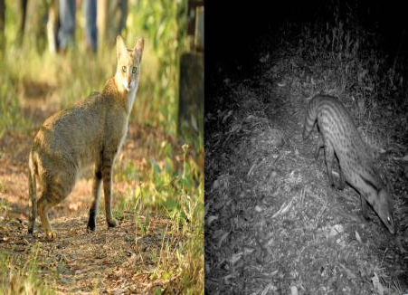
FAUNAL POPULATIONS AT HEL
Golden Jackal :
The Golden Jackal (Canis aureus) is found all across the green belt areas of HEL facility. HEL plant is supporting a sizable population of these endangered species, varying between 10-20 adults.
Jungle Cat & Small Indian Civet :
The Jungle Cat & Small Indian Civet have been spotted on multiple instances at the green belt and plantation area around HEL facility.

Slide 29
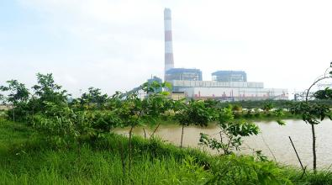
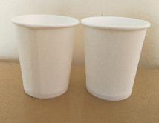
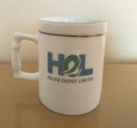
GREEN STEWARDSHIP UNDERTAKEN BY HEL
CO2 absorption by Green belt
238 MT CO2 absorption/ year in first five years.
Maximum absorption potential 1440 MT/ year.
Replacement of Paper cups by Ceramic cups
Saving of 1.40 Lakh cups/ year.
Water saving of 400 kl water required for manufacturing of cups.
12 no. of trees saved.
Mass distribution of Jute bags (no Plastic campaign)
Reduction of plastic usage in the neighbourhood.
Mass awareness on harmfulness of plastics.

Slide 30
GREEN STEWARDSHIP UNDERTAKEN BY HEL
HEL has initiated several measures aimed at promoting sustainable development through harnessing of renewable energy sources. It has commissioned a 30 kWp roof top solar plant in the Administrative building GAP required.
The automatic organic waste composter gives organic compost using kitchen and garden waste along with a volume reduction of 80 to 90% within 24 hours. The composter generates 5-7 kilograms of organic compost from kitchen wastes on a daily basis and which is reused as manure for HEL’s own organic farming.

Slide 31
“We believe that the comprehensive Environment management framework is the Key to Sustainability”

Slide 32
Thank You

