Slide 1
Sustainable Journey ,
Indorama India Pvt Ltd, Haldia
Case Study towards Net Zero at Haldia

Slide 2
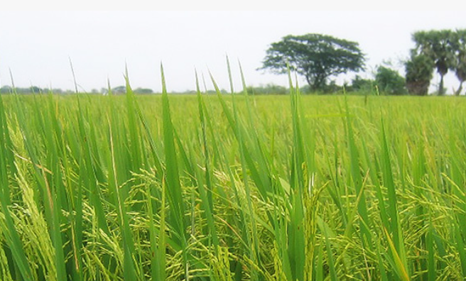
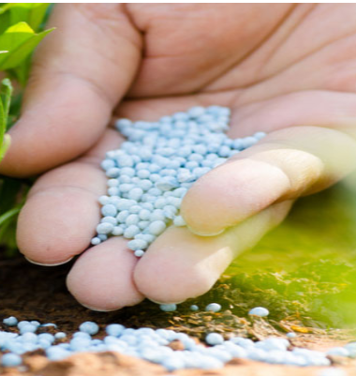
Indorama India, Haldia unit contribution towards society
Fertilisers enhances the nutritional content of the food crops and increases the productivity of the land.
Indorama India Pvt Ltd Contributing - Towards food security of the Nation by delivering fertilisers to the farmers

Slide 3
Back drop
Refinery , petrochemicals, power plant , steel , fertilizer category of industries are located in Haldia region.
These category of Industries are energy intensive & falls under designated consumer as
per Energy Conservation Act .
Within fertilizer category , Urea plant is considered as designated consumer .(Total energy consumption more than 30000 Metric tonne of oil equivalent.)
Indorama India Pvt Ltd , Haldia unit is phosphatic fertiliser unit . This is less energy intensive plant (<1 Gcal /MT of product) & doesn't fall under Designated consumer category.

Slide 4
Climate related impacts

Slide 12
Indorama Corporation – Decarbonization strategy
Indorama Corporation PTE. LTD. is a leading producer of fertilizers, polyolefins, fibers, yarns, and medical gloves having 30 manufacturing sites across eight countries around the world. Environment, Social, and Governance are the three main directions resulting from the strategy adopted at a global level in the Indorama Group. Integrated within this strategy, long-term initiatives are to be developed and ambitious goals anchored. Within the framework of production processes, Indorama makes a possible effort to constantly improve our energy efficiency.
Indorama is taking into consideration the changing global demands and is committed to making the chemical value chain safe, efficient, and sustainable to guarantee responsible growth. Working toward reducing the ecological impact of their products and ensuring safe and healthy working conditions are their one of the top priorities. Their sustainability journey shall also be built keeping in mind the three core areas of Environment, Social, and Governance and in harmony with the UN Sustainable Development Goals (SDGs).
Indorama can achieve its goal to build an environmentally responsible business by imbibing a sustainable business and operational ethos whilst reducing greenhouse gas emissions across their footprint by focusing on 3 pillars – Reduce, Substitute, and Compensate.
REDUCE: Reduce energy use by improving efficiencies, optimizing operations, and redesigning processes
SUBSTITUTE: Replace conventional, dirty energy sources with renewable technologies and low emission products
COMPENSATE: Remove unavoidable residual emissions through RECs and/or offsets
1
Contribute to emission reduction globally
Need to achieve net Zero
Three key reasons
2
Indorama understands the importance of conducting and growing its business in a sustainable manner; must be net zero to contribute to global GHG emission reduction, improve energy security and enhance operational performance.
Improve energy security
3
Enhance operational performance

Slide 13
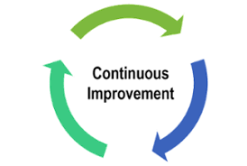
Decarbonization Journey in IRC
Finalization of Scope & Work Order
Development of carbon abatement
action plan/ GHG emission reduction
strategy for the following five facilities
of Indorama (IIB, IRS, ICS, IPL & IFL)
Deliverable 1:
Gaps and recommendations on
Scope 1 & 2 GHG emissions inventory
Deliverable 2:
Data collection framework for Scope 3
emissions with instructions/ guidelines
KPMG Onboarded
Jan- Feb’23
Mar- Apr’23
Deliverable 3: Carbon abatement action plan / GHG emission
reduction strategy for five sites
Deliverable 4: Final GHG emission reduction roadmap including
carbon offset roadmap
May-Aug’23
Nov-Dec’23
Net Zero Target
GHG Emission Reduction Strategy
Completed
In progress

Slide 14
Details of the Decarbonization Project
Deliverable 1: Gaps and recommendations on Scope 1 & 2, GHG emissions inventory
Scope
Workstream 1
Emission Validation
Understanding of GHG Data
Discussion with the Indorama team on the GHG data
Reviewing Organizational/ Operational Boundary
Reviewing GHG Inventory Quality/Gap Assessment
Revised GHG Estimates
Development of carbon abatement action plan/ GHG emission reduction strategy for the following five facilities of Indorama:
Completed
IIB
ICS
IRS
IPL
IFL
Workstream 2
Development of Scope 3 Emission Estimation Framework
Deliverable 2: Data collection framework for Scope 3 emissions with instructions/ guidelines
Indorama Eleme Fertilizer & Chemicals Limited, Nigeria (IFL)
Indorama Eleme Petrochemicals Limited, Nigeria (IPL)
PT. Indo-Rama Synthetics Tbk., Indonesia (IRS)
Indorama India Private Limited (Spandex Division)- Baddi
Industries Chimiques Du Senegal, Senegal (ICS)
Identifying relevant Scope 3 emissions categories
Peer benchmarking and Materiality assessment
Development of data collection Framework
Collection and collation of data
Completed
IIB
ICS
IRS
IPL
IFL
Deliverable 3: Carbon abatement action plan / GHG emission reduction strategy for five sites
Deliverable 4: Final GHG emission reduction roadmap including carbon offset roadmap
Workstream 3 & 4
GHG Emission Reduction Strategy
Identifying carbon abatement levers
Evaluating carbon abatement options
Developing carbon abatement roadmap
Developing carbon offset roadmap
In progress
Completed
In progress
IIB
ICS
IRS
IPL
IFL

Slide 15
Decarbonization Levers : 04 Climate Actions
Reduce energy use by improving efficiencies, Optimizing operations and redesigning process
LEDs, Heat recovery systems, Efficient layouts, Energy Layouts & Sustainable materials
Carbon capture and utilization, Circular economy, metal recycling
Reuse energy and resources to minimize emissions and waste
Reuse
Reduce
Compensate
Substitute
Replace conventional sources with renewable technologies and low emissions products
Electrification, Renewable Energy, Hydrogen and Derivatives, Storage and Batteries, Clean Mobility
Compensate emissions through offsets or by removing unavoidable residual emissions
Carbon Sinks, Nature-Based Solutions & Offsets

Slide 16
Initiatives towards reduction of Carbon foot print

Slide 17
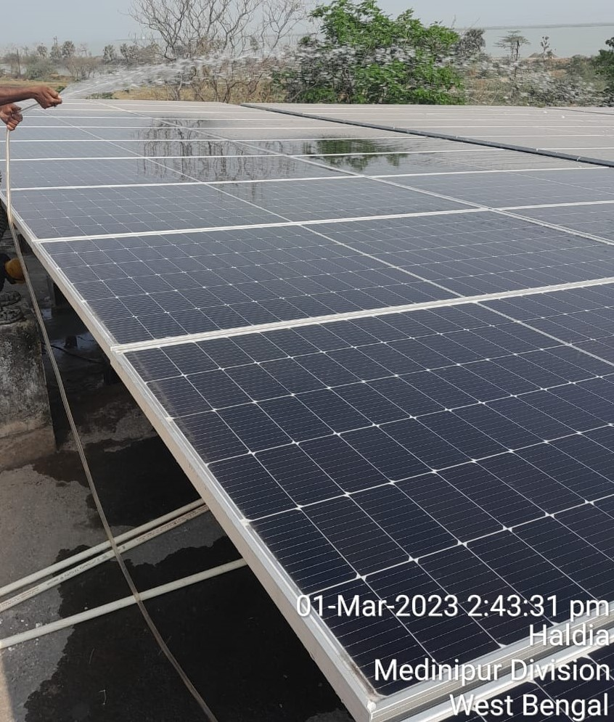
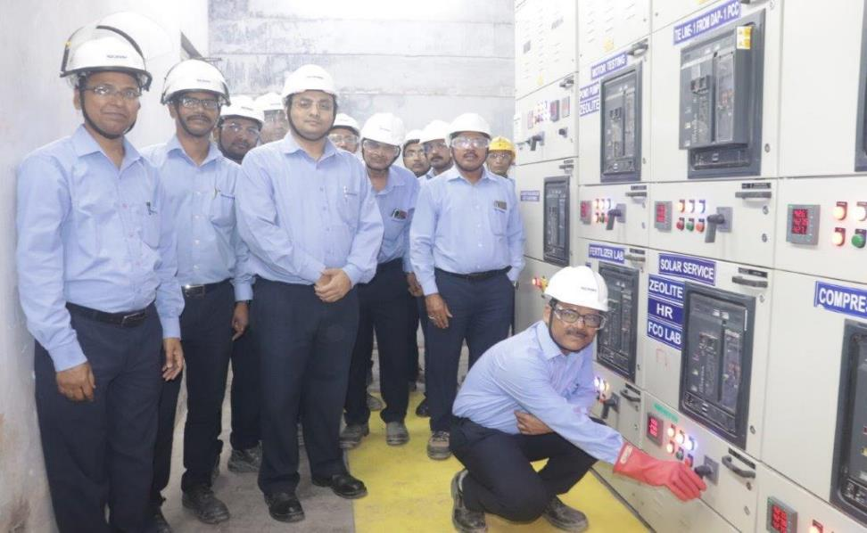
500 KWP Solar Project commissioned in Feb 23.
Solar Panel at Ammonia Building
Solar panel of 500 kWp installed to increase the use of renewable energy as a part of Eco Sustainability measures in Feb 2023.
Solar Power Commissioned on 20.02.2023

Slide 18
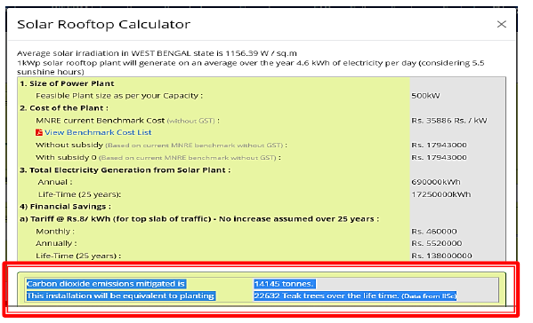
Emission reduction from Solar power
Carbon dioxide emission mitigated is 14145 tonnes.
This installation will be equivalent to planting 22632 Teak trees over the life time

Slide 19
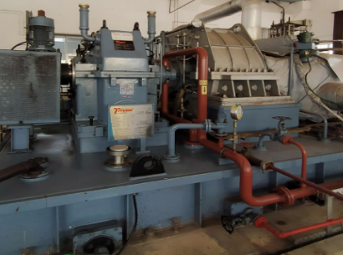
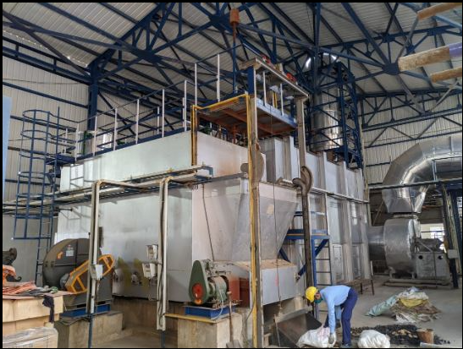
Environmental Projects (Steam Turbo generator from waste heat & biomass Furnace)
New STG
Commissioning of 8.3 MW Steam turbo generator (STG) completed to utilise waste heat of sulphuric acid plant in the month of Nov 20.
Benefits:
Reduction in carbon foot print .Total 78760 GJ power produced from waste heat , equivalent to 15848 Ton of CO2 emission reduction CO2 in 2022-23.
Biomass based HAG
Biomass briquette based Hot air generator commissioned in 2020 Dec in fertiliser plant. This has eliminated the usage of Furnace oil .
Benefits :
Elimination of fossil fuel & use of carbon neutral fuel . Total 44279 GJ energy used from biomass , equivalent to biogenic emission of 4500 Ton of Co2.

Slide 20
KPI – Carbon foot print & Renewable energy

Slide 21
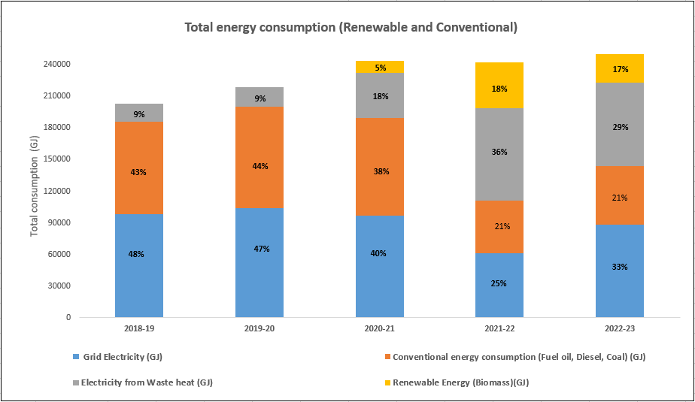
Energy consumption pattern
Energy from Renewable sources & waste heat has increased over the years. It is currently 50% of the total energy required for plant operation

Slide 22
Initiatives towards water conservation & effluent recycling

Slide 23
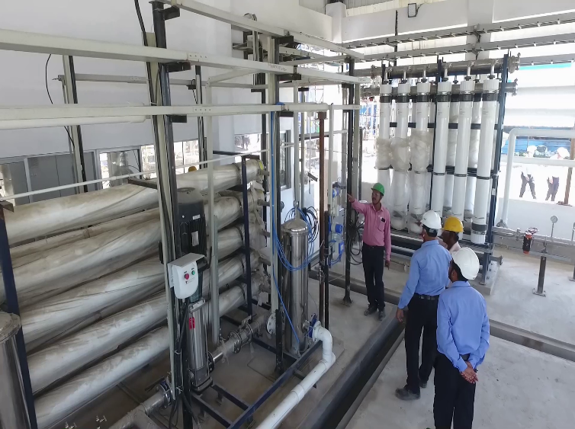
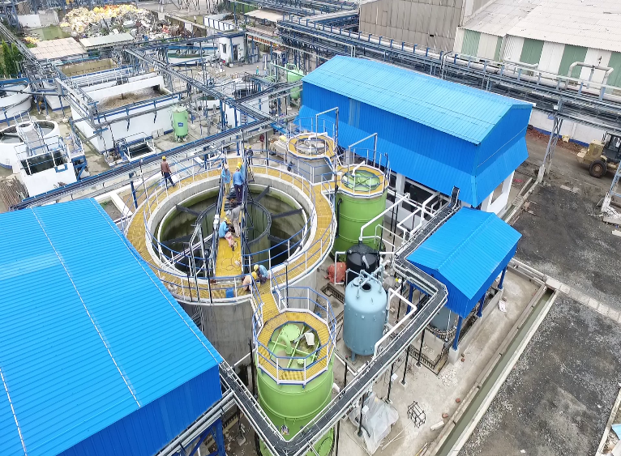
Effluent recycling Plant of Capacity 40 M3/Hr, commissioned in June-22 , achieved zero liquid discharge
RO & UF Section
ZLD Plant Overview
Effluent recycling plant commissioned in Sept 22 . Achievement of this project is that we have achieved zero liquid effluent discharge without the need for a Multiple Effect Evaporator (MEE). By utilizing the high TDS water in the fertilizer plants, we have successfully eliminated liquid effluent discharge without any adverse effects on the process.

Slide 24
Rain Water use & Storage
Total Capacity : 7000 m3

Slide 25
KPI – Water intensity & effluent recycling
Water Intensity (KL/MT of production
Good
Good

Slide 26
Other Initiatives ( CER & CSR)

Slide 27
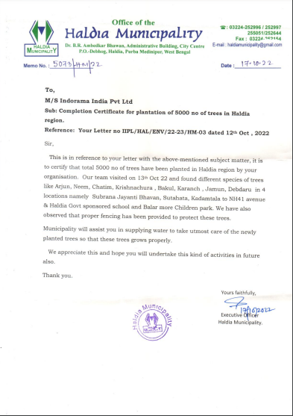
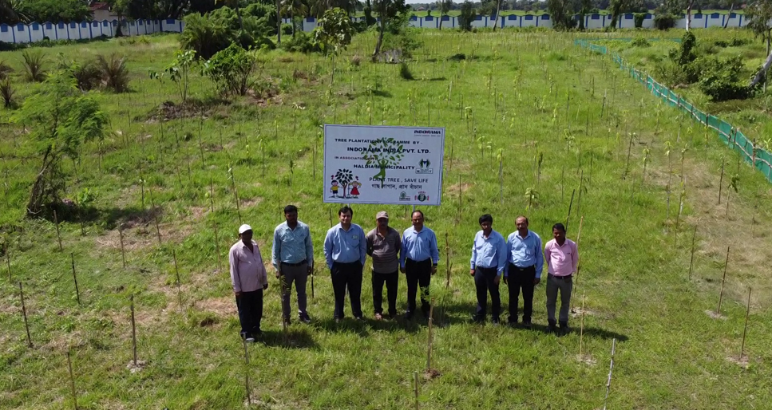
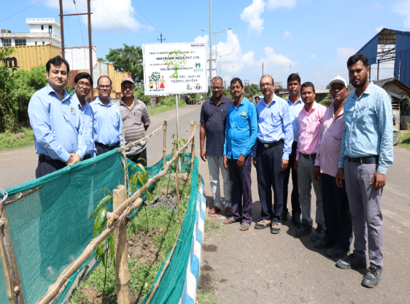
Tree plantation outside factory
5000 no of tree planted outside factory & received appreciation from Haldia Municipality in Oct 22.

Slide 28
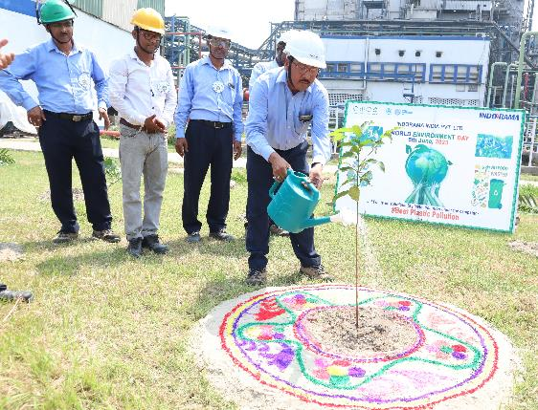
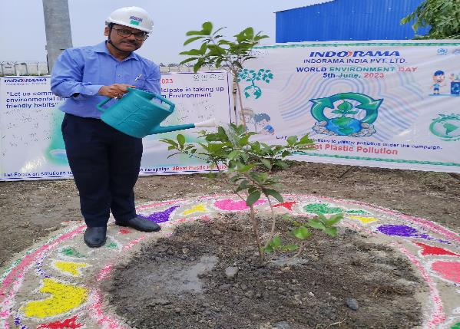
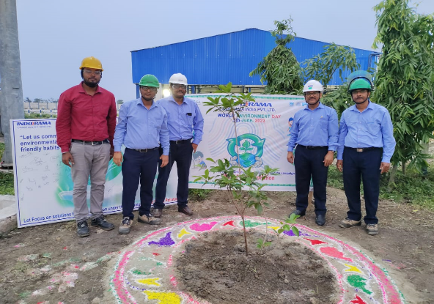
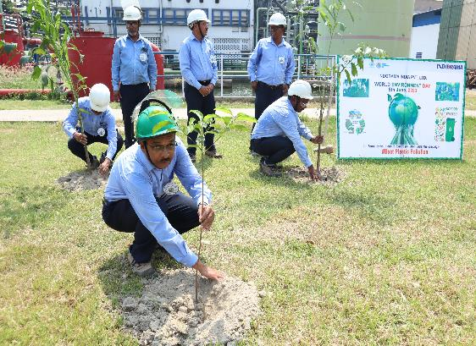
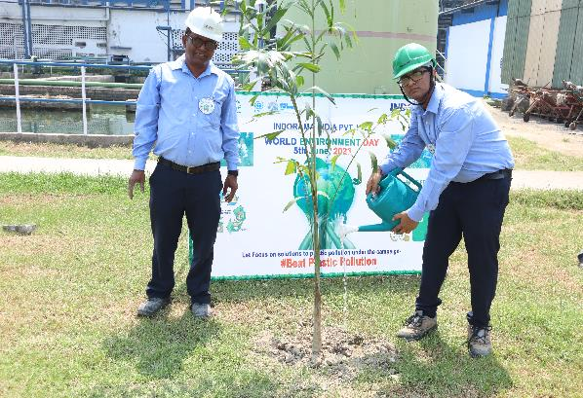
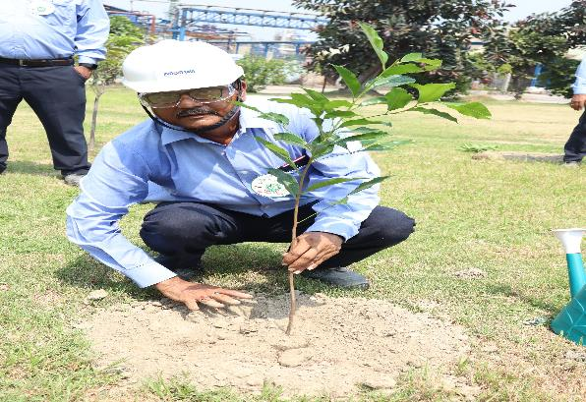
Tree Plantation At Factory
Total of 550 trees were planted in the factory and township.

Slide 29
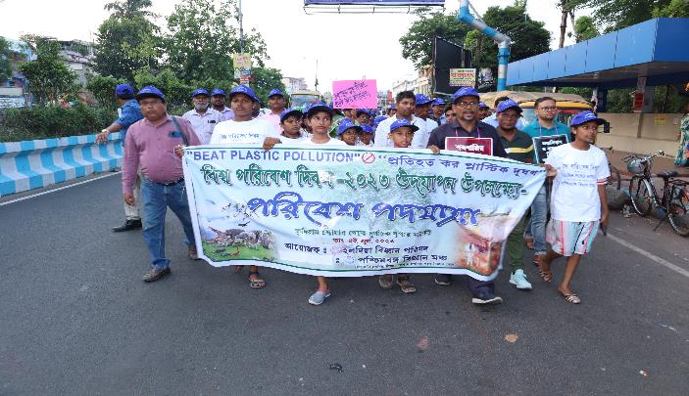
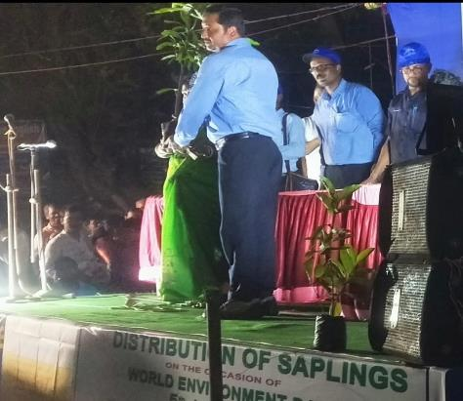
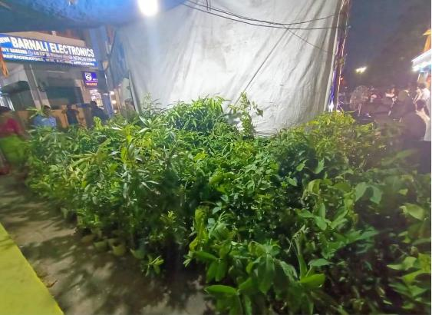
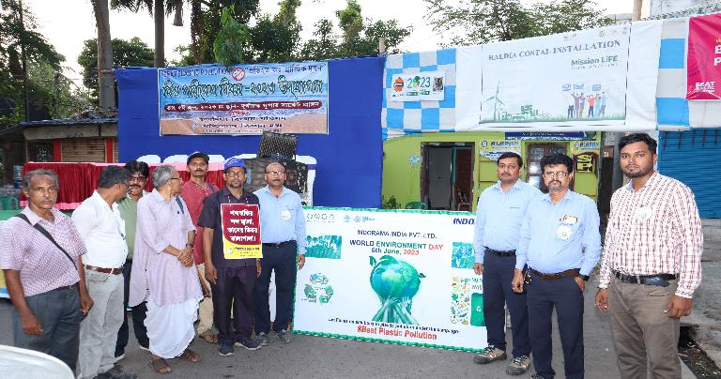
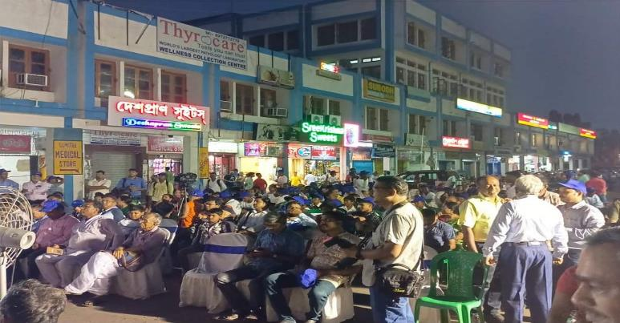
Env. Day Celebration In Collaboration With “Bigyan Mancha”
500 saplings were distributed to local residents in collaboration with ‘Paschim Banga Bigyan Mancha’, one of the largest people science organizations in West Bengal.

Slide 30
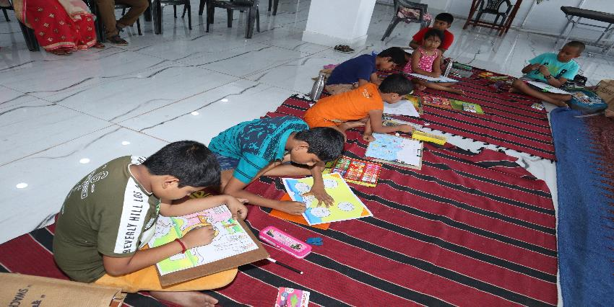
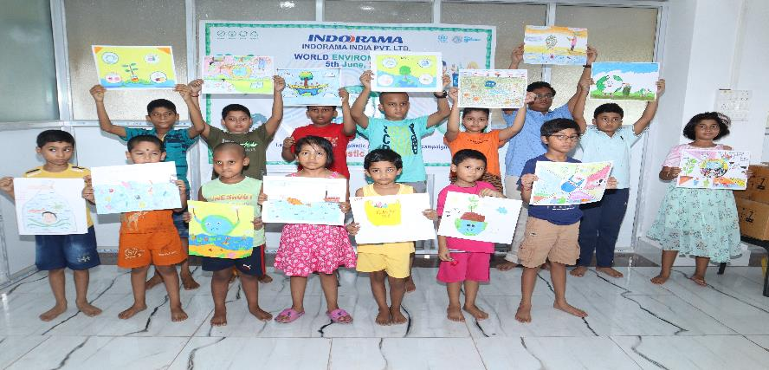
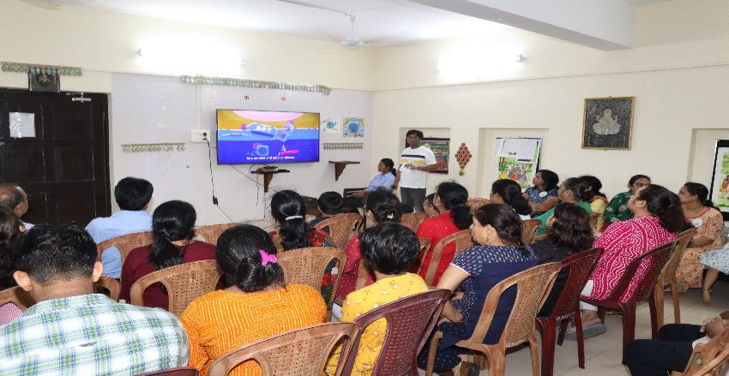
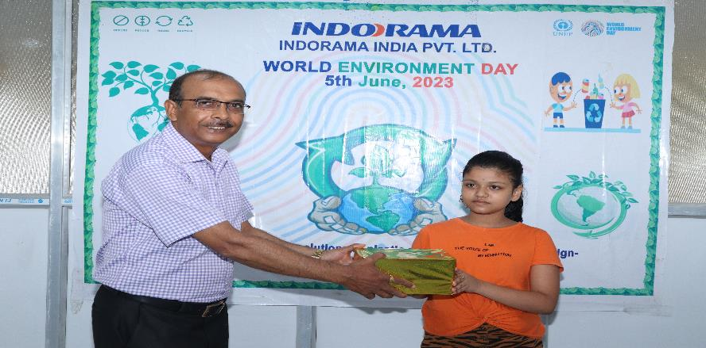
Awareness among Ladies & children , Drawing & Quiz Competition

Slide 31
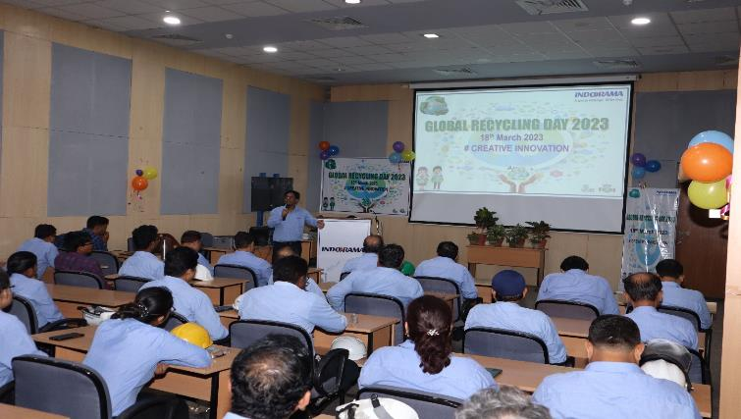
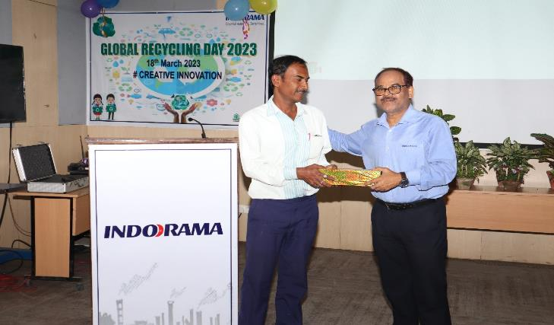
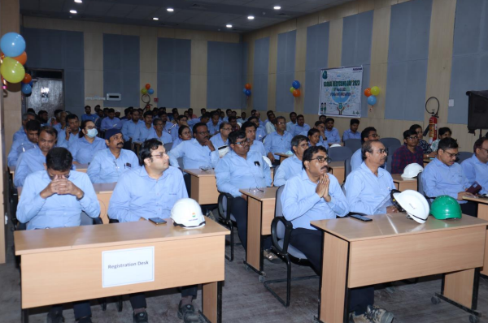
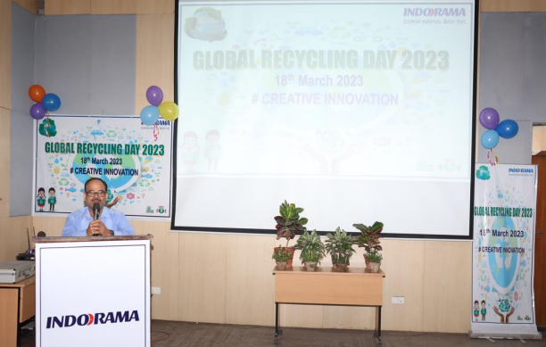
Global Recycling Day celebration
Global Recycling day was celebrated on 18th March 22 .
Awareness programme was planned on 3 R principles among employees,suppliers
Quiz programme was also organized at Site among employees.

Slide 32
CSR Focus area
CSR
Promoting Health Care
Eye Screening Camp
Eye cataract surgery
Women Empowerment
Tailoring Training
Beautician Training
Poultry Farm Management Training
General Health Camp
Support to specially abled people
Menstrual Hygiene Management
Sanitation Management
Clean Ganga

Slide 33
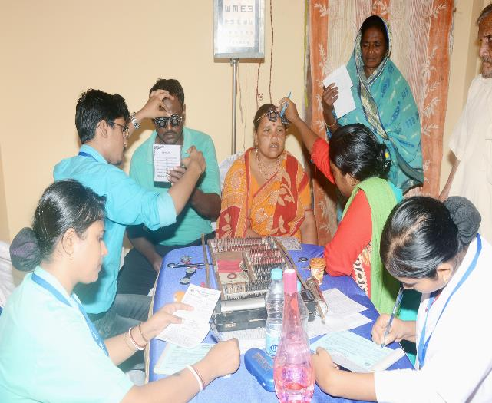
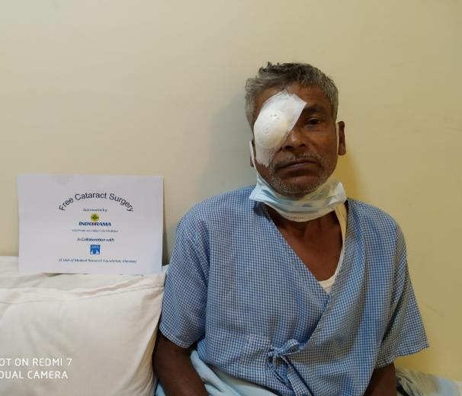
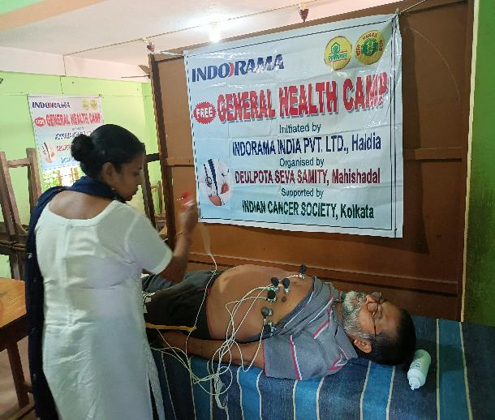
Promoting health care
There are 8786 people from the rural area of Haldia have treated at the free eye screening camp and there are 3774 people have benefited through free spectacles through Medical research Foundation and VMANNN | There are 1298 people from the rural areas of the West Bengal have freely done the cataract surgery through Medical research Foundation and VMANNN | There are 4548 people from the rural area of Haldia have benefited at the free health check-up camp through Deulpota Seva Samitii

Slide 34
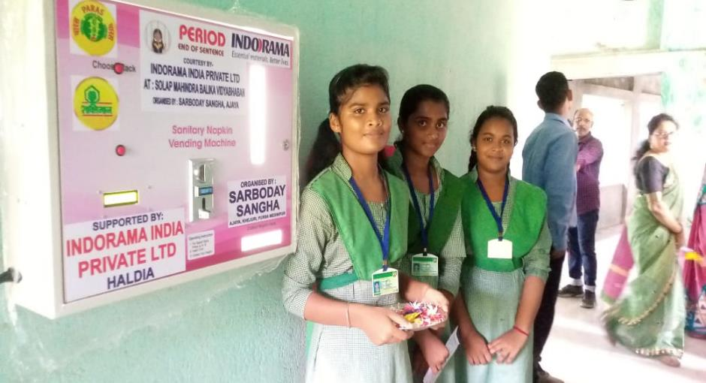
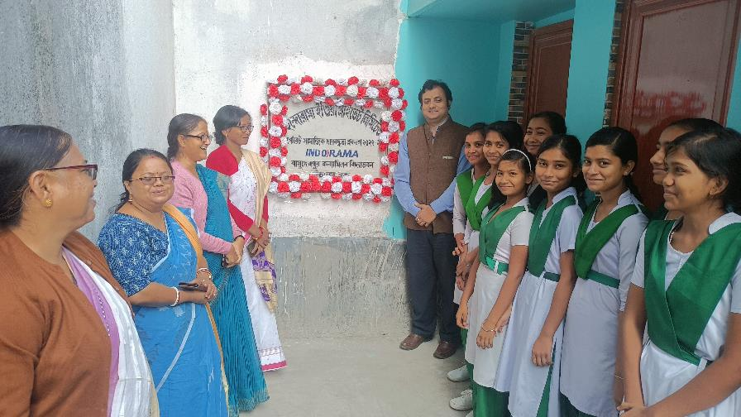
Hygiene and water, sanitation management
There are 10450 girl child of five Govt. high schools and women from the rural areas Haldia have benefited through Sarboday Sangha. | There are ten toilet blocks and one water station have constructed at two Govt. schools and there 1165 students have benefited through this project and this project is managed by Sarboday Sangha.

Slide 35
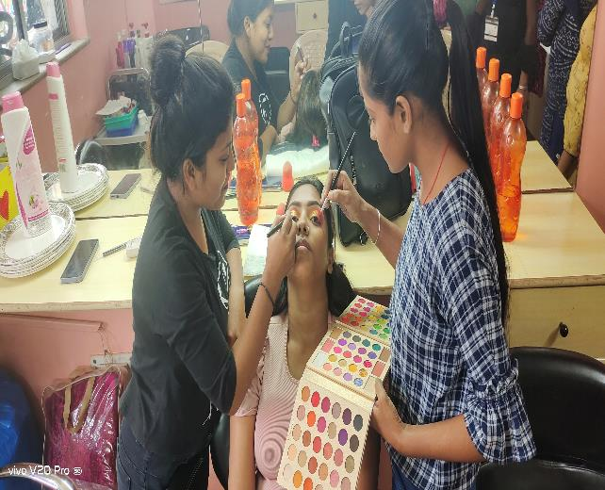
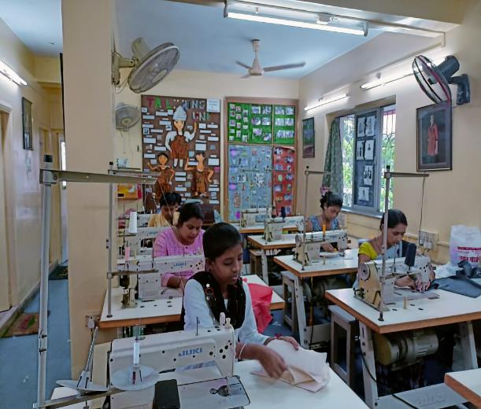
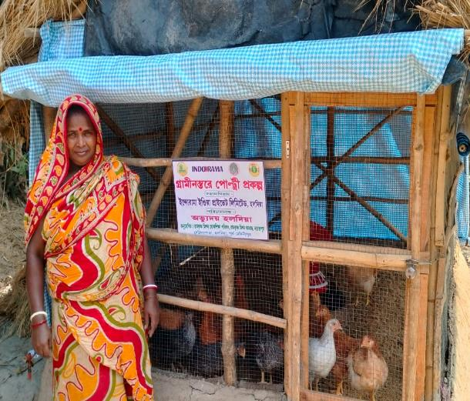
Empowering Women
There are 196 women from the urban are of Kolkata have trained on the beautician training at Kolkata through Hope Kolkata Foundation | There are 200 women from the urban are of Kolkata and rural area of Haldia have trained on the tailoring training through Hope Kolkata Foundation and Abhyudaya Haldia | There are 327 women from the rural area of Haldia have trained on the poultry farm management through Abhyudaya Haldia

Slide 36
Beneficiaries status
Project | Implementing NGO | No. of women trained
 |  | 2019-20 | 2021-22 | 2021-22 | 2022-23 | Total
Beautician training | Hope Kolkata Foundation | 60 | 30 | 38 | 68 | 196
Tailoring training | Hope Kolkata Foundation | 30 | 10 | 19 | 41 | 100
Tailoring training | Abhyudaya Haldia |  |  | 50 | 50 | 100
Poultry farm management training | Abhyudaya Haldia | 140 |  | 87 | 100 | 327

Slide 37
THANKS

