Slide 1
Best Practices on Industrial production & processes
Indorama India Pvt Ltd , Haldia

Slide 2















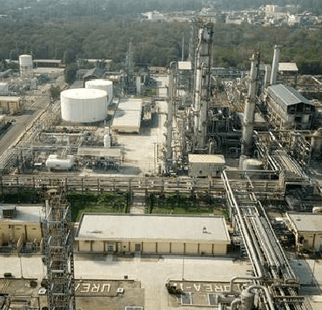
A Brief History
First manufacturing plant in Indonesia for textiles
Start production of disposable gloves
First polyester
fiber plant
First
PET plant
First overseas plant in Turkey for spun yarns
1976
1989
1991
1995
1998
2004
Start of spandex yarn production in India
Acquisition
of YTY
First yarn production unit in Uzbekistan
Creation of Indorama Ventures (Thailand)
Acquisition of the leading olefin company in Nigeria
2012
2012
2011
2010
2006
First cotton harvest
in Uzbekistan
Acquisition of Adufértil
2nd ammonia & urea
line in Nigeria
Startup of ammonia and urea production in Nigeria
Acquisition of fertilizer company in India
Start of fertilizer production in Uzbekistan
Acquisition of
Indogulf fertilizer
2016
2018
2019
2020
2021
2022

Slide 3

A Leading Materials Organisation
Indorama Corporation
(IRC)
Singapore
Shareholding %
Public Company
Fertilizers
76%
Polymers
Fiber & Yarns
Medical Gloves
Polyester
Indorama Eleme Fertilizers & Chemicals
Indorama Synthetics
90%
Indorama Synthetics
90%
YTY Group
100%
Indorama
Ventures PCL
32%
Industries Chimiques Du Senegal
78%
Indorama Eleme Petrochemicals Ltd.
65%
Indorama Agro
100%
Indorama India
Pvt . Ltd.
100%
Indorama
Ventures Olefins
10%
Indorama India
Pvt . Ltd.
100%
Indorama Kokand Fertilizers
96%
Adufertil Fertilizantes Ltda
100%

Slide 4
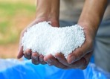
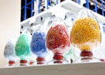


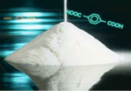







Products
Fertilizers
Polymers
Fibers & Yarns
Medical Gloves
Chemicals
HDPE
PA 6 & 66
PET
PX
LLDPE
PP
PTA
HPP
Spandex
Nitrogen
Polyolefin Resins
COPP
Man-Made Fibers
Viscose
Single Use Gloves
Aromatics
DAP
NPK
MEG
SSP
PED
Phosphate
P₂O₅
PET Resins & Bottles
Cotton Fiber
EO Derivatives
H₂SO₄
Spun Yarns
Specialty Chemicals
Apparel
Hygiene
Fabrics
Tire Cord

Slide 5







Overview Fertiliser Facilities
Port Harcourt, Nigeria
Mboro, Senegal
Mbao, Senegal
  Largest ammonia and urea producer in West Africa
  Largest integrated phosphoric acid producer in West Africa
  Producer of DAP and NPK compound fertilizers for West African market
  2 x 2300 tpd ammonia
  2 x 4000 tpd urea, 3 MM tpa of urea sales
  Extensive gas pipeline network
  Dedicated export jetty
  Extensive pan-Nigeria distribution network
  2 MM tpa phosphate rock mining operation
  2 x 300 kta phosphoric acid integrated with sulphuric acid production
  Extensive rail and road network
  250 kta DAP and NPK products
  Marine lines for importation of ammonia and exportation of phosphoric acid
Ammonia
Urea
Phosphate Rock
Phosphoric Acid
DAP
NPK
SSP
Ammonia
Urea
Phosphate Rock
Phosphoric Acid
DAP
NPK
SSP
Ammonia
Urea
Phosphate Rock
Phosphoric Acid
DAP
NPK
SSP
Haldia, India
Kokand, Uzbekistan
Jundial, São Paulo Brazil
  One of the largest producer of phosphate fertilizers for East and Northeast region
  of India
  Largest producer of phosphate compound fertilizers in Central Asia
  800 kta of phosphate fertilizer production
  Large trade of imported fertilizers
  Brand leadership under the Paras brand
  Extensive distribution network
  350 kta of SSP and NPK products
  Product diversity, including ammoniation
  Catering to vibrant domestic agricultural market
  Brazil is one of the world’s largest fertilizer importers
  Capacity of 1.1 MM tpa of NPK products
  Storage capacity of 70KT
  Catering to vibrant domestic agricultural market
Ammonia
Urea
Phosphate Rock
Phosphoric Acid
DAP
NPK
SSP
Ammonia
Urea
Phosphate Rock
Phosphoric Acid
DAP
NPK
SSP
Ammonia
Urea
Phosphate Rock
Phosphoric Acid
DAP
NPK
SSP
Jagdishpur, India
  India’s second most energy-efficient ammonia and urea producer
  1.2 MM tpa urea
  Specialty organic fertilizers
  Trade of farm inputs
Ammonia
Urea
Phosphate Rock
Phosphoric Acid
DAP
NPK
SSP

Slide 6
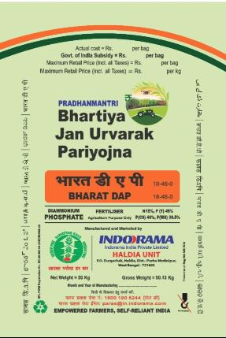
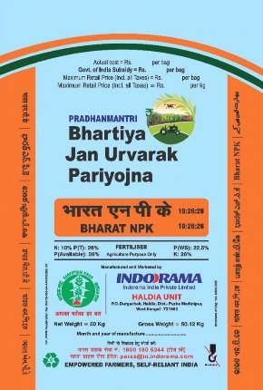
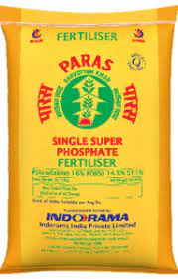
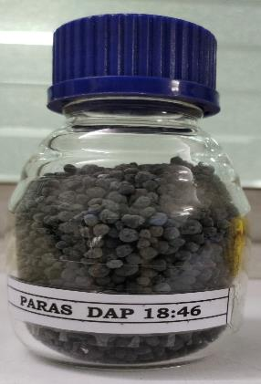
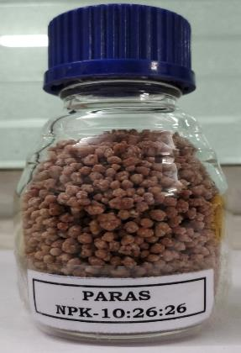
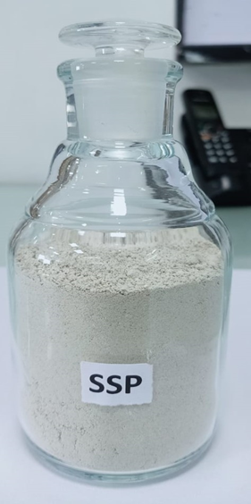
Indorama India– Phosphatic Fertilizers Plant at Haldia
  Indorama acquired Tata Chemical’s Phosphatic Fertilizers Business on 1st June 2018.
  Haldia plant is one of the largest DAP/NPK Plant in Eastern India.
  Production capacities of Haldia Plant is as below:
    DAP – 7,59000 TPA or NPK -1.0 million TPA
    Sulphuric acid – 247,500 TPA
    SSP – 2,08000 TPA
  PARAS Brand is one of the preferred brand in India by farmers.
  Import and sale additional 0.5 million TPA DAP/NPK/Potash India

Slide 7
Product Matrix
Raw Materials MFG PLANTS PRODUCTS
Sulphur
Phosphoric acid
Ammonia
MOP
Rock Phosphate
Sulphuric Acid I & II
DAP I & DAP II
SSP
Sulphuric Acid
DAP/ NPKs
SSP
Plant Capacity :
Sulphuric Acid plant 1 : 450 TPD
Sulphuric Acid Plant 2 : 300 TPD
SSP Plant : 600 TPD
Plant Capacity in DAP-1& 2 :
DAP production : 1800 TPD
NPK-10 production : 3050 TPD
NPK-12 Production : 2500 TPD
NPK-14 Production : 2300 TPD
NP 1620 ( New ) : 1200 TPD

Slide 8
Integrated Manufacturing Process
Sulphur
STG
Steam
Sulphuric Acid Plant I & II
SA
Steam
Sulphuric Acid
Sulphuric Acid
Single Super Phosphate Plant
Ammonia
DAP Plant I & II
SSP
DAP/ NPK
Ammonia storage tank
Phosphoric Acid
MOP
Rock Phosphate

Slide 9
Policy at organization & Entity Level & Management Standard
Polices of Indorama Corporation :
Community & Stakeholder Policy
Environment & Climate Change Policy
Health & Safety Policy
Humans Rights & Labour Policy
Product Stewardship Policy
Responsible Business Policy.
Polices of Indorama India Haldia :
Health & Safety Policy
Environment Policy
Energy Policy
Fire Policy
Well Being Policy
Quality Policy

Slide 10
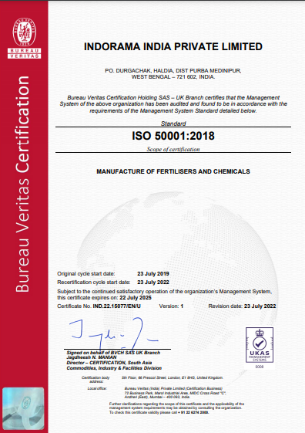
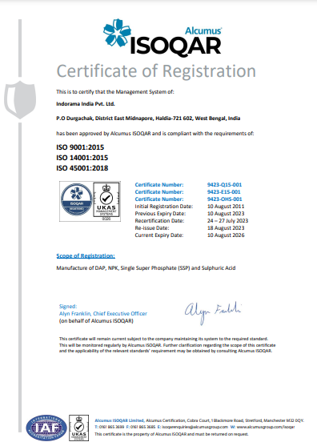
ISO Certification (9001, 14001,45001, 50001 )

Slide 11
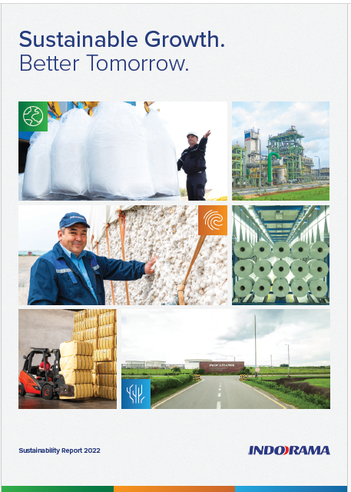
Sustainability /ESG reporting
Indorama Corporation published its first sustainability report for 2021. Sustainability report of 2022 published in Nov 2023.
Assurance audit was carried out by TUV India Pvt Ltd.
Chairman message :
“Our ESG initiatives
are coherent with our
business performance
and stakeholder
priorities.”
Vice Chairman message :
“Efforts are being made to conserve energy, assess viable energy efficient projects, and implement initiatives to aid in environmental stability.”

Slide 12
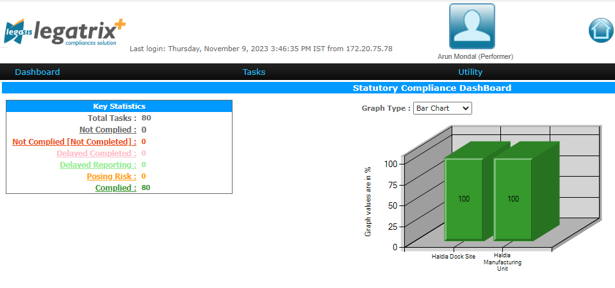
Statutory Compliances , E-portal
E-enabled legal compliance management system is available to ensure timely and effective compliance of the statute .
All applicable tasks related to all rules & regulations are updated in this compliance solution tool. Periodically it gives the alert, then the performer needs to comply that within the targeted date & time. In case the performer doesn't complete the task within time, alert triggers to next hierarchy.

Slide 13
Pillars of Safety Management System
100% safety training through Safety Kiosk
Work Permit System
Energy Isolation – LOTOTO (Lockout Tag out Tryout)
Safety Audit including Behavioral Safety Audit BSO
Hazard Identification & Risk Assessment, HAZOP
Near Miss reporting through PRISOM Portal
Reward and Recognition
Incident Investigation
Cardinal rules of Safety& Consequence Management , Safety Policy
Safety Processes :
ISO 45001 : 2018 Occupational health and safety management system
Safety System and healthy working environment
Safety training and Awareness
Safety audit
Emergency preparedness
Personal protective Equipment

Slide 14
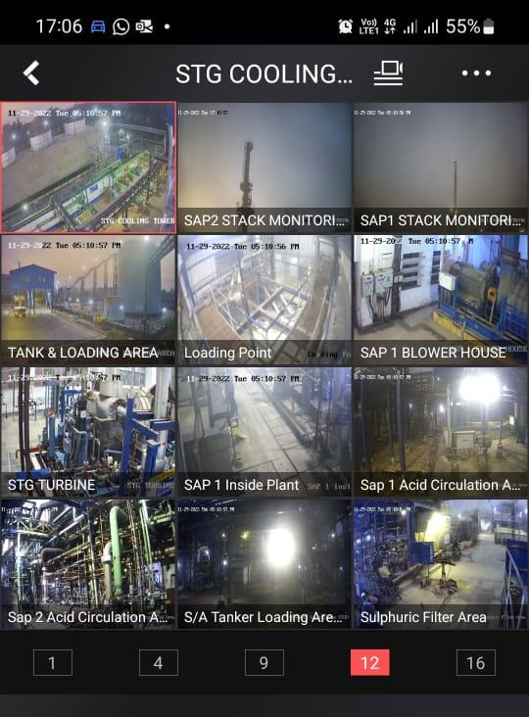
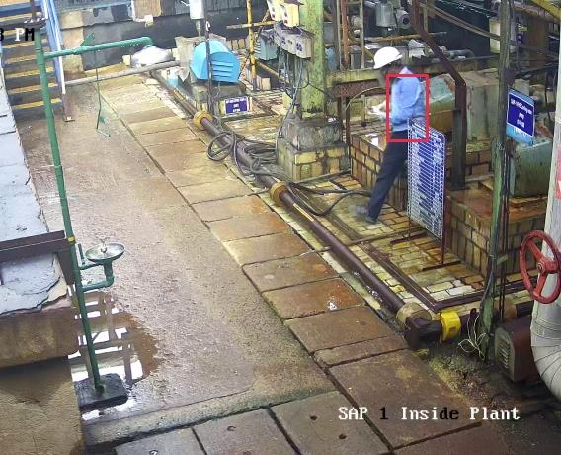

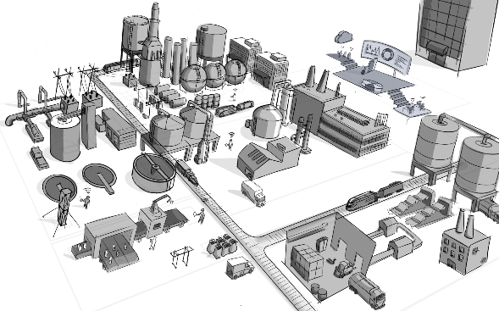

Digitalization in PPE detection , best practices in Safety
Installed PPE detection cameras in critical areas to stop the safety violation.
The locations are traceable from mobile also.
If any PPE violation occurred then immediately the alert message will be created.
Empowered shopfloor personnel get real-time information via mobile or wearable devices

Slide 15
Health Management System
Health Objectives :
To take up preventive measures against development of Occupational diseases
Emergency medical care and first aid
Awareness about Life style diseases
Review of periodic medical test reports and consultation
Analysis and maintenance of health data and measurement of Occupational Health Index
Preparation and circulation of periodic health check up data for the statutory compliance as per the act
Health & Well being Process
Primary medical treatment
Periodic medical examination
Pre employment medical
Wellbeing
Ill health monitoring

Slide 16
Pillars of Environment Management System
Objectives :
Regulatory compliance
Aspect, Impact analysis
Environment monitoring (Ambient air, Emission, Effluent, Water )
Effluent treatment & ZLD plant operation
Waste Management
Training and awareness programme to stakeholders, employees & their families
Overall improvement in Environment management system through capex projects.
Environment Management System
Environment Policy
ISO 14001 & ISO 50001 standard
Aspect , Impact & EIA(Environment Impact assessment)
Legal Management through Legatrix
Emergency response plan
Training & Awareness programmes
PRISOM software for incident reporting
Environmental Capex projects for improvement

Slide 17
Statutory Compliance related to Environment rules
Air Act
Water Act
Plastic Waste Rule
Hazardous Waste
Valid Consent to Operate under Air & Water Act from WBPCB , CTO number : CO 109250 , Validity upto 31st Dec , 2023 . . All Consent conditions are complied .
Renewal application submitted
to WBPCB in Sept 2023.
All Plants have adequate air pollution control equipment to control the air pollution from stack.
Online analysers (PM, SO2, NH3 ,HF) are installed in stack and connected to CPCB server .
All Consent condition under Air & Water act are complied.
40 m3/Hr effluent treatment plant , 160 m3/Day sewage treatment plant is available for treatment of industrial and domestic waste water.
PH, TSS, BOD,COD,Fluoride analysers are installed and connected to CPCB server.
40 m3/Hr effluent recycling plant installed in Sept 23 to achieve zero discharge. This is beyond compliance.
Brand owner registration under plastic waste management rule , 2016 received from Central Pollution Control Board.
Fulfilling EPR targets by hiring waste management agency.
EPR annual return 2022-23 submitted to Central Pollution Control board on 20th Oct 23 . Total EPR target fulfilled : 2148 MT
Hazardous waste authorization under Hazardous and other wastes (Management and Transboundary Movement Rules , 2016) , validity 31.01.2026
Conditions laid down in the authorization are complied .

Slide 18
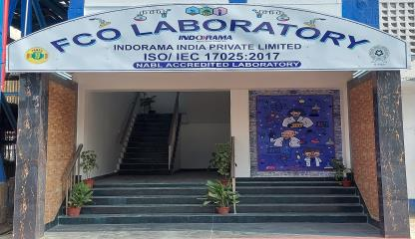
NABL Laboratory: Implementation of ISO 17025:2017 std, best practices in fertiliser industry

Slide 19

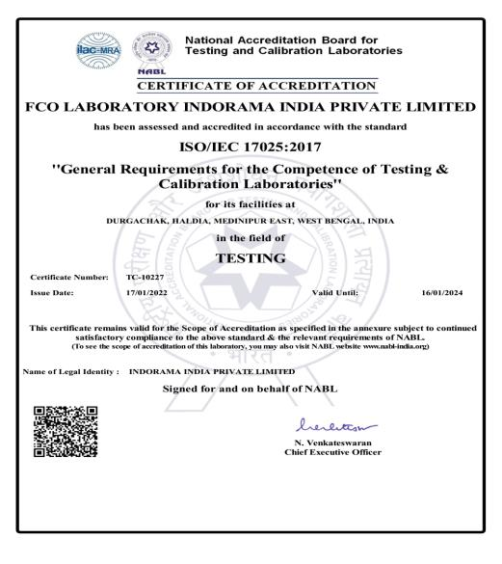
NABL Certificate of FCO Laboratory :
NABL certificates to FCO laboratory has been issued by Quality Council of India on 17.01.22 with validity 16.01.24 for parameters of 21 nos of products DAP, NPKs 10, 12 & 14, SSP.
Surveillance audit conducted on 25th & 26th Nov’22, certificate re-issue on 09.05.23 and valid till 16.01.24.
NABL accreditation parameters has been increased from 21 to 36 nos during surveillance audit after incorporation of new products NP 14:28 and APS 16:20:0:13 & 20:20:0:13.in last year.

Slide 20
Single plant , capable of producing different grades of NP & NPK

Slide 21
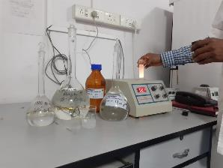
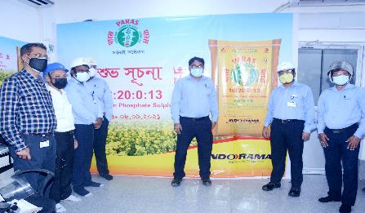
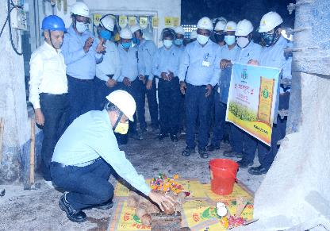
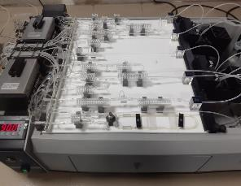
New Product development NPS 16:20:13 & NP 14:28:0
AMMONIUM PHOSPHATE SULPHATE (16:20:0:13) - Lab scale Trial
PARAMETERS | SPECIFICATION | Batch -1 | Batch3(1) | Batch3(1I) | Batch3 (III)
Moisture per cent by weight, Maximum | 1.00 | 0.40 | 1.15 | 1.10 | 1.15
Total Ammoniacal Nitrogen per cent by weight, Minimum | 16.00 | 18.74 | 16.11 | 16.55 | 16.82
Available Phosphorus (as P2O5) per cent by weight, Minimum | 20.00 | 20.28 | 20.50 | 20.69 | 20.74
Water Soluble phosphorus (as P2O5) per cent by weight, Minimum | 17.00 | 18.74 | 19.45 | 19.75 | 19.80
Sulphate Sulphur (as S) per cent by weight, Minimum | 13.00 | 15.63 | 13.11 | 13.45 | 13.35
Partical Size, Minimum | 90% of the material shall be retained between 1 mm and 4 mm IS sieve | 91.00 | 88.00 | 93.00 | 94.00
*** NOTE : Tolerance : Moisture - (+)0.5, Nutrient - (-)0.5, Size -(-) 3.0
Lab scale trial
Product launch at plant

Slide 22
Best Practices in Manufacturing (conservation of natural resources)
Specific consumption reduction of raw materials & natural resources like water , power, fuel
Reduction of effluent discharge & % ground water use , increase in reuse and recycle of waste water
Best Practices
Use of renewable energy like solar , biomass etc.
Reprocess of product related losses in supply chain.
Reduce , reuse and recycle of Waste , reduction of specific waste, %plastic packaging bags recycle/co process as per EPR regulation
Increase in % Share of Organic/bio fertiliser/City Compost etc, and bio potash , Specialty Fertilisers (slow released fertilizers, controlled-release fertilizer, stabilized fertilizer, customized fertilizer, fortified fertilizers. water soluble, micronutrients, liquid and nano fertilisers in total sales.

Slide 23
Approaches Towards Excellence
Maintenance Strategy based on equipment classification
Focused on Preventive & Proactive maintenance and daily LLF (Look Listen Feel) round.
Laser alignment of critical equipment.
Ensuring welding quality through (WQT) test
100% rotary equipment coverage under CBMS
Ensuring incoming material quality using PMI(positive material identification ) test
Reliability Improvement
Import substitution of Acid circulation pump, Stitching m/c
Valve servicing (in house)
Bearing replacement only based on CBM recommendation.
Reconditioning of imported chain of pulveriser (In-house).
Stitching machine needle cooling by air instead of oil
Using SBR rubber instead of EPDM for Granulator panel
Cost Optimization
Focusing on 100% PPE compliance
Tool box talk before job execution
Equipment guarding as per IS 9474
No Supervision no job for each critical job
HIRA for each job
Near miss jobs closure.
Safety Improvement

Slide 24
Implementation of Digitalization in manufacturing
Implementation of AI based surveillance System at Plant and Dock side: Implemented AI based surveillance system to increase effectiveness of surveillance of the plant and dock site are.
Implementation of Video Analytic base PPE checking System: video analytic based PPE checking system got implemented for SAP plant . This system will bring more control in creating safety environment at plant side through auto reporting regarding violation of PPE.
Automation of Bag counting at Truck loading point integrated with SAP: Bag counting gets automated with use of optical sensor and RFID integrated with SAP.
Implementation of Canteen Management System : Canteen management system got automated over KIOSK and Android base platform for meal booking .
Implementation of Supplier Portal integrated with SAP : vendor registration got automated with implementation of supplier portal to reduce work load of purchase and accounts department.
Implementation of Transporter Portal: Truck allocation by transporters and other activities get digitized with implementation of Transporter portal integrated with SAP.

Slide 25
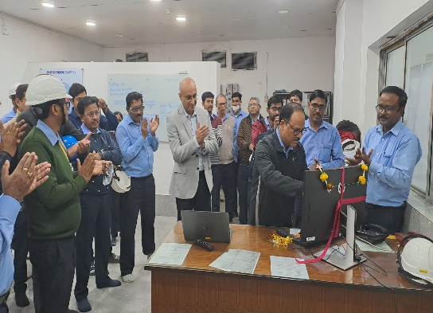
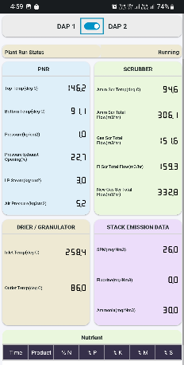
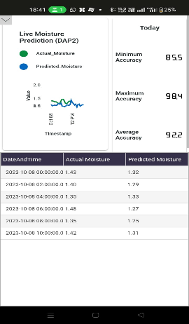
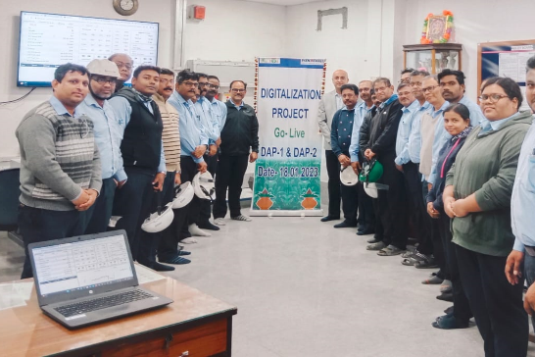
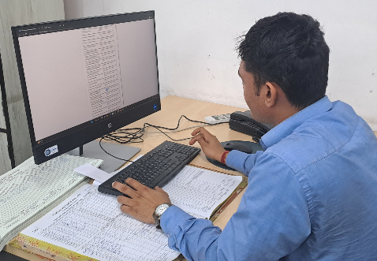
Digitalization Project Implementation in DAP Plants
Benefits and Savings through Digitalization
Applying Digitalization platform to monitor PNR top & bottom temperatures remotely during PNR boiling, it was possible to carry out the DoE (design of experiment) successfully
Derived the optimum Acid boiling combination. Digitalization platform helped the availability of live data for monitoring from remote (Home) during odd times and triggered the DoE of PNR descaling through multiple boiling back to back till top & bottom temperature equalizes.
Real-time tracking of plant parameters and product quality on mobile
Work In Progress and future plan
Moisture, N/P, & Stack emission prediction through Algorithm is under progress.
Phosphoric Acid (Dock site & Plant) quality and quantity tracking work-in-progress.
Soft Sensors for Ammonia ship discharge flow rate measurement.
Data entry on Digitalization platform by plant and laboratory
Digitalization project ‘Go-Live’ ceremony at control room

Slide 26
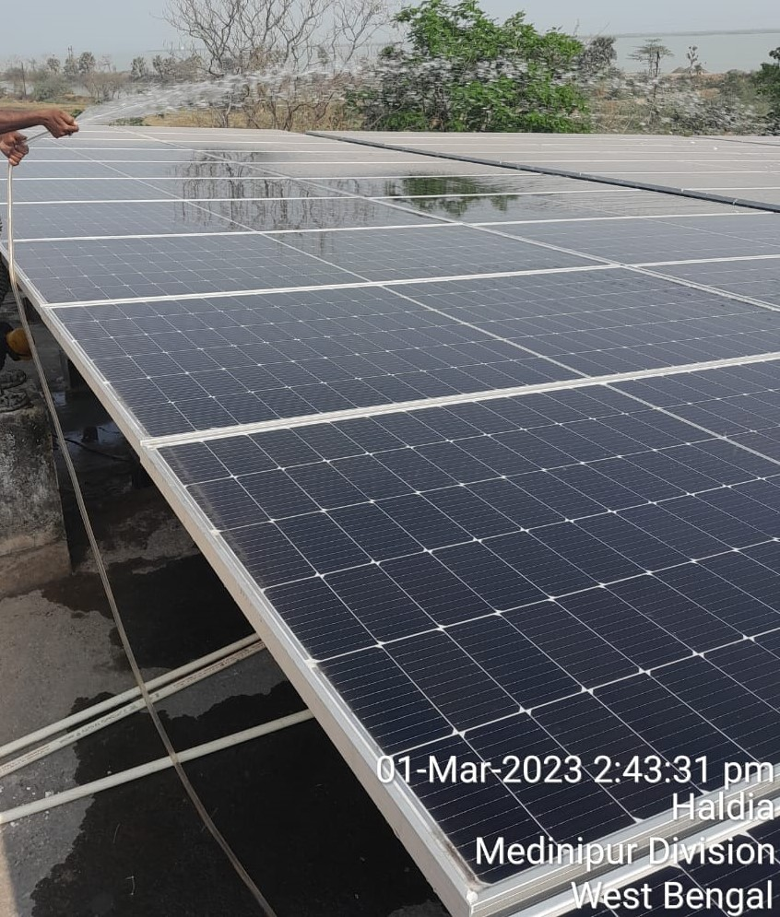
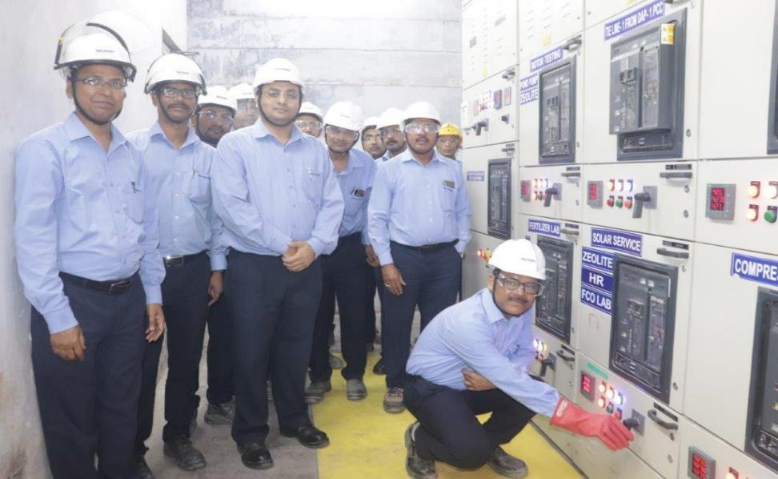
500 KWP Solar Project commissioned in Feb 23.
Solar Panel at Ammonia Building
Solar panel of 500 kWp installed to increase the use of renewable energy as a part of Eco Sustainability measures in Feb 2023.
Solar Power Commissioned on 20.02.2023

Slide 27
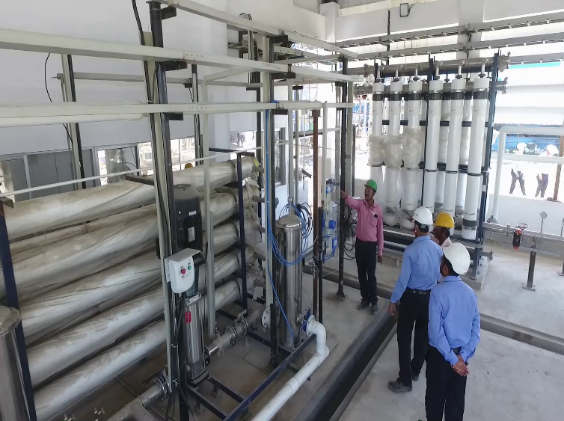
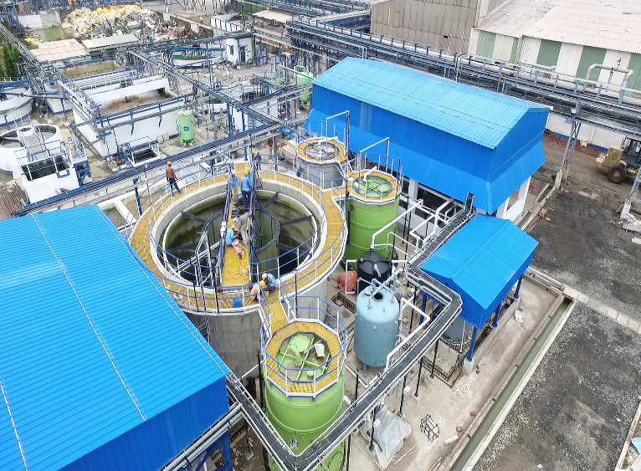
Effluent recycling Plant of Capacity 40 M3/Hr, commissioned in June-22 , achieved zero liquid discharge
RO & UF Section
ZLD Plant Overview
Effluent recycling plant commissioned in Sept 22 . Achievement of this project is that we have achieved zero liquid effluent discharge without the need for a Multiple Effect Evaporator (MEE). By utilizing the high TDS water in the fertilizer plants, we have successfully eliminated liquid effluent discharge without any adverse effects on the process.

Slide 28
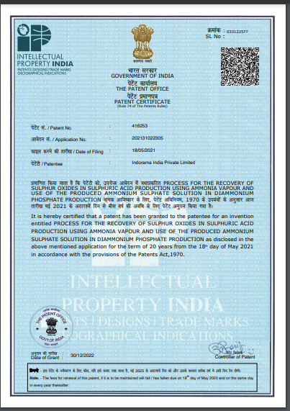
Environmental technology upgradation & Innovation
SO2 Scrubbing using NH3 in Sulphuric acid plant
SO2 (100- 150 )mg/Nm3, NH3– BDL
through stack
Received this patent for removal of SO2 in sulphuric acid plant by using ammonia and thereby using ammonia sulphate, residue in DAP/NPK plant in 2022
Zero Waste Generation in scrubbing
SAP1 alkali scrubber
SAP2 Alkali Scrubber
Ammonia vapor
Ammonia vaporiser
Ammonium Sulphate
Ammonium Sulphate
Liquid ammonia
DAP plant

Slide 29
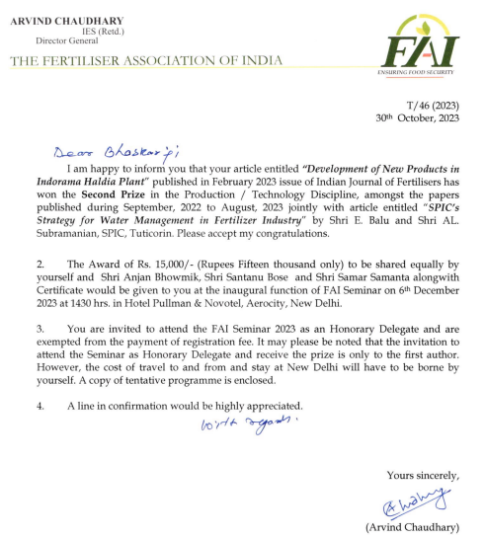
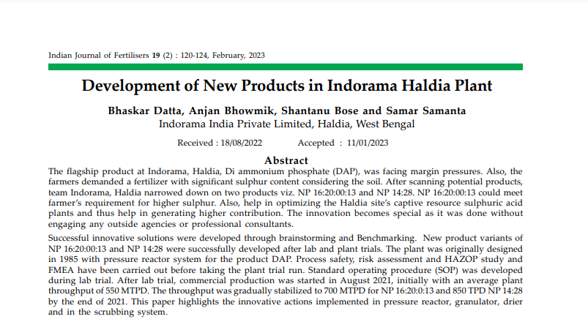
New Product development – published in FAI journal

Slide 30
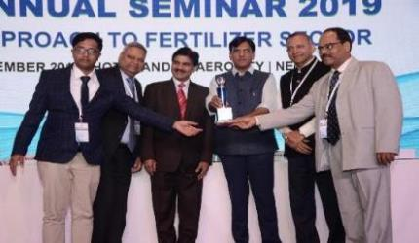
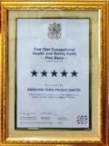
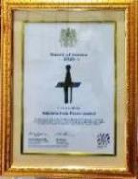
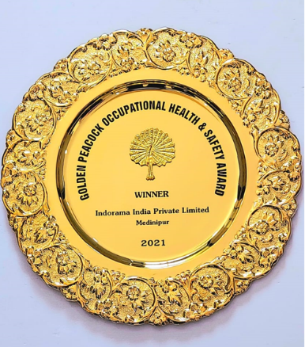
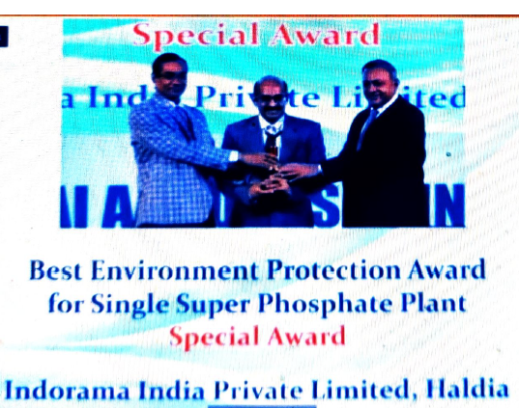
Awards & Recognition
FAI Annual Seminar 2019
5 Star rating in BSC Five star audit by British safety Council for Health and safety Management System and “Sword of Honour” for outstanding commitment towards Health and Safety in 2020-21.
FAI Award 2020-21
Golden peacock award for occupational health and safety in 20-21
Environment Protection Award for DAP/NPK without Captive acid in 18-19 , 19-20 and SSP (Single Super Phosphate) category in 18-19, 19-20 & 20-21 & 22-23 from FAI
( Fertiliser association of India)
Certificate of appreciation in SHE from CII & NSC in 2020-21

Slide 31
THANKS

