Slide 1
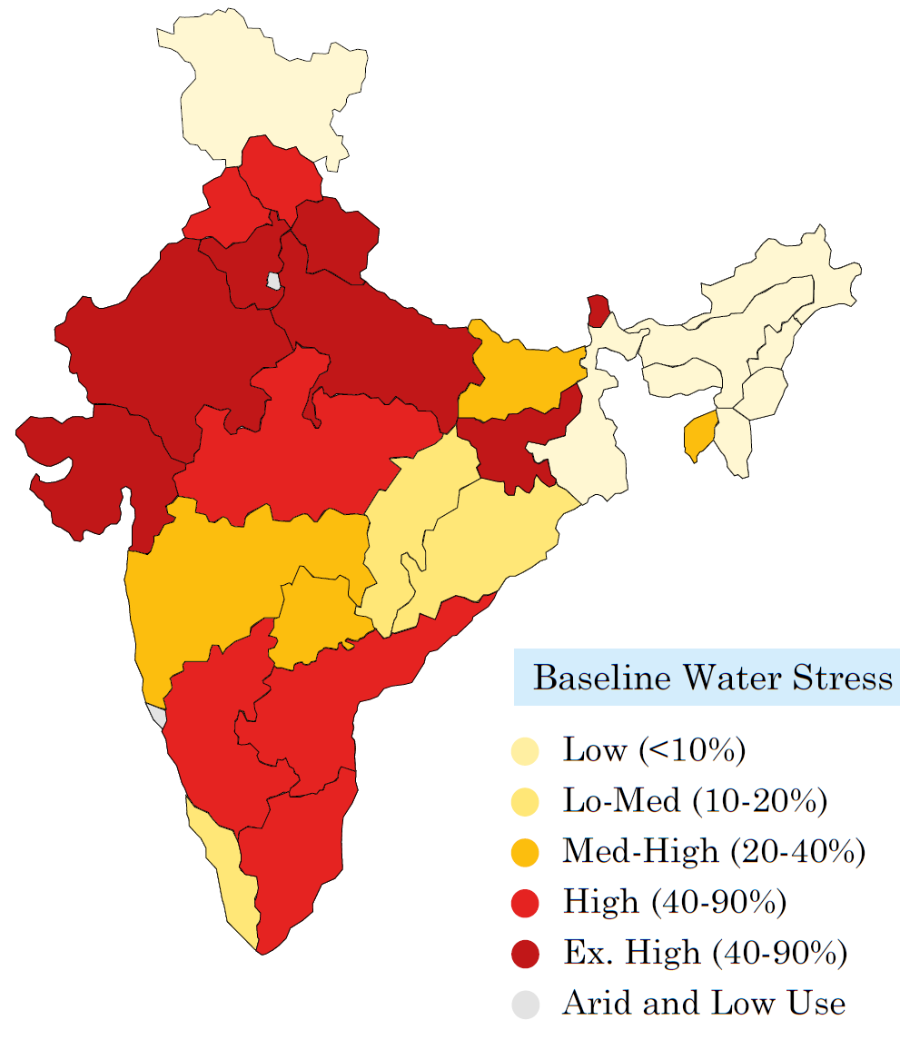
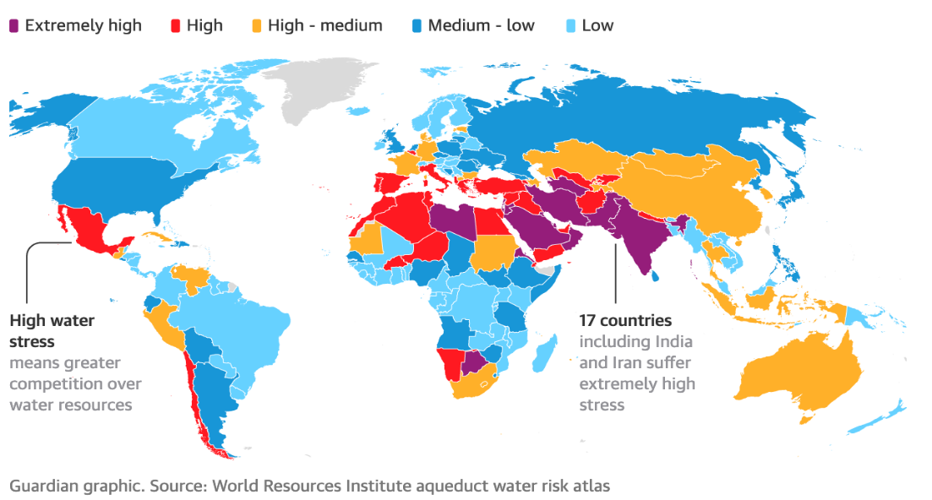
Water Stress Levels across the Globe & India
NITI Aayog's Composite Water Management Index Report revealed that out of the 1.2 Bn population more than 600 Mn people undergo extreme water stress in India today.
75% households do not have drinking water on premises and only 12% Indians who have access to safe drinking water.
Almost 77% of the sewage being discharged into the Indian Rivers is untreated which is further depleting the water resource
High water stress means greater competition over water resources
17 countries including India suffer extremely high water stress
SOURCE: WORLD RESOURCES INSTITUTE

Slide 2



Government Policy Initiatives : Over USD 70 Bn Budgetary Support
The emerging need for clean drinking water and safe disposal of sewerage water into rivers with defined norms have emphasized the need for allocation of funds to develop new water infrastructure & rejuvenate and refurbish the existing infrastructure with Operations and Management by private sector in Utilities to bring to bring the desired efficiency.
The recent Budget of Government of India for FY 2020 stressed on the significance of water conservation for the future of India and presented the Centre’s plan to boost the water and sanitation infrastructure of the country with a total allocation as per below:
Sl. No. | Key Government Policies | Fund Allocation | Impact & Thrust Areas
1 | Jal Jeevan Mission | USD 47 bn | To provide Functional Household Tap Connection to every rural household by 2024.
2 | National Mission for Clean Ganga | USD 2.7 bn | Rejuvenation/ Construction of STPs across Ganga Basin for discharge of treated water
3 | Smart Cities Mission | USD 27 bn | Water Recycling and Smart Metering
1 USD = 75 INR

Slide 3
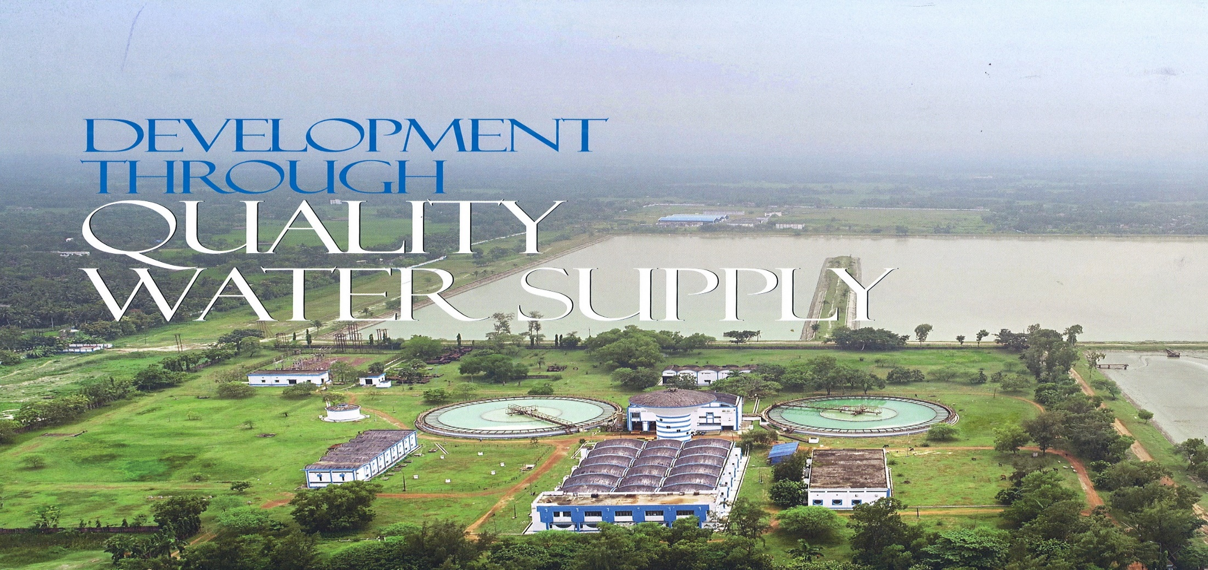

Haldia Water : 24x7 Water Services in the Industrial and Shipping Hub

Slide 4
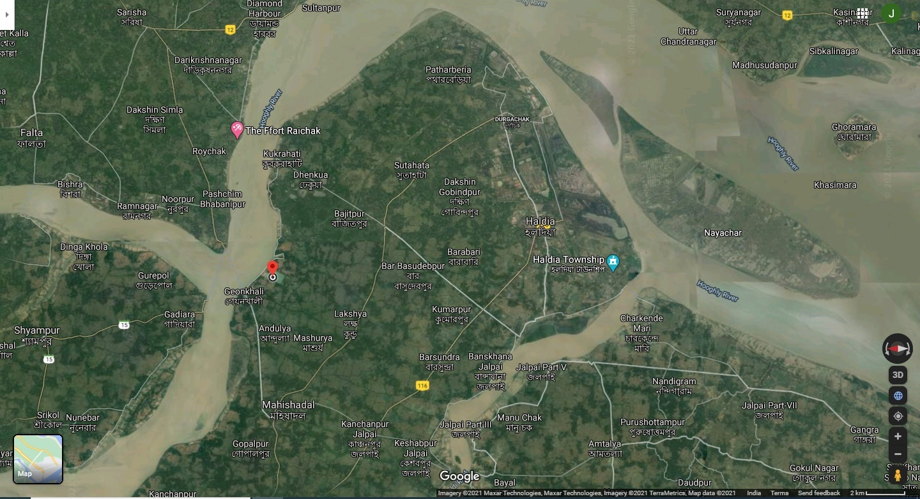
24x7 Water Supply Network
Pipeline network
of 124 miles
Basudevpur
Chaitanyapur
Hatiberia

Slide 5










Vision & Mission
Vision & Mission
Growth
To Grow with the dream of proving Clean Water to the Nation
Quality
Improving Our Quality by Benchmarking the Best Practices
Innovation & Technology
We believe we will achieve Growth by adopting Innovation & Technology
Asset
Our Employee is Our Greatest Asset
Safety
Our Prime Target
Zero Accident, Zero Waste & Zero Harm
Ethics
We follow no compromise on Quality and Customer Trust
CSR
Contribute to Community & Society on regular basis
Training
We Train to Empower Our Employee, we support their ideas to Value Generation

Slide 6





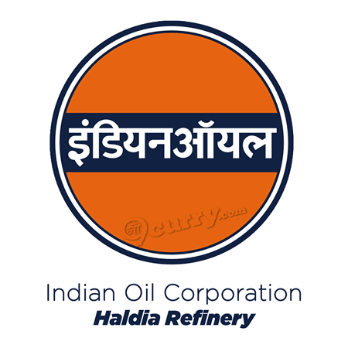




Project Background
Project Background
Haldia is an important industrial town in Eastern India with a residential population of 200,762 as per 2011 census and with presence of several important industries
Haldia Development Authority (“H.D.A”) is the nodal agency for providing water supply to various categories of customers like industrial, commercial, domestic and municipal in Haldia.
H.D.A. had set up a water treatment facility of 20 MGD capacity at Geonkhali in 1992, which was augmented to 25 MGD in 2005-06. Further, in 2008 a new 25 MGD water treatment plant was constructed.
Key Industries account for ~86% of water supply
In July 2019 the project for Repair, Up-gradation, Operation & Maintenance and Management of the 50 MGD WTP under PPP model for a period of 15 years was awarded to Haldia Water Services Private Limited, the Consortium of Shristi Infrastructure Development Corp. Ltd. (51%) , Swach Environment Pvt. Ltd. (38%) and Ion Exchange (I) Ltd. (11%)
The key responsibilities of the HWSPL would be repair, up-gradation, operation and maintenance, and management of the Haldia Water Supply System including billing and collection of water charges from the customers, with water supply from Hooghly river, with all pumping stations, electrical installations, existing and new WTPs, connecting pipelines and distribution system including cost of all materials, power and labour at Haldia, Purba Medinipur;

Slide 7
Project Highlights
Area covered: Haldia city of about 11000 hectares spreading across 5 assembly constituencies.
Population served: Over 250,000 population with Bulk Water to Municipal Corporation which serves around 50,000 house hold connections.
Customers: Domestic, Commercial and predominantly Industries viz. Haldia Petrochemcial, Indian Oil, MCPI, Tata Power, Emami Agro, Electro steel, Kolkata Port Trust etc.
Industrial Coverage: Serving more than 65 various types of industries, supplying about 125 MLD of water, which is about 85% of daily demand of water supply, which also caters to over 100,000 people who are working in the such industries.
Employment creation: Around 30 professional staff, 262 operators on contract and more than 25 vendors for service and supply (indirect workers around 100 nos).
Power consumption: HWSPL is one of the major customers to WBSEDCL with average monthly bills of more than Rs 2.00 crore per month on a consistent basis
Payments for Salary, Wages and Services: Around Rs. 1.50 crore per month.
Improvements planned: Around Rs 22.00 crore to be invested in the first eight years.

Slide 8
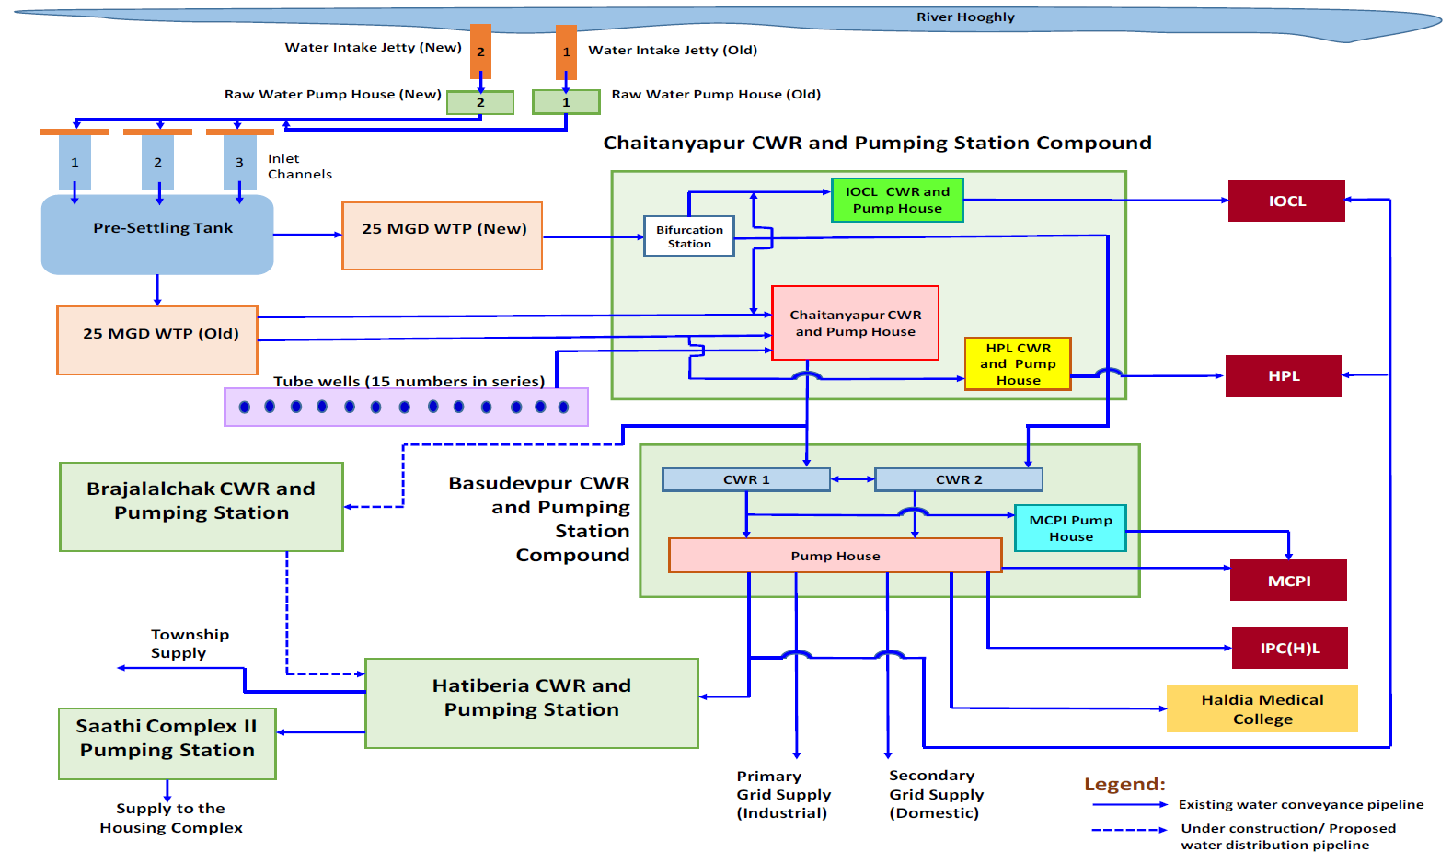

SCHEMATIC DIAGRAM OF OLD & NEW WTP PROCESS
PROJECT FLOW & SCHEME
LOCAL DISTRIBUTION
WATER TREATMENT PLANT
25MGD OLD WTP
HPL
PUMP HOUSE
PG
HATIBERIA
INTAKE PUMP HOUSE
25MGD OLD WTP
C-PUR
MAIN PUMP STATION
SG
MUNICIPAL SUPPLY
SMALL
MCPI
WATER TREATMENT PLANT
25MGD NEW WTP
BIG MCPI
INTAKE PUMP HOUSE
25MGD NEW WTP
BRAJALALCHAK
HATIBERIYA
PUMP STATION
IPCL
PLANT
HOOGHLY RIVER
MEDICAL
BASUDEV PUR
PUMP STATION
HPL
C-PUR
IOCL PUMP STATION

Slide 9
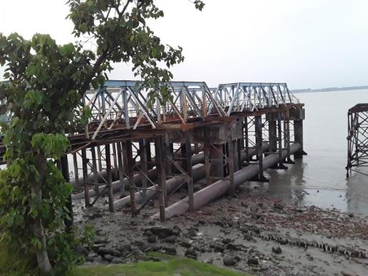
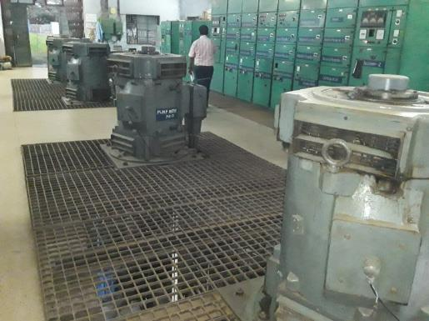
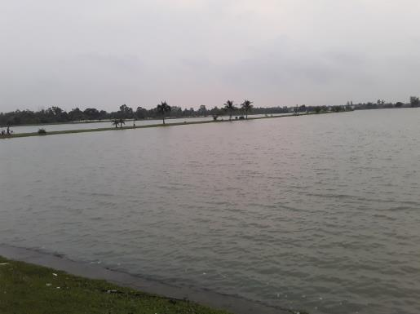
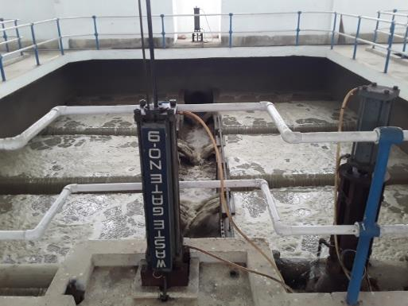
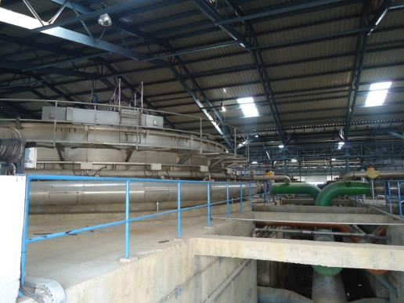
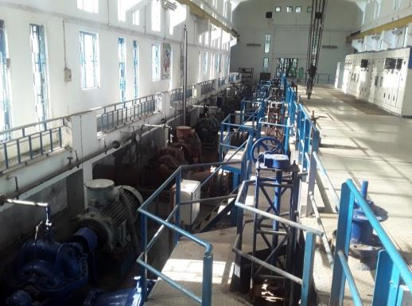
Select Site Pictures
Select Site Pictures
Intake Jetty
Raw Water Pump House
Pre-settling Tank
Gravity Sand Filter Backwash in Old WTP
DAF in New WTP
Pumping Stations

Slide 10
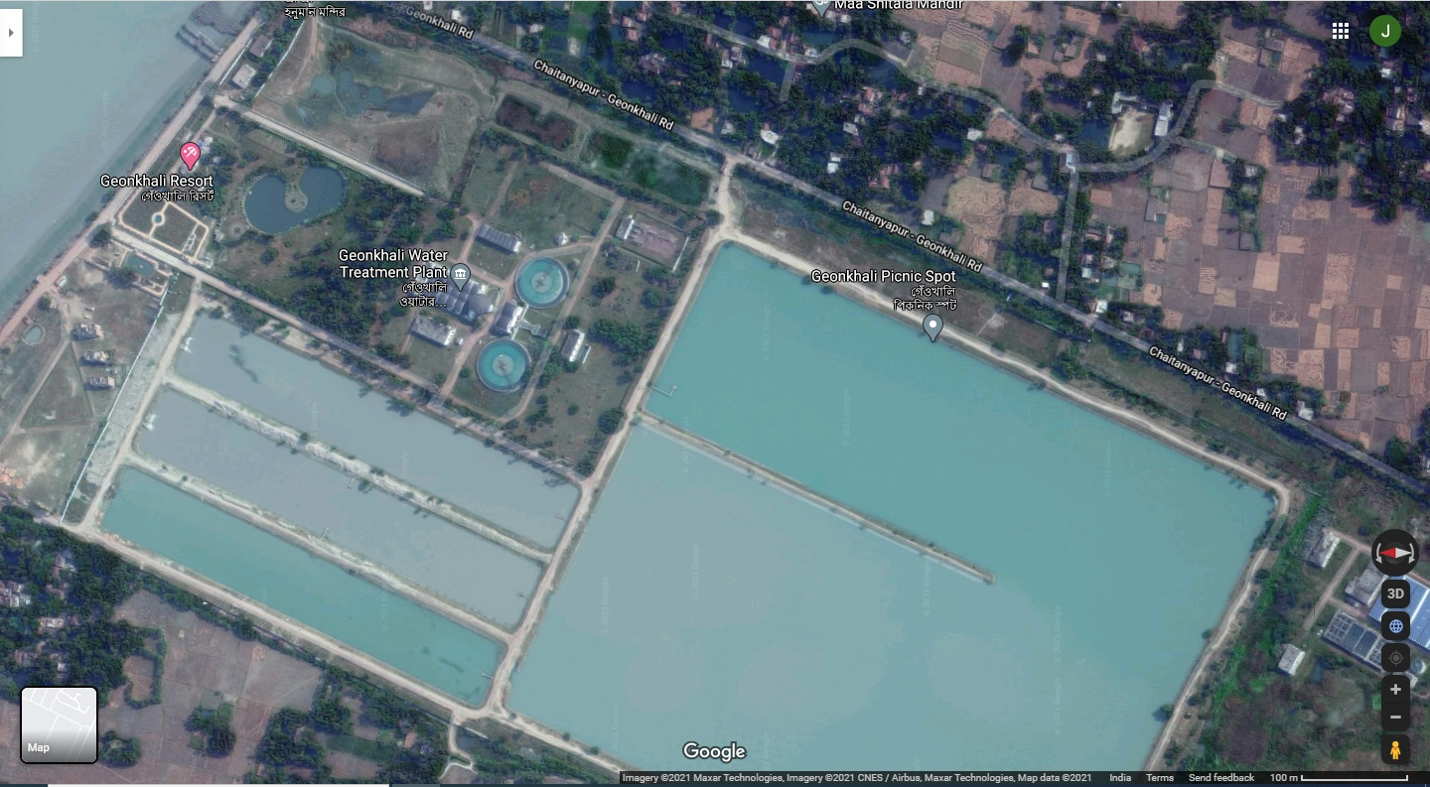

Geonkhali Old 25 MGD Water Treatment Plant
WATER INTAKE JETTY
INTAKE PUMP HOUSE
CLEAR WATER PUMP HOUSE
FILTER HOUSE
CLARIFIER 1
SETTLE WATER PUMP HOUSE
CLARIFIER 2
WATER SETTLING TANK
WATER INTAKE CHANNEL
WATER INTAKE CHANNEL
WATER SETTLING TANK
WATER INTAKE CHANNEL

Slide 11












Old 25 MGD WTP & Water Supply Process Flow
Old 25 MGD WTP & Water Supply Process Flow
Intake Water System
VSC Pump – 4 Nos (2W+2S)
Capacity: 4500 M3/Hr, Head: 12MWC
Power: 200KW
Settling Pump System
HSC Pump – 5 Nos (3W+2S)
Capacity: 1800 M3/Hr, Head: 15.2MWC
Power: 110KW
Intake Channel – 3 Nos
Capacity: 10 Million Gallons
Size: 400 X 30 X 4 Mtr
Pre Settling Tank– 1 No
Capacity: 200 Million Gallons
Size: 600 X 500 X 3 Mtr
Confluence of Rupnarayan and Hooghly River
Backwash Water System
HSC Pump – 2 Nos (1W+1S)
Capacity: 150M3/Hr, Head: 30MWC
Power: 75KW
VILLAGE DISTRIBUTION
Consumer
Agitation System -2 Nos
Clarifier System – 2Nos
3 hours Retention System
BACK WASH WATER FOR FILTER
Clear Water System
HSC Pump – 4 Nos (2W+2S)
Capacity: 1850 M3/Hr, Head: 36MWC
Power: 260KW
HSC Pump – 2 Nos (1W+1S)
Capacity: 1500 M3/Hr, Head: 30MWC
Power: 150KW
12 Nos – Twin Unit Filter Bed (10W+2S)
Capacity: 450M3/hr
Sludge System
HSC Pump – 2 Nos (1W+1S)
Capacity: 400M3/Hr, Head: 15MWC Power: 30KW
Gaseous Chlorine System
Fflocculant Dosing System

Slide 12




New 25 MGD WTP & Water Supply Process Flow
New 25 MGD WTP & Water Supply Process Flow
Intake Water System
VSC Pump – 4 Nos (2W+2S)
Capacity: 5100 M3/Hr, Head: 16MWC
Power: 325KW
Settling Pump System
HSC Pump – 4 Nos (2W+2S)
Capacity: 2580 M3/Hr, Head: 18MWC
Power: 180KW
Intake Channel – 3 Nos
Capacity: 10 Million Gallons
Size: 400 X 30 X 4 Mtr
Pre Settling Tank– 1 No
Capacity: 200 Million Gallons
Size: 600 X 500 X 3 Mtr
Confluence of Rupnarayan and Hooghly River
Agitation System -12 Nos
Sludge
Sludge Cake
Sludge
Centrifuge
Sludge Thickener
Sludge
Fflocculant Dosing System
Filtering System -06 Nos
Consumer
Clear Water System
VSC Pump – 6 Nos (3W+3S)
Capacity: 1250 M3/Hr, Head: 65MWC Power: 300KW
Gaseous Chlorine System

Slide 13
Key Highlights of the Concession Agreement (1 of 3)
Key Highlights of the Concession Agreement (1 of 3)
HWSPL entered the Concession Agreement (“CA”) with HDA on August 16, 2019 after payment of an upfront one time non-refundable and non-adjustable license fee of Rs. 8 crore to HDA.
HWSPL then took over the Project on November 1, 2019 for a period of 15 years. HWSPL shall continue to be the exclusive and dedicated operator as there is no other perennial source of water in Haldia,.
Fees Payable to HDA:
  Upfront one-time non-refundable and non-adjustable fee of Rs. 8.00 Cr payable on signing of Concession Agreement towards the right of the concession, refundable in case of termination due to a force majeure event, HDA event of default;
  Performance Security of Rs. 20 Cr in the form of guarantee of Scheduled Bank/ PFI to be issued before takeover / compliance date ;
  Fixed Annual License Fee of Rs. 24 Crores payable in equated monthly instalments;
  65.50% sharing of incremental revenue for water sales beyond 4.47 Cr kl p.a. payable at the weighted average water tariff at the end of each concession year;
  50% sharing of incremental revenue due to increase in water tariff for Industrial and Commercial incremental revenue beyond Minimum Water Tariff (5% increase p.a.) defined in the CA.
  50% sharing of savings on power cost due to decrease in power tariff below the Base Tariff (4% increase p.a.) defined in the CA.

Slide 14
Key Highlights of the Concession Agreement (2 of 3)
Key Highlights of the Concession Agreement (2 of 3)
Take or Pay Clause: Contracts entered into by HDA with customers have “take or pay” clause, wherein, the customers are required to pay for minimum 50% of the contractual volume, at the prevailing water tariff, irrespective of the water consumed.
Revenue Collection: Revenue collection is significantly high (>95%). However, in case of default in water payments for period of more than 120 days from the date of billing and HDA does not issue instruction for disconnection, HDA shall compensate the HWSPL for such amounts in default.
Minimum Water Tariff: Minimum Water Tariff defined for Industrial and Commercial customers with an escalation of 5% p.a. at the end of each Concession Year. Applicable Tariff for Year 1 and Year 2 given below:
Threshold limit for Municipal & Domestic Sales: Combined sales to the municipal and domestic sales beyond 0.99 Cr kl (6 MGD) shall be considered as sale under commercial tariff and the difference in rate is to be paid by HDA/ or adjusted against the License fees payable to HDA;
Customer Type | Year 1 (per/kl) | Year 2 (per/kl)
Industrial | 18.35 | 19.27
Commercial | 14.31 | 15.03
Domestic | 5.96 | 5.96
Municipal | 3.58 | 3.58
If the applicable Water Tariff for Industrial and/or commercial Customers is less than the Minimum Water Tariff at any time during any Concession year, the shortfall shall be adjusted from the License Fees payable to HDA.

Slide 15
Key Highlights of the Concession Agreement (3 of 3)
Key Highlights of the Concession Agreement (3 of 3)
Repair & Upgradations Works: A list of Repair and Upgradation works defined in the CA to be completed within first 8 years of the Concession Period.
Service Area: There remains a restrictive clause on the existing and future customers to setup their own water treatment plant. Further, HDA shall ensure that new industries coming to Haldia are mandatorily required to purchase water from this water supply project.
Asset ownership to remain with HDA during the term, including any refurbishment or replacement of project facilities excluding any moveable assets installed to improve operational efficiency not transferred to HDA, all such amount invested by the SPV refundable in case of termination due to a force majeure event, HDA event of default
Charge on Project Assets: HWSPL cannot assign or create any lien or encumbrance on the Project Facilities excluding creation of a security interest in favour of the Lenders on the grant of this Concession only, thereby giving them substitution rights
Deterioration in raw water quality: Significant change in the raw water quality causing a failure to meet performance standards is covered through force majeure event under climate change. In case there is a need for repair and/or upgradation in the existing system to treat the poor water quality, the expenses shall be compensated by the HDA.

Slide 16
Working Capital Cycle
3. HWS submits Revenue Appropriation Statement (RAS) to HDA
1. Bills raised by HWS to consumers on behalf of HDA
HWS
CONSUMERS
HDA
5. RCA Bank transfer funds to HWSPL
JOINT REVENUE COLLECTION A/C
4. As per RAS, HDA instructs RCA Bank to transfer funds to HWS Bank as per Article 13.5 of CA
2. Money deposited by consumers to Revenue Collection Account Bank (RCA Bank)
Billing within 5 days of the subsequent month as per meter reading & payment due date within 15 days of billing
Revenue from consumers (majorly Industrial consumers like Indian Oil Corporation, Haldia Petrochemicals, Tata Power, etc.) to flow into Joint Revenue Collection account controlled by HDA
Normal working capital cycle
  Power Bill from WBSEDCL to be paid by 12th of the subsequent month ~Rs. 2.2 cr p.m.
  95% revenue realization by 20th day of the subsequent month ~Rs. 6.5 cr p.m.
  Revenue Appropriation with HDA by 25th and funding into HWS account after deduction of Fixed License Fee of Rs. 2 cr. p.m.
  Payment for chemicals, stores and spares and contractual manpower by 30th of the subsequent month ~Rs. 1.5 cr p.m.
  Balance receivable realization within 120 days of first billing either through HDA or customer.

Slide 17



Organization Structure
Organization Structure
HWSPL TEAM STRENGTH
HWSPL Executive : 18 Nos
ION Executive : 18 Nos
Operation & Maintenance Crew: 259 Nos
DIRECTOR
VP CUM EIC
AVP PROJECTS
CHIEF MAINTENANCE NETWORK
CHIEF MANAGER COMMERCIAL
ADVISOR (PROCESS IMPROVEMENT & COST CONTROL)
SR. MANAGER PROCUREMENT
HEAD OPERATION/PRODUCTION
NETWPRK PIPELINE & NEW PROJECTS
Chief Plant & Pump House Maintenance – Mech/Elec/Flowmeter
HR - SPOC
Assist. Manager Network & Bridge Maintenance (01)
Mechanical Maintenance (02)
Operation & Quality Team IEL – 11 Nos
Electrical Maintenance (03)
ASSIST MANAGER COMMERCIAL
PRO & MIS
Chemist (02)
Maintenance Flow Measurement (01)
Safety Officer (01)
Maintenance Team IEL (05)
Operator (186 Nos)

Slide 18
Operation & Maintenance of 50 MGD WTP
25 MGD OWTP – Operation Started Since,1992 at Geonkhali, Haldia.
25 MGD NWTP – Operation Started Since,2014 at Geonkhali, Haldia.
Total 50 MGD Capacity WTP O&M on the behalf of HDA, W.B. ,Govt.
HWSPL taken over the project on Nov’2019 for 15yrs as per CA.
Water distributed to entire Haldia city as follows –
1. Industrial –
2. Commercial –
3. Domestic & Municipality –
Key features:-Total customers – 247no’s,
In Industrial – 64 no's , Major Customers -10no’s(HPL, MCPI, IOCL, IPCL, Tata Power, Indorama, Electro steel, Emami,Ruchi, Haldia Dock),
Commercial customers – 45 no’s.
Domestic & Municipality – 126 no’s.

Slide 19
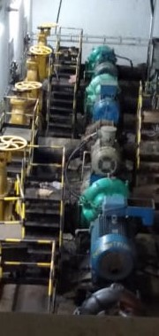
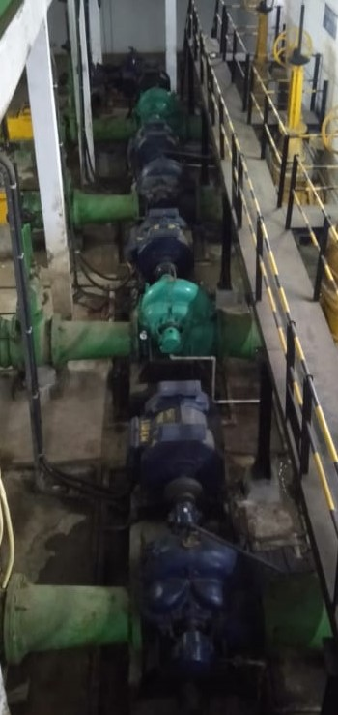
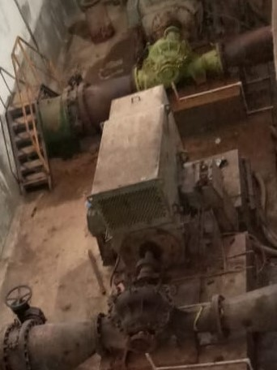
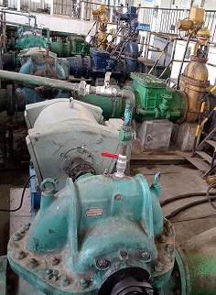
Major Achievement
Mechanical :-
      Installation/Replacement of New pump in place of non performing and low efficient pump.
2
3
1
2
2
1
1
1
Old Clear Water pump House
Old Settle Water pump House
New Clear Water pump House
Basuvebpur PG Pump House
Improvement:-
1.Capacity of water production enhanced.
2.Power Consumption reduced.
3. Minimized the down time.
4. Reduced maintenance cost.

Slide 20
Major Achievement
Mechanical :-
      Benefits of Installation/Replacement by New pump
PERFORMANCE OF OLD PUMP VS NEW PUMP
SL NO | LOCATION | PUMP NO | PUMP DETAILS | RATED CAPACITY ( m3/h) | ACTUAL CAPACITY ( m3/h) | % Flow | RATED EFFICIENCY | ACTUAL EFFICIENCY | REMARKS
1 | SETTLE WATER PUMP HOUSE | PUMP-1 | CAPACITY- 1800M3/H, HEAD -15.2 M, RPM- 980 ,MOTOR KW-110 | 1800 | 1500 | 83% | 85% | 71% | OLD PUMP
2 |  | PUMP-1 | CAPACITY- 1800 M3/H, HEAD -15.2 M, RPM-980, MOTOR KW-110 | 1800 | 1800 | 100% | 85% | 85% | NEW PUMP
3 | CLEAR WATER PUMP HOUSE | PUMP-6 | CAPACITY- 1950 M3/H, HEAD -36 M,RPM- 987, MOTOR KW-260 | 1950 | 1530 | 78% | 85% | 67% | NOW 3 PUMPS ARE RUNNING INSTEAD OF 4 PUMPS, ALSO WE ARE GETTING MORE WATER THROUGH THREE PUMPS RATHER THAN PREVIOUS COMBINATION I,e 4 PUMPS.
4 |  | PUMP-6 | CAPACITY- 1950 M3/H, HEAD -36 M, RPM- 987,MOTOR KW-260 | 1950 | 1950 | 100% | 85% | 85%
5 | NEW CLEAR WATER PUMP HOUSE | PUMP-1 | CAPACITY- 1250 M3/H, HEAD -65 M,RPM- 1485, MOTOR KW-300 | 1250 | 900 | 72% | 88% | 63% | AFTER INSTALLATION OF NEW PUMP WE ARE GETTING 3050 M3/ H INSTEAD OF 2700 M3/H . SO , WE ARE GETTING 350 M3/H MORE WATER FROM SAME COMBINATION.NOW PER DAY OUR PRODUCTION INCREASED FROM NEW WTP = 350 X24 =8400 KL
6 |  | PUMP-1 | CAPACITY- 1250 M3/H, HEAD -65 M, RPM- 1485, MOTOR KW-300 | 1250 | 1250 | 100% | 88% | 88%

Slide 21
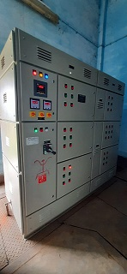
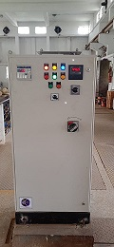
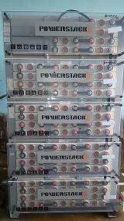
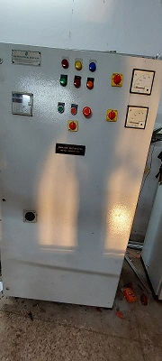
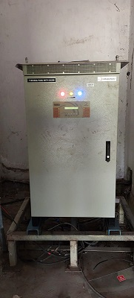
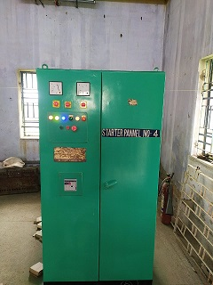
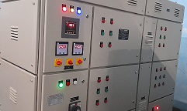
Major Achievement
Electrical :-
      New APFC, Battery Charger, Battery Bank & Star Delta Starter Panel Installation in place of old .
2
3
1
2
2
2
1
1
1
1
APFC Panel
SG Panel
Battery Bank
Star Delta Starter
APFC Panel
Old Clear Water pump House
Old Settle Water pump House
Battery Charger
Starter Panel
Old Clear Water pump House
Old Settle Water pump House
New Clear Water pump House
New Clear Water pump House
Improvement:- 1.Improved the power factor to 0.99.
2.Reduced Power Consumption and power cost.
3. Minimized the down time
4. Low maintenance cost

Slide 22
Major Achievement
Quality & Chemical :-
      24 hours Lab analysis for lifting of lower concentration of salinity water from River in lean season i.e. February to June month and Improved lower concentration of salinity in supply water.
      Liquid PAC (HB 10%) used instead of Alum Cake.
1
Benefits:- 1. Maintain quality of water supplied as per CA.
2. Reduce sludge generation by using of Liquid PAC
3. Reduce clarifier Maintenance cost and enhance the performance.
4.Reduce monthly cost of chemicals.
5.Reduce manpower Cost.
6.Reduce electrical cost for lowest running hours of sludge pump due to reducing
of sludge accumulation.
1
Old Clear Water pump House
Old Settle Water pump House
New Clear Water pump House

Slide 23
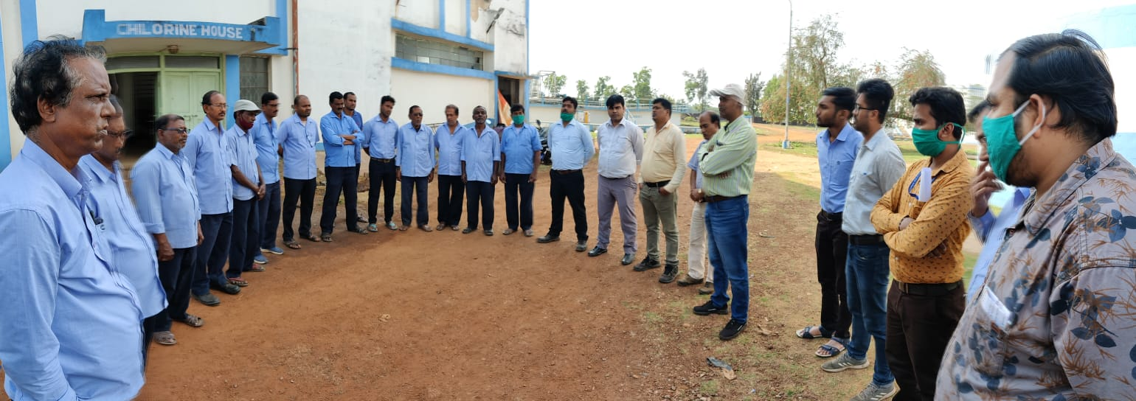
NATIONAL SAFETY DAY
HWSPL CELEBRATE 51ST NATIONAL SAFETY DAY:
4th March’22 HWSPL celebrating National Safety Day with the goal of raising awareness and commitment to working safely.
These year theme “NURTURE YOUNG MINDS – DEVELOP SAFETY CULTURE”.

Slide 24
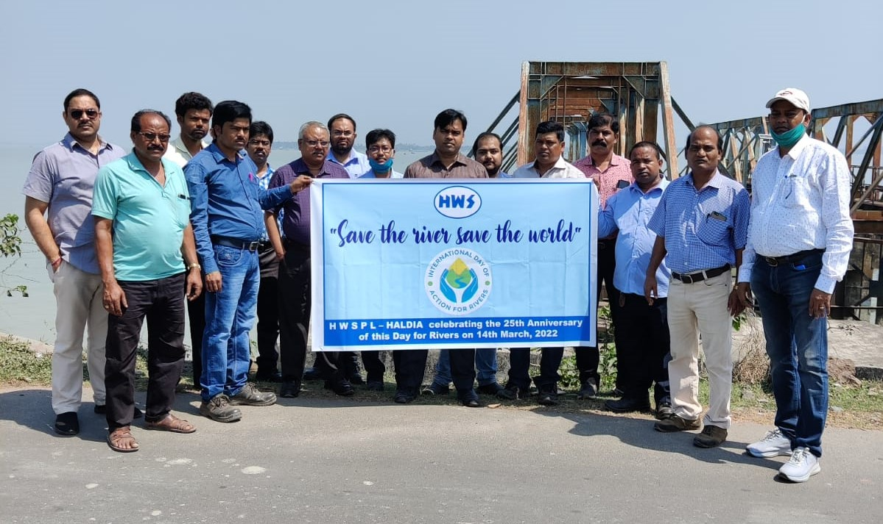
International Day of Action for Rivers – 14th March 2023
Rivers are key to restoring and maintaining the world’s biodiversity. River systems are the zone of Earth’s highest biological diversity – and also of our most intense human activity. This year the world meets for the 15th Convention on Biological Diversity (CBD). Freshwater ecosystems are the most degraded in the world and global action is needed to turn this around. Let’s make our voices heard.
We Haldia Water Services Private Limited – HALDIA celebrating the 25th Anniversary of this Day on 14.03 2023 for Rivers by also highlighting the importance of Rivers to Biodiversity.

Slide 25
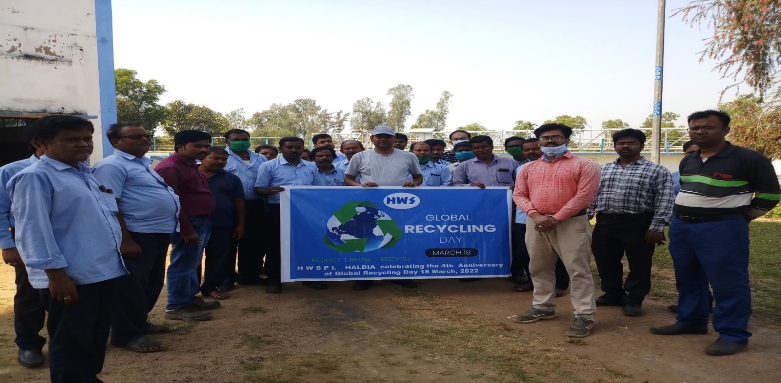
Global Recycling Day - 18th March 2023
We Haldia Water Services Private Limited – HALDIA organized the 5th Anniversary of Global Recycling Day on March 18 2023, by taking initiative that encourages us to look at our trash in a new light. There are several ways to recycle that allow some materials to be reused multiple times. Recycling is great for us and the environment because it lessens the energy we use, enhances the quality of water and air we breathe, and combats climate change.
We discussed following unused items that can be easily recycled /reused at home:
Plastic Bags. ...
Milk Cartons. ...
Plastic Water Bottles.
Empty Ice Cream Container. ...
Empty Roll-On Deodorant Bottles.
Paper
Book
Old Electronics
Shoes
Clothes
Ink Cartridges
Batteries

Slide 26
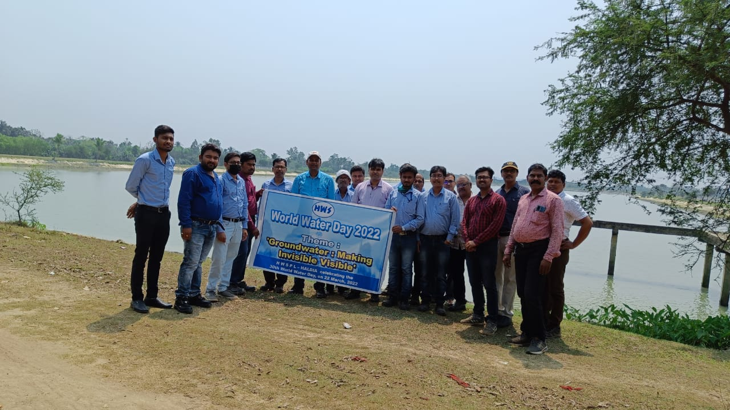
World Water Day – 22nd March 2023
We Haldia Water Services Private Limited – HALDIA celebrating the 31st World Water Day, held on 22 March. Globally celebrating since 1993, celebrates water and raises awareness of the 2.2 billion people living without access to safe water..
Theme 2023
“GROUNDWATER: MAKING THE INVISIBLE VISIBLE
No Water. No Life. No Blue. No Green

Slide 27



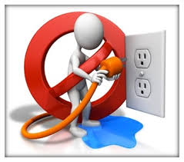
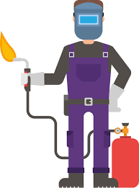
Safety Pillars
Safety Pillars
ELECTRICAL SAFETY
FIRE SAFETY
HEIGHT SAFETY
CHEMICAL SAFETY
HOT WORK SAFETY
EXCAVATION SAFETY

Slide 28
Performance & Way Forward
After 15 years
Water Supply: 40MGD
Revenue: INR 173.2 Million/Month
QUALITY & SAFETY
After 10 years
Water Supply: 40MGD
Revenue: INR 136.4 Million/Month
After 5 years
Water Supply: 40MGD
Revenue: INR 107.5 Million/Month
DEC - 21
Water Supply: 36MGD
Revenue: INR 79.4 Million.
JULY - 21
Water Supply: 35MGD
Revenue : INR 78.2 Million.
CUSTOMER SERVICE
JAN-21
Water Supply: 34 MGD
Revenue: INR 77.5 Million

Slide 29


Digitization & Innovation
Digitization & Innovation
Automation
System operation through automation to reduce manual intervene.
Automatic Pump Operation as per Line Pressure/ will stop or run as water stock in storage
Automation of Filter Backwashing System
Digitization
Manual reading Collection to GPS System enabled flowmeters to cater real time data.
New Projects
Project
Innovation
Adopting VVF Drive to from Star delta Connection
Scada System, online monitoring system to achieve high productivity and process safety

