Slide 1



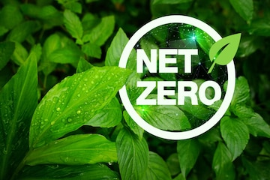
Improvement in Industrial Sustainability with an approach to
Presented by
Er. Sujit Pal
On behalf of Electrosteel Castings Ltd, Haldia unit

Slide 2
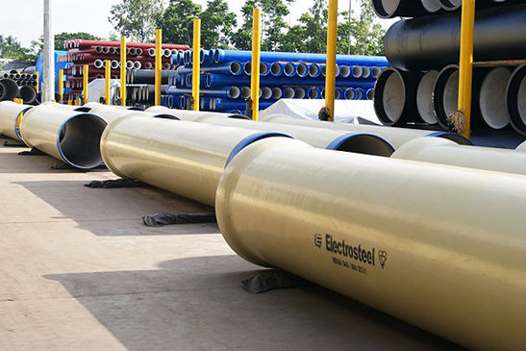
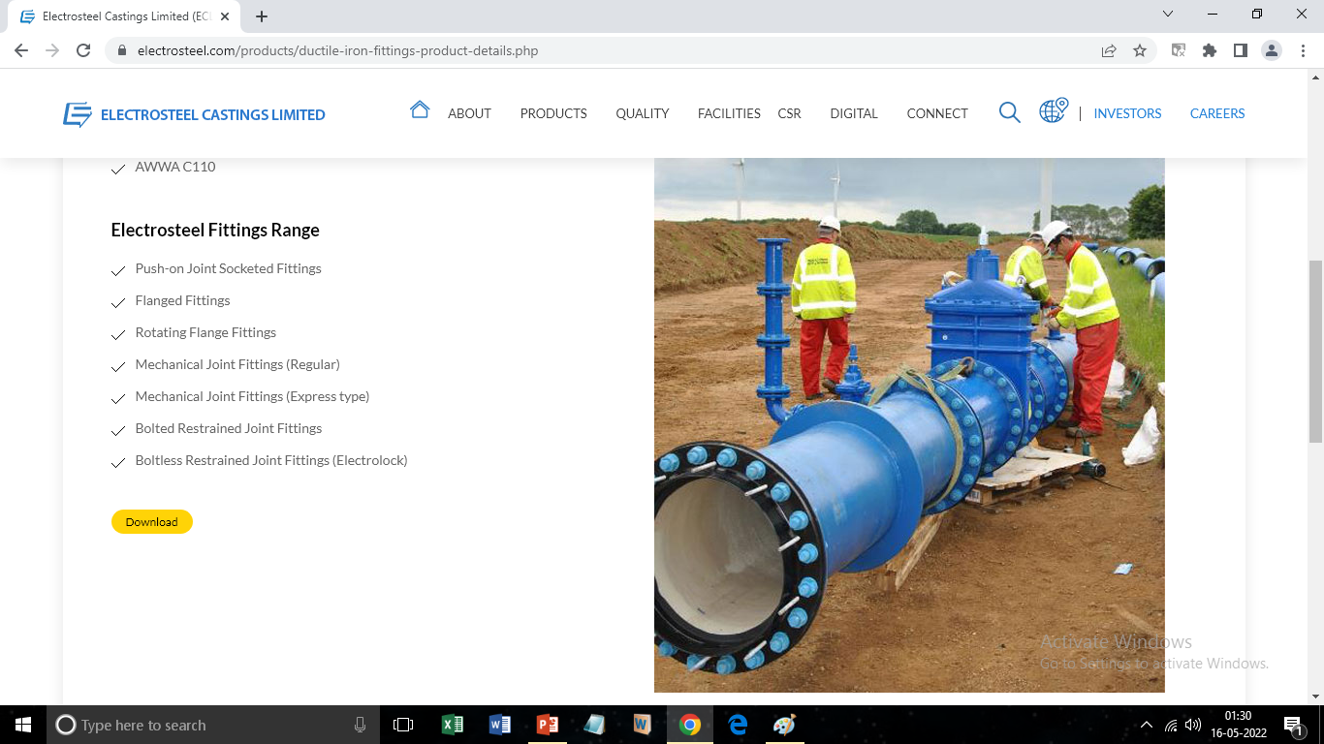
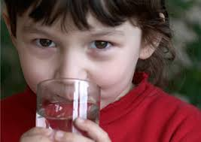
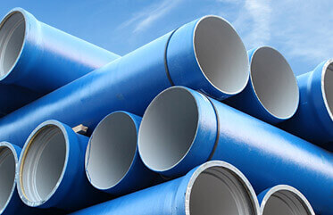
About us:
ELECTROSTEEL CASTINGS LTD is the pioneer of introducing ductile iron pipes in India. With five decades of experience, we are fulfilling its vision of ‘carrying life to people, safe drinking water for all’. Being country’s leading water infrastructure solution provider, we have been providing clean drinking water to millions of Indians and abroad.

Slide 3
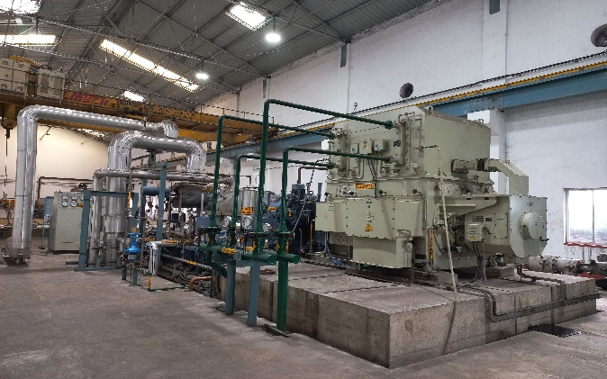
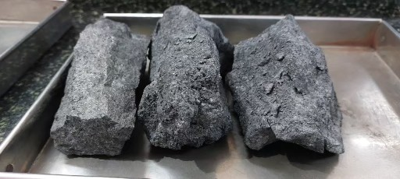
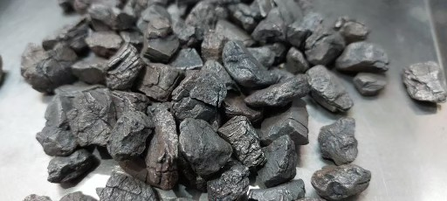
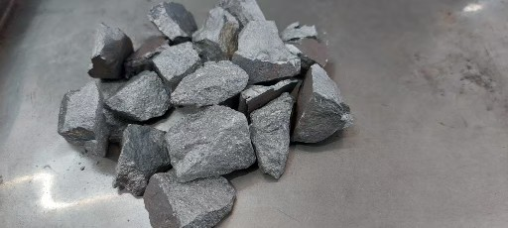
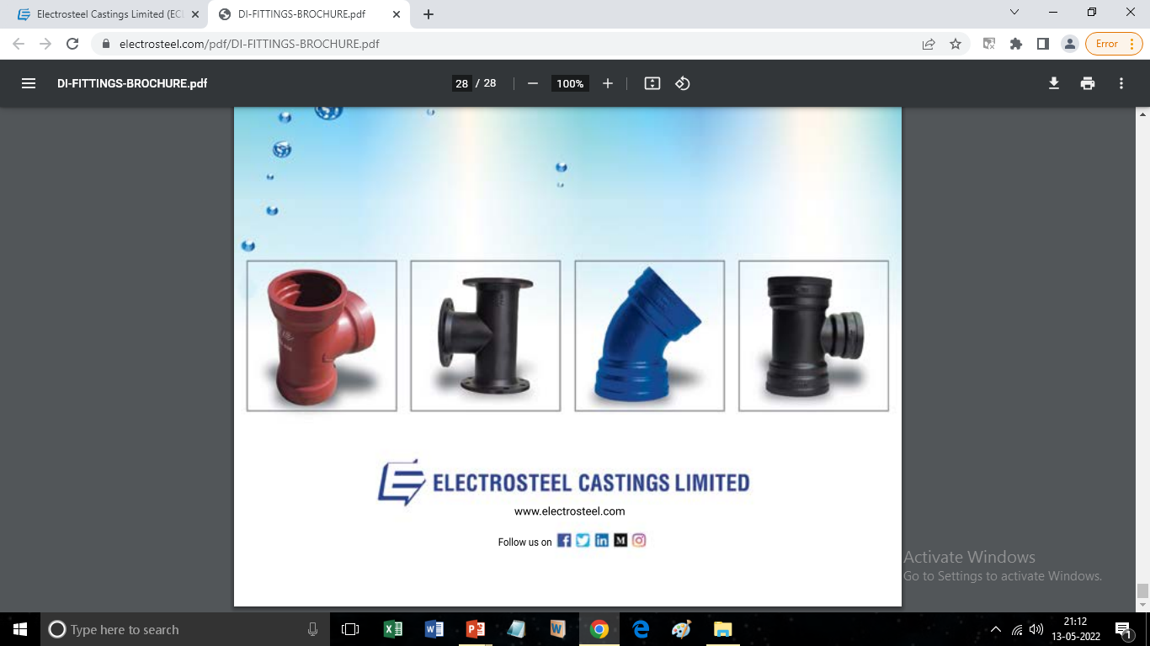
ELECTROSTEEL CASTINGS LTD, HALDIA UNIT:
To support as a backward integration of the Ductile Iron pipes plant located at Khardha,24 Parganas, Haldia Unit is having 2,40,000 TPA Coke Oven Plant, 2 X 100 TPD Sponge Iron unit, DI fittings and Accessories plant and one 9MVA Ferro-Alloy producing unit.
A 12 + 5 MW Waste Heat Recovery Power Plant is also located here, which generates power using the waste heat of Coke Oven Plant and Sponge Iron Plant and meets the demand of the entire plant and export excess power to State Grid.
PRODUCT BASKET:
POWER PLANT:
COKE:
SPONGE IRON:
SILICO-MANGANESE:
DI FITTINGS:

Slide 4
What is ‘net-zero’ ?
Emission by sources (e.g., Burning of fossil fuels, deforestation)
A
Removals by sinks (e.g., growing new forests, engineered & economical removal of CO2 from atmosphere).
B
(A-B) ‘zero’
So, ‘net zero’ approach is to make a balance between activity and activity
A
B

Slide 5
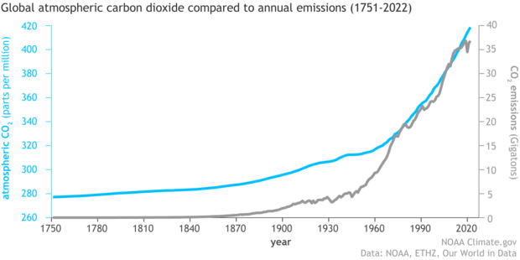
Why ‘net zero’ approach is significant ?
It reduces the greenhouse gas emissions that causes reduction in global warming by balancing the amount released into the atmosphere with the amount removed and stored by carbon sinks.
Atmospheric CO2 concentration has increased by 50% since the Industrial Revolution began in the 1800s, due to human activities like the burning of fossil fuels and large-scale deforestation. Based on the annual report from NOAA’s Global Monitoring Lab, global average atmospheric carbon dioxide set a new record high in 2022: 417.06 parts per million.

Slide 6
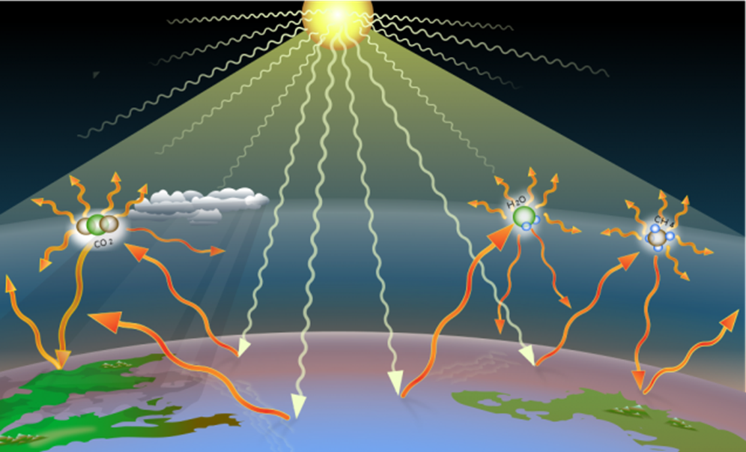
Why Greenhouse gases are responsible?
Energy from the Sun reaches Earth as mostly visible light. Earth surface absorbs some of the light’s energy and reradiates that energy as infrared energy, which has a longer, slower wavelength. Oxygen(O₂) and Nitrogen(N₂) don’t interfere with infrared waves in the atmosphere.
But, CO2 and other greenhouse gases soaks up this infrared energy, it vibrates and re-emits the infrared energy back in all directions. About half of that energy goes out into space, and about half of it returns to Earth as heat, contributing to the ‘greenhouse effect.’

Slide 7
Steps to achieve towards ‘net zero’ :
Primary Steps:
i) Evaluation of carbon footprint for each product.
ii) Identification the scope of reduction of direct fossil fuel consumption (development in Scope:1).
iii) Use of renewal energy (development in Scope:2).
iv) Alternate use of low carbon fuel/ H₂ gas.
V) Development of Green Belt.
Advance step:
Adopting Carbon capturing, utilisation and storing
(CCUS).

Slide 8
Evaluation of carbon footprint for each product.

Slide 9
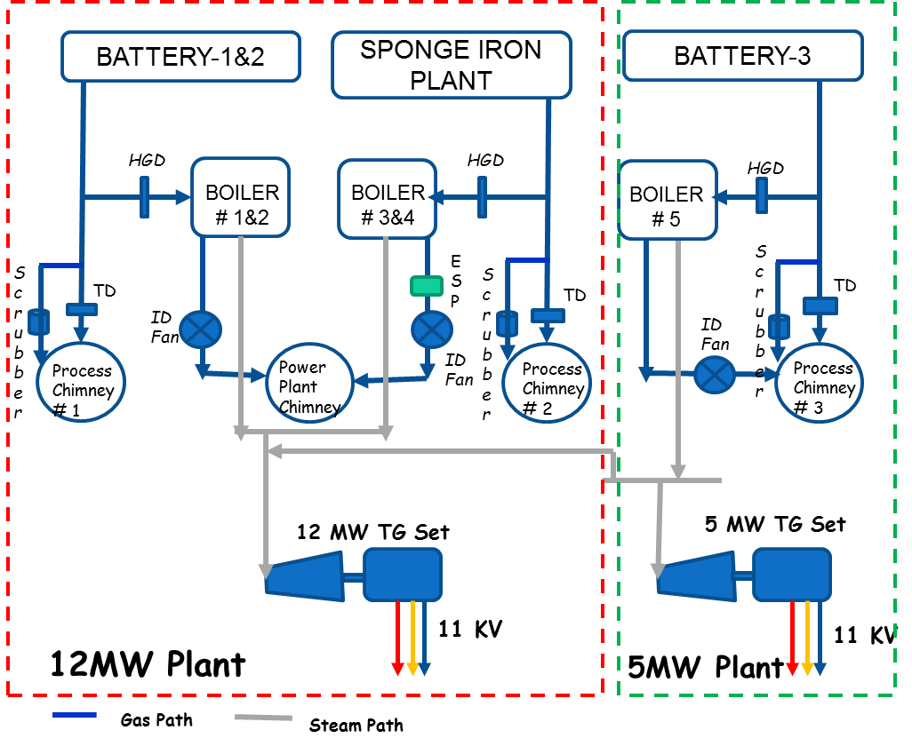
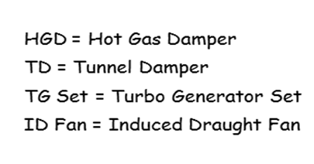
GENERATION OF POWER FROM WASTE HEAT RECOVERY SYSTEM
TO All process & export to Grid

Slide 10
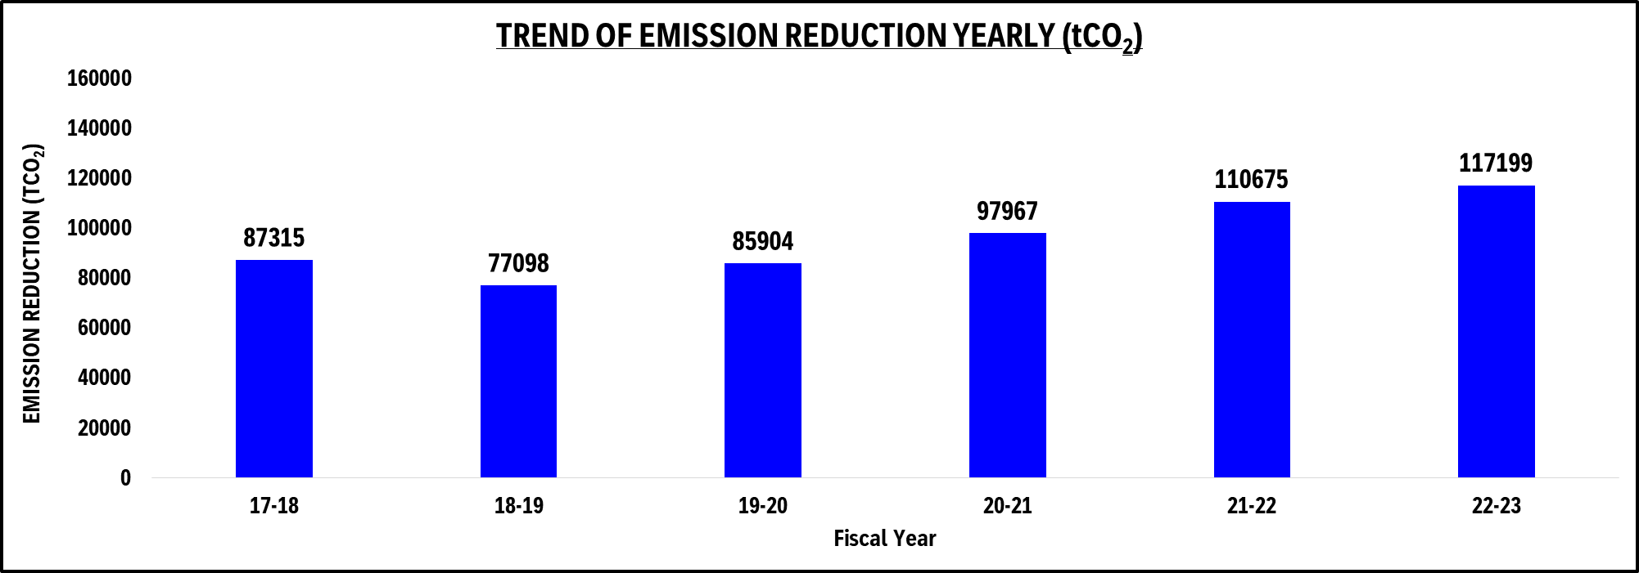
REDUCTION OF CO2 EMISSION THROUGH WASTE GAS POWER GENERATION

Slide 11
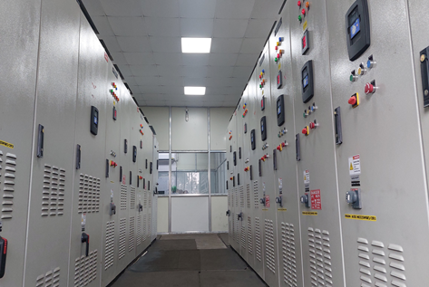
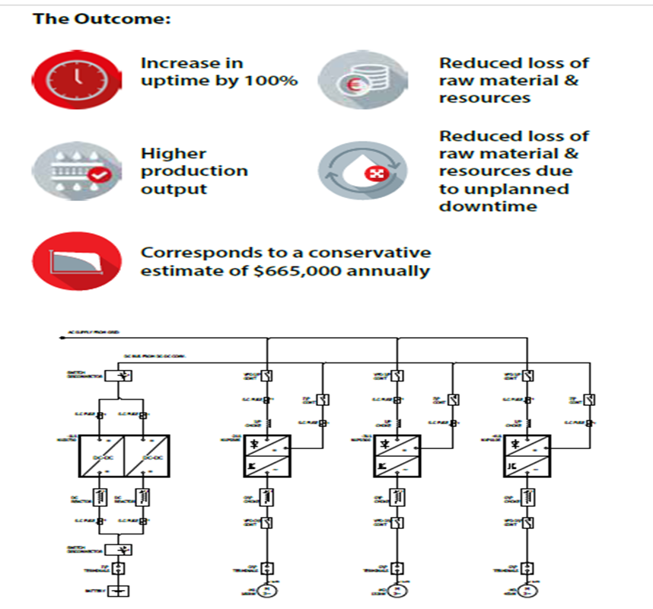
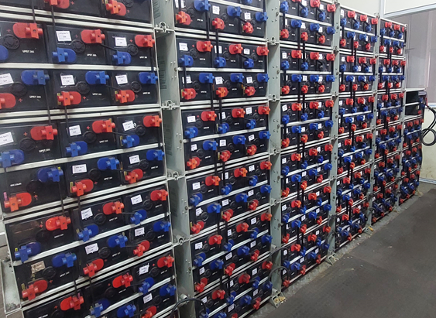
Sustainability enhancement through adopting new technology.
Local grid at 33kV level is too much volatile and frequent voltage dips caused regular tripping of the sophisticated drives of Auxiliary system of Power Plant. The problem aggravated during the monsoon. This resulted in significant downtime and subsequently loss of Generation.
To overcome the system, we introduced only single battery bank with a DC-DC converter backup system for all the auxiliary system.
During normal condition drives are running from the mains and when there is a voltage sag in mains, power is automatically transmitted to all the drives from battery to provided uninterrupted running of drives.

Slide 12
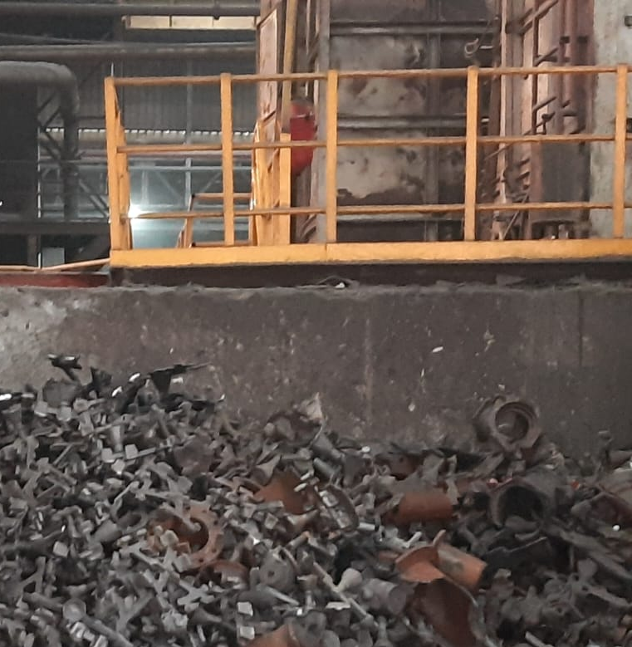
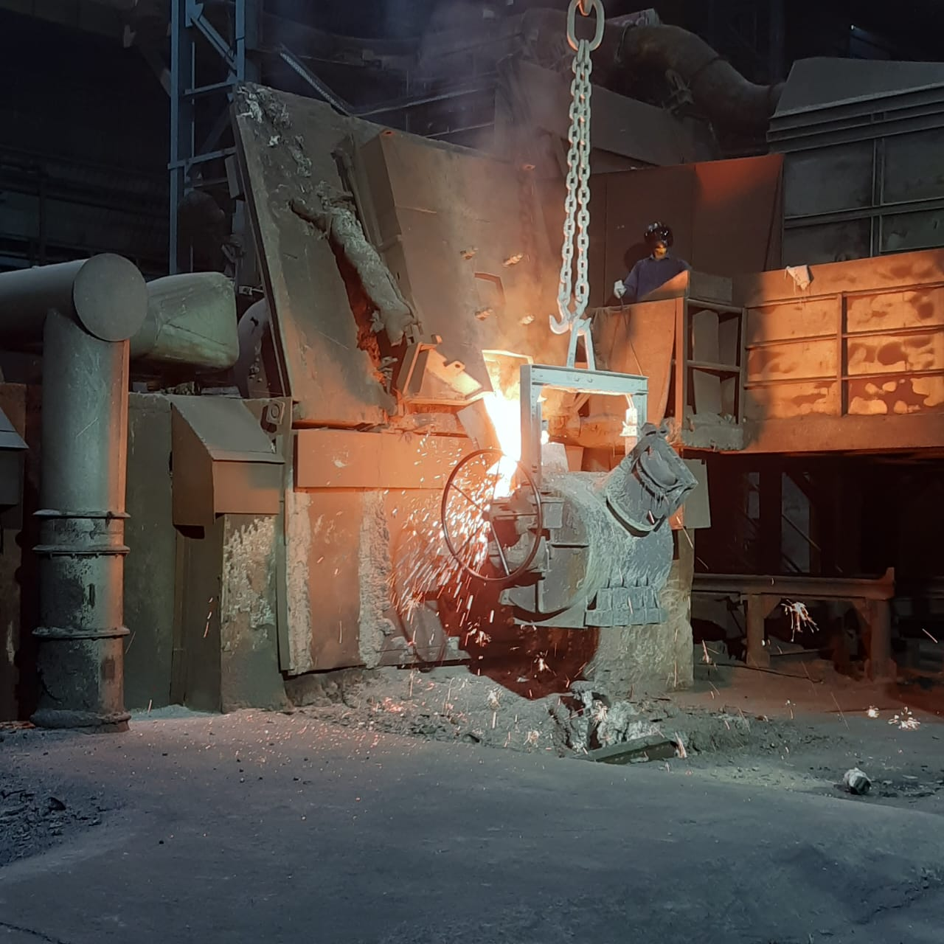
Reduction of Carbon emission by using Ductile Iron(DI) scrap :
Ductile Iron (DI) pipe fittings, are now manufacturing from 100% DI scraps which are generated during pipe manufacturing process in our mother plant at Khardha.
This is an another step towards prohibiting new CO₂ emissions.

Slide 13
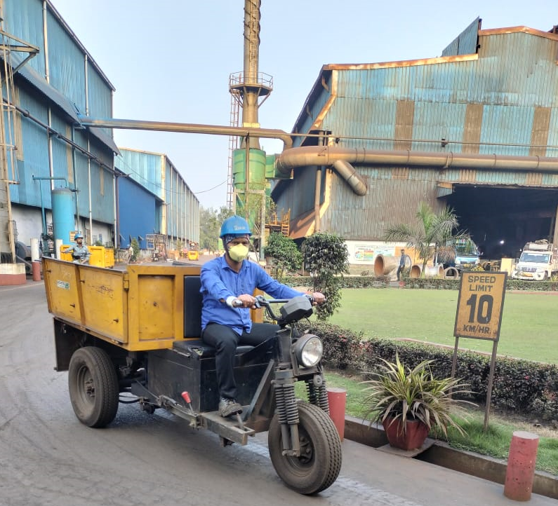
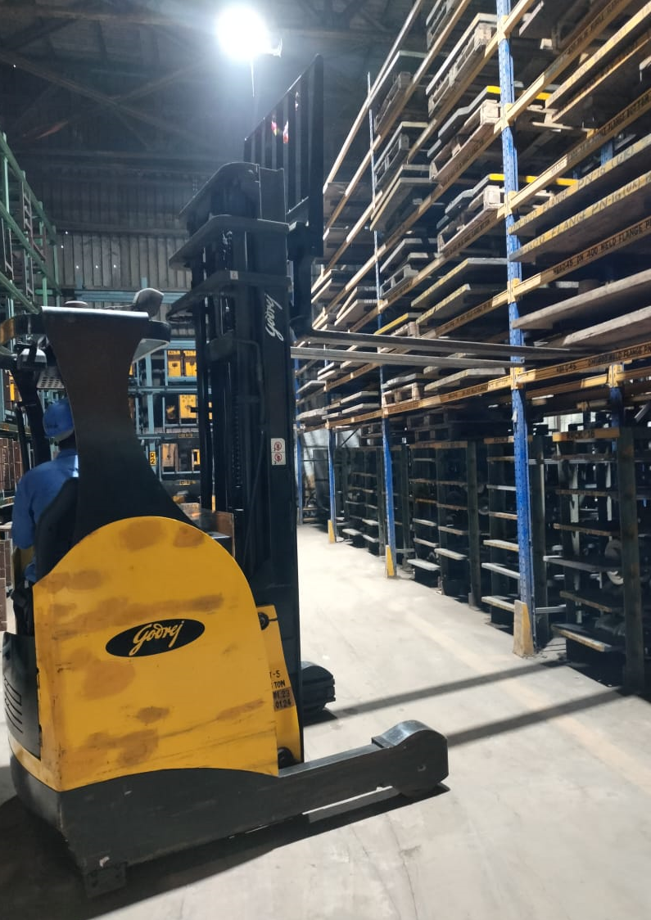
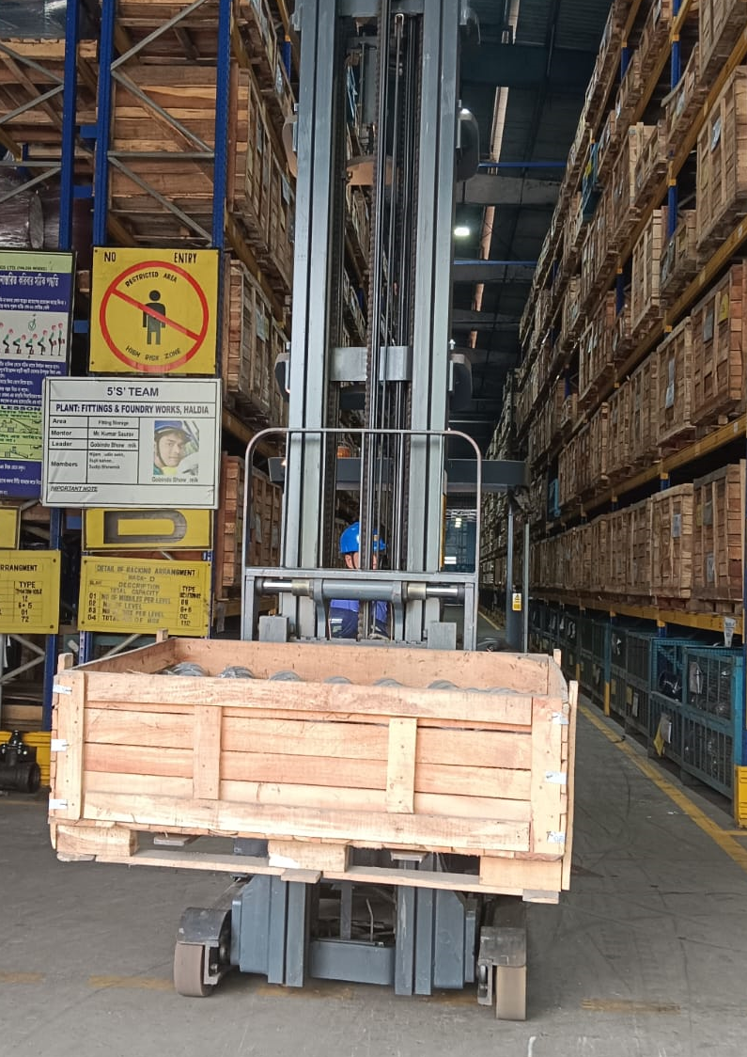
Introduction of Battery operated vehicle for reduction of fossil fuel :
Battery operated electric vans, electric stackers & electric fork- lifts are using inside the entire plant premises to reduce the direct use of fossil fuel.
e-Vehicle
e-Forklift
e-Stacker

Slide 14
Energy saving approaches:
Energy efficiency is the “first fuel” to accelerate progress toward net‑zero goals and higher global climate ambition at lower costs, and add a sustainable pathway towards the benefits for industry as well as society.
Introduction of VVVF drive, automation in different application, uses of high efficient equipment, LED etc. contributed toward this.

Slide 15
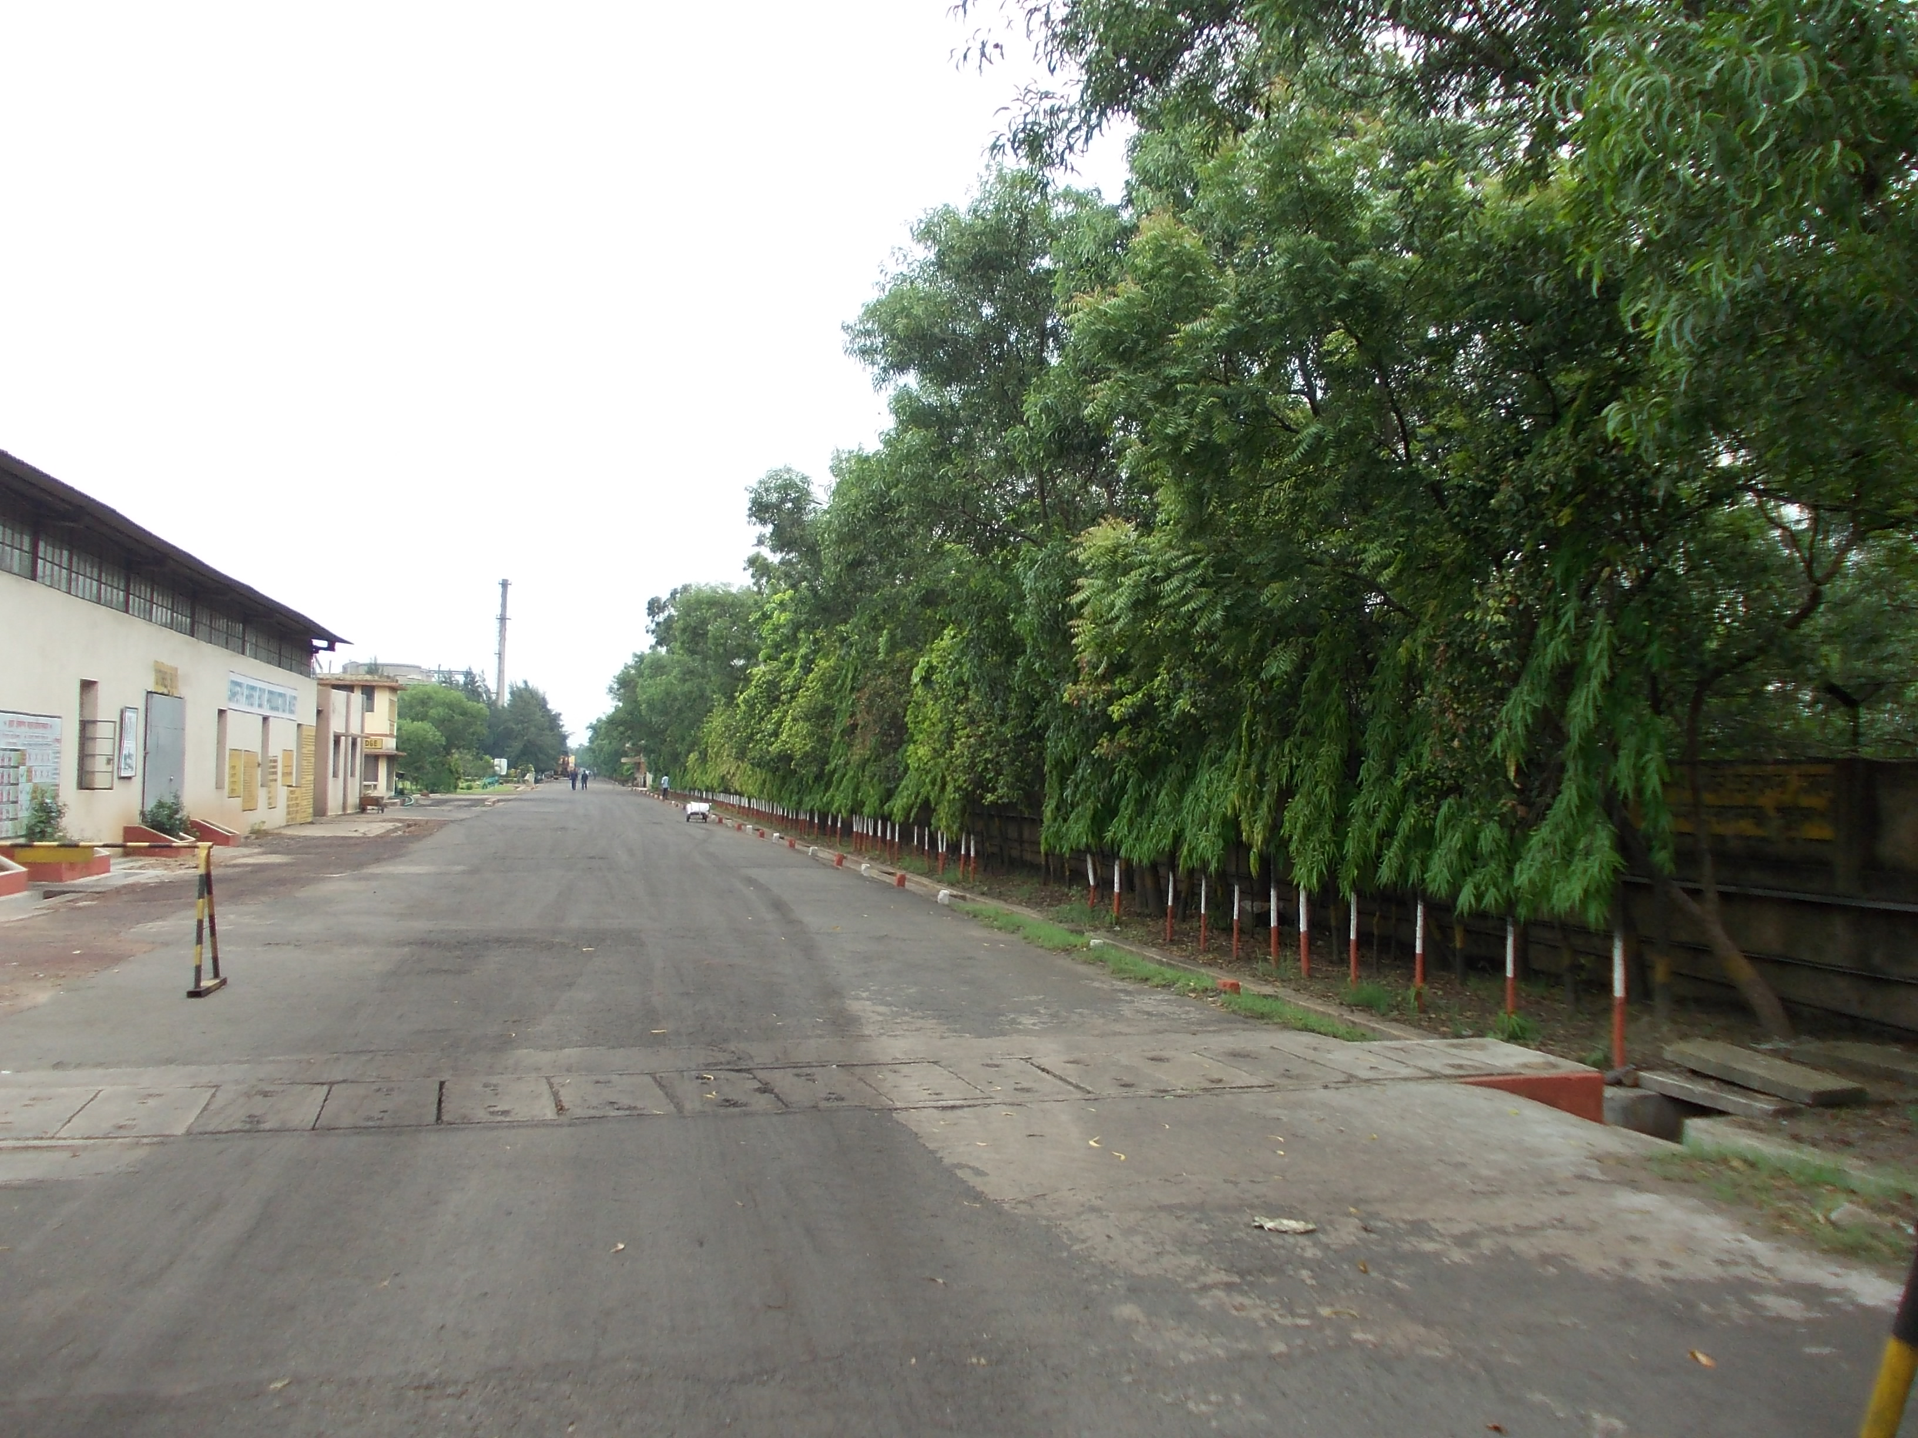
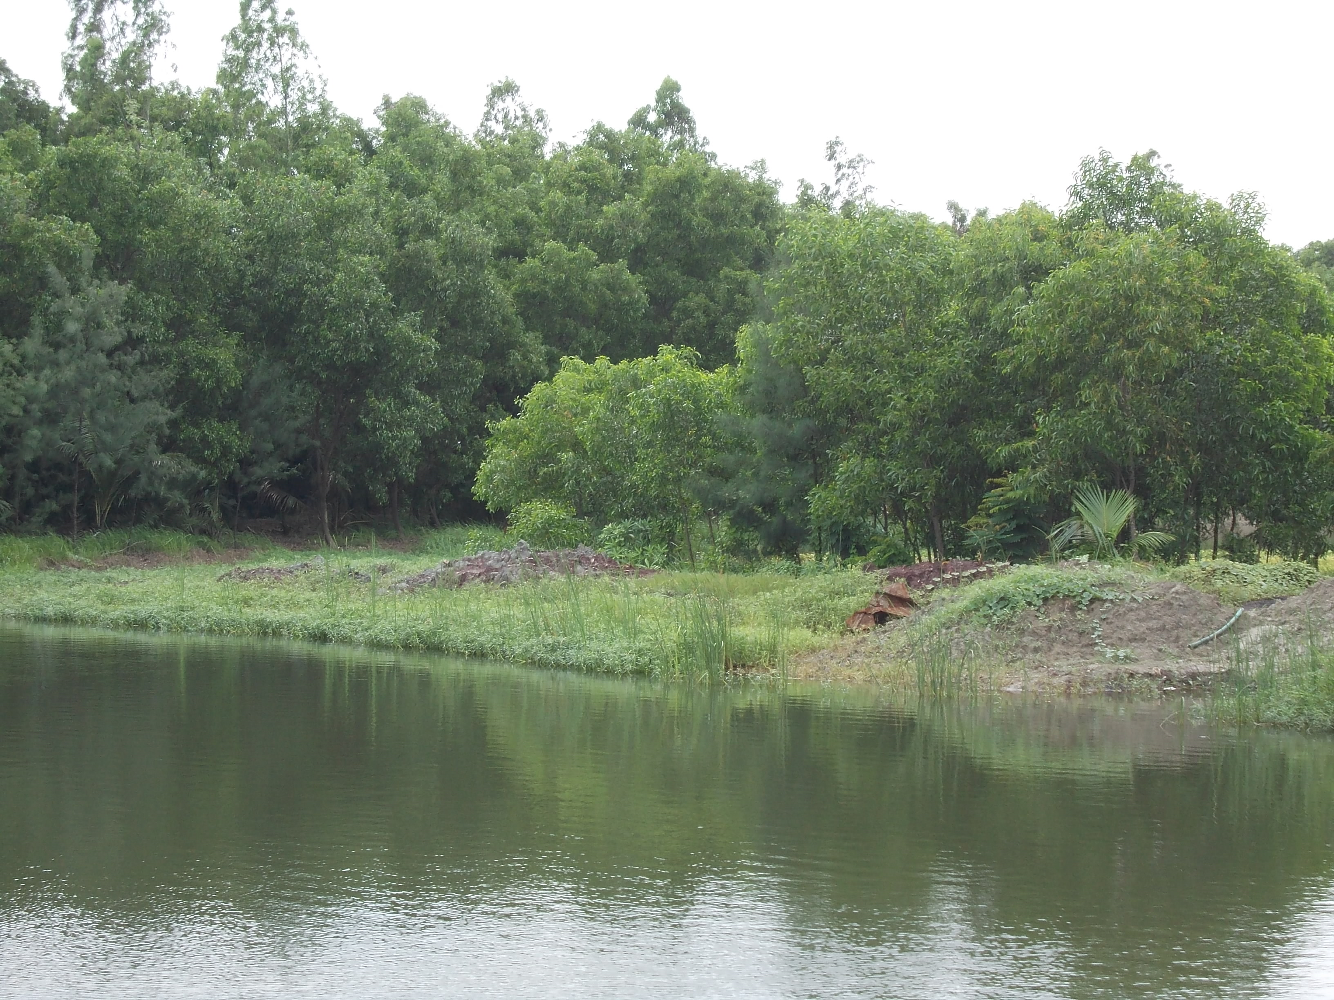
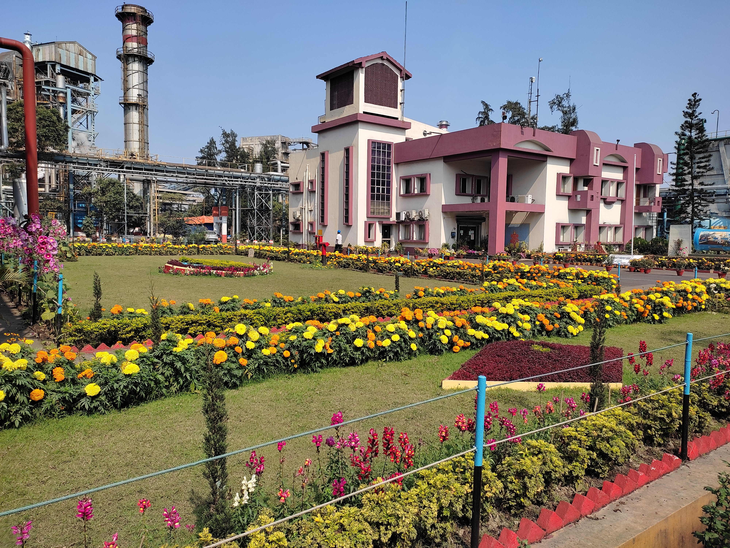
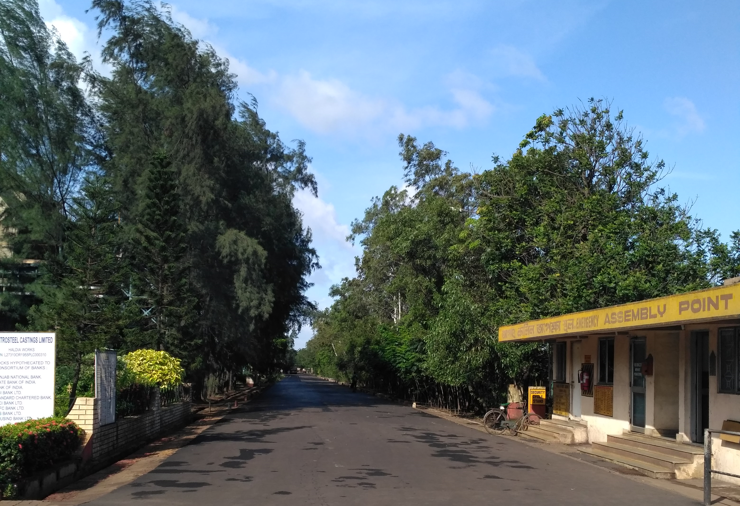
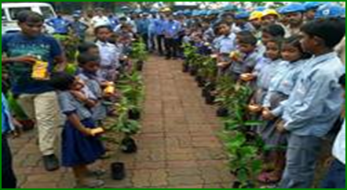
Development of Green Belt:
Around 50,000 trees we are maintaining inside the plant premises .
Every year distribution of saplings to nearest village and awareness development program is also conducted.

Slide 16
Future pathway for reduction in carbon footprint:
First phase of Roof-top solar of 1.5MWp is already in a very advanced stage and hopefully will be installed very soon.
2. Feasibility study of Coke dry quenching(CDQ) and Power
generation utilising the sensible heat from Coke is being carried
out in place of wet quenching.
Introduction of rice husk briquette into Sub-Merged Arc Furnace at Ferro-Alloy plant for reduction in consumption of fossil fuel.
Feasibility study on introduction of Hydrogen gas in DRI production.

Slide 17

Thank you

