Slide 1
Cabotage Policy
Presentation
5th March 2012
Planning Commission

Slide 2
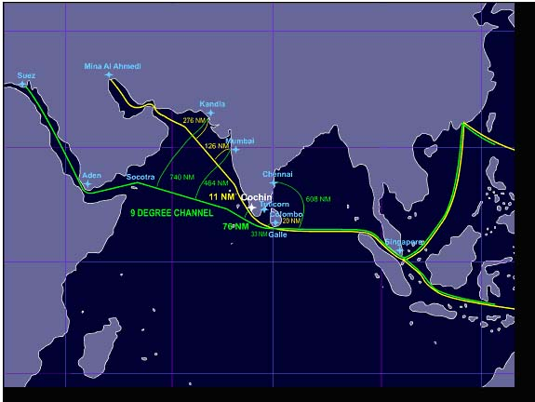
STRATEGICALLY LOCATED ON THE EAST WEST SEA TRADE ROUTES

Slide 3
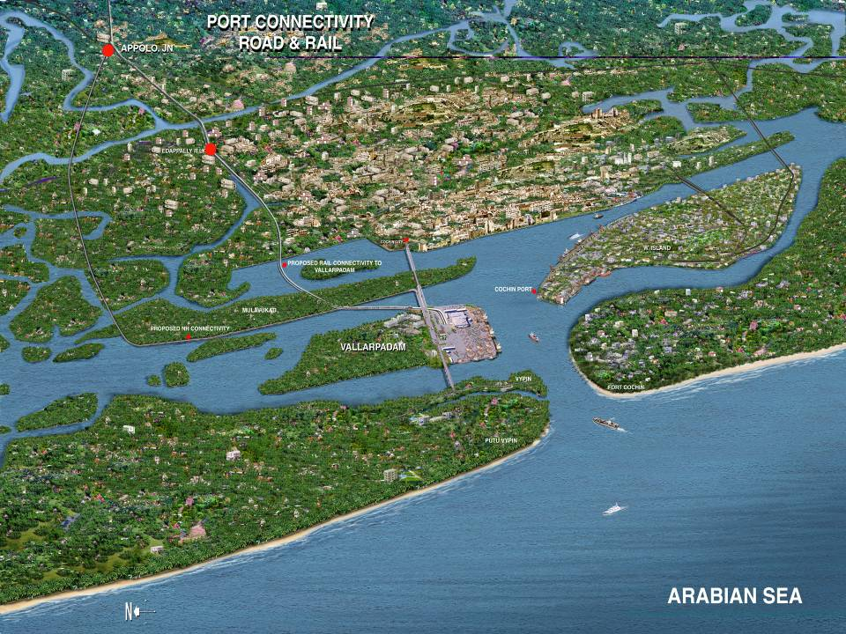
ICTT CONNECTIVITIES
NH 47
Rail connectivity
NH 17
NH connectivity
ICTT VALLARPADAM

Slide 4
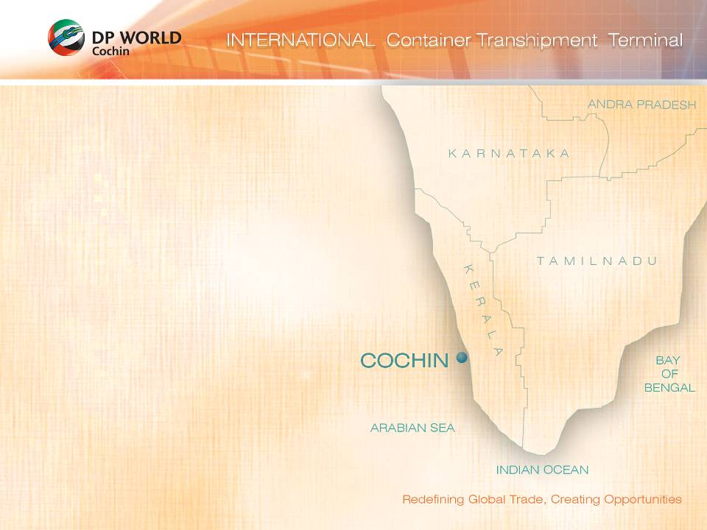
Hinterland - From DP World Cochin
Bangalore
Market | Size (TEU)
Bangalore | 220000
Tirupur | 66000
Coimbatore | 48000
Karur | 28800
Alleppey | 24000
Kollam | 24000
Udumalaipettai | 13000
Aroor | 8000
Salem | 11200
Pollachi | 8000
Namakkal | 5800
Salem
Erode
Namakkal
Tirupur
Coimbatore
Karur
Pollachi
Udumalaipettai
Aroor
Alleppey
Kollam

Slide 5
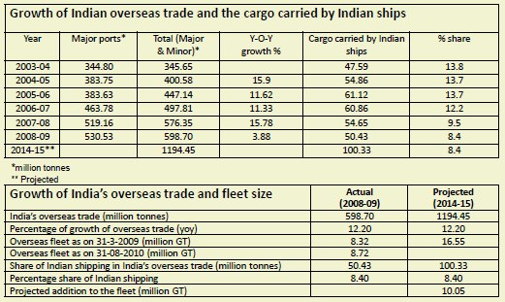
Existing Status of Coastal Shipping

Slide 6
Existing Status of Coastal Shipping
Overseas cargo has grown at 12%p.a., and coastal cargo at 3.3%p.a. during 2001 to 2010.
  Share of coastal cargo has fallen in total cargo traffic from 31% in 2000-01 to18% in 2009-10 .
Share of EXIM cargo carried by Indian ships has fallen from 13.8% in 2003-04 to 8.4% in 2008-09 despite Indian policy objectives of increasing it.

Slide 7
Coastal Cargo Pattern
Coastal cargo pattern being handled at the Indian ports is undergoing a change.
  share of bulk cargo (liquid, dry and break) commodities such as POL, Coal, Iron and Cement has come down from 94% in 2005-06 to 87% in 2009-10.
  Share of “Others” has seen an increase from 6% to 13%.

Slide 8
Cabotage
Cabotage policy is important
  Is practiced by USA, China, Indonesia, Greece
But stacking the cards against domestic shipping, and hoping that cabotage alone will turn the tide in its favour, has not worked: it has not increased Indian share in tonnage or cargo carried.
If past record is a guide for future policy formulation, then the policy of pushing cabotage alone to increase the role of coastal shipping seems to have been grossly overrated:
  Despite consistently practising cabotage, the Indian-flagged share in tonnage and in cargo has not risen noticeably despite increases in absolute figures.

Slide 9
Cabotage in Containerised Cargo
World fleet has reached 15 million TEUs in March 2011, but there are only 16 Indian-flagged vessels with a combined capacity of 22,000 TEUs
Levels of containerization in India are low compared to the international levels.
    8% for coastal trade and 18% in the EXIM trade
Almost all of Indian container cargo for transshipment is getting diverted to Colombo, Singapore and Jebel Ali since the feedering of the cargo is covered by the current cabotage policy
So “a nuanced approach towards transshipment cargo would require opening it up foreign flag so as to boost containerization and the requisite infrastructure and practices”.

Slide 10
Limited Feedering Capacity in India
Mainline vessels 4,000 – 6,500 TEUs
Insufficient feedering at Cochin, as India has a total capacity of 12,156 TEUs
  Even all of this is not available at Cochin
Leads to long detention of boxes at Cochin
Feedering by train means only 90 boxes at a time
Whereas Colombo has no such limitation

Slide 11
Position of Transhipment in ICTT
At present, transshipped cargo is only 6% of throughput, but massive detention.
In full flow, transshipment would be 80%
No of Transshipment Boxes in ICTT as on 23-8-11
Time of Dwell in ICTT | Boxes for Tuticorin
6 | 185
17 | 173
33 | 33
34 | 11
Total | 402
No of Transshipment Boxes in ICTT as on 29-7-11
Time of Dwell in ICTT | Boxes for Tuticorin
8 | 249
9 | 151
10 | 3
29 | 19
30 | 181
Total | 603
No of Transhipment Boxes on 27-9-11 is Nil

Slide 12
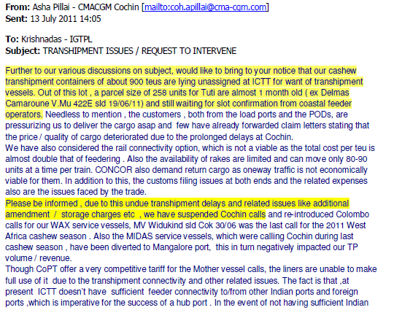
CMA CGM Pulls Out from ICTT
Insufficient feedering at ICTT caused CMA CGM to pull out

Slide 13
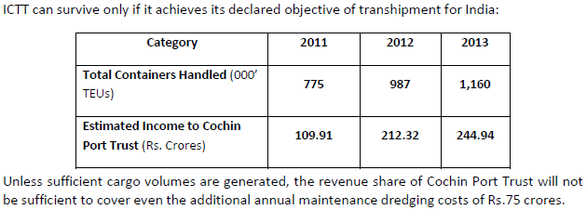
Cabotage is Crucial to ICTT

Slide 14
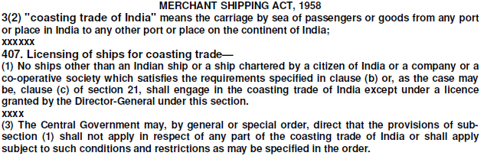
Cabotage Law
Transhipment containers from foreign ports for ports in India cannot be treated as coasting cargo under cabotage law.
  Transshipped Containers undergo customs examination only at the Indian port of origin /destination.
A container from Hamburg for Kandla may be transshipped at Vallarpadam or at Colombo at option of shipping line
  Entire journey of the container from Hamburg to Kandla is one international movement, as the customs examination of the container will take place only at the destination, ie Kandla.
Moreover, ICTT is located within a Special Economic Zone (SEZ), a deemed foreign territory.

