Slide 1
Trans-Boundary Inland Navigation: Indo-Bangla Trade Facilitation
BCCI Seminar on Importance of Waterways for Economic Development
Presented by
Syed Monowar Hussain
Kolkata, June 07, 2012

Slide 2
Related Issues
Presentation Outline
Current state of inland navigation in BD
Current state of PIWTT
Current state of Cooperation
Consequences of non-cooperation
What is to be done
Concluding remarks

Slide 3
Introductory Remarks
Bangladesh being a riverine country, waterways are available as a natural gift, providing a means of transport to millions at nominal cost.
Following liberation war, in early 1970s, IWT as a major mode, kept the economy going and carried 37% goods in 1975.
Situation, however, started changing fast, and road transport now dominates the transport scene. Road transport carried 80% of goods and 88% of Passengers in 2005 compared to 16% and 8% by IWT.
This trend not sustainable, as BD is a land scarce country, particularly if food self sufficiency is to be achieved.
Thus revival of IWT essential.

Slide 4
IWT operation in the sub-region started 175 years ago in 1834. This had been continuing even after the partition in 1947. Indo-Pak war in 1965 halted the operation

Slide 5
Inland Waterways of Bangladesh
Length of waterways : 24,000km
Navigable during monsoon : 6,000km
Navigable perennially : 3,800km

Slide 6
Waterways Route Classification
Route classification | LAD (lest available depth) | Length
Class-I | 3.96m | 683km
Class-II | 2.43m | 1027km
Class-III | 1.83m | 1885km
Class-IV | Less than 1.52m | 2400km
Total |  | 5995km

Slide 7
Installations
Inland river ports : 21
Developed landing stations : 380
Pontoon : 475
Dredgers : 10
Pilot station : 26
D.G.P.S Station : 05
Field Offices : 10

Slide 8
Institutions
Public
Bangladesh Inland Water Transport Authority.
Department of Shipping.
Bangladesh Inland Water Transport Corporation.
Private
Bangladesh Cargo Vessels Owner’s Association.
Bangladesh Coastal Ship Owner’s Association.
Bangladesh Oil Tanker Owner’s Association
Bangladesh Inland Waterways (Passenger carries) Association.
Bangladesh Launch Owner’s Association.

Slide 9
PROTOCOL ON INLAND WATER TRANSIT AND TRADE BETWEEN BANGLADESH AND INDIA
first signed in 1972.
Purpose: To make mutually beneficial arrangements for the use of their waterways for commerce between the two countries and for passage of goods between two places in one country through the territory of other.

Slide 10
Main features of the Protocol
Cross-border trade
Transit trade
Maintenance of the routes for smooth navigation
Transshipment at Ashuganj and at Sherpur

Slide 11
Routes under the Protocol
1.Kolkata-Haldia-Raimangal-Mongla-Khulna-Kawkhali-Barisal-Chandpur-Narayanganj-Aricha-Sirajganj-Chilmari-Dhubri-Pandu-Silghat
2. Reverse of the above
3.Kolkata-Haldia-Raimangal-Mongla-Khulna-kawkhali-Barisal-Chandpur-Bhairabbazar-Ashuganj-Sherpur-Zakiganj-Karimganj.
4. Reverse of the above
5. Rajshahi-Godagari-Dhulian
6. Reverse of the above
7.Karimganj-Sherpur-Ashuganj-Narayanganj-Aricha-Sirajganj-Chilmari-Dhubri-Pandu-Silghat.
8. Reverse of the above

Slide 12
According to Origin-Destination (O-D) freight movement’s main corridors are:
Kolkata-Narayanganj (cross-border trade)
Kolkata-Pandu (transit trade)
Kolkata-Karimganj (transit trade)
Pandu-Karimganj (transit trade)

Slide 13
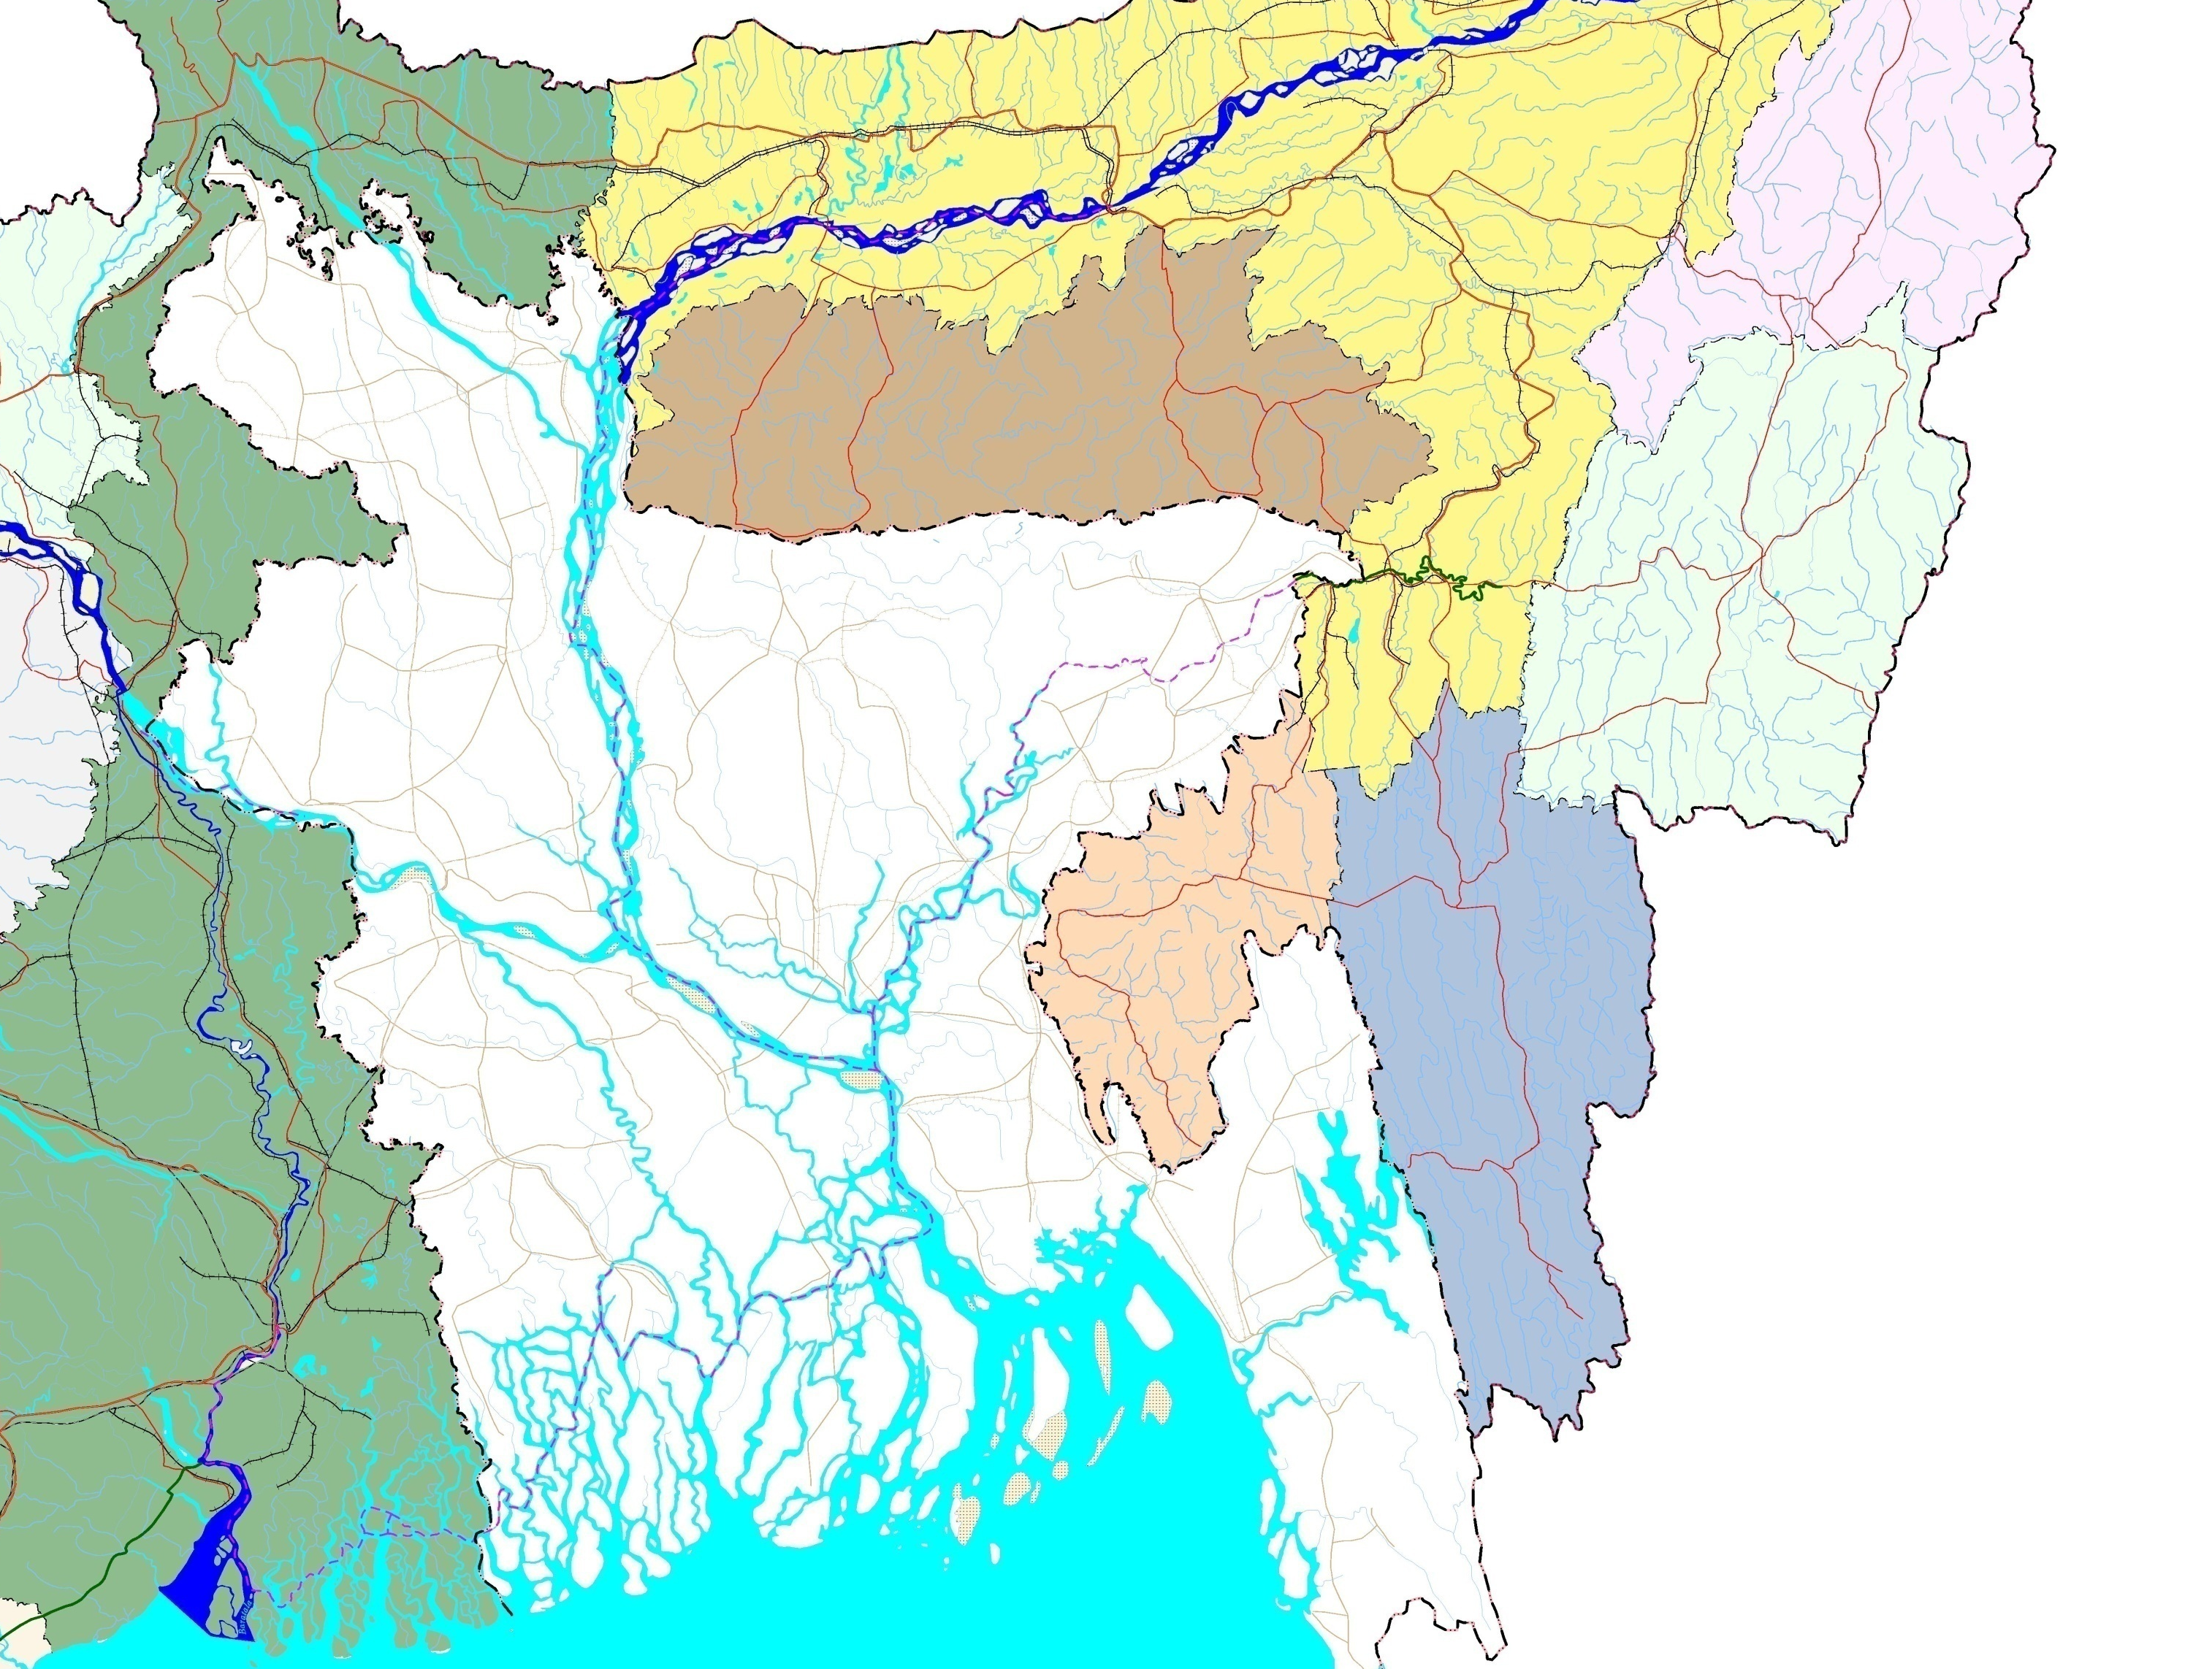
TEJPUR
NAGALAND
SILGHAT
31C
Brahmaputra R.
BANGLADESH-INDIA
PROTOCOL ROUTES
I N D I A
NW-2
A S S A M
JOGIGHOPA
36
31
PANDU
DISPUR
37
DHUBRI
37
DAIKHOWA
40
KOHIMA
SHISHUMARA
SHILLONG
31
51
M E G H A L A Y A
BIHAR
CHILMARI
53
Ganga R.
Barak
MANIPUR
BAHADURABAD
ZAKIGANJ
LAKHIPUR
34
Surma R.
53
IMPHAL
JHARKHAND
Jamuna R.
Kusiyara R.
KARIMGANJ
MARKULI
FENCHUGANJ
FARAKKA
B A N G L A D E S H
SHERPUR
N
DHULIAN
GODAGARI
SIRAJGANJ
AJMIRIGANJ
RAJSHAHI
54
Ganga R.
Baral R.
BHAIRAB BAZAR
ASHUGANJ
44
BAGHABARI
TRIPURA
ARICHA
Meghna R.`
AGARTALA
AIZWAL
Bhagirathi R.
DHAKA
MIZORAM
Legend
NW-1
NARAYANGANJ
Padma R.
Protocol Routes
Ports of Call in Bangladesh
Ports of Call in India
2
CHANDPUR
35
KHULNA
BARISAL
Meghna R.
WEST BENGAL
Protocol route distances
CHALNA
KAUKHALI
KOLKATA
MONGLA
Kolkata - Guwahati/Pandu..….. 1535 km
Kolkata - Karimganj............…....1318 km
Dhulian-Rajshahi...............….........78 km
6
41
HALDIA
Hooghly R.
NAMKHANA
Raimangal R.
Bay of Bengal
Myanmar(Burma)
ORISSA
Sunderbans

Slide 14
Conditions of the Protocol Routes
A vessel with 3.5m draught (capacity 1500 tons) may ply between Raimangal and Narayanganj/Ashuganj
Navigational problems exist in some spots downstream of Namkhana in India as such vessels are to load from Kolkata not more than 700-900 tons.
in Bangladesh Ashuganj-Zakiganj being a seasonal route is being used only during monsoon (April-October)
Due to draught restrictions vessels can not move with more than 1.83m draught (capacity 500-600 tons) in the route between Aricha and Daikhawa (northern border)

Slide 15
Ports of Call
Bangladesh | India
Narayanganj | Kolkata
Khulna | Haldia
Mongla | Pandu
Sirjganj | Karimganj
Ashuganj | Silghat

Slide 16
Traffic Statistics
Year | Cargo of inter-country trade | In-transit cargo | Total
2006-07 | 881,011 | 12,557 | 893,568
2007-08 | 996,245 | 8,230 | 1,004,475
2008-09 | 945,422 | 14,628 | 960,050
2009-10 | 1,278,636 | 4,474 | 1,283,110
2010-11 | 1,429,633 | 7,888 | 1,437,521
2011-12 | 1,482,307 | 2,695 | 1,485,002

Slide 17
Current poor state of knowledge
No data or information regarding the conditions of the river
No data or information regarding traffic flow and future projection
Lack of efficiency of the vessel
Lack of efficiency of the crew
Primitive loading/unloading

Slide 18
Impediments for Development
Modal option
Regulatory framework
Physical facilities

Slide 19
Provision for “Ports of Call” limits the scope and restricts facilitation of trade contrary to the situation prevailing in the road sector
No mandatory provision for night navigation facilities increases transportation time and cost

Slide 20
Current State of IWT Cooperation
Infrastructure gap
No provision for tourism
High waiting time
Container traffic is yet to take place
Customs service is not friendly
Existing provisions do not allow convenient movement
Conditions of fairway restrict utilization of capacity
Transshipment is yet to take place

Slide 21
Consequence of Non-Cooperation
Unhealthy market dependant only on “fly ash”
Assam tea and other goods travel through Chicken neck. But Ashuganj may save 50% of time and cost
High travel time creates lack of confidence
Cooperation area is limited only in carriage of cargo
Less use of rivers more cost to nations

Slide 22
What is to be Done
BD needs to change its perspective on issues of transport connectivity. Problems should be viewed from the opportunities to improve connectivity and widening opportunity
RMG and manpower export earnings provide BD’s largest net FE earning. BD should aim to become major exporter of transport services to India. This would greatly help to reduce large and growing trade gap.
BD should view the issues for the opportunities it provides to enhance and diverse its export capacity to India and structurally transform its economy.
BD should view its territory as a productive asset to connect the NE to mainland India
Economic power house; India, should come forward for assistance for a mutually beneficial arrangement

Slide 23
What is to be Done
BD should use its sector to develop a major export through “trading in service” as it “trades in commodities”. BD should see itself as an exporter of transport services to the region
Due to geographical location, BD could become a transport hub
Opening up access through Chittagong Port could provide incentive to exploit resources in the NE for mutual benefit
Trade in services may include rail, road, IWT and port services

Slide 24
What is to be Done
Improve navigability
Determine new routes (i.e. Dhuian to Dawlatdiya)
Introduce container service
Trade friendly customs procedure
Improvement of infrastructure
Introduction of Transhipment
Extension of cooperation area (i.e. Tourism)
Find out the most efficient economic export chain and establishing connectivity with other modes

Slide 25
Priority investigation area
find out the causes of the deteriorating conditions of the river and determine the ways and means for improving sustainable navigability;
find out the benefit of the socio-economics;
find out the benefit on environment;
find out appropriate technology to improve the efficiency of inland navigation;
find out the possibility of introducing passenger service and tourism under the bilateral Protocol;
find out the requirement for amendment/simplification/waiver of existing regulatory framework;
digital survey and electronic dissemination;
enhancing the efficiency of vessel and the crew;
appropriate mechanization of loading/unloading.

Slide 26
Concluding Remarks
Above suggestions may help to resolve present impasse
Through enhancing export of transport services of BD may substantially increase export earnings and reduce trade gap significantly
Business fortunes of all transport modes and port services would increase exponentially
IWT may become modern and competitive export industry
FDI and development partners can be attracted for development of infrastructures
India will get access to transport services which are cost effective, faster, safer and efficient

Slide 27
Thank you
hussain.syedmonowar@gmail.com

