Slide 1
ASSAM INLAND WATER TRANSPORT
BHARAT BHUSHAN DEV CHOUDHURY
DIRECTOR, INLAND WATER TRANSPORT,ASSAM

Slide 2
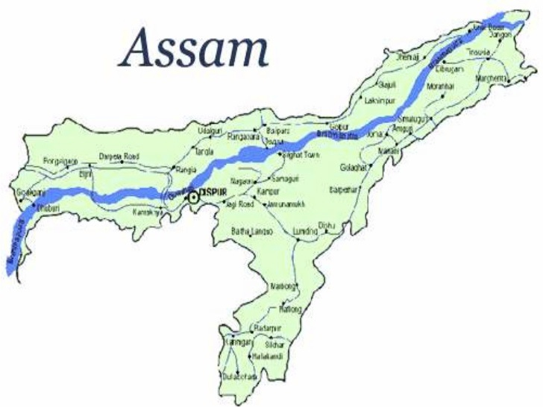
The State has the largest network of navigable waterways of any of India’s states.

Slide 3
The Brahmaputra
Flows through the heart of Assam

Slide 4
Brahmaputra - vital transport mode, despite challenges…
A formidable physical barrier to accessibility and mobility, but an equally important Transport asset

Slide 5
Assam IWT Sector character today…
Cross-river and Island ferry services - Single most important transport mode for large section of population, both urban and rural
Operations – DIWT Assam and by mostly small independent and informal country boat operators
Over 3,000 vessels
Ferry terminals are mostly improvised moorings
Demand (Brahmaputra and Barak):
  about 7.5 mn passengers annually,
  > 650,000 motorized vehicles, nearly a million bicycles and carts
  About 40,000 tonnes of goods and livestock

Slide 6
Assam IWT Sector character today…the challenges
Weak landing facilities / terminals, often relocating with river
Ageing and less efficient vessel fleet
Safety of operations
Absence of Night Navigation facilities
Inadequate service to remote villages and islands
Poor first / last mile access to services
Gender unfriendly
Underutilized resources

Slide 7
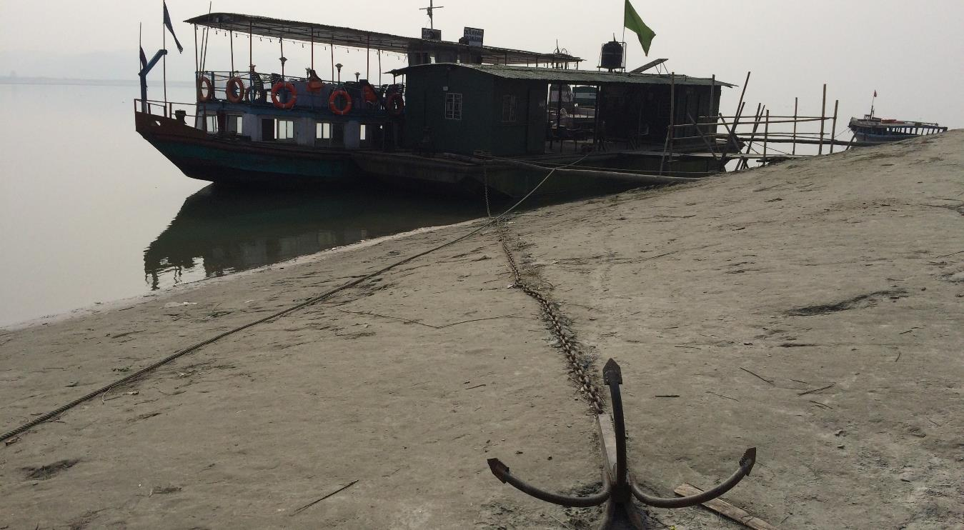
Typical terminal / Pier in Assam

Slide 8
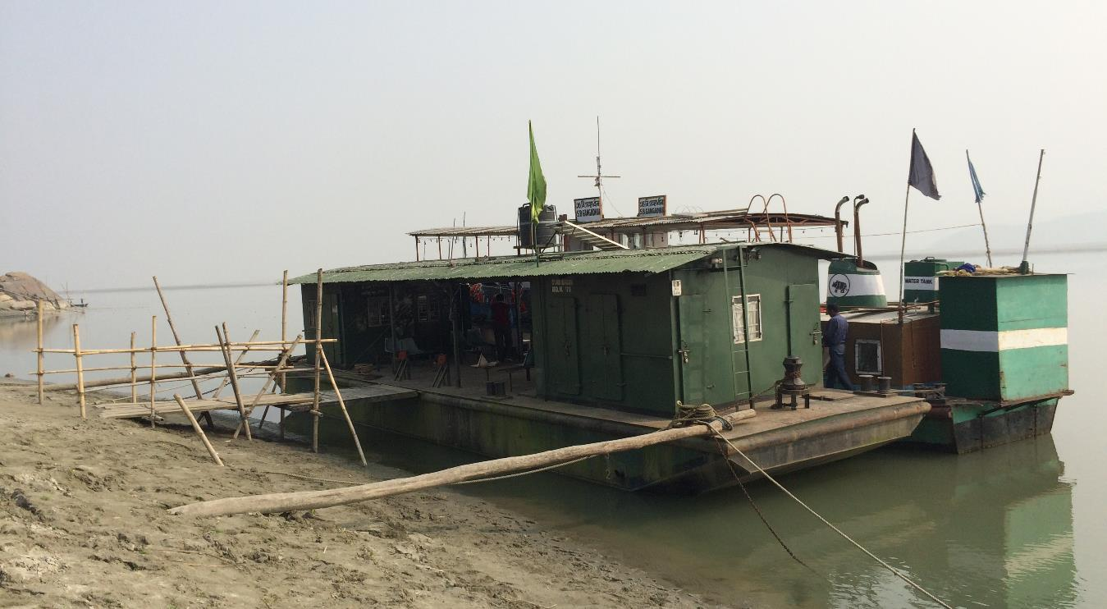

Slide 9
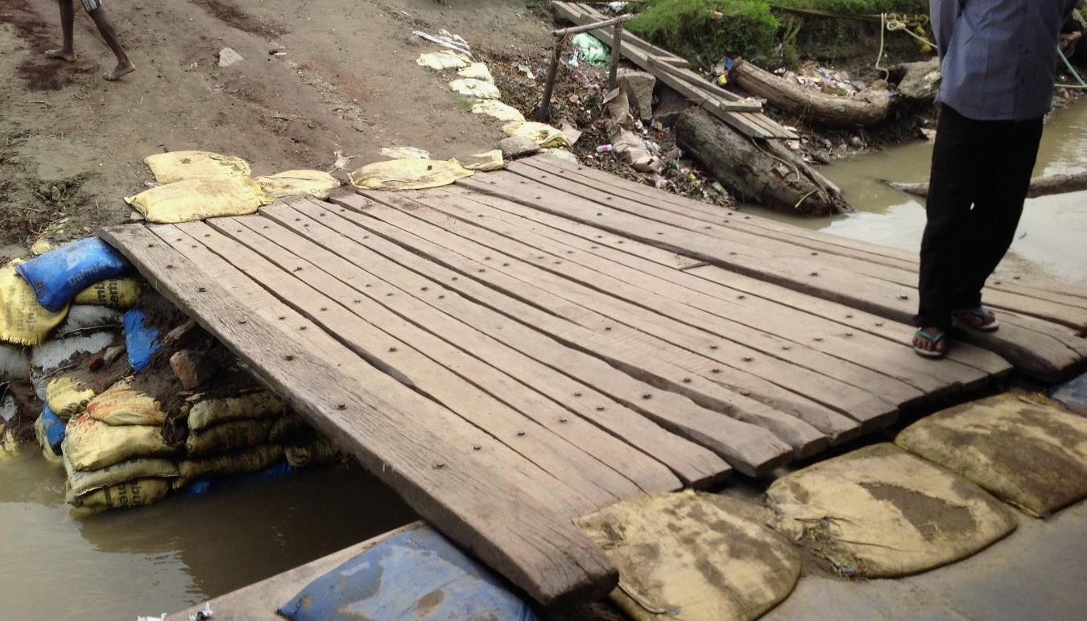

Slide 10
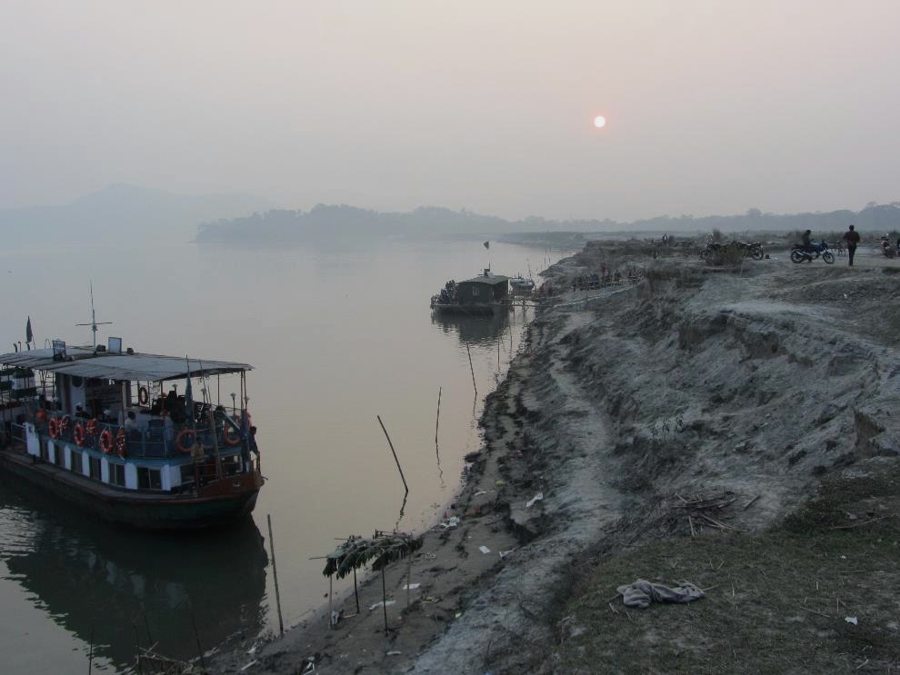

Slide 11
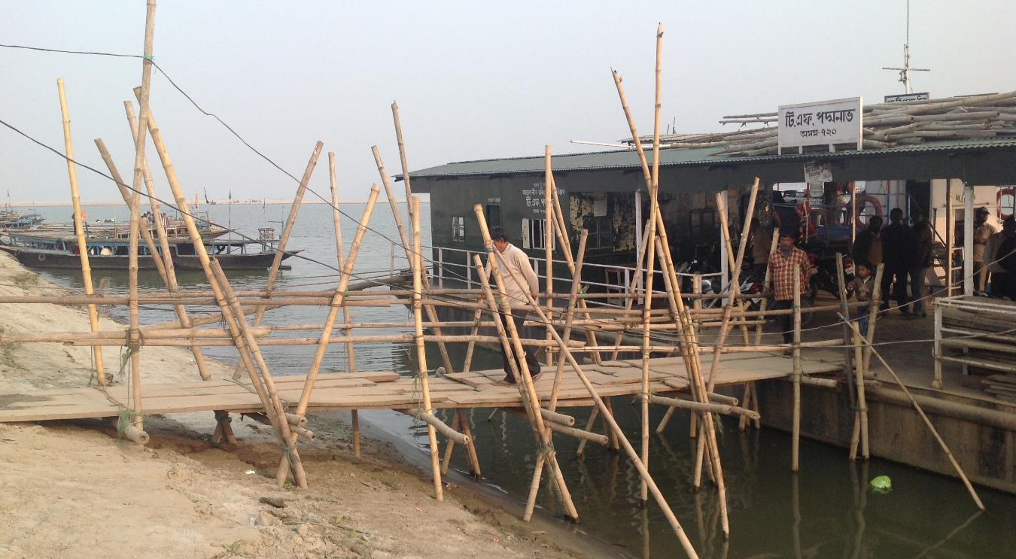

Slide 12
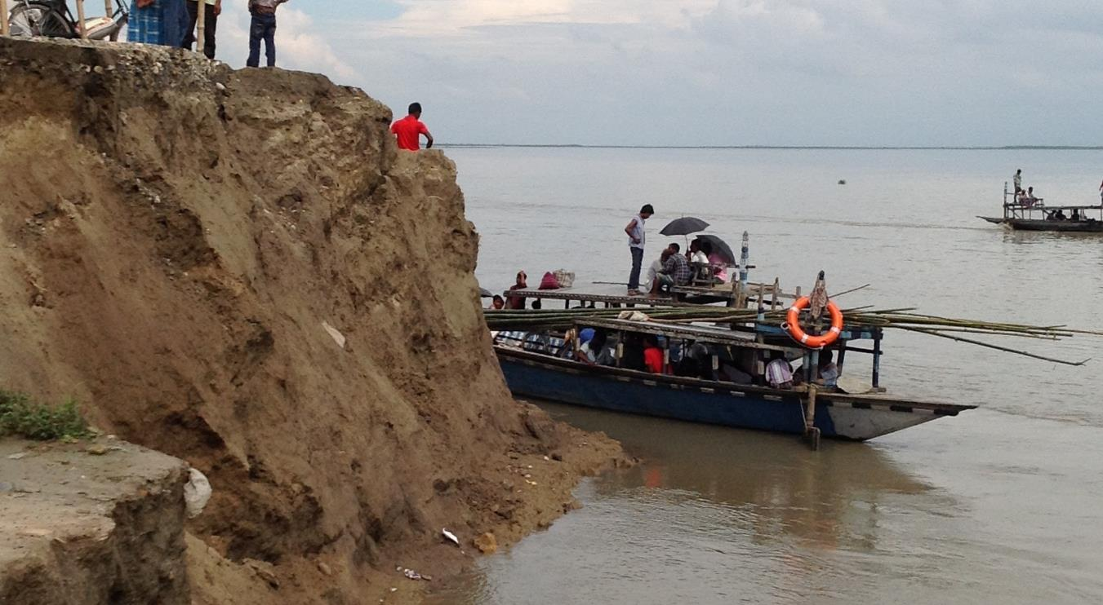

Slide 13
Need to bring about transformational Change ‘a river that economically unites rather than divides Assam.’

Slide 14
The Opportunity
To integrate high quality ferry services into the wider transport system within Assam

Slide 15
IWT…renewed national focus
Long history of using waterways for transport in India
Limited investment in maintaining or modernizing IWT routes
India’s Nationally Determined Contribution (INDC) towards climate change mitigation and adaptation goals committed in COP 21, Paris – observes important role of IWT
Regional integration especially with Bangladesh
Need to develop on the inherent strength and modernize the sector

Slide 16
Main stake holders
Users
IWT officers and staff
Boat operators

Slide 17
Assam IWT project
AIWT Project will work on:
Improve the accessibility across the Brahmaputra and other major rivers and to its islands with ferry System
Improve the institutional framework and strengthen the capacity of the state institutions, which administer, regulate and provide Inland Water Transport.
  Long term Strategy and Sectoral Master Plan
  Training and professional development of IWT Staff
  Quality, Efficiency and Safety of Ferry Operations
  Improved ferries
  Improved access / connectivity infrastructure
  Integration with City Development, Tourism plan
  Institutional framework

Slide 18
Assam IWT project
Component-1:
Developing Long Term Strategic Plan for IWT and feasibility studies for sector planning and investment.
Capacity Development- Strengthening the capacity of those associated with AIWT.

Slide 19
Assam IWT project
Component-2:
Investment to improve terminals, last mile connectivity, ferries, night navigation.
Encourage to invest in modern, greener and safer ferries.

Slide 20
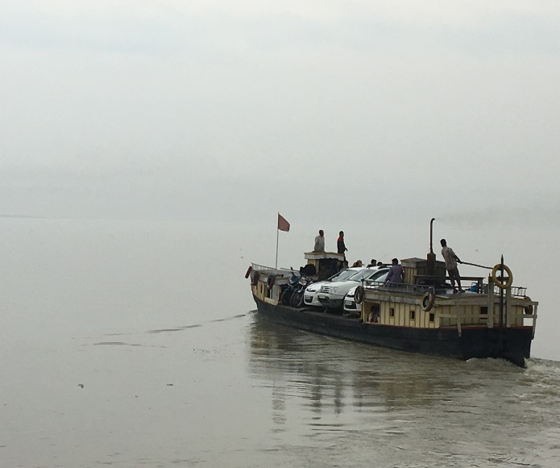
Thank You

