Slide 1
Mankad & Associates
Insurance Broking Pvt. Ltd.
Direct & Reinsurance Broker
License No. 115
Presentation on P&I Insurance
at
Bengal Chamber of Commerce & Industry, Kolkata

Slide 2
Introduction
Parent Company, P&I Services Pvt. Ltd.
Mankad & Associates, firm, established in 1989.
We were then mainly dealing in Re-insurance and Marine insurance allowed to place abroad.
Converted into a Corporate Entity, to carry out direct and re-insurance broking of Life & Non-Life.
Introduced Film Insurance Policy through United India Insurance Company Ltd. In 1995.
Introduced comprehensive port package policy for Gujarat Pipavav Port Trust, by re-insuring United India Insurance Company.
Awarded License by IRDA in February, 2003.
Experienced people from the Insurance Industry for guidance and assistance. in underwriting and claims administration

Slide 3
Origin of Marine Insurance
The history of Marine Insurance is intrinsically linked with maritime history generally & in particular with the development & expansion of international trade.
Historical records suggest that Phoenician traders used a form of marine insurance more than a thousand years before the Christian Era.
As insurance became widely available, ship owners & merchants were prepared to further expand & develop their overseas ventures & trades.

Slide 4
Origin of P&I Insurance
During the growth of trade & shipping, Hull Insurance developed earlier as owners realized the importance of protecting their assets.
Development of Liability Insurance was later & it happened with the experience of owners when they found they did not have insurance for claims from third parties.
The passing of certain Acts which enabled the next of kin of a seaman / passenger to pursue action against the owner.
Cargo claims through court rulings.

Slide 5
Origin of P&I Insurance
This led to formation of Protection & Indemnity Associations.
The Cover : During the course of operating ships, a shipowner can incur liabilities towards all manner of third parties. P&I Insurance provides this Third Party Liability Cover.
P&I Cover : As trade expanded, liabilities increased. New liabilities came up through Acts, court rulings or experience.
The P&I Insurance kept on evolving to meet the increased exposure and demand from shipowners.

Slide 6
LANDMARK DEVELOPMENTS
1680 : Lloyds Coffee House an active place for merchants, shipowners to arrange suitable Insurance Policies.
1719 : Act of Parliament in UK giving Royal Exchange Assurance, London Assurance & individual underwriters at Lloyds, a Marine Insurance monopoly, Mutual Hull Clubs start forming.
1824 : Above Act repealed. Hull Clubs decline.
1836 : De Vaux v Salvador decision. Established that liability damage to the other ship in a collision was not covered under standard marine policy. Hull Underwriters agreed to cover 3/4th RDC.
1846 : Lord Campbell’s Act gave dependants the right to sue for damages resulting from death caused by negligence.
1847 : The Harbour, Docks & Piers Clauses Act gave harbour authorities powers to recover for damage done to port works by ships, whether negligence be shown or not.
1854 : Merchant Shipping Act provided shipowners with financial limits of liability both for property damage & for loss of life and personal injury claims.

Slide 7
1874 : The first Indemnity Association formed – the Steamship Owners’ Mutual Protection and Indemnity Association by Mr. J. Stanley Mitcalfe.
1876 : The owners of the vessel “Emily” had to pay for cargo lost in a stranding due to negligence, on a finding that negligence was not a peril of the sea.
1894 : Merchant Shipping Act – with successive Acts in 1898 and 1906 – made shipowners responsible for the maintenance and repatriation of seamen discharged sick or injured abroad. Until then they had usually been abandoned at the responsibility of the nearest British consul, if he ever heard of their plight.
1897 : The first Workmen’s Compensation act provided for payment by employers to men engaged in dangerous occupations who were injured in any manner whilst at work.
1906 : The Workmen’s Compensation Act of 1897 was extended to all workers, including seamen and stevedores.
1922 : Brussels Convention on Bills of Lading. Many governments accepted the Hague Rules which had been drawn up by a conference of shipowners, underwriters and merchants. These Rules were a major attempt to apportion liability & responsibility for cargo losses & damage as between the carrier and the cargo owner.

Slide 8
1924 : UK Carriage of Goods by Sea Act incorporated the Hague Rules into UK legislation.
1925 : Crew Liabilities were again increased by the Merchant Shipping (International Labour Convention) Act which gave seamen up to two months wages during unemployment after a shipwreck.
1967 : “Torrey Canyon” ran aground near south coast of England, 120,000 tonnes of oil was spilt. Clean up costs exceeded $16 million. First major pollution incident to come to public attention.
1969 : International Conference on Civil Liability for Oil Pollution Damage (CLC) – provided uniform rules for compensating victims of oil pollution.
1971 : Conference on the establishment of an International Compensation Fund for Oil Pollution Damage (Fund) – provided compensation to supplement CLC.
1973 : International Conference on Oil Pollution (MARPOL) – covering tanker design, equipment & operation.

Slide 9
1979 : “Betelgeuse” exploded whilst discharging oil in Bantry Bay, Ireland. There was extensive damage to the terminal and berth, heavy oil pollution and 50 people died. Claims exceeded $120 million. International Group Agreement (IGA) formally constituted.
1989 : “Exxon Valdez” ran aground off coast of Alaska spilling 37,000 tonnes of oil causing extensive environmental damage. Final claims levels around $10 billion.
1990 : US Oil Pollution Act (OPA ‘90) introduced in the wake of “Exxon Valdez” incident.
1992 ; “Aegean Sea” broke in two off la Coruna, Spain. Extensive pollution. Claims approaching $200 million.

Slide 10
LIABILITIES
Some Liabilities are applicable by Common Law or in Tort, others by specific Acts or Contracts.
General Third Party, Property Damage, Injury are main examples of Common Law Liability arising from the operations of the Assured.
Damage to cargo carried attracts the provisions of Acts & International Conventions such as COGSA, Merchant Shipping Act, Hague Visby Rules.
Cargo damage / loss claims are also pursued under the carriage document i.e. Bill of Lading.
Crew claims are normally governed by contract under collective Bargaining Agreements or under specified conditions of local authorities.
Collision Liability coverage of 1/4th follows the market practice since traditionally Hull Underwriters were offering cover upto 3/4th Liability.

Slide 11
MUTUAL P&I ASSOCIATIONS
Shipowners were already used to the concept of mutuality through Hull Mutuals.
The same concept was adopted in setting up Mutuals to provide cover for Third Party Liability Risks.
The owners came together to contribute pre-agreed amount & adjust the same towards losses and expenses.
If the total outgo was more than the initial contribution, the Association could call the insured Members to make an additional contribution.
Thus the concept of Premium as Advance Call & Deferred or Supplementary Call was born.
P&I Associations have the leeway to make additional calls to balance the books.

Slide 12
MUTUAL P&I ASSOCIATIONS
In 1979, most of the P&I Associations came together to form the International Group.
As per the IG Agreement, the P&I Associations work closely on common matters involving shipping, liability to their insured members & providing coverage.
They do not compete with each other on price.
The IGA is approved by the EU under the anti-competition rules.
Currently there are 13 IG Mutual P&I Associations & collectively they insure more than 90% of the world tonnage.
Pool the risk amongst themselves & by common reinsurer which enables them to buy high limits.

Slide 13
MUTUAL P&I ASSOCIATIONS
As a Mutual, these P&I Associations were set up by the owners to cover the third party claims of each other. Therefore, they operate on a “No Profit No Loss” principle.
Any surplus after claims and expenses is transferred to reserves for future benefit of assureds claims.
As a Mutual, the Certificate of Entry does not have a Sum Insured for a Limit of Liability. It will follow the legal limitation available to the owner under various Acts / Conventions.
The exception to the above point is for claims arising from oil pollution which is capped at US$ 1 Billion and compensation claims for passenger limited to US$ 2 Billion. Further, the combined compensation claim limit in respect of passengers & crew is limited to US$ 3 Billion.

Slide 14
IG REINSURANCE ARRANGEMENT
US$ 2.7 BILLION | With various International Reinsurers
US$ 50 MILLION | Reinsured with the Captive Insure Hydra
US$ 20 MILLION | Pooled between all the IG P&I Associations
US$ 10 MILLION | Individual Club retention

Slide 15
FIXED PREMIUM P&I
The concept of additional calls in the future created an uncertainty about future costs.
The small shipowner operating barges or on a limited trade found this uncertainty very volatile for their type of operation.
Thus started the concept of fixed premium insurers who would charge a fixed cost for the vessel depending upon the limit of insurance taken.
These insurers typically focus on short trades and small vessels generally going upto 10,000 GRT.
Unlike Mutuals, they do not work on the Principle of “No Profit No Loss” and therefore may make a profit.
Avoid exposure to trade to USA.

Slide 16
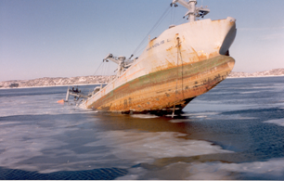
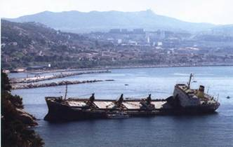
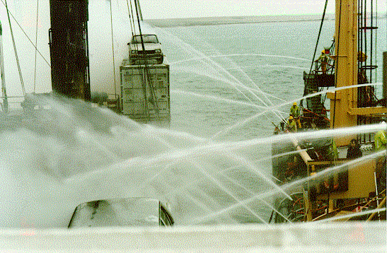
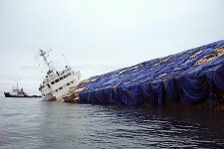
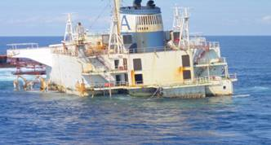
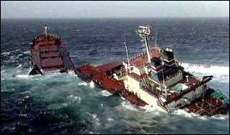
P&I - Classes
Class 1 P&I
Class 2 Freight, Demurrage and Defence (FD&D)

Slide 17
COASTAL P&I – MUTUAL OR FIXED
MUTUAL
Established P&I Insurer for long time.
Unparalleled acceptance.
Highest Limit offered.
Worldwide network of Correspondents.
Uncertainty of cost – not fixed.
Costly for small vessels.
Whether such high Limits required.

Slide 18
COASTAL P&I – MUTUAL OR FIXED
FIXED
Offering similar coverage.
Focus on small vessels.
Avoiding USA exposure.
Gaining rapid acceptance.
Fixed cost thereby offering stability.
Option of choosing Limit as required upto US$ 1 Billion.
Offering similar claims assistance / service as Mutual.

Slide 19
Cover in Present Form
Third Party Liabilities
  Cargo
  Damage to third party property such as port property
  Injury to third parties such as stevedores
  Pollution
  1/4th Collision Liability
  Stowaways
  Liability to Authorities – Customs
  Wreck Removal
Personal Injury to Seaman

Slide 20
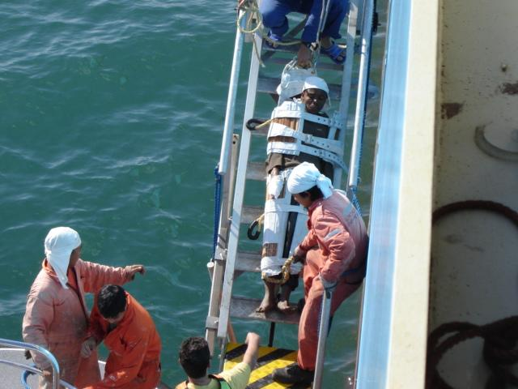
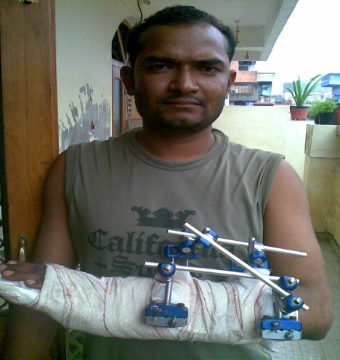
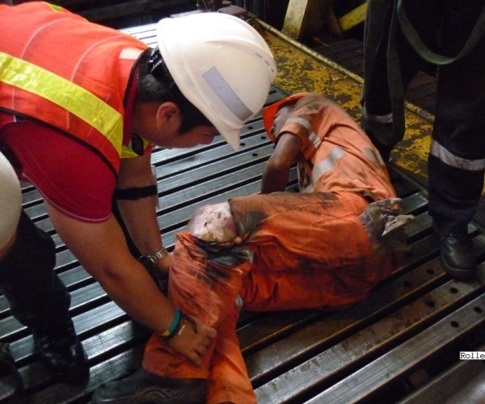
CREW & PERSONAL INJURY
Personal injury, loss of life and illness
Most costly cover in terms of claims paid
Liability under contract & negligence

Slide 21
Cover in Present Form
SEAMEN
Compensation for personal injury, illness or death.
Hospitalisation Expenses arising from injury and illness.
Compensation as per crew agreement which has to be approved by the underwriter.
Repatriation and substitution expenses.
Statutory Liability under Maritime Labour Convention.
Wages of the seaman during hospitalisation.

Slide 22
Cover in Present Form
EXPENSES
Expenses incurred by the owner in discharging his obligations towards making necessary arrangements for stowaways, refugees or persons saved at sea.
Diversion expenses i.e. additional expenses incurred to divert a vessel for search & rescue of persons at sea or for arranging necessary treatment of sick and injured persons aboard the insured vessel.

Slide 23
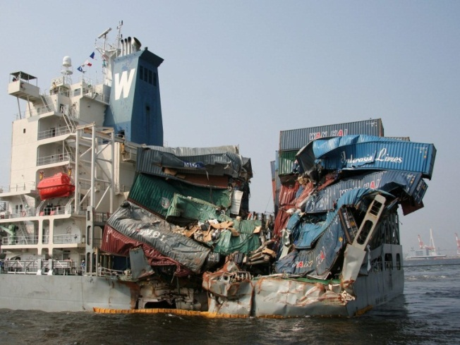
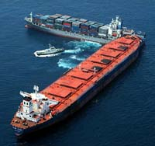
COLLISION
Traditional H&M cover for 3/4 RDC
P&I cover1/4 RDC
Many clubs offer 4/4 RDC

Slide 24
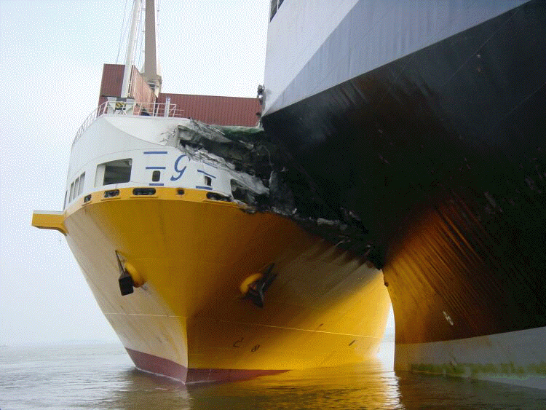
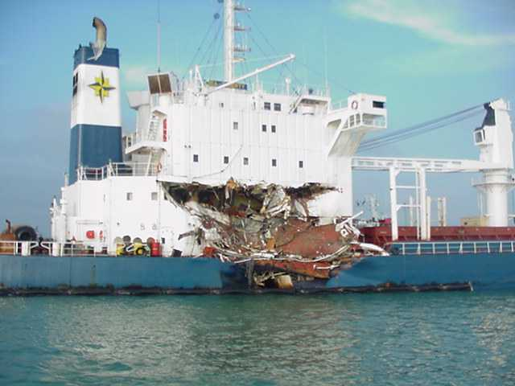
COLLISION
Risks covered 100% by P&I
  Wreck removal
  Personal injury
  Pollution
  Collision inquiries
  Excess collision liability

Slide 25
Cover in Present Form
COLLISION WITH OTHER VESSELS
Liability to pay damages arising out of collision between the insured vessel and any other vessel to the extent not covered under the Hull Policy.
Normally Hull Policies cover upto 3/4th Collision Liability and P&I Underwriters the balance 1/4th. However, it is possible to change this.
Underwriters will pay full 4/4th Liability following a collision for removal of wreck, cargoes, loss of life, injury or illness, pollution.
That part of the liability which exceeds the sum recoverable under the Hull Policies of the insured vessels solely by reason of the fact that liability exceeds the valuation in those policies subject to the condition that the Association will determine the correct value of the vessel and if it was insured at such value.

Slide 26
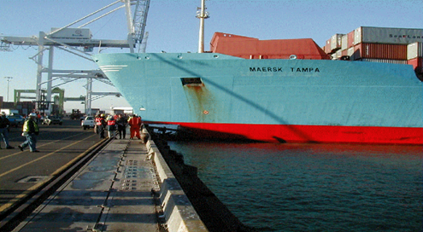
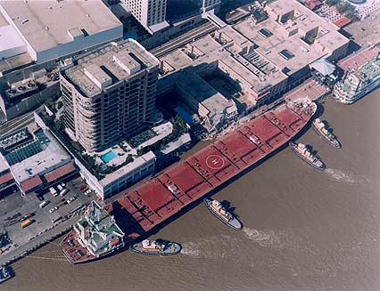
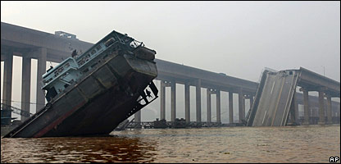
Fixed and Floating Objects – “FFO”
Repair costs
Specialist surveyors
Loss of use

Slide 27
TOWAGE
Liability under a contract for the towage of the insured vessel for entering a leaving port or maneuvering within the port .
Liability under a contract for the towage of insured vessel other than above is not covered unless agreed in writing by the underwriter.
Liability arising from the towage of another vessel by the insured vessel / other floating structure is covered if :
  For the purpose of saving or attempting to save life or property at sea or
  If such contract has been approved by the underwriters.

Slide 28
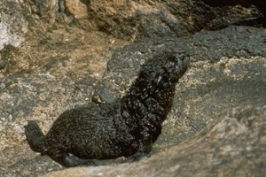
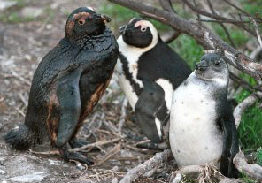
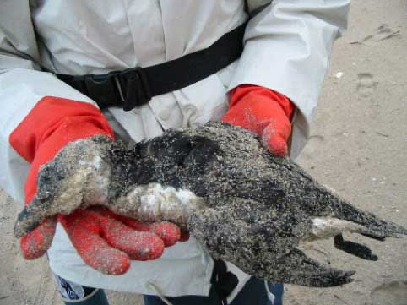
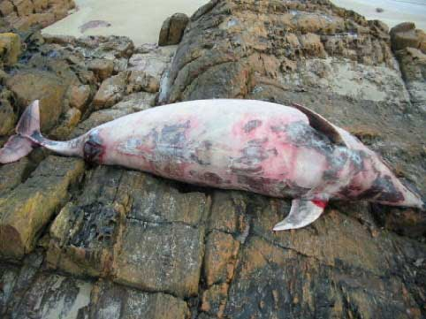
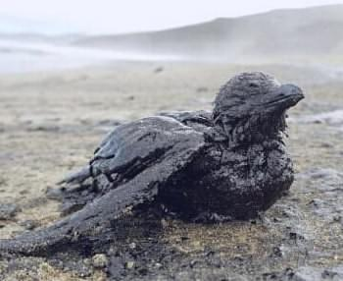
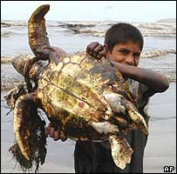
POLLUTION
Measures to prevent or minimise pollution
Costs of clean up
Compensation claims (civil losses)
Environmental damages
Restoration
Fines
Enquiries

Slide 29
POLLUTION
Liability, loss, damage, costs & expenses as below to the extent arising out of or incurred as a result of discharge or escape from the insured vessel of oil or any hazardous substance or the threat of the same.
Liability for loss, damage, contamination, costs & expenses.
Any loss, damage or expense arising under any agreement in respect of pollution approved by the Association.
Costs of any measures reasonably taken to avoid or minimise pollution.
Costs & liabilities incurred in compliance of any Government / Authority’s order / direction to prevent or reduce pollution provided such costs are not recoverable under Hull Policies.

Slide 30
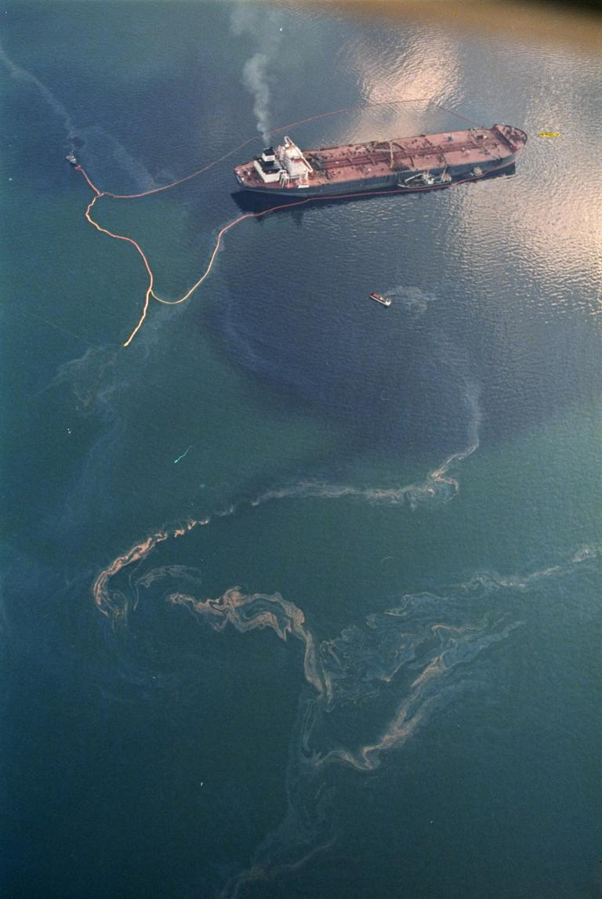
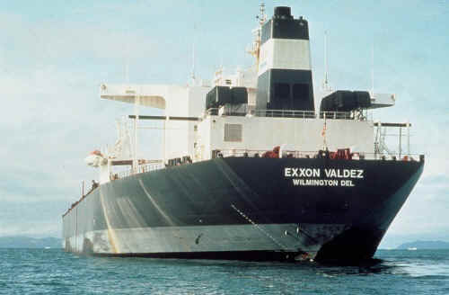
EXXON VALDEZ - OIL SPILL

Slide 31
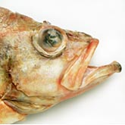
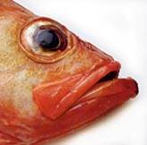
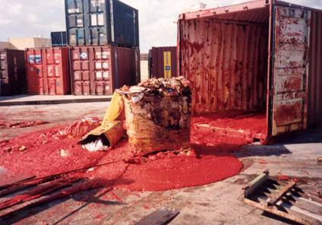
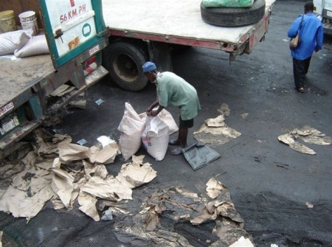
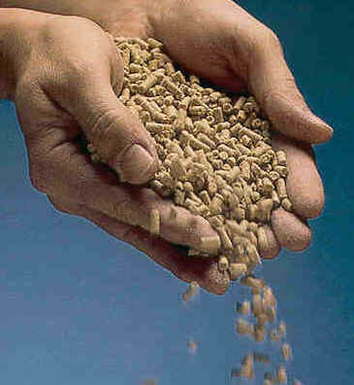
Cargo Cover
Loss, shortage, damage through a breach of contract of carriage
Additional costs of disposing of damaged & uncollected cargo

Slide 32
CARGO COVER
Shipowner becomes the bailey of the cargo.
Assumes responsibility to deliver the cargo in the same condition as received for carriage.
Liability under contracts such as bill of lading and charter party.
Liability under Law such as COGSA & Hague Visby Rules which are normally incorporated under the bill of lading.
Liability for loss or damage arising out of any breach.
Hague Visby Rules provide for limitation in respect of liability.
No cover without any bill of lading incorporating Hague Visby Rules unless underwriters have agreed for the same.
Trade in barges for lighterage operations may not involve bill of lading.

Slide 33
CARGO COVER - EXCLUSIONS
The issue of a bill of lading which contains any fraudulent misrepresentation.
Ante-dated or post dated bill of lading.
Delivery of cargo carried under a negotiable bill of lading without production of bill of lading.
Discharge of cargo at a port or place other than in accordance with the contract.
Any deliberate breach of the contract of carriage.

Slide 34
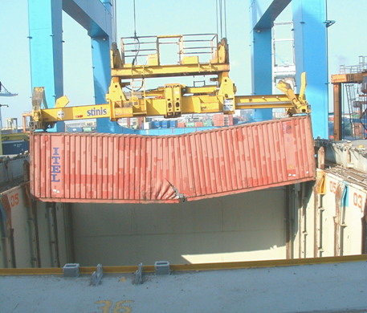
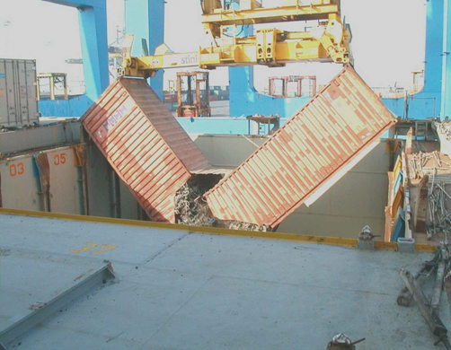
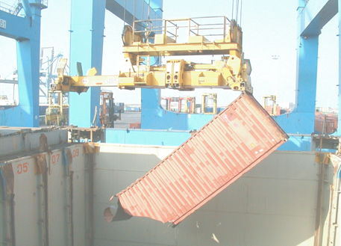
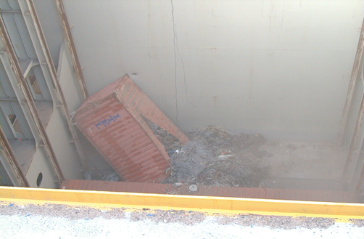

Slide 35
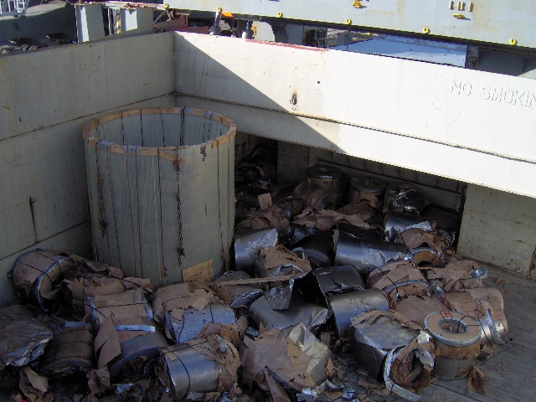
Collapse of Stow – Whose fault?
– Whose liability?

Slide 36
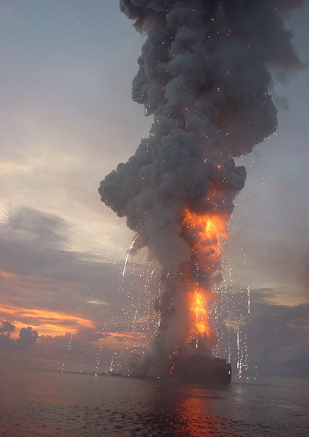
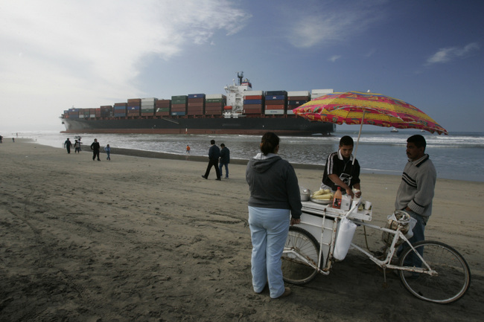
Unrecovered General Average
G.A. expenses
Contributions owed by cargo owners which are not recoverable due to breech of contract of carriage

Slide 37
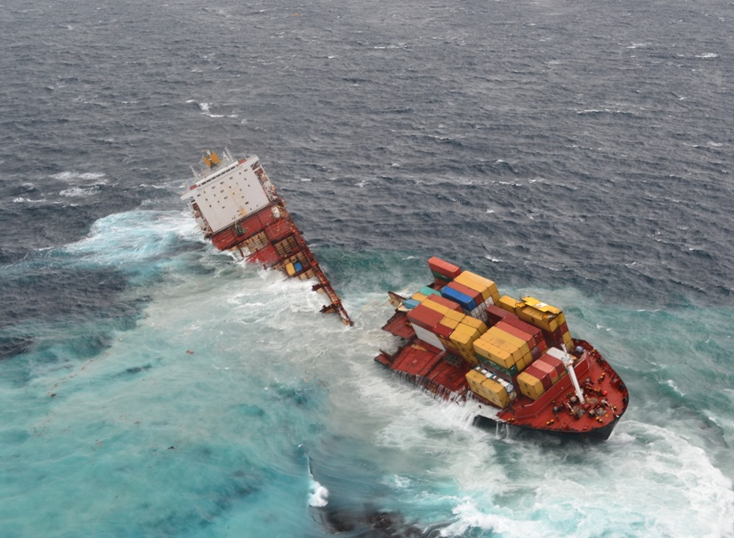
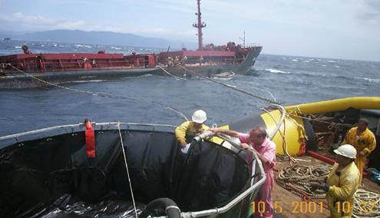
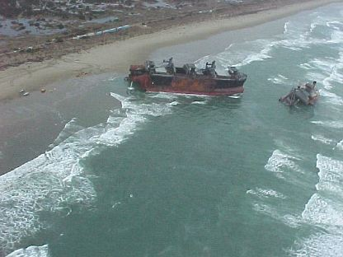
Wreck Liabilities and Removal
Raising and removal
Destruction
Lighting or marking
Must be compulsory
Environmental dangers

Slide 38
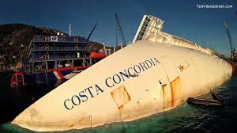
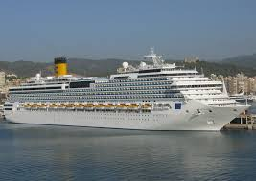
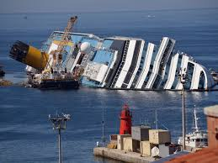
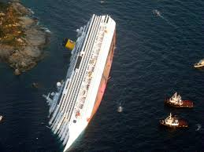
COSTA CONCORDIA

Slide 39
WRECK REMOVAL
Costa Concordia has been one of the costliest wreck removal cases with total cost exceeding US$ 1 Billion.
Liability has to be compulsory through Acts / Convention.
The Nairobi International Convention On The Removal Of Wrecks came into force in 2015.
India is a signatory to the Convention.
Applies to all vessels 300 gross tonnes & above.

Slide 40
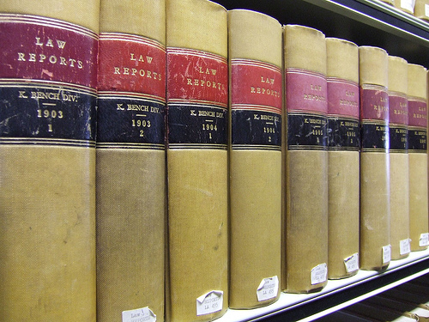
Class 2 – FD&D – legal assistance and costs
FD&D – Freight Demurrage and Defence
Commercial and contractual disputes
Provision of legal advice
Legal costs

Slide 41
Class 2 – FD&D – legal assistance and costs
Disputes covered
  Charterparty claims – hire, freight, demurrage
  Mortgage and insurance disputes
  Sale and purchase disputes
  Defective repair work
  Defence of claims
Appointment of lawyers
Prospects of success and enforcement

Slide 42
THANK YOU
Website : www.mankadinsure.com

