Slide 1
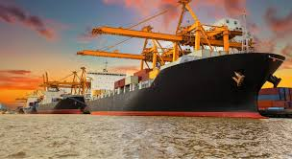
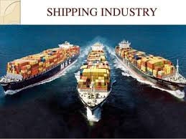
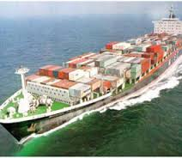
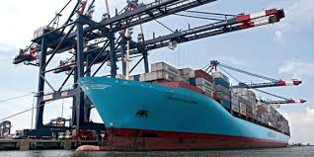
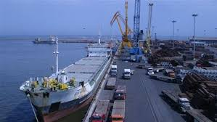
MARITIME & SHIPPING FINANCING JKKB BRIEF PRESENTATION – 11.11.2016

Slide 2
LIST OF CONTENTS
PORTS IN INDIA
NOTABLE TRENDS IN THE PORTS SECTOR
NATIONAL MARITIME AGENDA 2010-20
TYPES OF Ship financing
RISKS IN SHIP FINANCING
CONCLUSION
PRIVATE EQUITY INTEREST IN SHIPPING

Slide 3
PORTS IN INDIA

Slide 4
PORTS IN INDIA
There are two basic categories of ports in India
Major | Non – Major (Minor)
There are 12 major ports in the country; 6 on the Eastern coast and 6 on the Western Coast. | India has about 187 non major ports of which one-third are operational.
Major ports are under the jurisdiction of the Government of India and are governed by the Major Port Trusts Act, 1963 except Ennore port which is administered under the Companies Act, 1956. | Non-major ports come under the jurisdiction of the respective state Governments’ Maritime Boards (GMB).

Slide 5
NOTABLE TRENDS IN THE PORTS SECTOR
Increasing private participation
By March’15 around 99 Public Private Partnership (PPP) Projects are operational with a total cost of around USD 8813.80 million and capacity of 683.29 Million tonnes per annum.
Setting up of port based SEZ’s
SEZ’s are being developed in close proximity to several ports, thereby providing strategic advantage to industries within these zones.
Development of SEZs in Mundra, Krishnapatnam, Rewas and few others is underway.
In FY 15 total cargo handled at Indian ports increased by 8.20 per cent to 1052.50 Million tonnes from 972.40 million tonnes during FY14.
Focus on draft depth
All the greenfield ports are being developed at shores with natural deep drafts and the existing ports are investing on improving their draft depth.
Higher draft depth is required to accommodate large sized vessels. Due to the cost and time advantage associated with large sized vessels, much of the traffic is shifting to large vessels from smaller ones, especially in coal transportation.

Slide 6
NOTABLE TRENDS IN THE PORTS SECTOR
Specialist terminal based ports
Terminalisation: Focus on terminals that deal with a particular type of cargo
‘Landlord port’ model
To promote private investments, the government has reformed the organisational model of seaports-
Rising traffic at non major ports
Cargo traffic handled by the minor ports are outpacing cargo traffic at major ports.
This is useful for handling specific cargo such as LNG that requires specific equipment and hence high capital costs. Forming specialist terminals result in optimal use of resources and increased efficiencies.
Eg: ICTT in Cochin, LNG terminal in Dahej port.
From : A “service port” model where the port authority offers all the services.
To: A “landlord port” model where the port authority acts a regulator and landlord while port opertions are carried out by private Companies.
Traffic at non major ports has expanded at a CAGR of 31.50 per cent during FY 07-15.

Slide 7
TYPES OF SHIP FINANCING
Commercial loan
Bonds
Lease
Mezzanine Financing

Slide 8
TYPES OF SHIP FINANCING
Commercial Loan
Particulars | Details
Term | 2 to 15 years. Loans for certain types of vessels extended for more than 15 years.
Loan to value ratio | varies between 40% to 80%.

Slide 9
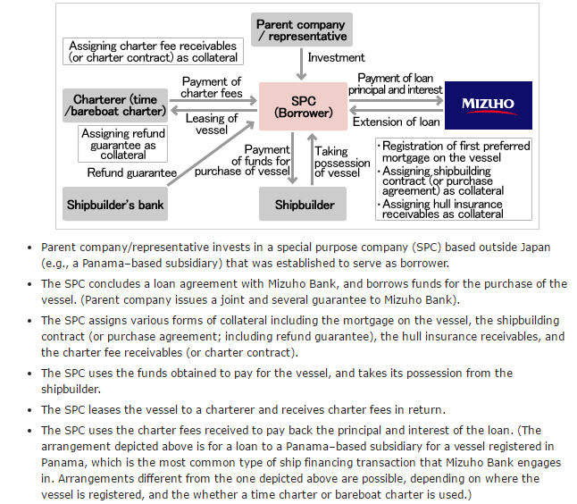
TYPES OF SHIP FINANCING
Commercial Loan : A typical financing structure of Mizuho Bank of Japan

Slide 10
TYPES OF SHIP FINANCING
Leases
Bareboat Charter
Arrangement for chartering a ship
Charterer obtains possession and full control of the Vessel
Charterer assumes legal and financial responsibility
Charter pays for all the expenses including insurance
Tax lease
In certain jurisdictions governments encourage investment by providing tax incentives such as accelerated depreciation or tax credits
The schemes allow tax payers with large profits to obtain tax relief
Benefit to owner as more likely to secure a cheaper cost of funding
Operating Lease
Right to use the assets is passed to a user or “lessee”
Risks remain with the lessor and maintenance is carried out by the lessor
At the end of the lease period the asset reverts to the lessor
Financial Lease
Risk and rewards of ownership rests with the Charterer while owner is simply the risk financier
Charter hire will “repay” the lessor’s cost of acquiring the assets plus interest
All operating responsibilities fall on the lessee

Slide 11
TYPES OF SHIP FINANCING
Types of bonds
Corporate Bonds
Convertible Bonds
High Yield Bonds (HYB)
Bonds
Features
Bonds are securitised loans with a long-term investment horizon
They have a redemption claim and a fixed interest rate (coupon), but are generally unsecured
Unlike shareholders, holders of bonds are creditors and have no influence on operational decisions.
By repaying the bonds at the maturity date, the company does not need to maintain running capital service and can, in this way, improve its liquidity
In spite of the above advantages, many companies resist this mode of loan financing because they are not prepared to allow themselves to be rated by a rating agency in the run up to a bond financing, nor are they prepared to bear the high costs for rating and placement.

Slide 12
TYPES OF SHIP FINANCING
Bonds
Factor | Effect
1. Fleet Age | Affects Asset Value
 | New Vessels are more expensive
 | HYB issued by companies having older fleet are seen to have wider spread
2. Tonnage | Larger tonnage is seen as weakening demand interest and deteriorating industry conditions
 | Larger this factor higher the spreads

Slide 13
TYPES OF SHIP FINANCING
Mezzanine Financing
Forms of Investments
Debt (with equity kicker)
Convertible Bonds
Investment Situations
Mid sized Shipping companies looking for additional capital to fund growth through acquisition.
Undervalued ship assets which can be used as a base to build an integrated asset-owning operating company.
Limited use. In US markets, this method of financing is used to acquire second hand ships.
Often availed as a split of the facility amount for senior debt. A portion of the senior debt is priced at a higher coupon and placed as sub-debt.

Slide 14
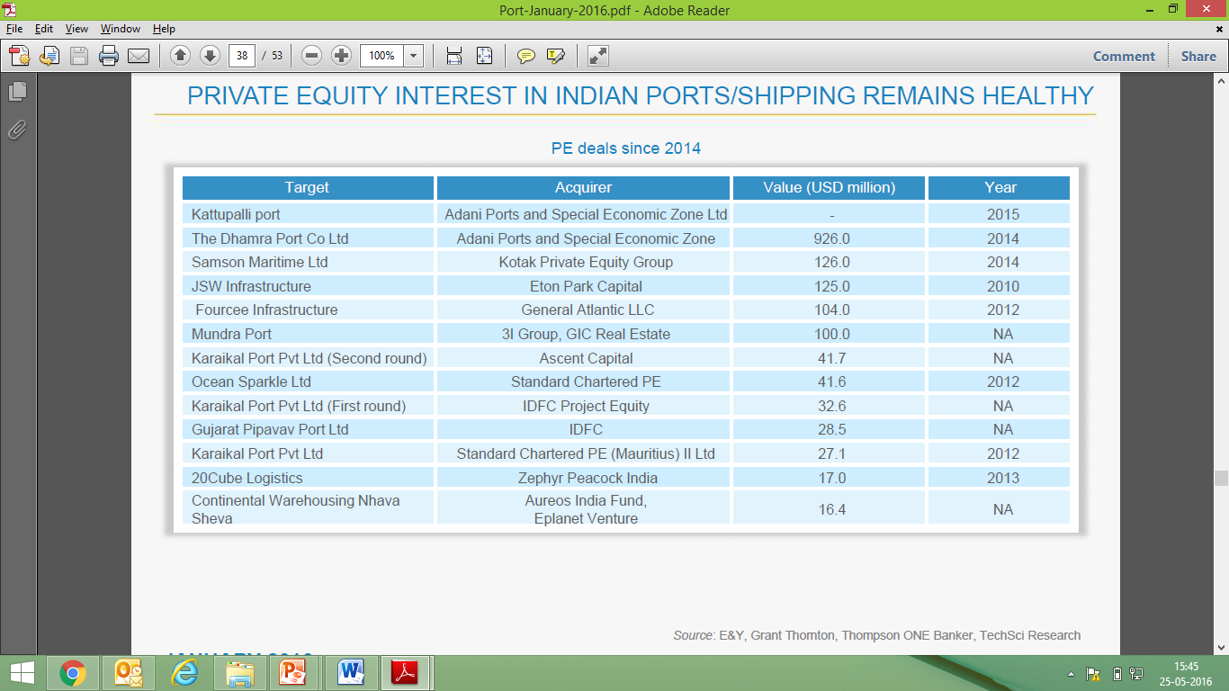
PRIVATE EQUITY INTEREST IN SHIPPING

Slide 15
RISKS IN SHIP FINANCING
Economical
Uncertain elements that exist in economy influence the profit perspective of shipping enterprise
Eg. Political, cultural, financial, taxation, foreign exchange risks and government policies
Technological
Technical advantage of the financed vessel
Legal
Risks brought forth by the difference in law of different countries and regions
If the shipyard chosen is capable in experience and technique of building such a vessel
if the ship-owner is experienced in operating such a vessel

Slide 16
NATIONAL MARITIME AGENDA 2010-2020

Slide 17
NATIONAL MARITIME AGENDA 2010-2020

Slide 18
CONCLUSION
Sustainable maritime development for protection of interests of stakeholders
Streamlining the regulatory framework
1. Overregulation leads to delay in port-development activities
2. Regulation in areas such as licensing, environment and conservation, safety, quality of service, dispute resolution, CFS, development etc may require re-evaluating and simplification
Development of Modern Infrastructure
1. Indian ports need to upgrade their infrastructure to meet future traffic requirements.
2. Identified projects must be executed in a time-bound manner
Multimodalism
1. In India, multimodalism is still at a nascent stage as the country has been slow in adopting containerization.
2. With increase in requirement for freight transport, the necessary impetus for growth of multi modal transport (railways, roadways, inland waterways)
Human Resource Development
1. High quality of training is essential for maritime personnel.
2. Recruitment and promotion rules should be standardized.
3. Training institutions should be encouraged to collaborate with reputed counterparts abroad for skill set development.

Slide 19
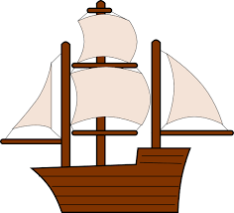
Thank You
Thank You!!!

