Slide 1
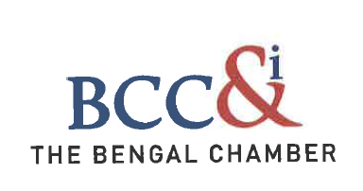
Maritime Infrastructure
Structuring/ Designing Ideal Financial Models for Prospective Entrepreneurs
November 2016
For private circulation only

Slide 2
  I. SREI BRIEF OVERVIEW
  II. MARITIME EQUIPMENT FINANCING
  III. PORT INFRASTRUCTURE FINANCING

Slide 3
Did you know?
1
st
Promoted India's 1st equipment banking Company – Quippo.
  Quippo – One of the largest infrastructure equipment rental company in the Country.
  Srei Equipment Finance– India’s largest construction and mining equipment financier with over ~30% market share.
1st company to lay the ground for passive telecom infrastructure in India.
  Quippo Telecom – The first company to enter into shared Passive telecom infrastructure in India. Quippo Telecom partnered with the Tata Teleservices and Viom has become one of the world’s largest independent telecom infrastructure companies.
1st to break new ground in rural IT infrastructure in India, under the National E-Governance Plan of the Government of India.
  Sahaj – India’s largest integrated rural network of over 40,768 Common Services Centres (CSC), covering 400 mn people (44% of India’s rural population).
Power Distribution Sector
  Power – Distribution Network with T&D losses of only 2.24 % against country average of 25%.
1st PPP in Water Distribution Sector
  Swach - Awarded the prestigious Nangloi PPP contract by Delhi Jal Board, in partnership with JV partner Veolia Water for water treatment and distribution.
SREI has several Innovations and Pioneering Initiatives to its Credit

Slide 4
COMPANY OVERVIEW
BUSINESS STRUCTURE
FOCUSED INFRASTRUCTURE SOLUTION PROVIDER
INFRASTRUCTURE EQUIPMENT GROUP
INFRASTRUCTURE PROJECT GROUP
EQUIPMENT FINANCING
ASSET MANAGEMENT :
DEBT
EQUITY
MEZZANINE
CONSTRUCTION EQUIPMENT RENTALS
PROJECT FINANCE,
PE / VENTURE FUND, PROJECT EQUITY
STRUCTURED FINANCE
EQUIPMENT VALUATION & AUCTIONS
ADVISORY
PROJECT ADVISORY
CAPITAL MARKETS - INVESTMENT
BANKING ADVISORY
STRONG EXPERTISE ACROSS SECTORS - TRANSPORTATION, POWER, TELECOM, RURAL INFRASTRUCTURE,, SEZ / INDUSTRIAL PARKS, PORTS
END TO END INFRASTRUCTURE SOLUTIONS
LEVERAGING OUR DEEP DOMAIN KNOWLEDGE ACROSS SECTORS AND STRONG RELATIONSHIPS IN THE INFRASTRUCTURE SPACE

Slide 5
EQUIPMENT GROUP
THE SREI ECO-SYSTEM
Sustainable Competitive Advantage
ASSET LIFECYCLE
ASSET PURCHASE
ASSET DEPLOYMENT
ASSET MANAGEMENT
ASSET EXIT / RESALE
STANDALONE NBFC / FINANCER
SREI - END TO END SOLUTION PROVIDER ACROSS THE VALUE CHAIN
LEVERAGING THE SREI ECO-SYSTEM TO DELIVER……
Assisting in right equipment purchase.
Customized financial solutions –
  Loans & Advances
  Operating Lease
  Equipment on Rentals
Equipment Banking
Captive Contracts
Leveraging relationships to improve deployment of assets during downtime.
Asset Maintenance - 32 captive stockyards for face lifting of assets. Thus improving residual value of assets.
Equipment Refurbishment
Valuation & Inspection
Valuation & Auctioning services – Asset disposal services
Advising on asset disposal & resale options.
SOLUTION PROVIDER
SREI Equipment Finance
QUIPPO CE
SREI Equipment Finance
SREI INFRA
QUIPPO CE
QUIPPO CE
QUIPPO AUCTION
I-QUIPPO
MANAGING CUSTOMER RELATIONSHIPS THROUGH THE ENTIRE ASSET LIFECYCLE

Slide 6
SREI INFRASTRUCTURE FINANCE LTD
KEY PRODUCT SEGMENTS
Srei Infrastructure Finance Ltd
FOCUSED INFRASTRUCTURE SOLUTIONS PROVIDER
DEEP DOMAIN KNOWLEDGE AND STRONG RELATIONSHIPS ACROSS THE ENTIRE INFRASTRUCTURE SPACE
PREFERRED PARTNER FOR MANAGING THE ENTIRE INFRASTRUCTURE PROJECT LIFECYCLE
DEBT
MEZZANINE
EQUITY
ADVISORY
Customized project
financing solutions -
Project Finance
Term Loan
Syndicate Loan
Lease Financing
Sale & Lease Back
Non-fund credit facilities
  Structured credit solutions that mitigate risk and provide flexibility for meeting unique needs of the customers –
  Structured Debt
  Subordinated Debt
  Bridge Financing
  Strategic equity solutions for key infrastructure projects–
  Transportation
  Telecom Infrastructure
  Power
  Rural IT Infrastructure
  SEZ & Industrial Parks
  Environment (Water & Waste Management)
Project development & management solutions –
Advised more than 75 projects costing over
Rs.75,000 crs.
Investment banking
advisory –
Mergers & Acquisitions
Private Equity
DCM, ECM & Corporate Advisory

Slide 7
  I. SREI BRIEF OVERVIEW
  II. MARITIME EQUIPMENT FINANCING
  III. PORT INFRASTRUCTURE FINANCING

Slide 8
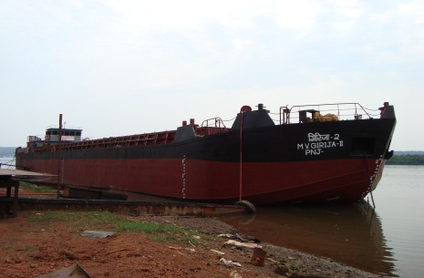
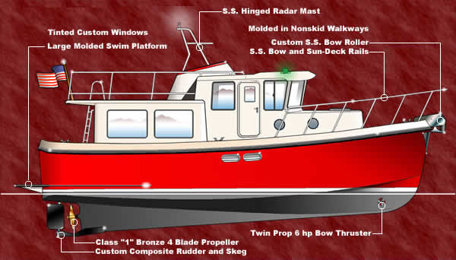
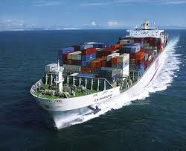
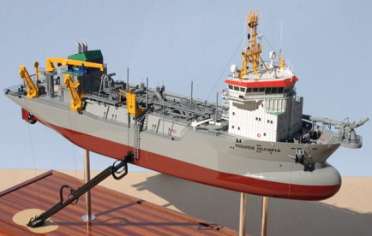
Typical Vessels Financed by Srei Equipment Finance
Barges
Tug Boats
Mini Bulk Carriers & Cargo Ships
Dredgers
Overview
Srei has done Selective funding in this segment
Shipping being a cyclical industry is heavily influenced by global economic headwinds and tough resale markets
Srei financed a few dredgers utilized for Capital/ Maintenance dredging for ports/ inland waterways to port service providers
Equipment values tend to be high however assets are financeable if accompanied by high value/ longer term contracts
Srei financed both Self Propelled & Dumb Barges
Barges (300 to 2500 DWT) are largely used for Shallow water operations and are ideal for Inland waterway transportation
At Rs. 3 crs. to Rs.10 crs. this is the ideal bite size for smaller logistics operators and company supply chains
Anchor Handling Tug Vessels (AHTSVs) both for Port Services and Oil & Gas Exploration services are financed by Srei
50 to 100 crs for 60 to 80 tonner vessels
Typically funded only against long term contracts for standard vessel specifications
Notes:
The equipment segment focussed on the Oil & gas industry has not done well e.g. Companies like Shiv Vani Oil & Gas. On the shipping side there are case of companies like Varun Shipping that have failed and companies such as GE Shipping and global offshore which are nor performing well. However companies such as Great Eastern Shipping, Ocean Sparkle which are doing well.

Slide 9
Major Issues with Maritime Equipment Financing
Capital Intensity & Contract Tenor Mismatch
Average minimum cost per unit for some of the high value equipment: Floating Dry-dock - Rs. 50 crore, Harbour Crane - Rs. 18 crore, Barge - Rs. 5 crore
Typical contracts for vessels are much lower than asset life. Most marine equipment have 10-25 years asset life (material Handling equipment 10-15 years) and Vessels (20-25 years)
This results in significant mismatch between contract tenors and economic asset life
Sectors Covered
Statutory Regulations
Too many Statutory Regulations - IRS, SMB, MMD, Class Certificate, Half Yearly Survey Report, are some of mandatory compliances
Difficult for Leasing companies to comply with multiplicity of shipping regulations
Lack of Structured Resale Market
In case of repossession by a lenders, the Indian resale market for such equipment is very shallow
Significant costs are attached to redeploying the assets in other economies, refurbishing assets and keeping of repossessed vessels
Shipyard and prevailing demand-supply situation in the shipping market has a significant impact on resale values
Currency Risks
Majority of the Ships being deployed in India are constructed by foreign shipyard in dollar contracts (viz Chinese, Korean, etc.)
Dollar Denominated Contracts upto payback period ensure cost benefit can be passed on to the end user
Notes:
Full forms: Indian Register for Shipping (IRS), State Maritime Board (SMB) Merchant Marine Department (MMD)
Certificate of Registration of Barge
Registration with MMD: Registration of Ship& MBC, is required from MMD.
Criteria :The vehicle is a sea going and intended to operate frequently between different country or within the Country.
Hypothecation :If the barges are mortgaged with banks or financial institution, the Hypothecation clause for the same needs to be endorsed in the Registration Certificate of Barge.
Registration with state Maritime Board :Registration of Barge, Dredger & Tugs is required from respective State Maritime Board.
Criteria :The vehicle are intended to use within the state,
Provisional Certificate: At First Provisional Registration Certificate is obtained and thereafter the same needs to be converted after 4-5 month for Final Registration Certificate.
Hypothecation: If the barges are mortgaged with banks or financial institution, the Hypothecation clause for the same needs to be endorsed in the Registration Certificate of Barge
If the Barges ,ship or vessel has foreign Registration, they can be also registered in any Indian Ports and with any Indian state maritime Board or with MMD after obtaining Certificate of Survey from the respective State maritime Board, MMD. (if it is a sea going vessel, internationally accepted class certificated must be available.)
Certificate of Survey
Certificate of Survey is also known as fitness certificate.
Non IRS Class + Registered with SMB: Survey From Respective SMB where it is operated
IRS Class + Registered with SMB: Survey From Respective SMB where it is operated+IRS
Registered with MMD: Survey From MMD+IRS
Certificate of survey is issued after proper technical inspection of the barge by the officer of state Maritime Board /MMD/IRS
Certificate of Survey is Valid for 5 month to 1 year depending upon the condition of Barge/Ship. Therefore the same needs to be renewed by conducting Survey by the state maritime Board/MMD /IRS.
Other Internationally accepted ship Classification Society :
a)Bureau Veritas b) German Llyod, c) Lloyd’s Register,d)Registro Italiano Navale,e)American Bureao of Shipping, f)Det Norske Veritas ,g) Korean Register of Shipping h) Nippon kaiji kyokai
Vessels which want to operate beyond the limit of country must have to be registered with Indian Register of Shipping (IRS)
Class Certificate from IRS , Survey Report from IRS/MMD and Certificate of Registration from MMD is mandatory requirement.
Other Certificate like “Cargo Ship Equipment Certificate”& “International Oil Pollution Prevention Certificate” issued by IRS may also be collected for Sea going Ship and Barges.
Class Certificate by IRS and Registration with State maritime Board/other Regulatory
Yes, it is permissible that Barge is Build as per IRS Class but Registered with State Maritime Board, such barges has limitation to Operate within the jurisdiction of State. In Such Case we received Class Certificate from IRS and Certificate of Registration & Survey Certificate from State Maritime Board.
Barge is Registered on one State and operated in other state
This is also possible, suppose barge is purchased from GOA, and registered with Captain of Port Goa, but later on it was intended to use in ports of Gujrat. Survey report to be obtained from GMB for operation of Barge/Ship in Gujarat.
Economic Life of Barge
Economic life of Barge depends upon its maintaince. On and average Barge has an economic life of 20-25 year approx. however it can be improve by periodic overhauling and sand blasting

Slide 10
Possible Solutions
Leasing
Leasing of Assets is a preferred solution provided:
  Standard Assets e.g. commonly in demand specification of assets, Quality Shipyards and sufficient residual economic life
  Tied contracts for the period of the lease term
  Client credibility & overall cash flows to take care of Residual Value risks
Issues with leasing: Potential tax leakage in sale and leaseback transactions and Buy back of vessels post lease needs to be structured appropriately to avoid classification as finance lease
Sectors Covered
Contract Structures
Medium term Dollar Contracts in line with Payback period of the vessels could significantly reduce costs for the industry which would in turn be passed on to the end users
Given that both Port and Oil & Gas industries have significant dollar revenues the same is possible
Consistent Policies (asset specification) and longer term plans are required w.r.t to high value equipment to ensure visibility of market for repossessed equipment
Regulations & Tax
Marine laws need to be in line with International norms. Compliances need to be streamlined
Laws need to be designed keeping in mind Operating Lease structures i.e. difference between lessor and operator in terms of compliances
Tax laws need to be neutral between Lease and Finance of assets
Notes:
A central repository of information on transactions relating to change in vessel ownership, build, shipyard and price and ownership could go a long way in building a market for such vessel and allowing Leasing companies to accurately price such assets. Data could be captured at govt/ industry level

Slide 11
  I. SREI BRIEF OVERVIEW
  II. MARITIME EQUIPMENT FINANCING
  III. PORT INFRASTRUCTURE FINANCING
11

Slide 12
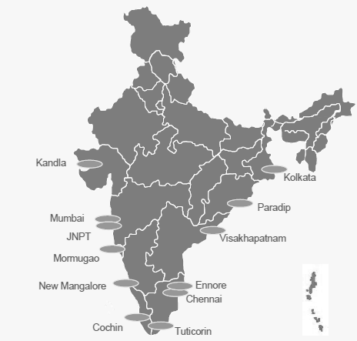
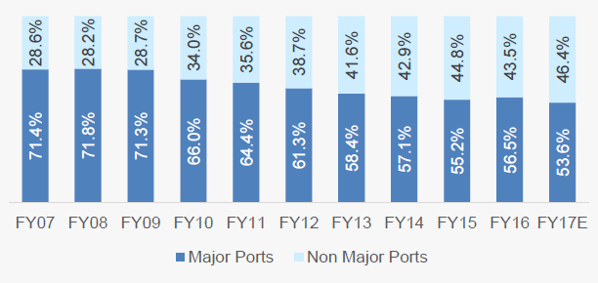
Sector Snapshot: Port Sector in India
Major Ports In India
Overview
Major Ports: There are 12 major ports in India 6 on the eastern coast and 6 on the western coast. Major Ports are under the jurisdiction of the government of India and all (except for Ennore) are covered under the Major Ports Trusts Act 1963.
Minor Ports: India has about 200 minor (non major ) ports including under development out of which one third are operational. Minor Ports are under the jurisdiction of respective state maritime boards
Share of Minor ports has been steadily increasing driven by Private Sector Entrepreneurial zeal
On a combined basis Major & Minor ports handled 1072.5 MMT of cargo in FY16, up from 1052.5 MMT in FY15., a growth of a mere 2%
  Capacity utilization of Major ports has steadily declined since 2008 to reach ~60% in 2016 even as TAT has improved to 2 days from 4
Over 99 PPP projects (including terminal level PPP) are operational with a capex of $8.8bn with capacity of 683.29 MMTPA
Source: IBEF, Indian Port Association, Ministry of Shipping
12

Slide 13
Key Drivers for Port Project Viability/ Financiability
Macro Economic Growth
Port Cargo Growth is highly correlated with Global Trade and EXIM cargo growth in the country. Higher industrial growth in India should have a major impact on the port sector
The last few years have witnessed a downtrend in the commodity cycle impacting break bulk cargo growth of commodities such as Coal.
Containerization of cargo has been gradually rising in India and globally
Tax Breaks to Boost Port Based Development
Tax breaks go a significant way in development of Port based industries which fuel the development of the hinterland and give a boost to employment and export oriented industries.
  E.g. tax breaks to Kutch post Earthquake have resulted in development of significant port based industries near Mundhra/ Kandla
The MAT on units in SEZ has severely impacted SEZ and conversely port based development in the country
Competition & Ability to gather critical mass in cargo
As the Industry has matured it has become increasingly critical for new port projects to be competitive, for which the following factors are important:
  Location: Distance to end user industries (land route),. Natural depth for attracting larger vessels are critical
  Connectivity: Road, Rail, Gas Grid, etc. needs to ensure quick TAT
  Captive Industries: Ability to set up captive end user industries viz. ADANI Wilmar, Mundhra Power project, etc. and conversely availability of land, power & water in close proximity for the same
New port projects will need to quickly gather critical mass to be the logical choice for shippers & logistics service providers
Connectivity & Infrastructure
Rail connectivity and TAT are critical for port development as Rail is significantly cheaper than road transport. Rail infrastructure in India is significantly hampered by low capacity. DMIC is likely to provide a boost to the same
Transmission linkages for port based power projects and pipeline grids for liquid and gas petro products are other critical infrastructure requirements
13
Notes:
Successful port companies include the likes of Adani (Mundhra, Dahej Coal terminal), Gangavaram, Gujarat Pipavav (owned by APM), Petronet Dahej LNG Terminal, Hazira, etc.
Several companies such as Boxtrans, DP World, etc operate terminals in Major & Minor Ports
A number of user industries in the cement, oil & gas, steel & coal space operate jetties for their captive cargo
A number of port projects are stuck for various reasons such as a viable business model, quality and capability of sponsors, competition in catchment area, industrial downturn, etc. and several operational ports are in severe stress (e.g. Karaikal (marg), Dighi, etc.) or mild stress (Kirshnapattinam)

Slide 14
Major Issues with Port Financing
Issues with Concession Agreements
Lack of tri-partriate contracts with lenders and investors for port financing in Concession Agreements
  Lender events of defaults not recognized as events of defaults under the concession agreements (often winding up required to enforce EOD)
  Lack of Clear process of communication between Maritime Boards and Lenders
Difficult to enforce substitution clauses by Lenders
  Valuation of port in case of substitution events do not take in to account commercial viability i.e. DCF valuation.
  Valuations based on 3rd party assessment of asset value subjects lenders to significant uncertainty in cases of default
  Vague pre-qualification criteria and lack of clear scoring mechanism create uncertainty for lender nominees in the event of substitution
  Lenders not allowed to take over asset themselves (i.e. SDR, S4, invocation of pledge with maritime boards managing the operations)
Regulatory & Policy
Compliance of Facilities to be provided by Maritime Board, State & Central Governments for development of the ports and SEZ is often wanting viz.
  Capex and Maintenance dredging (esp. in case of Terminals for Landlord models)
  Road connectivity to be provided by State Government
  Rail connectivity, related land acquisitions and permissions from Ministry of Railways
  Environment Approvals for units in SEZ (even after approval is provided to SEZ itself)
  Sewage disposal channels, transmission lines, gas grids etc.
Essentially a holistic planning of various key infrastructure Facilities (state , central, govt.) along with tax breaks for export oriented units is required to ensure success of highly capital intensive port projects
A holistic approach addressing Key Bottlenecks in Concession Agreement Regulatory, Fiscal & Policy Frame-work and its implementation to ensure port development

Slide 15
Conclusion
Equipment Financing/ Leasing
Equipment Financing & Leasing is a specialized business requiring skills in valuation, reposession, refurbishment and redeployment of assets
Given the international nature of the business several segments are heavily influenced by commodity prices (iron, coal, oil, etc.) , global trade and supply/ demand situation
The industry is currently facing such headwinds and only players with fleets built at the right cost and age, O&M capabilities and long term contracts are performing
Srei through its leasing business has done a number of transactions across the spectrum of marine equipment and can play a facilitating role in bridging the supply / demand and redeployment of equipment through contract cycles
Several challenges in the business in terms of asset valuation, regulatory compliance , tax structuring , repossession and redeployment need to be overcome to develop a vibrant market
Port Business
Port business and port based development is critical to nation building & employment generation
A successful port model requires
  A holistic approach and planning from Central, state governments and maritime boards
  Quality sponsors with long term vision for the business
  Tax and fiscal incentives for export oriented industries in the port hinterland
Given the maturity of the private sector investment in the port biz. a range of financing options
  Long term Loans (15 to 25 years) with periodic puts in consonance with RBI guidelines
  Refinancing through rated shorter tenure NCDs/ Masala Bonds with tail risk for operational projects
  Dollar denominated bonds and Foreign Currency Term Loans for operational projects
While Srei primarily operates in the Rupee Term Loans space, it also has
  Equity positions in the Ports & SEZ Space viz. Jetty in Nate, Maharashtra
  Equity positions in SEZ / Industrial Parks in Alibaug, Maharashtra (350 acres), in Kharagpur , WB (350 acres); in Nanguneri , TN (2518 acres); and
  Provides project & Financial advisory for the Sector
Notes:
At Nate Srei is building a jetty equivalent to 5 MTPA to support a 405 MW sea water cooled thermal power plant. Land of 1050 acres available for further development . Environmental approvals in place. Captive ports in Maharashtra can secure permission to handle 3rd party cargo. Port can be explanded to 15 -20 MTPA in subsequent phases

Slide 16
THANK YOU

