Slide 1

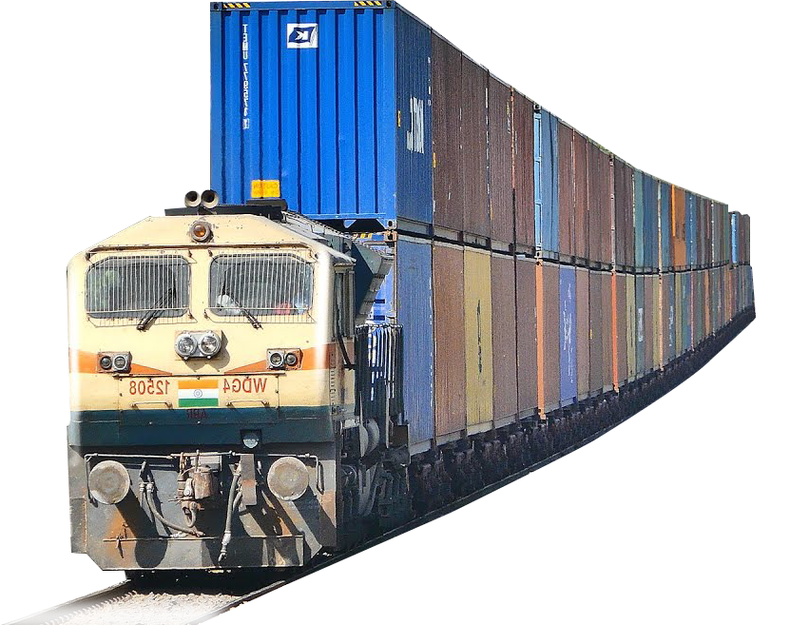
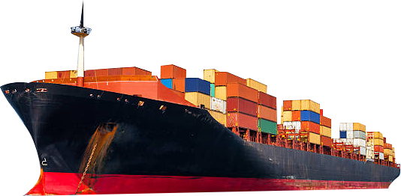
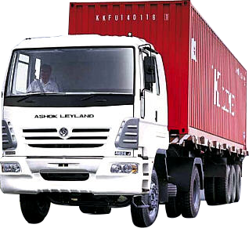

A ‘NAVRATNA’ CPSE
OUR ETHOS:
CUSTOMER VALUE CREATION

Slide 2

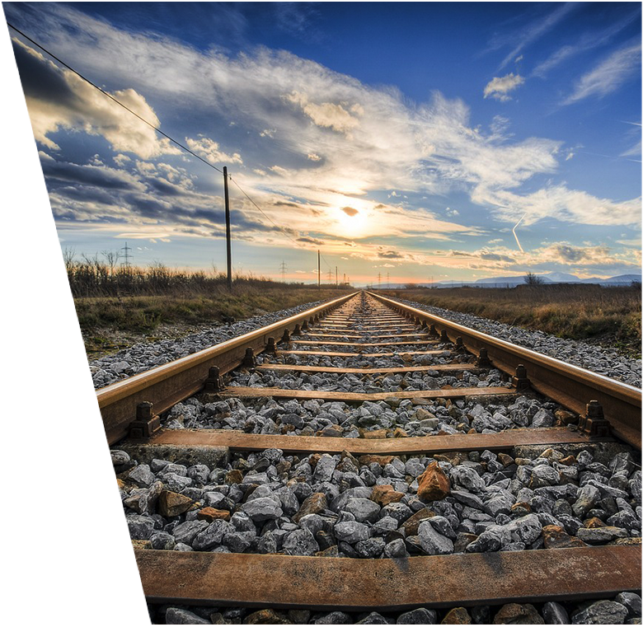
CONTAINERISED
Rail Logistics in India
Notes:
(train pic) Train track

Slide 3
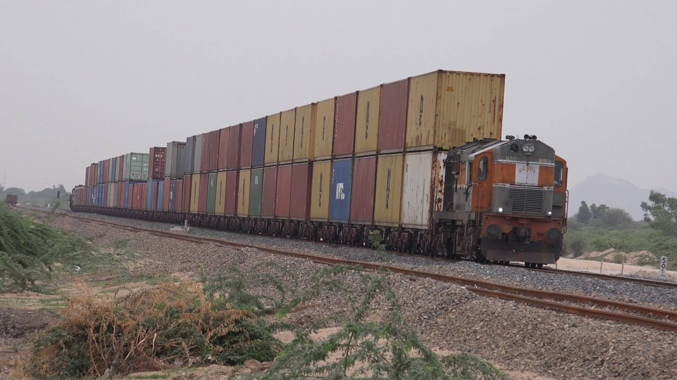
Logistics and
Rail Logistics
Market

Slide 4
Logistics Market
USD 160 billion is likely to touch USD 215 billion in the next two years.
Growing at the rate of 7.8 % during the last 5 years.
Expected to grow at a CAGR of 10.5 %
It employs about 22 million people
Notes:
Indian Economy = $ 2.7 trillion (logistics industry = 6.2% of the GDP)

Slide 5
Logistics Market
Transport - about half the size of the Indian logistics industry market,
Warehousing and storage - another 25-30% of the total market.
Value-added and freight forwarding services - about 20-25%.

Slide 6
Transport Market
Notes:
Road Transportation =60% of market share; Railway’s share is over 30%, water transport is at 7%, and air shipment 1%.

Slide 7
Containerised Traffic by Rail
 | 2013-14 | 2014-15 | 2015-16 | 2016-17 | 2017-18
Total Container Traffic carried by IR (In MMT) | 43.60 | 48.83 | 46.18 | 47.49 | 54.31
Traffic Carried by CONCOR (in MMT) | 32.93 | 36.19 | 33.40 | 34.70 | 39.97
% age of Share of CONCOR by rail | 75.53 | 74.11 | 72.33 | 73.07 | 73.60
Notes:
IR’s loading in 2017-18 was 1160 MT (Container traffic is 4.7% of the total Traffic); CONCOR=3.5% of IR’s loading. IR’s Container traffic is equal to 1.4% of the total market size in MT and CONCOR’s share is about 74%.

Slide 8

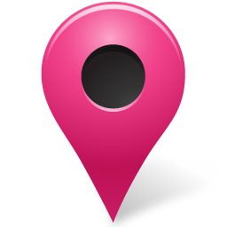
National Footprint / Terminals
Pan Indian presence with 81 facilities
(73 owned and 8 with exclusive access)
EximTerminals
Domestic Terminals
Combined Terminals

Slide 9

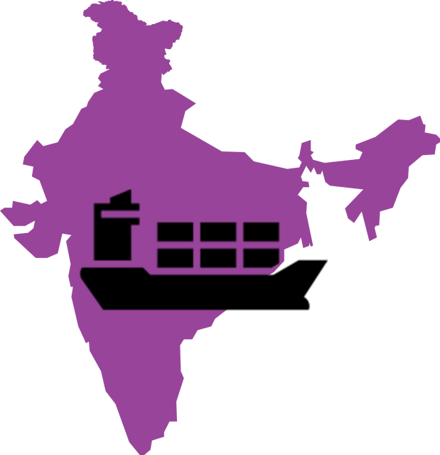
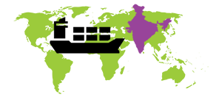
National Footprint
CONCOR operates 73 Terminals across India spread over 21 States.
  EXIM: 14 Domestic: 23 Mixed: 36
State | Nos. | State | Nos. | State | Nos. | State | Nos.
Maharashtra | 9 | Rajasthan | 5 | AP | 4 | Karnataka | 2
Gujarat | 7 | Punjab | 5 | Haryana | 3 | Telangana | 2
TamilNadu | 5 | MP | 5 | Odisha | 4 | Others | 11
UP | 5 | WB | 4 | Delhi | 2 | Total | 73

Slide 10
Trend in Containerised Rail logistics

Slide 11
Trend in Containerised Rail logistics

Slide 12
Bottlenecks
Route congestion
Lack of predictability in railway services – No time tabled trains
Lack of rationalization in railway tariffs
Poor port and last mile connectivity
High cost and time of border and ‘behind border’ activities
High Cost of inter-operability
Slow speed
Inadequacy of rakes
No single digital platform

Slide 13
Other Constraining issues
Study findings | Average Time to Import | Average Time to Export
D&B Study | More than 7 days | More than 5 days
Customs Data: Varies for Different Ports. Data for all ports not available | More than 5 days for JNPT to More than 8 days for Kandla | Not available
TRS 2018 (for JNPT) | Around 6 days | Around 3.5 days
Doing Business (World Bank) | More than 13 days | More than 6 days

Slide 14
Key Initiatives
Govt.’s target to increase rail share
DFC
Sagarmala (INR 8 Trillion)
Bharatmala (INR 5 Trillion)
Ambitious plan to double the export by 2020 from 2014 level (US$900 bln) – Increasing India’s share from 2% to 3.5%
Logistics Cell/Division
Notes:
A 10% decrease in indirect logistics cost can increase 5-8 per cent of exports.

Slide 15
Key Rail Logistics specific initiatives initiatives
Rail freight tariff structure be reduced and rationalized at least on select pilot routes;
Running of time-tabled freight trains for some select pilot routes;
Expediting commissioning of DFC;
“Common Development Plans” for revival of Railway sidings near major airports for promoting multi-modal air-rail connectivity and easing last mile connectivity to airports.

Slide 16
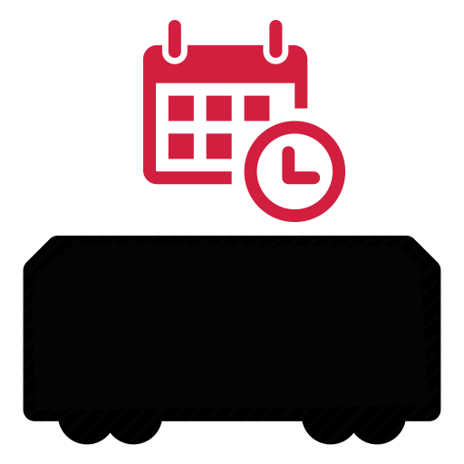
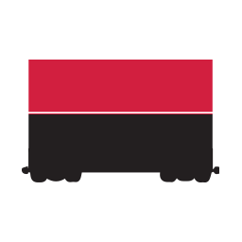
CONCOR / Innovations and Initiatives
TIMETABLED TRAINS
Dadri – Kathuwas & TKD-Kathuwas Daily Timetabled Trains started from 27.10.2016 to Mundra via Khatuwas called Link Express
Time Tabled Cargo Express in Domestic Circuit started between:-
TKD - TNPM, TKD – WFD, TKD – CMCN
DOUBLE STACK TRAINS
Rationalisation of rail freight with increased Double stack Container Train running, thus reducing the Logistics cost and passing the benefit to Customers
As against 332 Double Stack Rakes run in 2015-16, 938 Rakes were run in 2016-17 and 2273 rakes in 2017-18
More than 150 Double Stack Trains being run per month

Slide 17
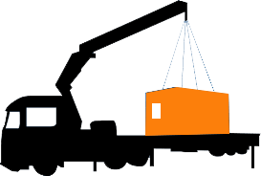
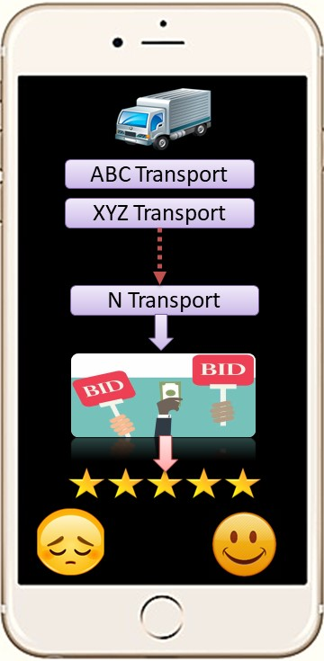
CONCOR / Technology the Bedrock
End to End logistics
Developing a Digital Platform for Panel of Road Service Providers for last mile Connectivity
Option for the Customer to choose the Tariff by Reverse Auction
Rating of the Service Provider and Quality monitoring

Slide 18


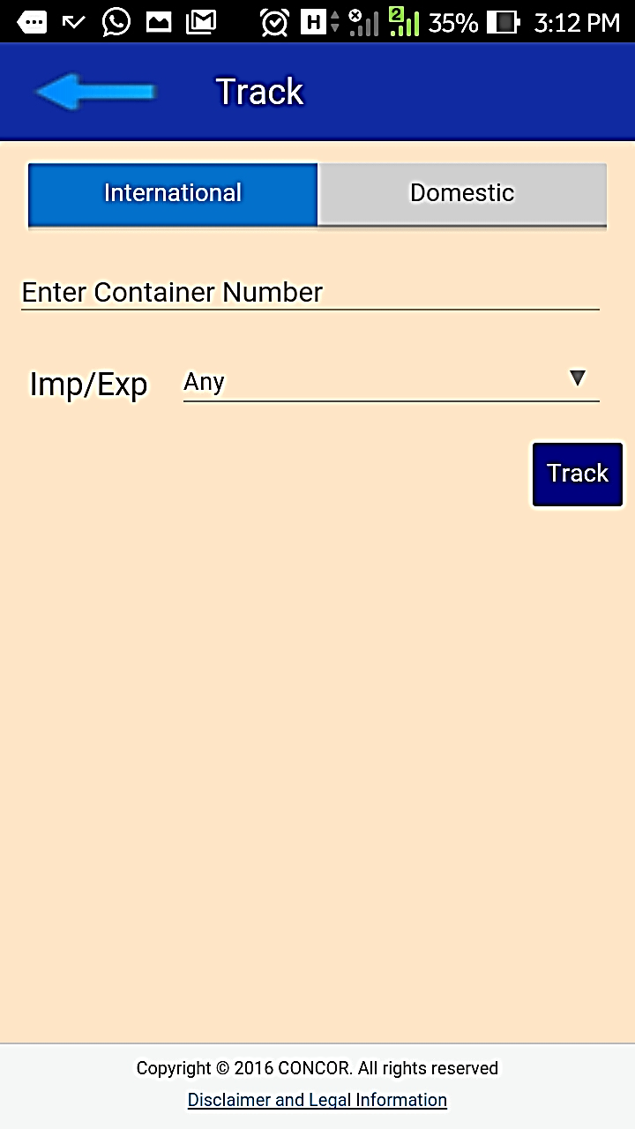
CONCOR / Technology the Bedrock
Mobile App
Information will be displayed for following parameters:
  Container No.
  Train No.
  Originating Station
  Destination Station
  Departure Date & Time
  Wagon Number
  Last reported Station

Slide 19
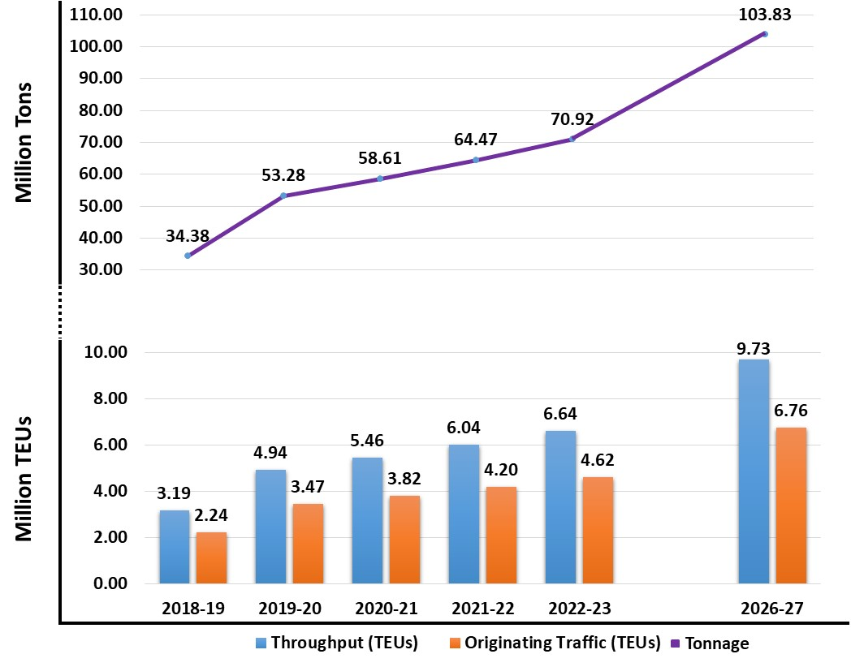
EXIM Projections

Slide 20
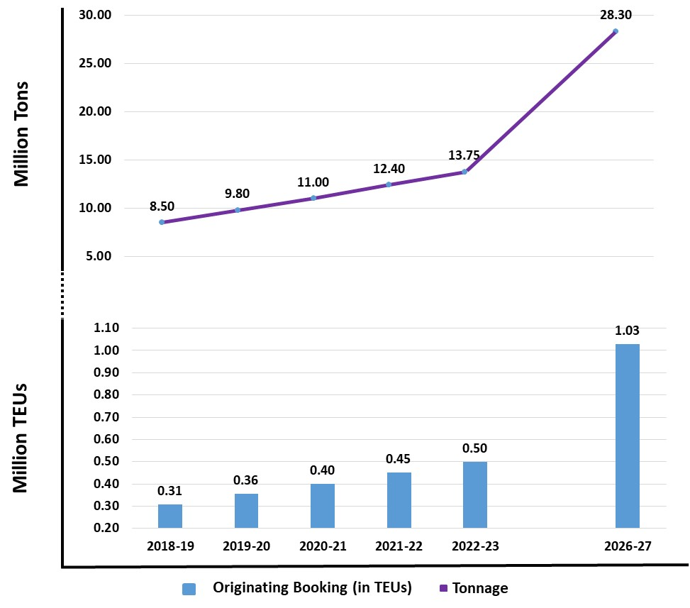
Domestic Projections

Slide 21

CONCOR
The Road Ahead
Notes:
Image to be replaced

Slide 22
The Road Ahead / Development of MMLPs
MORE THAN JUST A ICD/DCT/CFS
Large expanse of modern Warehousing
Double Stack Container Trains
Non Containerized Cargo: PFT-Access to Indian Railway freight wagons.
Specialized Cargo like Cars
Value Addition Warehousing Complex
Refrigerated Containers
Temp. Controlled Warehousing
PPP model for development of CFSs/Warehouses catering to customized requirements

Slide 23
The Road Ahead / Development of MMLPs
MMLPs in 2018-19
Logistics Parks projected to be developed in 2018-19
Mundra (Gujarat)
Sriperumbudur (Tamilnadu)
Swarupgunj(Rajsthan)
Kadakola (Karnataka)
Kakinada (AP)
Paradip (Orisha)
Krishnapatnam (Andhra Pradesh)

Slide 24
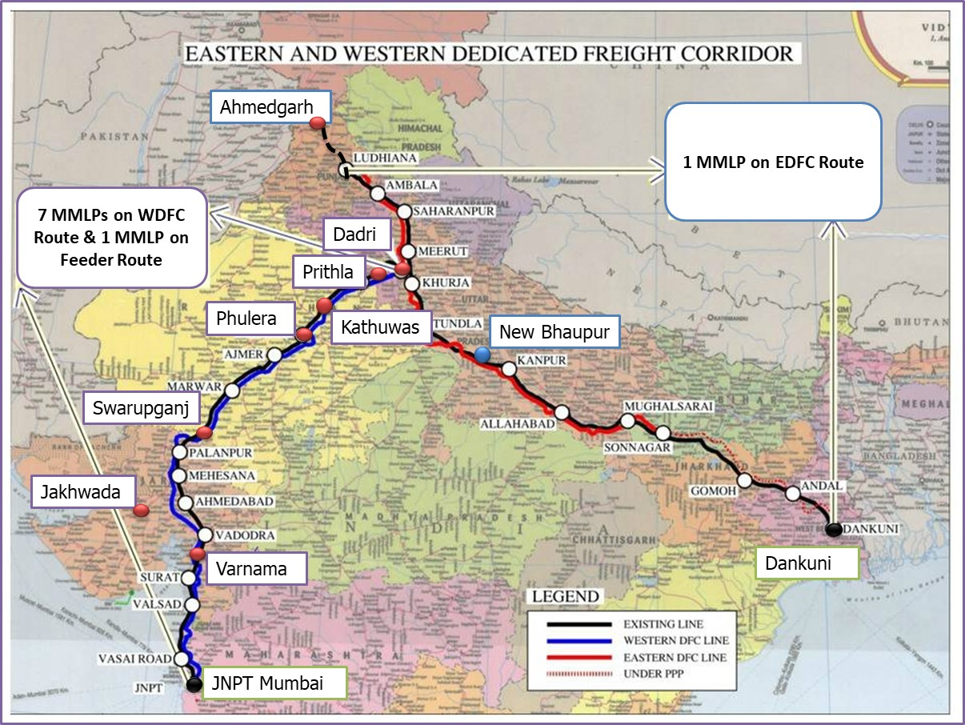
The Road Ahead /Aligning with DFC

Slide 25
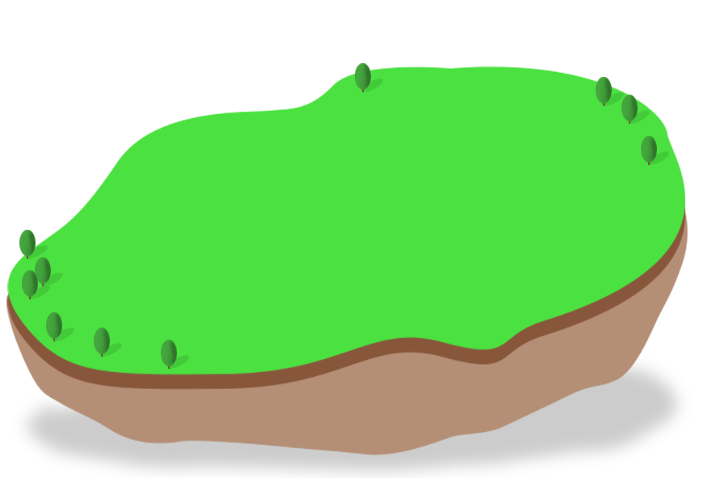

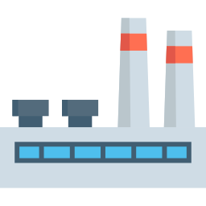
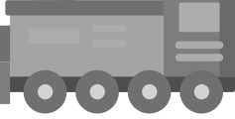
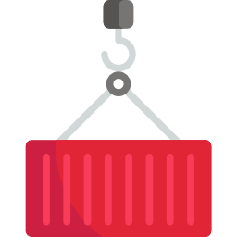
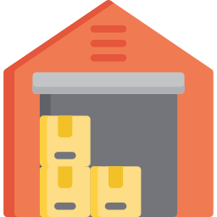
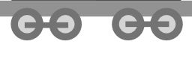

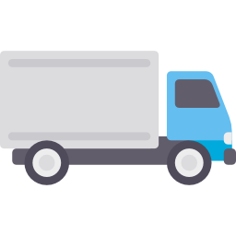
The Road Ahead/ ILMZ
Integrated Logistics and Manufacturing Zones

Slide 26
The Road Ahead / Distribution Logistics
NODES
Bengaluru/Krishnagiri
Hyderabad
NCR
Visakhapatnam
Ahmedabad
Kolkata
Guwahati
New Mumbai/Pune
Nagpur
Chennai
Mangalore
Varanasi
Notes:
Map + animation

Slide 27
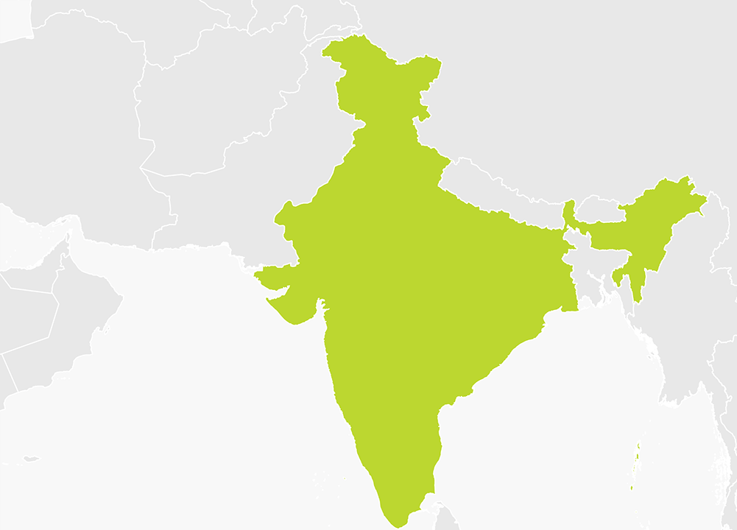
The Road Ahead / Offshore Initiatives
Connecting Nepal
Area: 40.48 Acres
Present ICD in Birgunj
Holding capacity 1600 TEUs
6 full length railway lines
2 warehouses with total capacity 17000 sq.mt.
Birgunj
(Nepal)
Kolkata
YEAR | NO. OF RAKES | ICD-BGJ (TEUs) | BULK CARGO RAKES
2016-17 | 395 | 34435 | 399
2017-18 | 424 | 37115 | 245
Vizag
(Visakhapatnam)
Further connecting Jainagar- Bardipas and Batnaha-Biratnagar (Nepal)

Slide 28
The Road Ahead / Offshore Initiatives
Connecting Bangladesh
MoU with Container Company of Bangladesh ltd. (CCBL) of Bangladesh Railways
Rail connectivity between Majerhat (Kolkata) in India and ICD Dhaka in Bangladesh
Expedite the Cargo movement from India to Bangladesh
Economical, cost effective and faster movement compared to the Ocean and Road route
Bangladesh
Kolkata

Slide 29
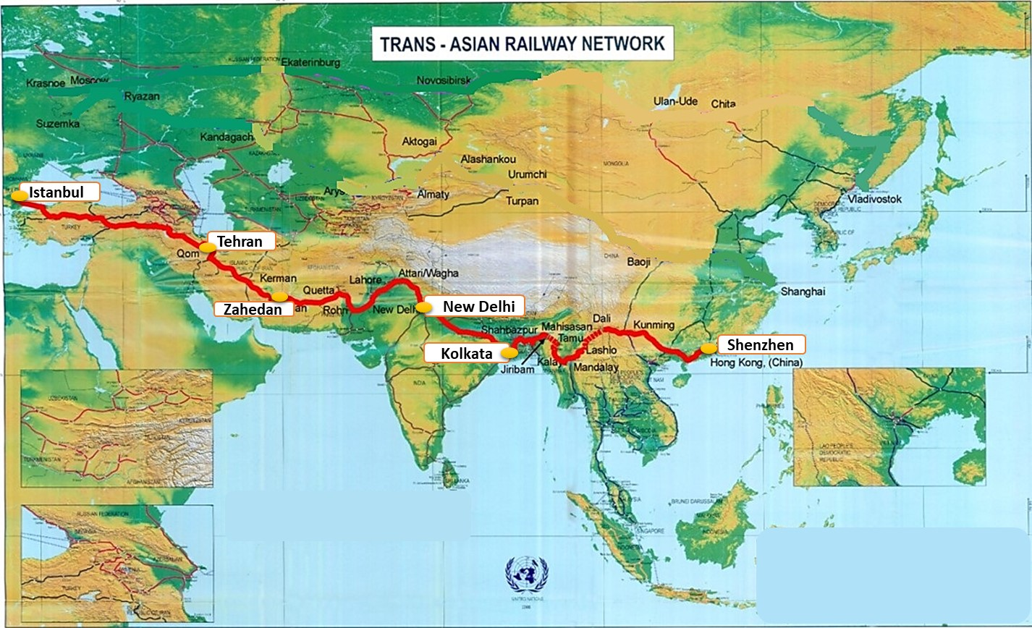
The Road Ahead / TAR
Looking for opportunities along the upcoming Trans Asian Railway Network

Slide 30
CONCOR / The Road Ahead
Investment Plan ( 2018-19 to 2022-23)
Target 100 Terminals
- Land Acquisition: 750 Cr.
- Terminal Development: 2900 Cr.
  ILMZ Development at 4 Locations: 2400 Cr
  Wagon Acquisition : 3515 Cr.
  Container Acquisition: 4090 Cr.
  Total CAPEX: Rs. 13655cr.
  Mergers & Acquisitions - 3000 Cr

Slide 31
THANK YOU

