Slide 1
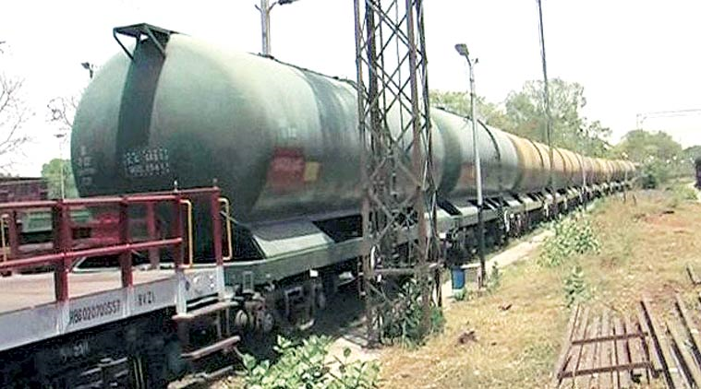
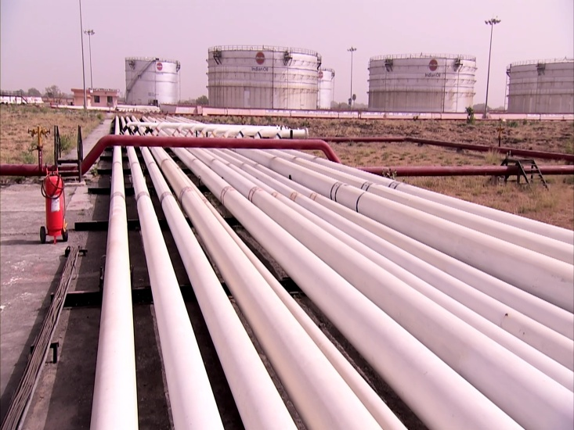
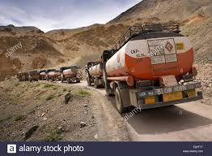
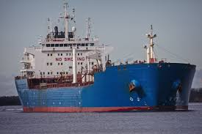
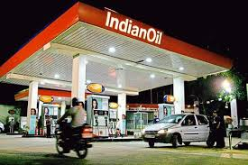
Logistics Operation in Oil Transportation & Bunkering in Indian Oil :
An Overview

Slide 2
Supply & Distribution of Petroleum Products -
Indian Oil Way

Slide 3





Refinery : POL Sources
HPC, Ramanmandi
IOC, Panipat
IOC, Bongaigaon
IOC, Mathura
IOC, Digboi
BPC, Bina
BPC, Numaligarh
IOC, Koyali
IOC, Guwahati
IOC, Barauni
EOL, Jamnagar
IOC, Haldia
RIL, Jamnagar
IOC, Paradip
HPC, Mumbai
BPC, Mumbai
HPC, Vizag
MRPL, Mangalore
IOC, Manali
BPC, Kochi
Refinery
Port
IOC, CBR

Slide 4
IOC Refining Capacity
IOC | 2016-17 | 2019-20 | 2024-25
JR | 13.7 | 13.7 | 17.8
PR | 15.0 | 15.0 | 22.0
MR | 8.0 | 8.0 | 9.2
BR | 6.0 | 6.0 | 9.0
HR | 7.5 | 7.9 | 8.0
PDR | 15.0 | 15.0 | 20.4
GR | 1.0 | 1.0 | 1.7
DR | 0.7 | 0.7 | 0.7
BGR | 2.4 | 2.4 | 2.7
CBDU-CPCL | 0.5 | 0.0 | 8.3
Manali-CPCL | 10.5 | 10.5 | 10.5
RRPL |  |  | 30.0
Total | 80.3 | 80.1 | 140.2

Slide 5
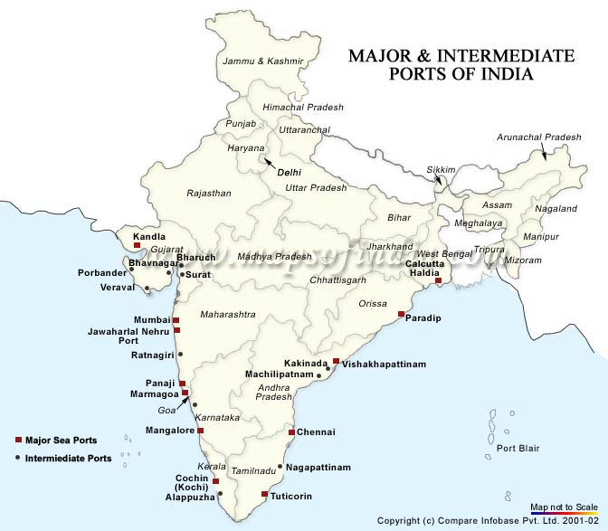
POL Ports in India
Imports
Exports
Only Coastal
Mundra
Jamnagar
Karwar

Slide 6
IOCL Crude PL Network
Fed through indigenous crude-Digboi, Guwahati and BGR
Two SPMs at Vadinar
One SPM at Mundra
Crude brought in
VLCCs & Smax feed the three refineries at J,M,P
Panipat
Nahorkatiya
Mathura
Chaksu
BGR
Digboi
Barauni
Guwahati
Mundra
Viramgam
Vadinar
Koyali
3 SBMs at Paradip.
VLCC & Smax
feed four refineries
PDR,BOR,BGR,HR
Haldia
Panna-Mukta
Mumbai
Mumbai
High
Paradip
Ravva
PY-3
Mainly fed through
Suezmaxes from MEG
Discharge directly at
Jetties

Slide 7
Growth in Petroleum Pdt
Pipelines Network
Upon Completion of Ongoing Projects
Name of the Company | Existing Length (km) | Ongoing Length (km) | Total Length (km) | Total Capacity on completion (MMTPA)
IOC | 6359 | 3016 | 9375 | 49.89
HPC+PMHB | 2898 | 716 | 3614 | 33.73
BPC+PCCK | 2201 | 294 | 2495 | 20.96
OIL | 654 | -- | 654 | 1.72
Total | 12112 | 4026 | 16138 | 106.30
2020-21
Jalandhar
Bhatinda
Ambala
Roorkee
Sangrur
Najibabad
R’mandi
Panipat
Rewari
Meerut
Mohanpura
B’durgarh
Bijwasan
Tinsukia
Jaipur
Sanganer
Mathura
Salawas
Ajmer
Jobner
Tundla
Baitalpur
Motihari
Siliguri
Digboi
Bharatpur
Lucknow
Hashimara
Betkuchhi
Numaligarh
Awa
Kota
Kanpur
Siwan
Bongaigaon
Guwahati
Palanpur
Kot
Bina
Barauni
Chittorgarh
Allahabad
M Sarai
Patna
Jasidih
Mundra
Ratlam
Ranchi
Rajbandh
Viramgam
Ahmedabad
Korba
Kolkata AFS
Kandla
Vadodara
Manglya
Jharsuguda
Mourigram
Vadinar
Koyali
Sambalpur
Jamnagar
Amod
Raipur
Saraipalli
Jatni
Haldia
Dahej
Hazira
Legend
 | IOC’s Existing Pipeline
 | IOC’s Ongoing Pipeline
 | BPCL’s Existing Pipeline
 | BPCL’s Ongoing Pipeline
 | HPCL’s Existing Pipeline
 | HPCL’s Ongoing Pipeline
 | OIL’s Existing Pipeline
 | PMHB’s Pipeline
 | PCCK’s Pipeline
 | Refinery
 | Pipeline Installation
Santacruz
Manmad
Berhampur
Paradip
Mumbai
Pune
Goa
Solapur
Hyderabad
Raj’mundry
Vizag
Goa AFS
Secunderabad
Hazarwadi
Suryapet
Vijayawada
Tatipaka
Bangalore/
De’gonthi
Chittoor
Mangalore
Hassan
Chennai
B’lore AFS
Chennai AFS
Sankari
Asanur
Coimbatore
Karur
CBR
Kochi AFS
Irugur
Trichy
Kochi
Madurai
IOC: Indian Oil Corporation Ltd., | HPC: Hindustan Petroleum Corporation Ltd., | BPC: Bharat Petroleum Corporation Ltd., | OIL: Oil India Ltd.,
PCCK: Cochin-Coimbatore-Karur Petronet Ltd., | PMHB: Mangalore-Hassan-Bangalore Petronet Ltd.
Note : Map is Indicative only, not to scale

Slide 8
BTPN RAKE AVAILABILITY WITH INDIAN RAILWAYS
Commodity | Number of rakes
White Oil | 190
Black Oil | 18
Crude | 2
Coal Tar | 2
Total | 212
4 wheeler rakes (conventional wagons) removed from circuit during May 2010
BTFLN (Frameless Tankwagons introduced in 2012) with a higher Capacity by 3 MT.
Rake capacity increased from 48 Tws to 49 in Sep 2011 and for most of the Locations it is extended to 50 TW per rake.

Slide 9
Industry Rail Loading Locations
Region | IOC | OMC/SAR
NR | Mathura | HMEL
 | Panipat | Bahadurgarh
 |  | Kanpur
 |  | Asouti
ER | Digboi Marketing Terminal | Numaligarh
 | BGR | Rangapani
 | Siliguri | Haldia
 | Barauni Refinery | Paradeep
 | HR
 | Paradeep
WR | IOTL (Raipur) | Manmad
 | Ratlam | Loni
 | JR | EOL-Jam
 | Kandla | RIL-Jam
 | IOTL (Mumbai) | Mahul
 |  | Mangaliagaon
 |  | BORL
SR | Vizag | Vizag
 | Tondiarpet | Vijaywada
 |  | Ennore
 |  | Kochi
 |  | Mangalore
 |  | Hassan
Total | 15 | 21

Slide 10
List of IOC Rail Unloading Location
REGION | Locations |  | Number
NR | Jammu | Bijwasan | 12
 | Jallandhar | Banthra
 | Lalkuan | Baitalpur
 | Gonda | Allahabad
 | Aonla | Kanpur
 | Amousi | Panipat
ER | Digboi | Dharmanagar | 10
 | Lumding | Siliguri
 | Ramnagar | Rajbandh
 | Malda | Haldia
 | Somnathpur | Raxaul
WR | Kandla | Tadali | 17
 | Mangalia | Akolner
 | Bhitoni | Miraj
 | Jayant | Akola
 | Khapri | Rajkot
 | Gwalior | IOTL (Mumbai)
 | Itarsi | Pakni
 | Sagar | Shirud
SR | Bijapur | Mysore | 13
 | Desur | Feroke
 | Navalur | Cherlapalli
 | Gulberga | Ongole
 | Ramagundam | Guntakal
 | Irugur | Sankari
 | Devengunthi
 |  |  | 52

Slide 11
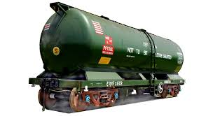
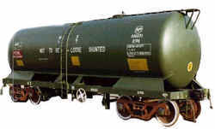
BTPN Tank Wagons

Slide 12
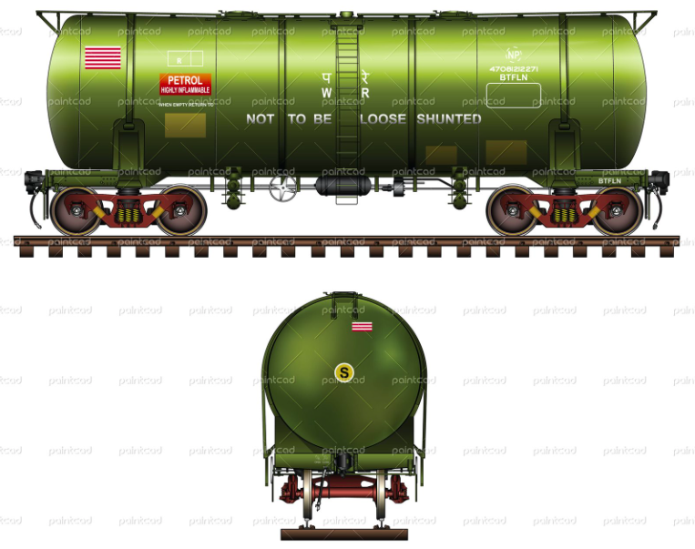
BTFLN Tank Wagons

Slide 13
Supply Chain Management

Slide 14
Underlying Philosophy Behind Supply Chain Concept
Materials Flow
Suppliers
Procurement
Operation
Distribution
Customers
Information Flow
Fund Flow

Slide 15
How do we define Supply Chain management?
A process of satisfying customer needs through coordination of materials and information flows that extend from the market through the firm’s operation and beyond that to the suppliers.
A shift to an integrated orientation from the conventional manufacturing or marketing orientation.

Slide 16
What is Supply Chain Management?
Objective: to plan and coordinate all the activities necessary to achieve desired level of delivered service and quality at lowest possible cost.
Scope : include the entire gamut of activities from the procurement of raw materials and resources, to delivery of final product to the customer.
Purpose : To satisfy the customer by establishing linkages of people at all levels in the organization directly or indirectly to the market place.

Slide 17
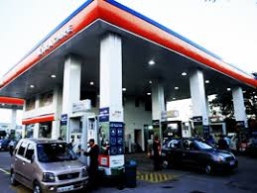
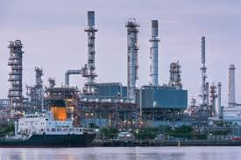
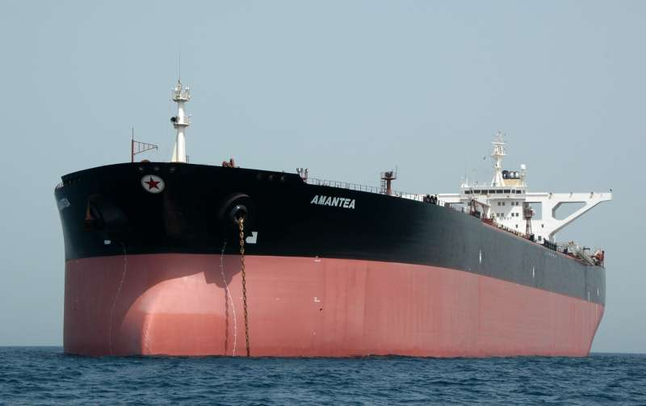

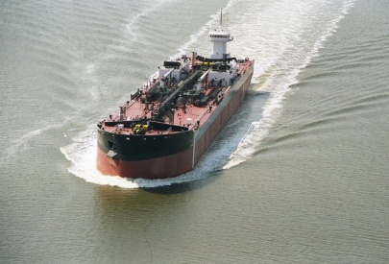
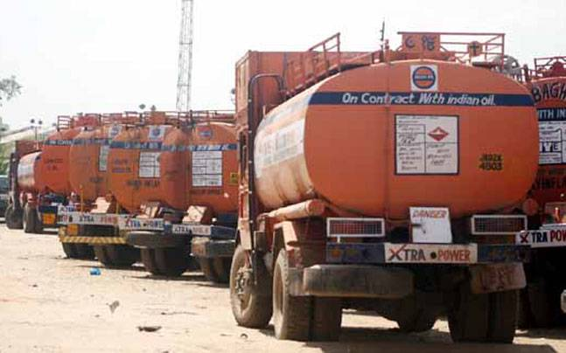
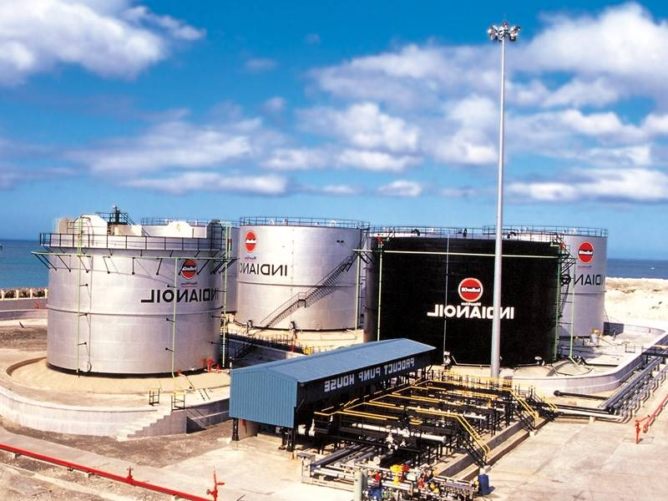
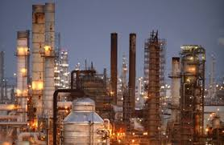
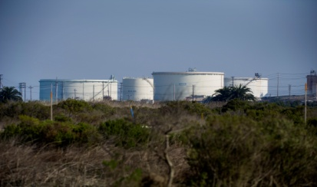
Links In Supply Chain
Demand Centres
Supply Sources
Transportation Network/ Mode
Own Refineries
Imports
Purchases
Exchanges Partners

Slide 18
Supply Chain : Petroleum sector
Supply Planning
Crude
Purchase
Crude
Transptn.
(Tanker/PL)
Crude
Storage
Refining
Refn Product
Storage
Distribution Planning
Retailing /
Consumer
(Demand Centre)
Mktg Product
Storage
(Terminal/ Depot/ TOPs)
Product
Transptn/Distribution
(Tanker/PL/Rail/Road)

Slide 19
SCM : IndianOil
Crude evaluation
& Procurement ?
What and How
to Feed ?
What & Where
To Make ?
Refn. HQ
IT/Shipping
Corporate
Optimization
Plng, Mktg HQ
Mktg S&D, HQ/ RO
Demand
Forecast ?
Distribution
Planning ?
What & where to
Store and from where ?
Notes:
19

Slide 20
  Supply Chain in Indian Oil
What was before?
A supply push
What is today?
A demand pull
How is it in future?
Integrated
Notes:
A plain old bulleted list can get boring, so use graphics to liven it up. An image that conveys what you’re saying in visual format (like this diagram) can reinforce your ideas in the audience’s mind.

Slide 21
Logistic Flow Chart
1. Crude Receipt at Ports
2. Dispatch of Crude to Refineries by pipelines
1. Dispatch of finished products from Terminals to Depots by rail, road.
1. Dispatch of finished products to Retail Markets from Depots by road.
1. Receipt of finished product at Ports from Stand Alone Refineries .
2. Upliftment of finished product from Refineries
1. Dispatch of finished products from Refineries/Coastal locations by pipelines, rail, roads, ocean tankers to hinterland storage locations.

Slide 22
IOC Mode-wise Primary Dispatch – 2012-13 v/s 2017-18

Slide 23
Importance of Quality Control in Supply Chain

Slide 24
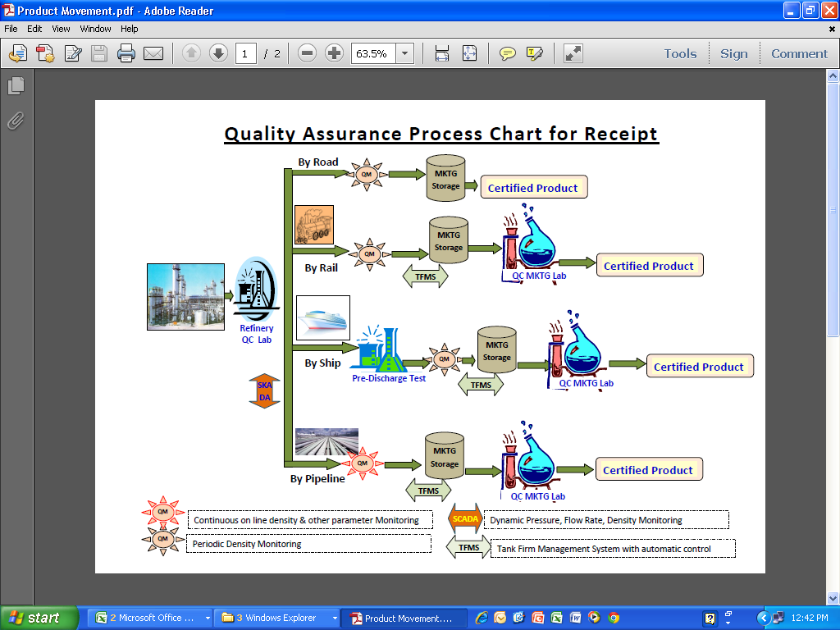
Utilization of different process tools is to ensure that, the Quality of product received at IOCL Marketing Locations is always in Refinery good condition

Slide 25
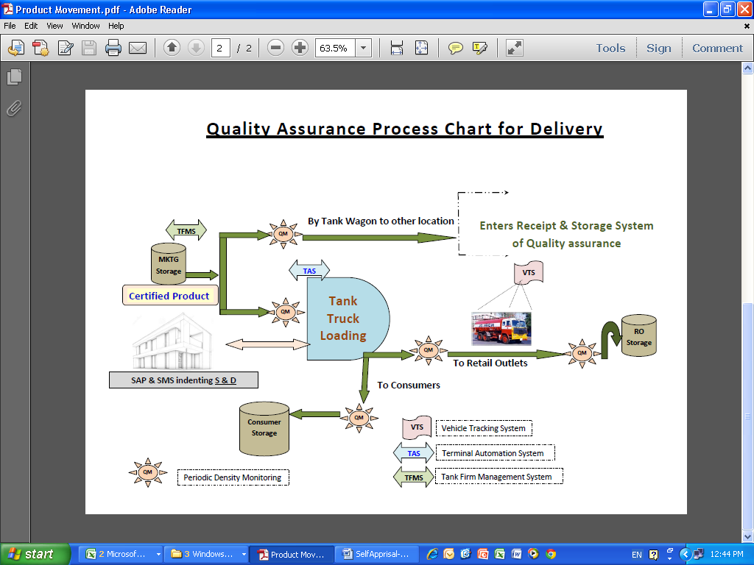
Utilization of different process tools to ensure that, the quality of product delivered from IOCL Marketing Locations is always in Refinery good condition

Slide 26
SUPPLY & DISTRIBUTION

Slide 27
Primary Activities
Demand Forecast
Refinery Production
Supply-Demand Balancing
Inventory Management
Purchase/Export Requirement
Exchange
Refinery Mapping with Supply Locations
Mode wise Distribution Plan
Mode wise scheduling
  Pipeline
  Rail
  Coastal
Course correction

Slide 28
Demand Forecast
16 State Offices [District-wise]
S&D [Distribution]
CO (Opt) [Location-wise]
HO Planning [State-wise]
Notes:
This slide template can show steps, stages or how various elements or factors combine to make one key result or goal. For instance, you could show how various departments in your business work together to make the sale, how key customer groups will all purchase your product, or how different funding sources will provide the total you need. This slide template also makes an excellent concluding slide for your presentation, enabling you to graphically sum up your key points into one final whole.

Slide 29
Optimization Models
Demand Forecasting Model - HO Planning/Corporate Office
Supply & Distribution – SAND Model - Globally Optimised – CO (Optimization
Inputs for SAND Model - Demand Nos, Mktg /Ref /Pipeline Infrastructures, Availability from Refs (IOC & Associate Refs), Exchanges with OMC, Inventories, Purchases from SAR, Imports
for both MDP & CLIP products
RPMS – Refinery Petrochemical Modeling System – at Refinery
[SARs – Stand Alone Refiners, i.e. MRPL, RIL, Nayara]
Notes:
* If any of these issues caused a schedule delay or need to be discussed further, include details in next slide.

Slide 30
Output of SAND Model
30

Slide 31
Output of SAND Model
31

Slide 32
Integrated Model
Integrated Planning
Demand Forecast
Price Forecast
Shutdown Schedule
Term Crude Availability
Committed Imports / Exports
Crude Requirement
Products Exchanges
Production Target Refineries
Products availability for Logistics Planning
Imports / Exports

Slide 33
Timelines for drawing Monthly Distribution Plan
(next month)
Firm Demand
Exchanges/ Purchases
Distribution Plan
5th
15th
28-30th
25th Meetings
Rail Slate meeting by month beginning
Notes:
The following slides show several examples of timelines using SmartArt graphics.
Include a timeline for the project, clearly marking milestones, important dates, and highlight where the project is now.

Slide 34
IT Implementation
Daily Activity Monitoring System (DAMS)
S&D Portal
Freight Operations Information System (FOIS)
Logistic Scheduler : Pipeline, Coastal

Slide 35
MOP&NG Focus Areas
Maintaining supplies in North-Eastern States in spite of tremendous logistics constraints. NE pre-monsoon topping up exercise done during Jan-Mar every year.
Maintaining supplies in Jammu & Kashmir in spite of bad road conditions & logistics constraints. Advance Winter Stocking (AWS) done during May-Sep every year.
Auto Fuel Policy : Implementation of BS VI Grade Auto Fuel by 2020.
Green Fuel Implementation
35
Notes:
35

Slide 36
CHALLENGES

Slide 37
Refinery Operation : Challenges
Maximize Gross Refinery Margin (GRM)
  Input cost reduction
  Maximize capacity utilization to reduce operating cost
  Maximize value added products
  Minimize low value products
  Operational Efficiency (Fuel & Loss, R&M cost etc.)
Quick response : market demand & contingencies
  unplanned shutdown of units
  Migration of BS-VI standards from 01.04.2020
Synergy among multi-refinery operation
  Intermediate stream sharing

Slide 38
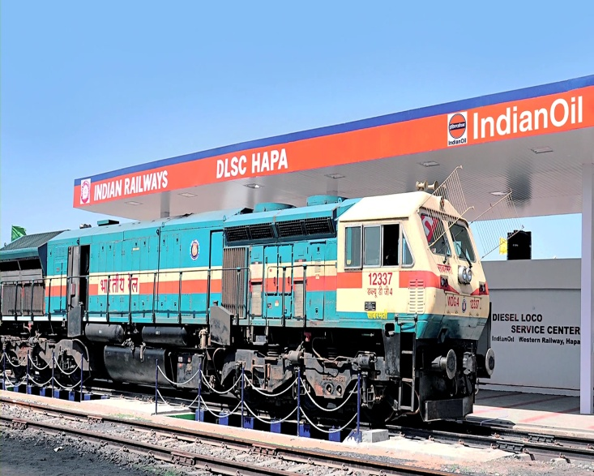
CHALLENGES
Pipeline
  High Infrastructure Cost
  Land requirement and statutory clearances
  Maintaining quality in Multi-product dispatch
  Batch length Requirement
  Pilferage threats
  Tax Implication for inter-state movement
  Grade conversion
Rail
  Availability of rakes .
  Absence of dedicated freight corridor.
  Free Rail movement with least congestion.

Slide 39
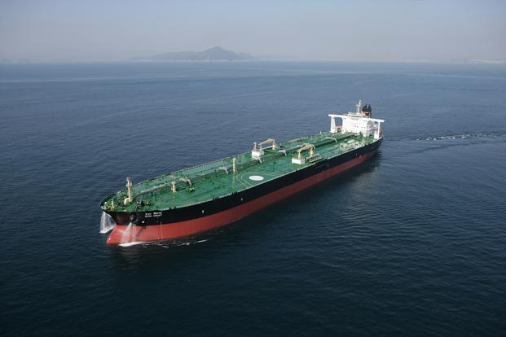
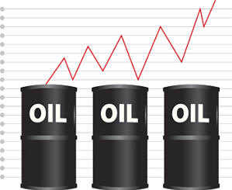
CHALLENGES
Port Infrastructure
  Saturation of Port Capacities
  Port Congestion
  Draft Restriction
  Vessel Availability
Demand Fluctuation
Availability of products always
in refinery good state

Slide 40
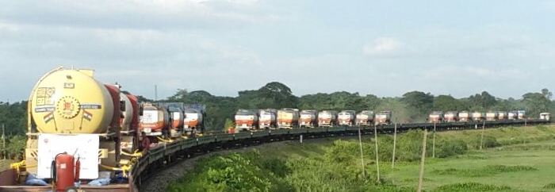
ROAD MOVEMENTS AT NORTH EAST
(THROUGH RO-RO)

Slide 41
WAY FORWARD….
Real time visibility through S&D Dash Board
Integration with Railway Freight Information System (FOIS)
New Pipelines
Re-orientation of operating locations
Debottlenecking of Port infrastructure
Integration of Primary & Secondary Logistics.

Slide 42
Up coming projects -Pipeline
Jaipur-Panipat pipeline – extension of KSPL –Comm shortly
Branch line in PAJPL to Una – Comm shortly
Branch pipeline to Motihari & Baitalpur with extension to Amlekhgunj/Chitvan (in NP)
Paradip Hyderabad pipeline
Koyali-Ahmednagar-Sholapur pipeline
Augmentation of HBPL[4-7.5] /HMRPL [1.7-2.6] /CTMPL [2.3-3.9] /PBPL[1.5-3] /BKPL5.5-7.8] /KSPL[6.0-8] /CBPL[2.5-4.5] /KRPL[2-4.6] - figs in MMTPA

Slide 43
Up coming projects -Pipeline
Extension of Mathura-Tundla pipeline to Kanpur & Lucknow
Paradip-Somnathpur-Haldia pipeline
Guwahati-Lumding-Silchar-Imphal pipeline
WCR-Sholapur-Gulberga-Hyderabad pipeline
WCR-Pune-Ahmednagar-Manmad-Akola-Nagpur-Jabalpur-Mirzapur pipeline with branch line to Panvel
Mathura-Aonla pipeline
Extension of Panipat-Jalandhar pipeline to Jammu
New CBR-Trichy-Madurai-Tuticorin pipeline

Slide 44
Up coming projects -Pipeline
Mathura Jhansi pipeline
PRRPL branch line to Meramandali CUF
Extension of CTMPL from Shankari to Irugur
Branch line from Mourigram to Siliguri via Malda
Extension of KRPL to Bhopal
Extension of CBPL to Guntakal via Chitradurga and branch line to Hubli from Chitradurga
Branch line to Ramagundam from Hyderabad

Slide 45
Up coming projects – Marketing Locns
Dharmanagar Re-sitement, TRP
Patna Re-sitement, BH
Motihari, BH
Dhenkanal, WB
Berhampore, Odisha
Asanur, TN
New Hyderabad, Telangana/AP
Chitradurga, Karnataka
Una
Jammu Re-sitement
Srinagar Re-sitement
Mirzapur
Phandakalan (Bhopal)
Borkhedi (Nagpur)
Panvel
Ratnagiri

Slide 46
Finally – A Recap
Improved profitability by :
Optimum Distribution → Savings in Logistics cost
  Inventory Management → Savings in working capital
  Infrastructure rationalization → Savings in Operating cost
  Market Re-alignment → Savings in Secondary distribution cost

Slide 47
World’s seaborne trade

Slide 48
World’s seaborne trade

Slide 49
World fleet, 2017
Source: Statistica GmBH

Slide 50
Global bunker trade

Slide 51
Global bunker trade
There are approx. 400 major bunkering ports in the world
Most of the demand is concentrated in a few strategic ports
4 out of 6 top bunkering hubs are also oil trading hubs and having comparatively lower oil prices
Million tons
World seaborne trade by region, 2015
(Percentage share of world tonnage)

Slide 52
Bunker fuels demand in India
Bunker Fuels demand at Indian ports is about 1% of the global demand
Growing Seaborne trade of about 7% in India providing opportunity for growth in bunkering demand
Annual bunker demand growth in India was about 10% before GST
Bunker demand in 2017-18 reduced drastically port GST rollout as 5% GST is imposed on FO bunker sale to foreign run vessels
FO bunker demand in India post GST reduced by about 25% as prices lost global competitiveness

Slide 53
Industry market share

Slide 54
Infrastructure presence at major port
  Bunkering infrastructure at 17 ports
  Largest oil company having bunkering facilities at all strategic locations across the 7517 kms long coastline
  Only Oil Company that developed fuel delivery infrastructure at all major port to meet
    defence need, and
    maritime trade growth of the Nation
  Approx. 3000 capable employees trained for catering maritime & defence needs along with other operations at all time & during exigencies round the clock

Slide 55
India maritime sector
Advantage India
One of the fastest growing major economies
4th most attractive FDI destination in the World as per United Nations Conference on Trade & Developments
More than 7517 km long coastline with about 200 major & non-major ports
Seaborne trade has grown at twice the global growth rate
More than 35,000 vessels call annually
Plans to create port capacity of around 3200 MMT to handle the expected traffic of about 2500 MMT by 2020
Source: Ministry of Shipping

Slide 56
India maritime sector
Containers
123.2 MMT
Crude & POL
579.6 MMT
Other Cargoes
157.9 MMT
Coal
270.3 MMT
CAGR 5.9%
CAGR 6.9%
CAGR 15%
CAGR 3.0%
Source: Ministry of Shipping

Slide 57
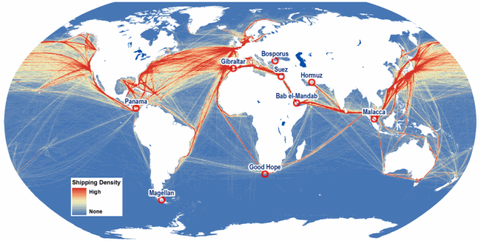
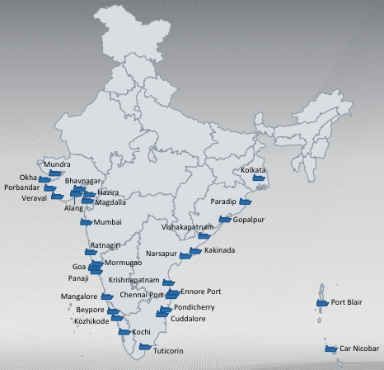
Constraint in bunkering growth
Geographical disadvantage:
  Except Kochi, none port located on major international shipping route
Bunker prices:
  Major oil hubs Singapore & Middle East located on either side of India
  Oil prices at India comparatively higher than prices at these oil hubs
Taxes:
  About 70% of total bunker demand is of foreign run vessels
  GST on FO bunker is 5% whereas tax on bunker in the countries surrounding India is Zero
High operating costs:
  Bunker Fuel demand not centralised at 1-2 ports but scattered at too many ports leading to high operating costs

Slide 58
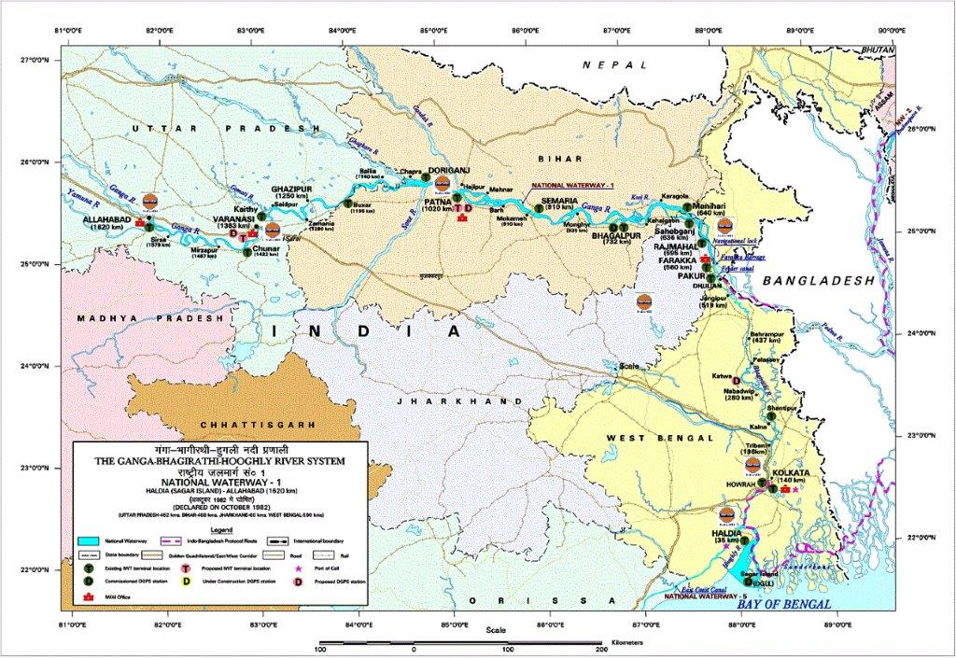
National Waterway maps with IndianOil locations: NW-1

Slide 59
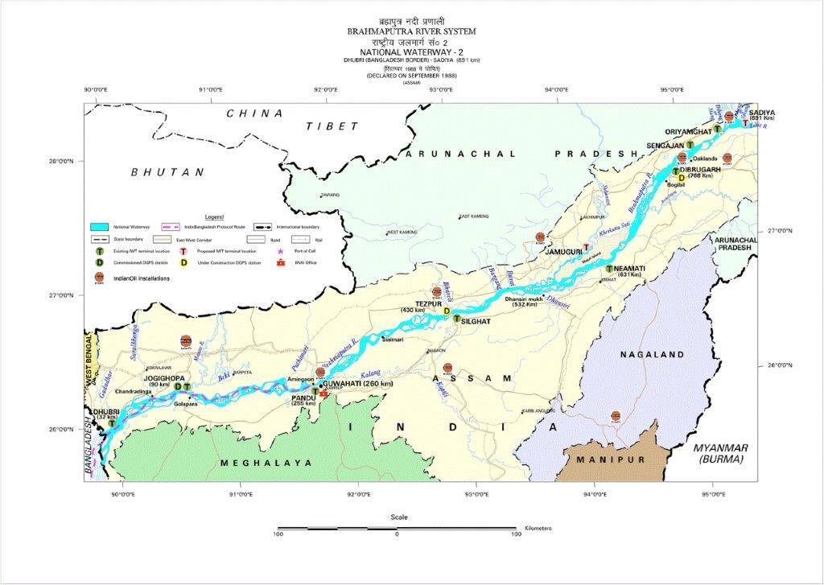
National Waterway maps with IndianOil locations: NW-2

Slide 60
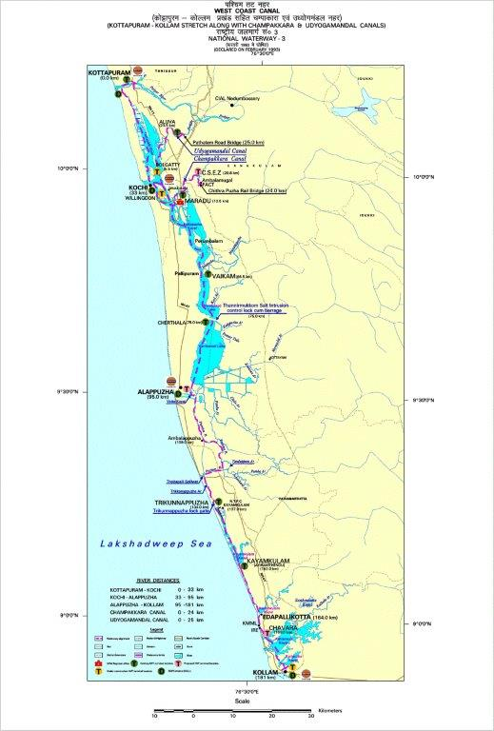
National Waterway maps with IndianOil locations: NW-3

Slide 61
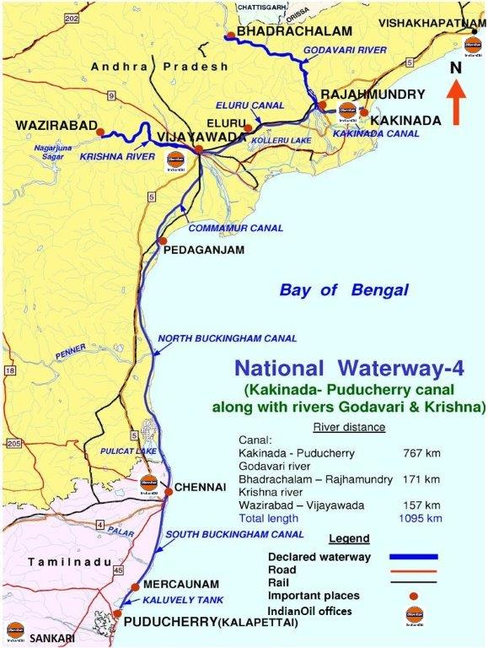
National Waterway maps with IndianOil locations: NW-4

Slide 62
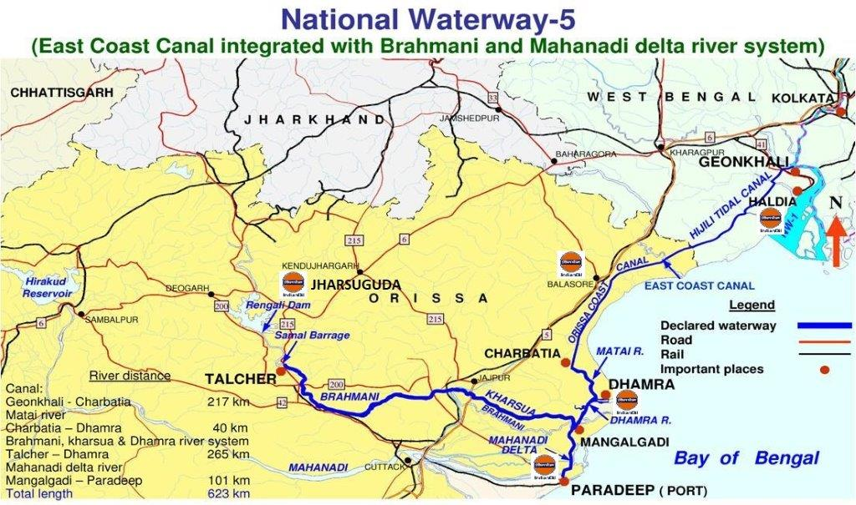
National Waterway maps with IndianOil locations: NW-5

Slide 63

from 2020

Slide 64
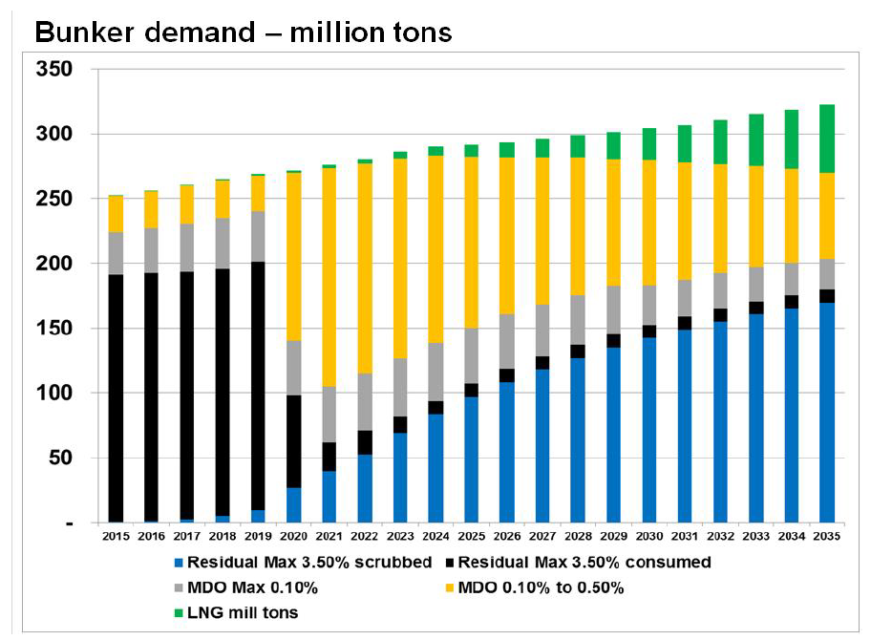
Global Bunker fuel demand post 2020 IMO regulations
Source: IBIA

Slide 65
How much will 2020 cost?

Slide 66
LNG bunkering demand
Indian market for LNG bunkering - challenges:
  lack of LNG fuelled vessels in the region
  investment required in LNG bunkering facilities
  development of new safety regulations

Slide 67
FO bunker demand in India…. 2020….
TMTPA
VLSFO 0.5% demand shall,
      peak during year 2021-22 & 2022-23
      gradually reduce and HSFO 3.5% demand shall increase

Slide 68
IOC’s Preparedness ….. VLSFO 0.5%
Gujarat Refinery:
  Production up to 1.0 MMTPA
  Product viscosity 380 cSt and Pour Point 21 Deg C in Summer & 6-12 Deg C in Winter as per climatic conditions
Logistics:
Local Bunkering
Barge
Gujarat Refinery
Rail
Port Location
Tanker
Other Port Locations
Barge
Bunkering
Kandla

Slide 69
Roadmap for readiness
NOV'18
Specs finalization considering infrastucture & operations feasibility
SEP'19
Production of 1st VLSFO batch at Refinery
OCT'19
Receipt of 1st batch of VLSFO at all Port Locations
SEP'19
Internal cleaning & readiness of Tanks & Pipelines for VLSFO receipt

Slide 70
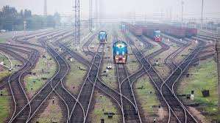
Never feel lost ........
All the tracks finally have some destination.......

Slide 71

Thank You

