Slide 1




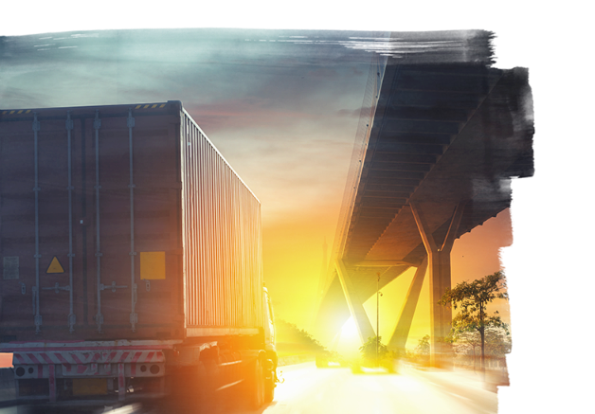
Logistics Sector
in India:
Where are we and Where do we go from here
7th December, 2018
© 2018 Jones Lang LaSalle IP, Inc. All rights reserved.
Surekha Bihani
Managing Director
Jones Lang Lasalle (JLL)
Kolkata

Slide 2
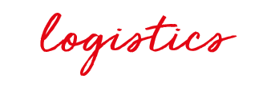
44th
in India?
Among 160 countries
Where are we?
LPI Rank, 2018
Zimbabwe, Myanmar, Iraq
India Mexico, Indonesia
China, UAE, South Africa
Germany, USA, Singapore
Early
Growth
Consolidation
Mature
India is currently under ‘Growth’ Phase and fast moving towards ‘Consolidation’ phase, which is expected in GST Regime.
Notes:
LPI (Logistics Performance Index)
is an interactive benchmarking tool created by Word Bank to help countries identify the challenges and opportunities they face in their performance on trade logistics and what they can do to improve their performance.

Slide 3
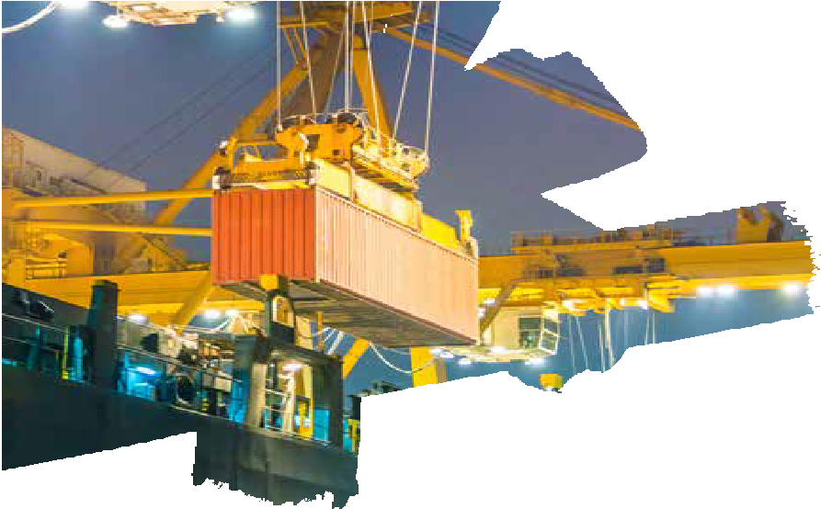


Infrastructure Catalyst
GST
EoDB
Infra Status
Integration of Ministries
10% of GDP
spent on infra
Make in India
Inter-modal
Connectivity
Road, Rail,
Water, Air
Policy Boosters
GROWTH DRIVERS
© 2018 Jones Lang LaSalle IP, Inc. All rights reserved.
© 2018 Jones Lang LaSalle IP, Inc. All rights reserved.
3
3
3
Notes:
Policy Boosters
Proposed export orientated industrial policy
Implementation of GST that erases the state boundaries for supply chain planning purposes
Granting Logistics an ‘infrastructure status’
Introduction of e-way bill (LPI score of 44th rank & Infra status for cheaper and easy credit)
EoDB rank 77 (Attempt to integrate - Ministry Of Shipping, Road Transport & Highways and Railways)
Infrastructure
The government increased budget expenditure on infrastructure for 2018-19 to INR 5.97 trillion from INR 4.94 trillion in 2017-18
‘Make in India’ initiatives to help growth of the manufacturing sector, local employability, optimum use of resources which in turn boost domestic consumption as well as export opportunity
Indian Government’s increasing thrust on core infrastructure sector as seen in projects
Dedicated Freight Corridors
Inland Waterways
Sagarmala Programme
Bharatmala Programme
is impacting the growth of industrial sector in the long run

Slide 4

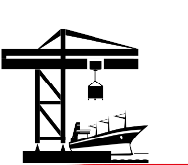
Dedicated industrial corridors & Freight corridors
to boost efficient industrial operation
SRINAGAR
AMRITSAR
LUDHIANA
DADRI
Multi-Modal Logistics:
Inland Waterways
for movement of cargo
MMLP project
initiated for modal shifting of cargo
KANDLA
KOLKATA
HALDIA
TAJPUR
VADHAVAN
PARADIP OUTER HARBOUR
MUMBAI
PARADIP
JNPT
LEGEND:
VISAKHAPATNAM
North-South Dedicated Freight Corridor
MACHLIPATTANAM
EDFC
MORMUGAO
WDFC
BELEKERI
Major ports
NMPT
ENNORE
Proposed Greenfield ports
CHENNAI
End-points of industrial corridor/ DFC
BENGALURU
Delhi-Chennai Industrial Corridor
KOCHI
Ludhiana-Kolkata Industrial Corridor
CUDDALORE
Delhi-Mumbai Industrial Corridor
ENAYAM
TUTICORIN
Bengaluru-Mumbai economic corridor
KANYAKUMARI
Chennai-Bengaluru Industrial Corridor
Bengaluru-Kolkata Industrial Corridor

Slide 5

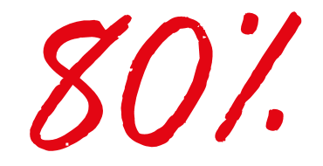

5% Warehousing
5% Customer Service
14%
9%
India’s GDP
is spent on Logistics
10% Packaging
Operating Cost
45% Transportation
Massive Opportunity
as we aspire to bring it down to 9% of GDP
15% Labour & Handling
Indian Logistics Sector
$370
billion
20% Inventories

Slide 6

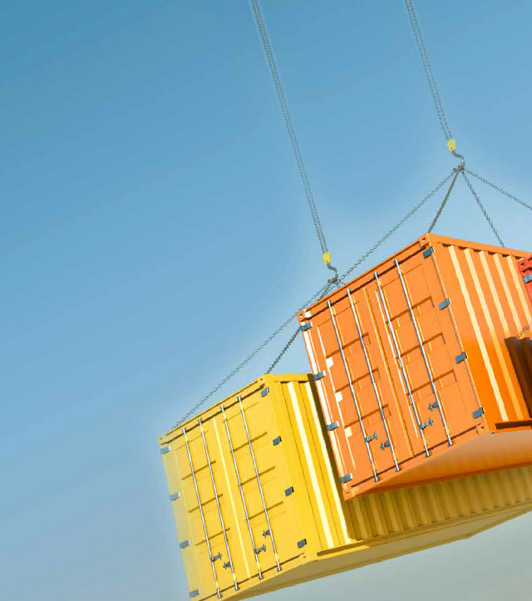
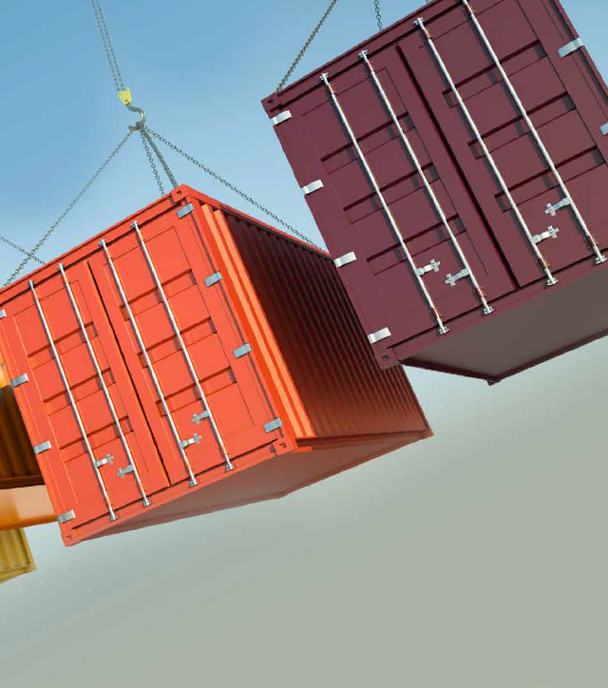
India Warehousing Market Size (mn sq ft)
286
2021
247
209
2020
2019
174
117
138
Grade A & B warehousing stock in 8 Primary Cities
2016
2017
2018*
Notes:
Estimated Warehouse Market Size to 174 mn sqft by 2018 year end

Slide 7
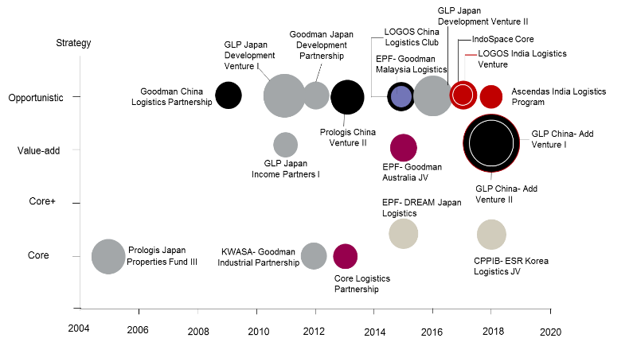
Investments
Select single country industrial and logistics joint venture programmes and strategic partnerships
9%
of Total PE Investment across all Asset Class
Logistics Sector
witnessed infusion of Private Equity Investment in 2017
Select Capital Partnering
IndoSpace | CPPIB
IndoSpace | GLP
ESR | Allianz
LOGOS | QuadReal/Ivanhoe
Firstspace | Ascendas
India starts getting PE interest
Year Establishment
(i) chart is as at October 2018
(ii) Notes:
- size of bubble indicates total (initial) equity commitment in US dollar
- excludes subsequent top-ups from strategic partners and/or sale of interests
Notes:
Indo-glp
Allinz – esr

Slide 8
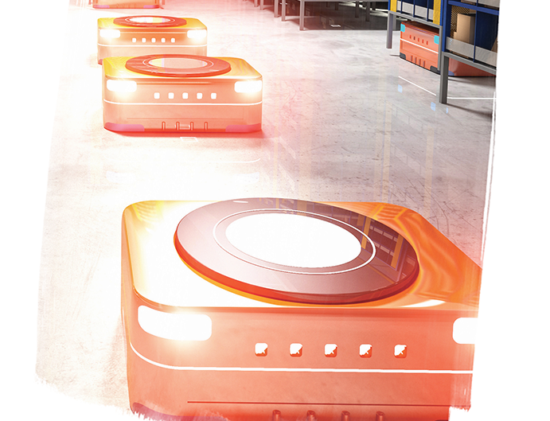

Outlook
Where do we go from here?
LOCATION | CAPITAL | STORAGE | TECH

Slide 9
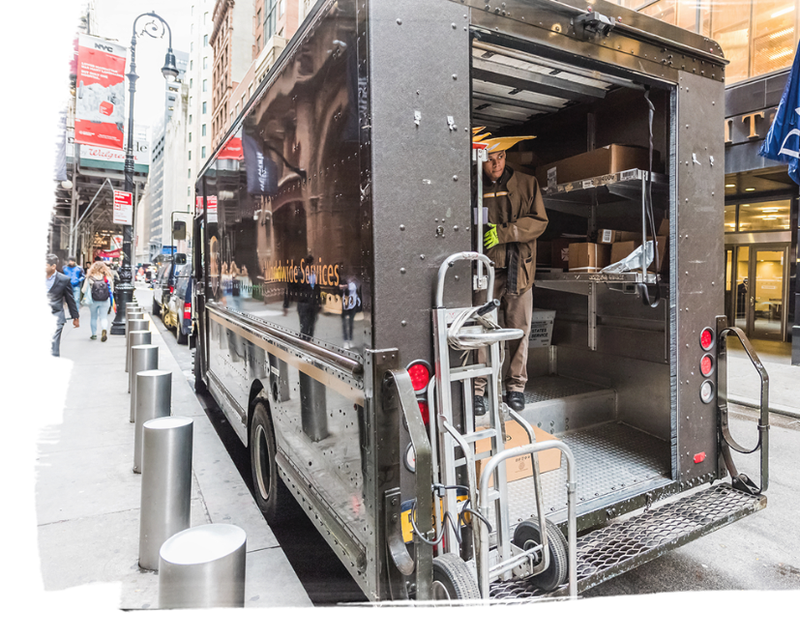

LOCATION
Following the Demand Drivers
In City
warehouses
Hub Spoke Facility
Multi-storey ramped warehouses
Shared Warehouses
Notes:
Multi-storey ramped warehouses, designed to be shared by multiple companies

Slide 10
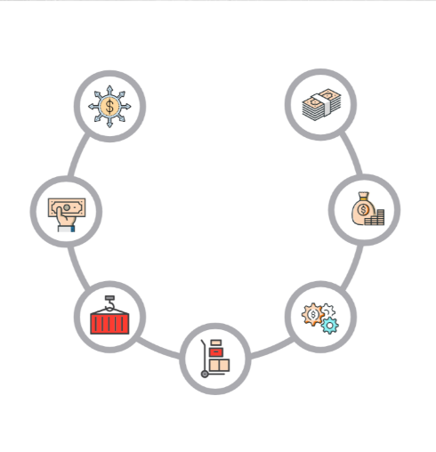

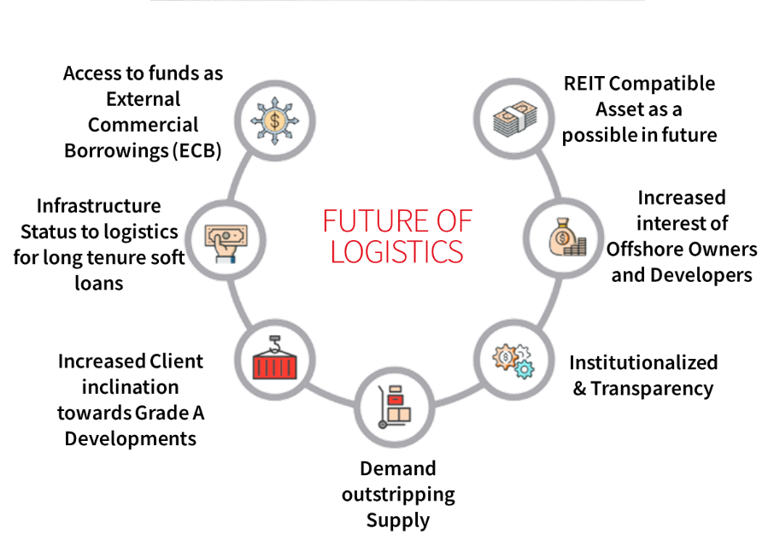

CAPITAL
Access to funds as External Commercial Borrowings (ECB)
REIT Compatible Asset as a possible in future
A Capital Opportunity
Infrastructure Status to logistics for long tenure soft loans
Increased interest of Offshore Owners and Developers
FUTURE OF LOGISTICS
Increased Client inclination towards Grade A Developments
Institutionalized & Transparency
Demand outstripping Supply
Notes:
Investments in LOGISTICS continues to be a sure bet, given preexisting structural shortages and vast new demand driven by e-commerce retailing

Slide 11


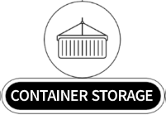
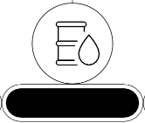


STORAGE
Rationalising Storage Scope
AGRICULTURE STORAGE
LIQUID STORAGE
COLD STORAGE
WAREHOUSE
Growing Potential
High Potential
Moderate Potential
Growing Potential
High Potential
DATA & DOCUMENT STORAGE
Nascent And Growing Market
in the country making it a potential investment domain in short to medium term.
SELF STORAGE SPACES
Nascent And Growing Market
With a large floating millenial population, it is a potential investment domain in medium to long term.
Notes:
Ease of decision making process through financial analysis. Site specific
analytics on real estate, capital expenditure, labour, and incentives potential.

Slide 12
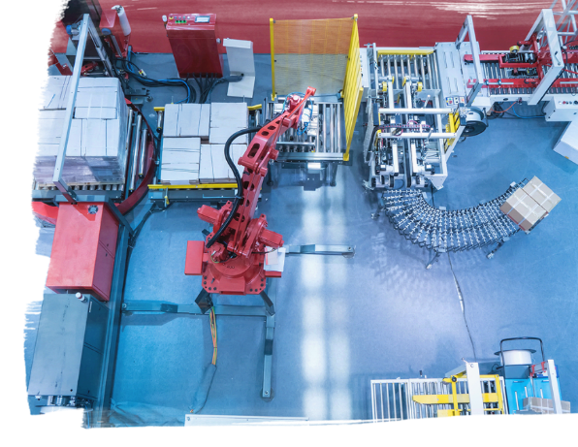
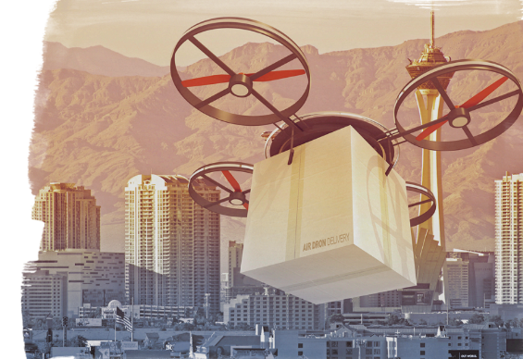
TECHnology
Efficiency Enhancement
Last Mile Delivery
Drones are the new trucks
Delivery Robots
Smart Operations/ MHE
-40%
+20%
Space requirement
efficiency
Notes:
The new drone policy released this week by GOI is to usher in Drone Delivery as a lucrative oppurtunity among e-commerce players mulling to increase their share in the highly competitive consumer space

Slide 13
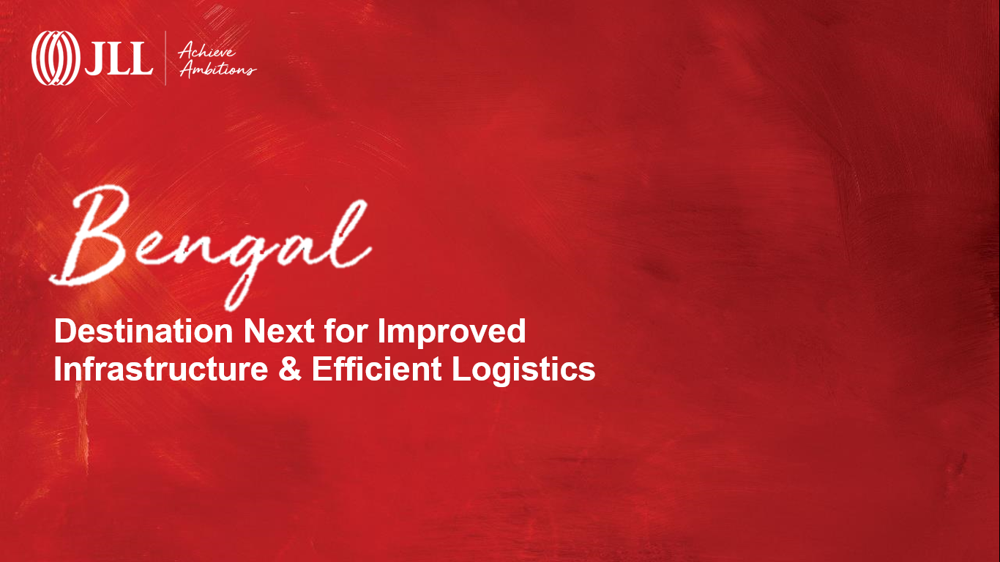

Destination Next for Improved Infrastructure & Efficient Logistics

Slide 14
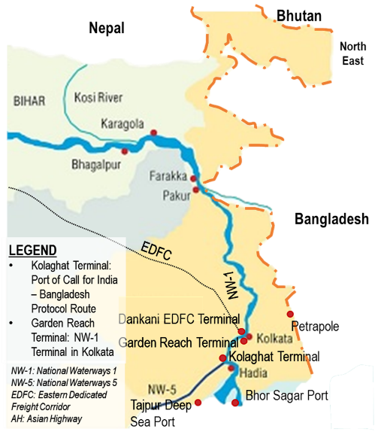
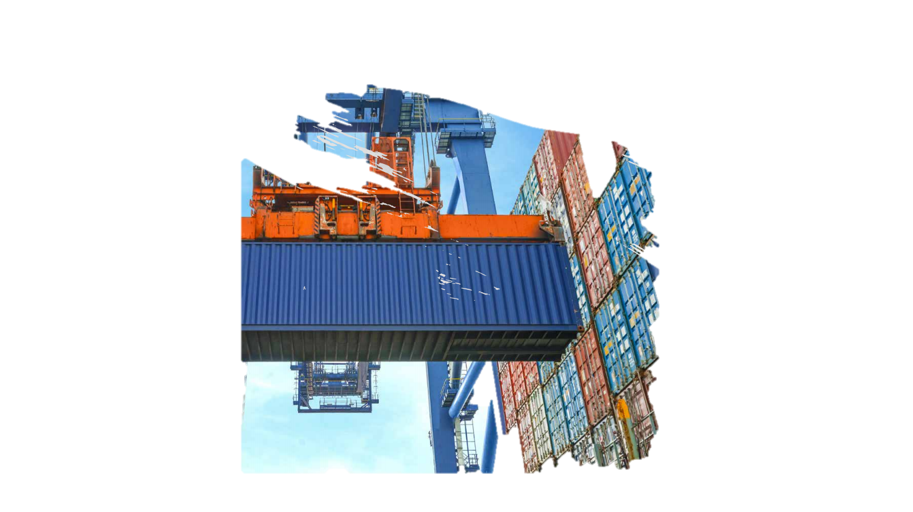
At a Glance
91.3 million
Population
Siliguri
USD 140.2 billion
GSDP at Current Prices
Vast waterways, Roadways and railways conncectivity
Asansol-Durgapur
12.02%
GVA y-o-ygrowth rate
Kolkata
Haldia
Source:West Bengal, IBEF Report, 2017; website - (https://www.ibef.org/download/West_Bengal-January-2017.pdf), BGBS website

Slide 15

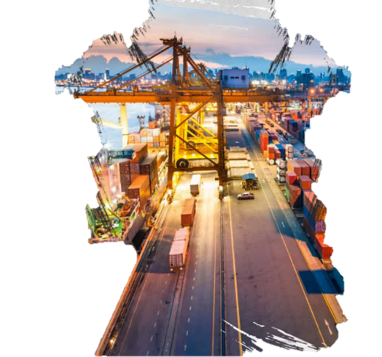


Growing Logistics Potential
Cross-country distribution advantage:
Bhutan border Road, Asian Highway II to improve the cross country distribution positioning of Bengal.
Higher infrastructure spending:
INR 202 billion allocated in 2017 state budget for the purpose of infrastructure development
Inland Waterway Distribution Advantage:
Proposed 1,620 kms long National Waterway 1 (NW-1) on Ganga from Haldia to Allahabad is inspected to add an extra logistics distribution model.
1
~1.8
Mn. Sft
WH Transacted in 2018
Notes:
AS on date –Absorption - Dec – 1.8 mn. Sft

Slide 16


