Slide 1
Land Ports Authority of India (Development of Integrated Check Posts) ‘THE GAME CHANGER’
Land Ports Authority of India
Department of Border Management
Ministry of Home Affairs
New Delhi

Slide 2
Prologue – Land Ports Authority of India
Securing the country’s borders against interests hostile to the country and putting in place systems that are able to interdict such elements while facilitating legitimate trade and commerce are among the principal objectives of Government of India.
The infrastructure available with Customs, Immigration and other regulatory agencies on land borders is generally inadequate.
Support facilities like warehouses, parking lots, banks, hotels etc, are either inadequate or absent.
All regulatory and support functions are generally not available in one Complex. Even when located in close proximity, there is no single agency responsible for coordinated functioning of various Government authorities and service providers.

Slide 3
Prologue – Land Ports Authority of India
To redress this situation Committee of Secretaries (CoS) recommended setting up of Integrated Check Posts at major entry points on India’s land borders.
These Integrated Check Posts should house all regulatory agencies like Immigration, Customs, Boarding Guarding Force, Plant and quarantine etc. together with support facilities like parking , warehousing, banking, foreign exchange bureau public convenience etc in a single walled sanitized complex equipped with all modern amenities.
The CoS also recommended establishing an institutional frame work that could undertake construction, management and maintenance of such integrated facilities.

Slide 4
Modern Passenger Terminal with the following facilities:
Dedicated and separate facility for processing arrival and departure passengers.
Modern Infrastructure for Immigration and Customs Clearances.
VIP Lounge, Prayer Room, Retail Areas, Child Care Room, Foreign Exchange Bureau and Canteen.
Offices of Customs, Immigration, Health, Public Convenience Training Room, Conference Hall.
Free ferry service at Attari and Agartala for passengers between zero point and passenger terminal

Slide 5
Cargo Terminal Building with following facilities:
Separate offices/working area with modern facilities for Customs, Plant & Quarantine Laboratory, Custodian, Bank and Clearing Agents, an EDI Room, Control Room and Waiting Hall.
Separate warehouses with cold storage facilities for import and export cargo.
Weigh bridges – dedicated and separate for Exports/Imports
Quarantine Block with doctor’s room, sick room, laboratory and holding area.
Area for loose cargo
Electrical sub-station
Secure and well lighted premises with CCTV surveillance, PA system and fire alarm system.
Separate parking area for passengers and cargo vehicles.
Toilets, canteen and rest area for drivers

Slide 6
Prologue – Land Ports Authority of India
Established under Land Ports Authority of India Act-2010
LPAI came into being from 1st March 2012
A Statutory Body under Department of Border Management, Ministry of Home Affairs.
The Mandate of Authority is to develop, sanitize and manage the facilities for cross-border movement of passengers and goods at designated points along the international land borders of India

Slide 7
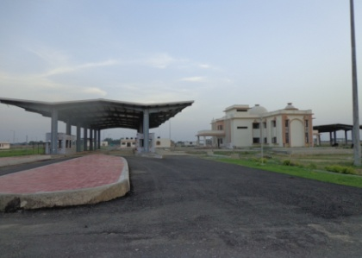
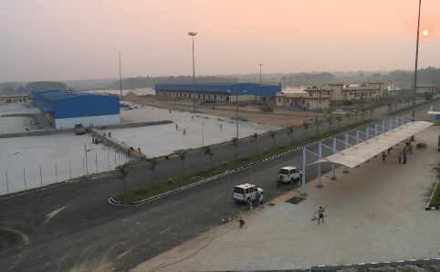
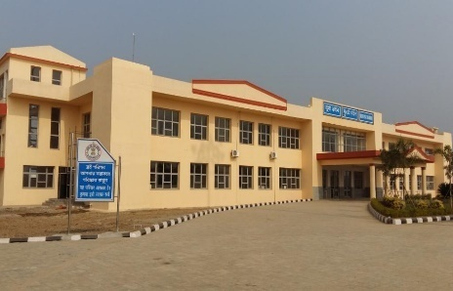
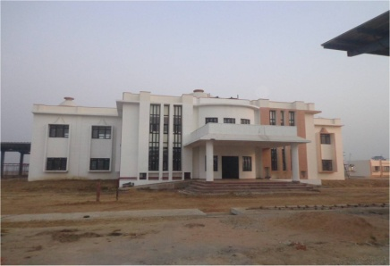
STATUS OF PHASE-I ICPs PROJECT
S.No | ICPs | STATE | BORDER | STATUS
1 | Attari | Punjab | Indo-Pakistan | Operationalized on 13.04.2012
2 | Agartala | Tripura | Indo-Bangladesh | Operationalized on 17.11.2013
3 | Petrapole | W.B. | Indo-Bangladesh | Operationalized on 12.02.2016
4 | Raxaul | Bihar | Indo-Nepal | Operationalized on 03.06.2016
5 | Jogbani | Bihar | Indo-Nepal | Operationalized on 15.11.2016
6 | Moreh | Manipur | Indo-Myanmar | Passenger Terminal operationalized in March, 2018.
7 | Dawki | Meghalaya | Indo-Bangladesh | Foundation stone laid by Hon‘ble MoS (Home) on 24.01.2017. Work in progress.

Slide 8
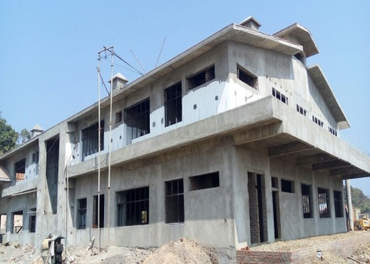
Completed Projects at a Glance
INTEGRATED CHECK POSTS OF LPAI

Slide 9
India-Pakistan Revenue at ICP, Attari
INR in crores
YEAR
 | 2010-11 | 2011-12 | 2012-13 | 2013-14 | 2014-15 | 2015-16 | 2016-17 | 2017-18 upto feb
Import | 452.08 | 965.00 | 1748.10 | 2053.70 | 2367.94 | 2414.08 | 2907.36 | 3177.59
Export | 1170.42 | 1375.15 | 3052.14 | 3390.02 | 2177.44 | 1328.14 | 1063.63 | 964.13
Revenue | -NA- | 86.79 | 145.32 | 172.10 | 196.43 | 174.60 | 242.49 | 398.73

Slide 11
78500
Years
 | Passengers Movement
Years | Incoming | Outgoing | Total
2012-13 | 39250 | 39250 | 78500
2013-14 | 43402 | 43402 | 86804
2014-15 | 54559 | 54559 | 109118
2015-16 | 49987 | 49987 | 99974

Slide 12
282.399
245.15
266.14
INR in crores
165
Years
Trade
Years | Incoming
2012-13 | 245.15
2013-14 | 165
2014-15 | 266.14
2015-16 | 282.399

Slide 13
37715
Years
 | Passengers Movement
Years | Incoming | Outgoing | Total
2012-13 | 17371 | 20,344 | 37715
2013-14 | 25336 | 26392 | 51,728
2014-15 | 38559 | 39621 | 78180
2015-16 | 44551 | 45904 | 90455

Slide 14
India- Bangladesh Trade at ICP, Petrapole
18501.69
16341.10
15187.43
INR in crores
2684.62
2367.11
YEAR
 | 2014-15 | 2015-16 | 2016-17
Import | 2367.11 | 2684.62 | 2847.47
Export | 12820.32 | 13656.48 | 15654.22
Total | 15187.43 | 16341.10 | 18501.69

Slide 15
India- Bangladesh passenger movement ICP, Petrapole
1589246
1910316
1258684
Years
 | Passengers Movement
Years | Incoming | Outgoing | Total
2014-15 | 639865 | 618819 | 1258684
2015-16 | 798713 | 790533 | 1589246
2016-17 | 986864 | 923452 | 1910316

Slide 16
Projects in pipeline
Development of 13 ICPs.
Development of Passenger Building Terminal at Petrapole.
Developing infrastructure at 69 LCS.
Development of Rail Linked ICP at Nichantpur – Agartala.
Development of ICP at Sabroom - Tripura

Slide 17
Development of Integrated Check Posts at 13 Locations
S.NO | Location | Border
1. | Hili - west Bengal | Bangladesh
2. | Changrabandha-Uttar Pradesh | Bangladesh
3. | Ghojadanga-West Bengal | Bangladesh
4. | Mahadipur-West Bengal | Bangladesh
5. | Fulbari-West Bengal | Bangladesh
6. | Sutarkandi-Assam | Bangladesh
7. | Kawrpuichhuah-Mizoram | Bangladesh
8. | Jaigaon- West Bengal | Bhutan
9. | Panitanki- West Bengal | Nepal
10. | Sunauli- Uttar Pradesh | Nepal
11. | Rupaidiha-Uttar Pradesh | Nepal
12. | Bambasa- Uttarakhand | Nepal
13. | Bhitamore-Bihar | Nepal

Slide 18
INTEGRATED CHECK POST PROJECTS
PHASE I & II
Land Ports Authority of India
Ministry of Home Affairs,
Government of India
PHASE - I
ATTARI - WAGAH
PHASE - II
BANBASA-MAHENDRA NAGAR
RUPAI DIHA - NEPALGANJ
SUNAULI - BHAIRAHAWA
BHITTAMORE - JALESWAR
JAIGAON- PHUENTSHOLING
RAXAUL - BIRGANJ
PANITANKI - KAKARBITA
JOGBANI - BIRATNAGAR
CHANGRABANDHA - BURIMARI
HILI - HILI
DAWKI - TAMABIL
FULBARI - BANGLABANDHA
SUTARKHANDI - SHEOLA
MAHADIPUR- SONA MAJID
MOREH - TAMU
AGARTALA - AKHAURA
PETRAPOLE - BENAPOLE
GHOJADANGA - BHORMA
KAWARPUCHIAH - THEGAMUKH

Slide 19
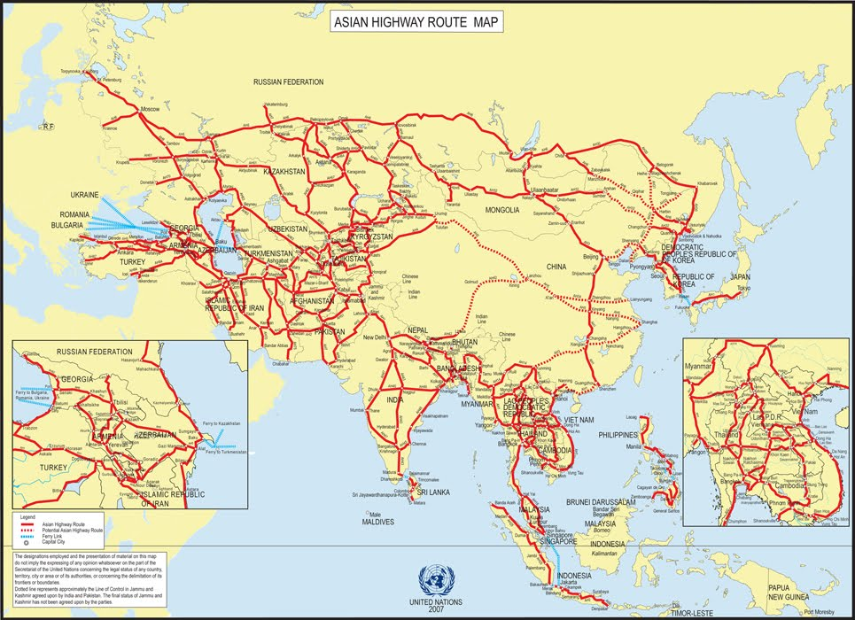

Slide 20
S.No | ICP | India National Highway | Asian Highway | Rail | Trade Rs. In crs | Passenger
1 | Jaigaon | NH317A | AH 48 and AH2 For Connecting India, Nepal & Bangladesh |  | 595.28 | 9764
2 | Hili | NH512/NH27 |  |  | 1150.23 | 102476
3 | Ghojadanga | NH 19 |  |  | 2482.82 | 204391
4 | Sunauli | NH29E |  |  | 7754.78 | 57,453
5 | Panitanki | NH27 |  |  | 1525.68 | 22,548
6 | Changrabandha | NH27 |  |  | 177.79 | 64,328
7 | Sutarkandi | NH27 |  |  | 114.02 | 5,690
8 | Rupaidiha | NH927 |  |  | 1407.62 | 546
9 | Kawrpuichhuah | NH302 |  |  | - | -
10 | Mahadipur | NH27 |  |  | 1323.81 | 66,393
11 | Fulbari | NH31 |  |  | 114.01 | 16,328
12 | Banbasa | NH9 |  |  | 550.73 | 43,087
13 | Bhithamore | NH227 |  |  | 469.96 | -

