Slide 1
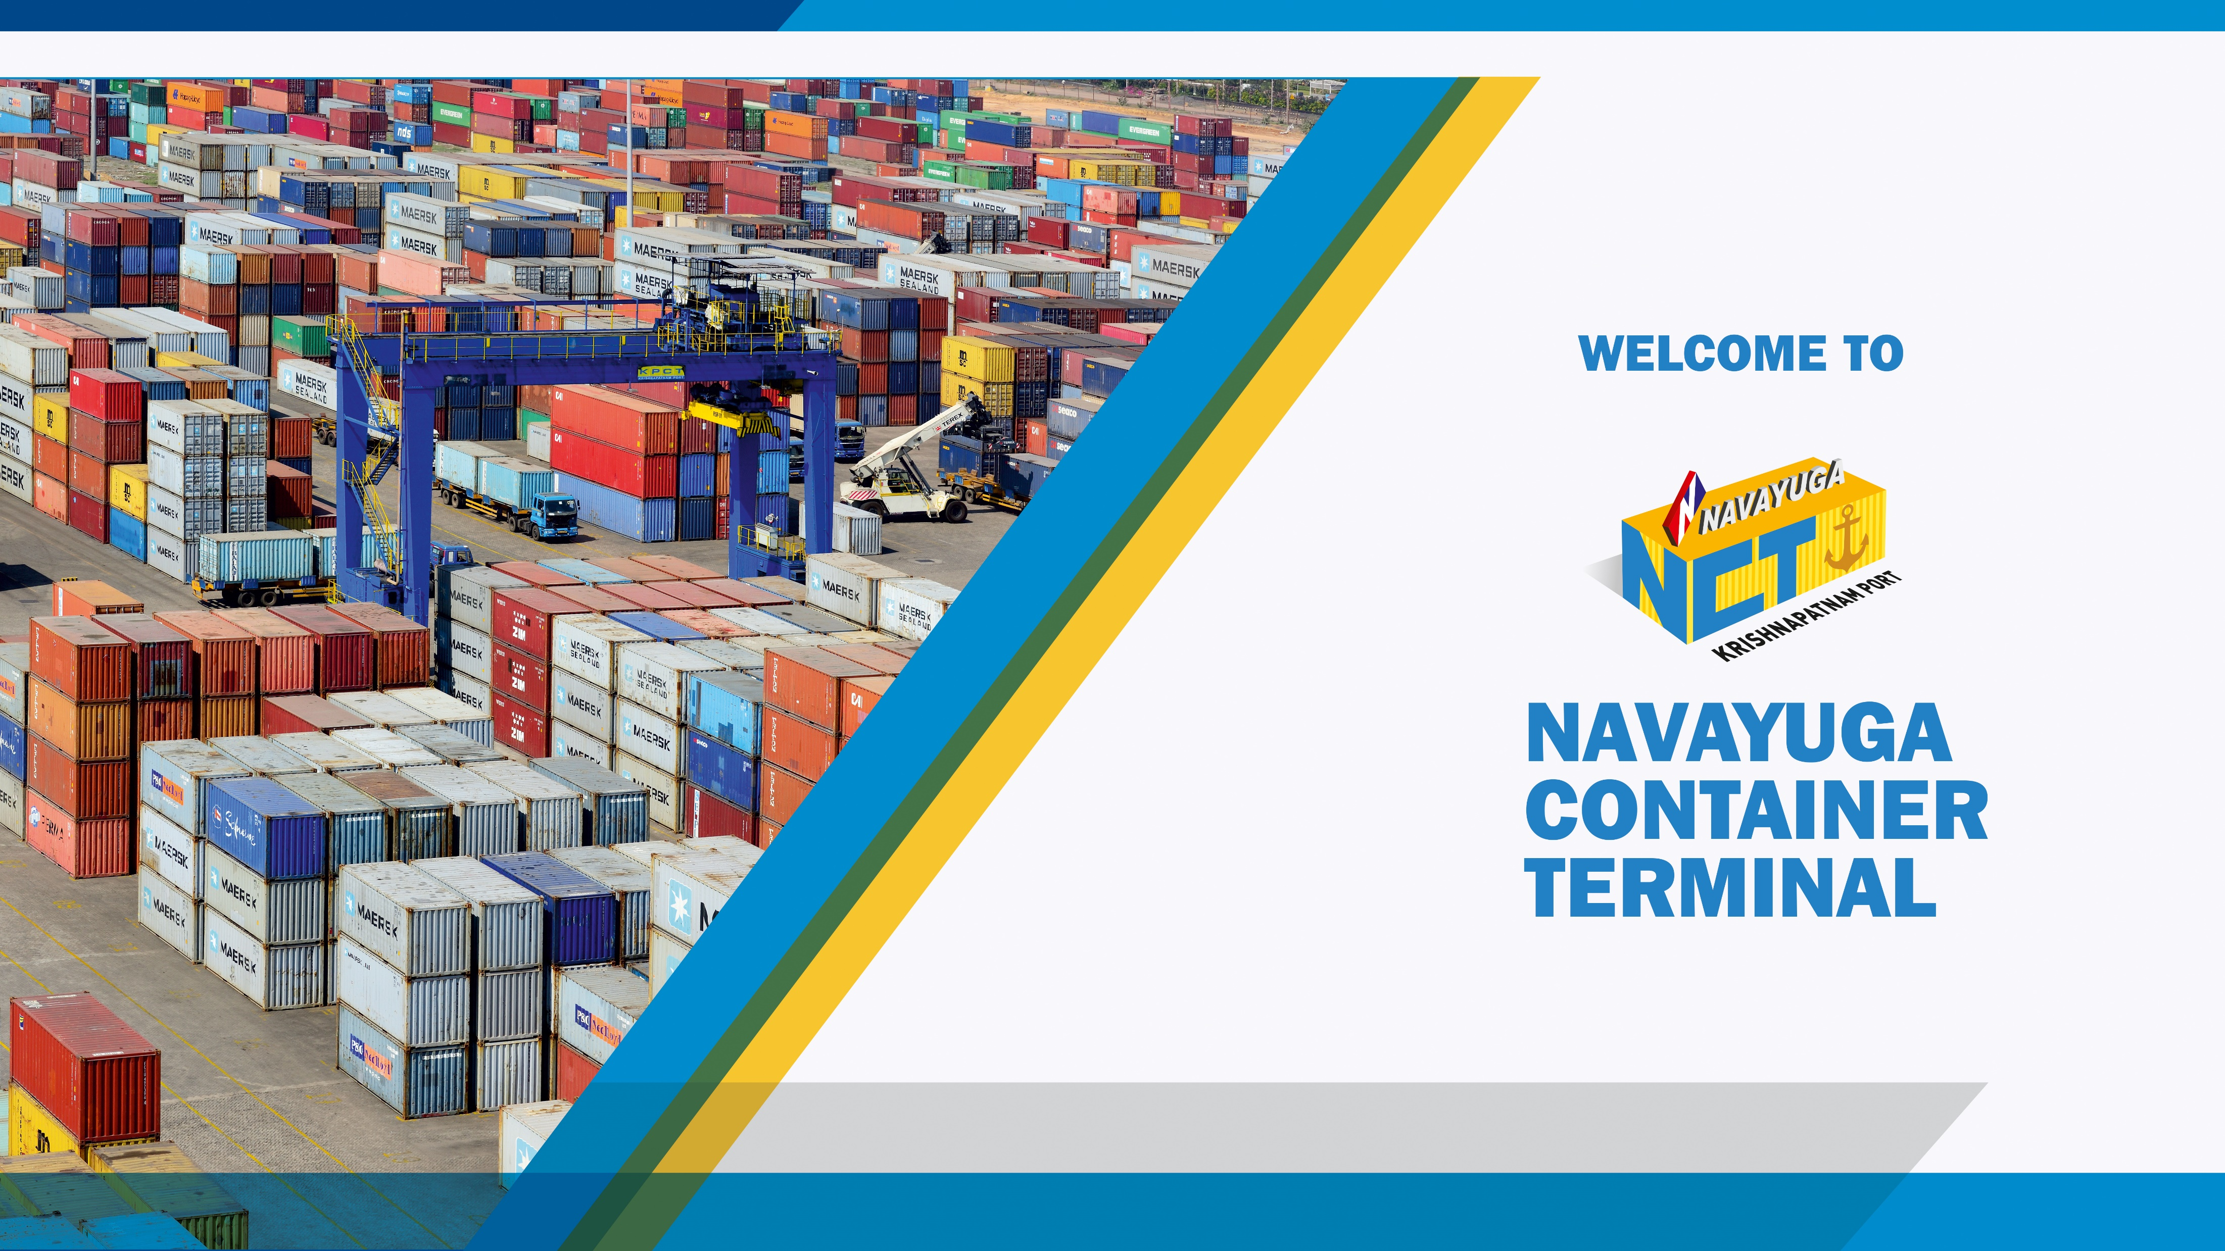
Bengal Chamber of Commerce & Industry
Kolkata, 7th December 2018

Slide 2


Government of India Initiatives

Slide 3

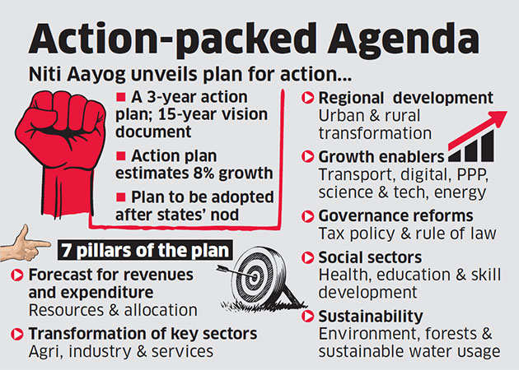
Niti Aayog Vision
Transport and Digital Connectivity
Strengthen infrastructure in roadways, railways, shipping & ports, inland waterways and civil aviation.
Ensure last-mile digital connectivity, particularly for e-governance and financial inclusion, through developing infrastructure, simplifying the payments structure and improving literacy.

Slide 4
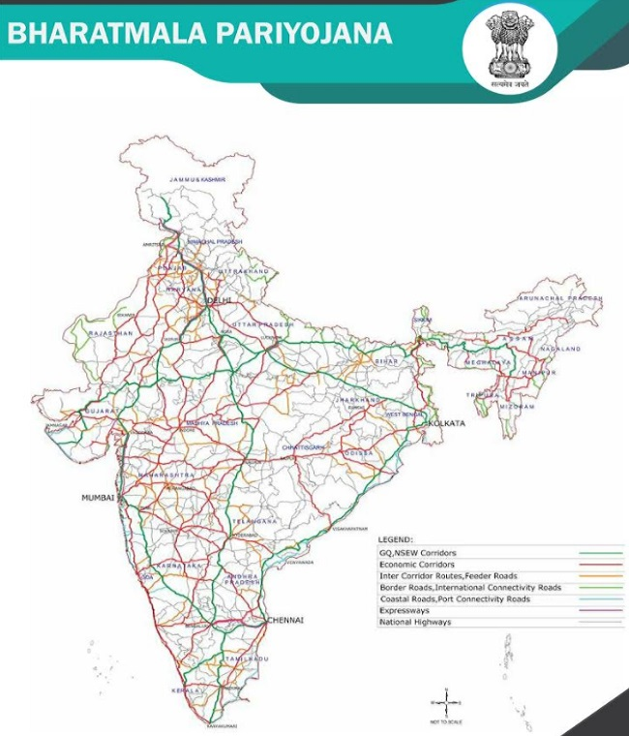
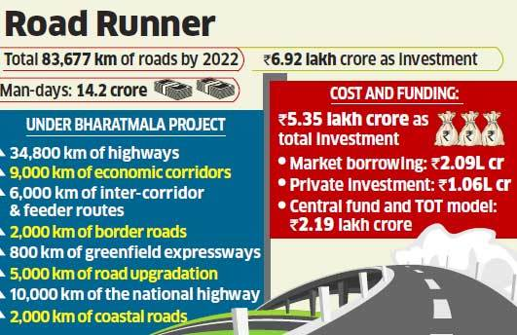
Bharatmala Road Network

Slide 5
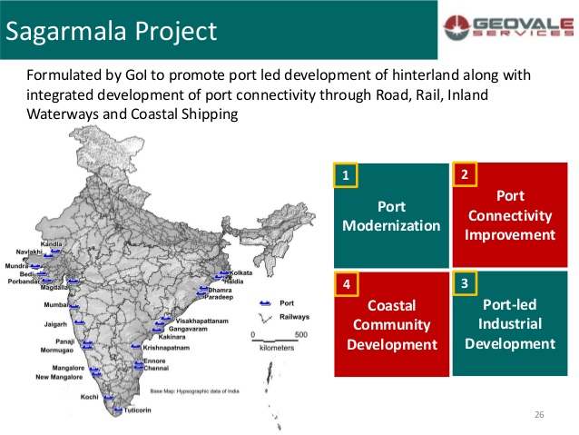

Slide 6
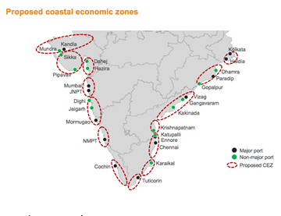
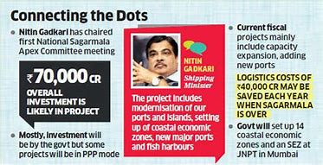
Coastal Economic Zones
Cabotage Waiver !

Slide 7
INFRASTRUCTURE & SERVICES

Slide 8
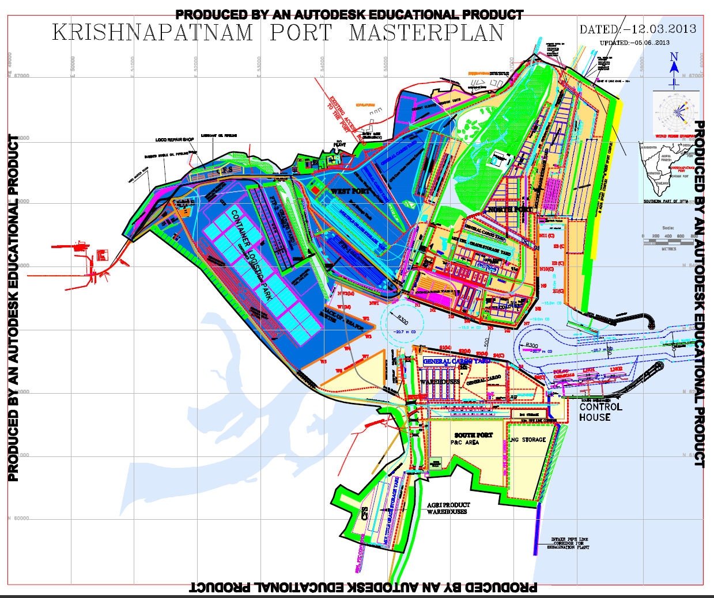
Access / Evacuation by Road
2
11 berths
70 MMT
1.2 m TEU Terminal
Super Post Panamax QCs
Rail Siding alongside
Port : 6800 acres
External Land : 12000 acres
Draft : 18.5 m
1
Future development
4.8 m TEU Terminal
  Future Expansion
  42 berths with capacity – 200 MTPA
  Container capacity – 6 Mn TEUs
  Deepest draft – 22 mts
3

Slide 9
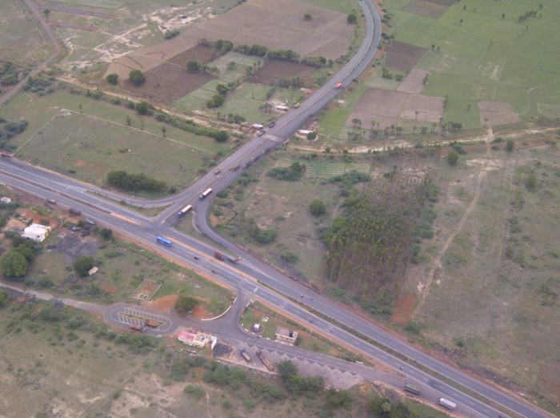
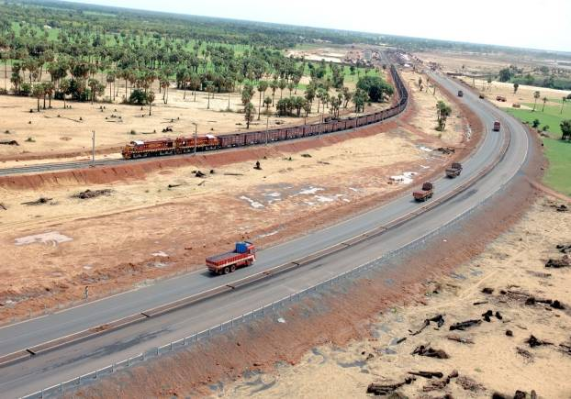
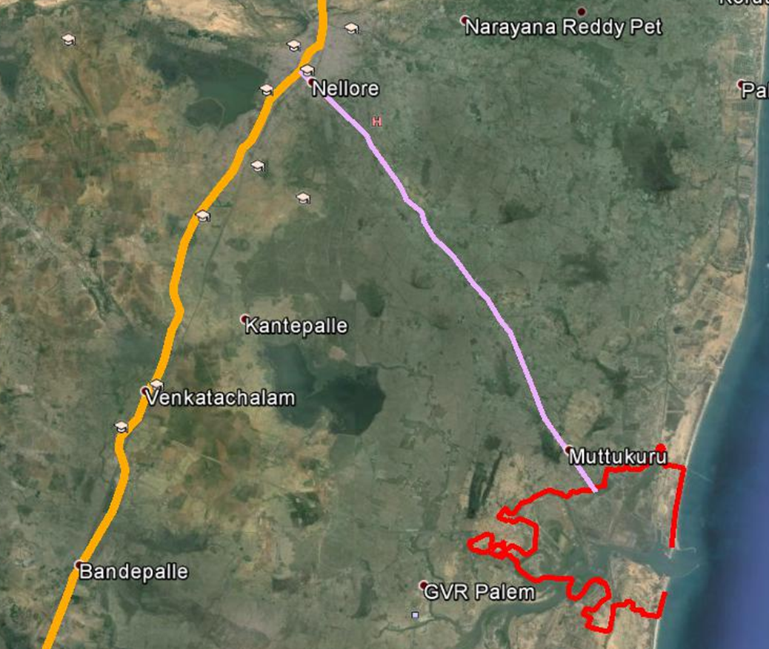
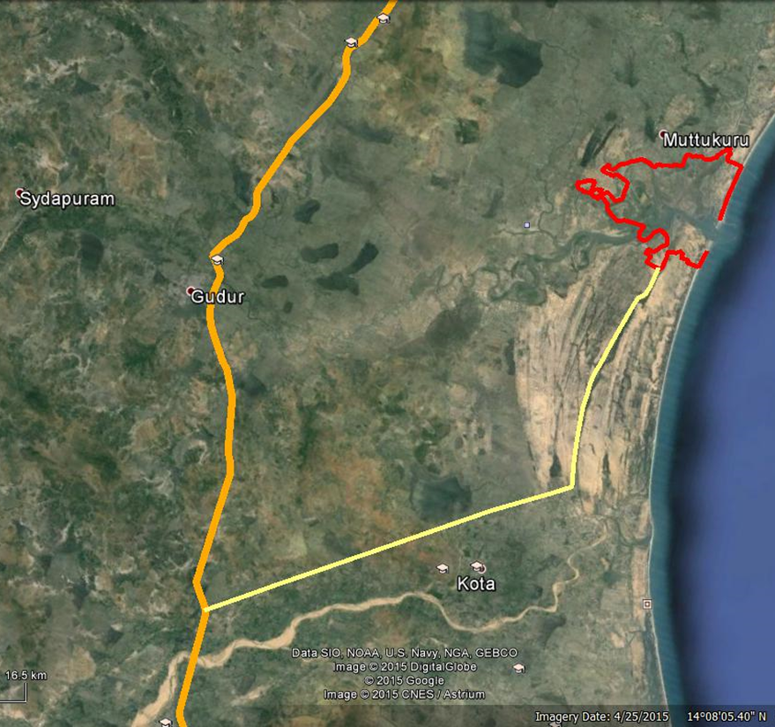
Road Connectivity Infrastructure
1
Dedicated 4-lane road
NH-5: Chennai to Kolkata
NH-5 Junction
2
3 access/ evacuation roads- West, North & South
3

Slide 10

Road widening approved
New Road Connectivity Projects
National Highway
Current Western Road
Widening to 6 lane approved
All projects approved by Govt
Tenders issued for construction
Tenders awarded
2-3 year timeline for the completion of all
3 New Roads approved

Slide 11
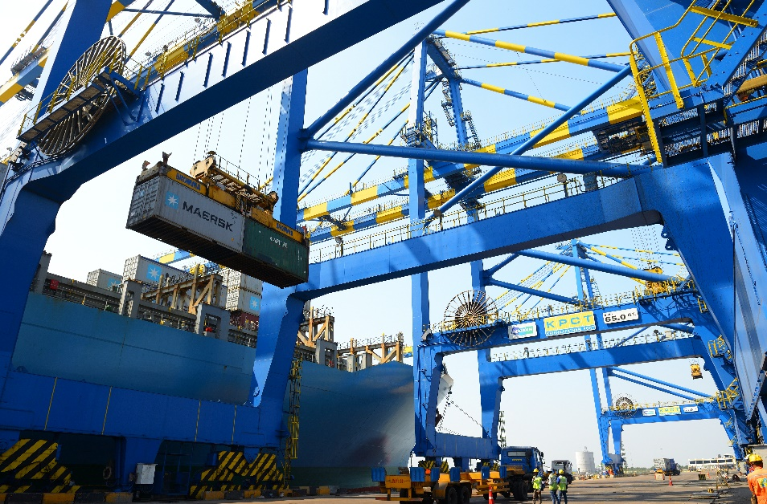
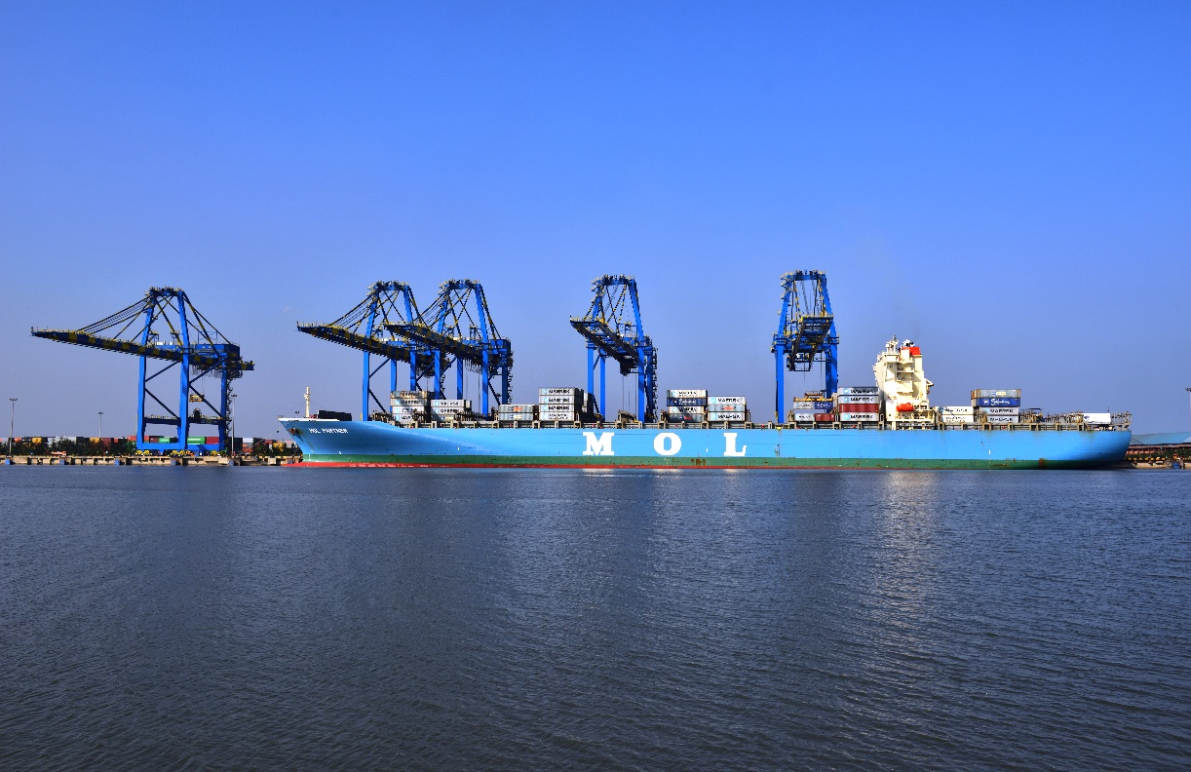
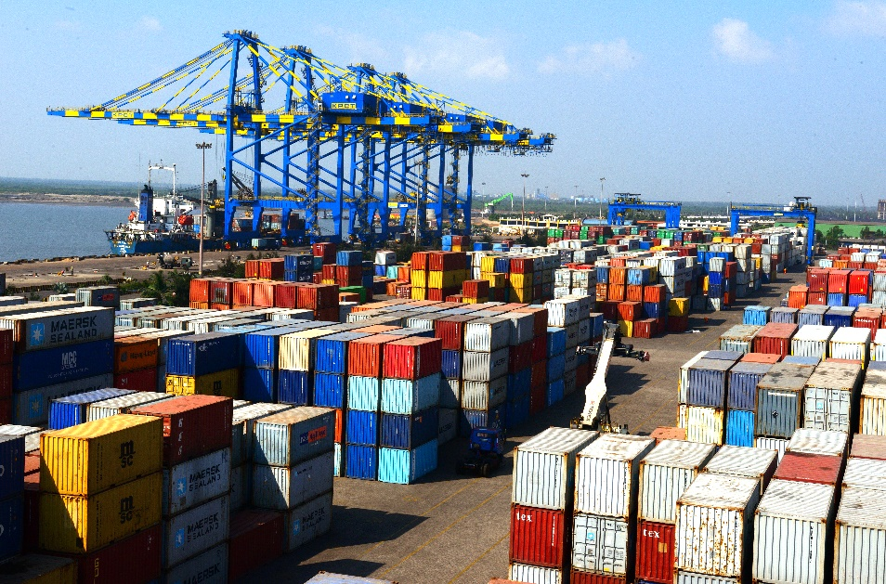
NCT – Terminal Infrastructure
16m draft
 | Phase I | Phase II
Date of Commissioning | Sep 2012
Container Berths | 2 | 7
Total Berth Length | 650 | 2000
Terminal Capacity | 1.2 Mn TEUs | 4.8 Mn TEUs
Draft Alongside | 16 mts | 21 mts
Total Area (hectares) | 36 ha | 600 ha
Yard Ground slots | 4600 TEUs | >10,000 TEUs
Yard Capacity | 18400 TEUs | >40,000 TEUs
Reefer plugs | 200 | >1000
Quay cranes twin lift SPP | 5 | 20
Rubber Tyred Gantry | 9 | 40x42 MT
Reach Stackers (Kalmar) | 10 x 42 MT | > 30

Slide 12
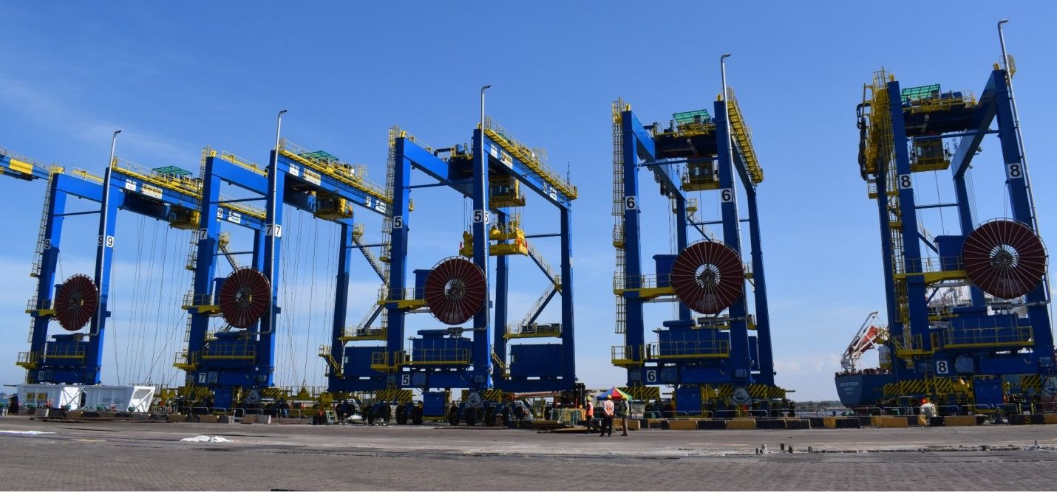
5 New RTGs
Commissioned
July 2018
5 new e-RTGs which have the potential to reduce energy costs by 80% and operating noise level by 65% whilst cutting down more than 1400 tonnes of Greenhouse Gases (GHG) emissions vis-à-vis the traditional diesel run RTGs.

Slide 13
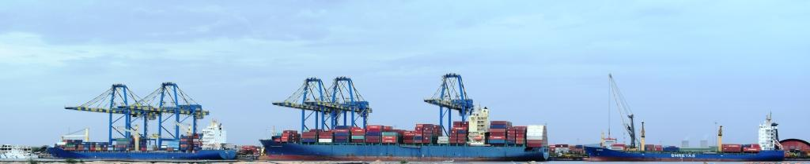
Berth Extension Plan
Current Coastal vessels : 150 m additional quay length; Handled with 2 MHCs
Scheduled for upgradation to a regular berth
Total Quay length : 650 +150 +100 = 900m
3 SPP QCs – new acquisition
Back up yard : Terminal capacity upgradation to 2 m TEUs

Slide 14
Berth Extension Plan
Scheduled upgradation
2019 / Qtr2
Timeline for readiness of the quay line extension to 900m and deployment of 3 new QCs : June 2019

Slide 15
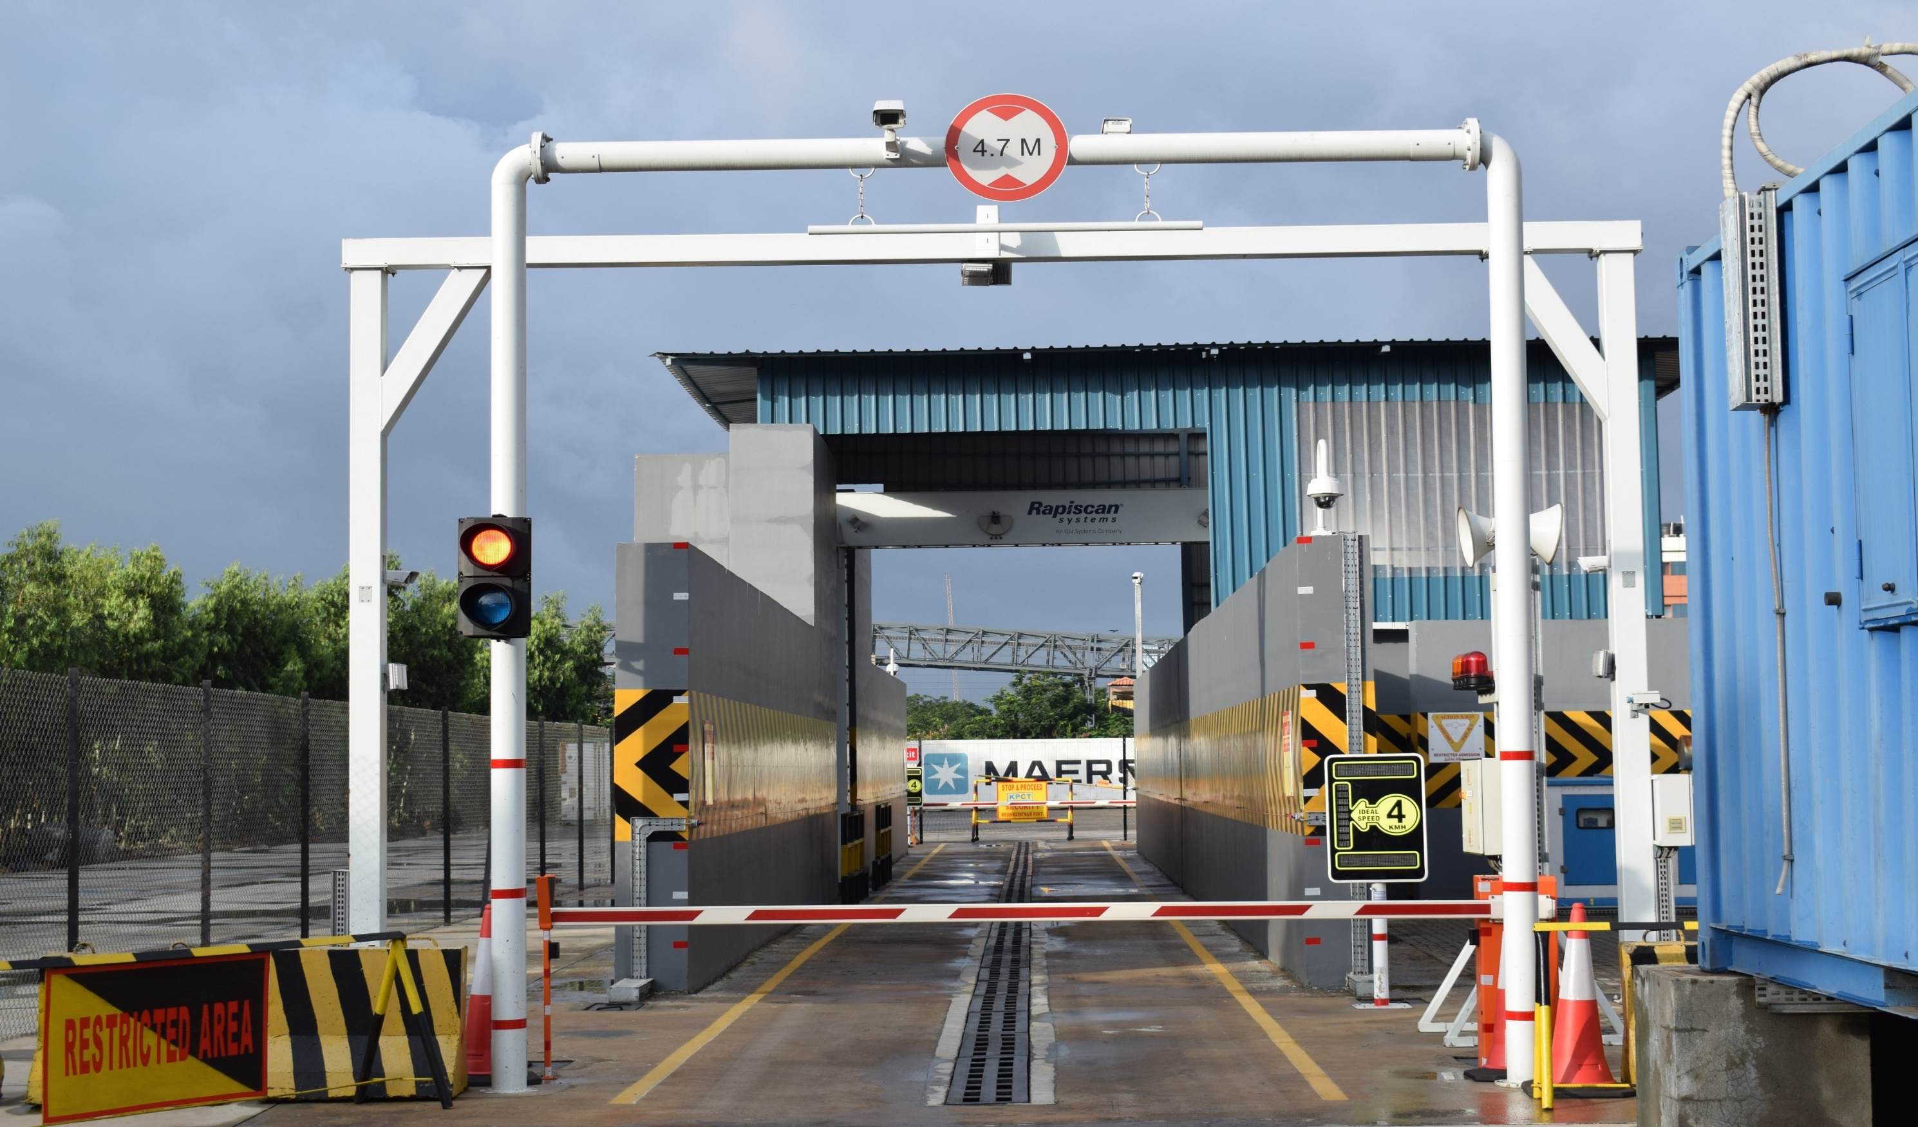
Container Scanner
Rapi Scan Scanner
Trailer Drive Through
Most sophisticated drive through container scanner installed, commissioned and Operational at NCT
Permission granted from 9th May 2018

Slide 16
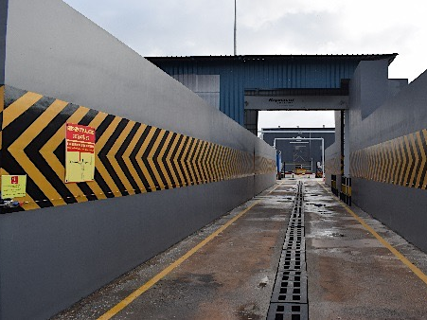
Container Scanner
1ST OF ITS KIND IN INDIA!
Rapiscan Eagle P60
High Throughput Inspection with a Portal Scanner
Inspect Dense Cargo with Powerful 6 MV X-ray Imaging
Find Contraband with Material Separation
Penetration up to 320 mm of steel
80 Scans / Hour

Slide 17
Vessel Services

Slide 18
Vessel Services at NCT
Service | Operator | Coverage Area | Frequency | Day of Call
Shuttle | Maersk | Colombo – Salalah - Colombo | Weekly | Sunday
CHX | Maersk | Tanjung Pelepas – Xingang - Qingdao - Busan- Shanghai - Nansha | Weekly | Monday
CCG | Simatech EMC | Colombo - Jebel ali | Tri Monthly | Tuesday
CCS-1 | FAR Shipping | Colombo | Weekly | Wednesday
ACS | Hyundai/ Zim | Port Klang – Singapore – Cai Lan - Busan – Ulsan – Shanghai – Ningbo – Yantian | Weekly | Friday
PIX-2 | Shreyas | Tuticorin – Cochin – Jebel Ali -Mundra | Weekly | Friday
 |  | Coastal Feeder Services for Transhipment Containers
ECS 2 loops/3 vessels | Shreyas | 1. Krishnapatnam - Haldia – Paradip /Vizag/Kakinada - Krishnapatnam 2. Krishnapatnam - Kolkata - Krishnapatnam | Tri-Weekly | Indian Flag feeder for transhipment containers
Bharat Feeder | Samudera | Krishnapatnam - Vizag - Kolkata - Krishnapatnam | Bi Monthly | Indian Flag feeder for transhipment containers
EXX | XCL | Kolkata – KICT - Krishnapatnam | Weekly | Foreign Flag feeder for transhipment containers

Slide 19
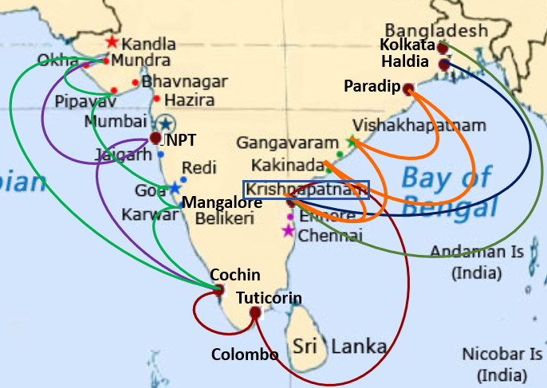
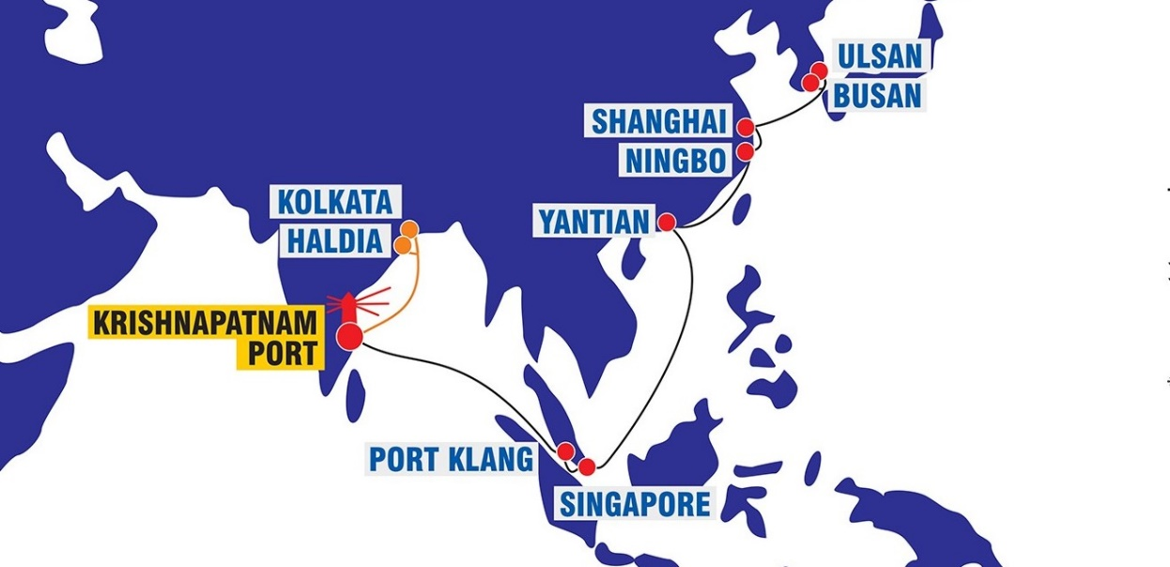
Coastal Feeder Network Efficiency
Shreyas, SCI, Samudera – Indian Flag
Xpress Feeders – Foreign Flag
5 coastal feeder sailings per week
Better utilization of feeder vessel : Singapore – Kolkata : 6.5 days Krishnapatnam – Kolkata : 3.5 days
Nov 2018
20600 TEUs T/P vol

Slide 20
East Coast Service – Shreyas Shipping
VESSEL | ETD Kolkata | ETA INKRI
Indian Express 003 | 07-Dec | 09-Dec
SSL Chennai 109 | 10-Dec | 12-Dec
Indian Express 004 | 17-Dec | 19-Dec
SSL Chennai 110 | 20-Dec | 22-Dec
Indian Express 005 | 27-Dec | 29-Dec
SSL Chennai 111 | 30-Dec | 01-Jan
Feeder Vessel Services
Krishnapatnam to Kolkata/Haldia
4 sailings per week
Every alternate day departure
EXX Service – Xpress Feeder
VESSEL | ETD Kolkata | ETA NCT
X-Press Hoogly 18209 | 06-Dec | 09-Dec
X-Press Hoogly 18210 | 16-Dec | 19-Dec
X-press Meghna 18079 | 26-Dec | 29-Dec
X-press Meghna 18080 | 05-Jan | 08-Jan
X-Press Hoogly 18212 | 09-Jan | 12-Jan
X-Press Hoogly 18213 | 19-Jan | 22-Jan
X-press Meghna 18082 | 28-Jan | 31-Jan
ECX Service – Shreyas Shipping
VESSEL | ETD Colombo | ETD Haldia | ETD PRT | ETD KAK | ETA INKRI
SSL Gujarat 79W | - | 01-Dec | 02-Dec | - | 05-Dec
SSL Gujarat 80S | 08-Dec | - | - | - | 11-Dec
SSSL Visakhapatnam 68S | - | 10-Dec | - | 12-Dec | 13-Dec
SSSL Visakhapatnam 69N | 16-Dec | - | - | - | 18-Dec
SSL Gujarat 80N | - | 16-Dec | - | - | 19-Dec
SSSL Visakhapatnam 69S | - | 24-Dec | - | - | 26-Dec
SSL Gujarat 81S | 23-Dec | - | - | - | 26-Dec

Slide 21
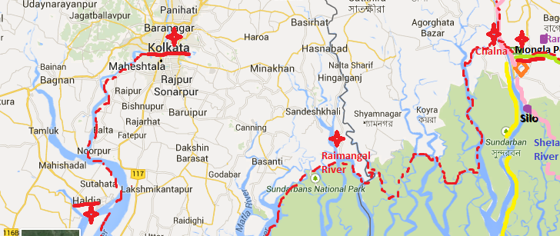
Coastal Feeder Network Efficiency
Need for Infrastructure upgrade for window berths.
Priority berthing for Coastal Vessels can be considered
Acceptance by receivers / shippers for shipments via Haldia will increase the efficiency of coastal feeders.

Slide 22
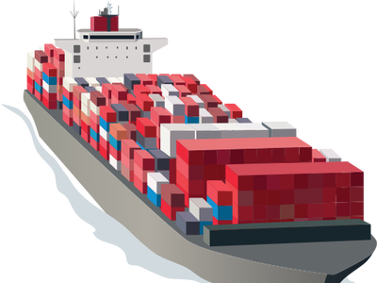
Cargo Control: India’s imports are controlled by overseas suppliers
Importers being subjected to higher logistics costs
Action Needed!
Conversion of import contracts from CIF to FOB

Slide 23
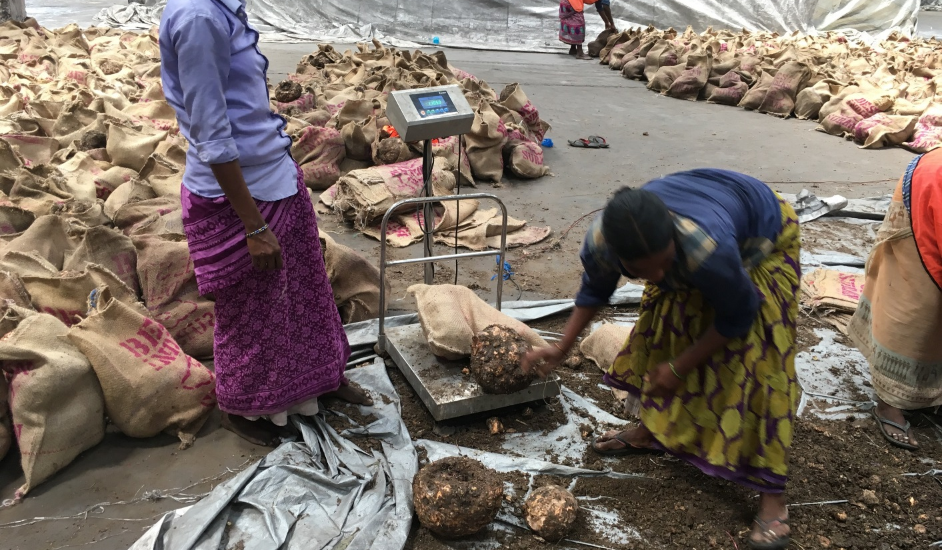
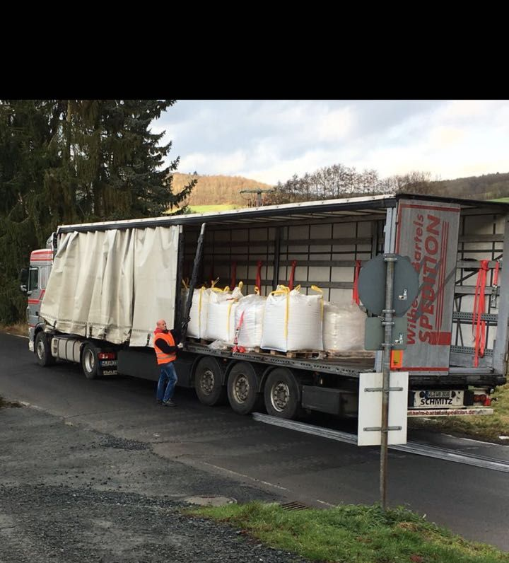
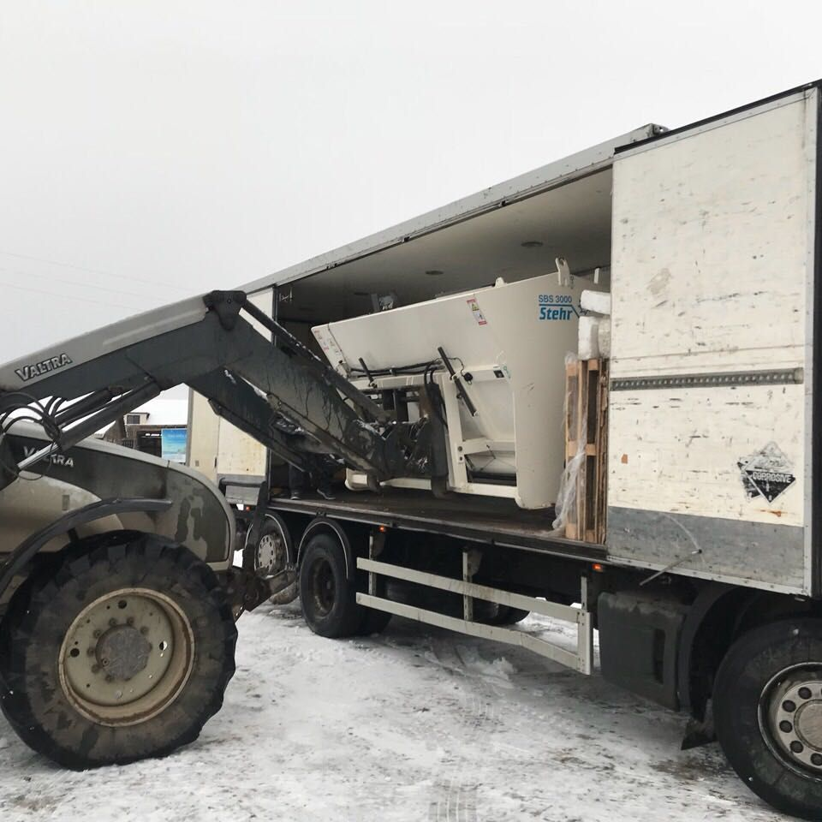
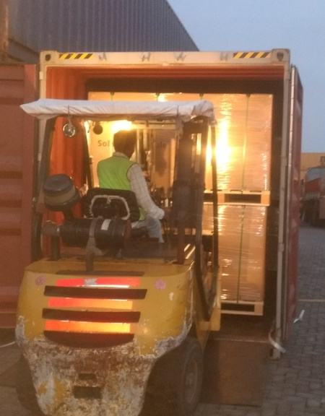

Ocean2Door for BCCI
Discussion & dialogue
Creative logistics
360 degree attention
Customised services
Minimum Saving :
USD 100 / container
Cleaning and Packaging Farm Produce
Door to Door Cargo Services
Chemicals in Curtain Containers
Current Volume : 1300 TEUs / month & growing !
Transfer to Domestic Containers

Slide 24


