Slide 1
PORTS OF THE EAST
SANTOSH MOHAPATRA

Slide 2
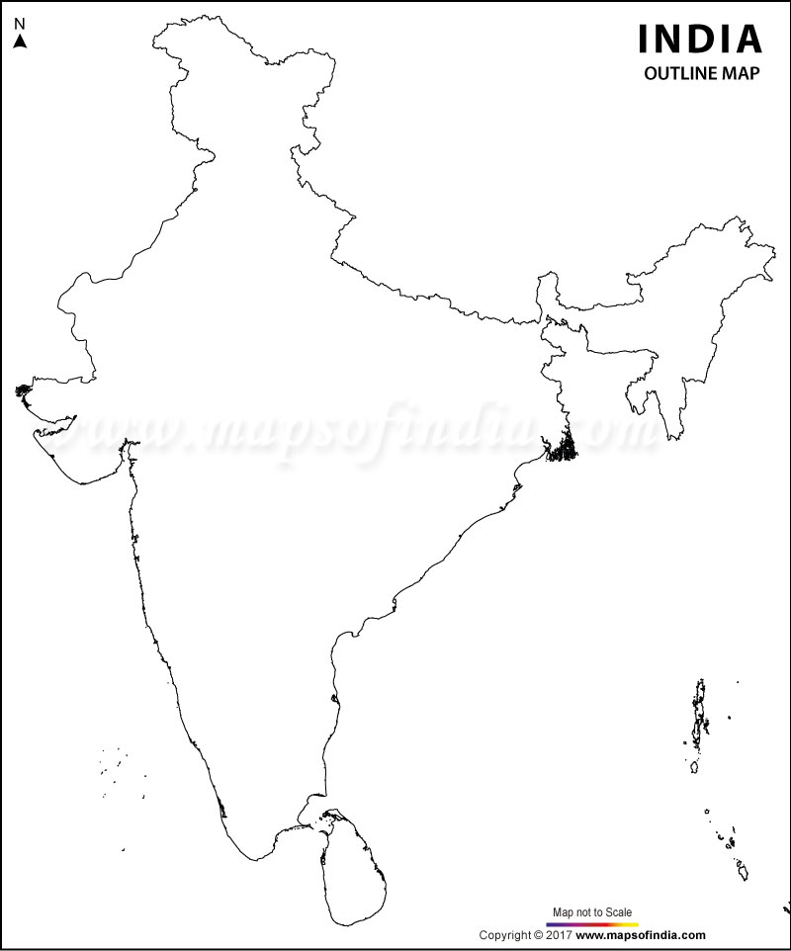
IF INDIA WERE ONE COUNTRY DIVIDED ON BASIS OF PORT ACCESS
WEST
EAST
SOUTH

Slide 3
THE EAST a large hinterland
Covers 12 states fully (West Bengal,Odisha,Jharkhand,Chhatisgarh,Assam,Meghalay,Manipur,Tripura,Nagaland,Mizoram,Sikkim and Arunachal Pradesh)
and 4 states partially (Andhra pradesh,Bihar, Madhya Pradesh and Uttar Pradesh)

Slide 4
THE EAST a land of rains, rivers and waterways
Receives highest raifall (more than half the rain the country receives)
Major Rivers (Ganga, Brahmaputra,Mahanadi, Godavari,Brahmani, Batarani,Subarnarekha)
and Waterways (Four out of six National Waterways (I,II,V and VI)

Slide 5
THE EAST ..of minerals and mineral based industries
Iron Ore
Coking Coal
Non coking coal
Buxite
manganese
Other minerals
Steel plants
Aluminium plants
Refineries
Powerplants

Slide 6
THE EAST but less industrialised than west and south
More core than down stream industries
Less of containers and more of bulk, dry bulk and liquid cargo
High cost of logistics
16% compared to national average of 12% and global 9%
Less density of rail connectivity
Perennial shortage of wagons

Slide 7
THE EAST the coastline
Largely Esturian
Deep sea goes farther as you move from south to north
Together with lack of naturally deep locations, make ports cost intensive
Other disadvantages
tidal differene
Cyclones
Small ports are a difficult proposition

Slide 8
PORTS OF THE EAST
FUNCTIONING AND PROPOSED
KOLKATA HALDIA
SAGAR
TAJPUR
SUBARNAREKHA
DHAMRA
PARADIP
ASTARANGA
GOPALPUR
BHAVANAPADU
VISHAKHAPATNAM
GANGAVARAM

Slide 9
THE PORTS (FUNCTIONING)
KOLKATA HALDIA 57 MT
PARADIP 102 MT
VISHAKHAPATNAM 65 MT
DHAMRA 22 MT
GANGAVARAM 20 MT
GOPALPUR 1-2 MT

Slide 10
THE PORTS (PROPOSED)
SAGAR ISLAND PROMOTED BY GOI/GOWB
TAJPUR -do- GOI/GOWB
SUBARNAREKHA -do- TATA STEEL
ASTARANGA -do- NAVYUG
BHAVNAPADU -do- ADANI

Slide 11
CARGO DRIVERS
NATIONAL STEEL POLICY 2017
300 MT OF STEEL WOULD MEAN
106 MT COKING COAL (even if is imported coal is reduced to 65% as envisaged)
85 MT LIMESTONE
18 MT STEEL TO BE EXPORTED
50 MT IRON ORE/PALLETS COASTAL TRANSPORT
UNLOCKING OF COAL BLOCKS
>100 MT COAL MAY GO BY COASTAL ROUTE
INCREASE IN CONTAINER TRAFFIC ‘CAUSE OF TRADE WITH ASIAN COUNTRIES

Slide 12
DEVELOPMENTS TO WATCH
UNDERSTANDING WITH MARITIME NEIGHBOURS (BANGLADESH AND MYANMAR)
CHINESE INITIATIVE IN THE REGION
GOVERNMENTS ENCOURAGEMENT OF COASTAL TRANSPORT
INLAND WATERWAYS- GOVT THRUST ON SAME
SAGARMALA- PORT DRIVEN INDUSTRIALISATION

Slide 13
ISSUES TO RESOLVE
CLOSE PROXIMITY AND MULTIPLICITY OF PORTS IN THE SAME AREA
PORT CONNECTIVITY
WAGONS
WATERWAY
SLURRY PIPE
INDUSTRY LOCATION TO MINIMISE LOGISTICS

