Slide 1
Pristine Hindustan Infraprojects Pvt. Ltd. (a JV of Pristine Logistics & Infraprojects Pvt. Ltd. & Hindustan Dock Yard Pvt. Ltd.)
Integrated Logistic Park at Siliguri, West Bengal

Slide 2
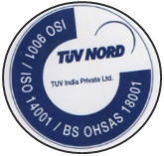
The Pristine Group
One of the largest private sector terminal operator in the country
An ISO 9001, ISO 14001, BS OHSAS 18001 Certified Company
Group founded by ex-IRTS officers
Funded by UTI and CDC in past and currently by Global Infrastructure Partners (formerly IDFC Alternatives)
Pristine believe in Innovative and Customized Solutions to its customers
First of its kind integrated terminals
Launch of Dwarf Container – A new class of containers
Best in class technology backed services
Pristine
Innovation
Infrastructure
Bandwidth
Present in all gamut of services from 2PL to 4PL
Customer driven approach with complete cargo control
Services through own infrastructure. Ensure control and continuity of services
Rail based terminal at 4 locations
10 terminals under development
Fleet size of 300 trailers
Category I license to operate container trains on Indian Railway network
Our Cargo handling capability includes
Containers, Liquid Cargo, Refrigerated Cargo, Iron & Steel, Cement, Food grains, sand, sponge, granite, gypsum, peas, dal, etc.

Slide 3
Our Presence
Ludhiana – Fully
developed Facility
Kanpur – Fully
developed Facility
Patna – Fully
developed Facility
Siliguri – Facility
under development
Cuttack – Facility
under development
Bengaluru – Facility
under development

Slide 4
Key Information - Terminals & Rail Operations
Chawapail,
Ludhiana
Panki, Kanpur
Bihta, Patna
Siliguri
Land Area
~ 45 Acres
~ 27 Acres
~ 24 Acres
~ 29 Acres
Handling Lines
3 lines
2 lines
2 lines
1 line*
Road Weigh Bridge
2 x 100 MT
Capacity
1 x 100 MT
Capacity
2 x 100 MT
Capacity
1 x 100 MT
Capacity
Rail-in-motion Weigh Bridge
120 MT Capacity
120 MT Capacity
120 MT Capacity
120 MT Capacity
Trailers
~ 300
Pristine Group has Category – I license for Container Train Operation on Indian Railway Network across India (INR 50 crores license)
Operate our own train across Indian Railway network

Slide 5
Inland Container Depot
A common user facility with public authority status equipped with fixed installations and offering services for handling and temporary storage of import/export laden and empty containers carried under customs control.
Houses Customs and other agencies competent to clear goods for home use, warehousing, temporary admissions, re-export, temporary storage for onward transit and outright export. Transshipment of cargo can also take place from such stations.

Slide 6
Primary functions of ICD
Receipt and dispatch/delivery of cargo.
Stuffing and stripping of containers.
Transit operations by rail/road to and from serving ports.
Customs clearance.
Consolidation and desegregation of LCL cargo.
Temporary storage of cargo and containers.
Reworking of containers.
Maintenance and repair of container units.

Slide 7
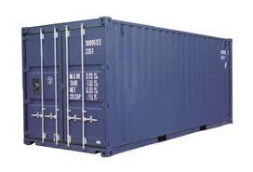
Concept of a Private Freight Terminal
Freight Forwarding by Rail
Bulk / Container Business
Liquid Logistics
Main IR network line
Rail siding drawn into facility
PFT rail line 1
Warehousing & Cold Chain
PFT rail line 2
Warehouse:
Cargo Storage
Warehouse Yard
Catchment Cargo by Rail
Customs Notified Area:- ICD
ICD
EXIM Containers Storage and Handling
Repair Facilities
Domestic Container Space
Freight Forwarding by Road
Catchment Cargo by Road
The Services’ paradigm provides for the greater accountability with respect to shortages / damages at one point vs distribution of accountability by engaging multiple vendors

Slide 8
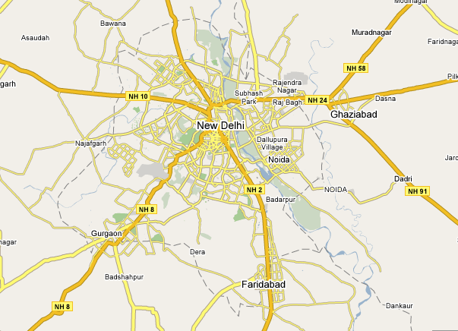
ICDs around Delhi / NCR
Panipat
Sonepat
Patparganj
Loni
Gzb/Noida
NH-8
Dadri
TKD
Patli
Faridabad
Rewari and Bhiwadi
Asaoti

Slide 9
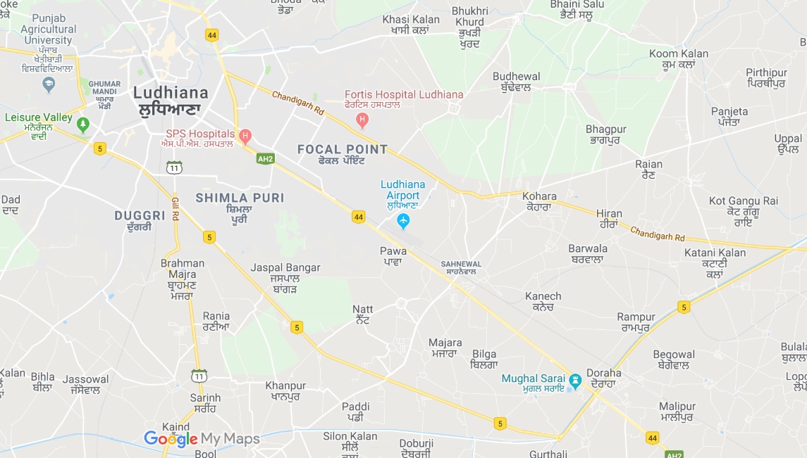
ICDs around Ludhiana, Punjab
ICD Sahnewal
ICD Kanech
Kila Raipur
ICD Chawa

Slide 10
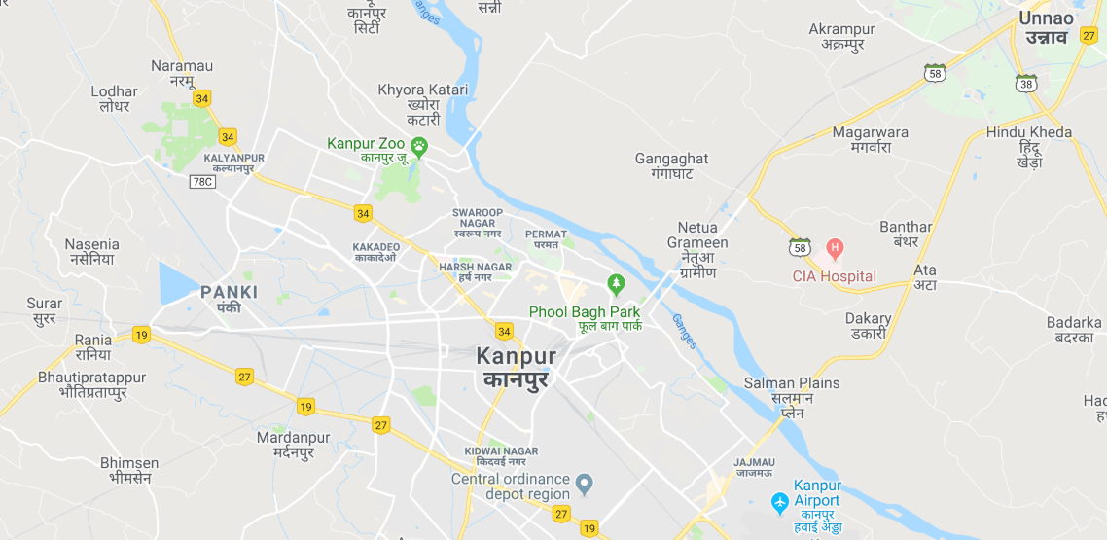
ICDs around Kanpur, Uttar Pradesh
ICD Panki
ICD JRY

Slide 11
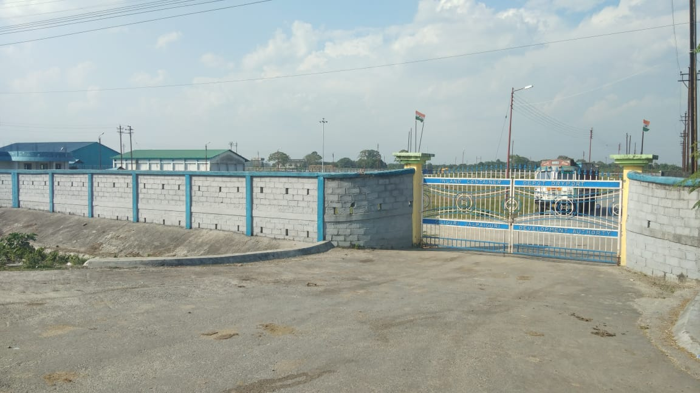
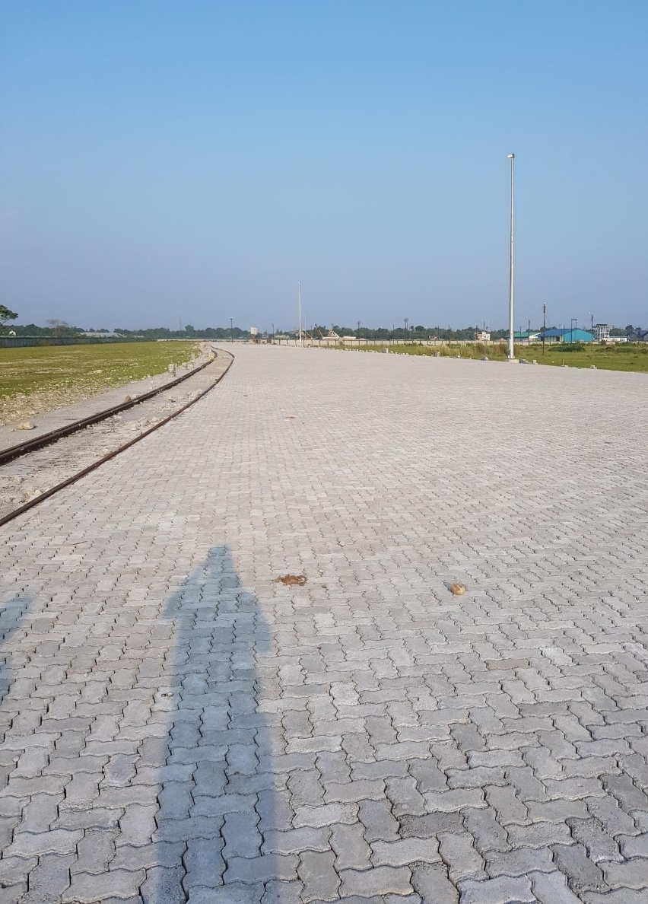
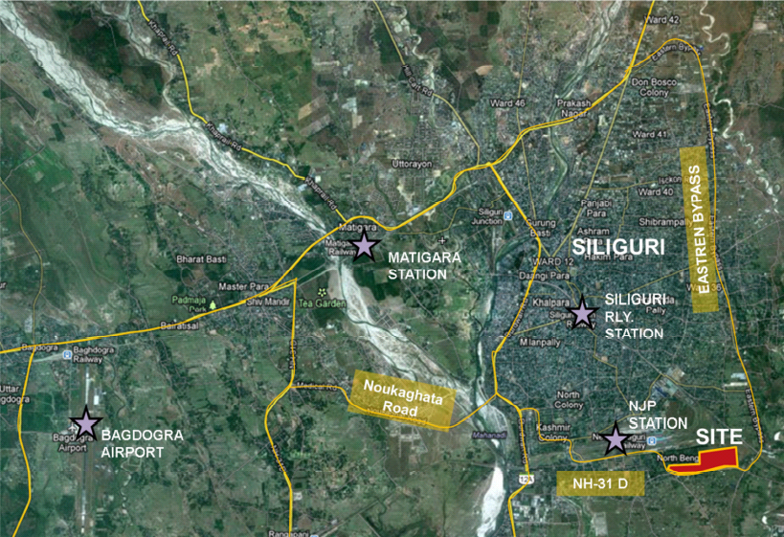
Our Presence
ICD Siliguri – An Overview

Slide 12
ICD Siliguri – Key Highlights
Strategically located – Convenient access to catchment area including North Bengal, Sikkim, Bihar, land-locked countries of Nepal & Bhutan
Best and committed management and operation team
Spread over 29 acres, equipped to handle 1,00,000 TEU per year
IT enabled facility with tracking & auto updating facility at each stage
Focus on Container Inventory Management & repo solutions
Continuous surveillance with round-the-clock monitoring facility – special focus on safety of containers and cargo
First multi-modal logistics park / ICD in North Bengal region

Slide 13
ICD Siliguri – Operational Overview
Land Area
Total - 29 Acres, Paved Area – 11 acres
Installed Capacity
1,00,000 TEUs P.A.
No. of handling line
1 Handling line of 740 m + 1 sick line
Equipment
2 Reach Stackers; 1 Hydra Crane; 3 Forklift; 56 Plugin Points
Trailers
40 Trailers
Custom Bonded Area
15,000 sq. m
Expected Commissioning Date
Dec’18

Slide 14
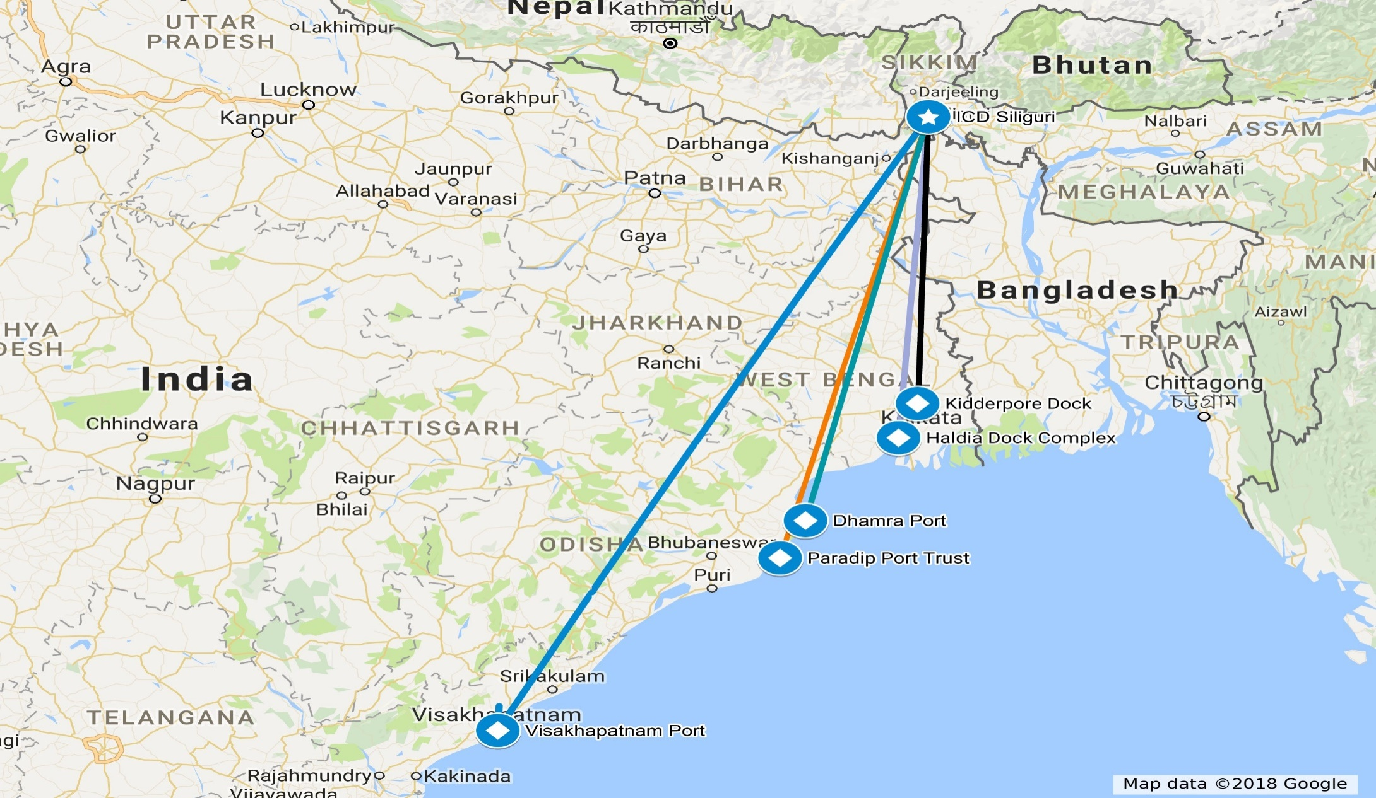
Sea Port Connectivity – ICD Siliguri
585 Kms
656 Kms
890 Kms
995 Kms
1417 Kms

Slide 15
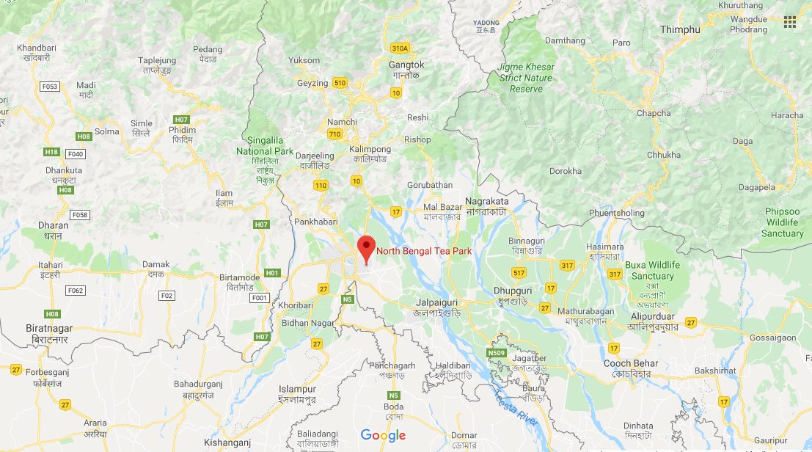
Locational Overview – Catchment Analysis
Pharma Industries
Bhutan Cluster
Phuentsholing Land Customs Station – 147 KM from ICD Siliguri
Nepal Cluster
Tea Industries, Consumer and Industrial items
Panitanki – Kakarbittha Land Customs Station – 33 KM from ICD Siliguri
ICD Siliguri
Tea Industries
Agri Exports
Meat Industry – Slaughter House (100% EOUs)

Slide 16
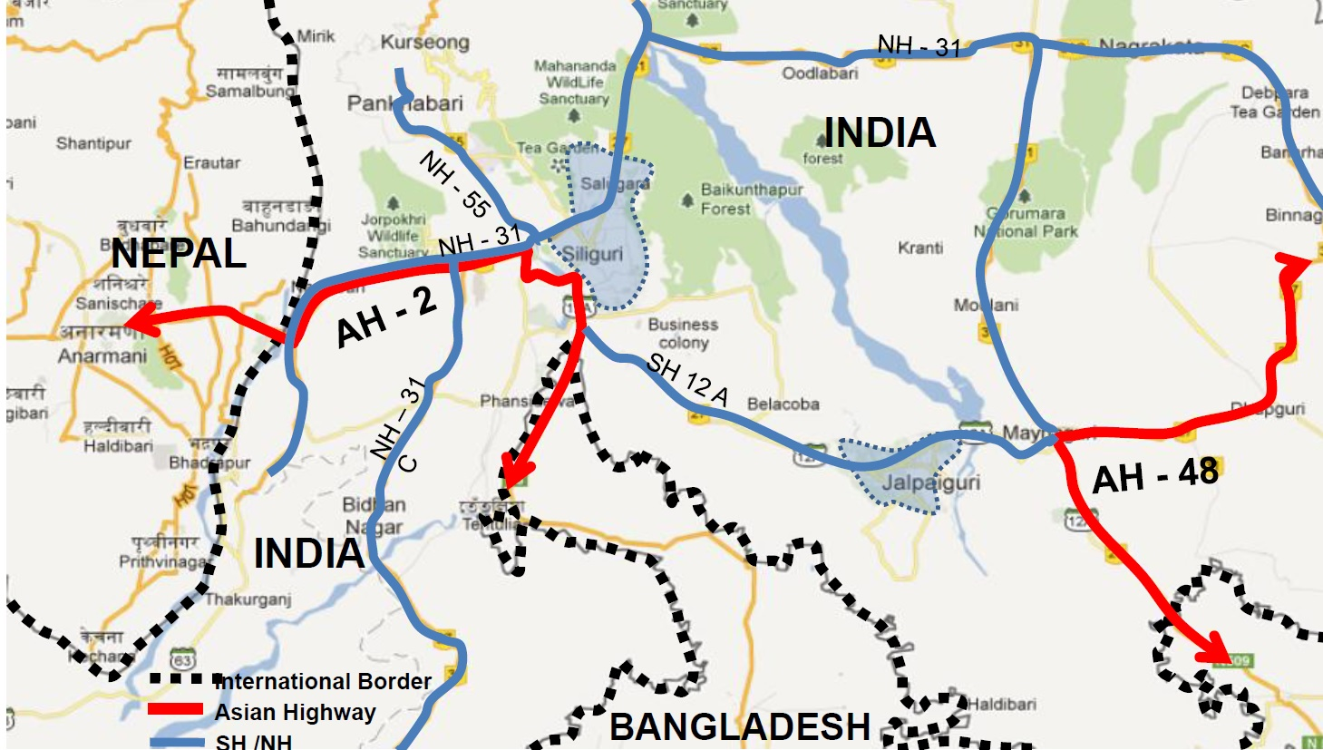
Asian Highway – Bangladesh, Nepal & Bhutan
Site Location

Slide 17
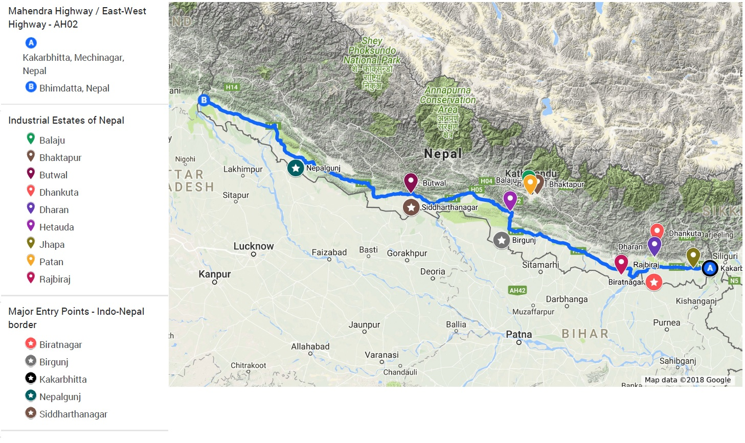
ICD Siliguri – Nepal Cluster

Slide 18
Our Offerings
1
Rail-linked Terminal Infrastructure within a gated complex
2
Container/ Cargo handling services at the rail side
3
Warehousing services, as per your specification, within the gated complex
4
Rail Transportation across Indian Network
5
Last mile transportation
6
Complete 3PL services including inventory management, sales & distribution

Slide 19
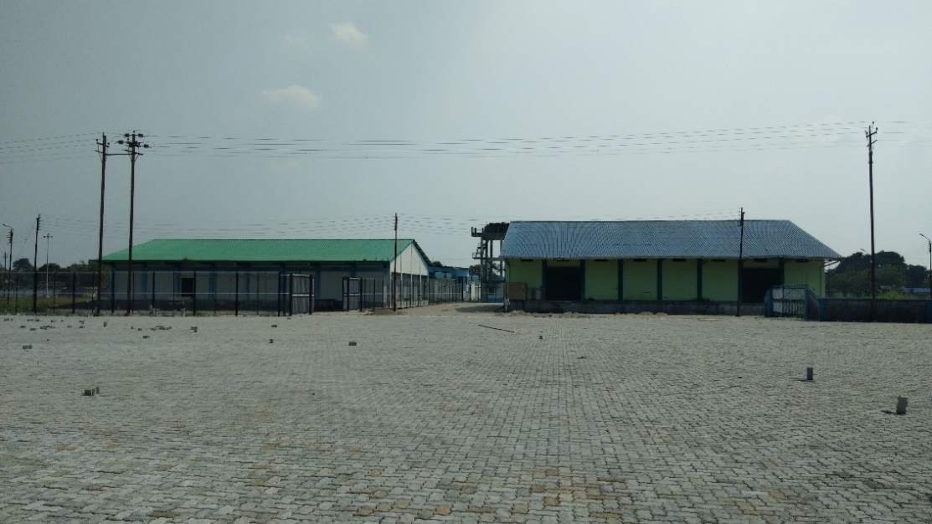
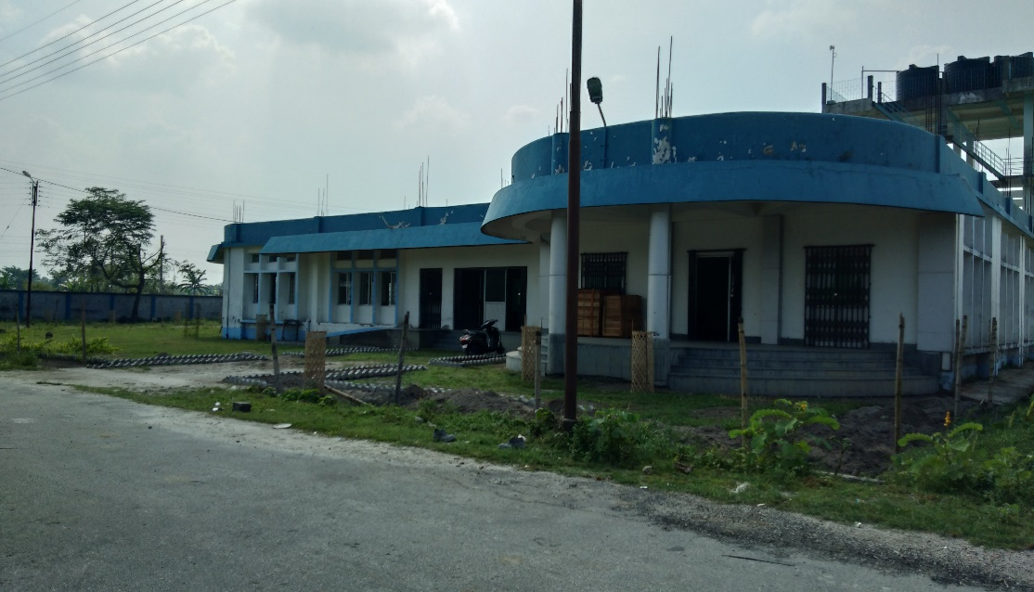
ICD Siliguri - A Pictorial Snap Shot

Slide 20
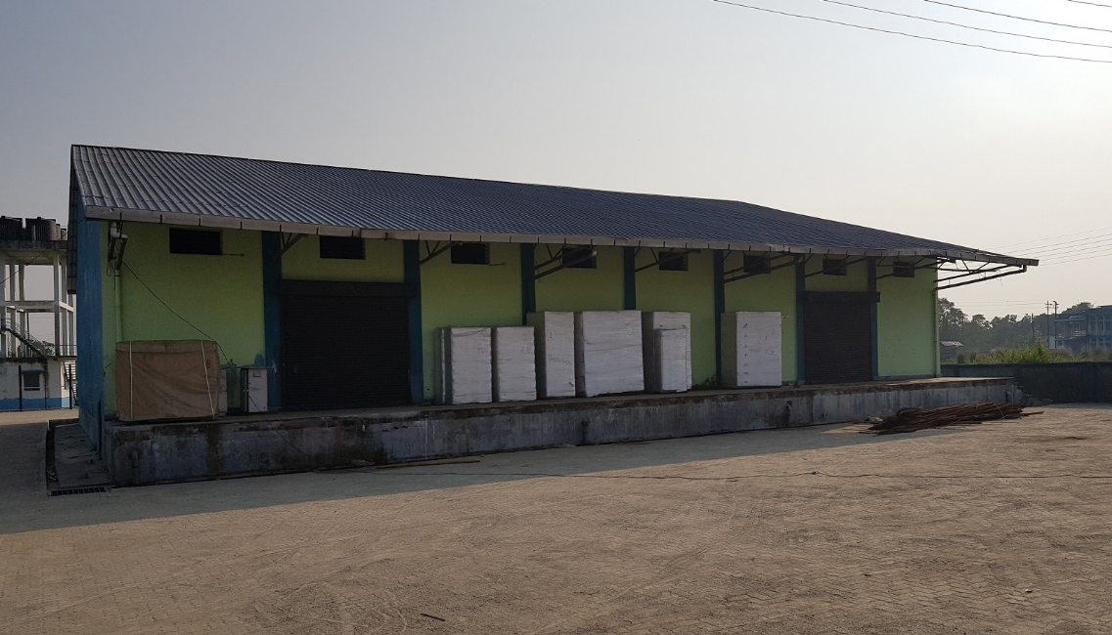
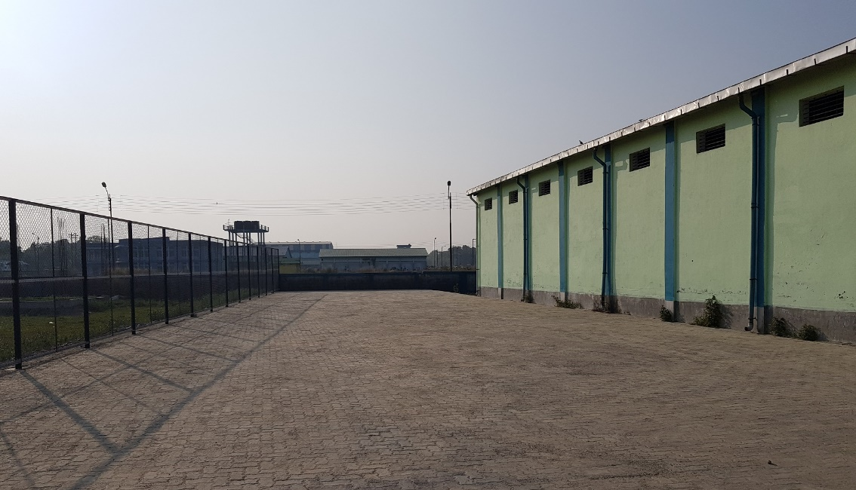
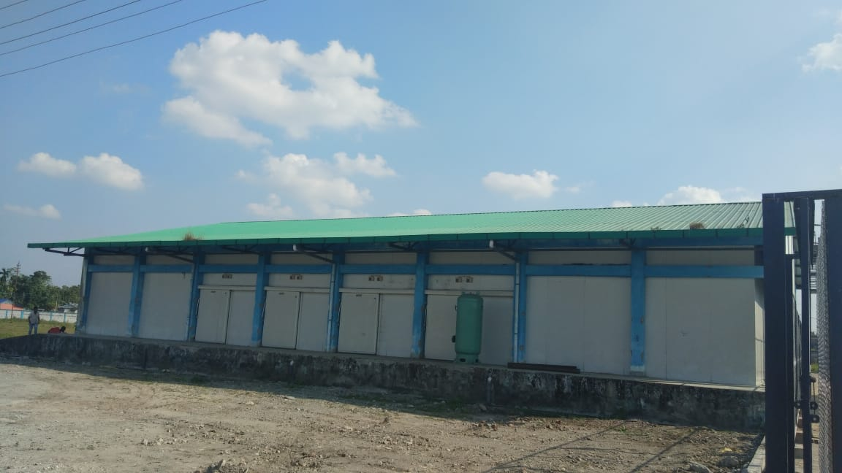
ICD Siliguri - A Pictorial Snap Shot

Slide 21
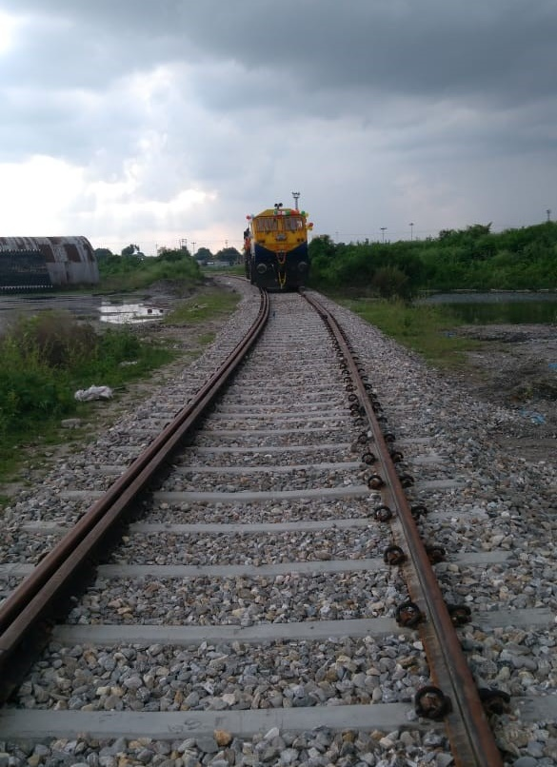
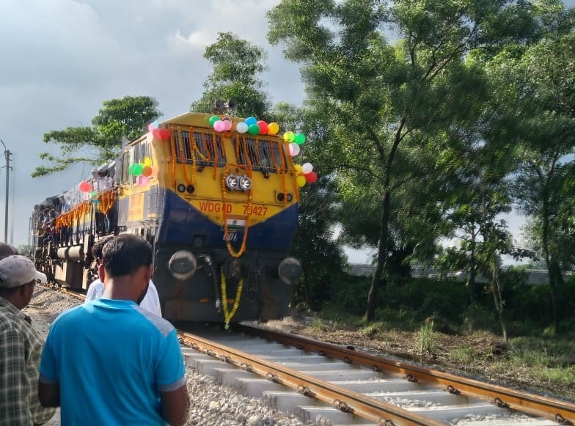
ICD Siliguri – Engine Rolling

Slide 22
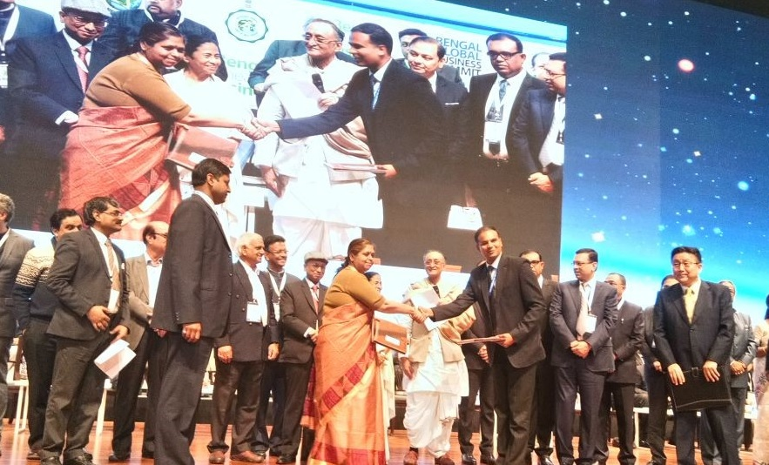
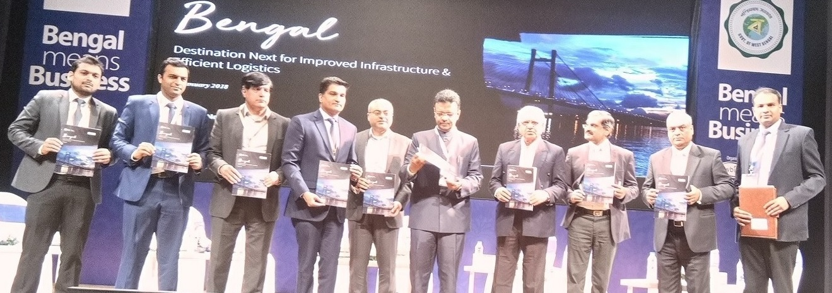
Bengal Global Business Summit - 2018

Slide 23
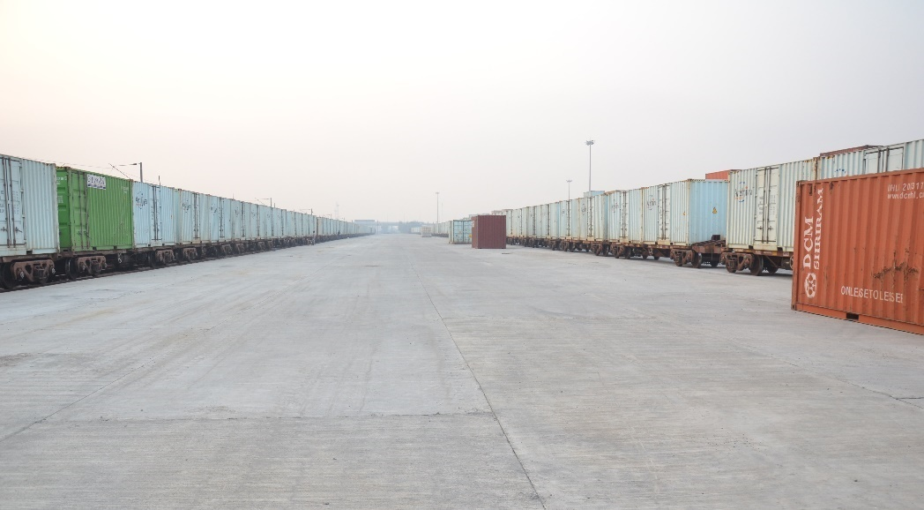
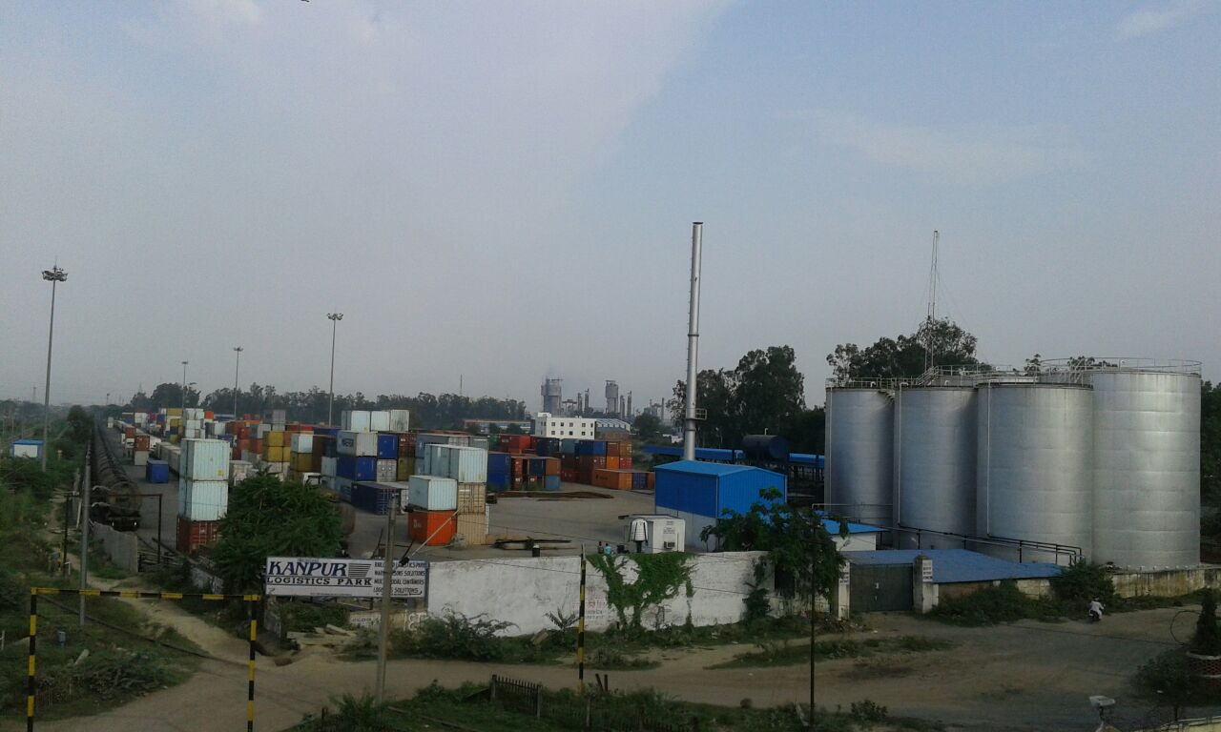
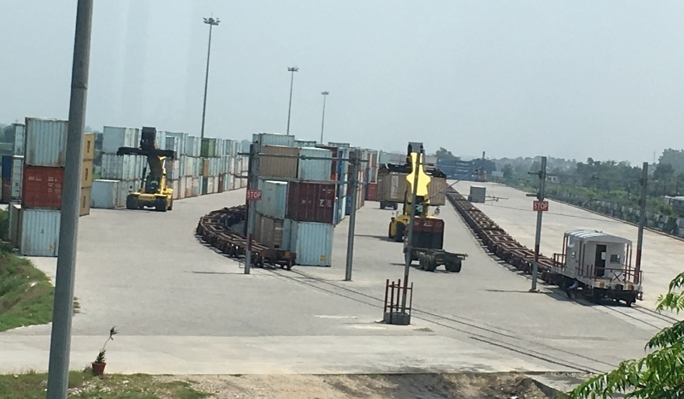
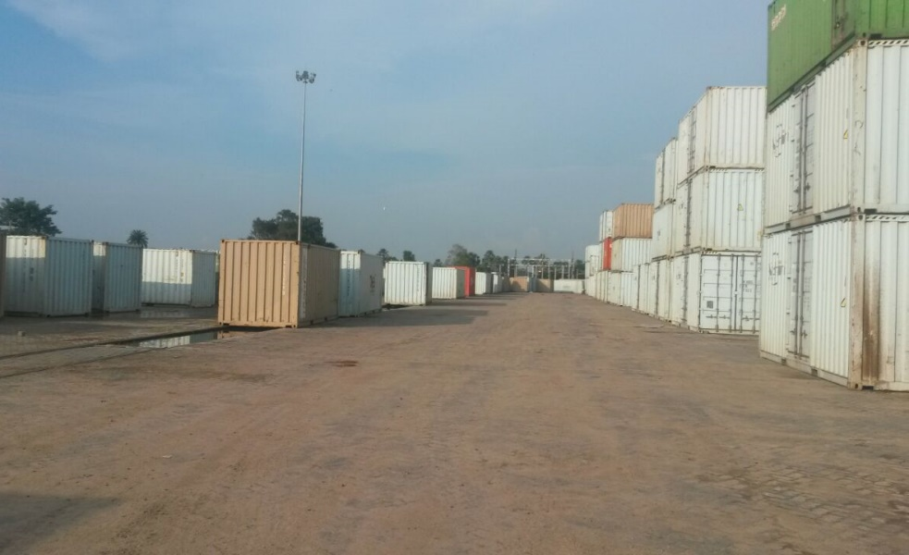
Pristine Group – Other Terminals

Slide 24
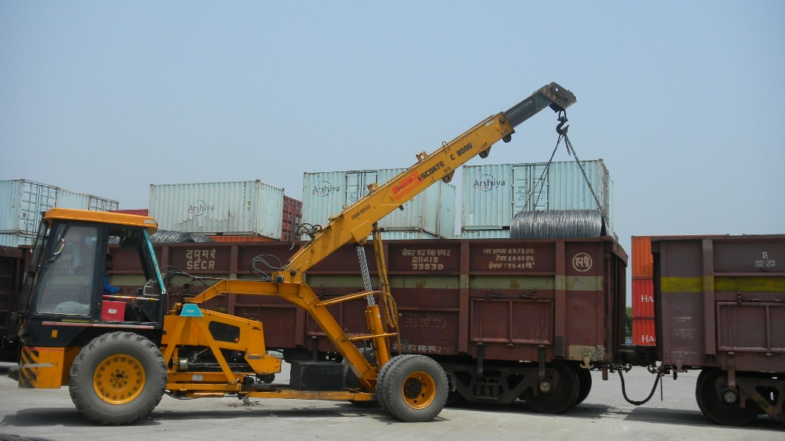
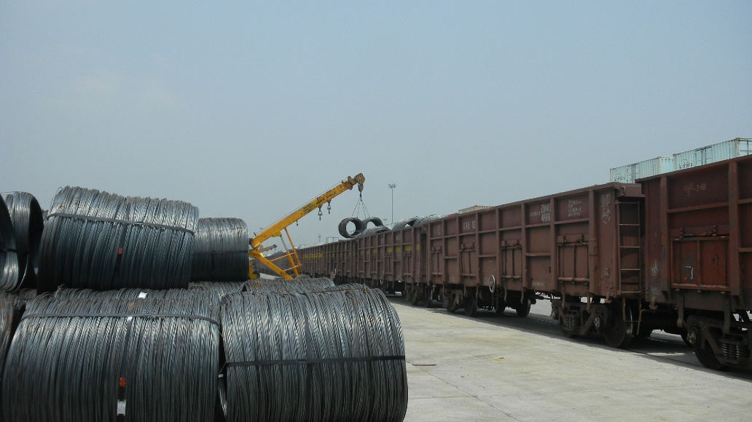
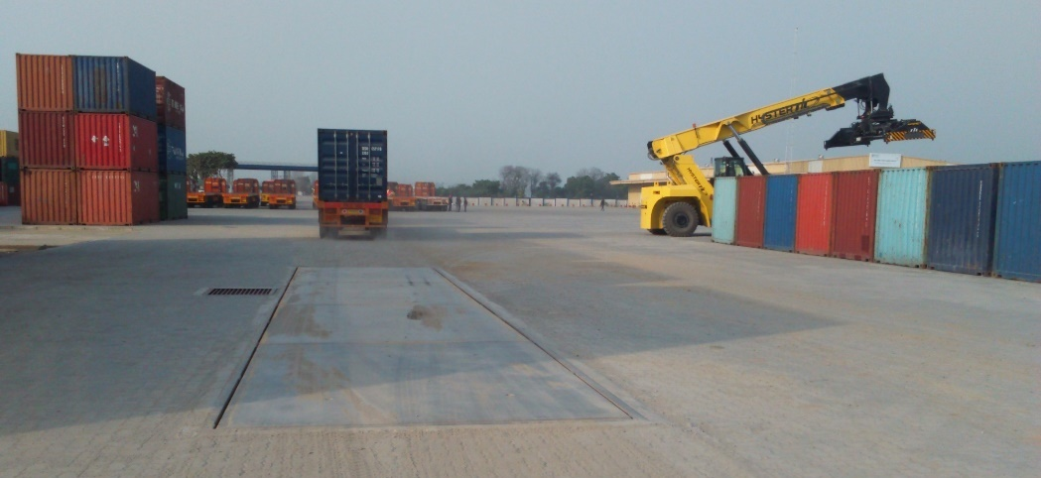
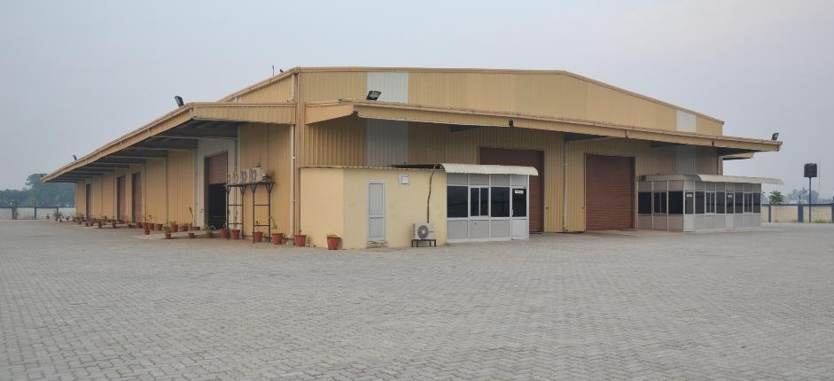
Pristine Group – Other Terminals

Slide 25
Pristine Group - Marquee Clientele

Slide 26
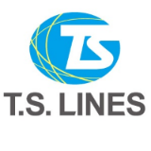
Pristine Group - Marquee Clientele

Slide 27
THANK YOU!
For more information, please contact:
Aviral Jain
CEO & Director
Pristine Hindustan Infraprojects Pvt. Ltd.
Email: aviral@pristinehindustan.com
Cell: +91-88960-66620
Address:
Corporate Office: Pristine, 3rd Floor, Wing – B, Commercial Plaza, Hotel Radisson Blu, Mahipalpur, New Delhi-110037 |  - 011 - 46772223/24/27/28, 47235800

