Slide 1
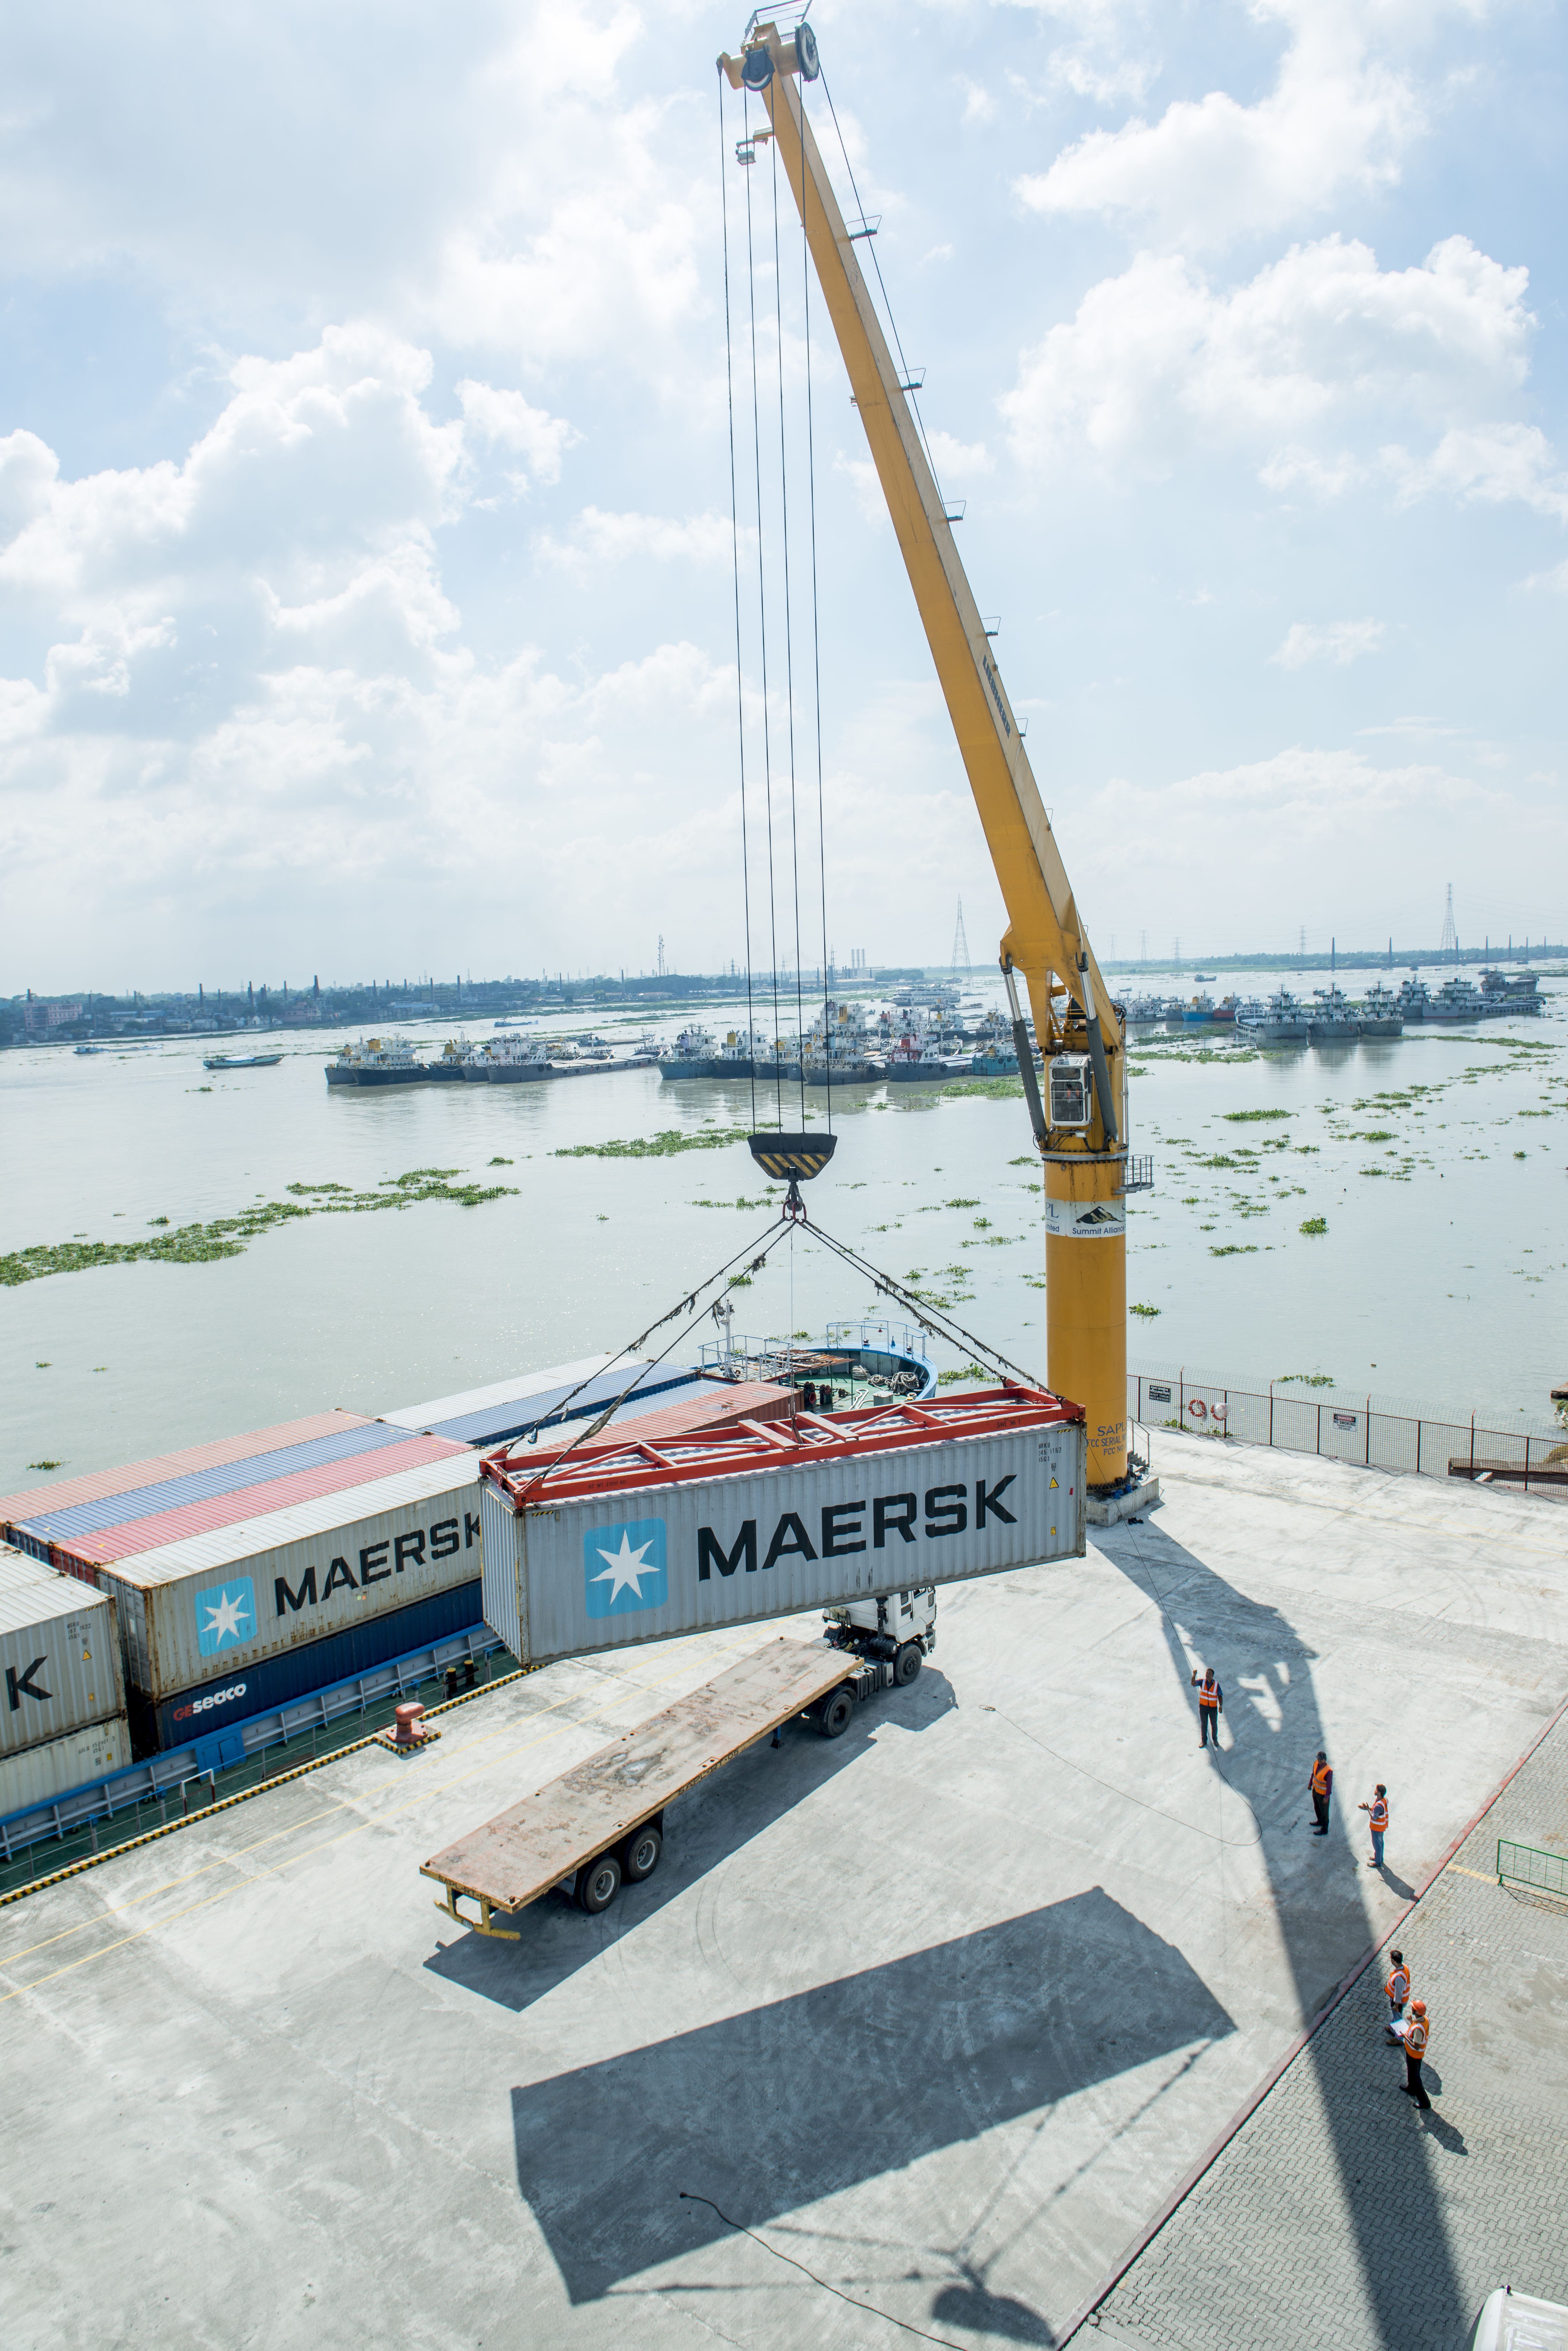


Welcome
Indo Bangladesh Trade and SAPL’s Roadmap using Inland Waterways Route

Slide 2
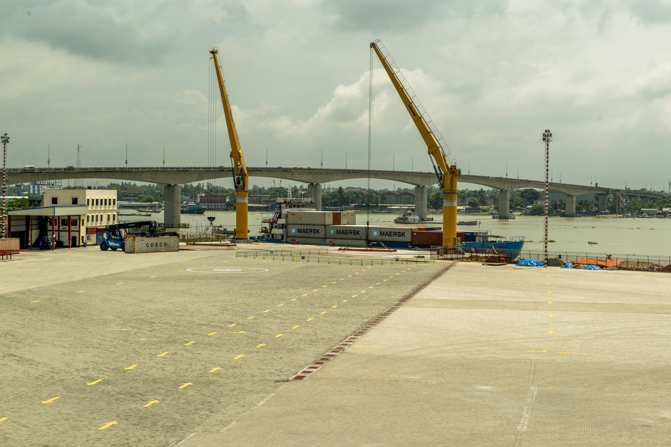
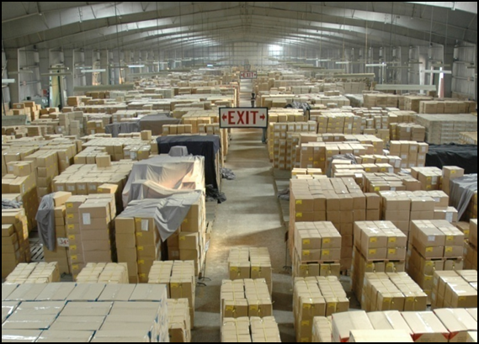
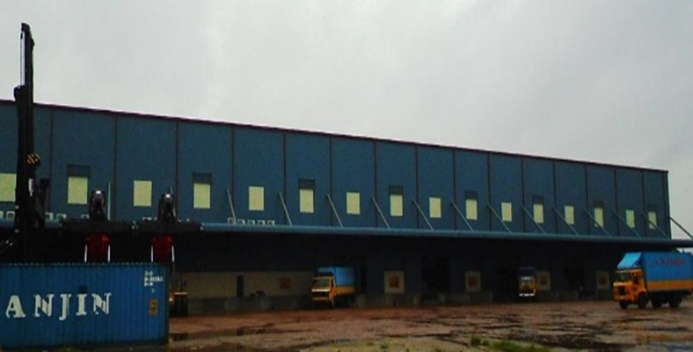
Background of Summit Alliance Port Limited (SAPL)
SAPL is the pioneer and market leader in the Private Port Operation, Inland Container Depot (ICD) and Container Freight Services (CFS) industry in Bangladesh.
SAPL RT is the 1st Private Port in Bangladesh situated at Muktarpur, Munsiganj (20 km away Dhaka). 1st Private port to facilitate Container Movements from Dhaka to Chittagong by Waterways. SAPL Muktarpur Terminal is also in the advance stage of being awarded Port of Call Status on Indo Bangladesh Protocol Route.
Existing ICD & CFS facilities are located only 7km away from Chittagong Port and with a Custom Bonded Area spread over 50 acres of free hold land with 51,000 sqm warehouse space.
The company presently handles over 20.2% of the country’s Entire Export and over 15.8% of the permitted containerized import items.
With over 25 years of experience SAPL enjoys excellent relationships with the major Shipping Lines, Exporters, Importers and Freight Forwarders.
SAPL is listed with the Dhaka Stock Exchange (DSE) and Chittagong Stock Exchange (CSE), Bangladesh.

Slide 3
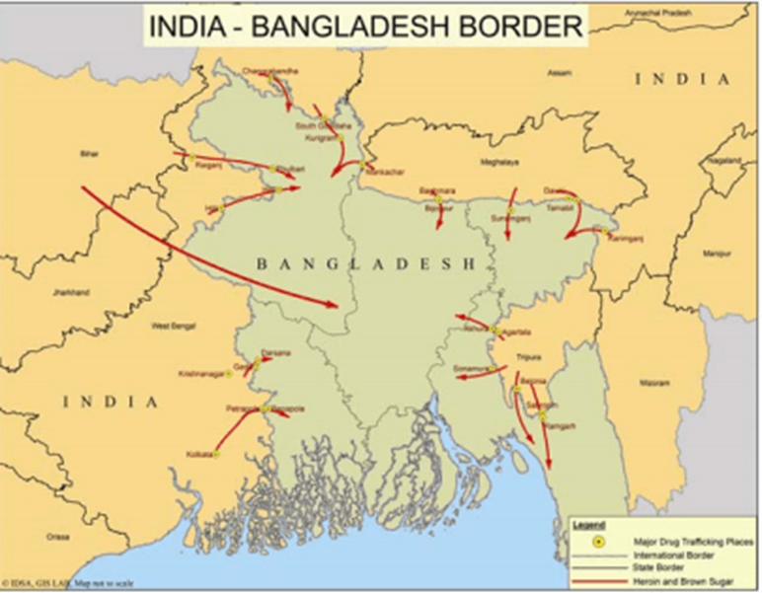
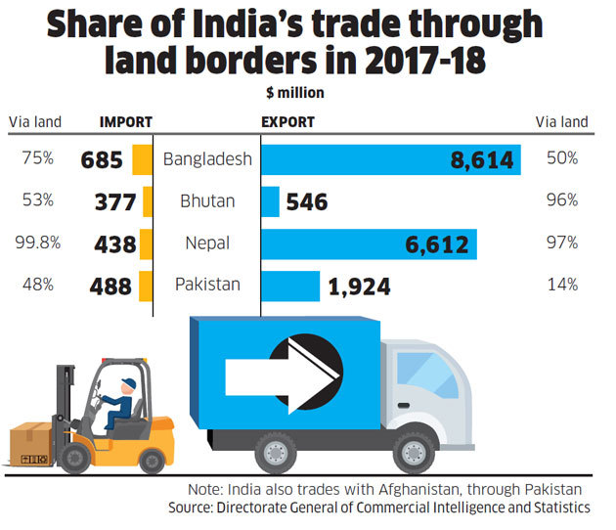

Indo Bangladesh Trade
India is Bangladesh's 2nd Largest Trade Partner in Import after China till Date.
Bangladesh is the Ninth Largest Importer of Indian goods in 2017.
Bilateral trade between India and Bangladesh was at $9 billion on 2017. The trade is set to go at $10 billion by 2018. Representing more than Triple the value of USD 2.7 billion ten years ago.
Bangladesh has 23 land ports with India's 4,095 kilometers.
Gateway Ports used in Bangladesh for Indian Exports are Chittagong, Mongla, Pangaon.
70% of Trade moves through Benapol/ Petrapol Border.
Indian exports meet 11-12 per cent of Bangladesh’s total import needs.
India shares less than two per cent of Bangladesh’s export basket, which primarily includes ready-made garments.
Rank | Importer | 2017 Indian Exports | 2016-17
1 | United States | $46.1 billion | 9.70%
2 | United Arab Emirates | $30 billion | -0.10%
3 | Hong Kong | $15 billion | 13.70%
4 | China | $12.5 billion | 40.10%
5 | Singapore | $11.6 billion | 57.40%
6 | United Kingdom | $9 billion | 4.60%
7 | Germany | $8.2 billion | 14.80%
8 | Vietnam | $8.1 billion | 36.30%
9 | Bangladesh | $7.2 billion | 27.20%
10 | Belgium | $6.2 billion | 16%

Slide 4
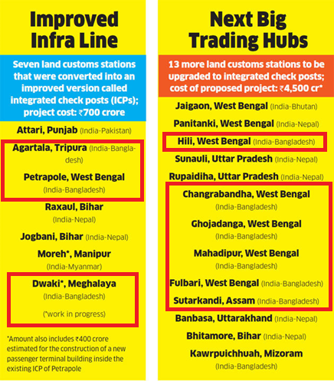
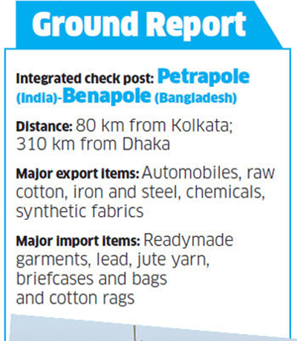
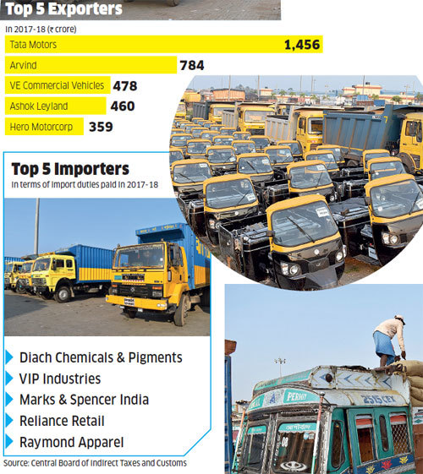
Petrapol / Benapol Integrated Check Post ( ICP )
Petrapole border crossing now being developed as an Integrated Check Post is one of the most busiest Land Customs Station in Asia and accounts for about 70% of Indo-Bangladesh Trade which are moved by costly road transport . The Trade statistics with number of cargo vehicles for the last 4 Financial years is as given below:
Year | Trade | Cargo Vehicles (Nos.)
 | ( ₹ Cr)
2014-15 | 15187 | 117526
2015-16 | 16341 | 128995
2016-17 | 18501 | 146706
2017-18 | 18799 | 146341
2018-19 (upto June) | 6410 | 52009

Slide 5
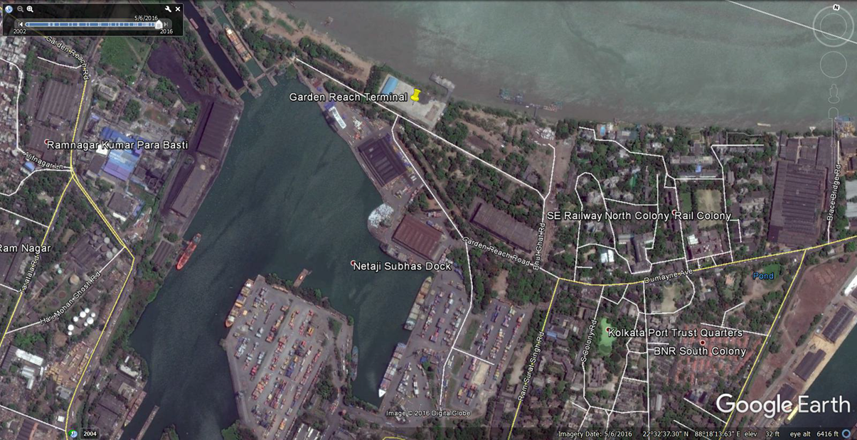
Overview / Main Features of the Garden Reach Terminal (GRT)
1st PPP Project of Inland Waterways Authority of India (IWAI).
A project under IWAI where SAPL India has received a 30 year Concession to Supply, Operate & Manage the facilities comprising of 11 acre (44,966.64 sqm) area at GR Jetty-I & BISN Jetty and GR Jetty-II including Warehouse (CFS) along with the existing fixed, floating & RO-RO jetties.
GR Jetty Terminals is located at 900 m upstream of Kolkata Port (Netaji Subash Dock) and shares the same access road. 5m depth is available at the Quay side which will allow 4m draft / 3,000+ tons DWT vessels to berth throughout the year.
1x70m Fixed Jetty Berth, 480 m Waterfront, 3 Pontoons, 1 Steel Gangway, 10,200 sqm open Space Area, 200 KW Power Supply.

Slide 6
SAPL’s Roadmap Garden Reach Terminal (GRT)
Terminals at GR Jetty will allow SAPL India to boost Regional connectivity and provide a one-stop service for cargo movement between West Bengal, North-East, Bangladesh via IBP Route and Nepal via National Waterway-1.
Cargo movement to / from Sagar , Haldia and other East Cost ports is also envisaged.
Terminal Service Agreement also allows us to operate the upcoming Kalughat Terminal at Patna which has been earmarked for Nepal’s cargo.
The cargo from GR Jetty shall be transported upto Sahibganj MMT and upcoming Kalughat terminals through NW-1 and thereafter by NH-31/33 upto Biratnagar and Birganj border check post with Nepal.
Initial Investment – 3 Million USD. 2nd Phase Investment – 5 Million USD.

Slide 7
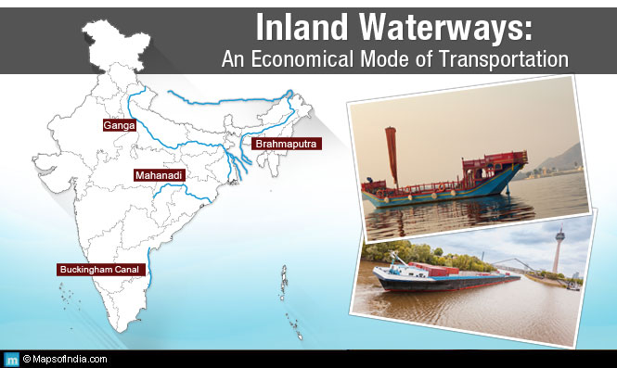
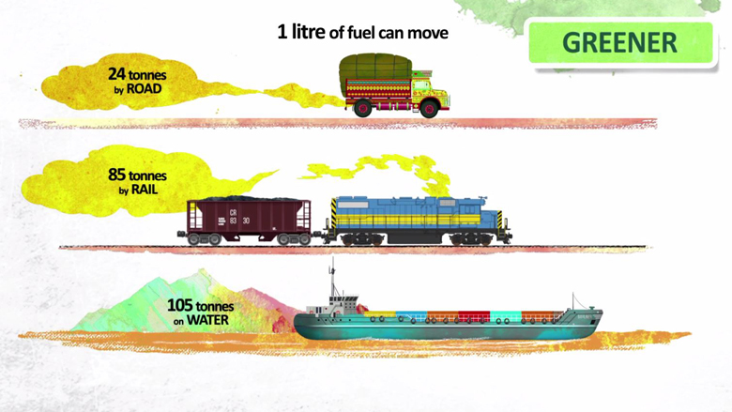
WHY We choose Inland Waterways?
Projected Future Traffic
Next 2 Financial Year of Operation – 7,97,000 ton
Inland Waterways Movement Importance
Congestion Free
Less Expensive
Bigger Parcel Size
Faster Commercial Transaction
Containerized Cargo movement From SAPL RT, Bangladesh to GRT bypassing Chittagong Port Congestion
River – Air Movement ( RMG )
Handled 61 vessels in 1st Month of operation
41998.92 Ton Load
Some Special Movement to Highlight below

Slide 8
Thank You

