Slide 1
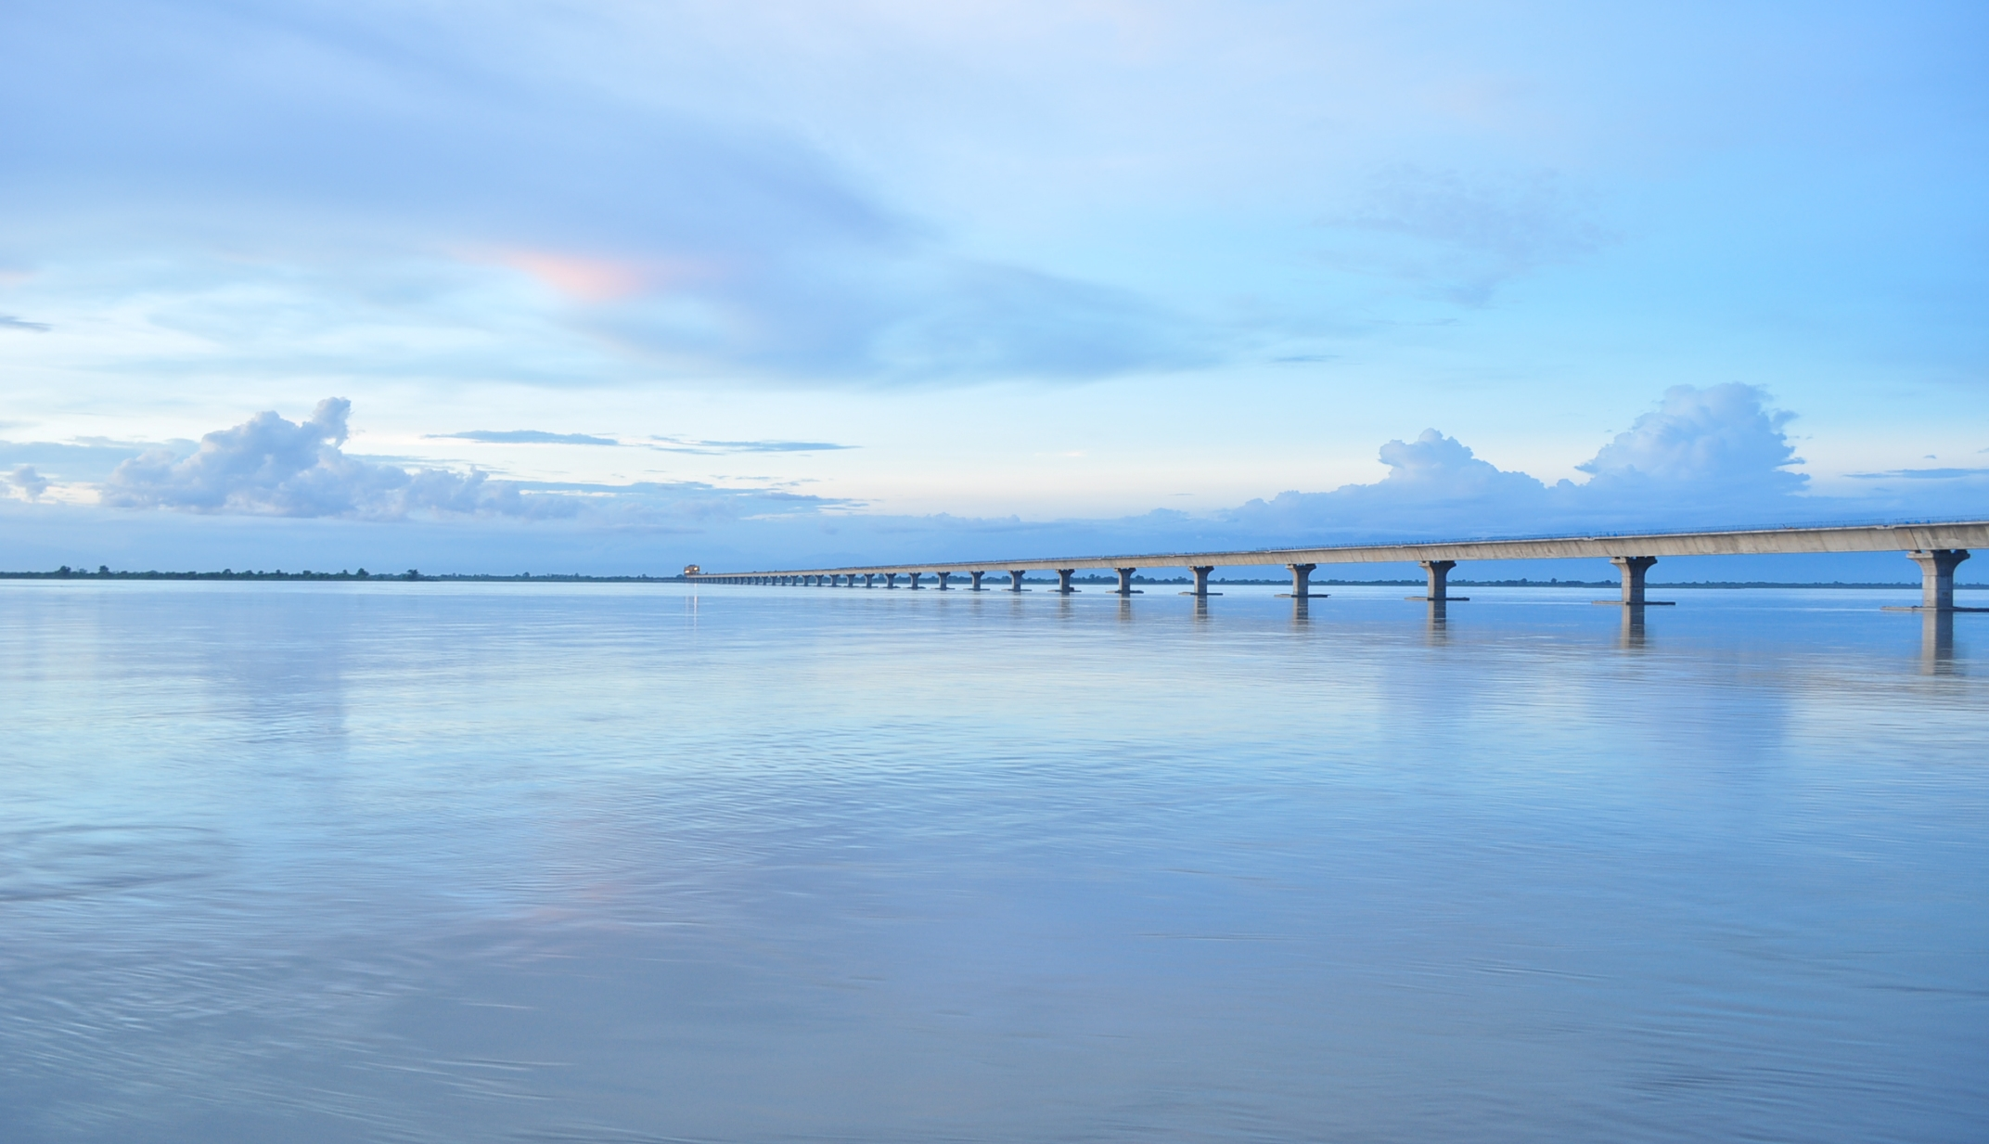
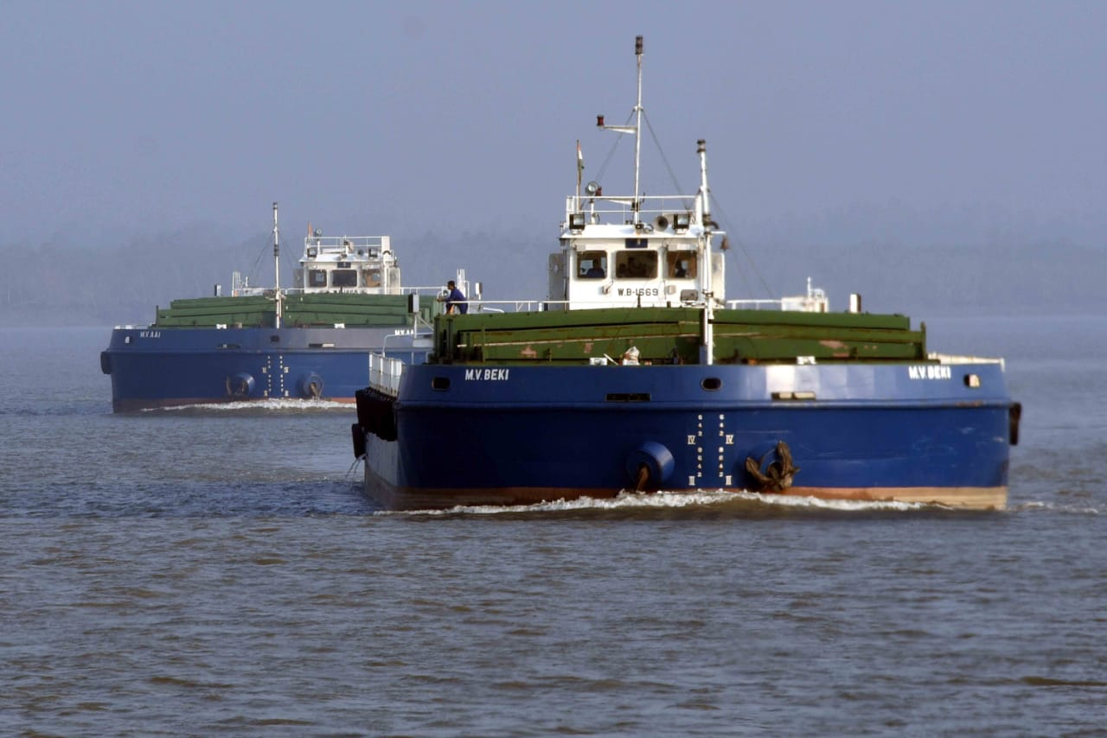
Inland Waterways Authority of India (IWAI)
Ministry of Ports, Shipping & Waterways,
Govt. of India
Annual Shipping & Logistics e-Conclave
BCC&I, February 04, 2021
Dr. Amita Prasad, Chairperson, IWAI

Slide 2
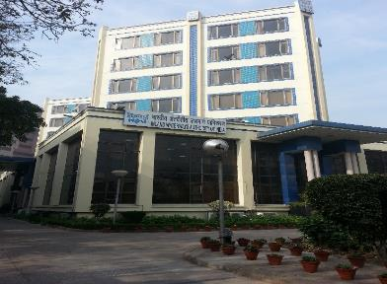
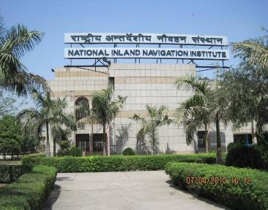
IWAI Overview
IWAI Bhawan
Head office at Noida
Constituted on 27th October, 1986
Mandate: Development & regulation of National Waterways in India including Indian side of Indo-Bangladesh Protocol route for transit & trade
Capacity Building in Waterways Navigation
National Inland Navigation Institute
Training Institute at Patna

Slide 3
Inland Water Transport (IWT) Sector Overview
111 National Waterways, 23 (5200 km) have been identified with potential for mechanized crafts, 17 are currently operational
73.6 MMT traffic in FY 2019-20, 2.4 times increase since 2015
Currently 2% Modal share of IWT against global share of 8% to 15% in other continents
MIV 2030 projects;
Growth by 2030; 140 MMTPA - with 14,000 KM waterways, there is ample opportunity.
NW -1
NW -2
NW -16
Gujarat Waterways
(NW-73, 100)
NW -94
IBP
NW-44
Maharashtra Waterways
(NW-10,83,85,91)
NW-97
Goa Waterways (NW-68, 111)
NW -4
NW -3
Inland Waterways Authority of India (IWAI)

Slide 4
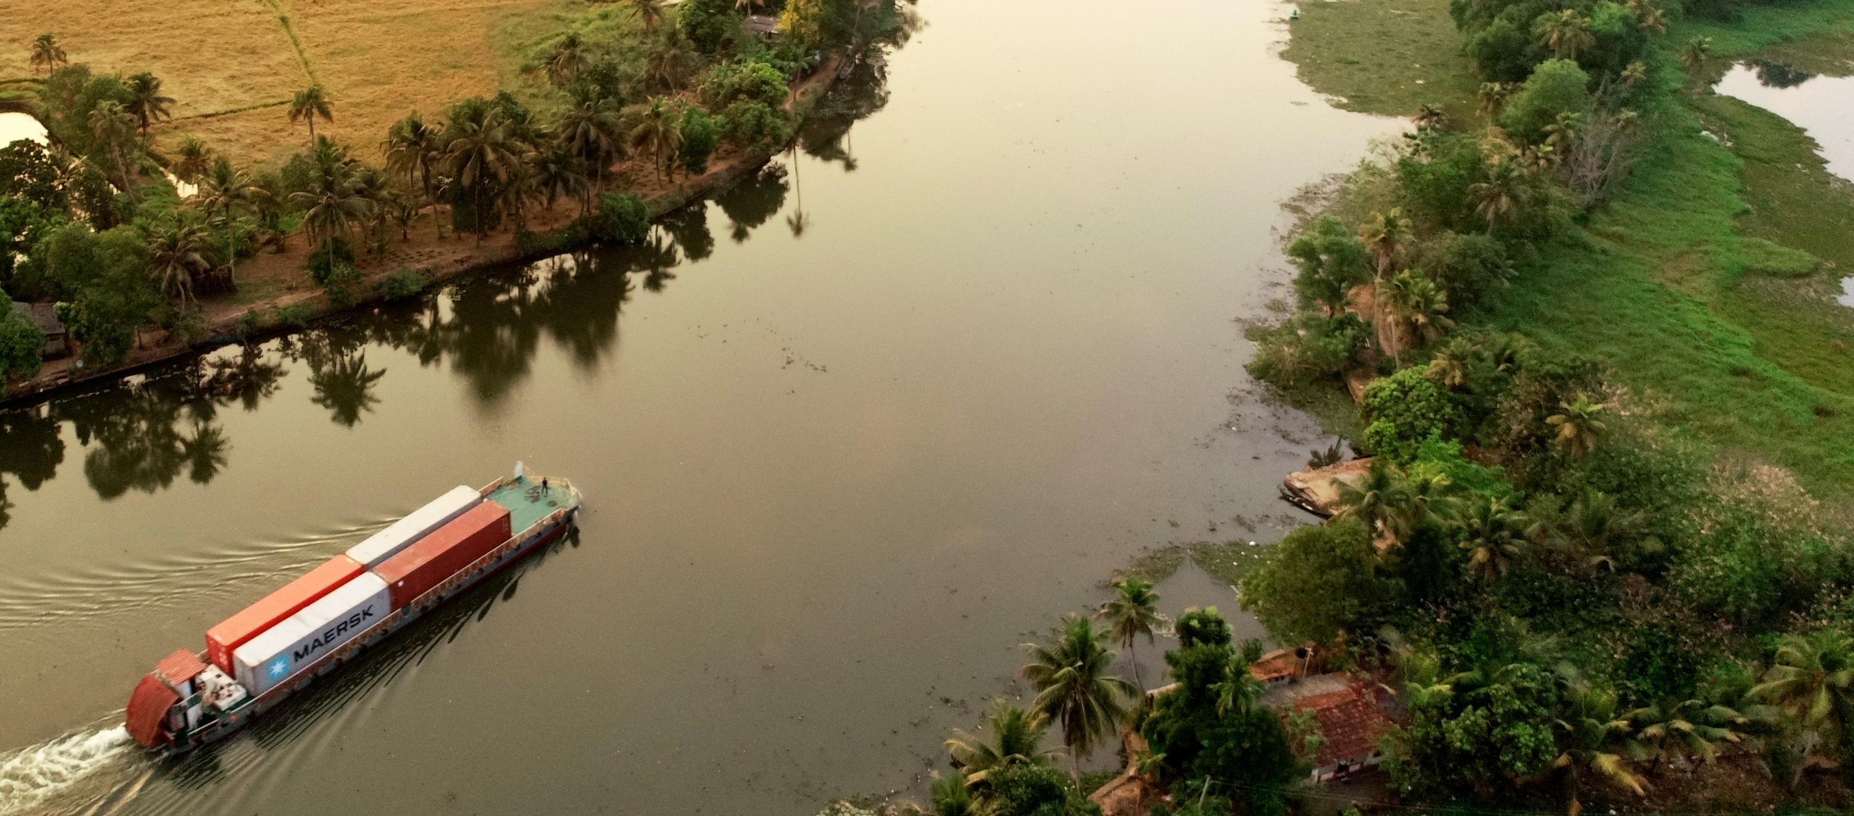
Key interventions undertaken for development of Inland Waterways…
Fairway Development:
Dredging, River training and conservancy works, bandalling, river marking, bank protection works
Navigational Aids:
Installation of navigational aids like buoys, River Information System (RIS), Digital Global Positioning Systems (DGPS), Beacon Lights etc.
Terminal Development:
Development of Multi-modal terminals (MMTs), Inter Modal Terminals (IMTs) and Ro-Ro Terminals
Other Riverine Structures:
Construction of navigational locks, ship repair facilities, bunkering stations etc.
Vessel operations:
Vessel designs and pilot runs
Inland Waterways Authority of India (IWAI)
5

Slide 5
Five-year Vision
Vision: Develop a self-sustainable, economical, safe & environment friendly supplementary mode of transport for the overall economic growth of the country
Initiatives taken to achieve vision
Modal share enhancement of IWT from current 2% to 2.5% by including bulk and containerised cargo
Develop 5,000 kms of IWT routes across states (India@75 as per NITI Aayog)
Enhance regional connectivity with North East India & neighbouring countries (Bangladesh, Nepal, Bhutan & Myanmar) through Eastern Waterway Connectivity – Transport Grid
Integrate IWT with Coastal Shipping and other modes
Target passenger / Cruise Tourism on waterways by encouraging private sector
Focussing on infrastructure and service gaps
Introduction of e-initiatives
Development of Vessel building, Ship Repair and Hybrid Engine.
Regional Connectivity
  Vessel Demand
  Cruise demand for both Coastal and River

Slide 6
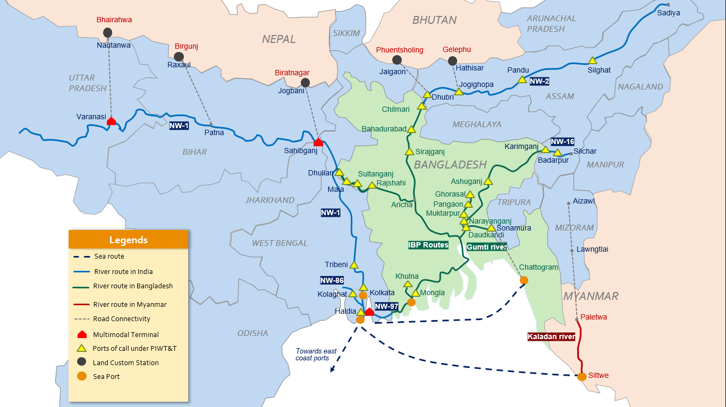
Development of Eastern Grid: Connectivity with Bangladesh,
Nepal, Bhutan and North Eastern States
Indo Bangladesh Protocol Routes (IBP):
10 Protocol routes covering 2650 kms
13 Ports of Call (PoC) each in both countries
3.5 MMT traffic in FY 19-20, CAGR~11% over last 5 years
600 vessels, 3,600 voyages currently in a year
Major commodities include fly ash, coal, stone chips, project cargo, steel products, containers etc.

Slide 7
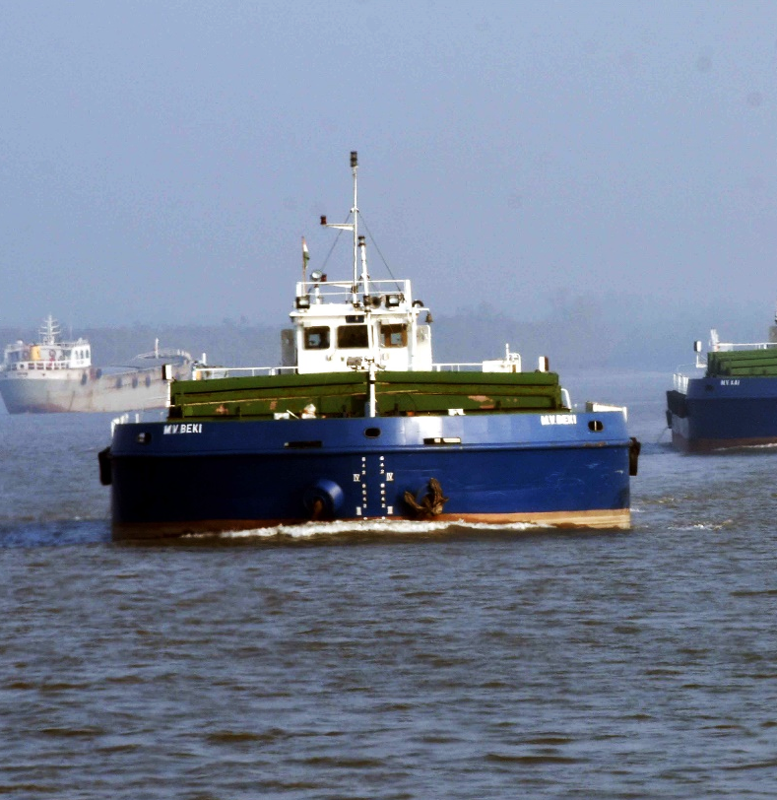
Opportunities in IWT
Construction of Shallow draft cargo and passenger vessels. The vessels are to be procured by Private players / Shipping companies independently.
Catamaran and environment friendly hybrid vessels.
Construction of Side floaters for reduction of Vessel draft.
Ship repair facilities proposed at Sahibganj & Kolkata on NW-1 and Jogighopa & Pandu on NW-2 which can be explored for development in collaboration with an Indian Partner.
Private sector participation in Terminal Management. Russian Firms may consider participating in the bidding process. Following terminals are to be given for O&M in FY 20-21.
MMT Varanasi (Uttar Pradesh), Sahebganj (Jharkhand), Haldia (West Bengal) and Gaighat Terminal (Patna) on NW-1.
Pandu and Dhubri Terminal on NW-2.
Karimganj & Badarpur on NW-16..
9 small terminals on NW-3 (Kerala).
Holistic development of waterway
TERMINAL
MANAGEMENT
INLAND VESSELS
TECHNOLOGICAL
INVESTMENT
TRAINING &
DEVELOPMENT
Smart Hydrography development
Development of smart vessel tracking system, auto pilotage, safety and navigation framework (AIS/ ENC/ Beacon/ Buoys etc.)
Cooperation in areas of imparting training and skill development for management of inland navigable channels may be explored

Slide 8
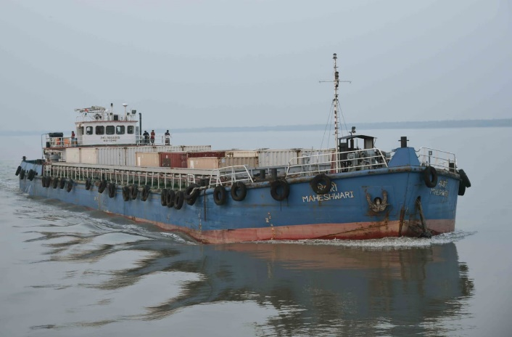
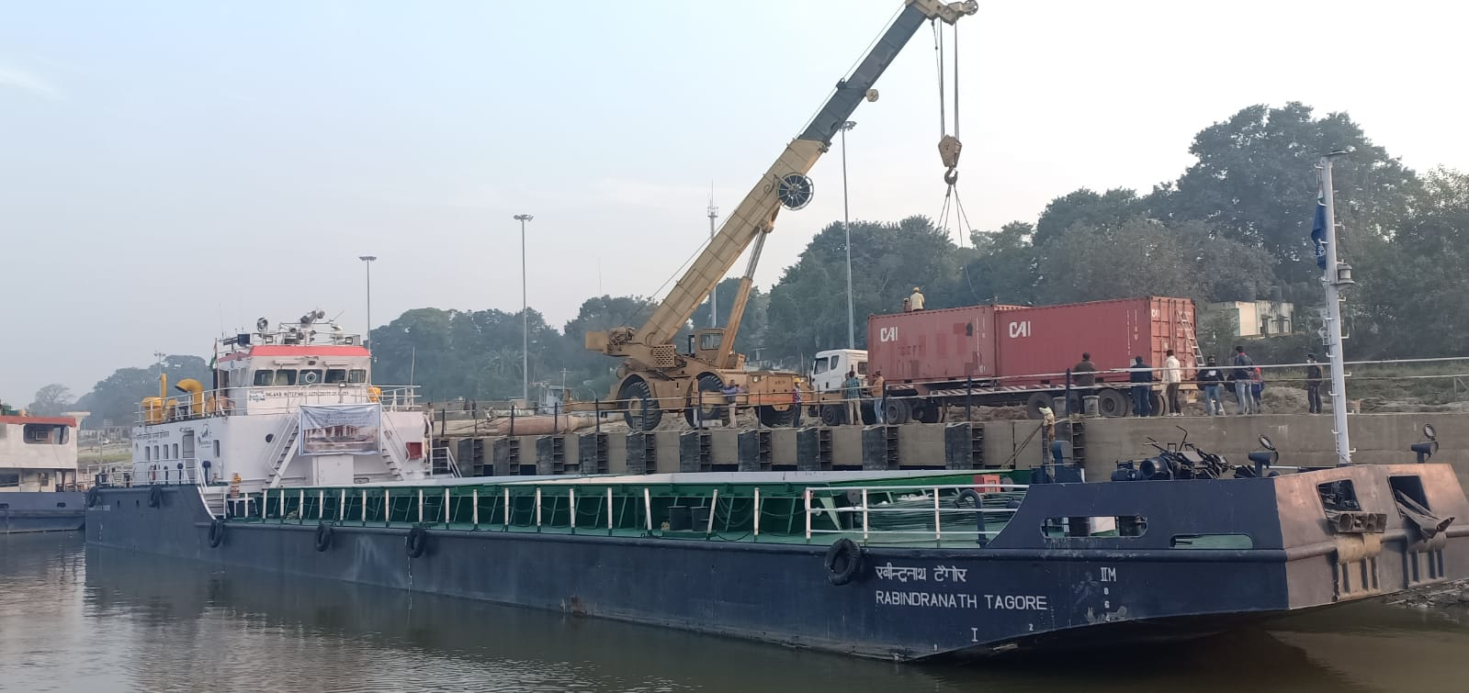
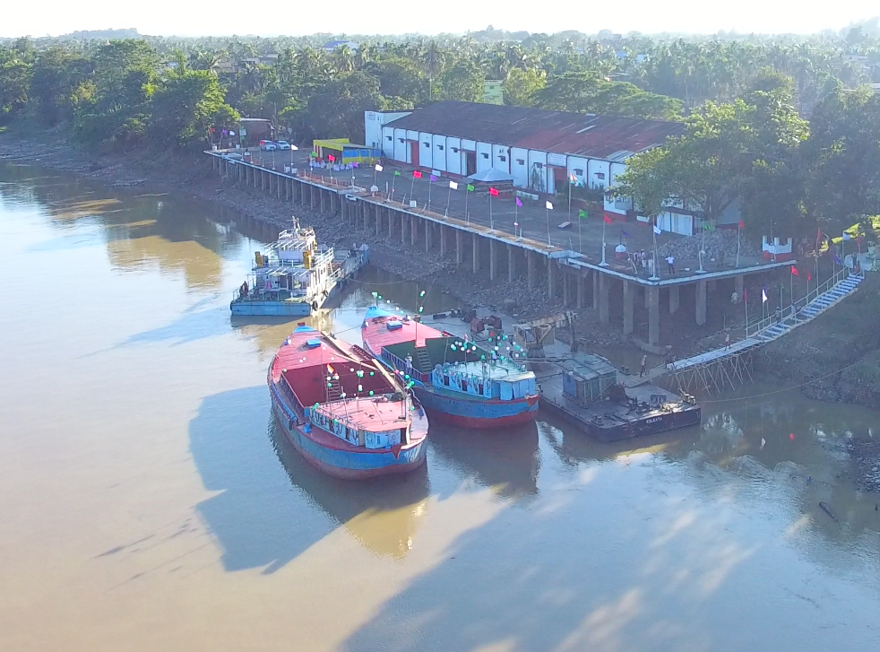
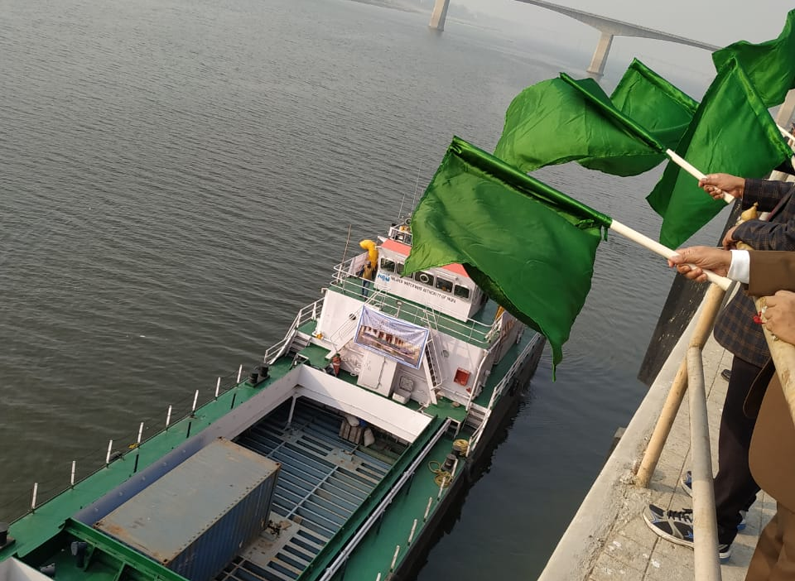
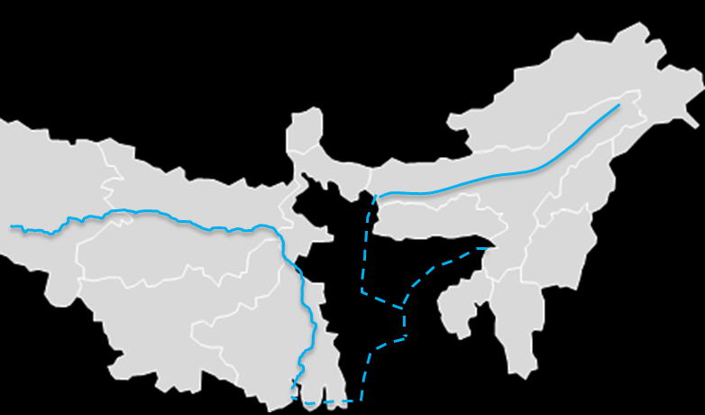
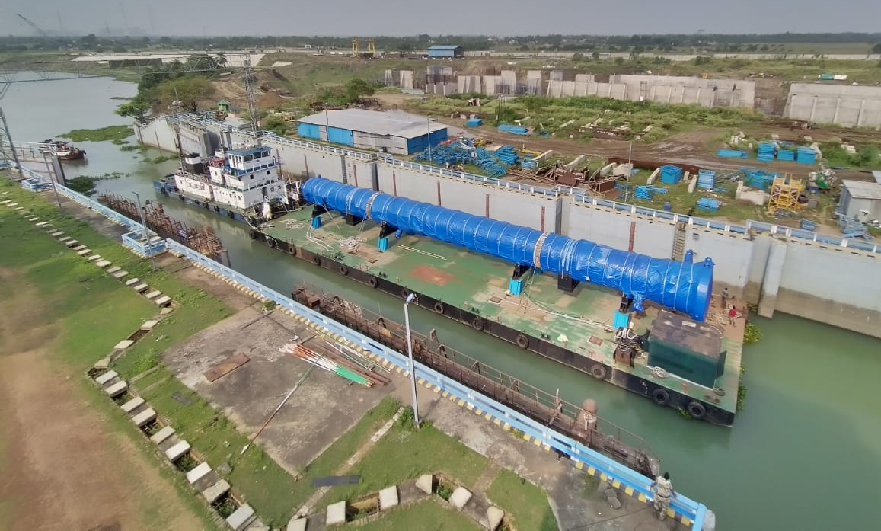
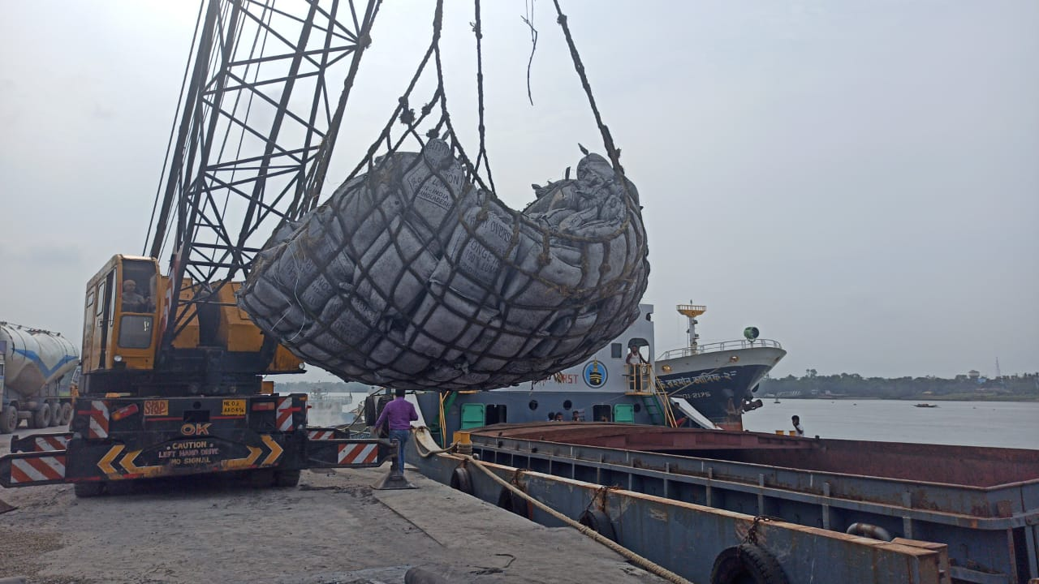
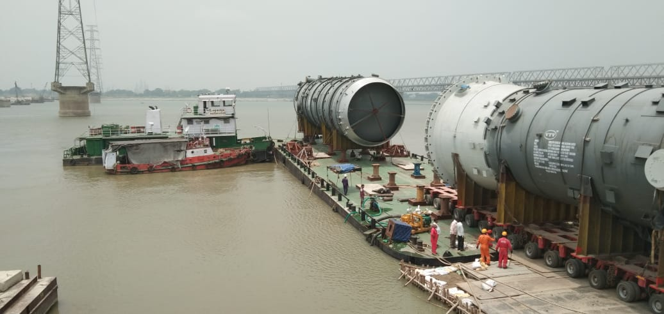
Pilot movements conducted to establish viability of
IWT connectivity through NW-1, NW-2 and IBP route
4
First containerized movement from Haldia Docks to Pandu with 48 TEUs of Edible oil, Petrochemicals, Beverages etc. (Nov’ 2019)
1
3
Operationalizing Karimganj terminal for EXIM cargo through INDO-BANGLADESH PROTOCOL route no. 3 & 4.
Schedule service started from Varanasi in Dec. 2020
Pandu
Kahalgaon
5
Dhubri
Narayanganj
18 movements of approx. 5,815 tonne of Over Dimensional Cargo moved on NW-1 from Kolkata/ Haldia port to destinations along NW-1
The first containerized export (sponge iron) from India to Bangladesh using Indo Bangladesh Protocol (IBP) routes was conducted in June 2020 (45 TEUs)
Haldia
2

Slide 9
Operation & Maintenance of
IWAI Terminals by Private Players
NEPAL
BHUTAN
Dhubri
Pandu
NW-2
NW-1
Jogighopa
Varanasi MMT
Patna
Karimganj
Sahibganj MMT
Badarpur
Bangladesh
NW-16
IBP Routes
Sonamura
NW-1
7 Jetties / terminals in Kolkata Region
Multi-modal terminal to be given for O&M by FY 21
Other IWAI terminals to be given for O&M by FY 21
Haldia MMT
Other important terminals which are operational
Notes:
With the view of improving the marketing and operational efficiencies at the existing terminals so as to unlock the value of its assets and infrastructure, IWAI is in process of handing over its terminals for Operations & Maintenance to Private organizations.
IWAI is also developing policy guideline to allow the private sector to develop their own jetties on private land and operate them for commercial purpose.
Allowing private entities to build, operate and manage the terminals will enable rapid development of terminal network on NWs and attract cargo towards IWT mode.
IWAI has already handed over its Garden Reach jetty I, II and BISN jetty at Kolkata to a private operator on O&M in October 2018 and this has resulted in significant increase (50% increase in FY19-20 as compared to FY18-19) of cargo handling at the jetties.
The process of handing over of the Multimodal Terminals (MMTs) at Varanasi, Haldia and Sahibganj on NW-1 to private operators is in progress. Similar process is in progress for IWAI’s jetties at Gaighat (Patna) on National Waterway-1 and Dhubri, Pandu (Guwahati) on National Waterway-2. Subsequently, IWAI’s terminals on NW-3 (West Coast Canal) and NW-16 (River Barak) are also planned to be handed over for O&M.

Slide 10
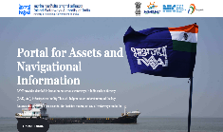
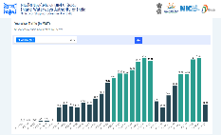
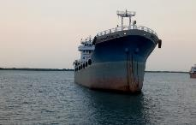
“Ease of Doing Business” – Development of digital portals of IWAI
Portal for Asset and Navigational Information (PANI)
CarD
(Cargo Data)
Sailing Permission portal for IBP route
Portal for Collection & compilation, Analysis and Dissemination of all the Cargo and Cruise movement data
Link: https://iwaicargoportal.nic.in/web/home
Digital portal for providing permissions, agent & vessel registration on the IBP route
Easy mobile & web based access for viewing, uploading and dissemination of Navigational information
Link: http://pani.iwai.nic.in/
Implemented by FY21
Notes:
To promote ease of doing business and improve and streamline administrative processes, IWAI has laid emphasis on the use of technology.
Currently, 5 digital portals are being developed which will assist the stakeholders of IWT in various areas like
Accessing navigational information for safe voyage
Collection, compilation, analysis and dissemination of Cargo data
Provision to get permissions, registrations etc. online
Accessing real time central repository for all vessel and crew details
Freight and vessel management system

Slide 11
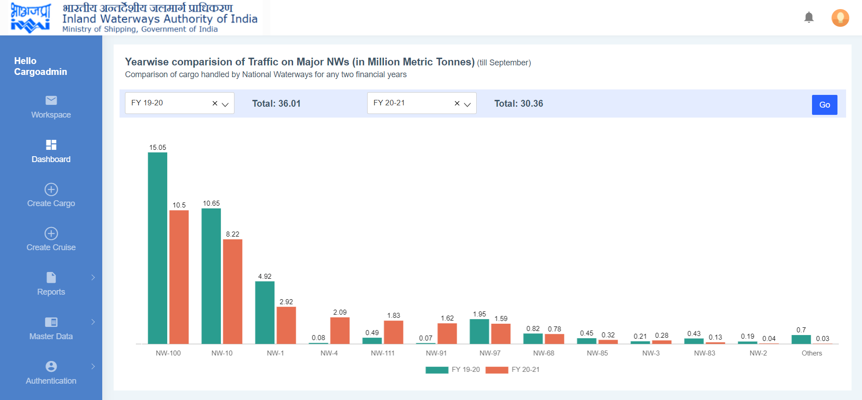
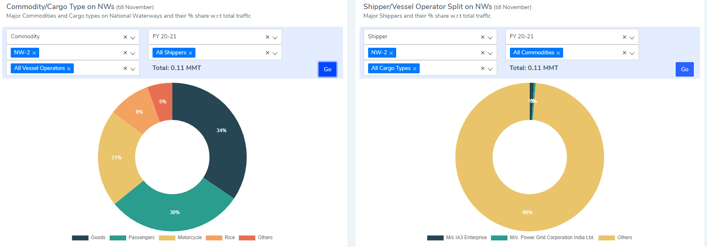
CAR-D (CARGO DATA) : KEY BENEFITS
Helps in understanding the traffic flow patterns, key commodities and potential/ key logistics players in the sector.
Facilitates cargo consolidation and promotion of inland waterways transport.
Availability of near real time tracking with interactive dashboard having analysis of Cargo and Cruise traffic data under a single portal.
Access of the data to general public showcasing capabilities and potential of IWT.
https://iwaicargoportal.nic.in/web/home

Slide 12
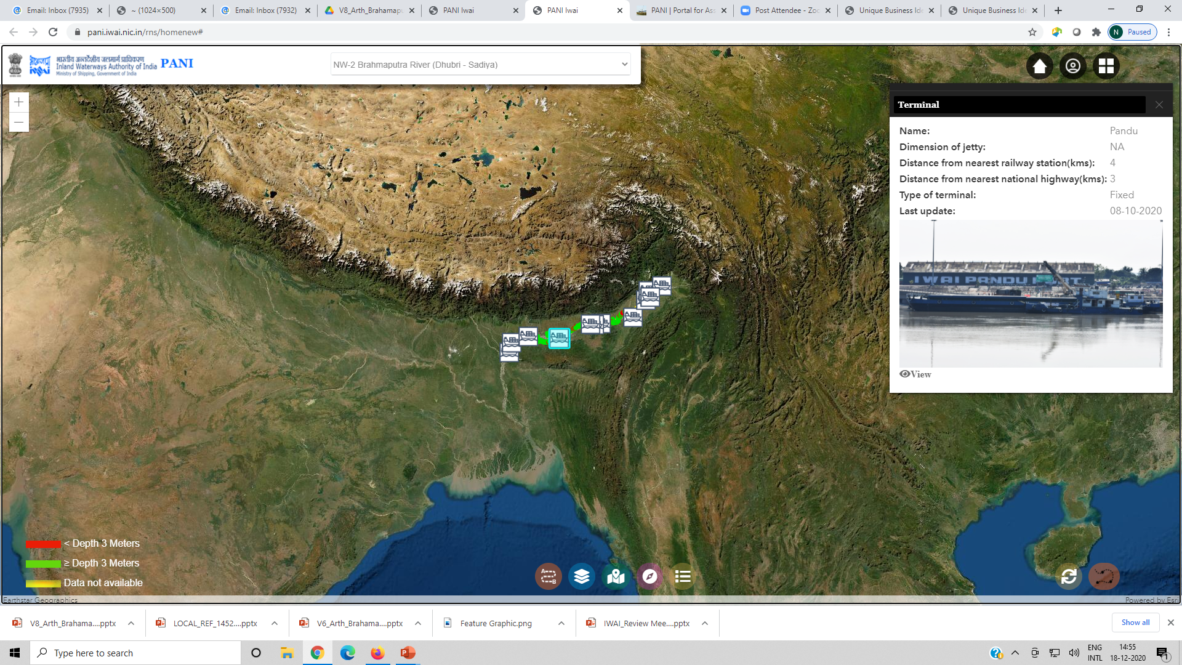
PANI (Portal For Assets And Navigational Information)
Integrated information system for River Navigation and
Infrastructure on a Single Platform
Provides near real time information for:
Fairway (Available depth)
Terminals, Pontoons and Tourist jetties
Ship repair facilities
Tariff details and Emergency services
GIS based Bharat Maps portal for visualization and easy accessibility
Accessible to external stakeholders and general public
http://pani.iwai.nic.in/

Slide 13
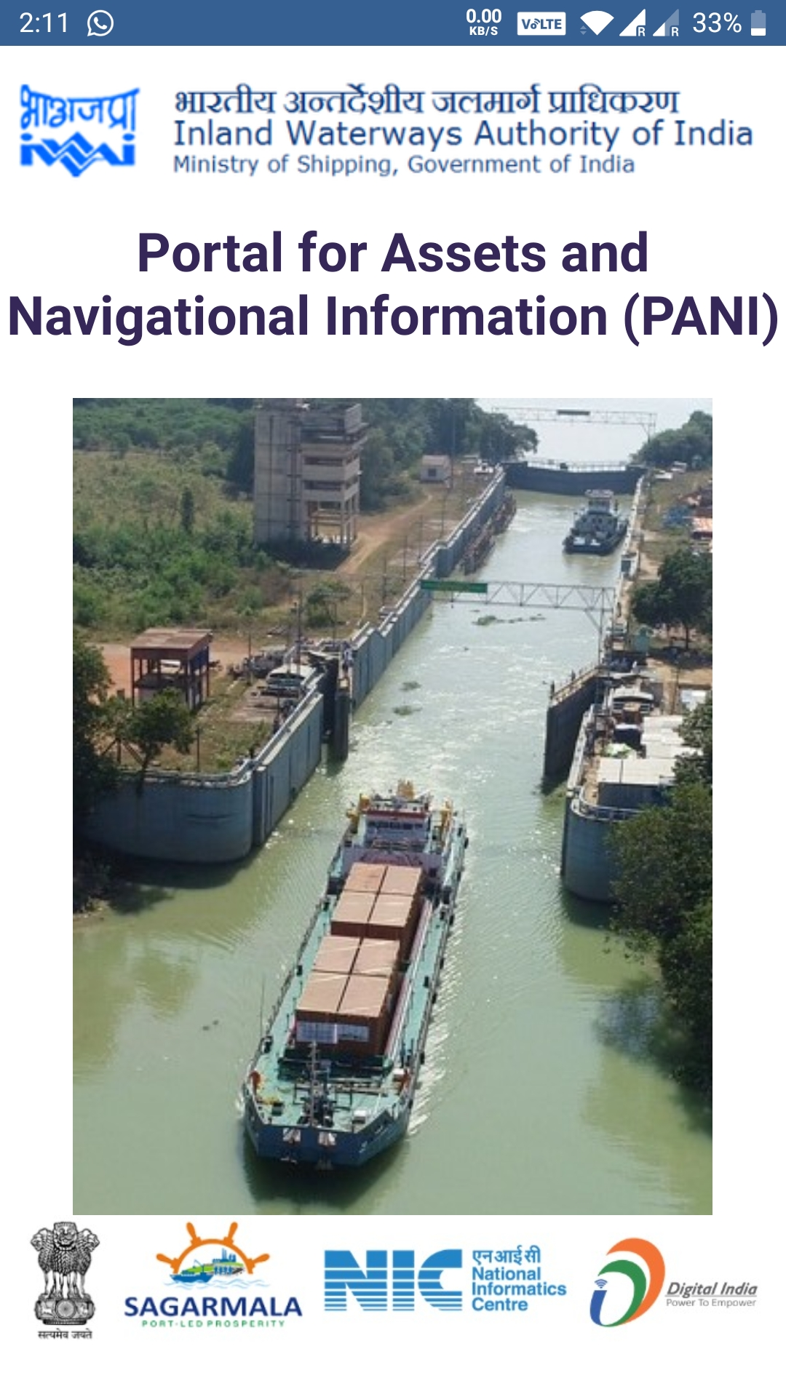
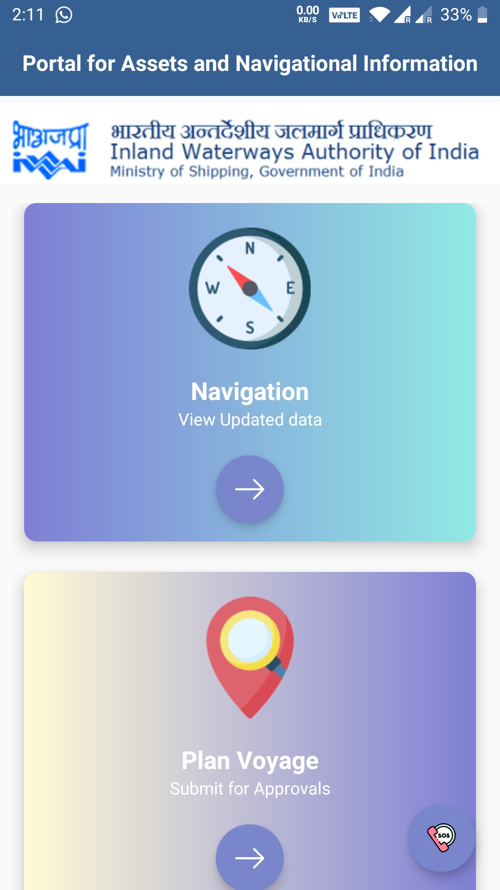
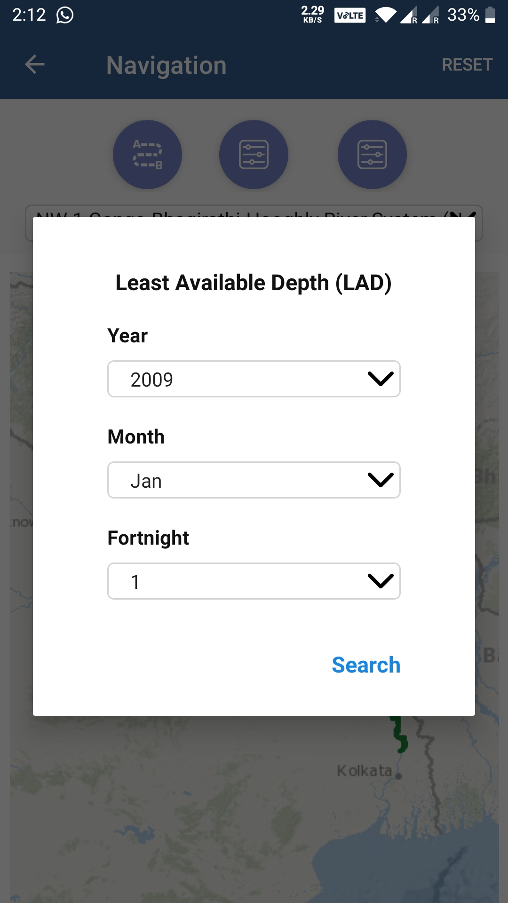
PANI : Mobile application
http://pani.iwai.nic.in/

Slide 14
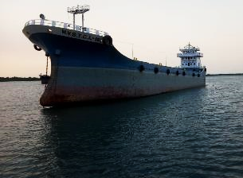
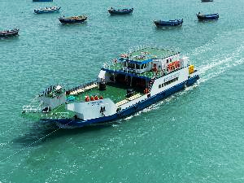
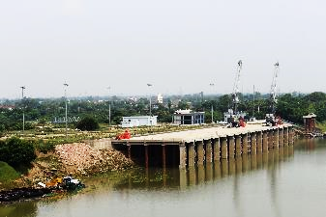
WATERWAYS: IWAI
Logistics and Infrastructure available
High Scope for River Cruise, ODC Cargo Movement
Shifting of a percentage of cargo to waterways, combining with Coastal shifting.

Slide 15
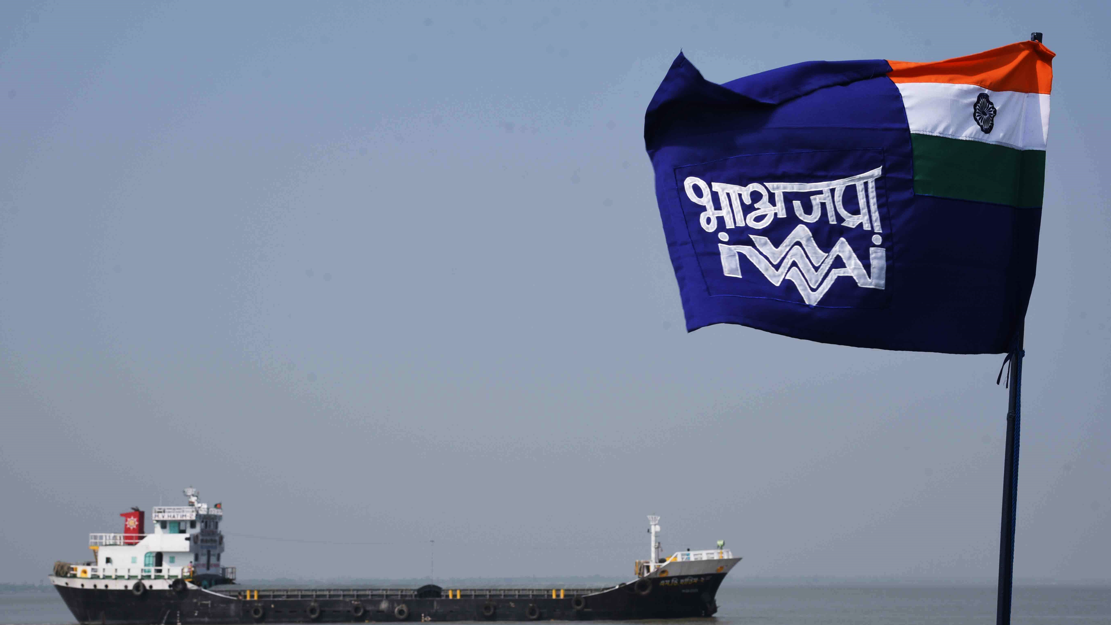
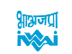
Thank you

