Slide 1
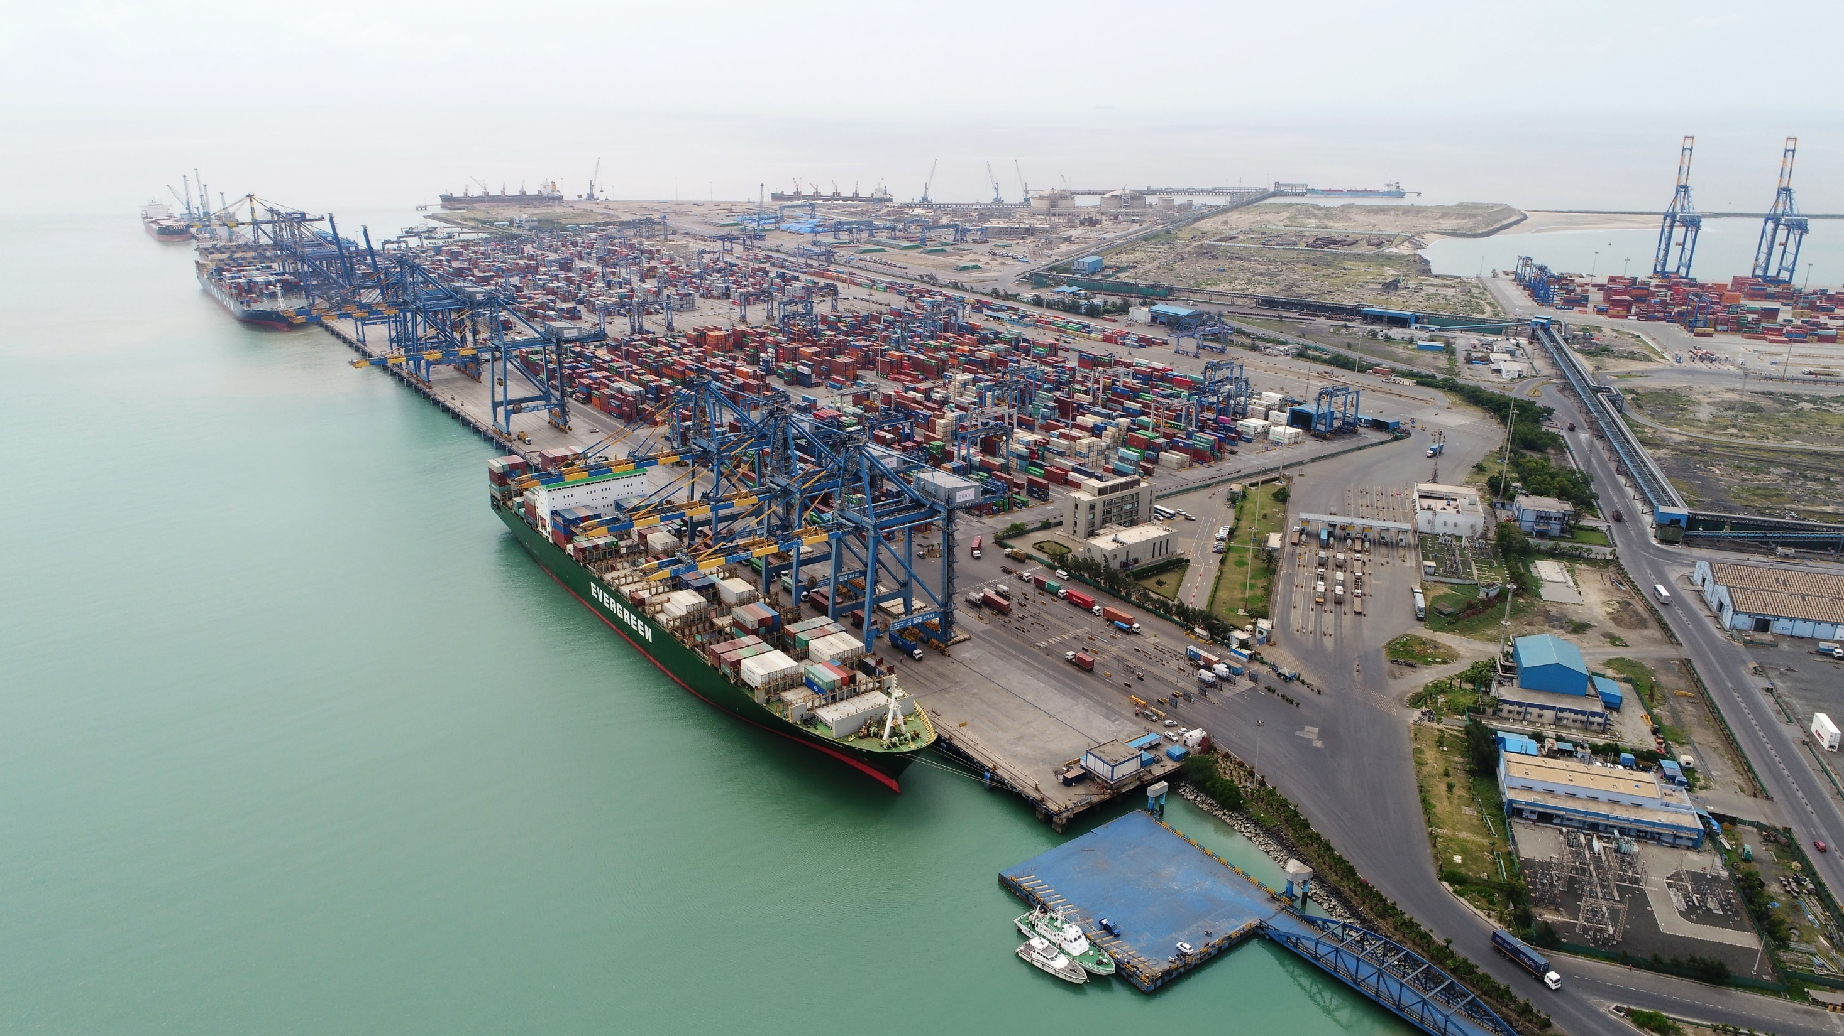
Adani Ports and Special Economic Zone Limited – Infrastructure & Performance Compendium

Slide 2
Adani : Leadership across infrastructure sector
We are India’s…
…passionately driven by…
Largest
Private Port
(562 MMTPA Capacity)
Vision
Values
To be the globally admired leader in integrated infrastructure businesses with a deep commitment to nation building
We shall be known for the scale of our ambition, speed of execution and quality of operation
Courage: We shall believe in our employees and other stakeholders
Trust: We shall embrace new ideas and businesses
Commitment: We shall stand by our promises and adhere to high standards of business
Largest
Container
Port operator
( 36% Market
Share)
Largest CGD^ operator
( 71 districts)
Growth with Goodness
Largest
Private
Thermal Power Producer
(14 GW)
Culture
P - Passion
R - Results
I - Integration
D - Dedication
E – Entrepreneurship
Largest Solar
Cell Manufacturer
(1.5 GW)
Largest
Airport
operator
(8 Airports)
Unparalleled and Unmatched growth journey in the last two decades across infrastructure domains
^- CGD- City Gas Distribution

Slide 3
Adani Ports- Transformative & Sustainable Journey

Slide 4
APSEZ : Harnessing synergy with Logistics
Technology Platform
Creating Value
Transportation
Facilities
Other Services
Rail
Logistics Parks
Stuffing / De-stuffing
Road
Warehousing
Cargo Aggregation
Inland Waterway
Inland Waterway Terminals
Customs Clearance
Air
Air Cargo Complex
Other Value added services
Coastal Shipping
Sea Ports
End-to-end Integrated Logistics Services
Example of Customer Centric End to End Logistics Offerings Ensuring Maximum Synergies
Logistics Parks
EXIM Yard
ICD – Partner Facilities and Acceptance Points
Network
Adani Agri
22KM
Manesar Plant
Patli, ICD
Mundra Port
2007
2007
2008
2018
2019
2019
2020
2021
Journey
Container Train
Logistics Park
Warehousing
Grain Silos
Inland Waterways
Automobile Trains
GP Trains
Air Freight Station
Integrated logistics compliments the network of port to serve customers throughout the vast hinterland of India

Slide 5
Adani Ports - Container Terminals Portfolio – East Coast

Slide 6
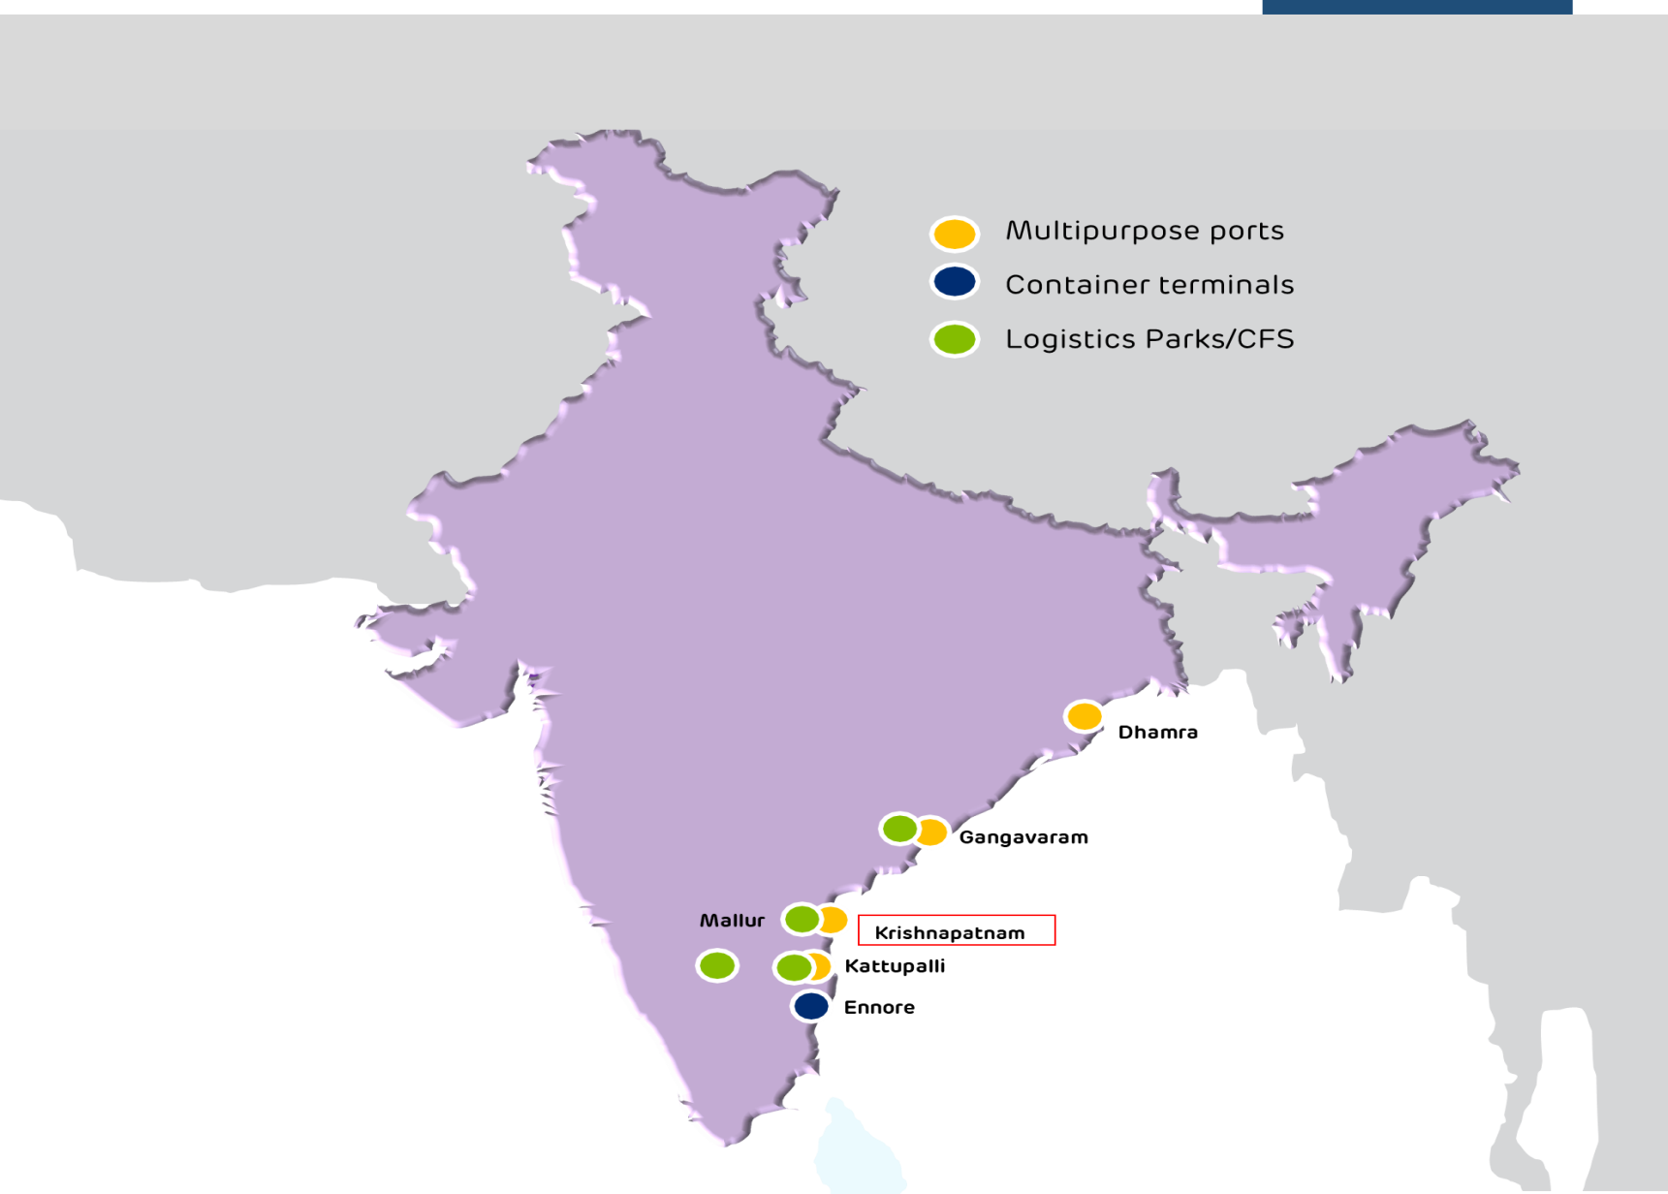
Adani’s Strategically Located Container Terminals
Kattupalli, Ennore & Krishnapatnam handles 40% of container traffic in Chennai cluster
Container terminal at Gangavaram to be ready in 1H 2022
Container terminal at Dhamra is also in the pipeline

Slide 7
Chennai Cluster (Kattupalli & Ennore)

Slide 8
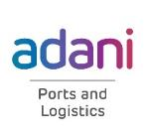
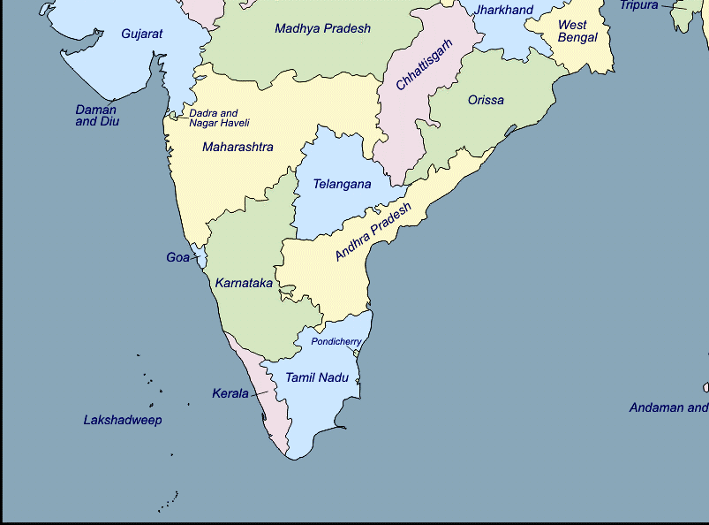
Kattupalli/Ennore Port Location and Hinterland
Located 30 km north of Chennai Port
Shares common hinterland with Chennai port i.e. Tamil Nadu, South East Karnataka, and South Andhra
Ideal location serving as alternative to Chennai Port which operates with the city & grapples with congestion
Maersk & MSC has completely moved out of Chennai terminals
Kattupalli/Ennore is the first port of choice for auto customers as the terminal adds value to JIT operations
Kattupalli
Ennore
Chennai

Slide 9
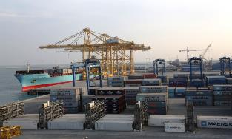
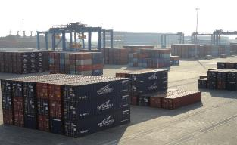
Kattupalli Container Terminal Infrastructure
Particulars | Details
Quay Length | 2 Berths, 710 M
Capacity | 1.2 Million Teus
Ground Slots | 5120 Teus
Reefer Plugs | 360 plugs, expandable
Quay Cranes | 7 Post Panamax cranes
Rubber Tyre Gantry Cranes | 18 nos of electric RTGCs for yard operations.

Slide 10
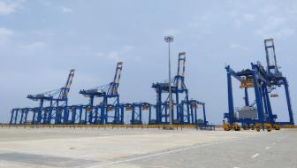
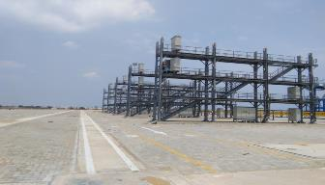
Ennore Container Terminal Infrastructure – Phase 1
Particulars | Details
Quay Length | 1 Berth, 400 M
Draft | 15 Meters
Capacity | 800,000 Teus
Ground Slots | 4000 Teus
Reefer Plugs | 150 plugs, expandable
Quay Cranes | 4 Post Panamax cranes
Rubber Tyre Gantry Cranes | 12 nos of electric RTGCs for yard operations.

Slide 11
Kattupalli & Ennore Hinterland Connectivity and Benefits
Excellent road connectivity to national & state highways
Congestion free approach roads.
8 Lanes Port Gate complex for smooth Inward/Outward movement of Containers.
Connected to all 29 CFSs in Chennai for Imports & Exports.
Close proximity to CFSs: 60% CFSs are within 20 KM.
Direct Delivery from Terminal for ACP Clients
Close Proximity to Industrial clusters
24 X 7 Customer service desk

Slide 12
Krishnapatnam

Slide 13
Krishnapatnam Port Location and Hinterland
Located 180 KMs North of Chennai on National Highway 16
Natural gateway port for South Andhra,
South Telengana
On-dock rail expands hinterland reach to Bengaluru, Hyderabad and Central India markets
Krishnapatnam

Slide 14
Krishnapatnam Container Terminal Infrastructure
Particulars | Details
Quay Length | 2 Berths, 650 M
Capacity | 1.2 Million Teus
Ground Slots | 4600 Teus
Reefer Plugs | 200 plugs, expandable
Quay Cranes | 5 Post Panamax cranes
Rubber Tyred Gantry Cranes | 9 nos of electric RTGCs for yard operations.

Slide 15
Expanding Container Traffic at APSEZ on East Coast
Ennore commenced from Oct FY19, Krishnapatnam acquired in FY21

Slide 16
Gangavaram

Slide 17
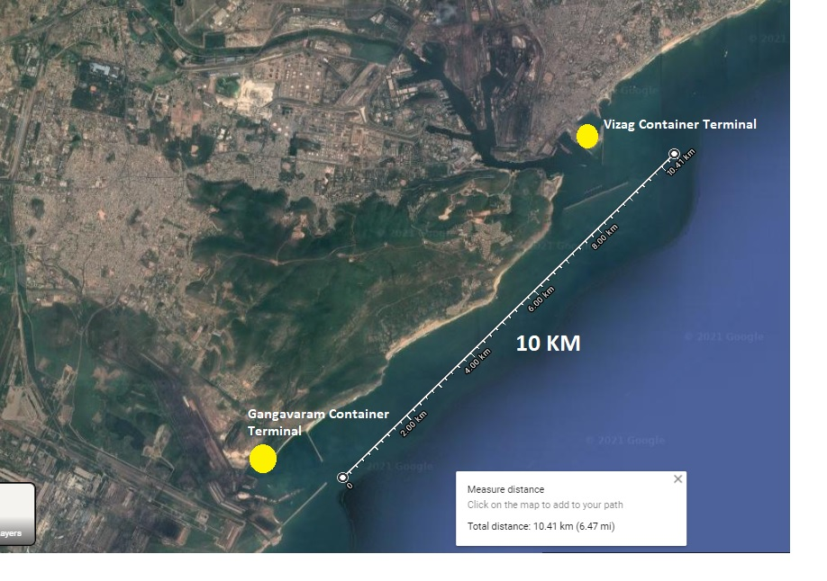
Gangavaram Port Location and Hinterland
Located south of Vizag City, Gangavaram port is a deep draft all weather port developed on BOOT concession with Govt. of Andhra Pradesh
Falls under jurisdiction of Vizag customs
Ideally located to cater to the hinterlands of Andhra Pradesh, Orissa, Chhattisgarh and Nepal
Port is equipped with huge back up area for future expansion (Total Port area is ~2800 acres)
All operations under single authority (marine and terminal)
5.4 NM

Slide 18
Gangavaram Container Terminal Infrastructure (Phase 1)
Particulars | Details
Quay Length | 1 Berth, 337 M
Draft | 15 Meters
Capacity | 500,000 TEUs / annum
Ground Slots | 3350 Teus
Reefer Plugs | 350 plugs, expandable
Quay Cranes | 3 Post Panamax cranes (22 across / 62 m outreach)
Rubber Tyre Gantry Cranes | 9 electric RTGCs for yard operations.
*Phase 1 – expected to be commissioned by June 2022.

Slide 19
Connectivity & Support Infrastructure
Seamless Road connectivity by a 4 lane expressway of 3.8 kms connecting the port with the National Highway of Chennai – Kolkata.
Railway connectivity has been established connecting the port to the main broad gauge national network of "Chennai-Visakhapatnam-Howrah" rail corridor.
Container Scanner
Dedicated on-dock Rail connectivity for container cargo
On-dock CFS with warehousing facilities
On–dock empty depot with MNR operations
IPOS (terminal operating system) in line with other Adani terminals

Slide 20
Other Upcoming Terminals in India

Slide 21
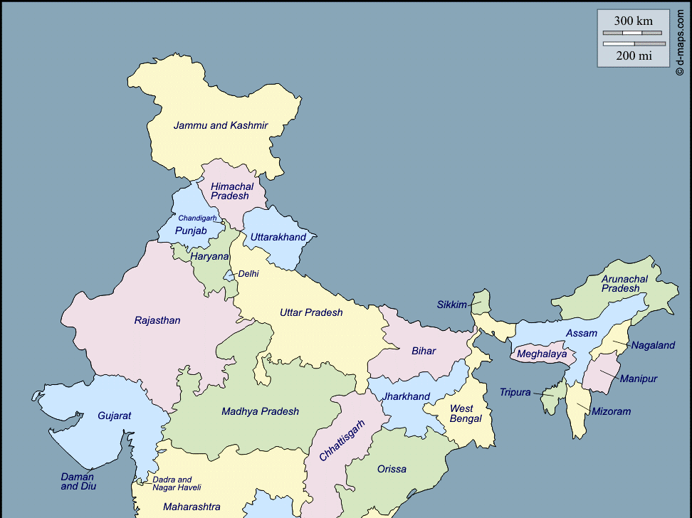
Dhamra Port Location and Hinterland
Located 120 nautical miles south of Kolkata Port
Natural Gateway port for Orissa, Chhattisgarh, Jharkhand and West Bengal due to close proximity.
Ideal port to serve as an alternate to Kolkata port grappling with draft limitation and congestion
Dhamra

Slide 22
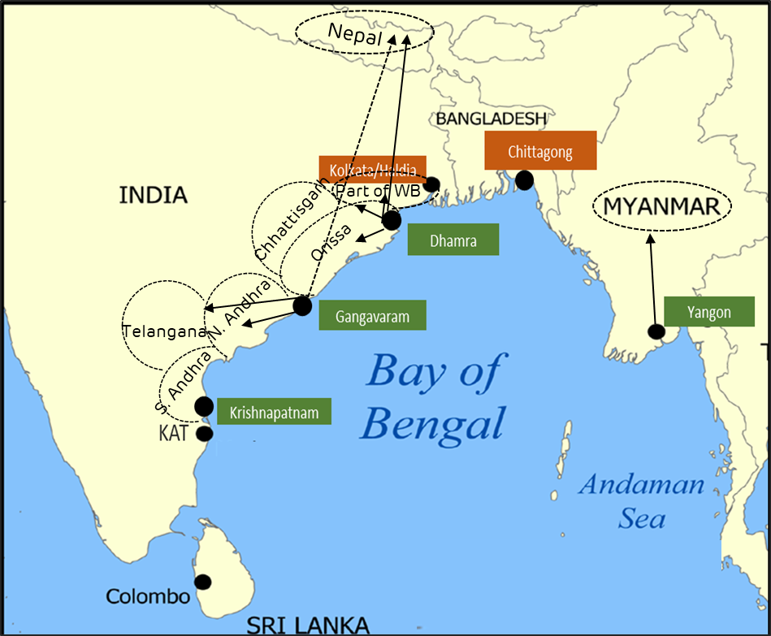
Dhamra to be a Bay of Bengal Hub
Upcoming Gangavaram container terminal will serve North Andhra and Odisha markets and will also connect Nepal by rail
Dhamra container terminal is poised to be a hub in the Bay of Bengal considering the natural draft and the infrastructure we are planning to build
Dhamra can serve ports in the region by feeders
Dhamra has the potential to be a transshipment hub on the East Coast of India
Dhamra is also positioned to serve Odisha and Nepal hinterlands

Slide 23
Thank You

