Slide 1
DP World

Slide 3
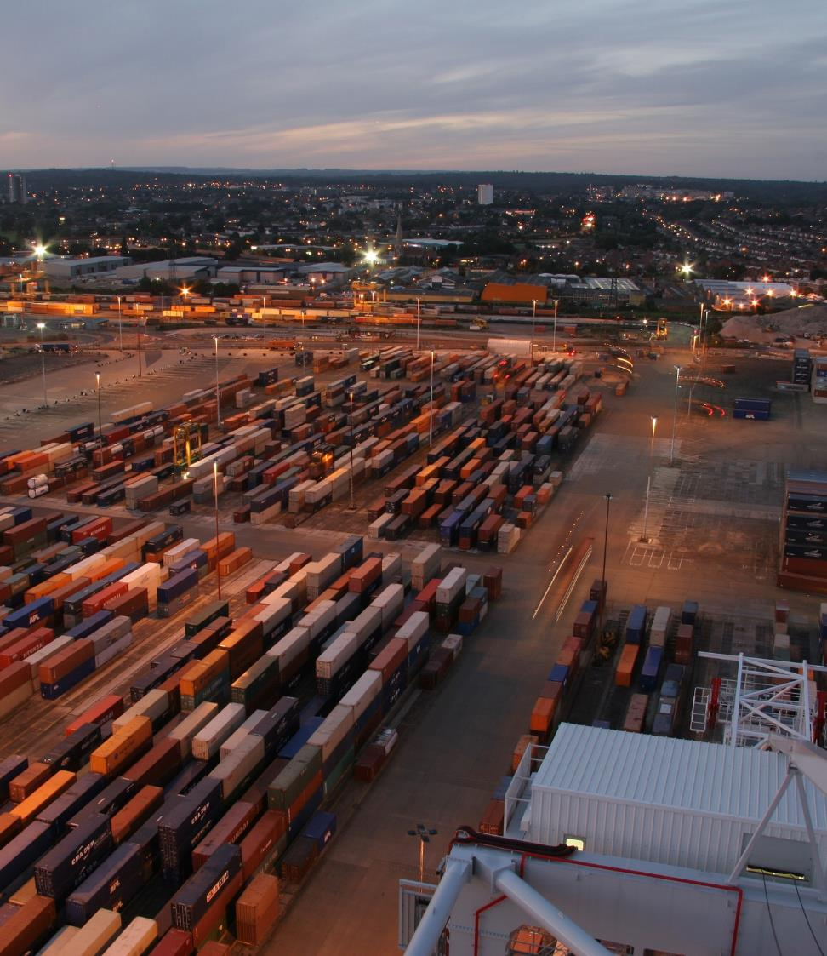
DP World India

Slide 4
Who are We ?
DP World is the leading provider of worldwide smart end-to-end supply chain & logistics services, enabling the flow of trade across the globe
In India, DP World is a market leader with a robust portfolio of integrated logistics assets
  Extensive Network Port Terminals, Inland Rail Terminals, Container Freight Stations, Global Logistics, Express & 3PL, Rail Services, Economic Zones and various value-added services
We cater to the complete spectrum of supply chain across all types of storage, all kinds of cargo and all types of transportation for both Domestic and Global customers
Our Digital solutions provide end-to-end seamless experience to customers for all their logistics needs
Our Purpose - We Enable smarter trade to make a better future for everyone
Adding Value Delivering exceptional customer services and building lasting partnerships through global excellence and local expertise. | Thinking Ahead Innovating to create the most efficient, safe and profitable trade solutions. | Building a Legacy Ensuring everything we do leaves long-term benefits for the world we live in.

Slide 5



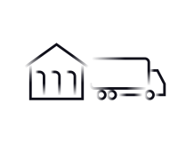




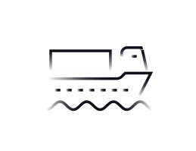





DP World INDIA Presence
Port Terminals
6
Port Terminal (incl. Kulpi concession)
9
Cold Chain storage locations
Multi-Modal Freight Terminal
Container Freight Station (CFS)
Economic Zones (upcoming)
5
Container Freight Stations
100+
Cities with Express
Logistics Centres
Jammu
Shimla
Cold Chain
Pathankot
Express Logistics
Chandigarh
Upcoming Freight Terminals
3
Economic Zones
(under development)
2
Mn sq. feet of warehouse space under Contract Logistics
PANIPAT
Dehradun
MODINAGAR
PALI
Jodhpur
HINDAUN
30
2
Container Train Operator (CTO) Licenses
Jaipur
Lucknow
Guwahati
Container Trains
Kanpur
Patna
Udaipur
Indore
Jabalpur
AHMEDABAD
Ranchi
Kolkata
7
MUNDRA
Bhopal
KULPI (upcoming)
Multimodal Inland Terminals connected to rail network
HAZIRA
Surat
Nagpur
Raipur
Cuttack
NVOCC and feeder services through Avana, Perma and Transworld
NHAVA SHEVA (MUMBAI)
Pune
Bhubaneshwar
Freight Forwarding Services
Aurangabad
VISAKHAPATNAM
HYDERABAD
Kolhapur
Hubli
Vijayawada
Trade Finance Solution (under development)
Digital Logistics Platform (Cargoes.com)
Goa
Nellore
Mangalore
BANGALORE
CHENNAI
    Only operator present in 3 Major Ports of India with a 28% EXIM market share
    Capability to design and deliver standard as well as bespoke multi-modal logistics solutions
    Hard-to-replicate portfolio of assets and services developed over 3 decades
Coimbatore
COCHIN
Tuticorin

Slide 6
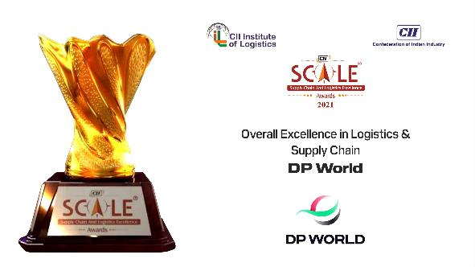
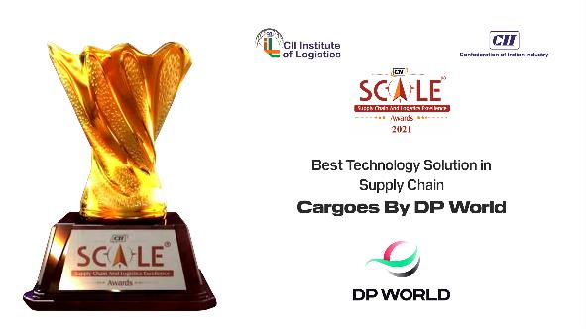
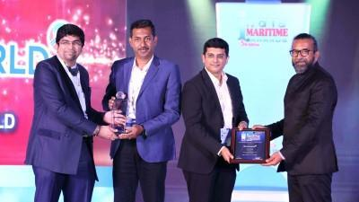
Awards and Recognitions
Over the years, DP World in India have received multiple accolades in areas of Business, Operations Excellence, Innovation, Employee Practices and CSR
For the last three consecutive years DP World India has won the Overall Excellence in Supply Chain & Logistics, Best Safety Practices, and Training & Skill Development Awards at the prestigious Confederation of India Industry (CII) Supply Chain & Logistics Excellence (SCALE) Award.
DP World’s new digital platform CARGOES By DP World won the Best Technology Solution in Supply Chain award at the prestigious Confederation of India Industry (CII) Supply Chain & Logistics Excellence (SCALE) Awards 2021.
DP World won the ‘Supply Chain Company of The Year’ Award at the prestigious India Maritime Awards.

Slide 7

Awards and Recognitions
SCALE AWARDS 2021
CARGOES By DP World recognized as the Best Technology Solution in Supply Chain at the Prestigious CII SCALE Awards 2021.

Slide 8
Digital Supply Chain of the Future

Slide 9
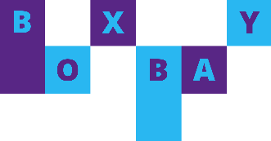
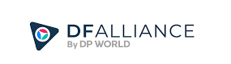
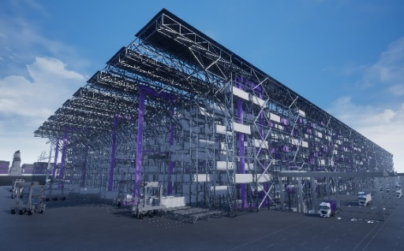
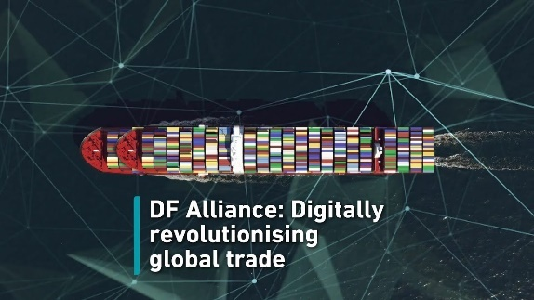
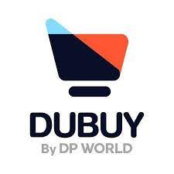
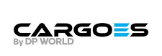

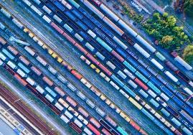
Unlocking continuous innovation to stay ahead of the curve
BOXBAY Container Stacking Solution
DF Alliance
Solutions for container storing and handling by means of High Bay Storage (HBS) systems
Disruptive technology that significantly improves operations at container terminals.
Storage capability of the terminals is enhanced by stacking containers as high as 11 tiers.
Connects freight forwarders around the world and provides web-based tools to drive business through an ultra-high-value membership package.
DUBUY.com
Cargoes PCS
Global wholesale e-commerce platform launching in Rwanda and unlocking access to global markets for smes, backed by DP world’s end-to-end integrated supply chains.
Provides end-to-end visibility and control throughout the customs process. Seamlessly fulfil customs requirements for presenting goods and temporary storage declarations by submitting paperwork through the PCS.
Private & Confidential
9

Slide 10

LOGISTICS
A Single Window Digital Solution
For All Logistics Needs
January 2022

Slide 11
UNCOVERING AND SOLVING CUSTOMER CHALLENGES

Slide 12
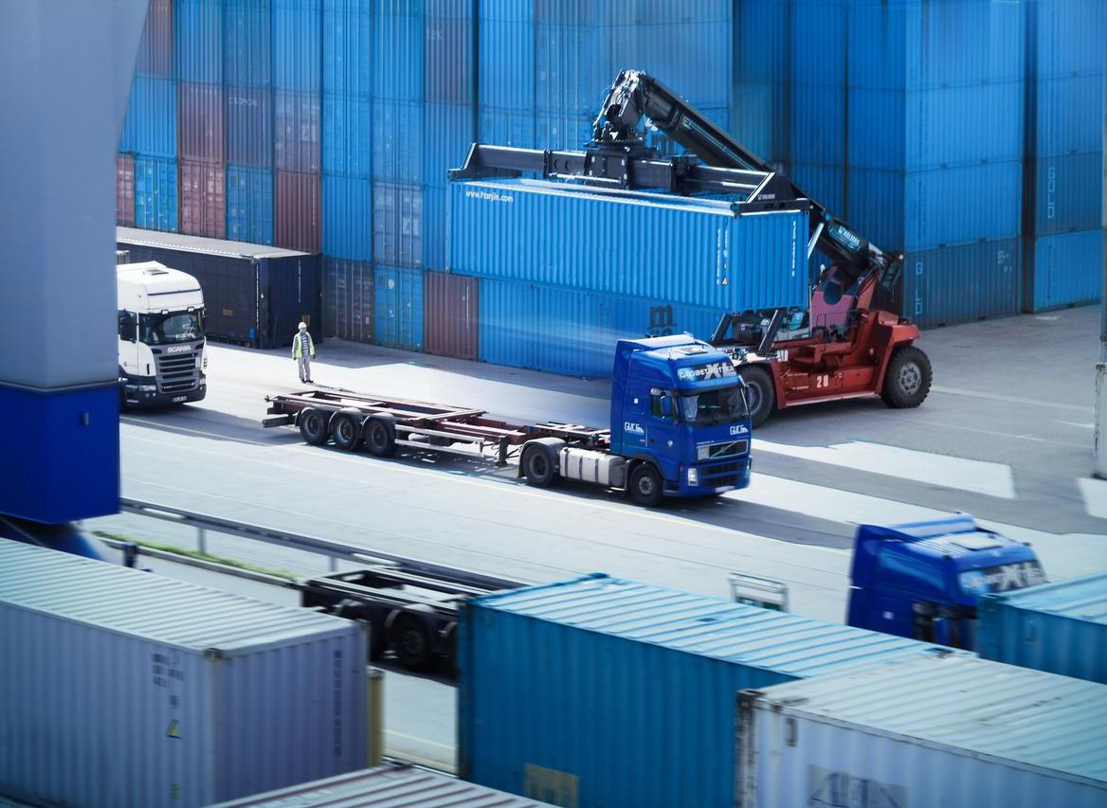






CHALLENGES
Complex Cargo Booking Process
No Guaranteed Booking
Multiple hidden charges
  Limited Visibility of the Cargo
  Multiple Handovers &
  Follow-ups
4

Slide 13
THE SOLUTION

Slide 14
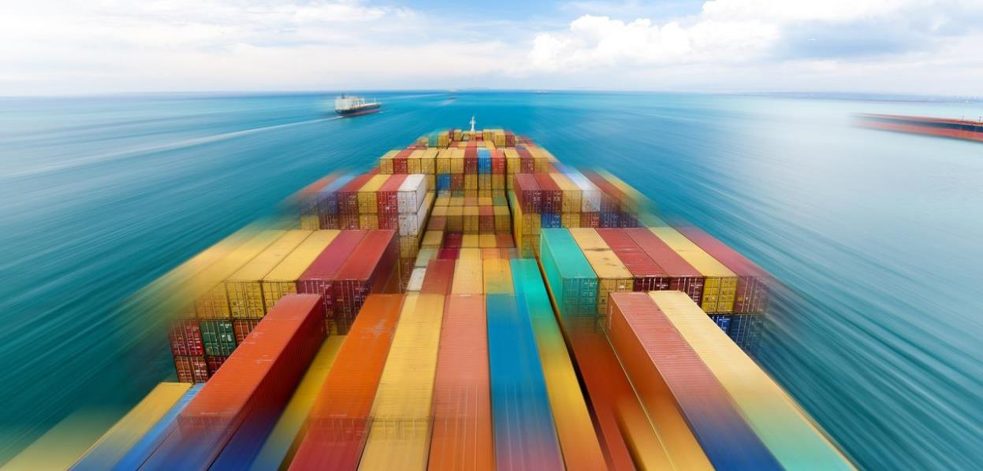
CARGOES
LOGISTICS
CARGOES Logistics by DP World a Single Window Digital Solution for all Logistics needs of customers
  Receive instant quotes online and book your freight in three easy steps. Simply enter the pickup location and port of destination, quantity, and container type and we instantly provide the best freight rates from across sea, road, or rail.
6

Slide 15







WHY CARGOES LOGISTICS?
Swift Cargo Booking
Super-Efficient Movement
Instant Quotes
Easy and swift booking
of your container shipment online in a few clicks.
Provides seamless, safe, secure, and efficient movement of your Ocean freight, from Origin to Destination.
Offers easy and best freight rate quotes comparison for container shipping.
Deep Tracking
Quality Assurance
Single Window Billing
Advanced container tracking to provide end-to-end visibility & predictability
of your cargo.
A product by DP World,
a global logistics company, with interconnected network
of owned assets across 68 countries.
Simplified single window billing along with multiple secure payment options and all-inclusive INR pricing (no complex invoicing).
7

Slide 16
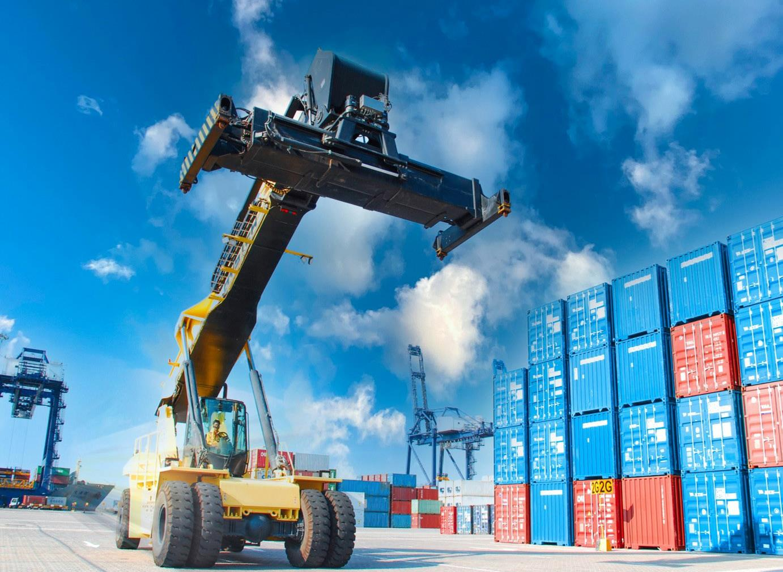

CARGOES LOGISTICS OFFERINGS
Multimodal Logistics options via DP World Rail & Inland assets
Multiple service offerings (Port to Port, Warehouse to Port, ICD to Port)
FCL Trucking Solution for first/last mile transportation
DP World owned/managed trailers for expediated/preferred
pick up/delivery slots
Highest degree of control on account of owned ICDs, Rail Network, Terminals and Carriers
Trade & Logistics Finance solutions
Ship from UAE to India as well as India to various destinations across Middle East, Subcontinent, Southeast Asia Far East Asia and North Africa
Optional Value-Added Service
Dedicated Customer Service
Process and Operations, owned and managed by MTO Registered Global Logistics vertical of DP World India
1
8

Slide 17





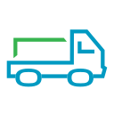

END-TO-END SOLUTION
Empty Containers from ICD
Land
Movement
Land
Movement
Arrival of Laden containers at ICD
Rail
Movement
Arrival at Origin Port
Origin ICD
Shippers Factory
Origin ICD
Origin Customs*
Port of Loading
Ocean
Movement
Empty Containers Back to Depot
Land
Movement
Land
Movement
Arrival at Destination Port
Container Depot
Consignee Facility
Destination Customs*
Port of Discharge
*Coming Soon
9-

Slide 18
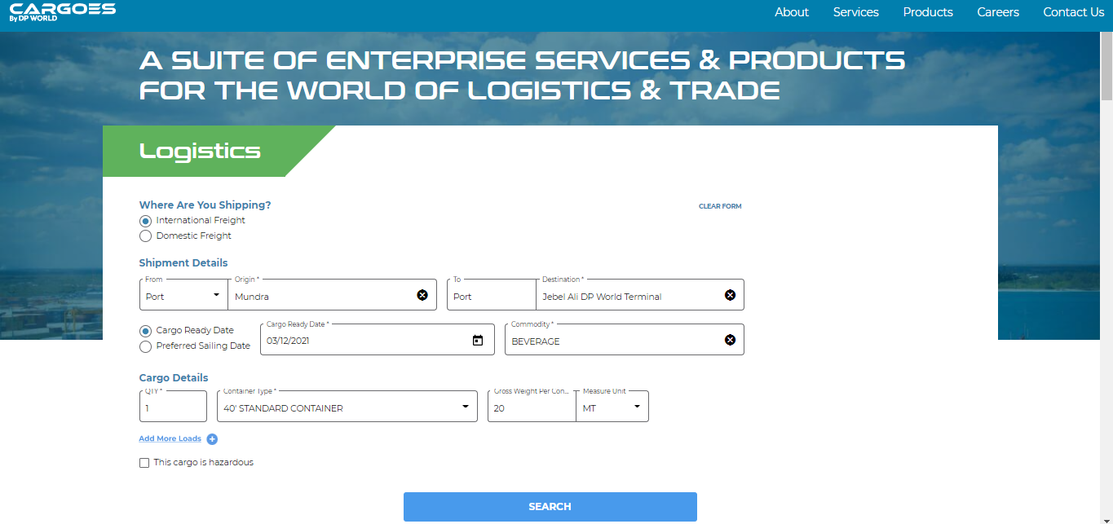
USER-FRIENDLY INTERFACE
10

Slide 19
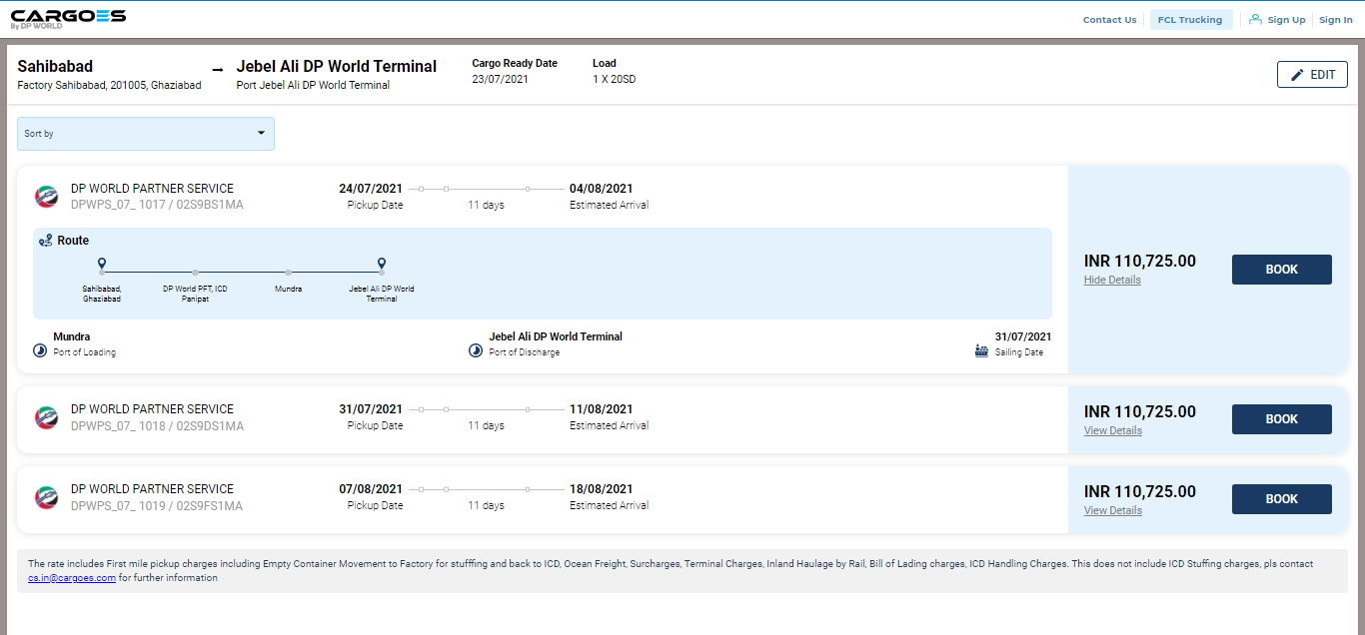
MULTIPLE SCHEDULES TO CHOOSE FROM
11

Slide 20
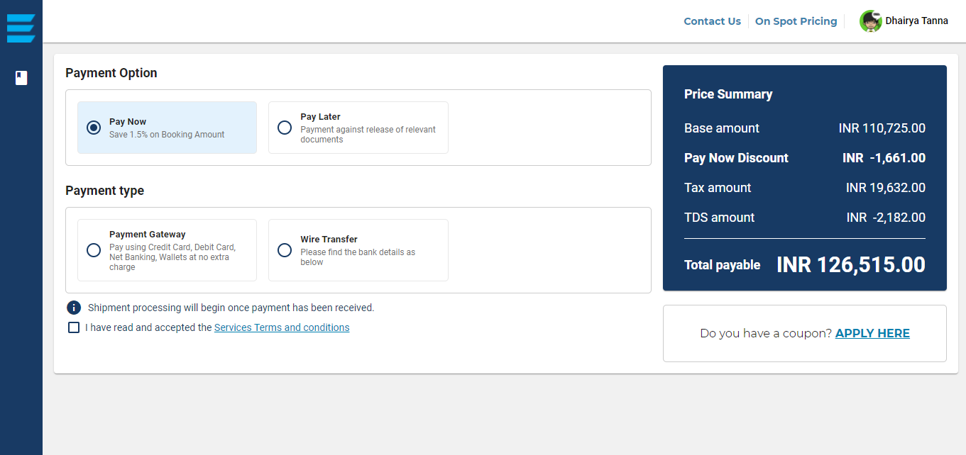
MULTIPLE PAYMENT OPTIONS
12

Slide 21
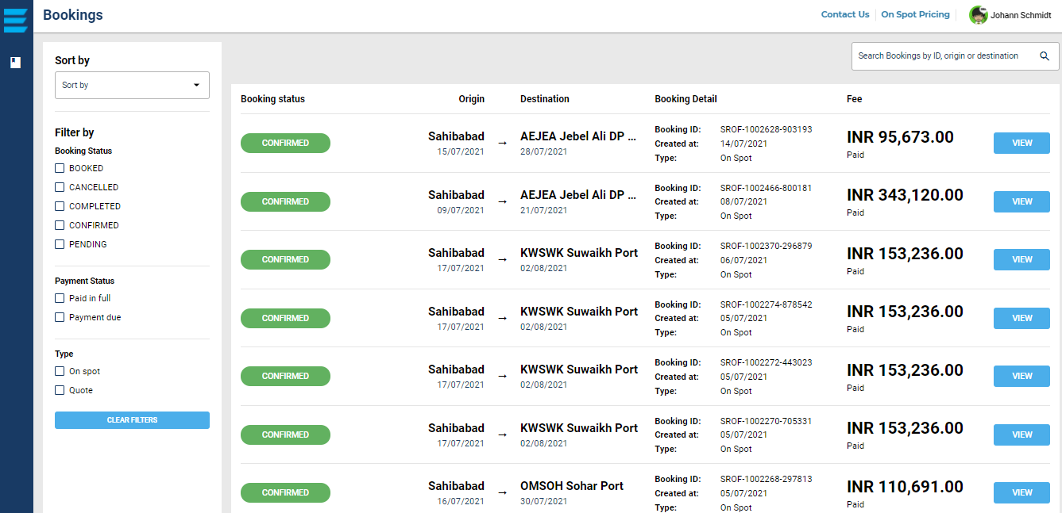
BOOKINGS – EASY TO MANAGE
13

Slide 22


ADVANCED TRACKING
End-to-end tracking integrating 6 different tech solutions
  IOT devices on railway rakes
  RFID tags on containers
  Rail operations system
  GPS devices on trailers and trucks
  SIM triangulation and
  Satellite based vessel position
Advance integration of multiple technologies provides Real-time visibility across all modes of transportation.
Automated email notifications for key events
Deep tracking solution provides supply chain predictability, thereby minimizing impact of any disruption
1
14
Notes:
No single solution gives a complete picture, however by putting one on top of another we give you a rich and real-time visibility across all modes of transportation.
Key events generate email notifications thereby eliminating the need to check each time manually.
Our proprietary AI/ML solution at the back-end constructs and maintains the relationship between the container and the asset throughout the lifecycle of the shipment.
Not only does this give our customers a real-time visibility but it also enables DP World to take timely proactive or corrective steps to minimize impact of any disruption.

Slide 23
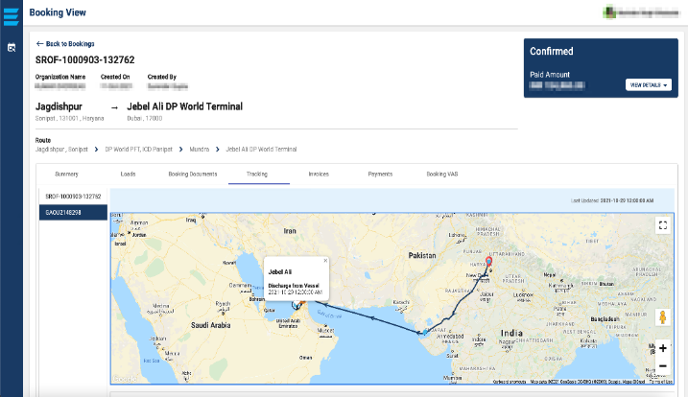
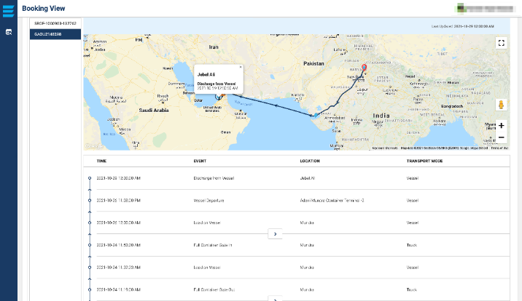
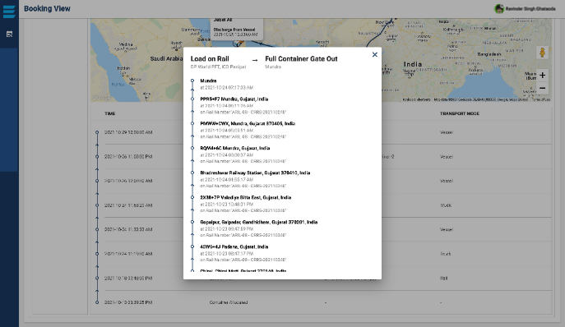
ADVANCED TRACKING
Level 1: Map view
Level 2: Map + Table view
15
Level 3: Detailed Table view

Slide 24
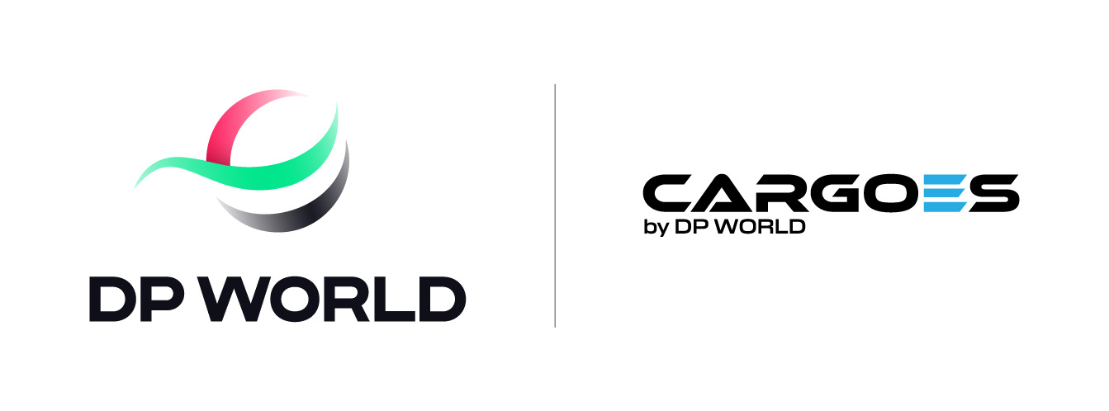

Slide 25
Thank you

