Slide 1
KALINGA INTERNATIONAL COAL TERMINAL PARADIP (KICTPPL)
AT
PARADIP PORT
25.02.2022

Slide 2
PARADIP PORT

Slide 3
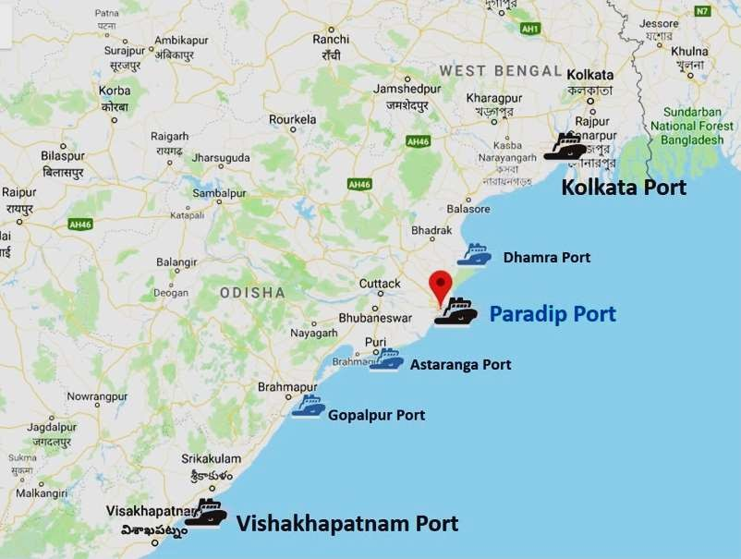
PARADIP PORT & ITS STRATEGIC LOCATION
210
Nautical Miles
260
Nautical Miles

Slide 4
PRINCIPAL COMMODITY WISE TRAFFIC HANDLED
Commodity | 2017-18 | 2018-19 | 2019-20 | 2020-21 | 2020-21 (April-Jan) | 2021-22 (April-Jan)
POL | 33.78 | 38.12 | 37.33 | 33.12 | 28.39 | 30.02
Thermal coal (Coastal & Import) | 29.30 | 32.32 | 26.95 | 24.21 | 19.51 | 23.91
Coking Coal (Import) | 12.86 | 12.38 | 12.00 | 13.01 | 10.39 | 11.50
Iron/Pellets | 12.19 | 12.21 | 22.95 | 28.57 | 23.47 | 16.24
FRM | 5.93 | 5.99 | 5.67 | 6.47 | 4.65 | 4.49
Steel | 1.45 | 1.41 | 1.74 | 3.09 | 1.77 | 1.22
Containerized Cargo | 0.10 | 0.19 | 0.22 | 0.28 | 0.22 | 0.16
Others | 6.40 | 6.65 | 5.83 | 5.80 | 5.21 | 6.11
Total | 102.01 | 109.27 | 112.69 | 114.55 | 93.61 | 93.65

Slide 5
PORT CAPACITY EXPANSION
COMPLETED PROJECTS
Sl.No. | Name of project | Brief Description | Status
1. | Development of Multipurpose Berth to handle Clean Cargo including Containers on BOT basis. PPP Operator: PICTPL | Capacity: 5 MTPA, Berth length: 450 m, Draft: 16 m with fully mechanized facilities for handling Clean Cargo including Containers | Completed (03.04.2019).
2. | Development of New Iron Ore Berth to handle Iron Ore exports on BOT basis. PPP Operator: JSW | Capacity: 10 MTPA, Berth length: 370 m, Draft: 16 m with all equipment and ancillary facilities for unloading Iron Ore from rakes and loading onto ships through conveyor system. | Completed (31.03.2020).
3. | Mechanization of EQ- 1,2 & 3 Berths to handle Coal exports on BOT basis. PPP Operator: JSW | Capacity: 30 MTPA, Berth length: 686 m, Draft: 15 m with all equipment and ancillary facilities for unloading Coal from rakes and loading onto ships through conveyor system. | Terminal is under trial operation. TDC: Q3 2021-22

Slide 6
PORT CAPACITY EXPANSION
ONGOING AND UPCOMING PROJECTS
Sl.No. | Name of the Project | Brief Description | Status
1. | Development of New Coal Berth for handling Coal imports on BOT basis. PPP Operator: KICTPPL | Capacity: 10 MTPA, Berth length: 370 m, Draft: 16 m with all equipment and ancillary facilities for unloading Coal from ships and loading onto rakes through conveyor system. | In completion stage.
2. | Deepening and Optimization of Inner Harbour facilities including development of Western Dock on BOT basis to handle Cape size vessels. | Capacity: 25 MTPA, Berth length: 1260 m, Draft: 18 m, Cargo: All dry bulk and break bulk cargo, both exports & imports through fully mechanized facilities. | RFQ applications received on 06.08.2021. Evaluation of applications is in progress.

Slide 7
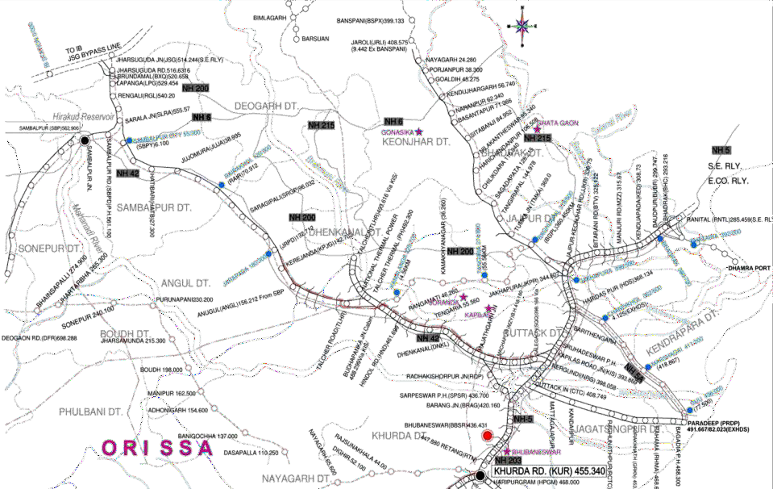
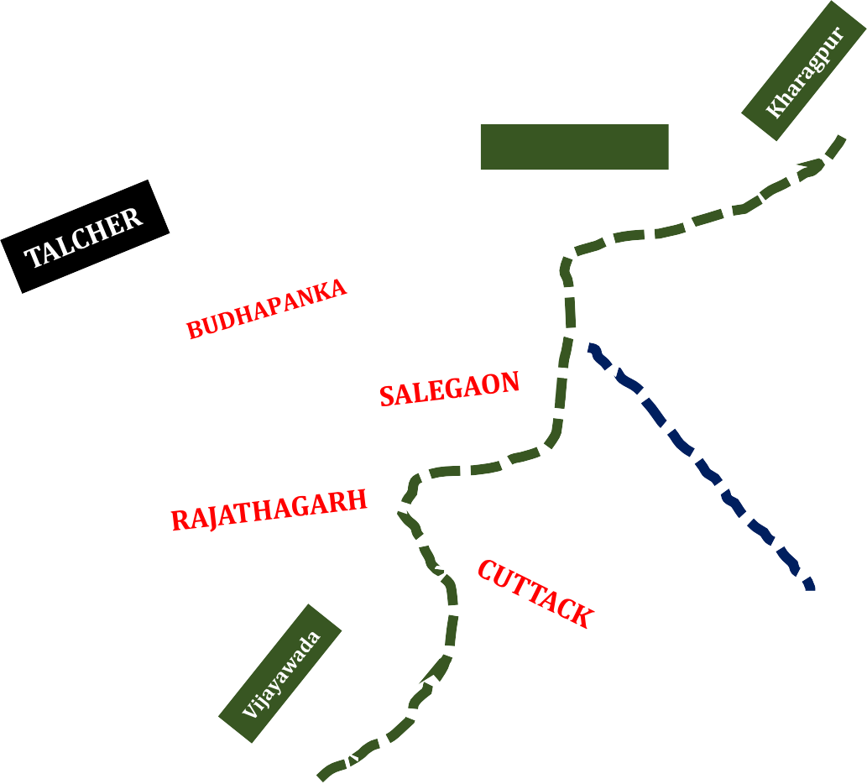
PARADIP PORT – RAIL CONNECTIVITY AND HINTERLAND HIGHLIGHTS
IB VALLEY COAL BLOCKS
Iron Ore Mines
SBP–JSG INDUSTRIAL CLUSTER
ANGL -DNKL INDUSTRIAL CLUSTER
East Coast DFC
HPRCL Line (82Km)
MMLP
Heavy Haul Line (87Km)
PARADIP PORT

Slide 8
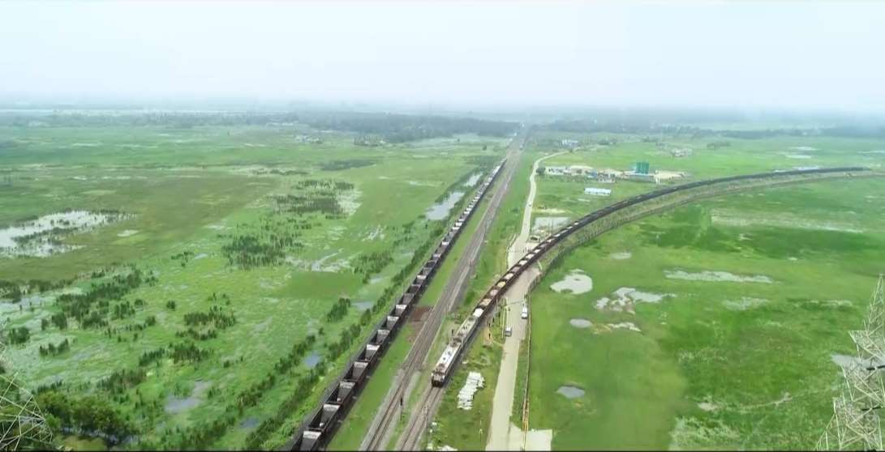
HARIDASPUR – PARADIP RAIL CONNECTIVITY

Slide 9
KICTPPL COAL IMPORT TERMINAL

Slide 10
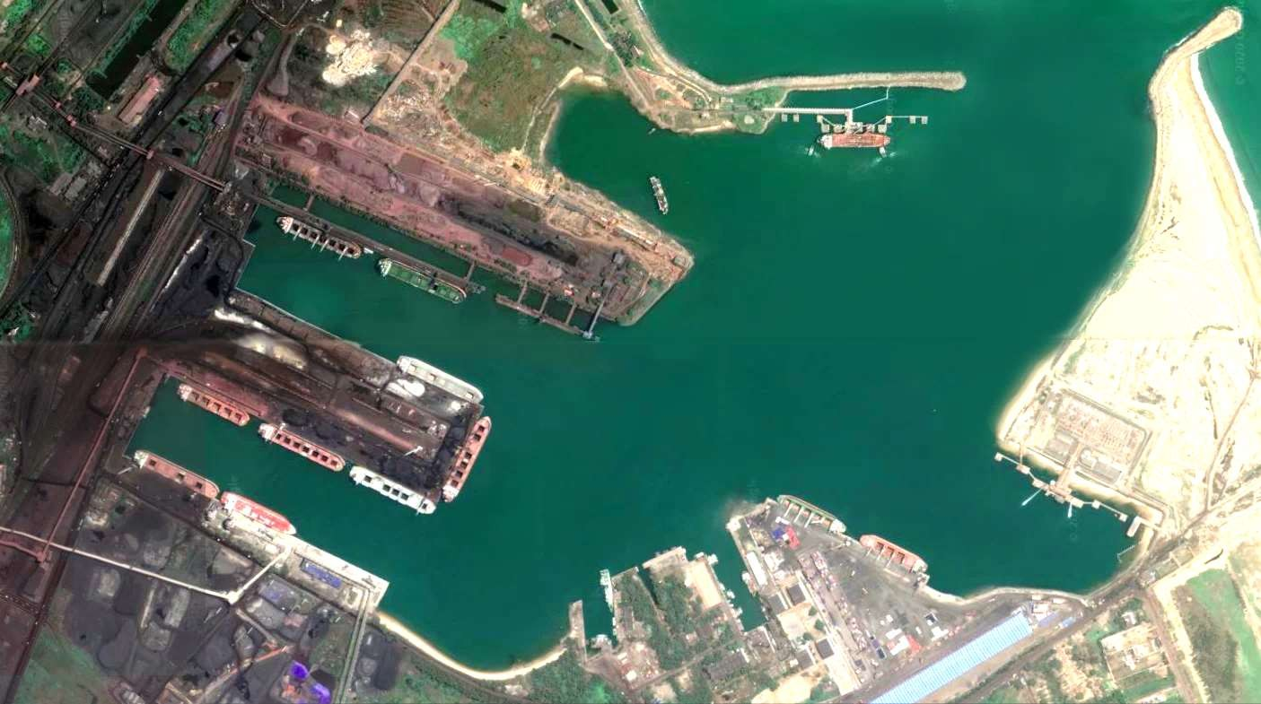
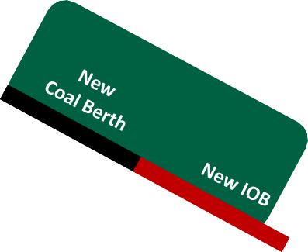
PARADIP PORT GENERAL LAYOUT WITH NEW TURNING CIRCLE
Approach Channel
10 km long, 18.7 M deep
South Breakwater 1317 m
North Oil Jetty
NEW Turning Circle 520mtr. Dia, 17M deep
OLD Turning Circle 520mtr. Dia, 17M deep

Slide 11
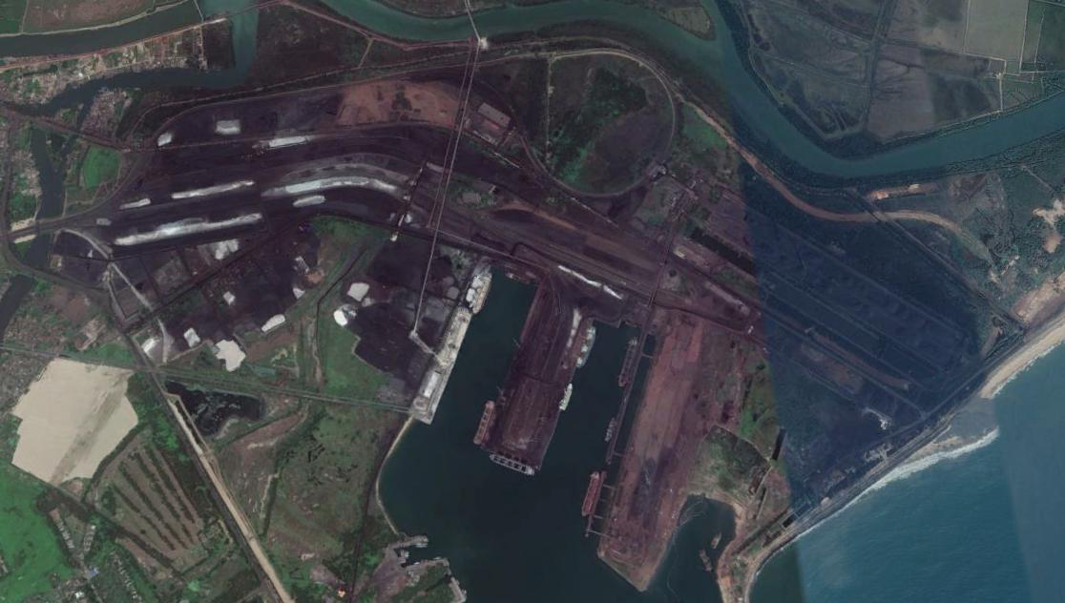
KICTPPL LOCATION AT PARADIP PORT
New BOT Railway Line
KICTPPL Coal Stock Yard
KICTPPL COAL Berth
JSW Iron Ore Berth

Slide 12
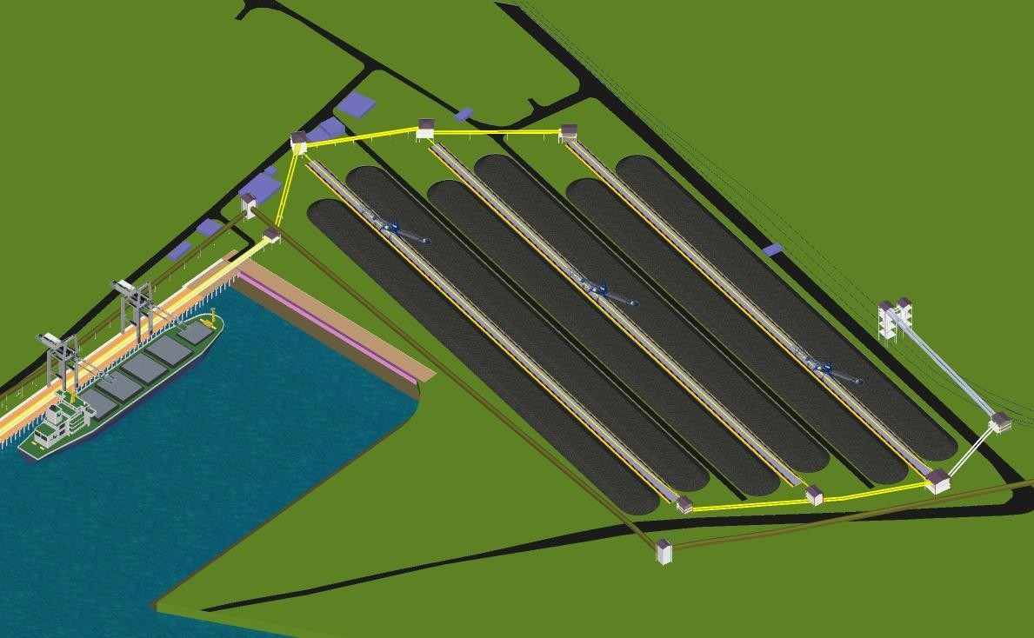
SCHEMATIC LAYOUT OF KICTPPL TERMINAL
Wagon Loading System
Coal Storage Area

Slide 13
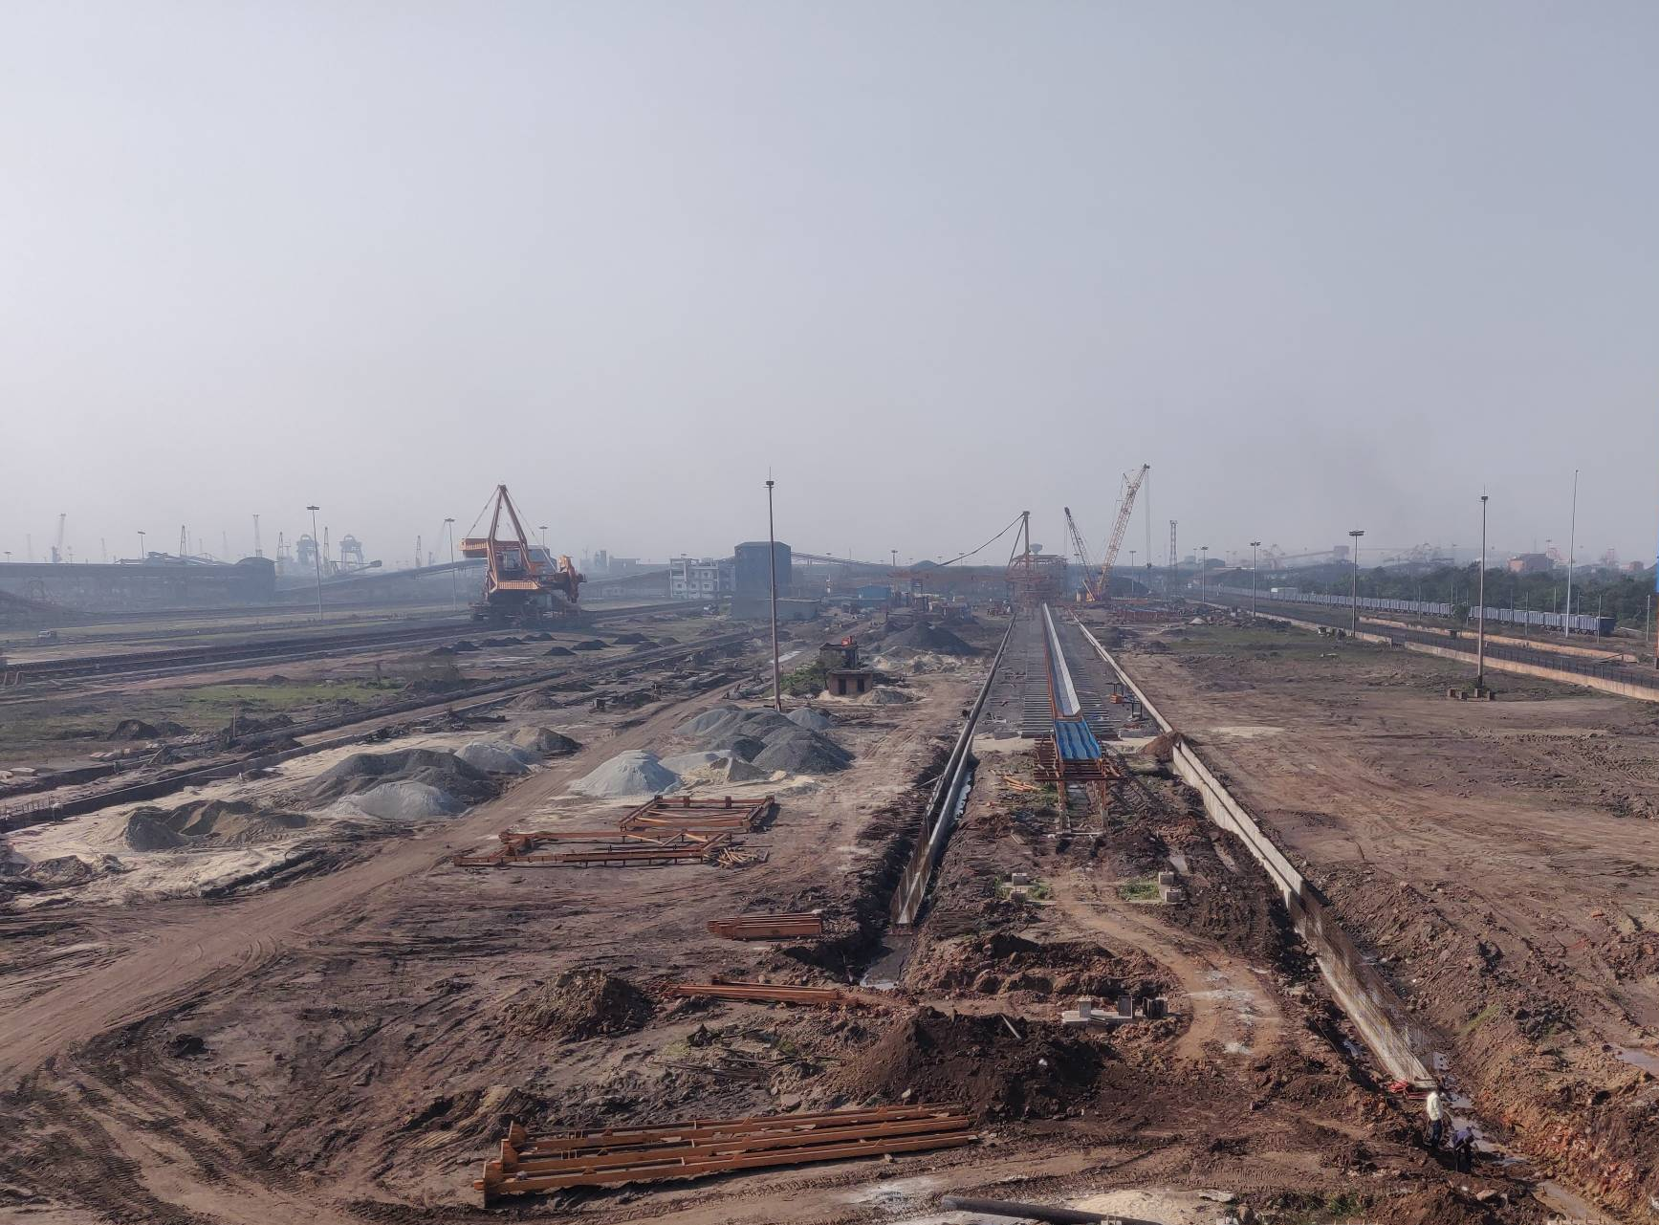
KICTPPL GROUND AREA PICTURE IN INITIAL CONSTRUCTION STAGE

Slide 14
KICTPPL JV PARTNERS
KAKINADA SEA PORTS LTD.
BOTHRA SHIPPING SERVICES PVT. LTD.
RIPLEY & COMPANY STEVEDORING PVT.LTD.

Slide 15
CONCESSION AGREEMENT
Concession Agreement : 4th Aug.2017
Award of Concession :19th April.2018
Concession Period :30 yrs. Revenue Sharing Basis
Provisional Commissioning Certificate issued by I.E.
Railway Notification for siding issued.
Statutory Notification of Customs for custodianship issued.
Port Trade Circular for commercial operation is in place.
Pre-weighbin loading machinery load test of RLS certified by Legal Metrology Department, Govt. of Odisha.

Slide 16
KICTPPL IMPORT COAL TERMINAL FEATURES
The Terminal – Capacities
Terminal Capacity : 10 MMTPA
Berth : 370m x 24m
Depth : 17.1m
Designed Vessel : 1,25,000DWT
Cargo : All Import Coals
Ship Unloading / Stacking Rate : 5500 TPH
Rake despatch Rate : 4500 TPH or 1.25 Hr/rake
Net Rake Despatch : in 2 Tracks - 2 Rakes in 1.25Hrs

Slide 17
KICTPPL IMPORT COAL TERMINAL FEATURES
Discharge System
Ship Unloaders : 2 Nos. x 2750TPH (each)
Stacker Reclaimer : 3 Nos
Stacking : 5,500TPH(each)
Reclaiming : 4,500TPH(each)
Dispatch System
Rapid Wagon Loading System : 2 nos. x 4500TPH
Silo Capacity : 2 nos. x 875T
Rake Loading time : 1hr 25m/ Rake simultaneous
Rake Loading : 2 Rakes at any time
Weighment System : Pre-load weighbin with FOIS system

Slide 18
TERMINAL FACILITIES COMMISSIONED
One Ship Unloader.
Two Stacker cum Reclaimer.
Conveyor system from Berth to stackyard and wagon loading area.
One Rapid Loading System.
Stackyard with approx.area-80,000 sqm.-capable of storing approx.4,00,000 Tons of Coal.
First full vessel was unloaded with 81,166 MT of Coking Coal on 22.02.2022.

Slide 19
OTHER FACILITIES TO BE COMMISSIONED BY 31.03.2022
Second Ship Unloader to be commissioned before 15.03.2022.
Second Rapid Loading system to be commissioned before 15.03.2022.
Third Stacker cum Reclaimer to be commissioned before 31.03.2022.
Additional three stockyards with 80,000 sqm. of area will be ready for Coal stacking by 31.03.2022.
Electrification work for rake loading on Engine on Load (EOL) basis under RLS is in position for trial within 28.02.2022.

Slide 20
TWO SHIP UNLOADERS AT BERTH

Slide 21
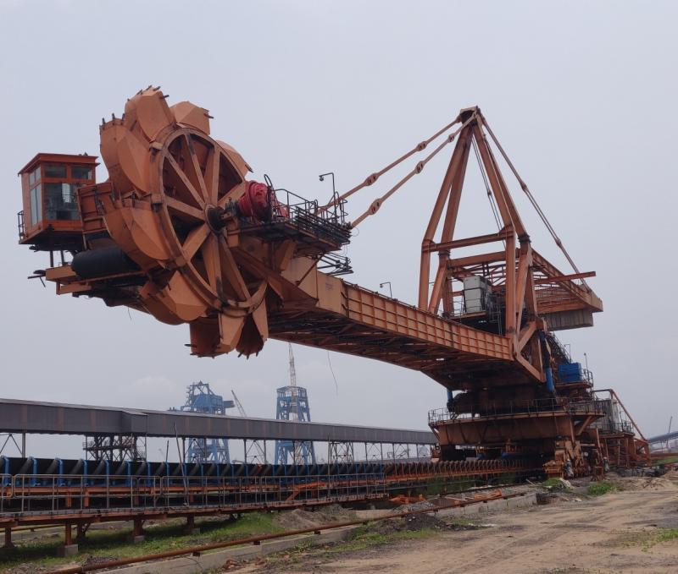
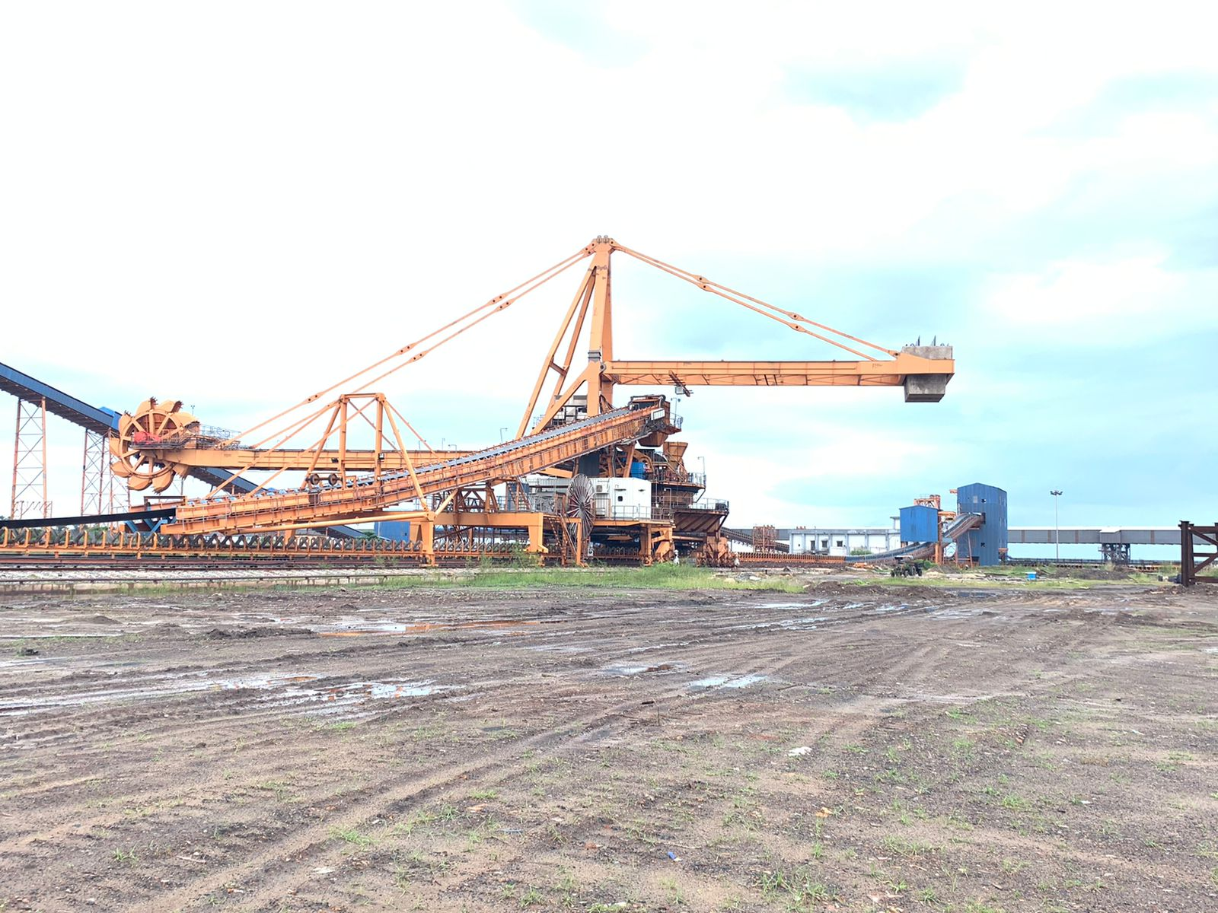
STACKER CUM RECLAIMERS AT STOCK YARD

Slide 22
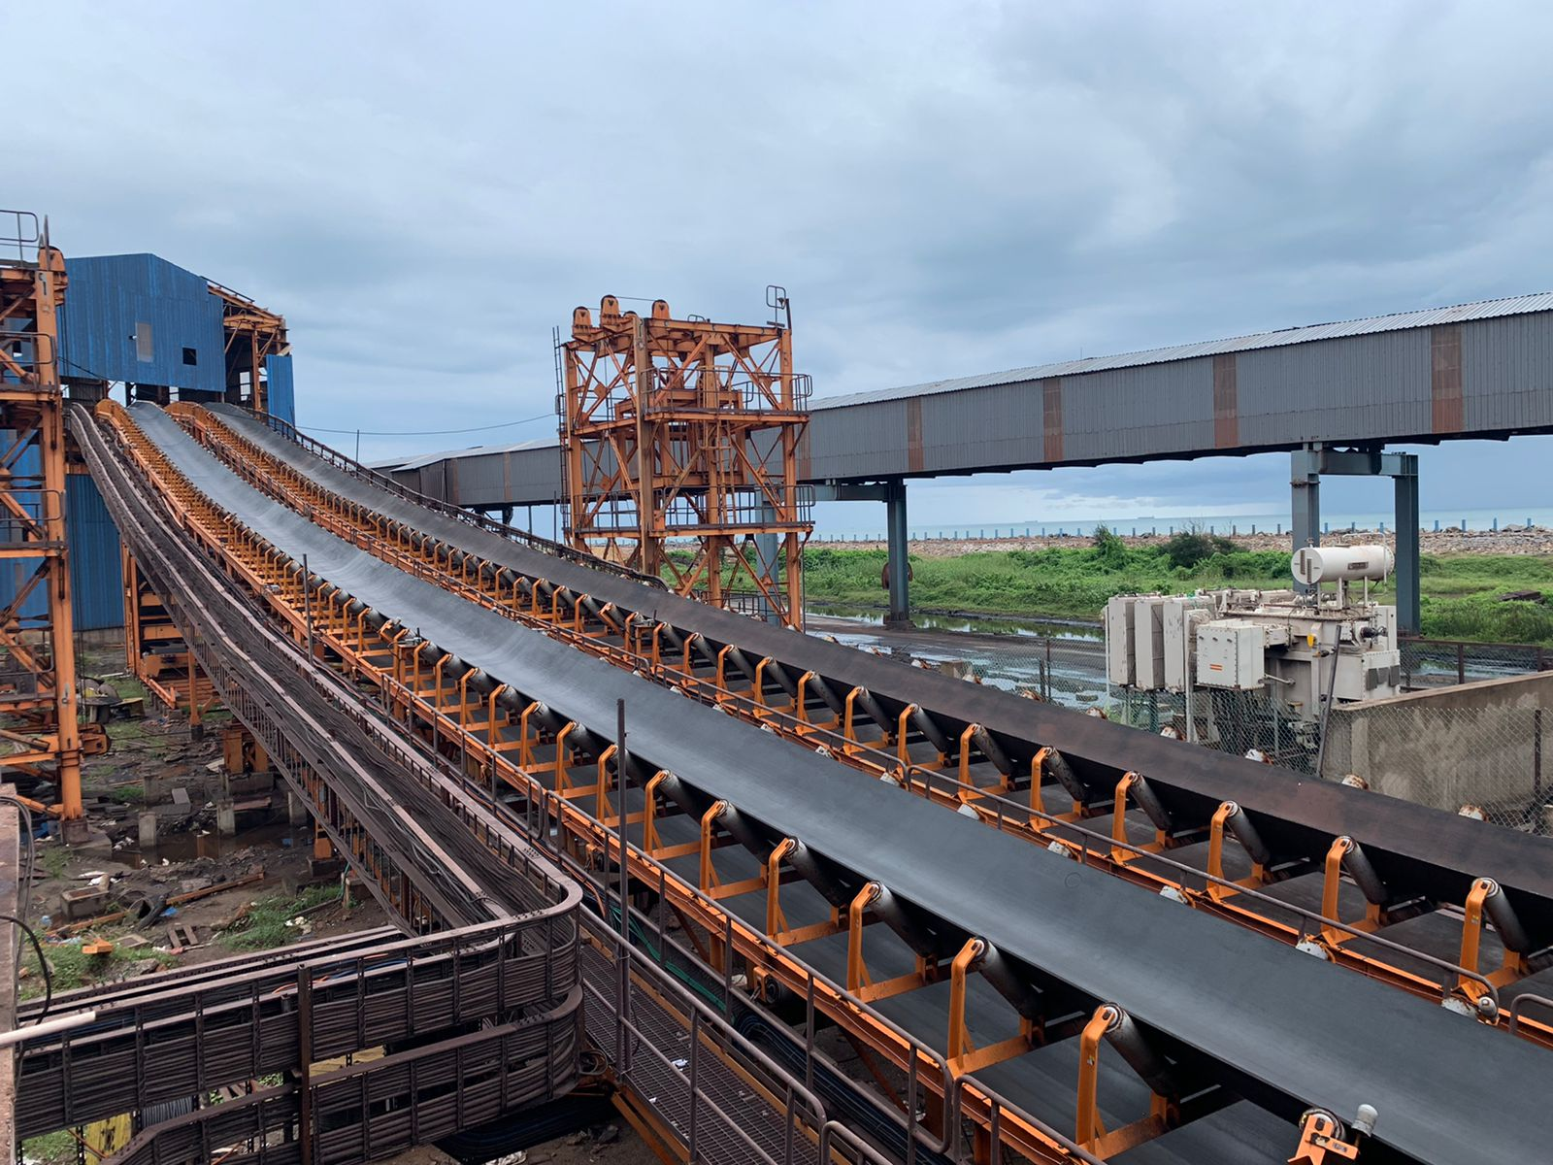
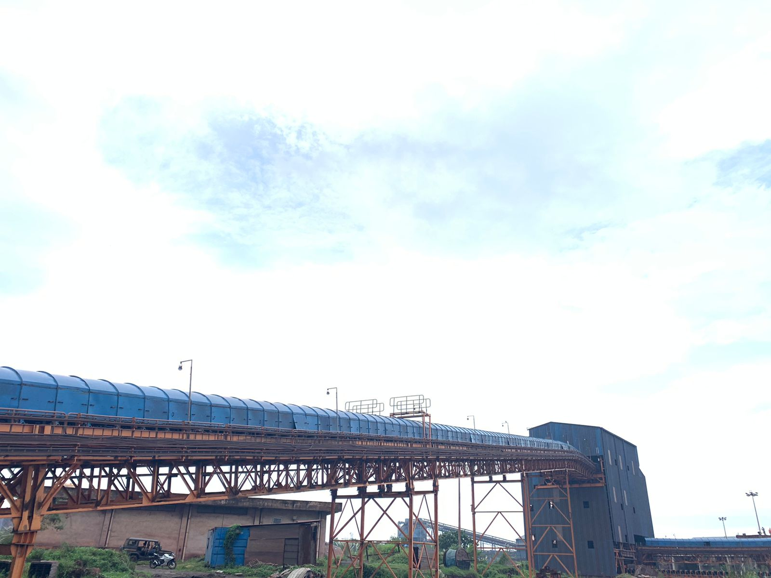
CONVEYOR SYSTEMS AT THE TERMINAL

Slide 23
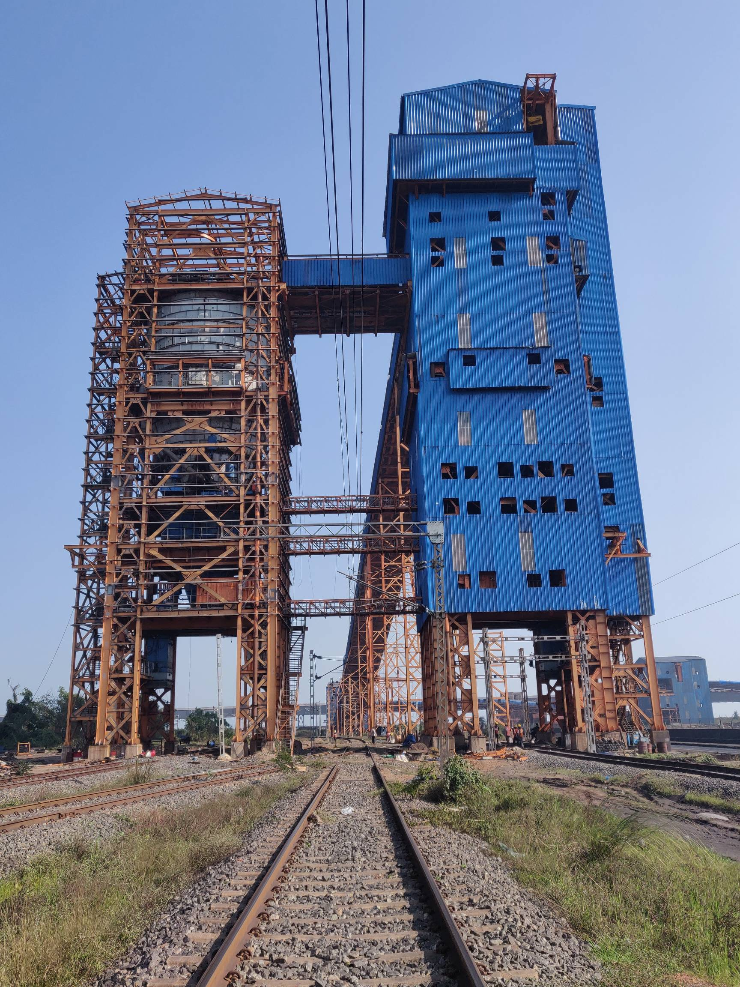
RAPID LOADING SYSTEM AT THE TERMINAL

Slide 24
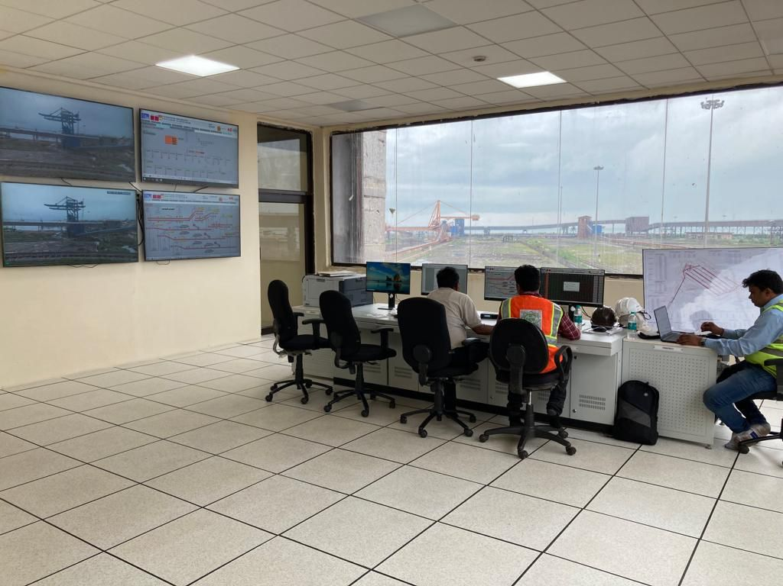
CENTRAL CONTROL ROOM AT THE TERMINAL

Slide 25
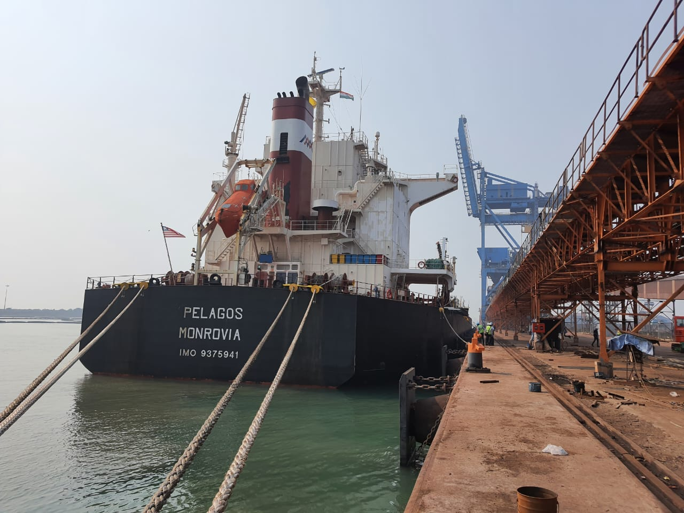
MV PELAGOS – FIRST VESSEL FOR COMMERCIAL OPERATION

Slide 26
SHIP UNLOADERS IN OPERATION ON SHIP

Slide 27
JETTY CONVEYOR IN UNLOADING OPERATION COAL FROM A SHIP

Slide 28
COAL STACKING BY STACKER CUM RECLAIMER

Slide 29
TRIAL LOADING OF COAL ON WAGON BY RLS-1

Slide 30
THANK YOU

