Slide 1
Comparison Of West & East Coast Ports And Challenges In Development Of Ports In East Coast of India BCC&I, 11th edition of Annual Shipping and Logistics Conclave February 25, 2022 Devdatta Bose Group Sector Head-Ports & Harbours Contact +91 9987615129

Slide 2
INTRODUCTION
1

Slide 3
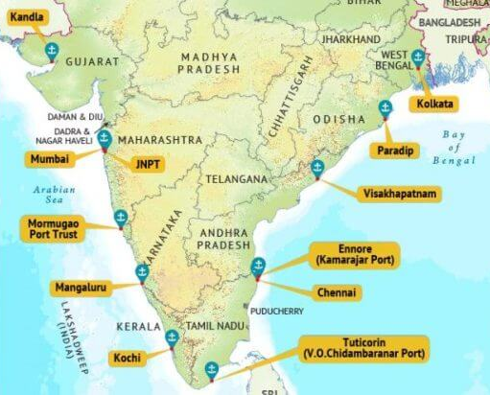
PORTS IN INDIA
Major Port Cargo Handling Capacity = 1560.61 MTPA as on Nov-21
Minor Port Cargo Handling Capacity = 1002.24 MTPA as on Nov-21
Source: Ministry of Ports, Shipping and Waterways

Slide 4
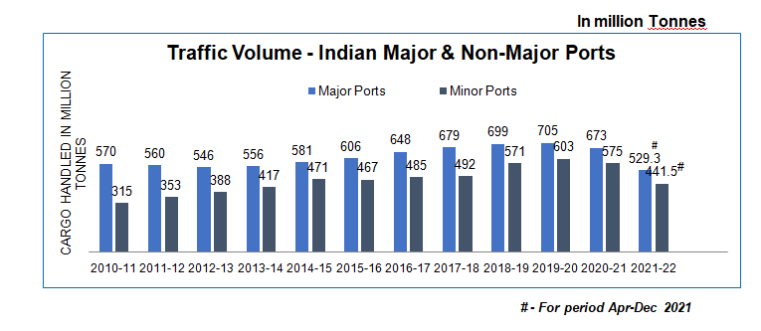
INDIAN PORTS TRAFFIC

Slide 5
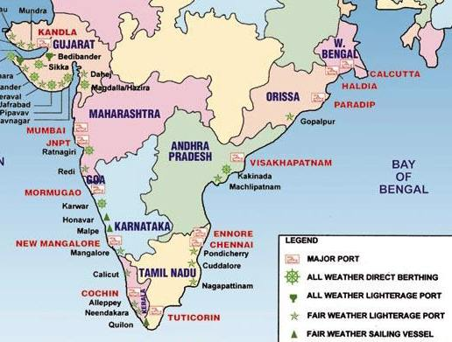
EAST INDIA PORTS

Slide 6
STUDY OF EAST COAST PORTS – LAYOUTS/PORT FEATURES
2

Slide 7
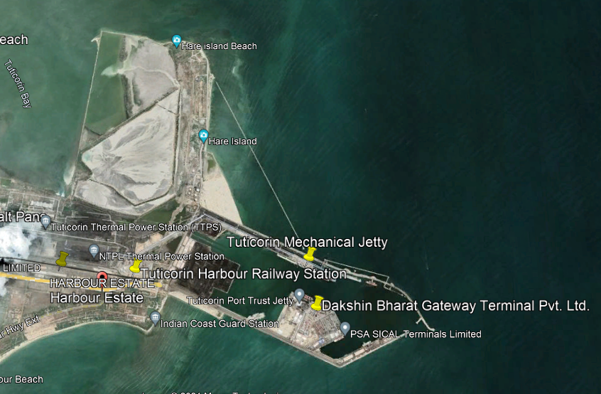
V.O.C.P.T
Artificial Harbour
Length of Entrance Channel: About 7 kilometres
Depth of Channel: -14.2m at chart datum
Length of Breakwaters
North Breakwater - 4098.66 m
South Breakwater - 3873.37 m
Nature of Dredge Material :
Maintenance Dredging Volume : 1.5 Million Cubic Meter _ September 2021 Data

Slide 8
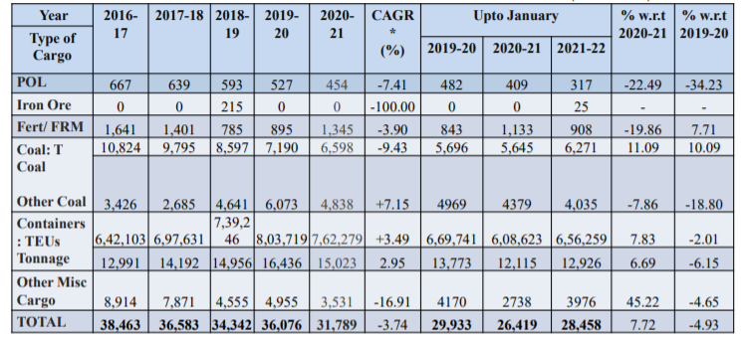
V.O.C.P.T
Traffic Handled ( in '000‘ Tonnes)

Slide 9
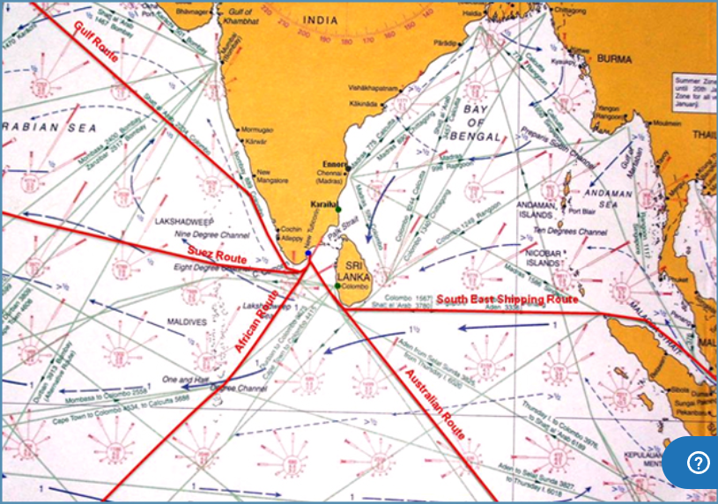
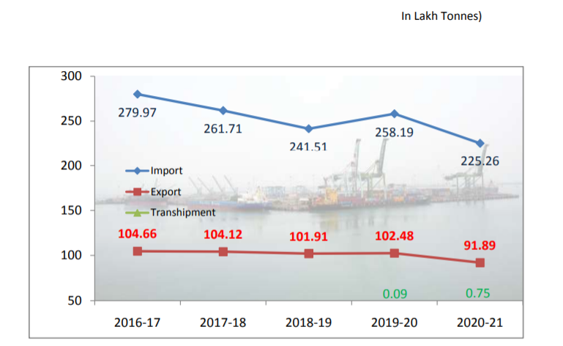
V.O.C.P.T
Strategic Location of VOCPT
Export/Import Transhipment Details
(in lakh tonnes)

Slide 10
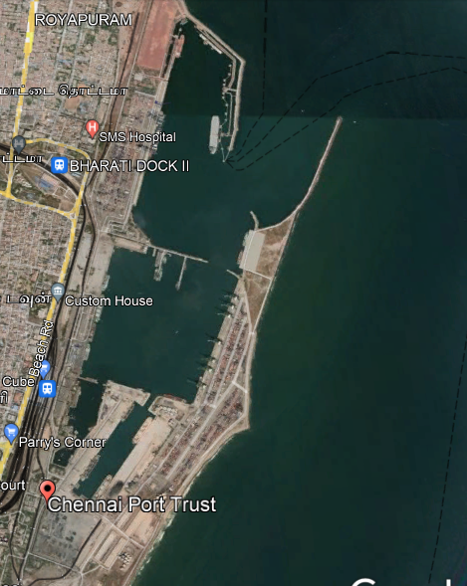
CHENNAI PORT
Artificial Harbour
Entrance Channel
Length of Channel: About 7 kilometres
Depth of Inner Channel: -18.6m at chart datum
Depth of Outer Channel: -19.2m at chart datum
Length of Breakwater
Inner Harbour
Eastern Breakwater - 1325 m
Northern Breakwater - 575 m
Outer Harbour
Eastern Breakwater - 590 m
Northern Breakwater - 460 m
Outer Arm - 1000 m
Upper Pitch Revetment - 950 m
Nature of Dredge Material : Predominantly sandy and silt
Maintenance Dredging Volume : 1.311 Million Cubic Meter _ September 2021 Data
Notes:
DCI has been awarded the Maintenance Dredging of Entrance Channels, Dr Ambedkar Dock Basin, Bharathi Dock Basin, Jawahar Dock, Turning Circle and all berths of Chennai Port. The total cost of the project is Rs.24.26 CR for dredging a quantity of 1.311 Million Cubic Meter. Dredging Corporation of India (DCI) will shortly commence Dredging with a completion period of Five months.

Slide 11
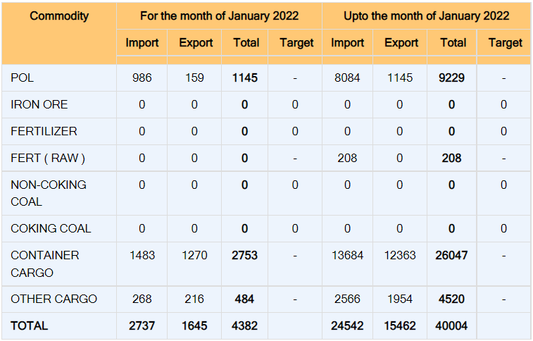
CHENNAI PORT
Traffic Handled During the month of January 2022 (IN '000' Tonnes)

Slide 12
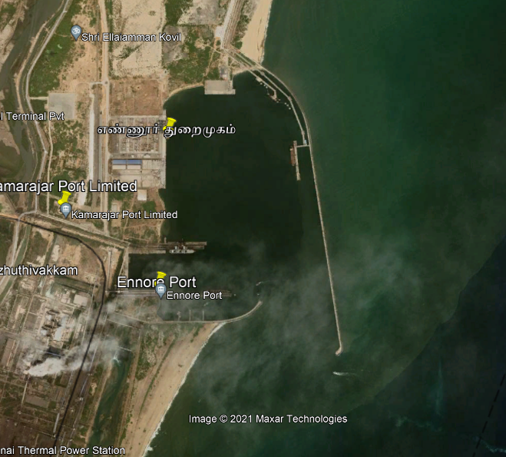
ENNORE PORT
Artificial Harbour
Length of Entrance Channel:5.2 km
Approach Channel (-)20.00m CD
Entrance Channel (-)19.00m CD
Harbour Basin (-)18.50m CD
Length of Breakwater
North Breakwater – 4000 m
South Breakwater – 1000 m
Nature of Dredge Material : sand
Maintenance Dredging Volume : 1 Million Cubic Meter including sand trap on southern side. Beach formation of 300 m width already formed
Notes:
DCI has been awarded the Maintenance Dredging of Entrance Channels, Dr Ambedkar Dock Basin, Bharathi Dock Basin, Jawahar Dock, Turning Circle and all berths of Chennai Port. The total cost of the project is Rs.24.26 CR for dredging a quantity of 1.311 Million Cubic Meter. Dredging Corporation of India (DCI) will shortly commence Dredging with a completion period of Five months.

Slide 13
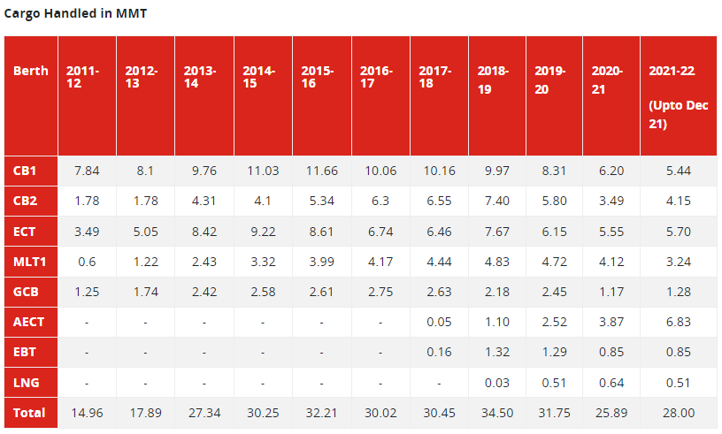
ENNORE PORT
in Million Tonnes
Notes:
DCI has been awarded the Maintenance Dredging of Entrance Channels, Dr Ambedkar Dock Basin, Bharathi Dock Basin, Jawahar Dock, Turning Circle and all berths of Chennai Port. The total cost of the project is Rs.24.26 CR for dredging a quantity of 1.311 Million Cubic Meter. Dredging Corporation of India (DCI) will shortly commence Dredging with a completion period of Five months.

Slide 14
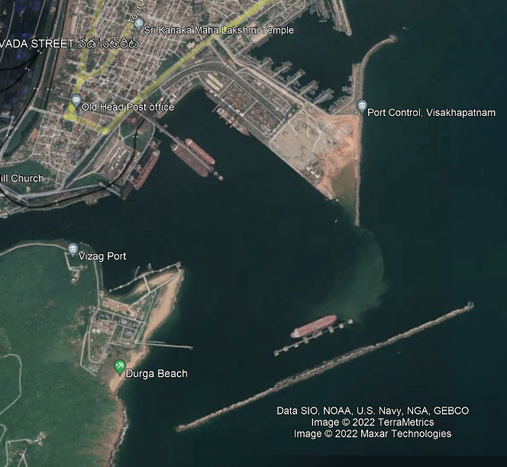
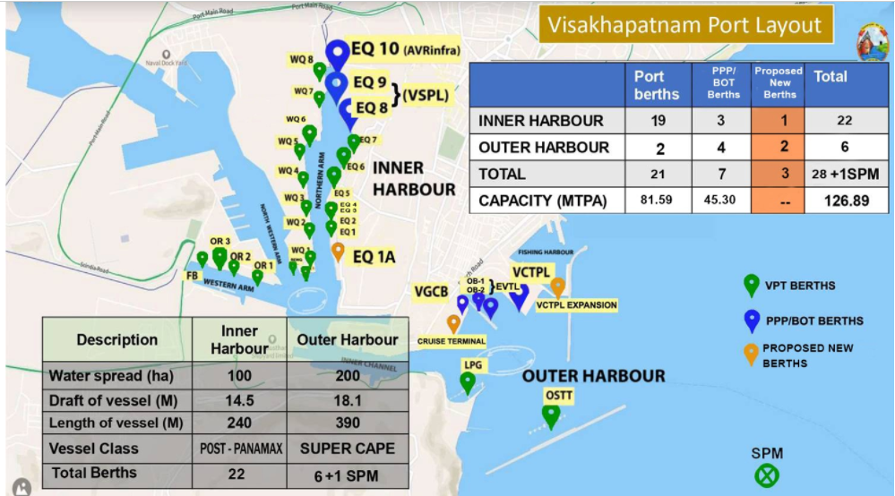
VISAKHAPATNAM PORT
Notes:
DCI has been awarded the Maintenance Dredging of Entrance Channels, Dr Ambedkar Dock Basin, Bharathi Dock Basin, Jawahar Dock, Turning Circle and all berths of Chennai Port. The total cost of the project is Rs.24.26 CR for dredging a quantity of 1.311 Million Cubic Meter. Dredging Corporation of India (DCI) will shortly commence Dredging with a completion period of Five months.

Slide 15
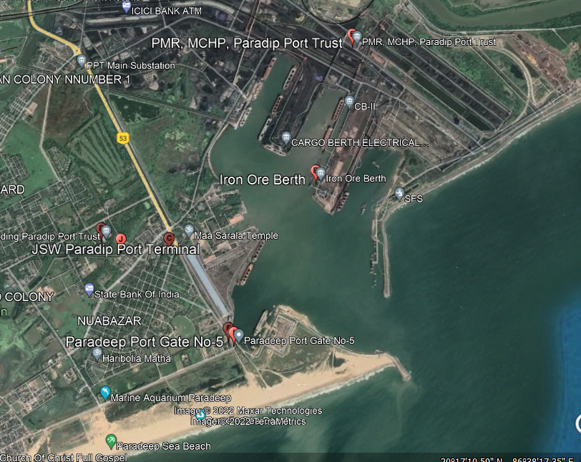
PARADIP PORT
Artificial Harbour
Length of Entrance Channel: 17 kilometres
Depth of Channel
Approach Channel : -18.70 m CD
Entrance Channel: -17.10 m CD
Turning Basin : -17.10 m CD
Length of Breakwaters
North Breakwater -538 m
South Breakwater -1217 m
Maintenance Dredging Volume : 7 Million Cubic Meter _ March 2022 Data
Notes:
DCI has been awarded the Maintenance Dredging of Entrance Channels, Dr Ambedkar Dock Basin, Bharathi Dock Basin, Jawahar Dock, Turning Circle and all berths of Chennai Port. The total cost of the project is Rs.24.26 CR for dredging a quantity of 1.311 Million Cubic Meter. Dredging Corporation of India (DCI) will shortly commence Dredging with a completion period of Five months.

Slide 16
GANGAVARAM PORT
Water Depth Upto -21 mCD
Super Cape Size Vessels Of upto 200,000 DWT
Port Layout is just an extension of shoreline it allows the longshore drift to pass on

Slide 17
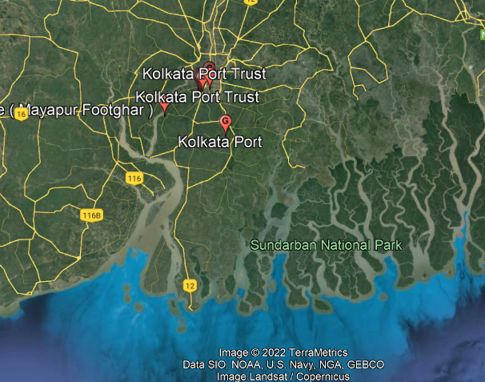
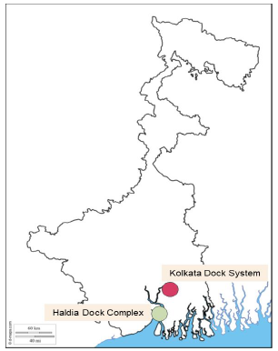
KOLKATA PORT
Being a riverine port, the port does not have adequate draft, which restricts handling of large vessels. Further, inadequate handling infrastructure, and high vessel and cargo turnaround time decreasing port traffic share

Slide 18
COMPARISON OF EAST & WEST COAST PORTS
3

Slide 19
COMPARISON OF EAST & WEST COAST PORTS – LENGTH OF ENTRANCE CHANNEL/TYPE OF HARBOUR
i

Slide 20
LOCATION AND TOPOGRAPHY – MAJOR PORTS – EAST COAST
PORT | LOCATION |  | ENTRANCE CHANNEL | TURNING CIRCLE |  | TYPE OF DOCK/PORT
 | Latitude | Longitude | Distance from harbour entrance (in km) | Number | Diameter (in m)
Kolkata | 22° 33’N | 88° 19’E | 232 | 2 | 190 / 288 | Riverine with impounded docks and river side jetty
Haldia | 20° 02’N | 88° 06’E | 115 | 1 | 549 | -do-
Paradip | 20° 15’N | 86° 40’E | 2.0 | 1 | 520 | Artificial lagoon port
Visakhapatnam -IH -OH | 17° 41’N | 83° 18’E | 2.2 0.4 | 1 1 | 366 610 | Natural Harbour

Slide 21
LOCATION AND TOPOGRAPHY – MAJOR PORTS – EAST COAST
Ennore | 13° 15’ 30”N | 80° 21’E | 3.775 | 1 | 600 | Artificial harbour
Chennai | 13° 06’N | 80° 18’E | 6.7 | 1 | 548 | Artificial harbour with wet docks
Tuticorin | 8° 45’N | 78° 13’E | 4.0 | 1 | 488 | Artificial harbour

Slide 22
LOCATION AND TOPOGRAPHY – MAJOR PORTS – WEST COAST
Cochin | 9° 58’N | 76° 14’E | 10.5 | 2 | 260 | Lagoon port
New Mangalore | 12° 5’N | 74° 48’E | 7.5 | 1 | 570 | Artificial lagoon port
Mormugao | 25° 15’N | 73° 47’E | 5.0 | 2 | 480 | Open protected harbour
Mumbai | 18° 54’N | 72° 49’E | 9.6 | 1 | 366 | Natural harbour with impounded wet docks
JNPT | 18° 56.43’N | 72° 56. 24’E | 17.0 (outer channel) Total 33 km | -- | -- | All weather tidal port
Kandla | 23° 01N | 70° 13’E | 25.0 | -- | -- | Estuary port

Slide 23
COMPARISON OF EAST & WEST COAST PORTS - DREDGING
ii

Slide 24
DREDGING IN INDIAN MAJOR PORTS _ EAST COAST
Type of Dredging | Capital Dredging |  |  |  |  |  | Maintenance Dredging
Year | 2017-18 |  | 2018-2019 |  | 2019-2020 |  | 2017-18 |  | 2018-2019 |  | 2019-2020
Major Port | Total Quantity | Expenditure | Total Quantity | Expenditure | Total Quantity | Expenditure | Total Quantity | Expenditure | Total Quantity | Expenditure | Total Quantity | Expenditure
Units | In million cum | In INR Crores | In million cum | In INR Crores | In million cum | In INR Crores | In million cum | In INR Crores | In million cum | In INR Crores | In million cum | In INR Crores
Kolkata |  |  |  |  |  |  | 10.2 | 260.36 | 17.03 | 278.29 | 11.77 | 298.12
Paradip | 0.7 | 13.37 | 0.98 | 18.72 | 1.84 | 35 | 5.51 | 56.95 | 5.06 | 53.09 | 7 | 68.56
Visakhapatnam | 0.5 | 17.69 | 0.27 | 12.99 | 0.156 | 6.27 | 8.379 | 28.05 | 0.29 | 22.22 | 0.32 | 26.07
Kamarajar(Ennore) |  |  | 0.873 | 42.94 | 1.42 | 52.18 |  |  |  |  | 4.57 | 110
Chennai |  |  |  |  | 0.023 | 3.03 | 0.2 | 11.81 | 0.07995 | 10.43 | 0.23 | 9.55
V.O.Chidambarnar |  |  | 0.347 | 86.8 | ** | 9.12 |  |  | *** | 15.87
Total | 1.2 | 31.06 | 2.47 | 161.45 | 3.439 | 105.6 | 24.289 | 357.17 | 22.46 | 379.9 | 23.89 | 512.3
NOTE
** On trail basis DCI CSD for 10 days
*** On Day Hire basis for a period of 43 & 19 days( Back hoe Dredger DCI & DCI TSHD respectively
Source: IPA

Slide 25
DREDGING IN INDIAN MAJOR PORTS- WEST COAST
Type of Dredging | Capital Dredging |  |  |  |  |  | Maintenance Dredging
Year | 2017-18 |  | 2018-2019 |  | 2019-2020 |  | 2017-18 |  | 2018-2019 |  | 2019-2020
Major Port | Total Quantity | Expenditure | Total Quantity | Expenditure | Total Quantity | Expenditure | Total Quantity | Expenditure | Total Quantity | Expenditure | Total Quantity | Expenditure
Units | In million cum | In INR Crores | In million cum | In INR Crores | In million cum | In INR Crores | In million cum | In INR Crores | In million cum | In INR Crores | In million cum | In INR Crores
Cochin |  |  |  |  | 1.225 | 42.26 | 27.68 | 135.64 | 27.21 | 105.514 | 22.6 | 91.399
New Mangalore | 0.242 | 10.18 |  |  |  |  | 7.58 | 39.42 | 7.2 | 32.9 | 7.2 | 32.9
Mormugoa |  |  |  |  |  |  | 1.77 | 14.67 | 2.53 | 13.89 | 3 | 21.2
Mumbai |  |  |  |  | 0.6 | 68.6 | 2.1 | 17.6 | 3.9 | 37.9 | 4 | 40
J.N.P.T | 9.14 | 827.1 | 20.17 | 995.51 |  |  |  |  |  |  | 10 | 100
Deendayal |  |  |  |  |  |  | 7.446 | 106.76 | 5.985 | 123.01 | 9 | 113
Total | 9.382 | 837.28 | 20.17 | 995.51 | 1.825 | 110.86 | 46.576 | 314.09 | 46.825 | 313.214 | 55.8 | 398.499
NOTE
** On trail basis DCI CSD for 10 days
*** On Day Hire basis for a period of 43 & 19 days( Back hoe Dredger DCI & DCI TSHD respectively
Source: IPA

Slide 26
COMPARISON OF EAST & WEST COAST PORTS – TRAFFIC HANDLED
iii

Slide 27
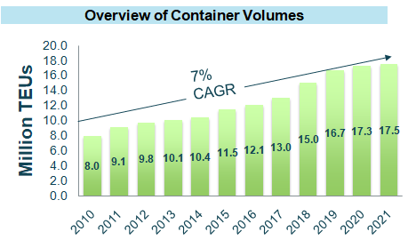
INDIAN CONTAINER MARKET
Overview of Container Volumes
Total Indian Container Traffic is 17.5 MTEUS and Shanghai Port handles about 43 MTEUs. Top 10 Container Ports in the world handles 250 MTEUs. 7 top container ports in China handles 70% of this traffic
Source:JM Baxi

Slide 28
INDIAN CONTAINER MARKET TRENDS
Total Installed container handling capacity (West & East coast) in FY’19-20 = 31.8 MTEUs
Total container traffic handled in (west & east coast) in FY19-20 is 16.70 MTEUs and in FY’20-21 is 17.3 MTEUs and FY’21-22 till Dec-21 is 17.5 MTEUs
Total West Coast installed container handling capacity = 18.45 MTEUs
Total container traffic handled in west coast in FY19-20 is 11.88 MTEUs and in FY’20-21 is 12.35 MTEUs and FY’21-22 till Dec-21 is 13.06 MTEUs
Total East Coast installed container handling capacity = 13.35 MTEUs
Total container traffic handled in East coast in FY19-20 is 4.82 MTEUs and in FY’20-21 is 4.92 MTEUs and FY’21-22 till Dec-21 is 4.41 MTEUs

Slide 29
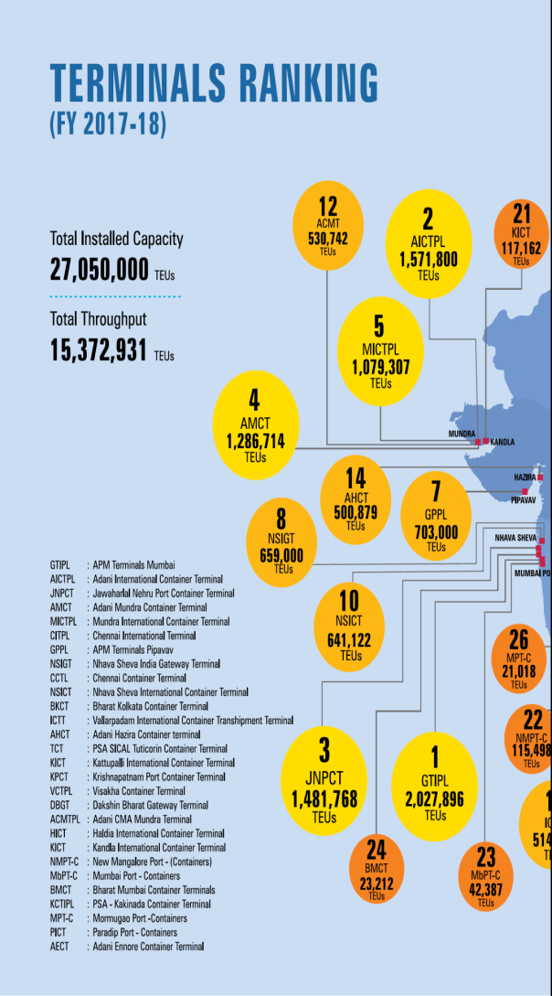
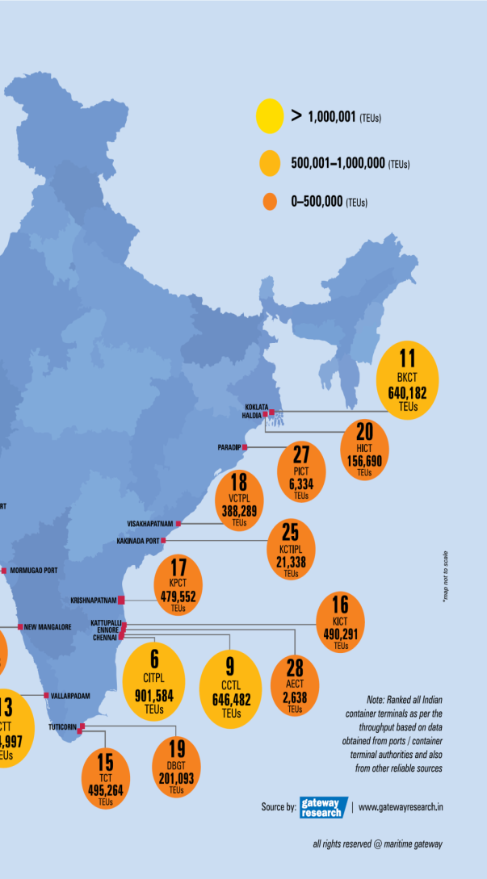
TOP INDIAN CONTAINER TERMINALS (WEST COAST)
Port Name | Type | Trade Region | Installed capacity | Traffic Handled in M.TEUs |  |  |  | Year-wise utilisation
 |  |  | in M.TEUs | 2018 | 2019 | 2020 | 2021 | 2018 | 2019 | 2020 | 2021
Kochi | Major | West Coast | 1 | 0.56 | 0.59 | 0.60 | 0.69 | 56% | 59% | 60% | 69%
New Mangalore | Major | West Coast | - | 0.12 | 0.13 | 0.15 | 0.15 | - | - | - | -
Mormugao | Major | West Coast | - | 0.03 | 0.04 | 0.03 | 0.02 | - | - | - | -
Mumbai | Major | West Coast | - | 0.04 | 0.03 | 0.03 | 0.02 | - | - | - | -
Jawaharlal Nehru | Major | West Coast | 7.7 | 4.83 | 5.13 | 5.03 | 4.61 | 63% | 67% | 65% | 60%
Hazira | Minor | West Coast | 1 | 0.55 | 0.62 | 0.63 | 0.66 | 55% | 62% | 63% | 66%
Pipavav | Minor | West Coast | 1.35 | 0.90 | 1.01 | 1.08 | 0.75 | 66% | 75% | 80% | 55%
Kandla | Major | West Coast | 0.6 | 0.12 | 0.28 | 0.45 | 0.51 | 20% | 47% | 75% | 86%
Mundra | Minor | West Coast | 6.8 | 3.60 | 4.05 | 4.35 | 5.66 | 53% | 59% | 64% | 83%

Slide 30
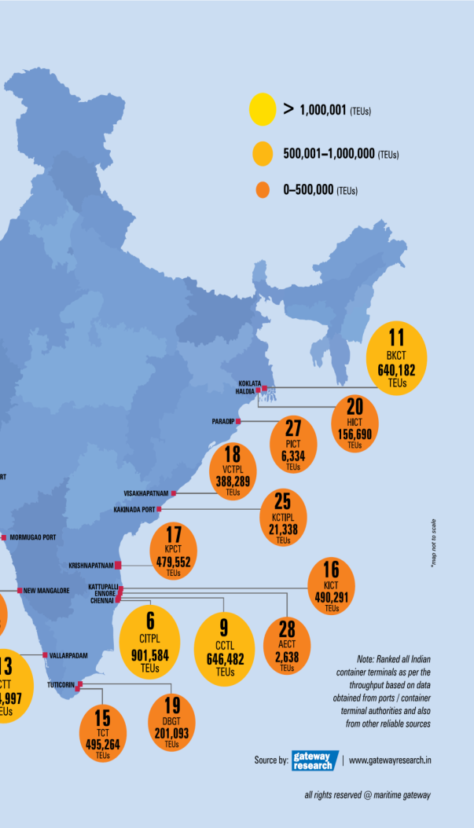
INDIAN CONTAINER TERMINALS (EAST COAST))
Port Name | Type | Trade Region | Installed capacity | Traffic Handled in MTEUs |  |  |  | Year-wise utilisation
 |  |  | in MTEUs | 2018 | 2019 | 2020 | 2021 | 2018 | 2019 | 2020 | 2021
Kolkata | Major | East Coast | 0.85 | 0.80 | 0.83 | 0.84 | 0.68 | 94% | 98% | 99% | 80%
Paradip | Major | East Coast | 5 | 0.01 | 0.01 | 0.01 | 0.02 | 0.1% | 0.3% | 0.2% | 0.3%
Visakhapatnam | Major | East Coast | 0.7 | 0.39 | 0.45 | 0.50 | 0.48 | 56% | 64% | 72% | 68%
Kakinada |  | East Coast | 0.1 |  |  |  | 0.02 |  |  |  | 22%
Krishnapatnam | Minor | East Coast | 1.2 | 0.49 | 0.51 | 0.55 | 0.33 | 41% | 42% | 46% | 28%
Ennore | Major | East Coast | 0.8 | 0.00 | 0.06 | 0.13 | 0.20 | 0.4% | 7.1% | 16.4% | 25.1%
Chennai | Major | East Coast | 2.45 | 1.55 | 1.62 | 1.38 | 1.36 | 63% | 66% | 56% | 56%
Katupalli | Minor | East Coast | 1.2 | 0.34 | 0.60 | 0.68 | 0.54 | 28% | 50% | 57% | 45%
Karaikal | Minor | East Coast | - | 0.00 | 0.01 | 0.01 | 0.01 | - | - | - | -
Tuticorin | Major | East Coast | 1.05 | 0.70 | 0.74 | 0.80 | 0.76 | 66% | 70% | 77% | 73%

Slide 31
MAJOR PORTS BULK TRAFFIC (EAST COAST))
( in '000‘ Tonnes)
Sl No. | Port | POL (Crude, Prod., LPG/LNG) | Other Liquids | Iron ore including Pellets | Fertilizers- RAW | Fertilizers- Finished | Coal- Thermal Steam | Coal- Coking & Others | Other Misc Cargo | Total Dry Bulk | Total Liquid Bulk | TOTAL
1a | Kolkata Dock System | 211 | 372 | - | 230 | 24 | - | 1172 | 2732 | 4158 | 583 | 4741
1b | Haldia Dock System | 7337 | 3882 | 880 | 181 | 304 | 95 | 9707 | 6068 | 17235 | 11219 | 28454
1 | TOTAL-SMPK | 7548 | 4254 | 880 | 411 | 328 | 95 | 10879 | 8800 | 21393 | 11802 | 33195
2 | Paradip | 25554 | 1460 | 14525 | 291 | 3636 | 20933 | 10606 | 6458 | 56449 | 27014 | 83463
3 | Visakhapatnam | 10350 | 1515 | 10837 | 861 | 1167 | 6937 | 3572 | 9198 | 32572 | 11865 | 44437
4 | Kamarajar(ennore) | 3642 | 101 | - | - | - | 13824 | 1472 | 2129 | 17425 | 3743 | 21168
5 | Chennai | 8084 | 824 | - | - | 208 | - | 7 | 3205 | 3420 | 8908 | 12328
6 | V.O.Chidambaranar | 277 | 739 | 25 | 249 | 572 | 5781 | 3876 | 2874 | 13377 | 1016 | 14393
EAST COAST TOTAL |  | 55455 | 8893 | 26267 | 1812 | 5911 | 47570 | 30412 | 32664 | 144636 | 64348 | 208984

Slide 32
INDIAN BULK TRAFFIC HANDLED (WEST COAST))
( in '000‘ Tonnes)
Sl No. | Port | POL (Crude, Prod., LPG/LNG) | Other Liquids | Iron ore including Pellets | Fertilizers- Finished | Fertilizers- Finished | Coal- Thermal Steam | Coal- Coking & Others | Other Misc Cargo | Total Dry | Total Liquid Bulk | TOTAL
1 | Cochin | 15970 | 369 | - | - | 236 | - | - | 976 | 1212 | 16339 | 35102
2 | New Mangalore | 16555 | 1775 | 2827 | 217 | 87 | 2603 | 386 | 1245 | 1332 | 18330 | 45357
3 | Mormugao | 357 | 127 | 2520 | 36 | - | 1363 | 5511 | 3337 | 3337 | 484 | 17072
4 | MbPT | 27177 | 1226 | 4954 | 278 | 85 | 4369 | 290 | 5750 | 5835 | 28403 | 78367
5 | JNPT | 2381 | 2118 | - | - | - | - | - | 560 | 560 | 4499 | 10118
6 | Deendayal | 44629 | 8290 | 614 | 2784 | 244 | 16209 | 533 | 16837 | 17081 | 52919 | 160140
 | TOTAL | 107069 | 13905 | 10915 | 3315 | 652 | 24544 | 6720 | 28705 | 29357 | 120974 | 413343

Slide 33
COMPARISON OF EAST & WEST COAST PORTS – COMMODITY SHARE
iii

Slide 34
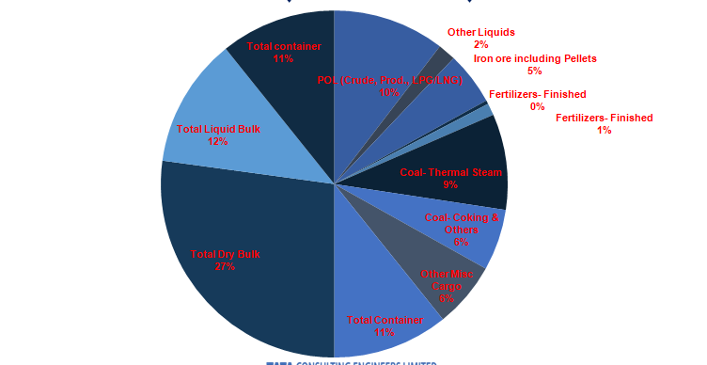
COMMODITY SHARE-(EAST COAST))

Slide 35
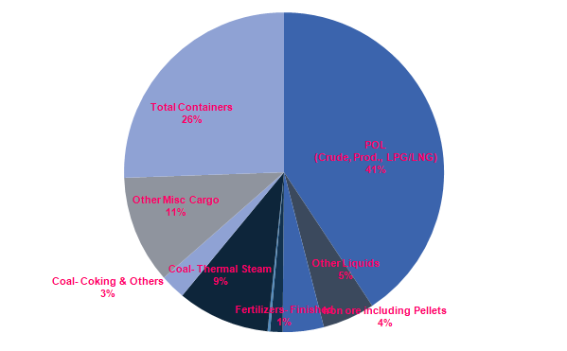
COMMODITY SHARE-(WEST COAST))

Slide 36
CHALLENGES IN DEVELOPMENT OF EAST COAST PORTS
4

Slide 37
LITTORAL DRIFT
i

Slide 38
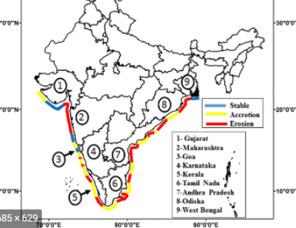
LITTORAL DRIFT – INDIAN COAST
Indian coast exhibited the same drift direction as shown in figure
Changes in transport magnitude were present
Study time /Model Simulation Projection period upto 2070
35% of the total coastline would remain unaffected
about 20% is expected to ‘worsen’ (i.e. expected to undergo higher magnitudes of erosion wrt present rate)
and 45% to ‘improve’ (i.e. expected to accrete/reach stability).
Net Littoral Drift Direction
Net Littoral Drift Direction
Notes:
Tidal marshes are dominantly composed of silt and clay however sand may be common in channels/rivers draining into marshes. Hence, marsh acts as a sink.

Slide 39
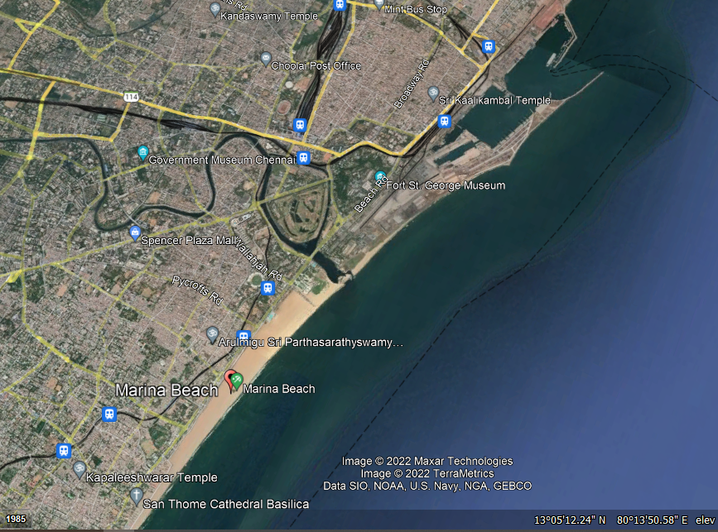
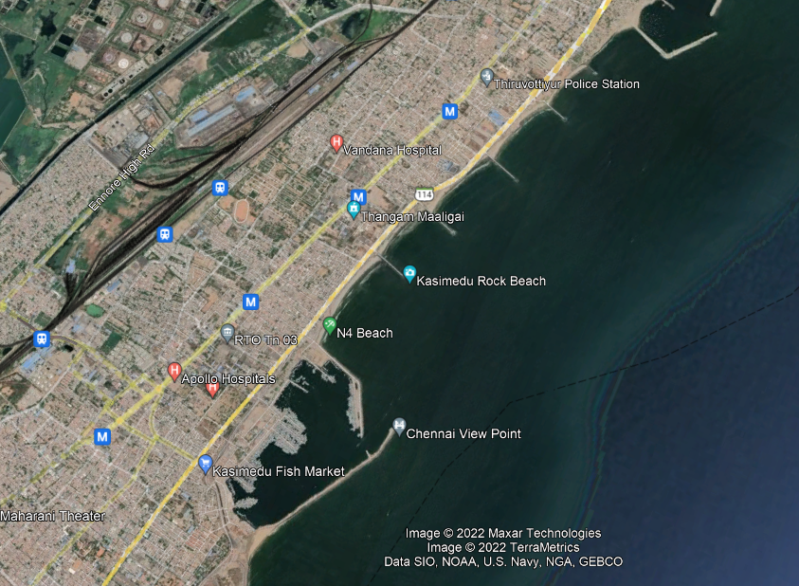
LITTORAL DRIFT _ EAST COAST_ CHENNAI PORT

Slide 40
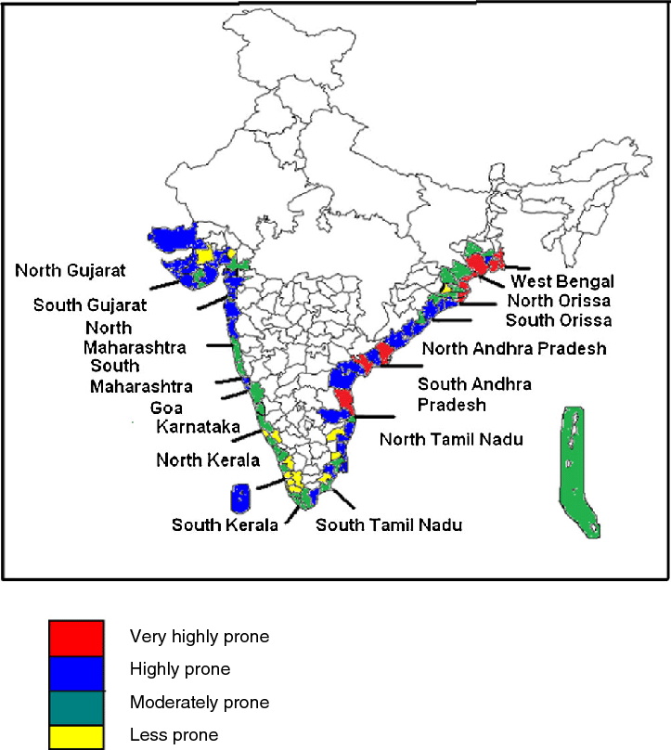
CYCLONES – INDIAN COAST TREND
East and West coasts of India long-term analysis of cyclones that struck the coasts of India between 1891 and 2018 indicates east coast at higher risk
In East Coast 262 cyclones occurred (92 of these severe)
Less severe cyclonic activity observed on West coast, where 33 cyclones occurred the same period, out of which 19 of were severe
Notes:
Tidal marshes are dominantly composed of silt and clay however sand may be common in channels/rivers draining into marshes. Hence, marsh acts as a sink.

Slide 41
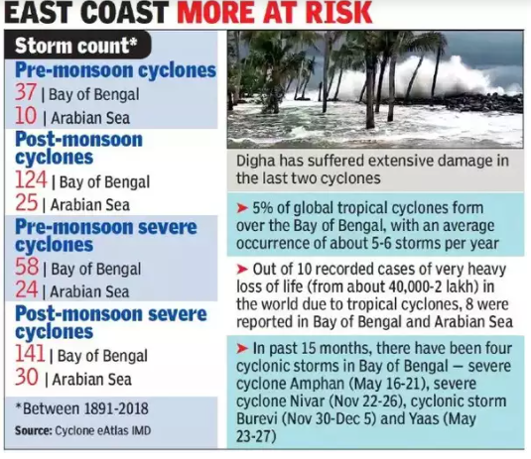
CYCLONES – INDIAN COAST TREND
Notes:
Tidal marshes are dominantly composed of silt and clay however sand may be common in channels/rivers draining into marshes. Hence, marsh acts as a sink.

Slide 42
OPPORTUNITIES IN DEVELOPMENT OF EAST COAST PORTS
5

Slide 43
WHY EAST COAST
ii

Slide 44
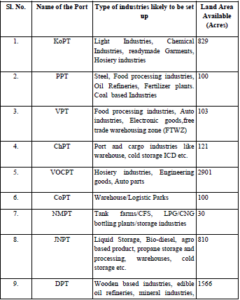
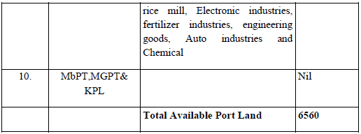
LAND BANK MONETISATION
Status of utilization of unused lands at various Ports of the country(Source: promotion of infrastructure in india's maritime sector presented to the RAJYA SABHA on 4th August, 2021)
Clear Land Utilization Policy for Industrialization is the need of the hour for enhancing the Port Traffic
East Coast Ports have potential to tap

Slide 45
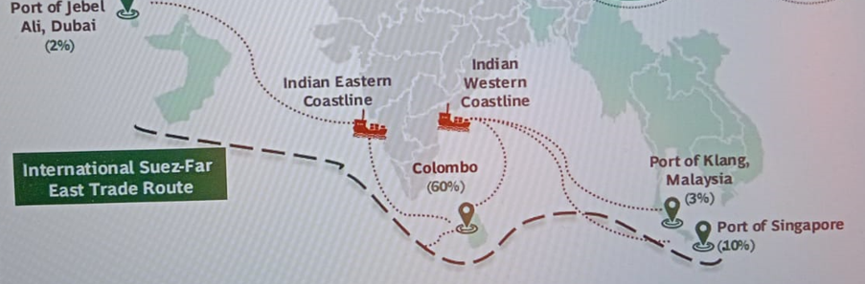
TRANSHIPMENT
India’s Current revenue loss = 1650 Crores INR likely to be three-fold in next few years unless Transhipment Hub is developed
A Bundle of Ports with Deeper Drafts (>20m depth) to be developed e.g. Campbell Bay, Vizhinjam, Kanyakumari

Slide 46
CONSIDERATION FOR PORT LOCATION_ EAST COAST
Availability of deeper depth contour closer to the shoreline so that approach Channel Length is optimsed consequently the capital and maintenance dredging are optimised
Exposed coastline to be avoided like Dhamra Port which is sheltered by Kanika Sands
In case of exposed coastline, breakwater length to be optimisedd. Unique concept of sunken ship breakwater has been used in Vizag Port
Port Layout to be finalized considering future expansion & final phase port traffic,
Stability of coastline impact ed by Littoral drift has significant importance in planning of a port in East Coast
Hinterland industrial development & connectivity(last-mile) should be also of prime importance
However land bank being available in east coast makes it attractive to have maritime clusters along east coast
East coast has potential for development of transshipment ports for east coast cargoes as well as neighbouring countries like Myanmar, Bangladesh

Slide 47
NEPAL CARGO TRANSHIPMENT
Rail Services Agreement (RSA) signed between India and Nepal in 2004
Maersk has facilitates End to End delivery of Cargo Movement of Nepal Cargo through Visakhapatnam port
Partially Nepal cargo (mainly road bound) continous to be handled at Kolkata/ Haldia ports.
Mostly Rail bound has shifted to Vishakpatnam
Maersk to ensure delivery, minimising delays, besides holding regular interactions with rail partners to augment capacity and to look at alternate modes of transport
Notes:
Nepal-bound cargo containers piled up at Visakhapatnam Port after the Container Corporation of India Ltd (Concor) cut train services drastically to Birganj inland container depot (ICD), the only rail-linked dry port in the land-locked nation.
The Birgunj ICD is Nepal’s key Customs facility for handling third country imports and is also considered the lifeline for its trade and industry.
Amendment to rail services pact
The development is the fall-out of an amendment last June to the Rail Services Agreement (RSA) signed between India and Nepal in 2004. The amendment allowed “any other authorised cargo train operators licensed by the Indian Railways or privately-owned wagons approved by the Indian Railways under any train operator or wagon investment schemes,” to ply between the two nations carrying cargo. The amendment effectively ended Concor’s 15-year monopoly on the sector.
To retain business, Concor cut rates by some 35 per cent from September 15 last year for hauling import containers landing at Visakhapatnam, Haldia and Kolkata ports and bound for Nepal.

Slide 48
INTERNATIONAL TRADE POLICIES
Bay of Bengal Initiative for Multi-Sectoral Technical and Economic Cooperation (BIMSTEC) is an international collaboration, involving Bangladesh, India, Myanmar, Sri Lanka, Thailand, Bhutan and Nepal. Its aim is to develop cross-border trade and investment.
Kaladan Multi-Modal Transit Transport Project is jointly identified by India and Myanmar to develop multi-modal transportation for cargo from east coast ports of India to Myanmar and from north-eastern region of India to Myanmar.
Bangladesh-China-India-Myanmar Economic Corridor (BCIM-EC)
- BCIM-EC project will link Kolkata with Kunming, the capital of China’s Yunnan province, passing through Myanmar and Bangladesh, with Mandalay and Dhaka among the focal points.
− BCIM-EC would reduce distance of Agartala from Kolkata which is currently 1650 km as one has to travel through ‘Chicken’s Neck’ in the north of West Bengal. In contrast the distance is reduced to just 350 kms if the route passes through Bangladesh.
− Yunnan and West Bengal can create synergies in sectors like agro-processing, and the fact that the capitals of these two provinces, Kunming and Kolkata, are the two ends of BCIM-EC, only adds to the business prospect
Notes:
Nepal-bound cargo containers piled up at Visakhapatnam Port after the Container Corporation of India Ltd (Concor) cut train services drastically to Birganj inland container depot (ICD), the only rail-linked dry port in the land-locked nation.
The Birgunj ICD is Nepal’s key Customs facility for handling third country imports and is also considered the lifeline for its trade and industry.
Amendment to rail services pact
The development is the fall-out of an amendment last June to the Rail Services Agreement (RSA) signed between India and Nepal in 2004. The amendment allowed “any other authorised cargo train operators licensed by the Indian Railways or privately-owned wagons approved by the Indian Railways under any train operator or wagon investment schemes,” to ply between the two nations carrying cargo. The amendment effectively ended Concor’s 15-year monopoly on the sector.
To retain business, Concor cut rates by some 35 per cent from September 15 last year for hauling import containers landing at Visakhapatnam, Haldia and Kolkata ports and bound for Nepal.

Slide 49
INDIAN PORT DEVELOPMENTS/OPPORTUNITIES
5

Slide 50
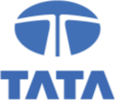
UPCOMING PORT PROJECTS/DEVELOPMENTS
Sl No | Project Name | Status Details/Target Year | Project Cost
1 | Development of Bhavnapadu Port , Srikakulam Dist. Andhra Pradesh | Tata Consulting Engineers –Inros Lackner as PMC consultants. Viswa Samudra as L1 bidder. LOI issued | Rs 2950 cr Phase-I
2 | Development of Ramanapadu Port, Prakasham Dist, Andhra Pradesh | DPR by Rites Consultancy Firm is approved PMC is AECOM. Construction Contract is being awarded Aurobindo-Navyuga consortium | Rs 3000 crore approx
3 | Development of Machilipatnam Port, Krishna Dist, Andhra Pradesh | Initial DPR by RITES Ltd submitted in 31st August 2020. Updated DPR being prepared by RHDV. | Rs 5,835 crore
Co
nfidential 35

Slide 51
UPCOMING PORT PROJECTS/DEVELOPMENTS
Sl No. | Project Name | Status Details/Target Year | Project Cost
3 | Development of Deep-water Outer Harbour, Paradip | Project with held due to viability concerns | Rs 8767 crore
4 | Development Deendayal – Tuna Tekra (in phases) on West Coast with 19m deep-draft | APSEZ challenged its exclusion from the tender in the Gujarat High Court. | Rs 3097 crore
Co
nfidential 35

Slide 52
UPCOMING PORT PROJECTS/DEVELOPMENTS
SL No. | Project | Status
5 | Creation Of Marine Infrastructure Facility At RBD, FOJ & Main Units Of GRSE, Kolkata | Consultancy services bid evaluation in progress. 4 parties short-listed for RFP including Tata Consulting Engineers-Inros Lackner
6 | Phase-1 development of Subarnarekha Port Private Ltd. in Balasore district of Odisha very near to Digha | Project Management Consultancy appointment tender evaluation in process. DPR completed
7 | Planning, Masterplan & Detailed Engineering & Program management support for Land-Use & Infrastructure for SMP, Kolkata | Bid under evaluation to appoint consultant
8 | Development of Greenfield Port at Tajpur, West Bengal | BOT operators have been invited( 2nd call in progress)

Slide 53
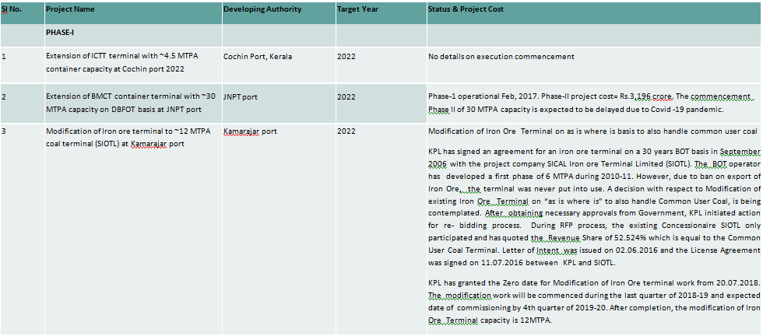
DRIVE CAPACITY EXPANSION ACROSS MAJOR PORTS(STATUS)

Slide 54
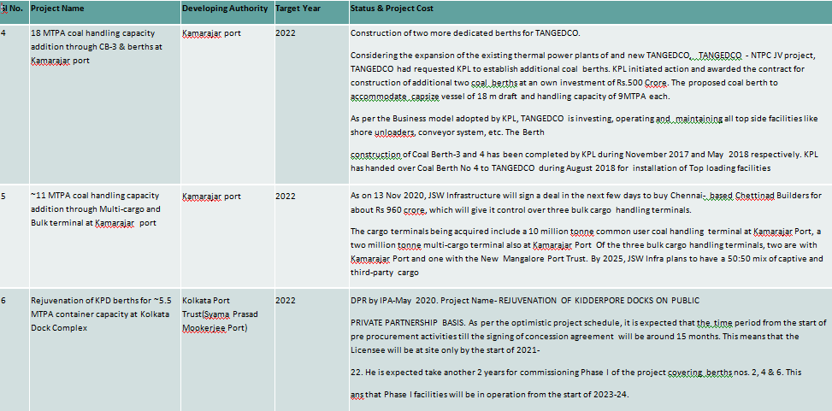
DRIVE CAPACITY EXPANSION ACROSS MAJOR PORTS(STATUS)

Slide 55
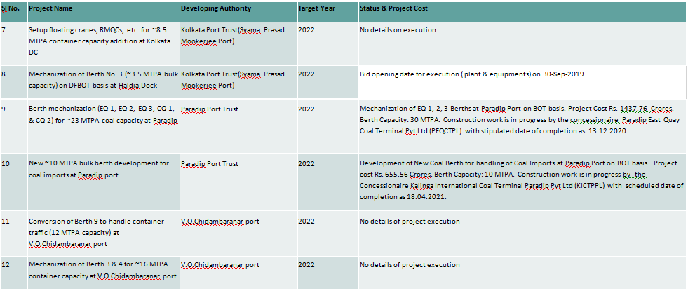
DRIVE CAPACITY EXPANSION ACROSS MAJOR PORTS(STATUS)

Slide 56
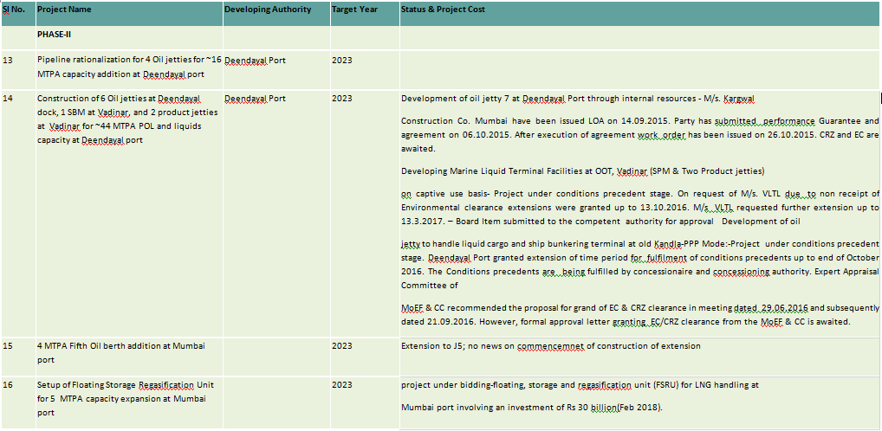
DRIVE CAPACITY EXPANSION ACROSS MAJOR PORTS(STATUS)

Slide 57
THANK YOU

