Slide 1

SUSTAINABILITY IN SHIPPING – INITIATIVES TAKEN BY TATA STEEL

Slide 2



TATA STEEL Goals
Safety and Sustainability is an integral part of Tata Steel business is driven by the Company’s leadership, with an organization-wide governance structure around it.
Vision - We aspire to be the global steel industry benchmark for value creation and corporate citizenship
Mission - Integrity | Excellence | Unity | Responsibility | Pioneering
Shipping Operations team focuses on three aspects which drives our policies, processes and decision making:
Sustainability
Safety
Corporate Social Responsibility
*From Tata Steel Website

Slide 3
Our Strategy
Sustainability
Safety
Corporate Social Responsibility
Baselining
Gap Analysis
Market Analysis
Options Assessment
Implementation of
Decarbonization
Options
Handholding mechanism
Tata Steel through its processes and expectations influences its partners to move towards more sustainable, safe and responsible practices
ITF
We only accept vessels with membership of ITF and related parties so as to ensure seafarers minimum rights related to wages, living conditions etc are guaranteed
11-14 months policy
If there is crew onboard for 11-14 months, we ask for repatriations plans from owners
GHG Rating
By further limiting vessels to only A-D rating from FY23, we intend to minimize our carbon footprints and influence industry in the direction of better rated vessel.
3-tier Vessel Vetting process
Escalation Mechanism
Insurance Coverage

Slide 4


Shipping Market (GHG Emissions - IMO and SCC)
IMO
SCC
Target
Taking 2008 as the baseline, IMO targets 50% reduction in Carbon Emissions by 2050
In terms of Carbon Intensity(EEOI), IMO Targets 40% reduction by 2030 and 70% by 2050
IMO 2014 GHG Study
2.6%(1b tonnes) of worlds emission through International Shipping
AIS data can be used directly for correlations(reliable method) to calculate EEOI
IMO 2020 GHG Study
2.89% of world emissions in 2018 was due to international shipping
EEOI method-29% better than in 2008(17.10 vs 11.67gCO2/t-nm)
Covid impact – lower GHG emissions in 2020-2021
Impact of IMO Studies on Shipping Industry
Benchmark and Holy grail for Shipping industry for GHG emissions. Drives industry practices
To ensure compliance with IMO, we joined SCC in August 2021
Target
A framework based on Poseidon Principle
Carbon intensity –the focus of this framework(more suitable at individual voyages level)
EEOI(New method(Energy Efficiency Operating Indicator) vs EEDI(Energy Efficiency Design Index-Previous method for Tata Steel Group) till 2021
Assumption
Linear correlation till 2050(Not actual and subject to change as assumptions will improve)
Ballast leg to be considered for our emissions(Not the case previously)
EEOI Method to be used
Impact of SCC on Shipping Industry
Principles:
Assessment | Accountability | Enforcement | Transparency
Members: 29 Members like Cargill, Klaveness, Maersk etc
This is a framework that enables industry leaders to report in a standard format and influence all stakeholders towards better sustainability goals

Slide 5


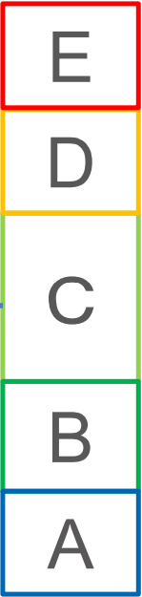
Future Regulations (GHG Emissions-EU Legislation & CII)
EU
ETS
Target - EU Targets climate neutrality by 2050 and 55% reduction in GHG emissions by 2030
Regulation - Shipping Industry to pay carbon taxes from 2023 under ETS in Europe as follows:
Year | 2022 | 2023 | 2024 | 2025 | 2026
% of Actual Carbon Emissions | 0% | 20% | 45% | 70% | 100%
CII
2019 Reference Line
Reduction from 2023
New Reference Line
Basis IMO DCS dataset, A-E Rating will be given to all the existing vessels from 2023.
Basis Reduction Calculations after 2023, each vessel will have to keep upgrading themselves so as to maintain their current ratings. Following reduction factors from ClassNK
Year | 2023 | 2024 | 2025 | 2026
Reduction % from Ref Line | 5% | 7% | 9% | 11%
ETS – Emissions Trading System, EU – European Union, ClassNK – Class Nippon Kaiji Kyokai
CII – Carbon Intensity Indicator, IMO DCS - International Martime Organization – Data Collection System

Slide 6
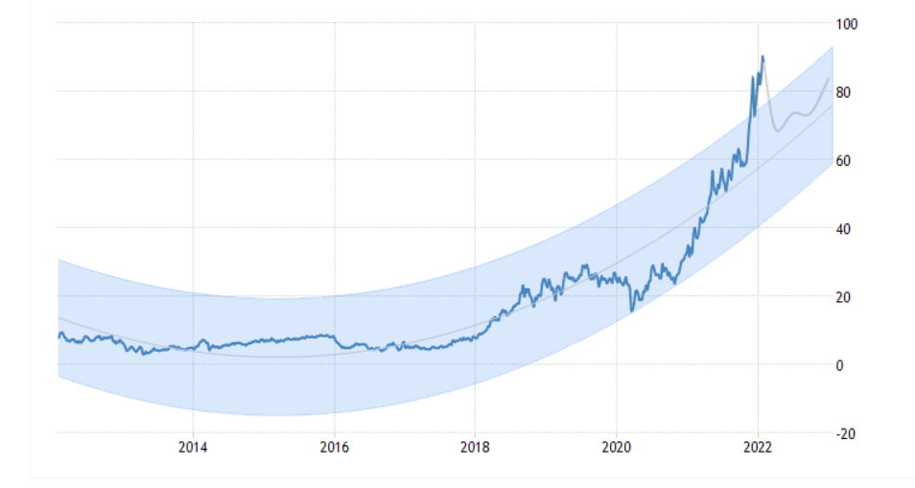
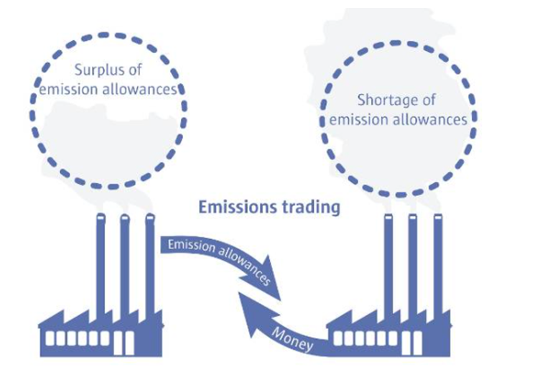
EU ETS Market
ETS is a system in which a limit is set on total carbon emissions which is then assigned to various installations as free allowance.
This limit is reduced over the years aligning with the EU sustainability goals and currently stands at 79% of 2005 emissions.
It is proposed that the limit be reduced by 43% by 2030.
ETS allows for trading of EUA’s(European Union Allowance) which are limited giving them a financial value and hence, fluctuations of its prices
79-80 EUR
For CY22
EUR/Ton
.
Year
A had 100 EUA. It invested in decarbonization technologies and reduced Carbon Emissions to only 80 MT. It can sell the remaining 20EUA in the market
B had 100 EUA. It Carbon Emissions increased to 120 MT. It can buy the remaining 20EUA from the market
Source - https://www.emissionsauthority.nl/topics/what-is-emissions-trading#:~:text=Emissions%20trading%20(EU%20ETS)%20is,those%20of%20the%20Kyoto%20Protocol.&text=Purchasers%20and%20suppliers%20trade%20in,a%20market%20price%20for%20CO2.

Slide 7






Options available to charterers like TATA STEEL
Sustainable Governance
Improving Technical Specifications
Larger size Vessels
Alternative fuels
Reduction of Port time/Demurrage
Knowledge Sharing

Slide 8






Sustainability Initiatives
Leaders
Sea Cargo Charter
Became members in Aug 2021
First Steel producer to join
A framework for shipping Decarbonization
Baltic Exchange membership
Membership from Feb 2022
Baltic & International Maritime Council
Future compliance with IMO emission regulations
Getting to Zero Coalition
Knowledge Sharing
Optimization
Rightship
Baselining for Sustainability Strategy
Optimum Voyage
Optimising voyage times of the vessel
Reduce GHG Emission with the help of Big Data
GHG Emission Policy
Focus on greener vessels with less GHG emissions.
Sea
Prediction and comparison of GHG emissions for voyages
Better decision making for chartering
Alternative Fuels
Wind
Green Ammonia
Bio Fuels
Electric - Shore Power
Hydrogen
LNG

Slide 9
Backup Slides

Slide 10
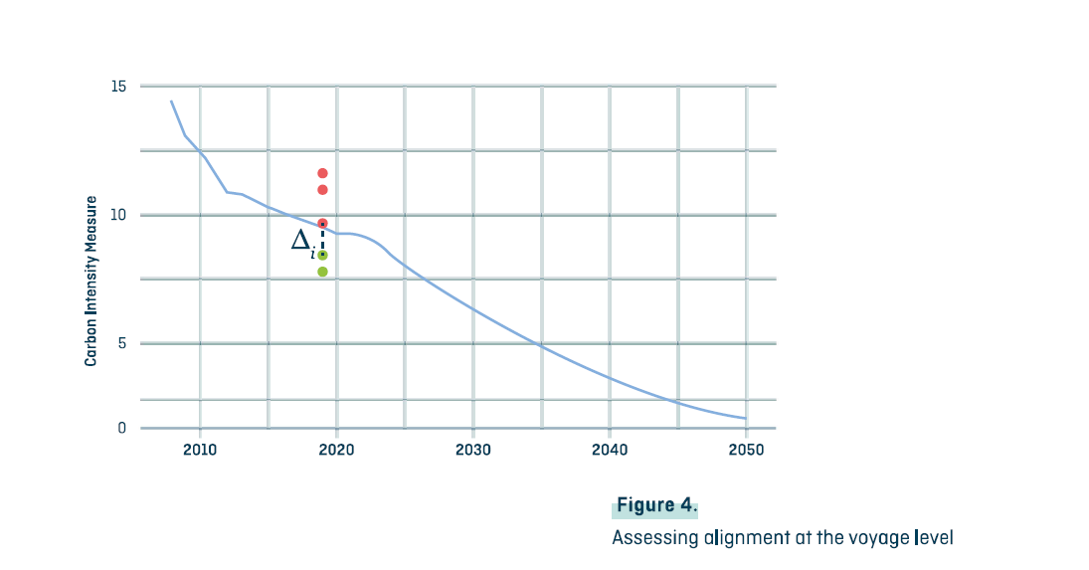

Carbon Intensity Targets - SCC

Slide 11
GHG Trend Line Backup

Slide 12
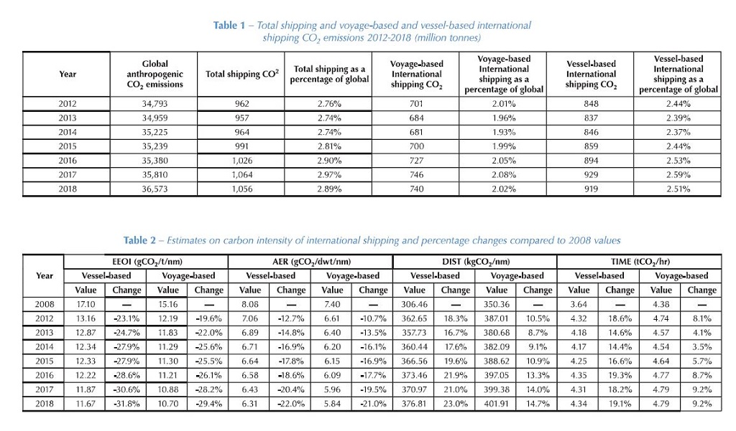
IMO GHG Study Data Set

Slide 13
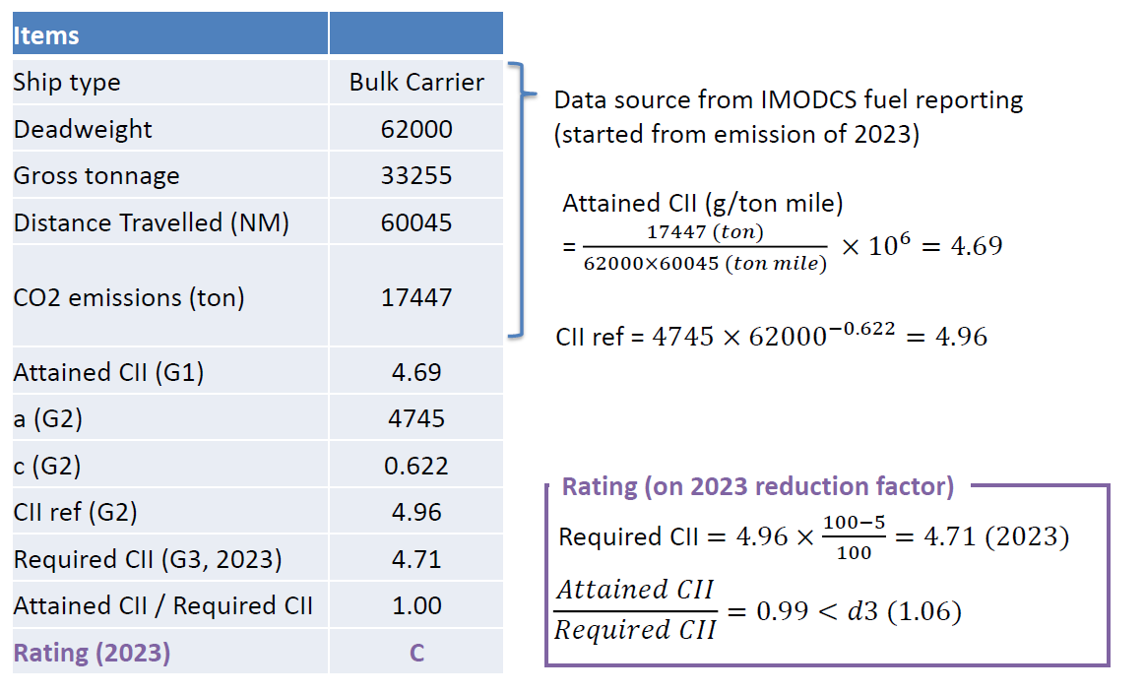
CII-Example-1
Source: From NKK https://www.classnk.or.jp/hp/pdf/activities/statutory/seemp/CII_en.pdf

Slide 14
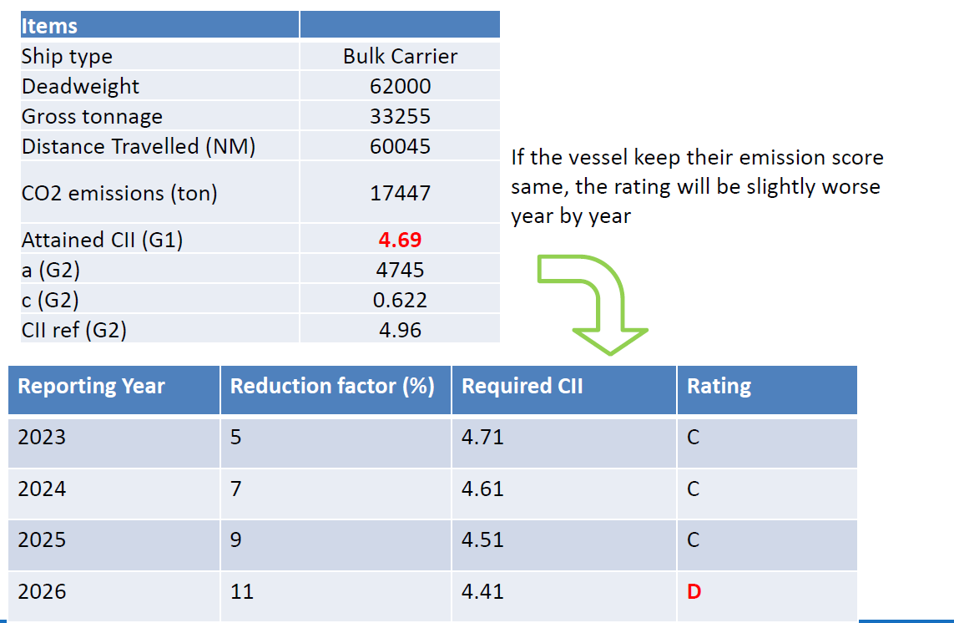
CII Example-2
Source: From NKK https://www.classnk.or.jp/hp/pdf/activities/statutory/seemp/CII_en.pdf

