Slide 1


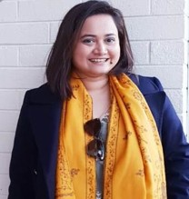
Ms. Angana Guha Roy Chowdhury, an alumnus of South Point School and Jadavpur University, Kolkata is working as Assistant Director General in The Bengal Chamber of Commerce and Industry (www.bengalchamber.com), one of India's oldest institutes of its kind dating its origins to 1833. Angana joined BCC&I in 2009 January as Programme Manager. She has set up and now leading BCC&I’s Office and engagements in Delhi.
She is a start-up enthusiast. She has set up Webel-BCC&I Tech Incubation Centre with Webel under the Information Technology and Electronics Department of Government of West Bengal. It is the first such initiative of BCC&I. Her team is running it now and her focus is to create more opportunities for the start-ups, incubated, by connecting them with investors and other stakeholders.
She leads BCC&I’s initiatives in IT and IT Entrepreneurship with signature engagements in Kolkata and Bengaluru.
She is passionate about sustainability. She has led BCC&I’s initiative of participating in COP26, United Nations Climate Change Conference. BCC&I was granted approval to present a Panel Discussion on Accelerating Electric Mobility with Green Jobs and Gender Parity on 10th November at Green Zone, COP26 in Glasgow. She is also the anchor of clean energy and sustainability focused programmes of BCC&I including decarbonization, net zero, circular economy, ESG among others.
She has curated and ideated a flagship discussion forum for Women IT professionals and entrepreneurs called Pink IT in Kolkata which has been running successfully under her leadership. Similarly, she leads POSH Awareness programmes of BCC&I. She was the Chairperson of POSH Internal Committee at BCC&I.
She leads Chamber’s overseas linkages. The overseas delegations (inbound and outbound), in recent times, are primarily coordinated by her and her team.
She has vast experience in liaising with the Industry, Government, Consulates/Embassies among others. Her expertise includes organizing B2B and B2G. She has led Seminars, Workshops, B2B Meets and Exhibitions in Kolkata (along with districts including Haldia, Durgapur, Siliguri), Delhi, Mumbai, Bengaluru, Chittagong, London among other places.
She is responsible for anchoring some of the most prestigious events and activities mounted by BCC&I including the visit of the Hon’ble President of India in September 2013 and that of Hon’ble Vice President of Mauritius in 2017.
She is an alumnus of the International Visitors Leadership Program (IVLP) invited by the State Department of USA. IVLP is the U.S. Department of State’s premier professional exchange program. Through short-term visits to the United States, current and emerging foreign leaders in a variety of fields experience this country firsthand and cultivate lasting relationships with their American counterparts.
As a student, she participated in the Swinton Exchange Programme organized by Swinton Comprehensive School at Lake District, UK, in 2002. She also joined the International Gold Event 2005 & its Youth Forum of International Award for Young People (IAYP) in Hong Kong & China which was chaired by HRH the Earl of Wessex.
She is an adventurer especially in high altitude trekking including Everest Base Camp (5534m) and Kalapathar (5550m).
Angana Guha Roy Chowdhury Assistant Director General, BCC&I

Slide 2
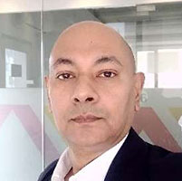
An Architect from Jadavpur University Kolkata, by virtue of his primary qualification,
Ritwik Sengupta, pursued his M. Des. Sc. from Sydney University and subsequently,
PG Diploma in CRM, from Symbiosis University .
Ritwik started his career as a Project Engineering Coordinator for the landmark NSEIL-HQ, Bandra Kurla, Mumbai, his subsequent stint as Lead Architect with Bechtel
Corporation earned him exposure in front-ending design convergence for large scale Industrial and Infrastructure projects. A consummate professional, he has led several teams in Project (Engineering) Management, as well as, Business Development & Operations, across broad-based MNC organizations in multiple sector industries including Thermal and Nuclear Power, Oil & Gas, ITES, Roads & Highways and Buildings & Infrastructure for over 30 years. His spearheading roles in M&BD, with broad based organizations across shores, has facilitated him to be a first generation entrepreneur, since 2021.
Ritwik has been keen & engaged in leading activities of socio-cultural organizations over past several years and have been able to win friends and well wishers in the process. Ritwik, is the present President of Alumni Association of NCE Bengal & Jadavpur University (AANCEBJU), Delhi Chapter. His steadiness to garner buy-in from stakeholders in projects or systematic endeavours, his anticipative grasp of dependences, augments his tact in delivery of the desired outcome.
Ritwik Sengupta
President, JU Alumni Association, Delhi Chapter & Founder Partner Nelsa Projects Consultants LLP

Slide 3
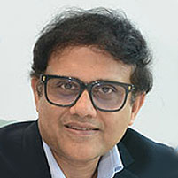
Mr. Abhijit Roy, Managing Director &amp; Chief Executive Officer of Berger Paints India Limited is a Mechanical Engineer from Jadavpur University and an alumnus of IIM Bangalore.
He started his career with Asian Paints (I) Ltd. &amp; joined Berger Paints in 1996 and took over as Managing Director and CEO of Berger Paints India Limited in 2012.
It was under his exemplary leadership that Berger’s market capitalisation increased from Rs.3000 Crores to more than Rs. 60000 Crores today.
Mr. Abhijit Roy was listed by Business Today as Best 100 CEOs of India thrice, in
2016, 2017 and 2018. He was nominated as Best CEO in Private sector by Forbes
India twice in 2016 &amp; 2017, received Most Enterprising CEO Award from Times
Business Awards, Business Leader of the Year Award by SANMARG Group and
DISTINGUISHED ALMUNI AWARD by IIM Bangalore in 2024. He was invited as a
speaker by the prestigious HARVARD BUSINESS SCHOOL in February 2025 to
speak on The Art of Building Timeless Indian Brands.
He is the past Chairman of CONFEDERATION OF INDIAN INDUSTRY (CII),
Eastern Region &amp; past President of INDIAN PAINT ASSOCIATION (IPA) and the
current President of Bengal Chamber of Commerce & Industries.
Abhijit Roy
President, BCC&I and
Managing Director & CEO, Berger Paints India Ltd

Slide 4
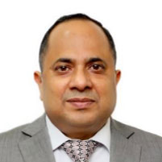
Shri Ghanshyam Prasad, born on 15th of May 1967, is presently holding the
post of Chairperson, Central Electricity Authority, Ministry of Power and Ex-Officio
Secretary to the Government of India from 15th July 2022.
He is Member, ex-officio, of the Central Electricity Regulatory Commission. He
is also the 1st Executive Director of the BIMSTEC Energy Centre (BEC). He is the
president of Central Board of Irrigation and Power (CBIP), Power Sector Skill Council
(PSSC) and Excellence Enhancement Centre (EEC) for Indian Power Sector.
He also has corporate experience and was Government Nominee Director of
Power Grid Corporation of India Limited (PGCIL), a Maharatna Company; Power
System Operation Corporation Limited (POSOCO), now renamed as Grid Controller of India Limited; and Jammu and Kashmir State Power development Corporation Limited (J&KPDCL). Presently he is the Director on the Board of Nuclear Power Corporation of India Limited in an ex-officio capacity.
He did his B.Tech (Electrical Engineering) for IIT/BHU, Benares Hindu
University. He holds a M.Tech in Energy and Environment Management from IIT,
Delhi and also MBA (Finance) from IGNOU, Delhi.
With experience of more than 35 years in the power sector, he has worked and
contributed in the areas of generation including the renewable energy, transmission, distribution, power market development/trading of power, Reforms & restructuring in power sector, energy efficiency, regulatory commission experience, disaster management in power sector, data analytics and information management system. He was also a part of the G20 Energy transition working group. He has received the policy pioneer of the year award by India Energy Storage Alliance (IESA) on 3rd May 2022. He has led the Indian side in the Joint Working Group (JWG) with Nepal, Bangladesh, Myanmar and Australia.
Ghanshyam Prasad
Chairperson, Central Electricity Authority (CEA)

Slide 5
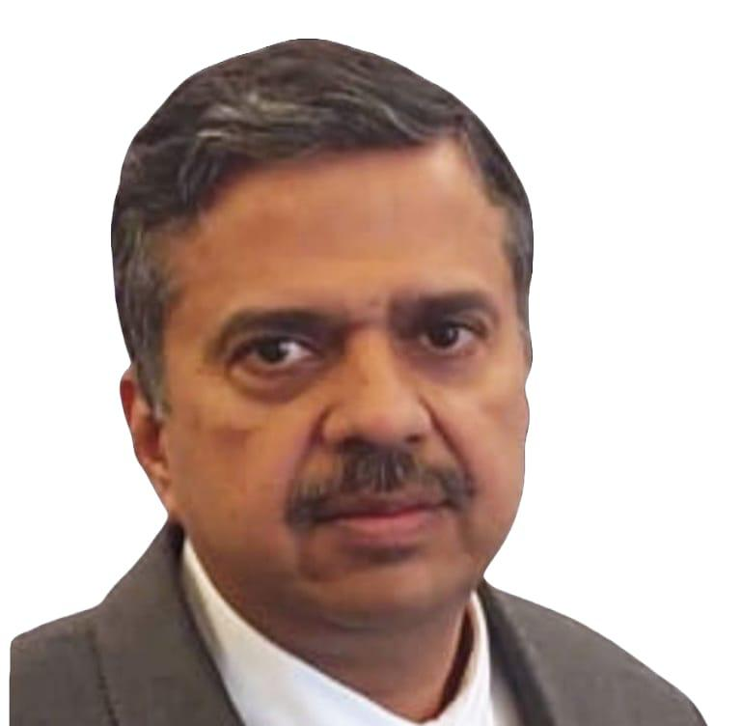
Shri Palash Srivastava
Managing Director (Additional Charge), India Infrastructure Finance Company Limited
Shri Palash Srivastava is a distinguished leader in infrastructure financing with nearly three decades of expertise in public-private partnerships (PPPs), structured finance and capacity building. Throughout your career, you have been instrumental in project appraisal, long-term financing and structured investments for large-scale infrastructure projects in roads, ports, airports, railways, urban transport, water supply and solid waste management. His expertise spans emerging sectors such as aerospace, space, agri storage, industrial parks, Special Economic Zones (SEZs), IT infrastructure, real estate, healthcare and tourism. At IIFCL, you have been instrumental in advancing long-term project financing, facilitating private sector participation through structured lending and ensuring the successful execution of critical infrastructure projects.
He has played a key role in shaping national infrastructure policies, contributing to the National PPP Capacity Building Programme, Working Group for Financing Urbanization-12th Five Year Plan, Rakesh Mohan Committee for Transport and Kelkar Committee on Revision and Revitalization of PPP Model of Infrastructure Development.
He played a key role in formulating environment rating standards for infrastructure projects to facilitate green financing, which was launched at COP 21. He has also pioneered structured financial solutions and managed syndication for large-scale infrastructure development.
Prior to joining IIFCL, he held key leadership positions in organisations including IIFCL Projects Limited (IPL), IDFC Group, CRISIL, Feedback Ventures, IL&FS and Aditya Birla Group.
He holds an MBA from RA Poddar Institute of Management, Mumbai and a degree in Civil Engineering from Malaviya National Institute of Technology (MNIT), Jaipur.
Palash Srivastava
Managing Director (Addl.Charge), India Infrastructure Finance Company Ltd

Slide 6
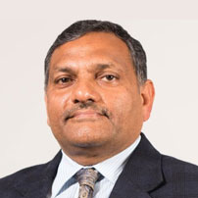
Amrit Lal Meena, have rich experience of working in Bihar for 24 years and 11 years in Govt of India. Served as collector of five districts Siwan, Nalanda, Bhojpur, Gaya and Muzaffarpur continuously for over 9 years from 95 to 2004. Handled highly Naxal infested districts with people centric administrative skills.
His accessibility, sensitivity towards cause of common people, push for development works and balanced enforcement of laws were unique traits. Worked in ministry of rural development as PS during 2004-09. Have been instrumental in formulation of MGNREGA. Have contributed in development of rural roads in Bihar. Worked as Joint Secretary, Ministry of food processing, contributed in development of cold chain sector in India. At state level he has served as Secretary in 10 departments from 2012-2021 Worked in Ministry of Commerce and Industry, Govt of India as special secretary logistics. Contributed in formulation and roll out of PM GatiShakti National Master Plan and National Logistics Policy. Rich experience of monitoring major Infrastructure Projects across sectors and states under Project Monitoring Group.
For the last two years he is serving as Secretary Ministry of Coal. Coal sector has seen double digit historical coal production growth. Market cap of coal CPSEs have gone up over 150% in last two years. Transparent auction of Commercial coal blocks has brought in massive response from Industry, thereby contributing to energy security of nation. With massive push for coal gasification and venturing in renewable energy, coal CPSEs are diversifying as sustainable strong organisations.
Have received three national awards including National Literacy award in 2003, National award for Implementation of MGNREGA in Bihar in 2013 and National e-governance award in 2014.
Amrit Lal Meena
Former Chief Secretary Govt of Bihar & Secretary Coal Ministry, Govt. of India

Slide 7
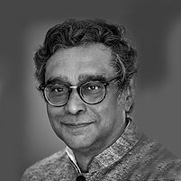
Shri Swapan Dasgupta is a Former Member of Parliament in Rajya Sabha, the Upper House of India’s Parliament. He is one of India’s most widely read political columnists for the past three decades. Having worked in almost all the leading publications in India in senior editorial positions, he has been an independent columnist since 2003. In 2015 he was awarded the Padma Bhushan by the President of India.
Swapan Dasgupta
Former Member of Parliament in Rajya Sabha, Padma Bhushan awardee 2015

Slide 8
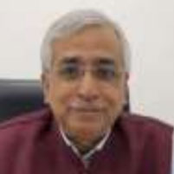
Biswapriya (BP) Mukherjee is the founder, promoter, and CEO of Oroprise Solutions Pvt. Ltd. As the CEO of the company, Mr Mukherjee is responsible crystallizing the strategic direction, enabling the operational rhythm, catalysing the cultural DNA, and managing the overall P&L. Founded in 2014, Oroprise has been empowering customers in the Western Europe, the US, Middle East and India as well.
More than three and a half decades of multi-faceted and eclectic experience in the power and IT sector, Mr Mukherjee has both business stewardship as well as operational vanguard experience in some marquee global corporations like SAP, Ferranti, and PA Consulting, and in reputed Indian entities like CESC of RP-SG group. He has been a business leader of IT companies, value-based consultant, and field service manager in power companies.
Prior to founding Oroprise Solutions, he was the country-head of Ferranti Computer Systems, a leading Belgium-headquartered software product company. In SAP, he was the part of SAP India leadership team being the head of Industry Solution Group responsible for business development for more than twenty industry verticals.
He is an engineer with post-graduation in business management. He has been a speaker, writer, and presenter on a range of industry themes like next generation leadership, organizational transformation, digital city evolution, and fast track adoption of new technology.
Biswapriya (BP) Mukherjee Vice President, JU Alumni Association, Delhi Chapter & Founder & CEO
Oroprise Solutions Pvt. Ltd.

Slide 9
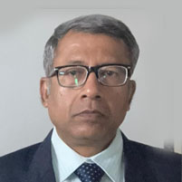
Mr. Devdeep Bose, a Mech Engg of ‘88 batch is a seasoned energy sector professional with nearly four decades of experience in power plant commissioning, operations &amp; maintenance, and safety management. He currently serves as a Consultant at STEAG Energy Services (India) Pvt. Ltd., Noida, contributing to high-efficiency and sustainable energy projects.
Previously, Mr. Bose held several leadership positions at NTPC Limited, including General Manager (Commissioning, Testing &amp; Safety) at the Advanced Super Critical Thermal Power Plant, Patratu, and AGM (O&amp;M) at Sipat Super Thermal Power Project, Chhattisgarh.
Known for his expertise in operational excellence, performance optimization, and safety systems, Mr. Bose has played a vital role in advancing India’s thermal power efficiency and clean energy goals, combining deep technical insight with strategic leadership.
Debdeep Bose
Consultant, STEAG Energy Services (India) Pvt. Ltd. Former GM Operation & Maintenance of NTPC Limited

Slide 10
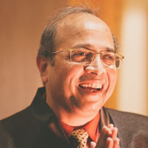
Santanu Roy, topper of Jadavpur University (’84 Mechanical) with MBA in Operations Management, superannuated in 22 from GAIL as Executive Director – Business Development. Sustainable Development &amp; Corporate Affairs. He was part of Top Management Team in GAIL for over a decade and had previously headed Strategy & Planning and Projects Development.
Mr Roy had an enviable track record of thinking strategically at macro level, management skills and excellent business acumen to build several new sustainable business models. His tenure saw remarkable success in mainstreaming sustainability through win-win collaborations, formulation of “Net Zero Emission” Path and innovative measures leading to “Value Beyond Business”.
He remains passionate about integrating strategy with sustainable energy solutions and is active in business consultancy / mentorship.
Santanu Roy
Principal Advisor,
GPS Renewables (Mech 84)

Slide 11
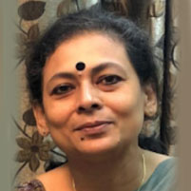
Prof. Anindita Roy Saha is a scholar, researcher, environmentalist and above all a teacher. With Environmental, Ecological and Resource Economics as her academic specialization, she has been involved in teaching and research in this area for three decades. She is a Professor at the Department of Economics at Indraprastha College for Women, University of Delhi.
Prof. Saha graduated from Jadavpur University, Kolkata and completed her post-graduation and Ph D degrees at Jawaharlal Nehru University, New Delhi. Her doctoral research in Energy Economics gradually transcended to the interest and specialization in the Economics of Environment, Sustainable Development and Climate Change within the broader domain of Development Economics. She has been associated with the Department of Environmental Studies at the University of Delhi, Jawaharlal Nehru University, Ambedkar University Delhi, Indira Gandhi National Open University, Nalanda University and Amity University in various academic capacities.
Prof. Saha has a long list of research publications, research supervision, and academic deliberations at international and national levels. She has recently co-edited a book titled ‘Sustainable evelopment Insights from India: India Studies in Business and Economics’ from Springer, Singapore. Her latest work is a research project on migration impacts of climate change in South Asia awarded by the Indian Council of Social Science Research, New Delhi. Besides academics, she is committed to creating a healthier, sustainable, and connected future for communities.
Anindita Roy Saha
Professor, DU (Economics, 87)

Slide 12
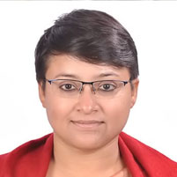
Sudeshna Das is a passionate advocate of sustainable development, social responsibility, environmental stewardship, and inclusive innovation, with over two decades of experience spanning both the corporate and social sectors. Her work reflects a deep commitment to building impact-driven and responsible business ecosystems that seamlessly bridge profit with purpose.
A B.Tech in Bio-Chemical Engineering from Jadavpur University, Sudeshna began her career with PepsiCo India Holdings Ltd. and went on to hold leadership roles at GS1 India (under the Ministry of Commerce) and Electronics For You, a leading technology media group. She has also served in teaching and mentorship roles at the West Bengal University of Technology and Padmashree D.Y. Patil University, Mumbai. Her professional expertise spans strategic alliances, marketing, research, stakeholder engagement, learning and development, and corporate and sustainability communication, honed through her work across diverse sectors.
As the Founder &amp; Chief Strategist of KrishiCraft, an initiative under Avahita, a sustainable-tech start-up, Sudeshna leads efforts to go beyond profit and innovation integrating technology, sustainability, and social responsibility to create long-term value for people, planet, and prosperity.. Under her leadership, Avahita has been recognized as a National Award-winning start-up under the Best Entrepreneurship Category by the Indian Council of Agricultural Research (ICAR), Ministry of Agriculture, for its exemplary contribution to sustainable agri-value chain development.
A believer in mindful action and compassionate leadership, Sudeshna combines strategic foresight with empathy to drive initiatives that foster economic empowerment, environmental balance, and social impact. She continues to work for the localization of the UN Sustainable Development Goals (SDGs) and envisions a future where sustainability, innovation, and community well-being thrive together in harmony.
Sudeshna Das
Founder & Chief Strategist, KrishiCraft (Bio Chem 2004)

Slide 13
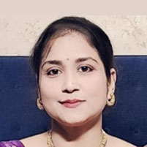
Srabani Biswas is a passionate and accomplished educator with over 15 years of experience in teaching and academic coordination across primary and secondary levels. She holds a Master’s and Bachelor’s degree in Comparative Literature from the prestigious Jadavpur University, Kolkata, both with First Class
honors, reflecting her strong academic foundation and intellectual rigor. Her professional journey is further enriched by a B.Ed. From Chaudhary Ranbir Singh University, Diploma in Child Psychology, Diploma in Fine Arts from Bangiya Sangeet Parishad, showcasing her commitment to both pedagogical excellence and creative expression.
Throughout her career, Srabani has demonstrated exceptional versatility in adapting her teaching methods to suit the diverse learning needs of students in both urban and rural settings. Her tenure at SCR Public School as a Post Graduate Teacher (PGT) in English and Social Studies, and her earlier role as a Primary Teacher and Art Coordinator at Presidium School, underline her ability to engage students across age groups and subjects. She is known for creating inclusive, stimulating classroom environments that foster curiosity, creativity, and critical thinking.
Beyond the classroom, Srabani is a dynamic organizer and community leader. She has successfully planned and executed numerous school events, excursions, seminars, and cultural programs, enriching the educational experience for her students. Her leadership roles as the Secretary and former Joint Secretary of the Jadavpur University Alumni Association (Delhi Chapter), and as the Cultural Secretary of the Dwarka Expressway Durga Puja Committee, reflect her dedication to community building and cultural engagement.
Srabani Biswas has consistently demonstrated her commitment to social welfare through generous donations to NGOs and the Ramkrishna Mission orphanage. She regularly donates a portion of her earnings to support education, healthcare, and the overall well-being of underprivileged children. Her contributions not only provide financial assistance but also reflect her deep-rooted values of compassion, empathy, and community service, making a meaningful impact beyond the classroom.
With a strong sense of responsibility, a collaborative spirit, and a deep commitment to student development and community service, Srabani Biswas stands out as a multifaceted professional who brings energy, empathy, and excellence to every endeavor.
Srabani Biswas
Secretary JU Alumni Association, Delhi Chapter (Comp Litt 2008)

Slide 14
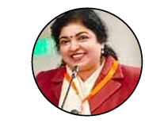
Schooling in Patha Bhavan school, Kolkata. A bachelor of pharmacy from Jadavpur University, she worked as supervisor in the R&D laboratory of Reckitt & Colman of India limited for 5 years. Presently she is based in Delhi and has changed her career course totally. She is now a professional singer a voice over artist , an actor and a show anchor
Kaushiki Deb
Executive Committee Member, Jadavpur University, Alumni Association Delhi Chapter

Slide 15
Prof. Anindita Roy Saha is a scholar, researcher, environmentalist and above all a teacher. With Environmental, Ecological and Resource Economics as her academic specialization, she has been involved in teaching and research in this area for three decades. She is a Professor at the Department of Economics at Indraprastha College for Women, University of Delhi.
Prof. Saha graduated from Jadavpur University, Kolkata and completed her post-graduation and Ph D degrees at Jawaharlal Nehru University, New Delhi. Her doctoral research in Energy Economics gradually transcended to the interest and specialization in the Economics of Environment, Sustainable Development and Climate Change within the broader domain of Development Economics. She has been associated with the Department of Environmental Studies at the University of Delhi, Jawaharlal Nehru University, Ambedkar University Delhi, Indira Gandhi National Open University, Nalanda University and Amity University in various academic capacities.
Prof. Saha has a long list of research publications, research supervision, and academic deliberations at international and national levels. She has recently co-edited a book titled ‘Sustainable evelopment Insights from India: India Studies in Business and Economics’ from Springer, Singapore. Her latest work is a research project on migration impacts of climate change in South Asia awarded by the Indian Council of Social Science Research, New Delhi. Besides academics, she is committed to creating a healthier, sustainable, and connected future for communities.
Anindita Roy Saha
Professor, DU (Economics, 87)

Slide 16
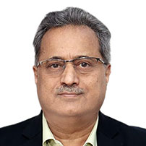
Ujjwal Kanti Bhattacharya – Managing Director, STEAG Energy Services (India) Pvt. Ltd.A seasoned power sector executive with over four decades of leadership in energy and infrastructure. He has held senior roles at India’s NTPC (including Director – Projects & Technical) and led major joint ventures and energy ventures abroad, and now heads STEAG’s India operations from March 2025. His tenure at NTPC was marked by record growth – 13,600 MW of capacity was added under his stewardship (including ~2.3 GW of renewable capacity), driving revenue up ~77% and tripling market value. He championed NTPC’s globalization through joint ventures overseas and introduced advanced contracting and technology practices.
Strategic Growth & Turnarounds: He led high-impact projects and turnarounds. Early in his career he revived a 450 MW Talcher thermal power station into a top-performing unit. As NTPC-GE (JV) Services Ltd. (NGSL) Chairman, he turned around an underperforming EPC business into profitability, adding solar EPC and O&M services. In total he directed four major project/company turnarounds and mobilized ~$2 billion in overseas project financing.
Ujjwal Kumar Bhattacharya Managing Director Steag & Former Director, NTPC

Slide 17
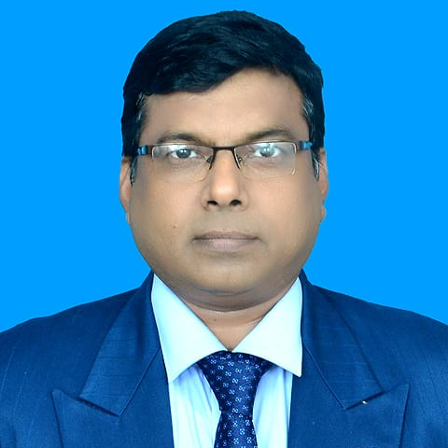
Mrityunjay Prasad Sr. General Manager (M) & Resident Director, Damodar Valley Corporation (DVC), New Delhi.Mrityunjay Prasad is a seasoned power-sector professional with 27+ years of experience in Thermal Power Plant O&M, Fuel Management, Coal Logistics, Materials Management, and Corporate–Ministerial Coordination. Having spent his entire career with the Damodar Valley Corporation (DVC) under the Ministry of Power, Government of India, he has played a pivotal role in strengthening operational efficiency, policy alignment, and strategic transformation across the organization.
In his current role as Sr. General Manager (M) & Resident Director, DVC, New Delhi, he leads high-level coordination with the Ministry of Power, Ministry of Coal, Railway Board, and other central agencies on corporate affairs, policy matters, and inter-ministerial engagements. He supports innovation-led initiatives in the power sector, drives commercial strategies, ensures regulatory compliance, and represents DVC in government forums and administrative interactions.
Earlier, as General Manager (O&M) at Bokaro Thermal Power Station, he oversaw plant operations, maintenance, ash management, environmental compliance, and infrastructure upgrades. As Deputy General Manager (Fuel), he managed fuel sourcing, multimodal logistics, coal quality assurance, and ERP-led system improvements.Known for his strategic thinking, collaborative leadership, and ability to implement technology-driven solutions, Mr Prasad has contributed to ERP/EBA rollouts, standardization practices, and process optimization across DVC units. Passionate about sustainable and innovative approaches, he remains committed to enhancing efficiency and societal value through responsible energy management.
His guiding philosophy, "आत्मज्ञानार्थं जगत हिताय च", reflects his dedication to purposeful, ethical, and impactful leadership.Education:PGDM (Logistics & Supply Chain), IIMM KolkataB.E. Mechanical Engineering (Distinction), BIT SindriPresently working professional reserach scholar with Gati Shakti University, Ministry of Railways, Vadodara.
Mrityunjay Prasad
Sr. GM & RD, New Delhi,
DVC

Slide 18
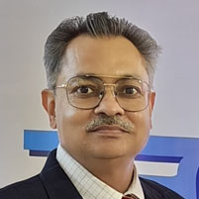
Asim Prasad heads the Corporate Strategy, Planning, Advocacy, and Corporate Affairs departments as Executive Director (Corporate Strategy, Planning,
Advocacy, and Corporate Affairs) at GAIL (India) Limited Corporate Office, New
Delhi. During his 31-year professional career at GAIL, he held various positions at
different installations across diverse business verticals, including operations and
maintenance, pipeline project management, natural gas transmission, and gas
marketing. He has been involved in the execution of several prestigious projects
on Natural Gas Transmission and Distribution and LPG Transmission Pipelines.
Also, as Zonal Chief General Manager & OIC at GAIL Kolkata Zonal Office, he established the natural gas market in eastern states, promoting sustainable socio- economic development in Jharkhand and West Bengal. One of his initiatives
involved conceptualizing and successfully implementing a pilot project to run two
100-ton BEML BH100 dumper trucks in dual fuel LNG mode. Mr. Prasad holds a B.Tech in Mechanical Engineering from IIT Kanpur, a Post Graduate Diploma in Project Management, and a Master's in Business Administration. He has several publications in conference proceedings and indexed journals of international repute. He is a Fellow at the Institute of Engineers India, Kolkata, a member of the Project Management Institute, New York, a member of the Engineering Council of India, and a Life member of ASCI, Hyderabad, NIPM, Kolkata, and IIM, Mumbai, erstwhile NITIE, Mumbai.
Asim Prasad
Co- Chairperson, BCC&I Energy, Environment & Water (National) Committee & Executive Director (Corporate Strategy, Planning Advocacy and Corporate Affairs) GAIL (India) Ltd DVC NTPC
.

Slide 19
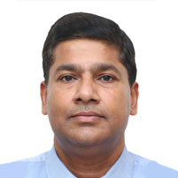
Mr. Parveen Kumar Goel has experience of about 30 years in Environment field. Mr. Goel holds a Batchelor’s degree in Civil Engineering from Delhi College of Engineering and Master’s degree in Environmental Engineering from I.I.T. Kanpur. Since then Mr. Goel has been working with Engineers India Limited.
Presently he is working as Chief General Manager and heading EIA, Sustainability & Water department of EIL. His area of expertise includes water & wastewater management, effluent recycle and zero liquid discharge systems, solid &amp; hazardous waste management, waste to energy facilities, sea water desalination plants, environmental impact assessment and other specialized
studies in the field of Environment.
Parveen Kumar Goel
Chief General Manager, EWS-EIA,
Sustainability and Water, EIL.

Slide 20
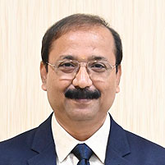
Mr. Tapan Kumar Bandyopadhyay brings over 38 years of distinguished experience in the Indian power sector, encompassing operations, fuel management, safety, environment, sustainability and ash Management. A veteran at NTPC, he has led diverse functions across operations &amp; maintenance, project execution, coal and ash handling, safety and environmental management, including heading major business units such as NTPC Solapur.
Currently serving as the Chief Sustainability Officer cum Executive Director at NTPC’s Corporate Centre, he leads the organization’s strategic efforts in sustainable development, environment management, and ash utilization. He is at the forefront of developing NTPC’s Net Zero Strategy, overseeing ESG performance, ratings, and sustainability disclosures aligned with global standards.
His expertise is instrumental in aligning NTPC’s decarbonisation roadmap with national and global climate goals, including Net Zero townships and offices initiatives.
Tapan Kumar Bandyopadhyay, Chief Sustainability Officer & Executive Director (Safety, Sustainable Development, Environment & Ash Management), NTPC Limited, Corporate Centre, Noida

Slide 21
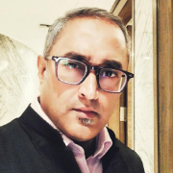
A competent professional with 20+ years of accomplished career track of delivering, sustaining revenues & profits. An effective communicator with exceptional client relationship management skills with ability to relate to people at any level of business and management.
Major skills include pre-sales proposals, handling customer conflict and identifying new business opportunities.
Currently working as the Chief Manager with The Bengal Chamber of Commerce & Industry(BCC&I) who has introduced many new clients to the portfolio of the Chamber namely in the Energy/Power and Renewable Energy sector.
Adept in developing strong professional networks, specializes in revenue growth and public relations. Experienced in Government relations, corporate communications, policy advocacy, business development, Marketing Communications, Business Development, Corporate tie ups, conceptualization and execution of large-scale Events, Seminars and Exhibitions, Key Account Management, Policy Advocacy, Market Intelligence on a Pan India basis
Avishek Mukherjee
Chief Manager, BCC&I

Slide 22
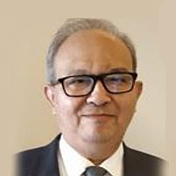
Debashish is a graduate of Indian Institute of Technology (BHU) Varanasi in Mechanical Engineering. He is a Director at Vriksh Consulting Pvt Ltd, a management consulting organisation that helps businesses scale up and build capacity. Its activities include setting up and expanding the sales network in BOT model, Sales, Strategic HR, Digital Enhancement of Businesses, Business Funding and Training & Development. He has played a role in BHEL’s absorption of 500 MW and 1300 MW Turbine-Generator technology for manufacturing turbines and generators for thermal power plants. He has established and optimised the manufacturing process for turbine parts and assemblies like turbine blades, turbine casings, turbine rotors, governing components, valve bodies on CNC machines during his tenure at BHEL. Thereafter, in Escorts, he set up the first CAD/CAM centre, and was a core team member in the development of an indigenous 4 stroke engine for Escorts Motorcycles.
Debashish has worked with top-notch organisations like BHEL, Escorts, and Siemens. In a career spanning 35+ years, he has contributed to the businesses of over 150 organisations comprising MNCs, PSUs, Private companies, and government organisations, some of which are Hero Motors, ONGC, NTPC, Hero Cycles, International Tractors, Mercedes Benz, DCM Shriram, Municipal Corporation of Greater Mumbai, Employees’ Provident Fund Organisation. He has delivered over 100 ERP, IT and Business Consulting projects in the domains of automotive, engineering, manufacturing, chemicals and fertiliser, cements and refractories, public services, power utilities and steel manufacturing.
Debashish Bhattacharya Technologist in ERP, IIT BHU, Past President, Global PAN IIT Alumni

Slide 23
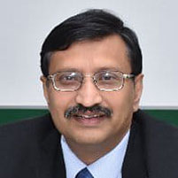
Present Position: Co Founder of an IIT Kanpur Fintech Startup. Advisor to Fintech and Payments
Organizations., AI , Identity management, Large Project Organization, Startup mentoring Past
Positions : Program Director and Head (UIDAI-MSP). Sr. Vice President HCL, Advisor and Consultant to NIC Govt of India. Total Experience : More Than 35 years. Organizations Worked : HCL , UIDAI-MSP, Wipro Technologies, Tata Steel, Siemens Business Services, Qualifications : BE Comp Sc 1986 Jadavpur University Kolkata , MS (BITS Pilani) 1991, Adv Dipl In Mgmt. Specialities : AI and Fintech , Very Large Programs , Identity management , Innovation in building Fintech Solutions and Payments, Financial Inclusions, Aadhaar pay, UPI, Card and Mobile Payments. Building next gen financial solutions on Blockchain. Digital Identities and Solutions, India Stack. Leading worlds Largest Ídentity Project aadhaar from 2012 – 2017. Building Competencies and Practices, Global Pre Sales and Delivery, vendor ecosystem management and Fortune 500 and Indian government customer management. Public Speaker
Delivered lectures on Digital Identity , Payments in various national and international conferences. Delivery strategist and strongly believes in effective implementation as a Mantra of success
Biswanath Sengupta
Co-Founder Arthavedika, Tech Advisor ADB, NIC.

Slide 24
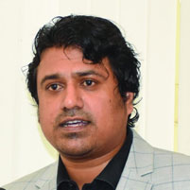
Mr. Girish Surpur brings over two decades of experience in the Information and
Communication Technology (ICT) domain, specializing in Sales, Presales, and
Business Development within the logistics sector. He holds a Bachelor of
Engineering (BE) in Computer Science from SDM College of Engineering &amp;
Technology, Dharwad, and a Master of Business Administration (MBA) from the
Indian Institute of Technology (IIT), Roorkee.
At NEC , Mr. Surpur plays a pivotal role in driving strategic growth, business
expansion, and technology-led transformation initiatives. His deep industry
knowledge and proven leadership have helped the company strengthen its market presence, forge key partnerships, and deliver innovative ICT solutions tailored to the evolving needs of the logistics industry.
Girish Kumar Surpur
Head Logistics, NEC,

Slide 25
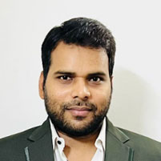
Abhishek Srivastava is a Senior Consultant with over a decade of experience in designing, implementing, and optimizing IT ecosystem involving multiple technology domains and industry verticals. His career has spanned engagements with leading global enterprises, government entities, and IT service organizations, where he has played a pivotal role in mapping business strategy with infrastructure needs.
He has worked extensively across sectors including government and public sector
undertakings, manufacturing, consumer goods, and financial services — helping organizations accelerate their digital transformation journeys through secure, scalable, and automated hybrid environments built on best-in-class platforms. Abhishek’s expertise covers the full lifecycle of tech adoption — from infrastructure design and deployment to automation, monitoring, and disaster recovery — ensuring performance, resilience, and compliance for mission-critical systems.
He is a Senior Professional with Oroprise Solutions leading engagements to build large systemic architecture. His consultative approach, combined with a deep technical foundation, has earned him recognition for bridging the gap between business objectives and technology execution. Prior to Joining Oroprise Solutions, he has worked for celebrated companies like Infosys, Wipro & HCL.
An engineering graduate, Abhishek has grown up in the iconic city of Prayagraj and currently stays in Noida. Beyond his professional duties, he contributes in diverse community bonding initiatives and sustainable measures.
Abhishek Srivastava
Senior Consultant

Slide 26
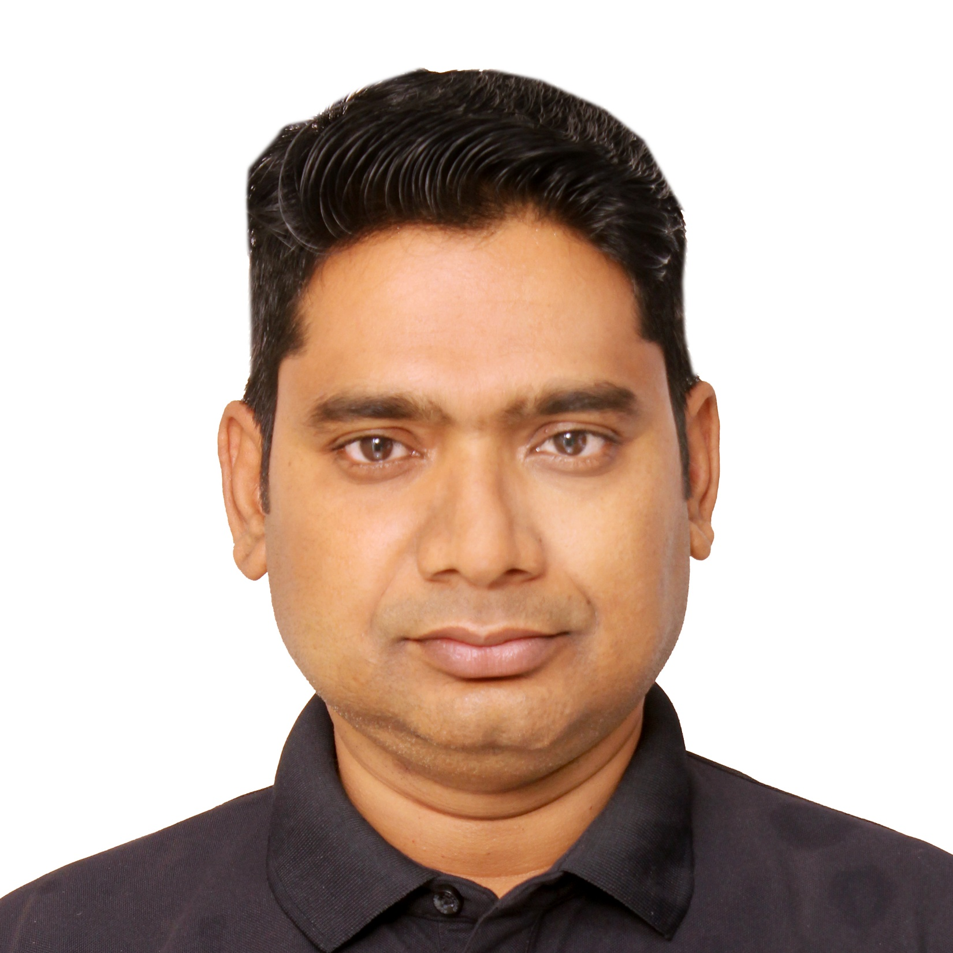
Prasenjit Samanta is the Practice Lead – GIS & Urban Solutions for Oroprise Solutions. As the Practice Lead, Prasenjit is responsible for pre-selling and delivery of all GIS and City-related projects in India, Middle-East, and the USA. In Europe market he has been working on tech-based projects on Cloud Infrastructure and Service-desk management.
Over the last two decades, he has played leading roles in implementing projects involving GIS, ERP, CRM, Data Insights and Field-Service applications for cities and urban local bodies on multiple proprietary platforms and databases like ESRI, Oracle and Microsoft as well as opensource bespoke solutions.
He has been working for Oroprise Solutions for almost a decade and lately he has successfully delivered projects for cities and urban entities like City of Decatur, Illinois, USA, Dubai, Haldia Municipality, and Kolkata & West Bengal Police. He has immense contribution in conceiving and delivering revenue management systems for urban local bodies.
A Masters in Remote Sensing & GIS with a post graduate diploma in Urban Development Planning, Prasenjit shuttles between Noida and Kolkata as his base location. As his part-time avocation, he teaches in institutes on subjects like Remote Sensing & GIS and smart cities.
Prasenjit Samanta
Practice Lead – GIS & Urban Solutions, Oroprise Solutions

Slide 27
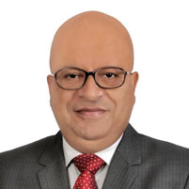
Mr Subimal Bhattacharjee currently is an independent adviser, consultant on cyber security, defense and high end technology policy issues based out of New Delhi.
He is also a globally acclaimed cyber issues specialist and has served as a member of the research advisory committee of the Global Commission on Internet Governance besides being experts for 2 UN led initiatives in the subject. He is currently a member of the Editorial board of Cyber Journal, Chatham House London. He was recently a Visiting Scholar in residence at Ostrom Workshop, Indiana University, Bloomington, USA.
His forays into writing and film making are also established and he is a regular columnist and television panelist on contemporary technology and security issues. He has been a speaker at all the top think tanks of the world. He holds a post graduate degree in
mathematics from the University of Delhi, Delhi and Bachelors degree in law from Maharishi University of Information Technology, Lucknow India.
Subimal Bhattacharjee Independent adviser, Consultant on Cyber Security, Defense and High end Technology Policy issues and Columnist

Slide 28
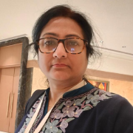
Dipannita Mukherjee is an accomplished professional with over two decades of experience in customer relations, operations management, and institutional
communications.
Currently serving as Chief Manager – Delhi at The Bengal
Chamber of Commerce and Industry, she oversees strategic engagement, member relations, and outreach initiatives in the National Capital Region.
Prior to joining the Chamber, Dipannita held key leadership roles across diverse sectors — including education, electronics, financial services, and telecommunications. Her professional journey spans positions such as Customer Service Manager at Woodman Electronics Pvt. Ltd., Admissions & PR Head at BDM International School, Deputy Manager at India Infoline Ltd., and Assistant Manager – Customer Service
at Vodafone East Ltd., where she led large teams, streamlined service delivery, and ensured excellence in customer satisfaction and communication.
Known for her proactive approach and people-centric leadership, she brings expertise in stakeholder management, quality assurance, and customer experience design.
Dipannita holds a Bachelor’s Degree in Commerce from Durgapur Government College, following her schooling at St. Michael’s School and Carmel Convent High School, Durgapur.
Dipannita Mukherjee Chakraborty, Chief Manager, BCC&I

Slide 29
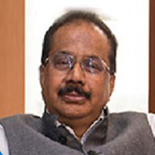
Mr. S. Radhakrishnan, alumnus of St. Xavier’s College, Kolkata, he obtained a Law degree and qualified as a professional Company Secretary. He is a Fellow Member of the Institute of Company Secretaries of India and a Member of the All India Management Association.
He joined Dishergarh Power Supply Company Limited (now India Power Co. Ltd.), a Power Generation and Distribution Company as Company Secretary and went on to be at the helm of affairs as Managing Director of DPSC Limited on January 25, 2003, a post at which he remained till February 10, 2010.
Mr. Radhakrishnan was also instrumental in forming DESCON Limited in March, 1995. DESCON was a knowledge based Consultancy Company specializing in the field of IT,  ITES, GIS, Power Engineering & Design and Consultancy Services. He was also Managing Director of Descon Limited from 2003 till 30 th April, 2014.
Former President, The Bengal Chamber of Commerce and Industry. He is the Executive Director &amp; President, Infinity Infotech Parks Limited and Founder & Director of BDSCUBE Tech.
Mr. S. Radhakrishnan Former President, BCC&I; Director & President, Infinity Group and Founder & Director of BDSCUBE Technology Pvt Ltd

Slide 30
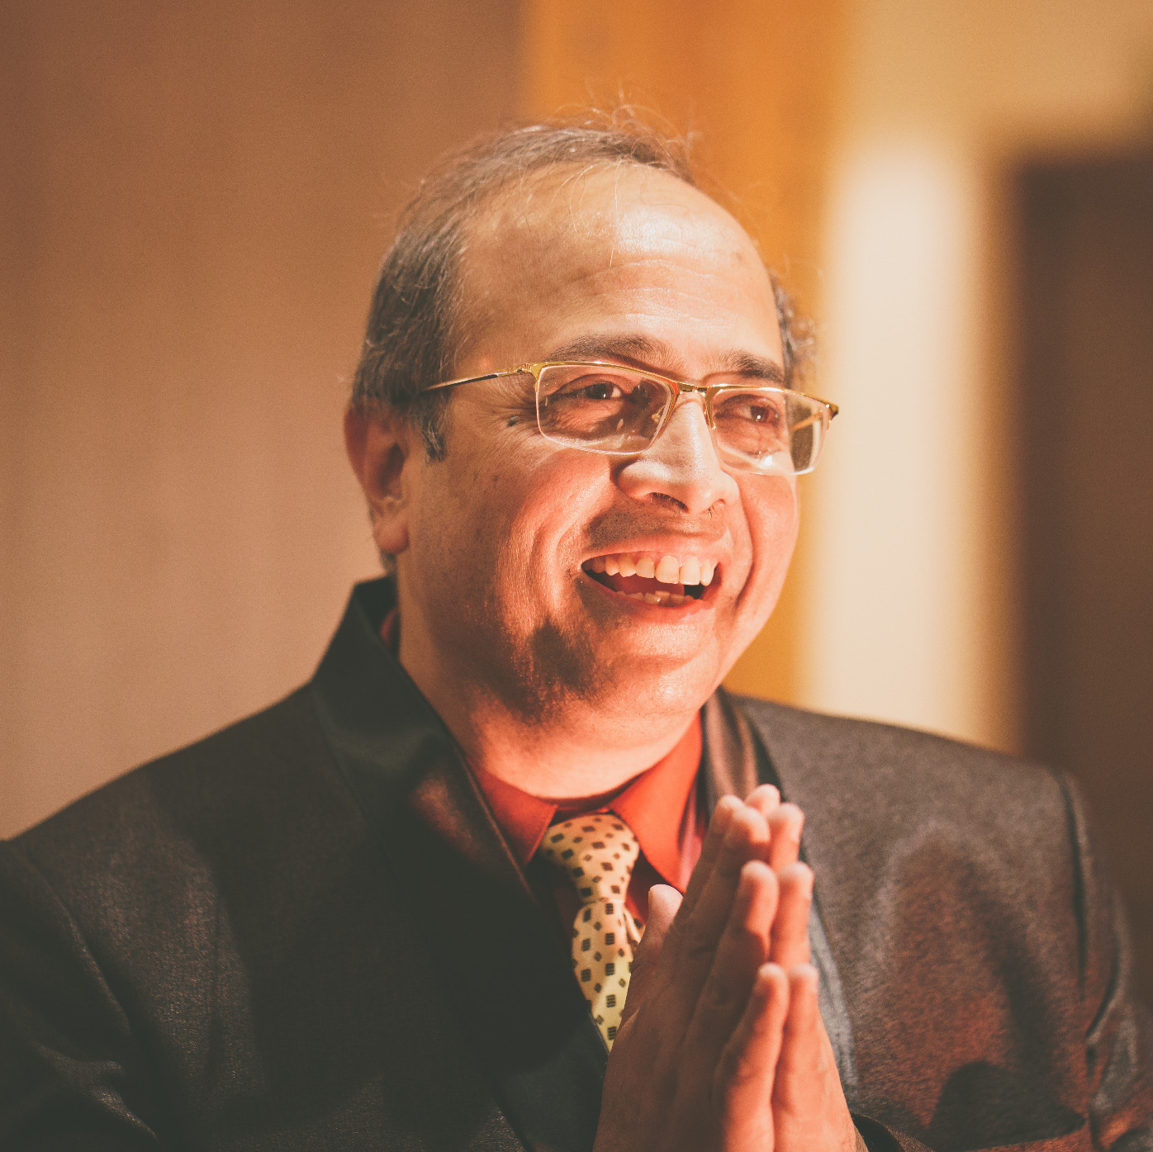
Santanu Roy, topper of Jadavpur University (’84 Mechanical) with MBA in Operations Management, superannuated in ’22 from GAIL as Executive
Director - Business Development. Sustainable Development & Corporate Affairs.
He was part of Top Management Team in GAIL for over a decade and had previously headed Strategy & Planning and Projects Development.
Mr Roy had an enviable track record of thinking strategically at macro level, management skills and excellent business acumen to build several new sustainable business models. His tenure saw remarkable success in mainstreaming sustainability through win-win collaborations, formulation of “Net Zero Emission” Path and innovative measures leading to “Value Beyond Business”. He remains passionate about integrating strategy with sustainable energy solutions and is active in business consultancy / mentorship.
Santanu Roy
Principal Advisor, GPS Renewables (Mech 84)

Slide 31
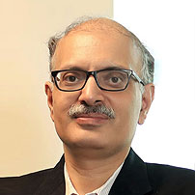
Dr Gaurav Bhatiani is a senior leader, with three decades of experience in research,
development, advisory and corporate roles in energy and environmental sectors.
Dr. Bhatiani enables and empowers organizations to succeed through strategic
business transformation, mentoring and technical advisory. He is currently a Senior Fellow at the Ashoka Centre for a People Centric Energy Transition, Ashoka University and a Visiting Professor at the Indian School of Business, Hyderabad. He is also mentoring select clean energy companies as a Senior Advisor. Dr. Bhatiani has an extensive track record of managing large and interdisciplinary teams across energy, infrastructure and environmental sectors. His work includes advising governments, public utilities, and regulatory bodies on policy, regulation, and reform strategies. As a senior corporate executive, he led economic and investment analysis, and financing of multi-billion-dollar infrastructure projects.
He has published extensively, served various industry bodies and is a featured
speaker at conferences and seminars. Dr. Bhatiani holds a Ph.D. with a specialization in energy economics and regulation from the University of Delhi. He was awarded the Gold Medal for securing top rank in the master’s program in business and economics. He holds a bachelor’s degree in electrical engineering from the Indian Institute of Technology (Roorkee).
Gaurav Bhatiani
Leader, Energy, Economy & Environment & Professor (Indian School of Business)

Slide 32
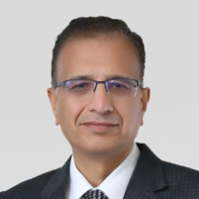
A senior executive with over 30 years of experience in steering complex initiatives in Project finance, IT applications, Treasury and Sustainability domains. Has been key part of the team delivering two landmark projects - a $3 billion Greenfield Refinery and $3 billion petrochemical complex.
Currently leading HMEL&s Sustainability and Energy transition strategies for core business and emerging sectors, originating decarbonization projects including renewables, solar manufacturing,
biogas, green hydrogen / ammonia, with RE projects in implementation and others advancing through approvals. Close collaboration with regulators and policymakers to align with emerging climate policies, ensuring compliance while advancing the energy transition agenda.
Girish Ghildiyal
Head Sustainability & New Energy, HPCL-Mittal Energy

Slide 33
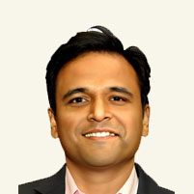
Heading Sales and Business Development in Roofsol Energy. Director and Member of Founding team at Roofsol Energy. Total work experience in B2B sales
and marketing 15 years.
11 years of experience in selling solar projects in Rooftop C&I and Open access.
Agriculture Engineer from Konkan Krishi Vidyapeeth Maharashtra and MBA in Marketing from Mumbai University.
Anurag Chivilkar
Director & VP, Roofsol Energy

Slide 34
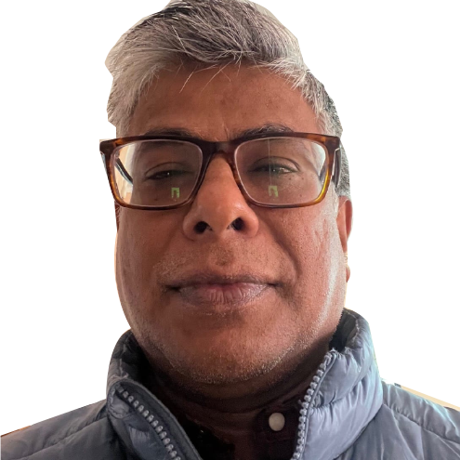
Kaushik Das Gupta has been a journalist for close to 25 years. He was trained in
history at the Delhi University and JNU; a 12-year-old stint with Down To Earth and
the Centre for Science and Environment imbued in him an abdiding interest in
ecology. Kaushik tries to bring his academic education and the knowledge that has accrued to him at work to his understanding of the environment – in other words, he tries to understand how human initiatives shape the environment and are often shaped by it.
His interest in Delhi’s history and the city’s environment as well as his
lived experience as an asthmatic have also shaped his understanding of air pollution.
He currently works at Indian Express, as a part of the team that shapes the paper’s
editorial stance.
Kaushik Dasgupta
Indian Express

Slide 35
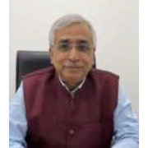
Biswapriya (BP) Mukherjee is the founder, promoter, and CEO of Oroprise Solutions Pvt. Ltd. As the CEO of the company, Mr Mukherjee is responsible crystallizing the strategic direction, enabling the operational rhythm, catalysing the cultural DNA, and managing the overall P&L. Founded in 2014, Oroprise has been empowering customers in the Western Europe, the US, Middle East and India as well.
More than three and a half decades of multi-faceted and eclectic experience in the power and IT sector, Mr Mukherjee has both business stewardship as well as operational vanguard experience in some marquee global corporations like SAP, Ferranti, and PA Consulting, and in reputed Indian entities like CESC of RP-SG group. He has been a business leader of IT companies, value-based consultant, and field service manager in power companies.
Prior to founding Oroprise Solutions, he was the country-head of Ferranti Computer Systems, a leading Belgium-headquartered software product company. In SAP, he was the part of SAP India leadership team being the head of Industry Solution Group responsible for business development for more than twenty industry verticals.
He is an engineer with post-graduation in business management. He has been a speaker, writer, and presenter on a range of industry themes like next generation leadership, organizational transformation, digital city evolution, and fast track adoption of new technology.
Biswapriya (BP) Mukherjee
Programme Convener

